Slide 1
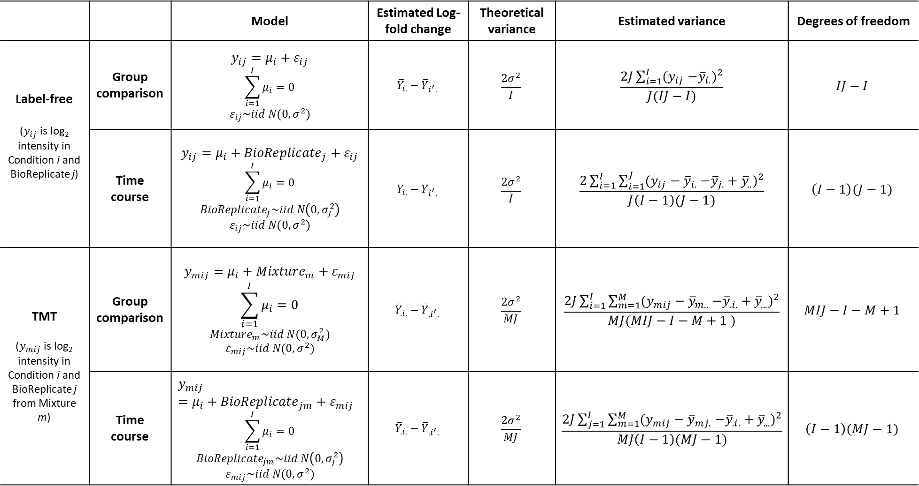
 |  | Model | Estimated Log-fold change | Theoretical variance | Estimated variance | Degrees of freedom
Label-free ($y_{ij}$ is log₂ intensity in Condition i and BioReplicate j) | Group comparison | $$y_{ij}=μ_{i}+ε_{ij}$$ $$\sum_{i=1}^{I}{μ_{i}}=0$$ $$ε_{ij}\sim iid N(0,σ^{2})$$ | $${\overline{Y}}_{i.}−{\overline{Y}}_{i^{′}.}$$ | $$\frac{2σ^{2}}{I}$$ | $$\frac{2J\sum_{i=1}^{I}{(y_{ij}{−{\overline{y}}_{i.})}^{2}}}{J(IJ−I)}$$ | $$IJ−I$$
 | Time course | $$y_{ij}=μ_{i}+{BioReplicate}_{j}+ε_{ij}$$ $$\sum_{i=1}^{I}{μ_{i}}=0$$ $$BioReplicate_{j}\sim iid N\left(0,σ_{J}^{2}\right)$$ $$ε_{ij}\sim iid N(0,σ^{2})$$ | $${\overline{Y}}_{i.}−{\overline{Y}}_{i^{′}.}$$ | $$\frac{2σ^{2}}{I}$$ | $$\frac{2\sum_{i=1}^{I}{\sum_{i=1}^{J}{(y_{ij}−{\overline{y}}_{i.}{−{\overline{y}}_{j.}+{\overline{y}}_{..})}^{2}}}}{J\left(I−1\right)(J−1)}$$ | $$\left(I−1\right)(J−1)$$
TMT ($y_{mij}$ is log₂ intensity in Condition i and BioReplicate j from Mixture m) | Group comparison | $$y_{mij}=μ_{i}+{Mixture}_{m}+ε_{mij}$$ $$\sum_{i=1}^{I}{μ_{i}}=0$$ $${Mixture}_{m}\sim iid N(0,σ_{M}^{2})$$ $$ε_{mij}\sim iid N(0,σ^{2})$$ | $${\overline{Y}}_{.i.}−{\overline{Y}}_{{.i}^{′}.}$$ | $$\frac{2σ^{2}}{MJ}$$ | $$\frac{2J\sum_{i=1}^{I}{\sum_{m=1}^{M}{(y_{mij}−{\overline{y}}_{m..}{−{\overline{y}}_{.i.}+{\overline{y}}_{...})}^{2}}}}{MJ(MIJ−I−M+1 )}$$ | $$MIJ−I−M+1$$
 | Time course | $$y_{mij}=μ_{i}+{BioReplicate}_{jm}+ε_{mij}$$ $$\sum_{i=1}^{I}{μ_{i}}=0$$ $$BioReplicate_{jm}\sim iid N\left(0,σ_{J}^{2}\right)$$ $$ε_{mij}\sim iid N(0,σ^{2})$$ | $${\overline{Y}}_{.i.}−{\overline{Y}}_{{.i}^{′}.}$$ | $$\frac{2σ^{2}}{MJ}$$ | $$\frac{2J\sum_{j=1}^{I}{\sum_{m=1}^{M}{(y_{mij}−{\overline{y}}_{mj.}{−{\overline{y}}_{.i.}+{\overline{y}}_{...})}^{2}}}}{MJ\left(I−1\right)(MJ−1)}$$ | $$\left(I−1\right)(MJ−1)$$

