Slide 1

Benchmarking statistical methods for mass-spectrometry-based proteomics

Slide 2
Introduction
Numerous statistical approaches exist for the analysis of mass spectrometry proteomics data. Our research aims to determine the most effective method by examining how upstream processing influences the data. We will assess the available upstream processing options and investigate how they impact the performance of statistical methods.

Slide 3
Statistical Methods Used for comparison
MSstats
DeqMS
MSqRob2
PmartR
DEP
proDA
In future we will add Limma as well for the comparison. Currently we are processing label free datasets but later we will add TMT labelled data as well.

Slide 4
Data Overview
Dataset | Comparison | Number of Conditions | Number of Biological Replicates | Number of Technical Replicates | Data Processing Tool
Dataset1-DDA ControlledMix | Group | 5 | 1 | 3 | Skyline MaxQuant Progenesis P.D.
Dataset2-DDA:Choi2017 | Group | 4 | 1 | 3 | Skyline MaxQuant Progenesis
Dataset3-DDA:Meierhofer2016 | Paired | 2 | 6 | 2 | MaxQuant

Slide 5
Practical details of the existing workflows used in the evaluation
 | MSstats | PmartR | DEP | ProDA | DEqMS | MSqRob2
Input File | We have used 2 options for the pre-processing the raw data Native processing to convert the raw data into the format required by each method Pre-processing using MSstats Converter and converting the data into the format required by each method | Use MSstats converters from Skyline, MaxQuant, Progenesis, Proteome Discoverer. This includes filtering implemented in MSstats converters. Reformat as required for each tool

Slide 6
 | MSstats | PmartR | DEP | ProDA | DEqMS | MSqRob2
Filtering | Filtered Decoy or iRT proteins, Shared peptides, Peaks with id confidence score below cutoff, Contaminant peptides or peptides including M or oxidation M sequence Aggregate multiple peaks per feature and sum: maximum peak or sum of peaks Filter Features observed in one run ,proteins with one feature | Molecules Filter Proteomics Filter IMD-Anova Filter | The dataset is filtered for proteins that have a maximum of 'thr' missing values in at least one condition. (thr=0) | None | None | Filter protein groups for which none of its member proteins is present in a smaller protein group. (to all the data)

Slide 7
 | MSstats | PmartR | DEP | ProDA | DEqMS | MSqRob2
Normalization | equalizeMedians | Median | Variance stabilizing transformation | Median | None | Median
Imputation | Decide the censored missing value and impute them by AFT model(default) | None | Imputes missing values in a proteomics dataset using MinProb function | None | None | None
Summarization | TMP | Roll up (median is applied to all peptides that map to a single protein to obtain protein abundance) | Already converted to SummarizedExperiment object | A matrix object with one column per sample and one row per protein | None | Aggregate peptides for each protein

Slide 8
 | MSstats | PmartR | DEP | ProDA | DEqMS | MSqRob2
Statistical Model | Linear Mixed effect Model | Anova Model | Protein-wise linear models and empirical Bayes statistics using limma | Linear probabilistic dropout model | Follows Limma workflow (lmFit,contrsts.fit,eBayes) and includes the [spectraCounteBayes] function to moderate variance based on feature counts | Linear mixed-effects model with Empirical Bayes moderation (formula=~Condition)
Multiple Testing | BH | Bonferroni | Setted the threshold(0.05) for the adjusted P value | BH | BH | BH

Slide 9

Distribution of Missing Values and Coefficient of variation among different datasets

Slide 10
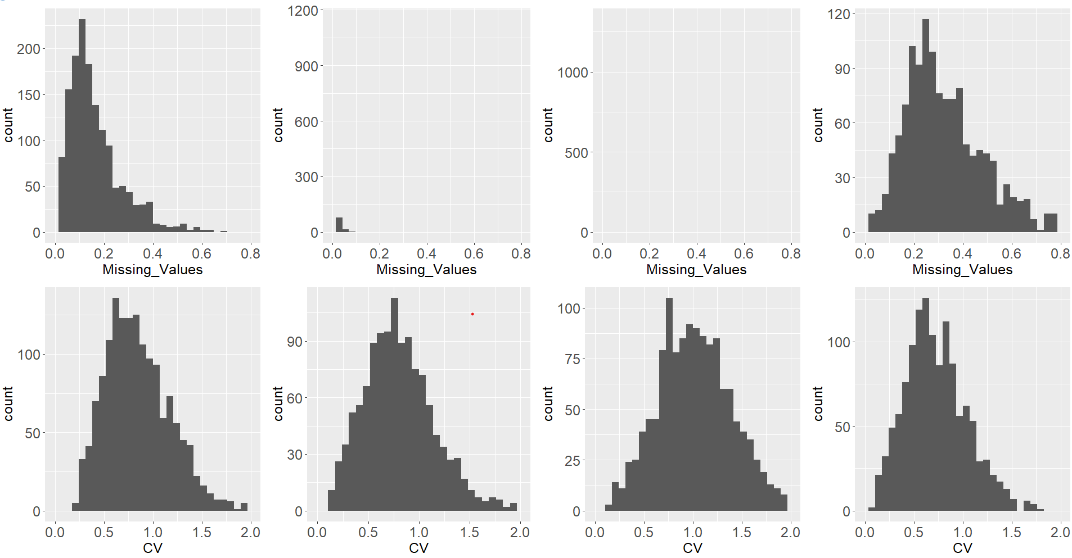
Dataset 1--DDA: Controlled Mixture
MaxQuant
Skyline
Progenesis
P.D.

Slide 11
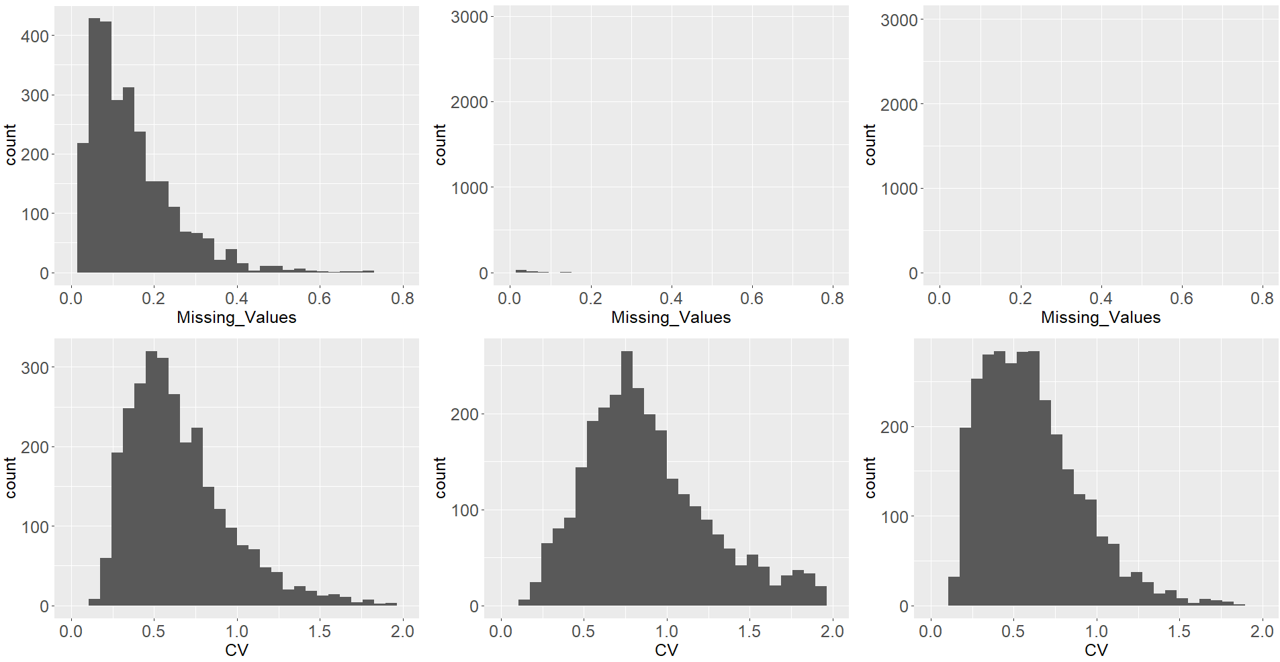
Dataset 2--DDA: Choi2017
Skyline
Progenesis
MaxQuant

Slide 12
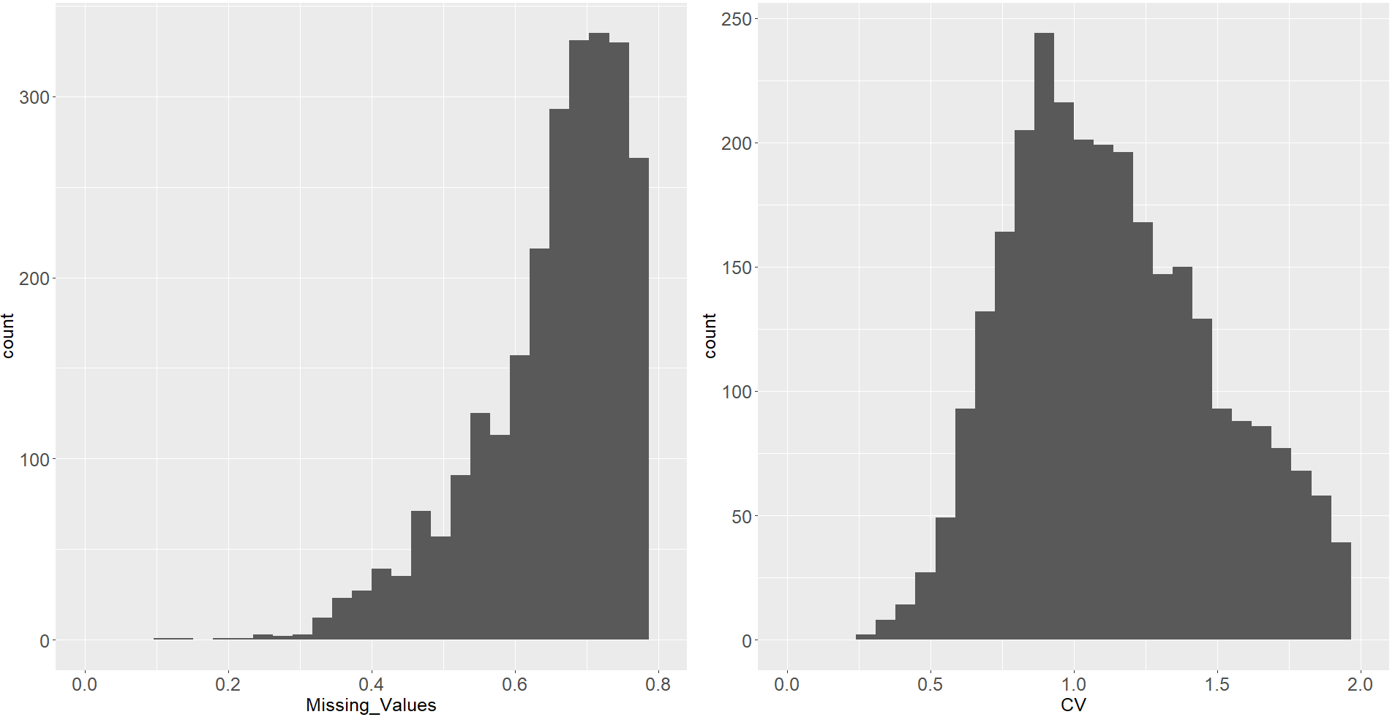
Dataset3--DDA:Meierhofer2016 MaxQuant
Histogram of Missing values of Intensities for each protein
Histogram of Coefficient of Variation of Intensities for each protein

Slide 13

Results of Native Pre-Processing

Slide 14
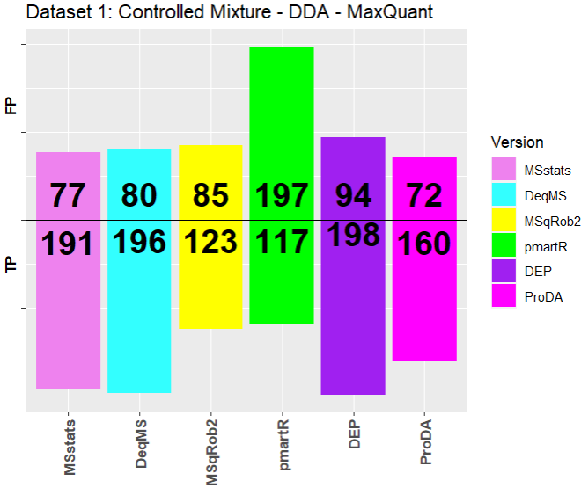
Dataset1--DDA: Controlled Mixture MaxQuant ( 30 Significant Proteins)
Pre-Processing done manually
 | MSstats | DEqMS | MSqRob2 | pmartR | DEP | ProDA
Input File | MSstats Converter output object | LFQ Intensities present→Extracted LFQ intensity columns from the raw data and set the rownames as protein ids. | Combined the raw data by grouping by protein names, run, PSM(combination of sequence and charge) and calculated intensity by aggregating Intensity using max function. | Combined the raw data by grouping by peptide sequence, run and calculated intensity by aggregating Intensity using sum function. | LFQ Intensities present→Filter the columns as stated in manual including protein names,charge, LFQ intensities and summarized data using ** import_Maxquant[Pre-processing for maxquant with LFQ intensities are there] function in DEP | LFQ Intensities present→Extracted LFQ intensity columns from the raw data and set the rownames as protein ids.

Slide 15
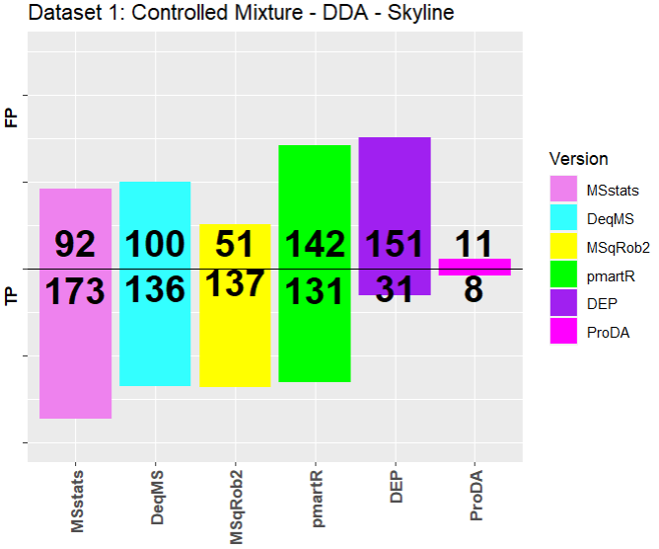
Dataset1-- DDA: Controlled Mixture Skyline ( 30 Significant Proteins)
Pre-Processing done manually
 | MSstats | DEqMS | MSqRob2 | pmartR | DEP | ProDA
Input File | MSstats Converter output object | Combined the raw data by grouping by protein names, run, PSM(combination of sequence and charge) and calculated intensity by aggregating normalized abundance using sum. | Combined the raw data by grouping by protein names, run, PSM and calculated intensity by aggregating Intensity using max function. | Combined the raw data by grouping by peptide, run and calculated intensity by aggregating Intensity using sum function. | Combined the raw data by grouping by protein name, run and calculated intensity by aggregating Intensity using sum function. | Combined the raw data by grouping by protein name, run and calculated intensity by aggregating Intensity using sum function.

Slide 16
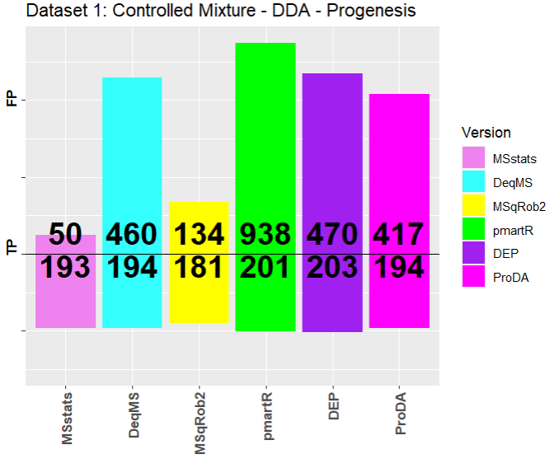
Dataset1-- DDA: Controlled Mixture Progenesis ( 30 Significant Proteins)
Pre-Processing done manually
 | MSstats | DEqMS | MSqRob2 | pmartR | DEP | ProDA
Input File | MSstats Converter output object | Combined the raw data by grouping by protein names, run, PSM(combination of sequence and charge) and calculated intensity by aggregating normalized abundance using sum. | Combined the raw data by grouping by protein names, run, PSM and calculated intensity by aggregating Intensity using max function. | Combined the raw data by grouping by peptide, run and calculated intensity by aggregating Intensity using sum function. | Combined the raw data by grouping by protein name, run and calculated intensity by aggregating Intensity using sum function. | Combined the raw data by grouping by protein name, run and calculated intensity by aggregating Intensity using sum function.

Slide 17
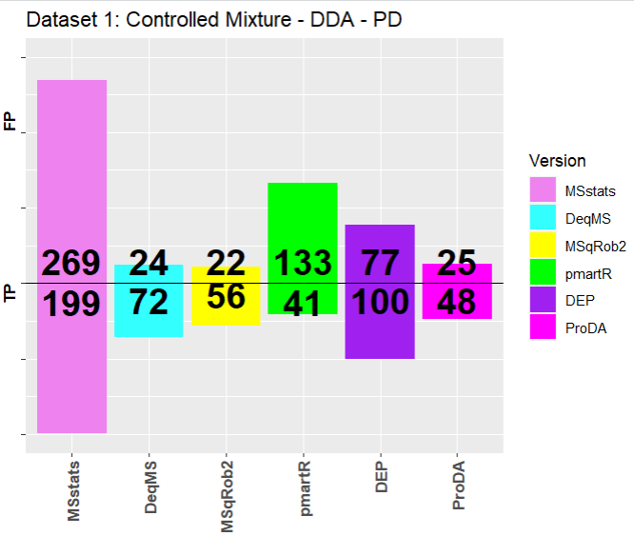
Dataset1-- DDA: Controlled Mixture P.D. ( 30 Significant Proteins)
Pre-Processing done manually
 | MSstats | DEqMS | MSqRob2 | pmartR | DEP | ProDA
Input File | MSstats Converter output object | Combined the raw data by grouping by protein names, run, PSM(combination of sequence and charge) and calculated intensity by aggregating normalized abundance using sum. | Combined the raw data by grouping by protein names, run, PSM and calculated intensity by aggregating Intensity using max function. | Combined the raw data by grouping by peptide, run and calculated intensity by aggregating Intensity using sum function. | Combined the raw data by grouping by protein name, run and calculated intensity by aggregating Intensity using sum function. | Combined the raw data by grouping by protein name, run and calculated intensity by aggregating Intensity using sum function.

Slide 18
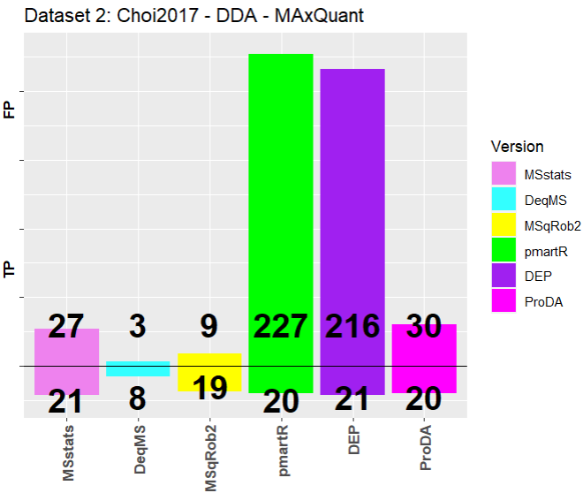
Dataset2--DDA: Choi2017 MaxQuant ( 6 Significant Proteins)
Pre-Processing done manually
 | MSstats | DEqMS | MSqRob2 | pmartR | DEP | ProDA
Input File | MSstats Converter output object | Combined the raw data by grouping by protein names, run, PSM(combination of sequence and charge) and calculated intensity by aggregating normalized abundance using sum. | Combined the raw data by grouping by protein names, run, PSM and calculated intensity by aggregating Intensity using max function. | Combined the raw data by grouping by peptide, run and calculated intensity by aggregating Intensity using sum function. | Combined the raw data by grouping by protein name, run and calculated intensity by aggregating Intensity using sum function. | Combined the raw data by grouping by protein name, run and calculated intensity by aggregating Intensity using sum function.

Slide 19
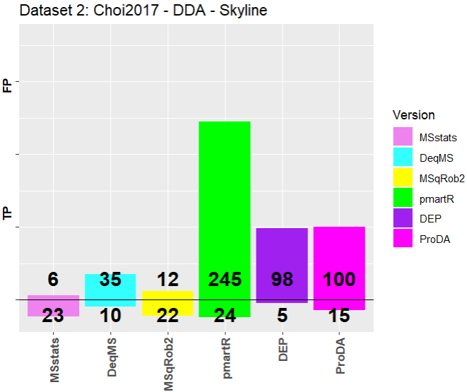
Dataset2--DDA: Choi2017 Skyline ( 6 Significant Proteins)
Pre-Processing done manually
 | MSstats | DEqMS | MSqRob2 | pmartR | DEP | ProDA
Input File | MSstats Converter output object | Combined the raw data by grouping by protein names, run, PSM(combination of sequence and charge) and calculated intensity by aggregating normalized abundance using sum. | Combined the raw data by grouping by protein names, run, PSM and calculated intensity by aggregating Intensity using max function. | Combined the raw data by grouping by peptide, run and calculated intensity by aggregating Intensity using sum function. | Combined the raw data by grouping by protein name, run and calculated intensity by aggregating Intensity using sum function. | Combined the raw data by grouping by protein name, run and calculated intensity by aggregating Intensity using sum function.

Slide 20
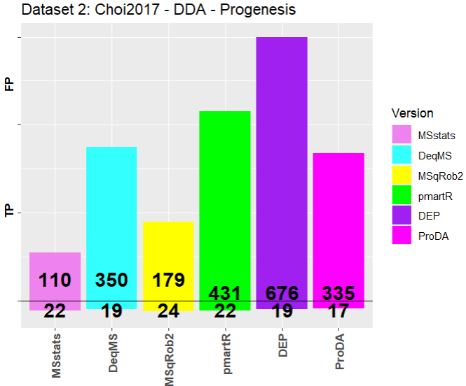
Dataset2--DDA: Choi2017 Progenesis ( 6 Significant Proteins)
Pre-Processing done manually
 | MSstats | DEqMS | MSqRob2 | pmartR | DEP | ProDA
Input File | MSstats Converter output object | Combined the raw data by grouping by protein names, run, PSM(combination of sequence and charge) and calculated intensity by aggregating normalized abundance using sum. | Combined the raw data by grouping by protein names, run, PSM and calculated intensity by aggregating Intensity using max function. | Combined the raw data by grouping by peptide, run and calculated intensity by aggregating Intensity using sum function. | Combined the raw data by grouping by protein name, run and calculated intensity by aggregating Intensity using sum function. | Combined the raw data by grouping by protein name, run and calculated intensity by aggregating Intensity using sum function.

Slide 21
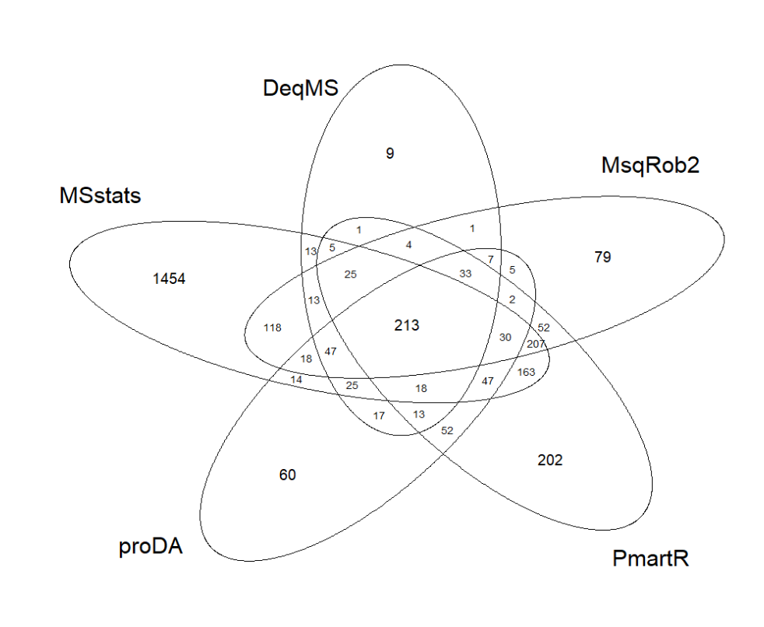
Dataset3--DDA:Meierhofer2016 MaxQuant
Pre-Processing done using manually
 | MSstats | DEqMS | MSqRob2 | pmartR | DEP | ProDA
Input File | MSstats Converter output object | Combined the raw data by grouping by protein names, run, PSM(combination of sequence and charge) and calculated intensity by aggregating normalized abundance using sum. | Combined the raw data by grouping by protein names, run, PSM and calculated intensity by aggregating Intensity using max function. | Combined the raw data by grouping by peptide, run and calculated intensity by aggregating Intensity using sum function. | Combined the raw data by grouping by protein name, run and calculated intensity by aggregating Intensity using sum function. | Combined the raw data by grouping by protein name, run and calculated intensity by aggregating Intensity using sum function.
DEP-> 0 significant proteins

Slide 22
Results of MSstats Converter Pre-Processing

Slide 23
Pre-Processing Steps
 | MSstats | DEqMS | MSqRob2 | pmartR | DEP | ProDA
Input File | MSstats Converter output object | Combined the raw data by grouping by protein names, run, PSM(combination of sequence and charge) and calculated intensity by aggregating Intensity using log2 of sum function. | Combined the raw data by grouping by protein names, run, PSM(combination of sequence and charge) and calculated intensity by aggregating Intensity using max function. | Combined the raw data by grouping by peptide sequence, run and calculated intensity by aggregating Intensity using sum function. | Combined the raw data by grouping by protein name, run and calculated intensity by aggregating Intensity using sum function. | Combined the raw data by grouping by protein name, run and calculated intensity by aggregating Intensity using sum function.

Slide 24
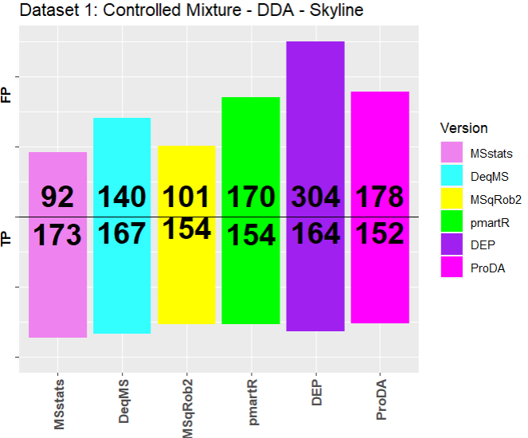
Dataset1-- DDA: Controlled Mixture Skyline ( 30 Significant Proteins) Pre-Processing done using MSstats Converter vs manually
MSstats Converter Pre-processing
Native Pre-processing

Slide 25
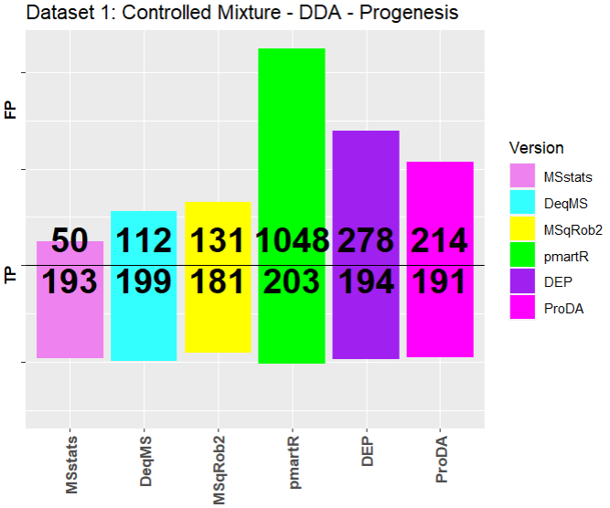
Dataset1-- DDA: Controlled Mixture Progenesis ( 30 Significant Proteins) Pre-Processing done using MSstats Converter vs manually
MSstats Converter Pre-processing
Native Pre-processing

Slide 26
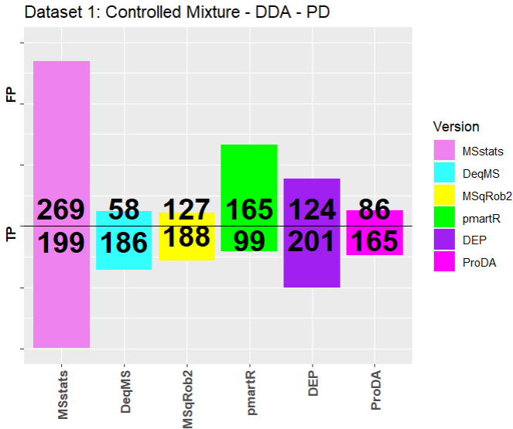
Dataset1-- DDA: Controlled Mixture P.D. ( 30 Significant Proteins) Pre-Processing done using MSstats Converter vs manually
MSstats Converter Pre-processing
Native Pre-processing

Slide 27
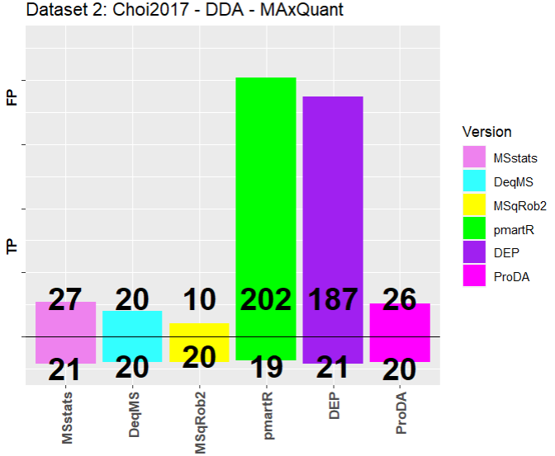
Dataset2-- DDA: Choi2017 MaxQuant ( 30 Significant Proteins) Pre-Processing done using MSstats Converter vs manually
MSstats Converter Pre-processing
Native Pre-processing

Slide 28
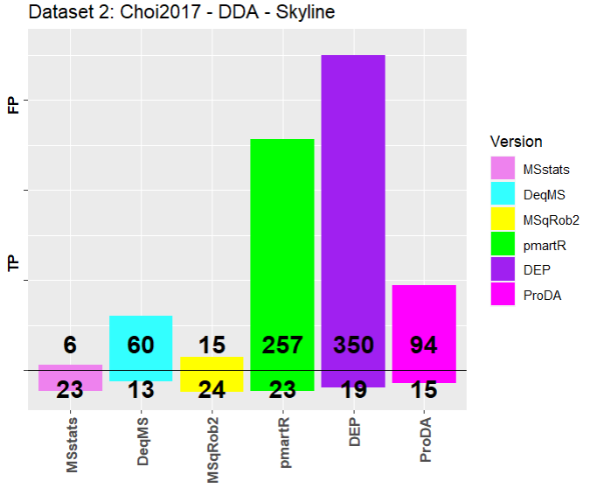
Dataset2-- DDA: Choi2017 Skyline ( 30 Significant Proteins) Pre-Processing done using MSstats Converter vs manually
MSstats Converter Pre-processing
Native Pre-processing

Slide 29
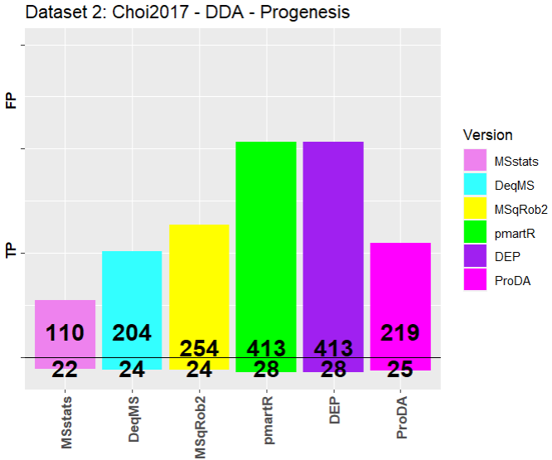
Dataset2-- DDA: Choi2017 Progenesis ( 30 Significant Proteins) Pre-Processing done using MSstats Converter vs manually
MSstats Converter Pre-processing
Native Pre-processing

Slide 30
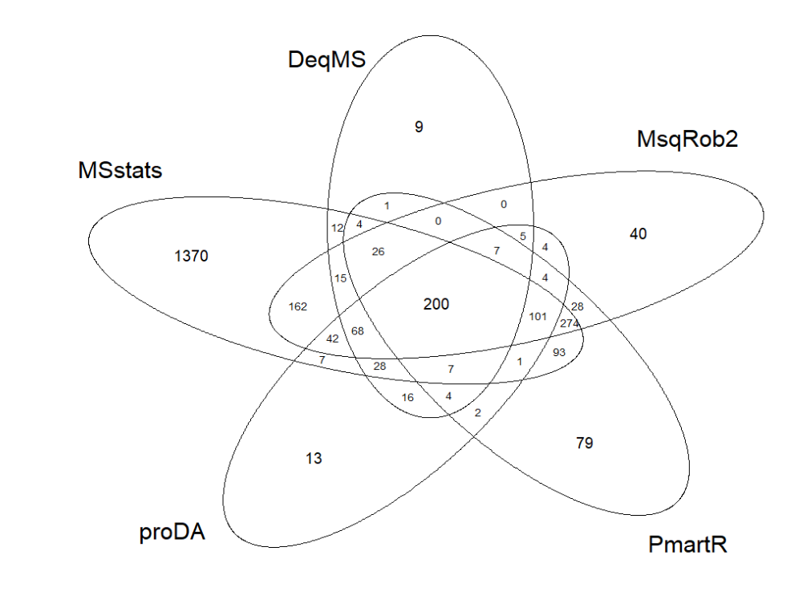
Dataset3-- Meierhofer2016 MaxQuant
Pre-Processing done using MSstats Converter vs manually
MSstats Converter Pre-processing
Native Pre-processing
DEP-> 0 significant proteins

Slide 31

Thank you

