Slide 1

Benchmarking Statistical Methods for mass-spectrometry-based proteomics

Slide 2
Methods Used
MSstats
PmartR
DEP
ProDA
MSqRob2
DEqMS

Slide 3
Methods Workflow
 | MSstats | PmartR | DEP | ProDA | DEqMS | MSqRob2
Acquisition | Designed for label -free DDA, DIA, SRM with/without heavy labeled references | Designed for labelled, label - free DDA; isobaric labeling | Designed for raw data : MaxQuant or IsobarQuant Label free,TMT | Designed for label-free mass spectrometry data | DDA, DIA | DDA, DIA
Input | Convert features from –Skyline, MaxQuant ,Progenesis, Proteome Discoverer ,Spectronaut OpenSWATH, DIA-Umpire, OpenMS Custom tabular format | Custom S3 object( require 3 data frames in a particular format to convert them into pepData object) | Convert features from: MaxQuant IsobarQuant | Custom data frame | Users should prepare data in the required format. | Users should prepare data in the required format.

Slide 4
 | MSstats | PmartR | DEP | ProDA | DEqMS | MSqRob2
Filtering | All converters apply not only the same preprocessing filtering, but also the tool-specific data manipulation. Here are all filtering strategies: Filter Decoy or iRT proteins Shared peptides Peaks with id confidence score below cutoff Contaminant peptides or peptides including M or oxidation M sequence Aggregate multiple peaks per feature and sum: maximum peak or sum of peaks Filter Features observed in one run Proteins with one feature Integrate metadata to corresponding MS runs | Filter BioMolecules Proteomics filter (remove degenerate peptides or require minimum # ofpeptides per protein) Molecule filter (remove biomolecules not present in ≥ xsamples) Coefficient of variation (CV) filter (remove highly variablebiomolecules Custom filter (IMD)-ANOVA filter (remove biomolecules for which we cannot perform statistics) FilterSamples • robust Mahalanobis distance (rMd) filter (identify outlying samples based on various metrics) | The dataset is filtered for proteins that have a maximum of 'thr' missing values in at least one condition. | None | None | Recommends QFeatures package functions

Slide 5
 | MSstats | PmartR | DEP | ProDA | DEqMS | MSqRob2
Normalization | Log2 or 10 transformation for peak intensities Four normalization options : No normalization Equalize median Quantile Using standard proteins or peptides | Quantile Loess Automatically selects best normalization among –Median centering, Mean centering, Z-score transformation ,MAD transformation | Normalize data using variance stabilizing normalization | Median Normalization | equalMedianNormalization] | Recommends QFeatures package functions
Imputation | Decide the censored missing value and impute them by AFT model | None | Imputes missing values using functions: “bpca", "knn", "QRILC", "MLE", "MinDet", "MinProb", "man", "min", "zero", "mixed" or "nbavg" | None | None | Qfeatures [impute] function. Model is designed to handle missing values

Slide 6
 | MSstats | PmartR | DEP | ProDA | DEqMS | MSqRob2
Summarization | Robust summarization per runs across features, by TMP Additionally, mean-based summarization is available as an option. | RRollup, Qrollup ZRollup Mean Median BP-Quant accounts for protein isoforms | Use Summarized Experiment to summarize assay data | A matrix object with one column per sample and one row per protein | Median summarization for each run - Requires reference column | Recommends [aggregateFeatures] from Qfeatures.

Slide 7
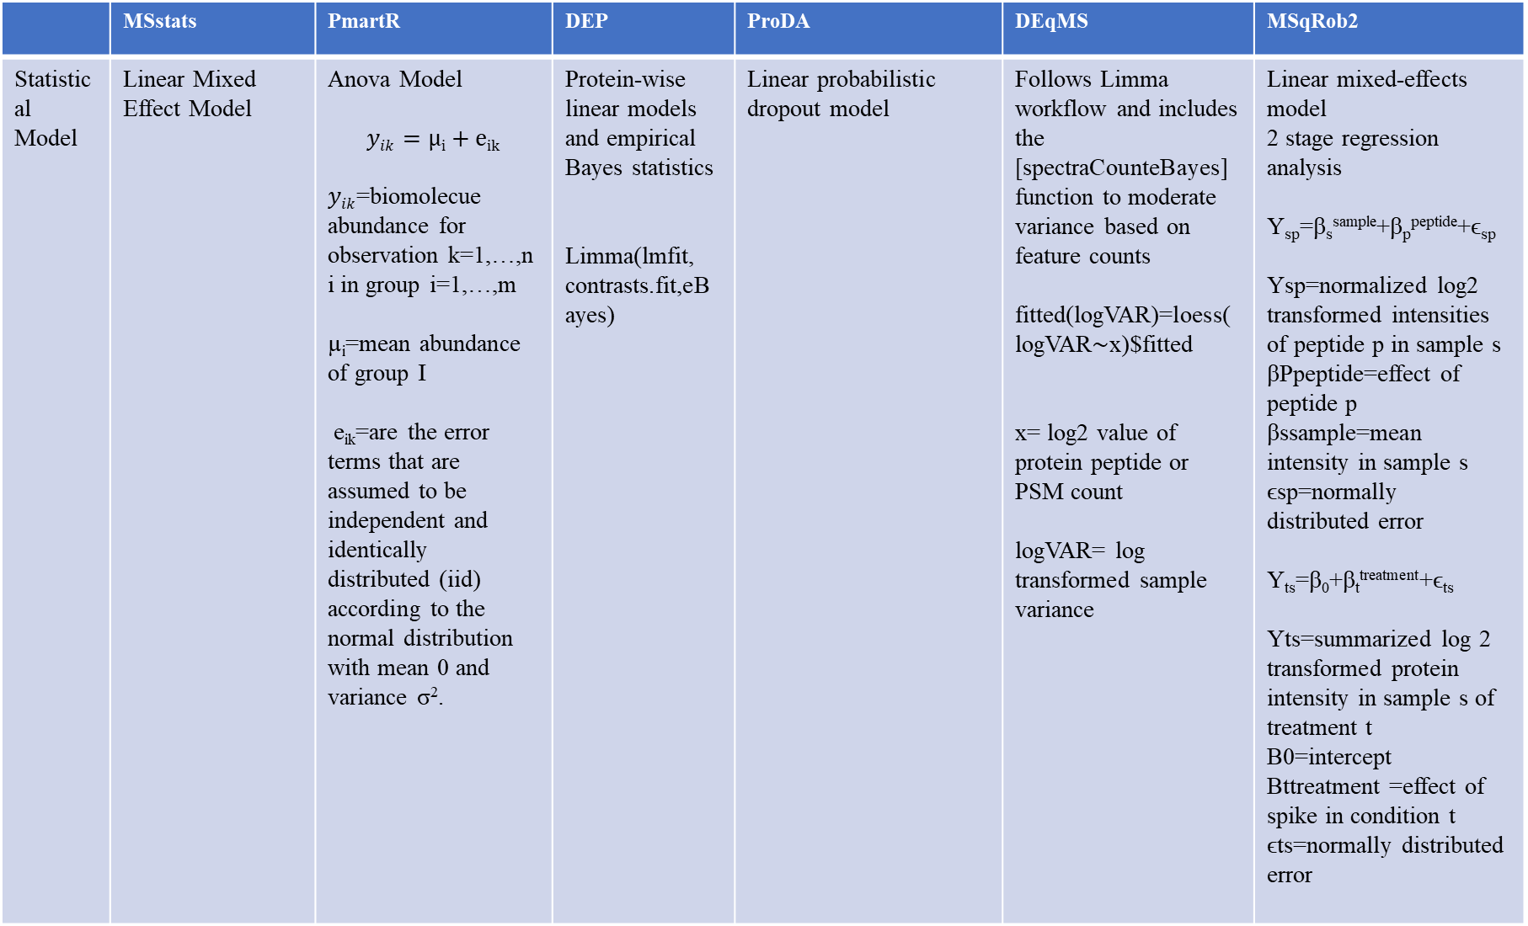
 | MSstats | PmartR | DEP | ProDA | DEqMS | MSqRob2
Statistical Model | Linear Mixed Effect Model | Anova Model $$yik=µi+eik$$ $yik$=biomolecue abundance for observation k=1,…,ni in group i=1,…,m µ_{i}=mean abundance of group I e_{ik}=are the error terms that are assumed to be independent and identically distributed (iid) according to the normal distribution with mean 0 and variance σ². | Protein-wise linear models and empirical Bayes statistics Limma(lmfit, contrasts.fit,eBayes) | Linear probabilistic dropout model | Follows Limma workflow and includes the [spectraCounteBayes] function to moderate variance based on feature counts fitted(logVAR)=loess(logVAR∼x)$fitted x= log2 value of protein peptide or PSM count logVAR= log transformed sample variance | Linear mixed-effects model 2 stage regression analysis Y_{sp}=β_{s}^{sample}+β_{p}^{peptide}+ϵ_{sp} Ysp=normalized log2 transformed intensities of peptide p in sample s βPpeptide=effect of peptide p βssample=mean intensity in sample s ϵsp=normally distributed error Y_{ts}=β₀+β_{t}^{treatment}+ϵ_{ts} Yts=summarized log 2 transformed protein intensity in sample s of treatment t Β0=intercept Βttreatment =effect of spike in condition t ϵts=normally distributed error

Slide 8
 | MSstats | PmartR | DEP | ProDA | DEqMS | MSqRob2
Statistical Inference | Anova based comparisons | Anova test, gtest | Fdrtool statistics(normal) | Wald test to test individual coefficient Likelihood ratio F-test to compare the original model with a reduced model | Empirical estimation of the prior distribution for the parameters from the data and a posterior estimation of the parameters. | Empirical Bayes moderation
Multiple Testing | Benjamin Hochberg | Multiple testing using: Holm, Tukey , Bonferroni, Dunnett | fdrtool package | Benjamin Hochberg | Benjamin Hochberg | BH, BY and holm

Slide 9
Practical details of the existing workflows used in the evaluation
 | MSstats | PmartR | DEP | ProDA | DEqMS | MSqRob2
Input File | Tool specific converters Use MSstats converters from Skyline, MaxQuant, Progenesis, Proteome Discoverer. This includes filtering implemented in MSstats converters. Reformat as required for each tool ** For maxquant output if data contains LFQ intensities then DEqMS, DEP, proDA , MSqRob2 can be run without using converters by reformatting the data | Use MSstats converters from Skyline, MaxQuant, Progenesis, Proteome Discoverer. This includes filtering implemented in MSstats converters. Reformat as required for each tool
Additional Pre-processing | None | Replace 0 with Na’s Log2 transform the data Assign grouping variables to data (condition) | SummarizedExperiment object with log2-transformed values | Replace the zeros with NAs and take the log2() of the data | Filter protein table. DEqMS require minimum two values for each group. | Convert data to Qfeature Object Convert 0 to NA Log2 transform data

Slide 10
 | MSstats | PmartR | DEP | ProDA | DEqMS | MSqRob2
Filtering | Filtered Decoy or iRT proteins, Shared peptides, Peaks with id confidence score below cutoff, Contaminant peptides or peptides including M or oxidation M sequence Aggregate multiple peaks per feature and sum: maximum peak or sum of peaks Filter Features observed in one run ,proteins with one feature | Molecules Filter Proteomics Filter IMD-Anova Filter | The dataset is filtered for proteins that have a maximum of 'thr' missing values in at least one condition. (thr=0) | None | None | Filter protein groups for which none of its member proteins is present in a smaller protein group. (to all the data)

Slide 11
 | MSstats | PmartR | DEP | ProDA | DEqMS | MSqRob2
Normalization | equalizeMedians | Median | Variance stabilizing transformation | Median | None | Median
Imputation | Decide the censored missing value and impute them by AFT model(default) | None | Imputes missing values in a proteomics dataset using MinProb function | None | None | None
Summarization | TMP | Roll up (median is applied to all peptides that map to a single protein to obtain protein abundance) | Already converted to SummarizedExperiment object | A matrix object with one column per sample and one row per protein | None | Aggregate peptides for each protein

Slide 12
 | MSstats | PmartR | DEP | ProDA | DEqMS | MSqRob2
Statistical Model | Linear Mixed effect Model | Anova Model | Protein-wise linear models and empirical Bayes statistics using limma | Linear probabilistic dropout model | Follows Limma workflow (lmFit,contrsts.fit,eBayes) and includes the [spectraCounteBayes] function to moderate variance based on feature counts | Linear mixed-effects model with Empirical Bayes moderation (formula=~Condition)
Multiple Testing | BH | Bonferroni | Setted the threshold(0.05) for the adjusted P value | BH | BH | BH

Slide 13
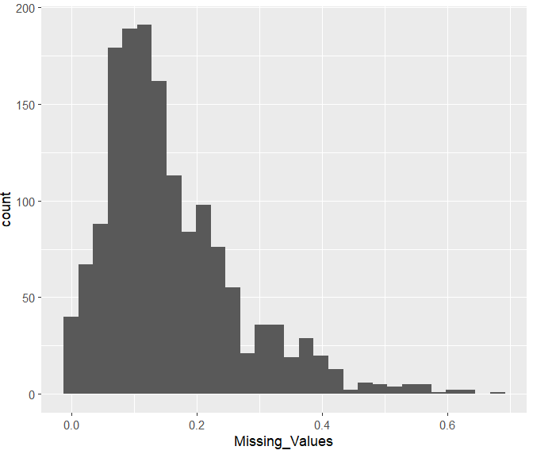
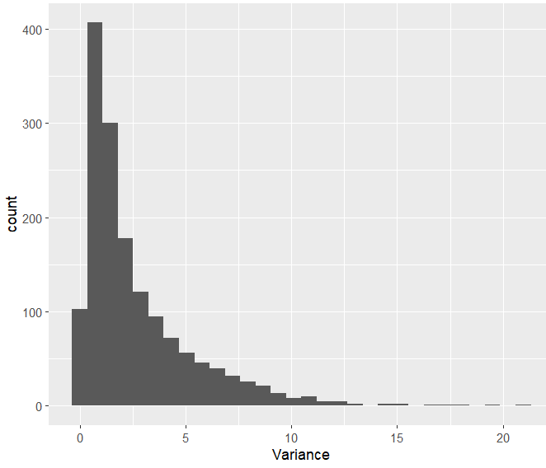
DDA: Controlled Mixture MaxQuant ( 30 Significant Proteins)
Histogram of Missing values of Intensities for each protein
Histogram of Variance of Intensities for each protein

Slide 14
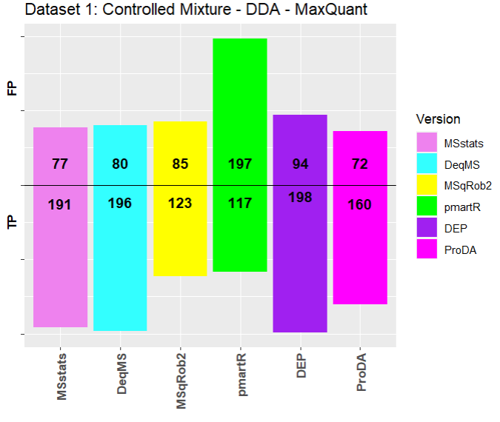
DDA: Controlled Mixture MaxQuant ( 30 Significant Proteins)
Pre-Processing done manually
 | Input File
MSstats | MSstats Converter output object
DeqMS | Extracted LFQ intensity columns from the raw data and set the rownames as protein ids.
MSqRob2 | Combined the raw data by grouping by protein names, run,PSM(combination of sequence and charge) and summarized intensity using max.
PmartR | Combined the raw data by grouping by peptide sequence, run and summarized intensity using sum.
DEP | Filter the columns as stated in manual including protein names,charge, LFQ intensities and summarized data using import_Maxquant function in DEP
ProDA | Extracted LFQ intensity columns from the raw data and set the rownames as protein ids.

Slide 15
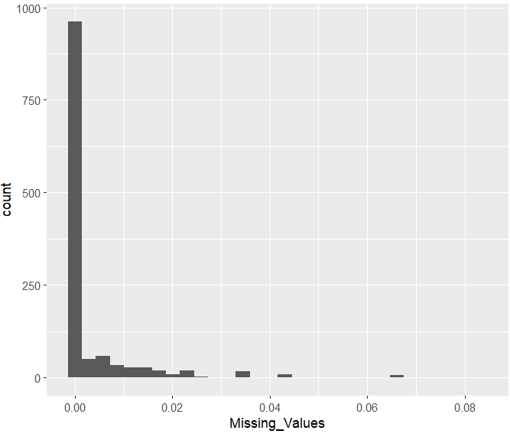
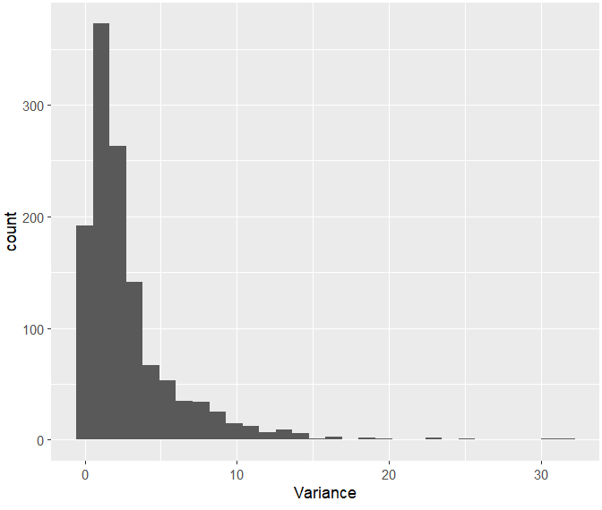
DDA: Controlled Mixture Skyline ( 30 Significant Proteins)
Histogram of Missing values of Intensities for each protein
Histogram of Variance of Intensities for each protein

Slide 16
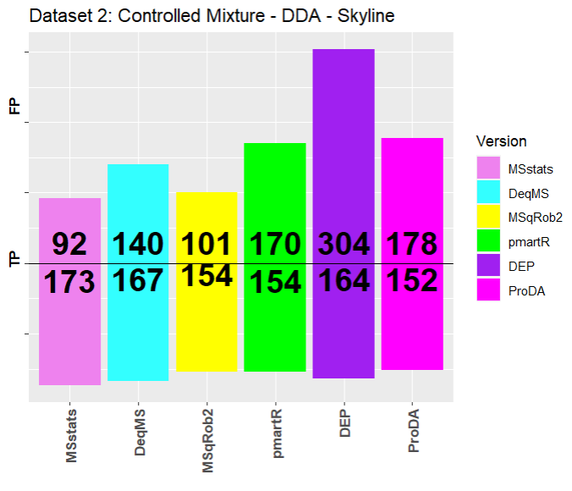
DDA: Controlled Mixture Skyline ( 30 Significant Proteins) Pre-Processing done using MSstats Converter
 | Input File
MSstats | MSstats Converter output object
DeqMS | MSstats Converter output object -> Summarised by grouping by protein name, run and aggregating intensity by taking log2 of sum(Intensity).
MSqRob2 | Combined the MSstats Converter output object by grouping by protein names, run,PSM(combination of sequence and charge) and summarized intensity using max.
PmartR | Combined the MSstats Converter output object by grouping by peptide sequence, run and summarized intensity using sum.
DEP | Combined the MSstats Converter output object by grouping by protein name, run and summarized intensity using max.
ProDA | Combined the MSstats Converter output object by grouping by protein name, run and summarized intensity using max.

Slide 17
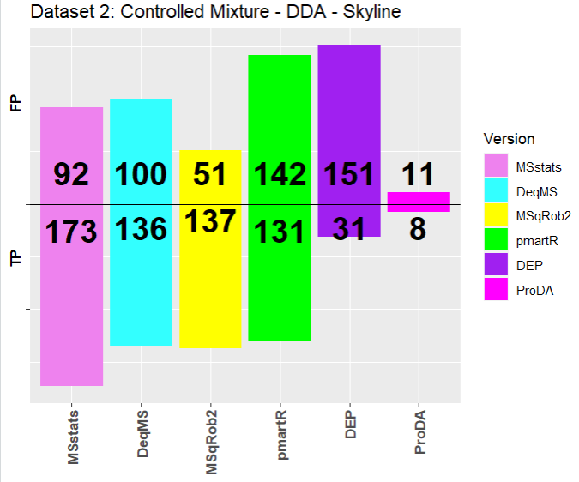
DDA: Controlled Mixture Skyline ( 30 Significant Proteins) Pre-Processing done manually
 | Input File
MSstats | MSstats Converter output object
DeqMS | Combined the raw data by grouping by protein names, run, PSM(combination of sequence and charge) and calculated intensity by aggregating area using max function.
MSqRob2 | Combined the raw data by grouping by protein names, run, PSM(combination of sequence and charge) and calculated intensity by aggregating area using max function.
PmartR | Combined the raw data by grouping by peptide sequence, run and calculated intensity by aggregating area using sum function.
DEP | Combined the raw data by grouping by protein name, run and calculated intensity by aggregating area using max function.
ProDA | Combined the raw data by grouping by protein name, run and calculated intensity by aggregating area using max function.

Slide 18
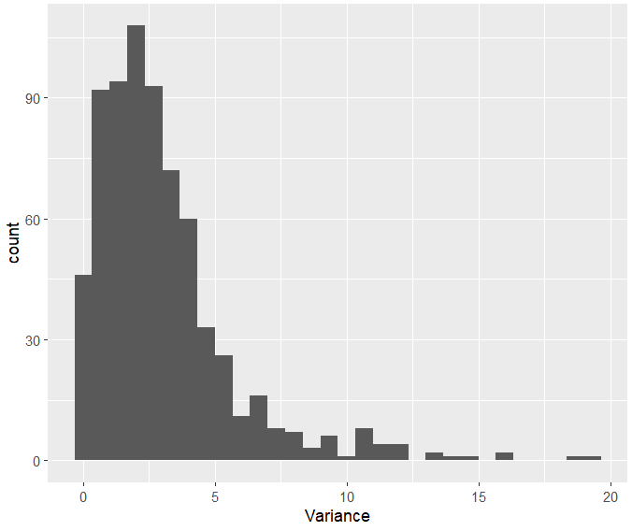
DDA: Controlled Mixture Progenesis ( 30 Significant Proteins) There were no missing values in the dataset
Histogram of Variance of Intensities for each protein

Slide 19
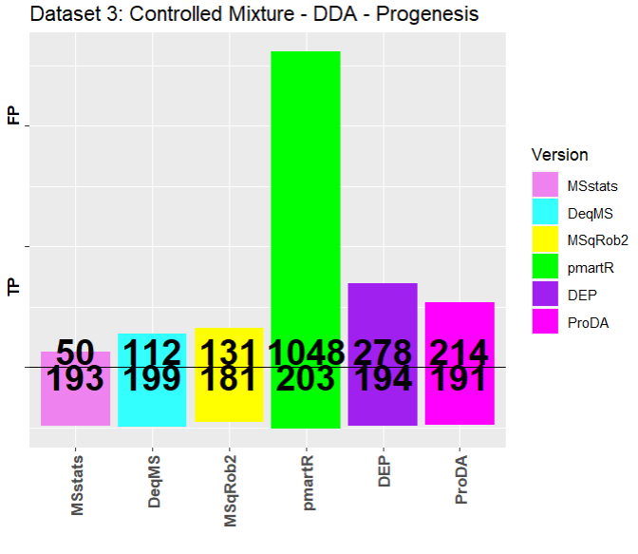
DDA: Controlled Mixture Progenesis ( 30 Significant Proteins)
Pre-Processing done using MSstats Converter
 | Input File
MSstats | MSstats Converter output object
DeqMS | MSstats Converter output object -> Summarised by grouping by protein name, run and aggregating intensity by taking log2 of sum(Intensity).
MSqRob2 | Combined the MSstats Converter output object by grouping by protein names, run,PSM(combination of sequence and charge) and summarized intensity using max.
PmartR | Combined the MSstats Converter output object by grouping by peptide sequence, run and summarized intensity using sum.
DEP | Combined the MSstats Converter output object by grouping by protein name, run and summarized intensity using max.
ProDA | Combined the MSstats Converter output object by grouping by protein name, run and summarized intensity using max.

Slide 20
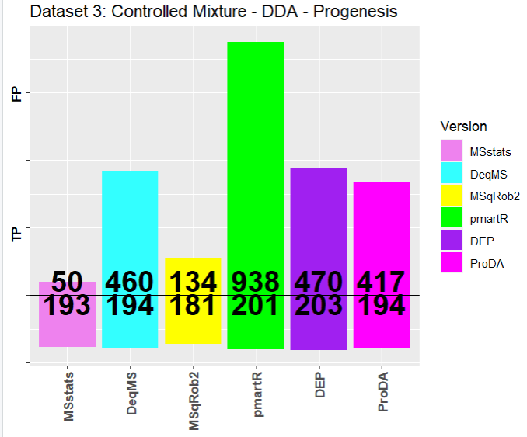
DDA: Controlled Mixture Progenesis ( 30 Significant Proteins) Pre-Processing done manually
 | Input File
MSstats | MSstats Converter output object
For all below methods first selected the required columns from the data as there were multiple abundance columns and converted into to proper format so that below processing could be done | For all below methods first selected the required columns from the data as there were multiple abundance columns and converted into to proper format so that below processing could be done
DeqMS | Combined the raw data by grouping by protein names, run, PSM(combination of sequence and charge) and calculated intensity by aggregating normalized abundance using sum.
MSqRob2 | Combined the raw data by grouping by protein names, run, PSM(combination of sequence and charge) and calculated intensity by aggregating normalized abundance using max.
PmartR | Combined the raw data by grouping by peptide sequence, run and calculated intensity by aggregating normalized abundance using sum function.
DEP | Combined the raw data by grouping by protein name, run and calculated intensity by aggregating normalized abundance using max function.
ProDA | Combined the raw data by grouping by protein name, run and calculated intensity by aggregating normalized abundance using max function.

Slide 21
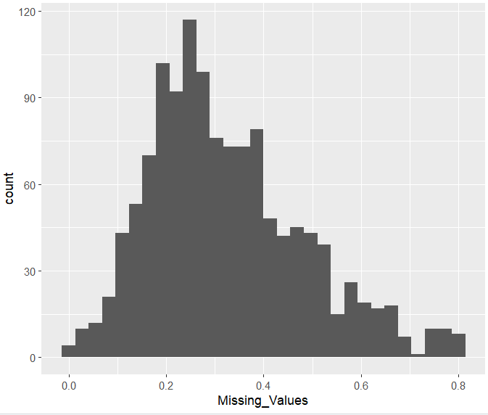
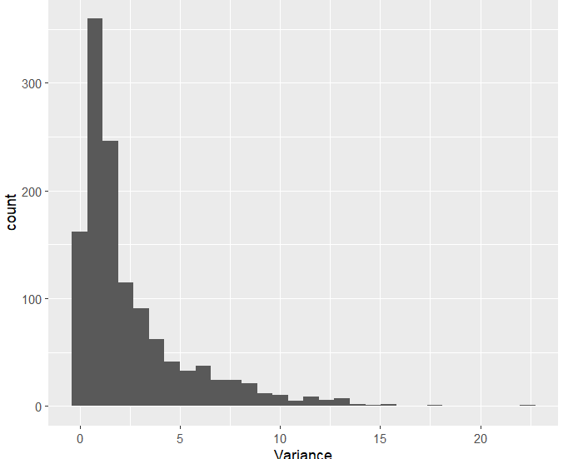
DDA: Controlled Mixture PD ( 30 Significant Proteins)
Histogram of Missing values of Intensities for each protein
Histogram of Variance of Intensities for each protein

Slide 22
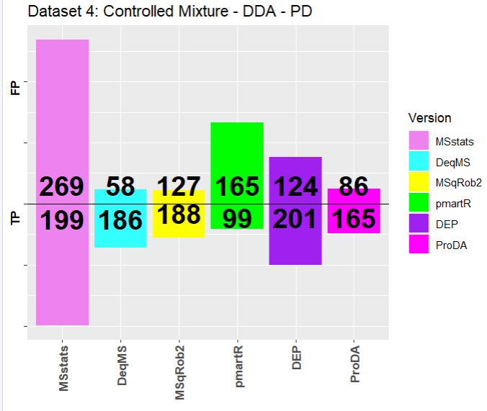
DDA: Controlled Mixture PD ( 30 Significant Proteins)
Pre-Processing done using MSstats Converter
 | Input File
MSstats | MSstats Converter output object
DeqMS | MSstats Converter output object -> Summarised by grouping by protein name, run and aggregating intensity by taking log2 of sum(Intensity).
MSqRob2 | Combined the MSstats Converter output object by grouping by protein names, run,PSM(combination of sequence and charge) and summarized intensity using max.
PmartR | Combined the MSstats Converter output object by grouping by peptide sequence, run and summarized intensity using sum.
DEP | Combined the MSstats Converter output object by grouping by protein name, run and summarized intensity using sum.
ProDA | Combined the MSstats Converter output object by grouping by protein name, run and summarized intensity using sum.

Slide 23
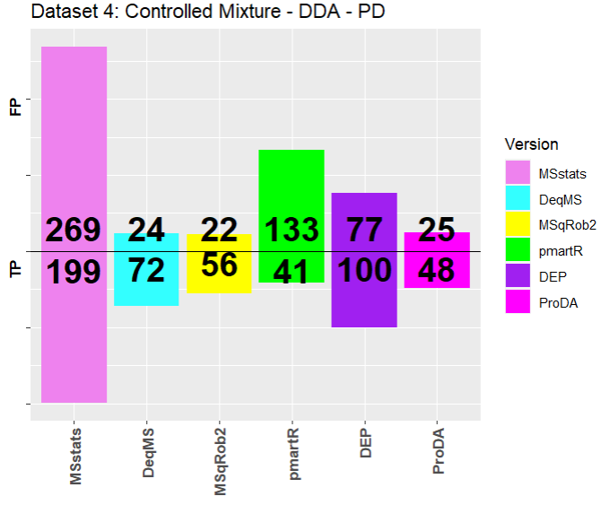
DDA: Controlled Mixture PD ( 30 Significant Proteins)
Pre-Processing done manually
 | Input File
MSstats | MSstats Converter output object
DeqMS | Combined the raw data by grouping by protein names, run, PSM(combination of sequence and charge) and calculated intensity by aggregating Intensity using sum function.
MSqRob2 | Combined the raw data by grouping by protein names, run, PSM(combination of sequence and charge) and calculated intensity by aggregating Intensity using max function.
PmartR | Combined the raw data by grouping by peptide sequence, run and calculated intensity by aggregating Intensity using sum function.
DEP | Combined the raw data by grouping by protein name, run and calculated intensity by aggregating Intensity using sum function.
ProDA | Combined the raw data by grouping by protein name, run and calculated intensity by aggregating Intensity using sum function.

Slide 24
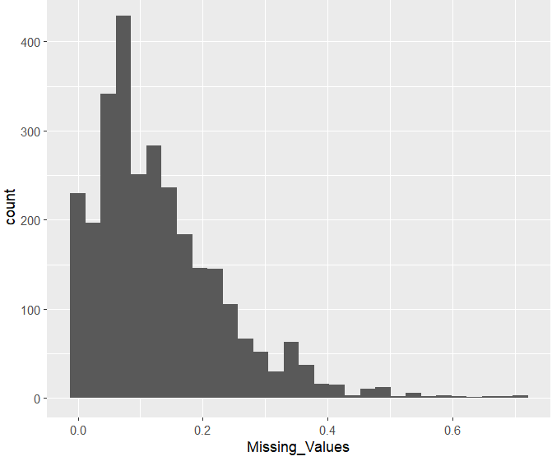
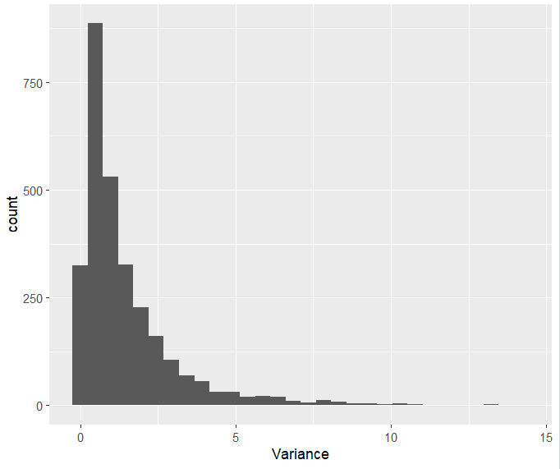
DDA: Choi2017 MaxQuant ( 6 Significant Proteins)
Histogram of Missing values of Intensities for each protein
Histogram of Variance of Intensities for each protein

Slide 25
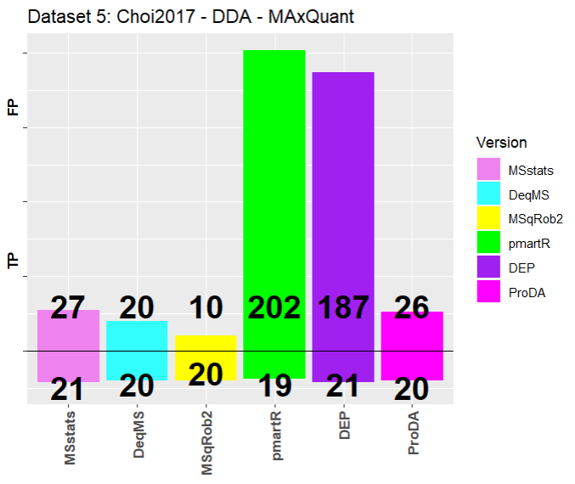
DDA: Choi2017 MaxQuant ( 6 Significant Proteins)
Pre-Processing done using MSstats Converter
 | Input File
MSstats | MSstats Converter output object
DeqMS | MSstats Converter output object -> Summarised by grouping by protein name, run and aggregating intensity by taking log2 of sum(Intensity).
MSqRob2 | Combined the MSstats Converter output object by grouping by protein names, run,PSM(combination of sequence and charge) and summarized intensity using max.
PmartR | Combined the MSstats Converter output object by grouping by peptide sequence, run and summarized intensity using sum.
DEP | Combined the MSstats Converter output object by grouping by protein name, run and summarized intensity using sum.
ProDA | Combined the MSstats Converter output object by grouping by protein name, run and summarized intensity using sum.

Slide 26
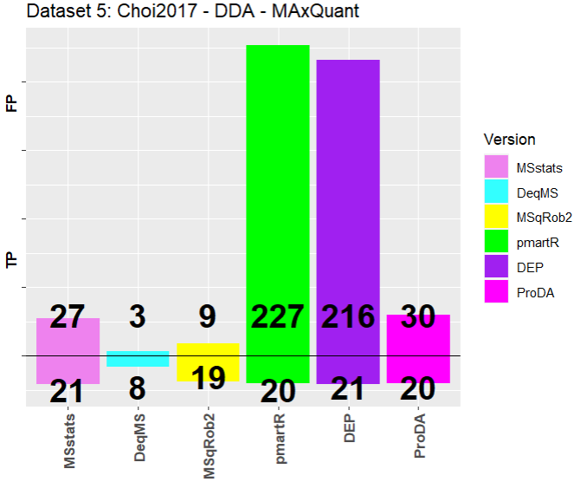
DDA: Choi2017 MaxQuant ( 6 Significant Proteins)
Pre-Processing done manually
 | Input File
MSstats | MSstats Converter output object
DeqMS | Combined the raw data by grouping by protein names, run, PSM(combination of sequence and charge) and calculated intensity by aggregating Intensity using sum function.
MSqRob2 | Combined the raw data by grouping by protein names, run, PSM(combination of sequence and charge) and calculated intensity by aggregating Intensity using max function.
PmartR | Combined the raw data by grouping by peptide sequence, run and calculated intensity by aggregating Intensity using sum function.
DEP | Combined the raw data by grouping by protein name, run and calculated intensity by aggregating Intensity using sum function.
ProDA | Combined the raw data by grouping by protein name, run and calculated intensity by aggregating Intensity using sum function.

Slide 27
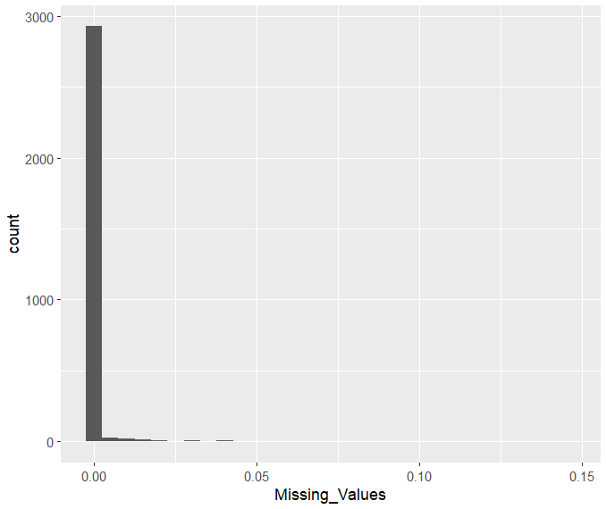
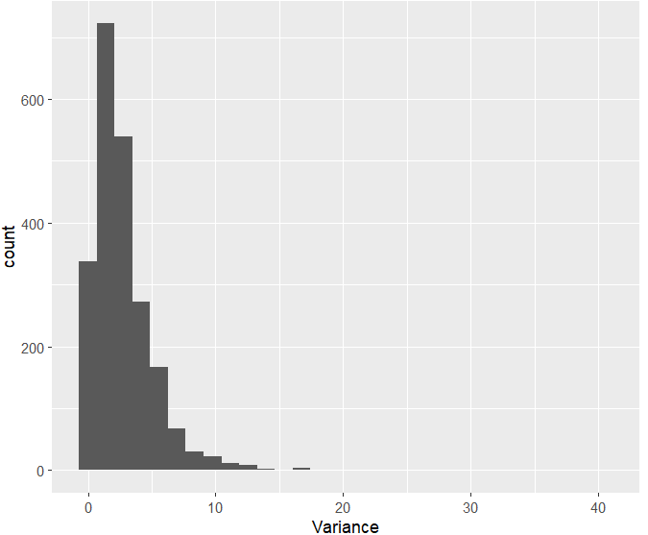
DDA: Choi2017 Skyline ( 6 Significant Proteins)
Histogram of Missing values of Intensities for each protein
Histogram of Variance of Intensities for each protein

Slide 28
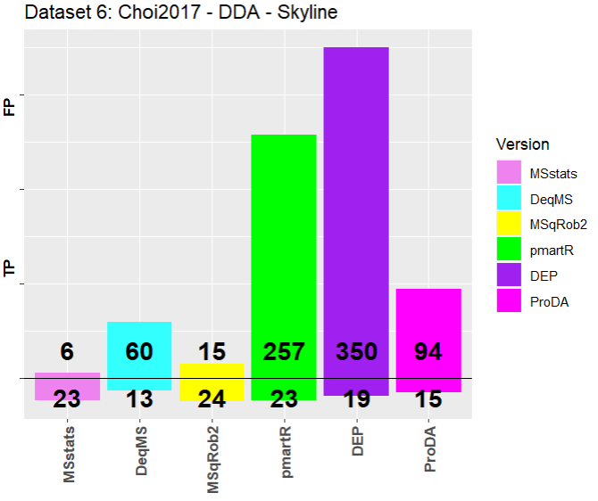
DDA: Choi2017 Skyline ( 6 Significant Proteins)
Pre-Processing done using MSstats Converter
 | Input File
MSstats | MSstats Converter output object
DeqMS | MSstats Converter output object -> Summarised by grouping by protein name, run and aggregating intensity by taking log2 of sum(Intensity).
MSqRob2 | Combined the MSstats Converter output object by grouping by protein names, run,PSM(combination of sequence and charge) and summarized intensity using max.
PmartR | Combined the MSstats Converter output object by grouping by peptide sequence, run and summarized intensity using sum.
DEP | Combined the MSstats Converter output object by grouping by protein name, run and summarized intensity using sum.
ProDA | Combined the MSstats Converter output object by grouping by protein name, run and summarized intensity using sum.

Slide 29
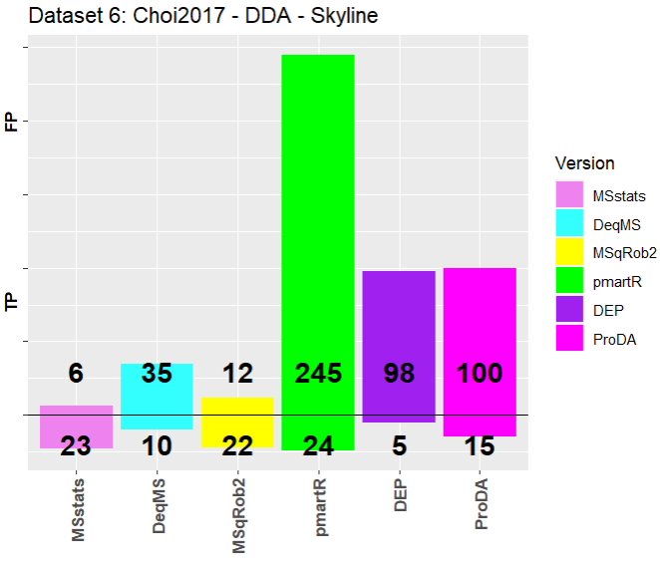
DDA: Choi2017 Skyline ( 6 Significant Proteins)
Pre-Processing done manually
 | Input File
MSstats | MSstats Converter output object
DeqMS | Combined the raw data by grouping by protein names, run, PSM(combination of sequence and charge) and calculated intensity by aggregating area using sum function.
MSqRob2 | Combined the raw data by grouping by protein names, run, PSM(combination of sequence and charge) and calculated intensity by aggregating area using max function.
PmartR | Combined the raw data by grouping by peptide sequence, run and calculated intensity by aggregating area using sum function.
DEP | Combined the raw data by grouping by protein name, run and calculated intensity by aggregating area using max function.
ProDA | Combined the raw data by grouping by protein name, run and calculated intensity by aggregating area using sum function.

Slide 30
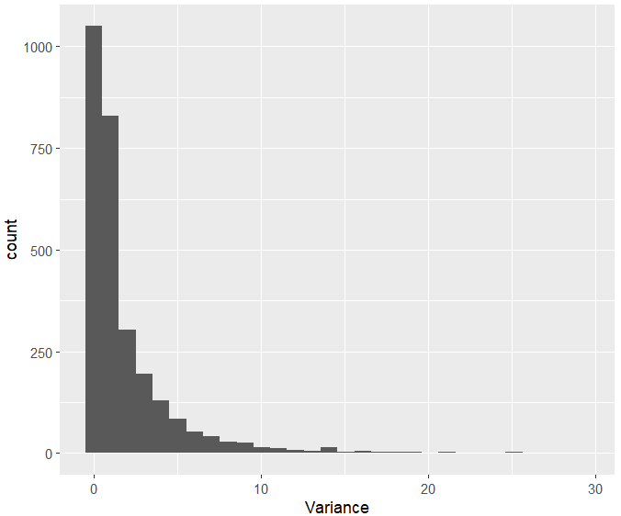
DDA: Choi2017 Progenesis ( 6 Significant Proteins) There were no missing values in the dataset
Histogram of Variance of Intensities for each protein

Slide 31
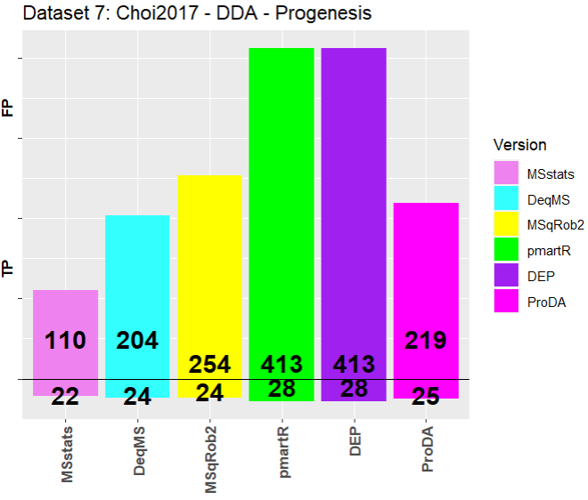
DDA: Choi2017 Progenesis ( 6 Significant Proteins)
Pre-Processing done using MSstats Converter
 | Input File
MSstats | MSstats Converter output object
DeqMS | MSstats Converter output object -> Summarized by grouping by protein name, run and aggregating intensity by taking log2 of sum(Intensity).
MSqRob2 | Combined the MSstats Converter output object by grouping by protein names, run,PSM(combination of sequence and charge) and summarized intensity using max.
PmartR | Combined the MSstats Converter output object by grouping by peptide sequence, run and summarized intensity using sum.
DEP | Combined the MSstats Converter output object by grouping by protein name, run and summarized intensity using sum.
ProDA | Combined the MSstats Converter output object by grouping by protein name, run and summarized intensity using sum.

Slide 32
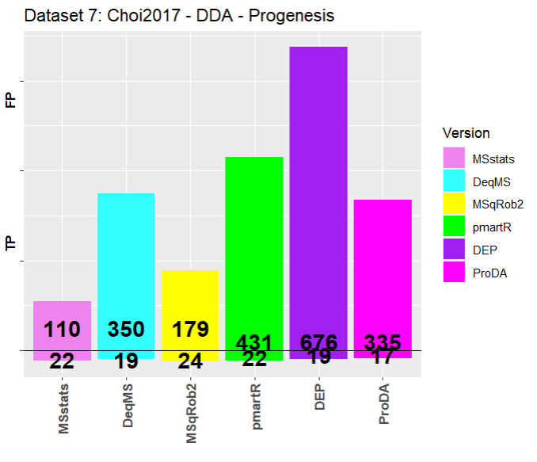
DDA: Choi2017 Progenesis ( 6 Significant Proteins)
Pre-Processing done manually
 | Input File
MSstats | MSstats Converter output object
For all below methods first selected the required columns from the data as there were multiple abundance columns and converted into to proper format so that below processing could be done | For all below methods first selected the required columns from the data as there were multiple abundance columns and converted into to proper format so that below processing could be done
DeqMS | Combined the raw data by grouping by protein names, run, PSM(combination of sequence and charge) and calculated intensity by aggregating normalized abundance using sum.
MSqRob2 | Combined the raw data by grouping by protein names, run, PSM(combination of sequence and charge) and calculated intensity by aggregating normalized abundance using max.
PmartR | Combined the raw data by grouping by peptide sequence, run and calculated intensity by aggregating normalized abundance using sum function.
DEP | Combined the raw data by grouping by protein name, run and calculated intensity by aggregating normalized abundance using max function.
ProDA | Combined the raw data by grouping by protein name, run and calculated intensity by aggregating normalized abundance using max function.

Slide 33
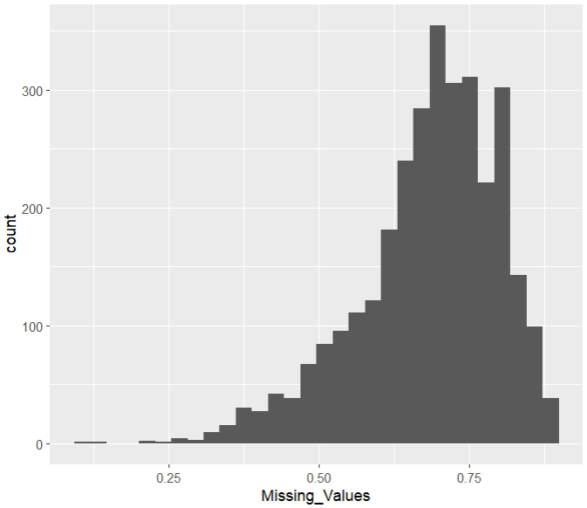
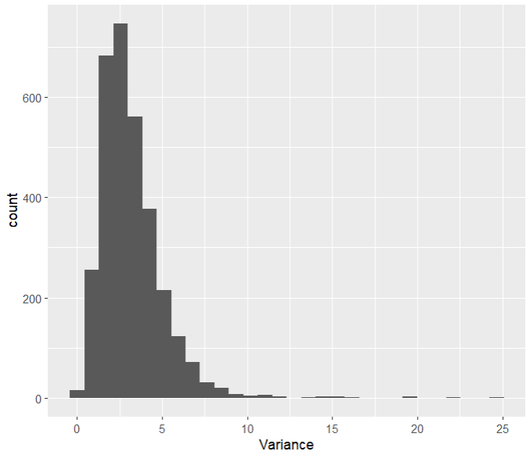
DDA:Meierhofer2016 MaxQuant
Histogram of Missing values of Intensities for each protein
Histogram of Variance of Intensities for each protein

Slide 34
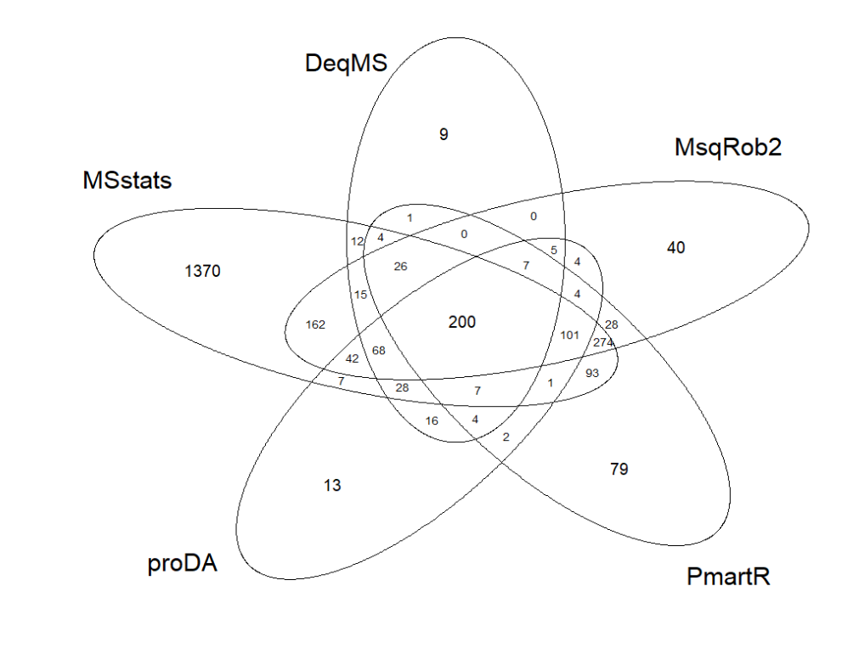
DDA:Meierhofer2016 MaxQuant
Pre-Processing done using MSstats Converter
 | Input File
MSstats | MSstats Converter output object
DeqMS | MSstats Converter output object -> Summarized by grouping by protein name, run and aggregating intensity by taking log2 of sum(Intensity).
MSqRob2 | Combined the MSstats Converter output object by grouping by protein names, run,PSM(combination of sequence and charge) and summarized intensity using max.
PmartR | Combined the MSstats Converter output object by grouping by peptide sequence, run and summarized intensity using sum.
DEP | Combined the MSstats Converter output object by grouping by protein name, run and summarized intensity using sum.
ProDA | Combined the MSstats Converter output object by grouping by protein name, run and summarized intensity using sum.
DEP-> 0 significant proteins

Slide 35
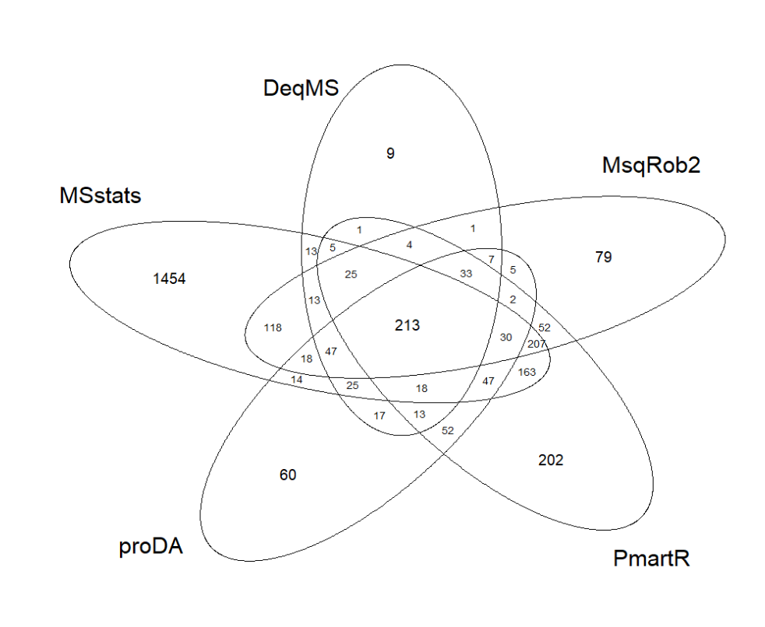
DDA:Meierhofer2016 MaxQuant
Pre-Processing done using manually
 | Input File
MSstats | MSstats Converter output object
DeqMS | Combined the raw data by grouping by protein names, run, PSM(combination of sequence and charge) and calculated intensity by aggregating Intensity using log2 of sum function.
MSqRob2 | Combined the raw data by grouping by protein names, run, PSM(combination of sequence and charge) and calculated intensity by aggregating Intensity using max function.
PmartR | Combined the raw data by grouping by peptide sequence, run and calculated intensity by aggregating Intensity using sum function.
DEP | Combined the raw data by grouping by protein name, run and calculated intensity by aggregating Intensity using sum function.
ProDA | Combined the raw data by grouping by protein name, run and calculated intensity by aggregating Intensity using sum function.
DEP-> 0 significant proteins

