Slide 1
HICT 33103 – QUIZ 2:
PRACTICAL SKILLS ASSESSMENT
GWU-HICT-2021-60

Slide 2
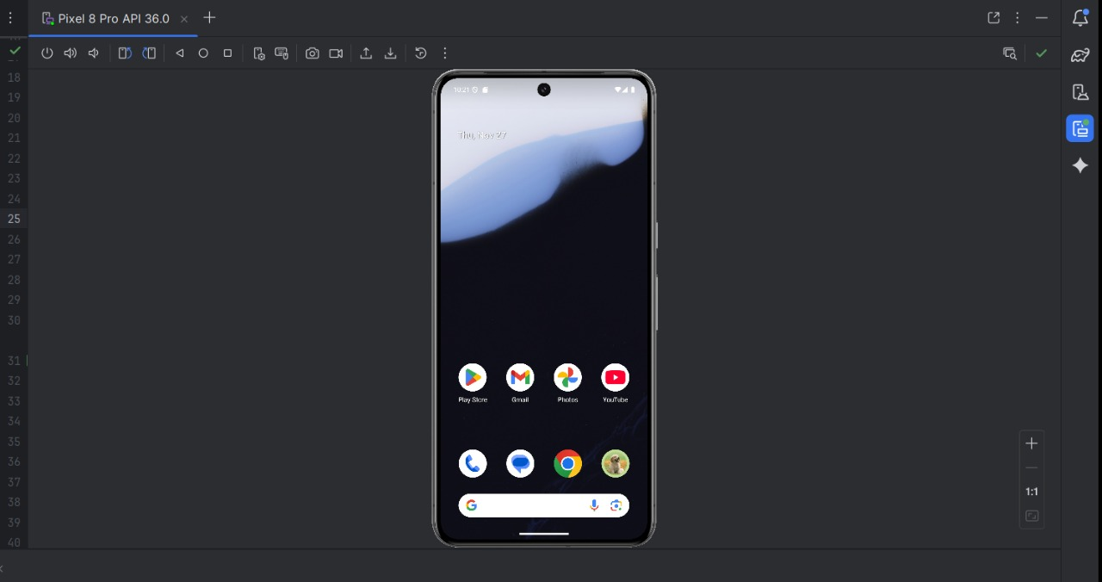
HOME

Slide 3
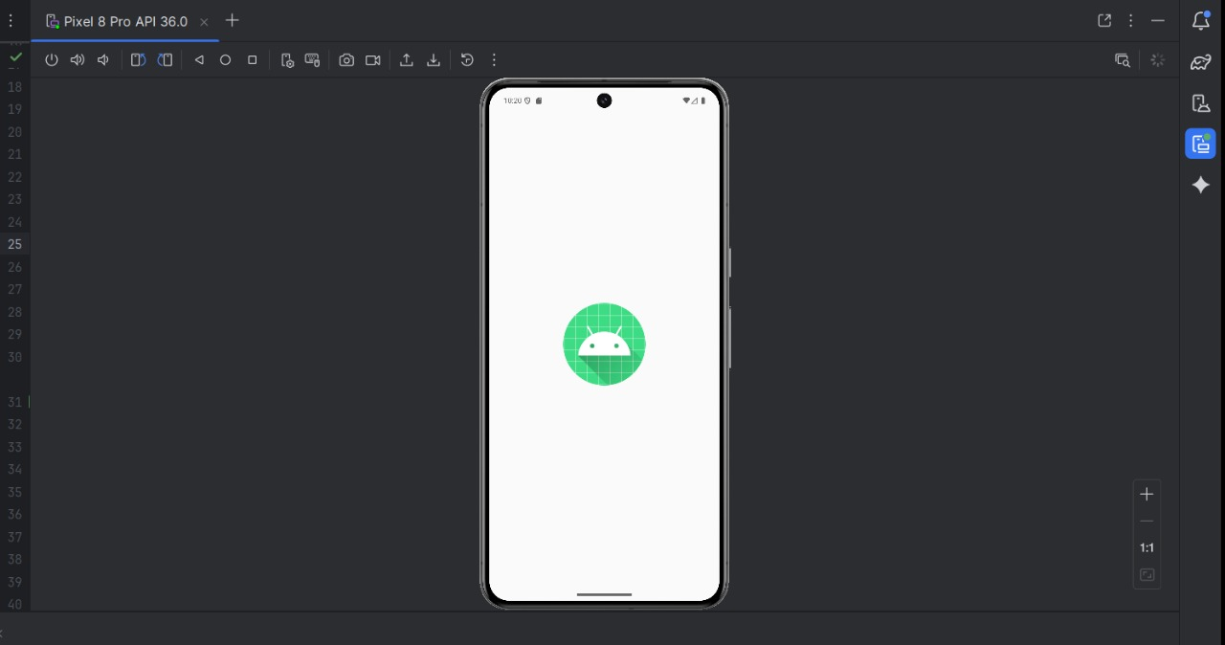
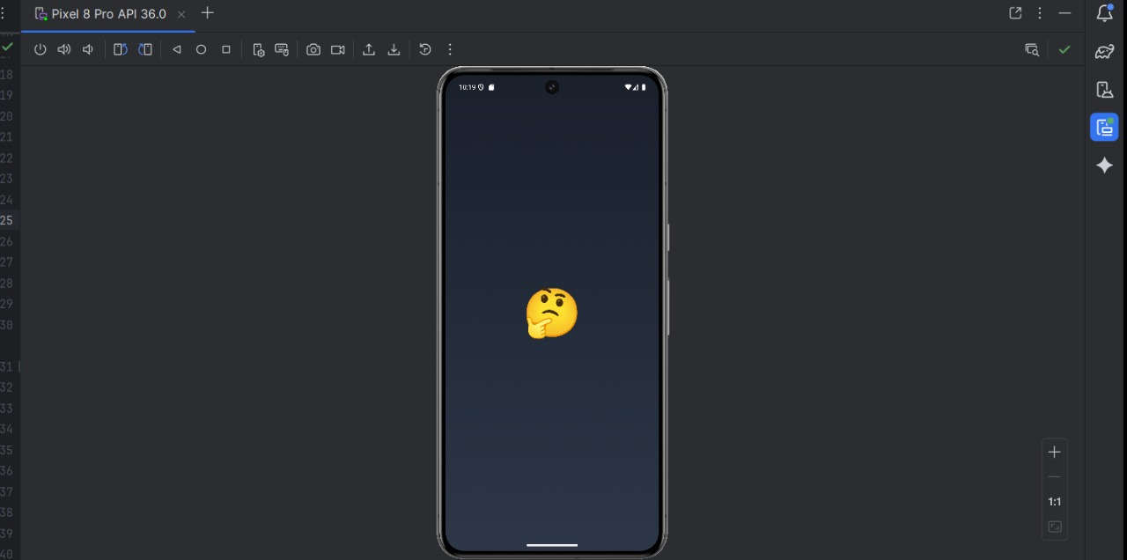
OPENING

Slide 4
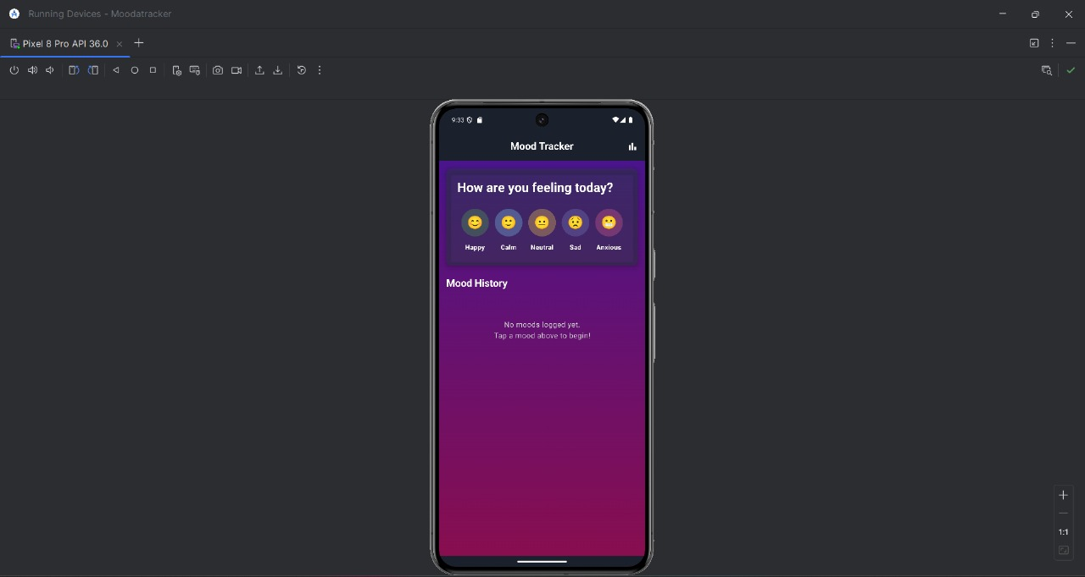
APP- HOME

Slide 5
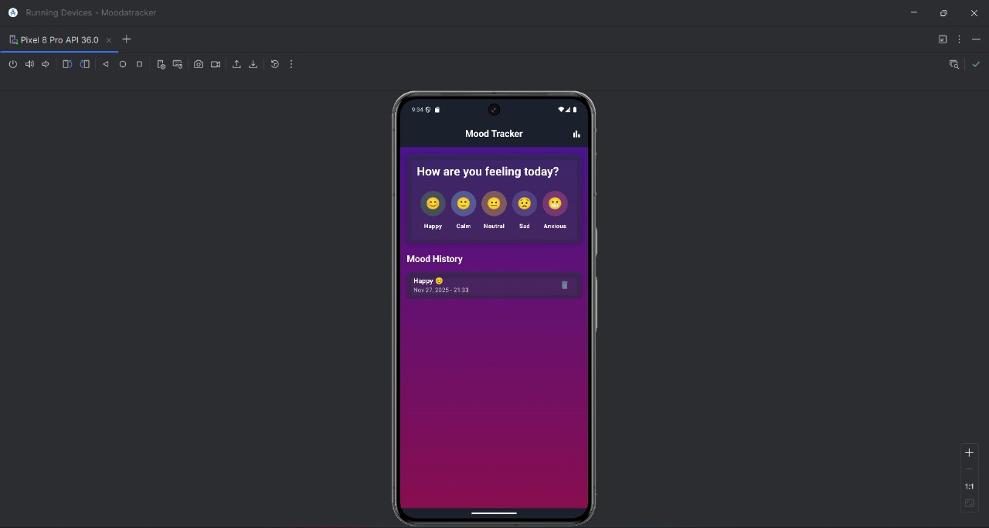
SELECTING A MOOD

Slide 6
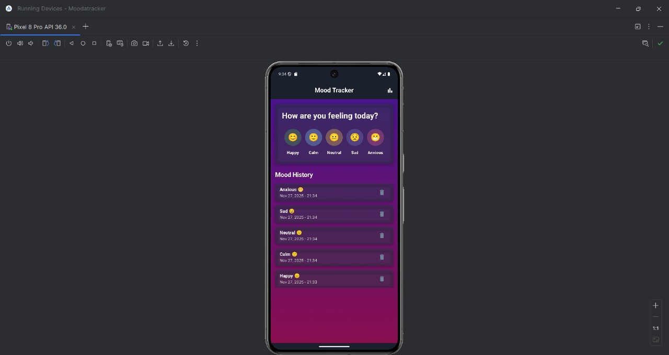
SAVING

Slide 7
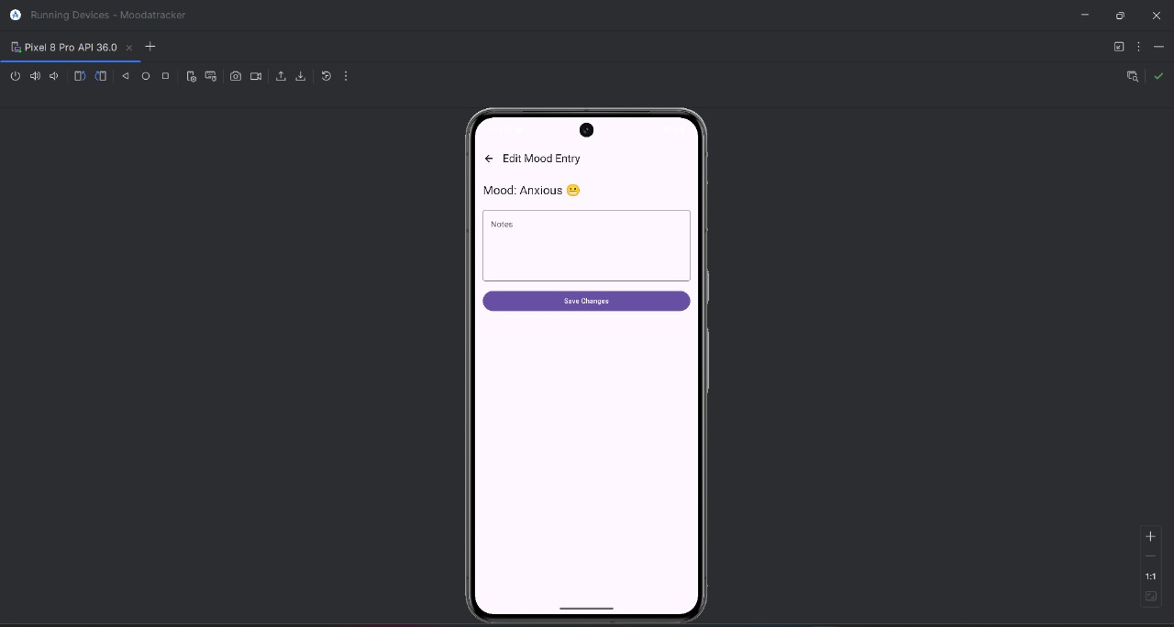
CHECKING

Slide 8
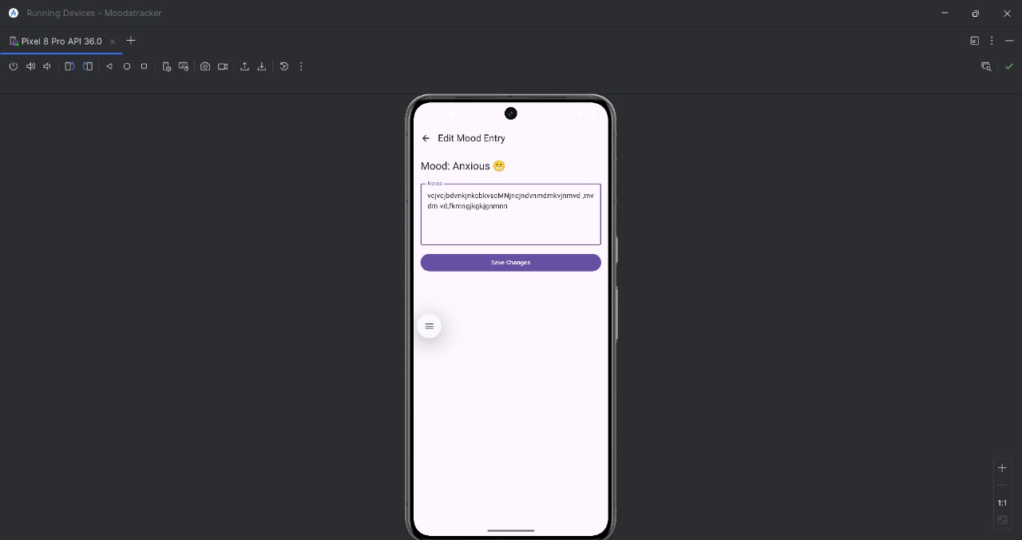
ADD NOTE

Slide 9

AFTER SAVING BACK TO HOME

Slide 10
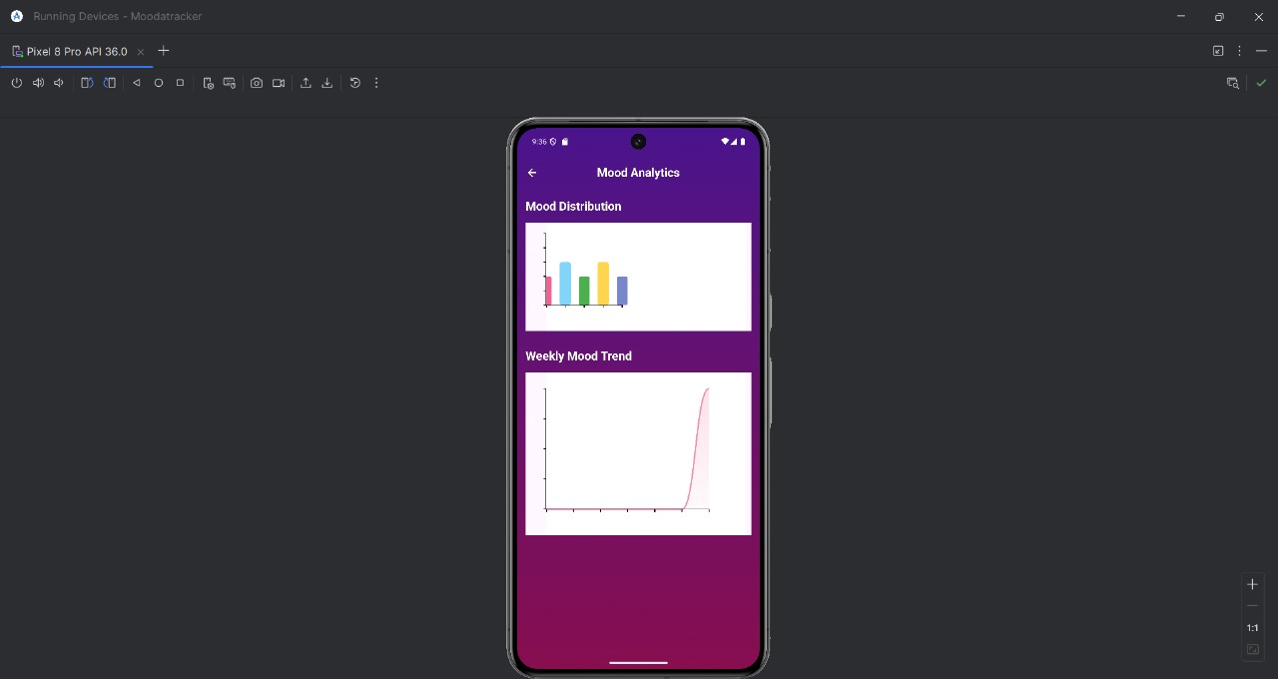
DATA VISUALIZATION CHART.

Slide 11
THANK YOU

