Slide 1
Project Title: Patient Monitoring in Ambulance and Other Vehicles
Course: EC6020: Embedded Systems Design
Group No: 31
Team Members:
2021/E/074 K. Vashiharan
2021/E/164 T. Sarujan
2021/E/169 V. Vithushikan
2021/E/189 R. Nidhushan

Slide 2
Introduction
This project addresses the challenge of continuous health monitoring during patient transportation.
The lack of real-time communication with hospitals can worsen patient outcomes.
To improve emergency response, the proposed system enables real-time tracking of vital signs and location, ensuring timely medical intervention and better patient care.

Slide 3
Problem Statement
Key Challenges:
➢ Delayed response due to lack of real-time data sharing, delaying hospital preparation.
➢ Manual reporting by paramedics can introduce errors
➢ Existing systems are mostly restricted to ambulances.

Slide 4

Proposed Solution
Real-time health monitoring (Heart rate, SpO₂, temperature, GPS tracking).
Cloud-based data transmission for seamless hospital access.
Instant alerts for critical conditions.
Multi-vehicle compatibility (ambulances, police, rescue teams,personal vehicles).
User-friendly dashboard for hospital and paramedics.

Slide 5

Novelty of the Project
Multi-Vehicle Integration – Not limited to ambulances.
Predictive Analytics – Alerts before deterioration.
Low-Cost IoT Implementation – ESP32 + cloud services.
Real-Time Communication – Mobile & web apps.
Scalability – Expandable for multiple hospitals/vehicles.

Slide 6
High-Level Architecture
ESP32 – Main controller.
MAX30100 – Heart rate & SpO₂ sensor.
DS18B20 – Temperature sensor.
NEO-6M GPS – Location tracking.
OLED Display – Onboard status monitoring.
Cloud Integration – Data transmission.
Mobile & Web Apps – Real-time patient data visualization.

Slide 7
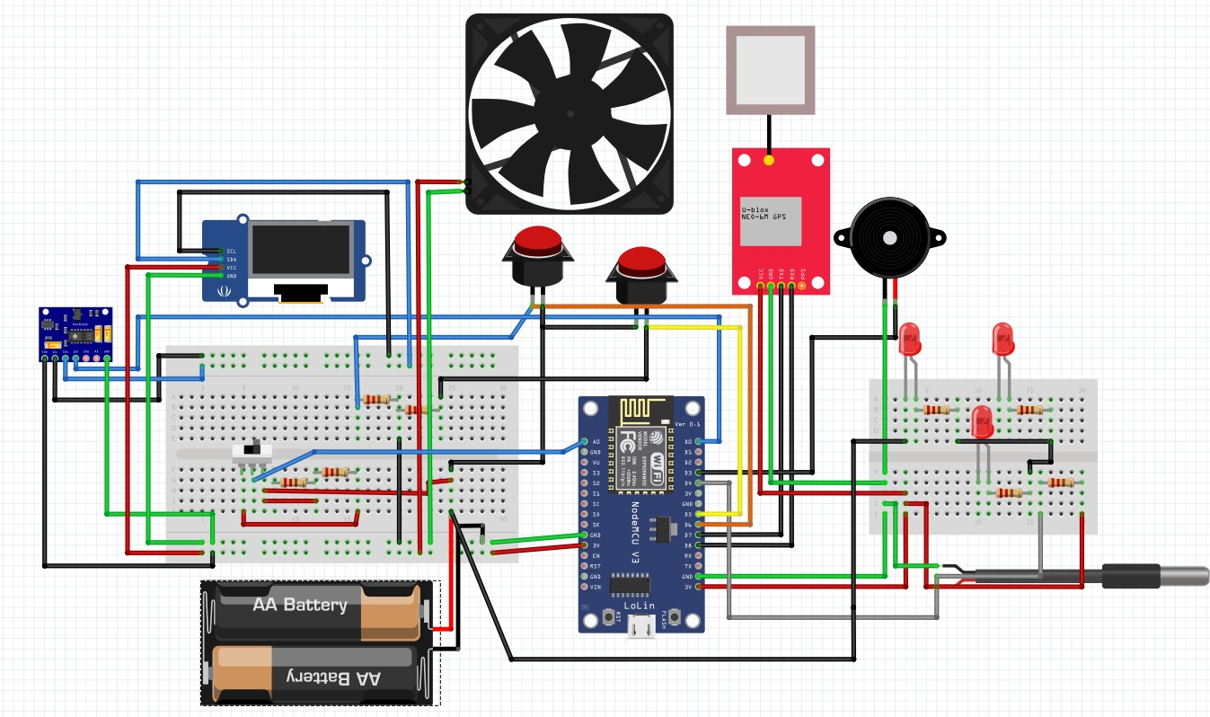
Circuit Design

Slide 8
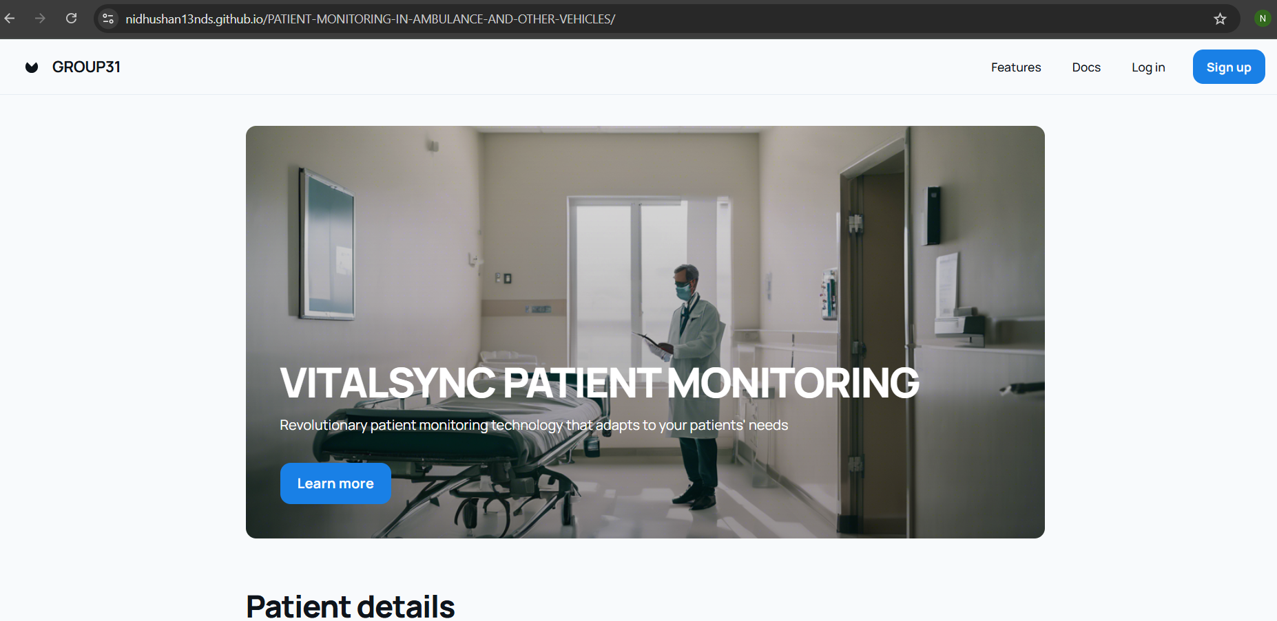
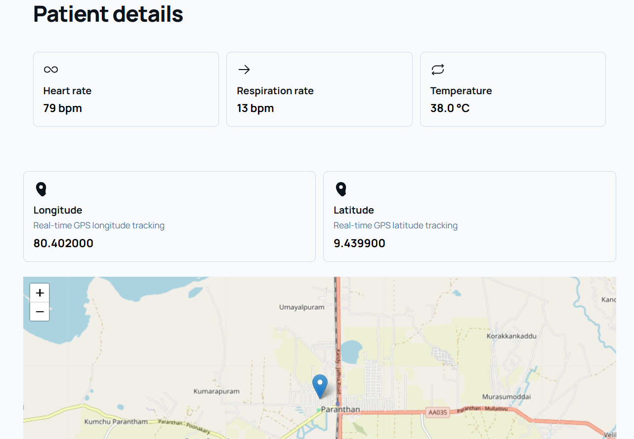
WebApp
https://nidhushan13nds.github.io/PATIENT-MONITORING-IN-AMBULANCE-AND-OTHER-VEHICLES/

Slide 9
Timeline
Activity | Weeks
 | 5 | 6 | 7 | 8 | 9 | 10 | 11 | 12 | 13 | 14
Find and purchase components
Design the system and do initial testing
Assemble the hardware and write the firmware
Integrate the sensors and display
Build the web application and set up the database
Test the system and improve the user interface
Fix any issues and do final integration
Write the documentation and prepare for the presentation
Final review and project submission

Slide 10
Budget
components | price
ESP32 | 1300
DS18B20 temperature sensor | 300
MAX30100 heart rate sensor | 500
NEO6MV2 gps module | 1500
OLED mini display 0.96 inch | 950
Copper board (5cm*7cm) | 150
Jumper wires(40pcs) | 300
Push button, Switch | 80
Outer cover & Other

Slide 11
Thank you

