Slide 1
Digital Logic & Systems Counters
Wenye Li, Ph.D
The Chinese University of Hong Kong

Slide 2
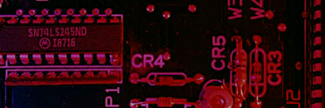
Summary
Counting in Binary
As you know, the binary count sequence follows a familiar pattern of 0’s and 1’s.
0 0 0
0 0 1
0 1 0
0 1 1
1 0 0
1 0 1
1 1 0
1 1 1
LSB changes on every number.
The next bit changes on every other number.
The next bit changes on every fourth number.

Slide 3
Summary
Counting in Binary
A counter can form the same pattern of 0’s and 1’s with logic levels. The first stage in the counter represents the least significant bit – notice that these waveforms follow the same pattern as counting in binary.
LSB
MSB

Slide 4
Summary
Three bit Asynchronous Counter
In an asynchronous counter, the clock is applied only to the first stage. Subsequent stages derive the clock from the previous stage.
The three-bit asynchronous counter shown is typical. It uses J-K flip-flops in the toggle mode.
HIGH
J₀
Q₀
J₁
Q₁
J₂
Q₂
CLK
C
C
C
Q₀
Q₁
K₀
K₁
K₂
Waveforms are on the following slide…

Slide 5
Summary
Three bit Asynchronous Counter
Notice that the Q₀ output is triggered on the leading edge of the clock signal. The following stage is triggered from Q₀. The leading edge of Q₀ is equivalent to the trailing edge of Q₀. The resulting sequence is that of an 3-bit binary up counter.
CLK
Q₀
Q₁
Q₂

Slide 6
Summary
Propagation Delay
Asynchronous counters are sometimes called ripple counters, because the stages do not all change together. For certain applications requiring high clock rates, this is a major disadvantage.
Notice how delays are cumulative as each stage in a counter is clocked later than the previous stage.
CLK
Q₀
Q₁
Q₂
Q₀ is delayed by 1 propagation delay, Q₂ by 2 delays and Q₃ by 3 delays.

Slide 7
Summary
Asynchronous Decade Counter
This counter uses partial decoding to recycle the count sequence to zero after the 1001 state. The flip-flops are trailing-edge triggered, so clocks are derived from the Q outputs. Other truncated sequences can be obtained using a similar technique.
CLR
HIGH
Q₀
Q₁
Q₂
Q₃
J₀
J₁
J₂
J₃
CLK
C
C
C
C
K₀
K₁
K₂
K₃
Waveforms are on the following slide…

Slide 8
Summary
Asynchronous Decade Counter
When Q₁ and Q₃ are HIGH together, the counter is cleared by a “glitch” on the CLR line.
CLK
Q₀
Q₁
Glitch
Q₂
Q₃
CLR
Glitch

Slide 9
Summary
The 74LS93A Asynchronous Counter
The 74LS93A has one independent toggle J-K flip-flop driven by CLK A and three toggle J-K flip-flops that form an asynchronous counter driven by CLK B.
The counter can be extended to form a 4-bit counter by connecting Q₀ to the CLK B input. Two inputs are provided that clear the count.
CLK B
J₀
J₁
J₂
J₃
CLK A
C
C
C
C
K₀
K₁
K₂
K₃
All J and K inputs are connected internally HIGH
RO (1)
RO (2)
Q₀
Q₁
Q₂
Q₃

Slide 10
Summary
Synchronous Counters
In a synchronous counter all flip-flops are clocked together with a common clock pulse. Synchronous counters overcome the disadvantage of accumulated propagation delays, but generally they require more circuitry to control states changes.
This 3-bit binary synchronous counter has the same count sequence as the 3-bit asynchronous counter shown previously.
HIGH
Q₀
Q₀
Q₁
Q₀Q₁
Q₂
J₀
J₁
J₂
C
C
C
K₀
K₁
K₂
CLK
The next slide shows how to analyze this counter by writing the logic equations for each input. Notice the inputs to each flip-flop…

Slide 11
Summary
Analysis of Synchronous Counters
A tabular technique for analysis is illustrated for the counter on the previous slide. Start by setting up the outputs as shown, then write the logic equation for each input. This has been done for the counter.
1. Put the counter in an arbitrary state; then determine the inputs for this state.
2. Use the new inputs to determine the next state: Q₂ and Q₁ will latch and Q₀ will toggle.
3. Set up the next group of inputs from the current output.
Outputs
Logic for inputs
Q₂ Q₁ Q₀ | J₂ = Q₀Q₁ | K₂ = Q₀Q₁ | J₁ = Q₀ | K₁ = Q₀ | J₀ = 1 | K₀ = 1
0 0 0
0
0
0
0
1
1
0 0 1
0
0
1
1
1
1
0 1 0
4. Q₂ will latch again but both Q₁ and Q₀ will toggle.
Continue like this, to complete the table. The next slide shows the completed table…

Slide 12
Summary
Analysis of Synchronous Counters
Outputs
Logic for inputs
Q₂ Q₁ Q₀ | J₂ = Q₀Q₁ | K₂ = Q₀Q₁ | J₁ = Q₀ | K₁ = Q₀ | J₀ = 1 | K₀ = 1
0 0 0
0
0
0
0
1
1
0 0 1
0
0
1
1
1
1
0 1 0
0
0
0
0
1
1
0 1 1
1
1
1
1
1
1
1 0 0
0
0
0
0
1
1
1 0 1
0
0
1
1
1
1
1 1 0
0
0
0
0
1
1
1 1 1
1
1
1
1
1
1
0 0 0
At this points all states have been accounted for and the counter is ready to recycle…

Slide 13
Summary
A 4-bit Synchronous Binary Counter
The 4-bit binary counter has one more AND gate than the 3-bit counter just described. The shaded areas show where the AND gate outputs are HIGH causing the next FF to toggle.
Q₀
Q₁
Q₂
Q₃

Slide 14
Summary
BCD Decade Counter
With some additional logic, a binary counter can be converted to a BCD synchronous decade counter. After reaching the count 1001, the counter recycles to 0000.
This gate detects 1001, and causes FF3 to toggle on the next clock pulse. FF0 toggles on every clock pulse. Thus, the count starts over at 0000.
Q₃
Q₀

Slide 15
Summary
BCD Decade Counter
Waveforms for the decade counter:
CLK
Q₀
Q₁
Q₂
Q₃
These same waveforms can be obtained with an asynchronous counter in IC form – the 74LS90. It is available in a dual version – the 74LS390, which can be cascaded. It is slower than synchronous counters (max count frequency is 35 MHz), but is simpler.

Slide 16
Summary
A 4-bit Synchronous Binary Counter
The 74LS163 is a 4-bit IC synchronous counter with additional features over a basic counter. It has parallel load, a CLR input, two chip enables, and a ripple count output that signals when the count has reached the terminal count.
Data inputs
D₀
D₁
D₂
D₃
CLR
LOAD
ENT
RCO
ENP
CLK
Example waveforms are on the next slide…
Q₀
Q₁
Q₂
Q₃
Data outputs

Slide 17
Summary
CLR
LOAD
D₀
Data inputs
D₁
D₂
D₃
CLK
ENP
ENT
Q₀
Data outputs
Q₁
Q₂
Q₃
RCO
12 13 14 15 0 1 2
Count Inhibit
Clear Preset

Slide 18
Summary
Up/Down Synchronous Counters
An up/down counter is capable of progressing in either direction depending on a control input.
UP
Q₀.UP
HIGH
FF0
FF1
FF2
Q₂
J₀
Q₀
J₁
Q₁
J₂
UP/DOWN
C
C
C
Q₀
Q₁
Q₂
K₀
K₁
K₂
DOWN
Q₀.DOWN
CLK

Slide 19
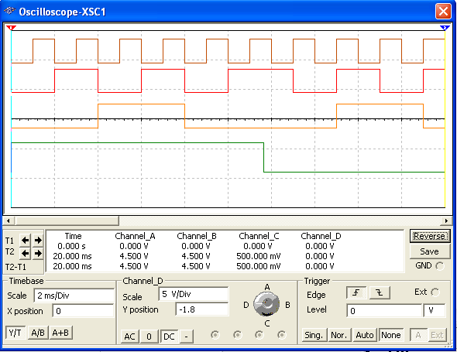
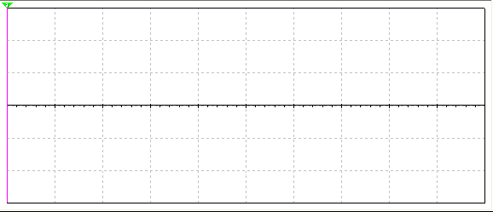
Summary
Up/Down Synchronous Counters
Q₀
Q₁
Q₂
UP/DOWN
Count up
Count down

Slide 20
Summary
Up/Down Synchronous Counters
D₀
D₁
D₂
D₃
Data inputs
The 74HC190 is a high speed CMOS synchronous up/down decade counter with parallel load capability. It also has a active LOW ripple clock output (RCO) and a MAX/MIN output when the terminal count is reached.
74HC190
CTEN
MAX/MIN
D/U
CTR DIV 10
LOAD
CLK
C
RCO
Q₀
Q₁
Q₂
Q₃
Data outputs
D₀
D₁
D₂
D₃
Data inputs
The 74HC191 has the same inputs and outputs but is a synchronous up/down binary counter.
74HC191
CTEN
MAX/MIN
D/U
CTR DIV 16
LOAD
CLK
C
RCO
Q₀
Q₁
Q₂
Q₃
Data outputs

Slide 21
Summary
Synchronous Counter Design
Most requirements for synchronous counters can be met with available ICs. In cases where a special sequence is needed, you can apply a step-by-step design process.
The steps in design are described in detail in the text and lab manual. Start with the desired sequence and draw a state diagram and next-state table. The gray code sequence from the text is illustrated:
State diagram:
Next state table:

Slide 22
Summary
Synchronous Counter Design
The J-K transition table lists all combinations of present output (Q_{N}) and next output (Q_{N+1}) on the left. The inputs that produce that transition are listed on the right.
Each time a flip-flop is clocked, the J and K inputs required for that transition are mapped onto a K-map.
An example of the J₀ map is:
The logic for each input is read and the circuit is constructed. The next slide shows the circuit for the gray code counter…

Slide 23
Summary
Synchronous Counter Design
FF0
FF1
FF2
Q₂
J₀
Q₀
J₁
Q₁
J₂
C
C
C
Q₀
Q₁
Q₂
K₀
K₁
K₂
CLK

Slide 24
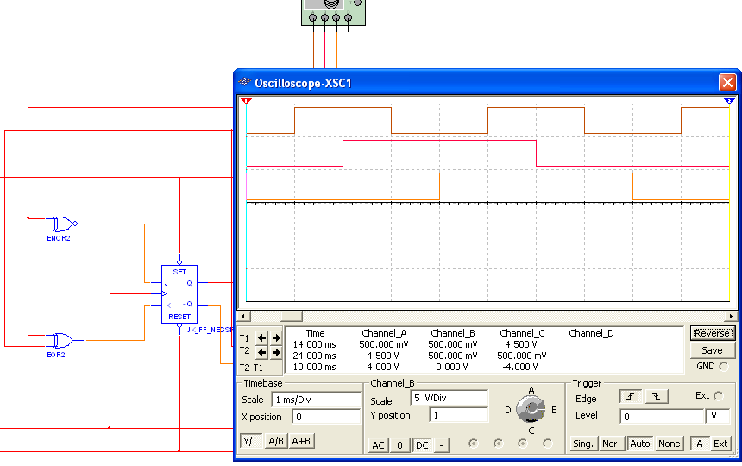

Summary
Q₀
Q₁
Q₂

Slide 25
Summary
Cascaded counters
Cascading is a method of achieving higher-modulus counters. For synchronous IC counters, the next counter is enabled only when the terminal count of the previous stage is reached.
HIGH
Counter 1
Counter 2
f_{out}
CTEN
TC
CTEN
TC
CTR DIV 16
CTR DIV 16
CLK
C
Q₀
Q₂
Q₁
Q₃
C
Q₀
Q₂
Q₁
Q₃
f_{in}
Example
What is the modulus of the cascaded DIV 16 counters?
If f_{in} =100 kHz, what is f_{out}?
Solution
a) Each counter divides the frequency by 16. Thus the modulus is 16² = 256.
b) The output frequency is 100 kHz/256 = 391 Hz

Slide 26
Summary
Counter Decoding
Decoding is the detection of a binary number and can be done with an AND gate.
Question
What number is decoded by this gate?

Slide 27
Summary
Partial Decoding
The decade counter shown previously incorporates partial decoding (looking at only the MSB and the LSB) to detect 1001. This was possible because this is the first occurrence of this combination in the sequence.
Detects 1001 by looking only at two bits

Slide 28
Summary
Resetting the Count with a Decoder
The divide-by-60 counter in the text also uses partial decoding to clear the tens count when a 6 was detected.
The divide characteristic illustrated here is a good way to obtain a lower frequency using a counter. For example, the 60 Hz power line can be converted to 1 Hz.

Slide 29
Summary
Counter Decoding
Example
Show how to decode state 5 with an active LOW output.
Solution
Notice that a NAND gate was used to give the active LOW output.

Slide 30
Selected Key Terms
Asynchronous
Modulus
Synchronous
Terminal count
State machine
Cascade
Not occurring at the same time.
The number of unique states through which a counter will sequence.
Occurring at the same time.
The final state in a counter’s sequence.
A logic system exhibiting a sequence of states or values.
To connect “end-to-end” as when several counters are connected from the terminal count output of one to the enable input of the next counter.

Slide 31

Quiz
1. The counter shown below is an example of
a. an asynchronous counter
b. a BCD counter
c. a synchronous counter
d. none of the above
HIGH
J₀
Q₀
J₁
Q₁
J₂
Q₂
CLK
C
C
C
Q₀
Q₁
K₀
K₁
K₂

Slide 32
Quiz
The Q₀ output of the counter shown
a. is present before Q₁ or Q₂
b. changes on every clock pulse
c. has a higher frequency than Q₁ or Q₂
d. all of the above
HIGH
J₀
Q₀
J₁
Q₁
J₂
Q₂
CLK
C
C
C
Q₀
Q₁
K₀
K₁
K₂

Slide 33
Quiz
3. To cause a D flip-flop to toggle, connect the
a. clock to the D input
b. Q output to the D input
c. Q output to the D input
d. clock to the preset input

Slide 34
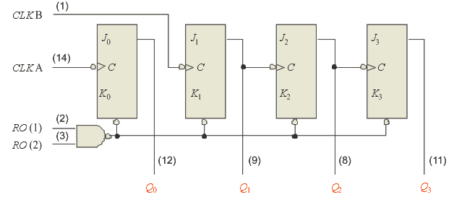
Quiz
4. The 7493A asynchronous counter diagram is shown (J’s and K’s are HIGH.) To make the count have a modulus of 16, connect
a. Q₀ to RO(1) and RO(2) to
b. Q₃ to RO(1) and RO(2)
c. CLK A and CLK B together
d. Q₀ to CLK B

Slide 35
Quiz
5. Assume Q₀ is LOW. The next clock pulse will cause
a. FF1 and FF2 to both toggle
b. FF1 and FF2 to both latch
c. FF1 to latch; FF2 to toggle
d. FF1 to toggle; FF2 to latch
FF0
FF1
FF2
LOW

Slide 36
Quiz
6. A 4-bit binary counter has a terminal count of
a. 4
b. 10
c. 15
d. 16

Slide 37
Quiz
7. Assume the clock for a 4-bit binary counter is 80 kHz. The output frequency of the fourth stage (Q₃) is
a. 5 kHz
b. 10 kHz
c. 20 kHz
d. 320 kHz

Slide 38
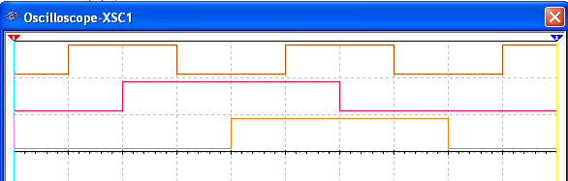
Quiz
8. A 3-bit count sequence is shown for a counter (Q₂ is the MSB). The sequence is
a. 0-1-2-3-4-5-6-7-0 (repeat)
b. 0-1-3-2-6-7-5-4-0 (repeat)
c. 0-2-4-6-1-3-5-7-0 (repeat)
d. 0-4-6-2-3-7-5-1-0 (repeat)
Q₀
Q₁
Q₂

Slide 39
Quiz
9. FF2 represents the MSB. The counts that are being decoded by the 3-input AND gates are
a. 2 and 3
b. 3 and 6
c. 2 and 5
d. 5 and 6

Slide 40
Quiz
10. Assume the input frequency (f_{in}) is 256 Hz. The output frequency (f_{out}) will be
a. 16 Hz
b. 1 kHz
c. 65 kHz
d. none of the above
HIGH
Counter 1
Counter 2
f_{out}
CTEN
TC
CTEN
TC
CTR DIV 16
CTR DIV 16
CLK
C
Q₀
Q₂
Q₁
Q₃
C
Q₀
Q₂
Q₁
Q₃
f_{in}

Slide 41
Quiz
Answers:
1. a
2. d
3. c
4. d
5. b
6. c
7. a
8. b
9. b
10. d

