Slide 1


Slide 2
Agenda
01 Who am I?
And how I came to know Mojo
02 Is Mojo faster than Python?
What was all the buzz about?
03 The company behind Mojo
Who created it?
04 How does Mojo work
Python & Mojo
05 My opinion on Mojo
Is it usable yet?

Slide 3

Who am I
Vito Minheere
Python Data Engineer @ Codebeez
6 years of Python experience
Currently working at the Sociale Verzekeringsbank

Slide 4

How I heard about Mojo

Slide 5

Is Mojo faster than Python?

Slide 6
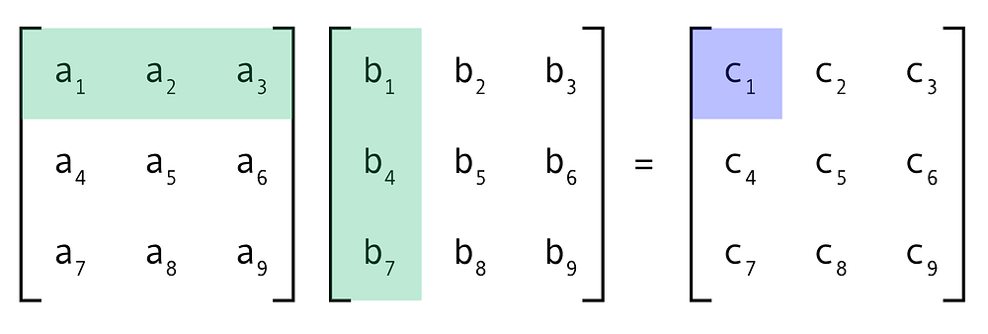
Matrix Multiplication

Slide 7
Matrix Multiplication
def matmul_untyped(C, A, B): for m in range(C.rows): for k in range(A.cols): for n in range(C.cols): C[m, n] += A[m, k] * B[k, n]
Loops in Python are slow
Types are checked every loop

Slide 8
Matrix Multiplication
# This exactly the same Python implementation, # but is infact Mojo code! def matmul_untyped(C, A, B): for m in range(C.rows): for k in range(A.cols): for n in range(C.cols): C[m, n] += A[m, k] * B[k, n]
Python code can be reused in Mojo
Running the same code in Mojo is 4.8x faster

Slide 9
Optimizations
GFLOP per second = 1 billion floating point operations
Python used 0,0022 GFLOP/s
Step | Mojo | Speedup
Adding types | 3,8 | 1654x
Vectorizing inner loop | 16,6 | 7118x
Parallelizing | 146,4 | 62648x
Tiling | 166,7 | 71290x
Autotune | 180,1 | 77052x
Notes:
Compared to standard Python using cPython

Slide 10
Optimized Mojo Code
fn matmul_tiled_unrolled_parallelized(C: Matrix, A: Matrix, B: Matrix): @parameter fn calc_row(m: Int): @parameter fn calc_tile[tile_x: Int, tile_y: Int](x: Int, y: Int): for k in range(y, y + tile_y): @parameter fn dot[nelts : Int,](n : Int): C.store[nelts](m,n+x, C.load[nelts](m,n+x) + A[m,k] * B.load[nelts](k,n+x)) vectorize_unroll[nelts, tile_x//nelts, dot](tile_x) alias tile_size = autotune(4, 6, 8, 16, 32) tile[calc_tile, nelts*tile_size, tile_size](A.cols, C.cols) parallelize[calc_row](C.rows, C.rows)

Slide 11
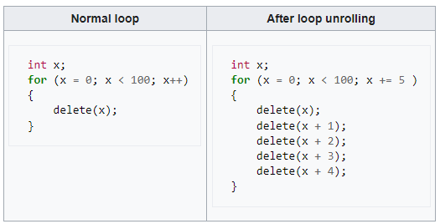
Vectorize unroll

Slide 12
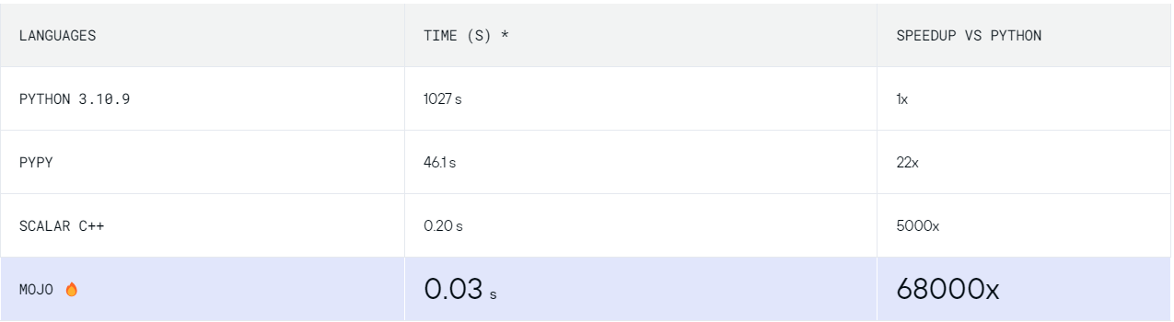

35.000x faster than Python?

Slide 13

Who is behind Mojo?
Modular
Mojo🔥
Modular
AI Engine
Notes:
Modular Engine
The Modular Engine executes all of your TensorFlow and PyTorch models with no model rewriting or conversions
Mojo
Mojo combines the usability of Python with the performance of C, unlocking unparalleled programmability of AI hardware and extensibility of AI models.
Modular engineers initially wrote this code in MLIR directly but found it to be a productivity challenge.

Slide 14







Modular
Chris Lattner
Tim Davis
Notes:
Swift, Apple, LLVM
Google, Google ML, Tensorflow

Slide 15


What is Mojo?
Standalone language
Superset of Python*
Mojo
JIT & AOT Compilation
Notes:
Wrote a small, fast, static language with Python syntax, and with a runtime bridge to CPython
Said they would make it a superset in the future

Slide 16
Just In Time Compilation
def matmul_untyped(C, A, B): for m in range(C.rows): for k in range(A.cols): for n in range(C.cols): C[m, n] += A[m, k] * B[k, n]
Notes:
A Mojo def function receives a copy of all arguments

Slide 17
Ahead Of Time Compilation
fn matmul(C: Matrix, A: Matrix, B: Matrix): for m in range(C.rows): for k in range(A.cols): for n in range(C.cols): C[m, n] += A[m, k] * B[k, n]
Notes:
All values passed into a Mojo fn function are immutable references by default. This means the function can read the original object (it is not a copy), but it cannot modify the object at all.
This is the borrow principle from Rust

Slide 18
What is Mojo?
Standalone language
Borrow checker & Ownership
Superset of Python*
Mojo
Competitor to Rust & Julia
Interpreted & Compiled

Slide 19


Mojo is faster than Python
SIMD
MLIR
LLVM

Slide 20
What makes Mojo so fast?
SIMD
MLIR
LLVM

Slide 21
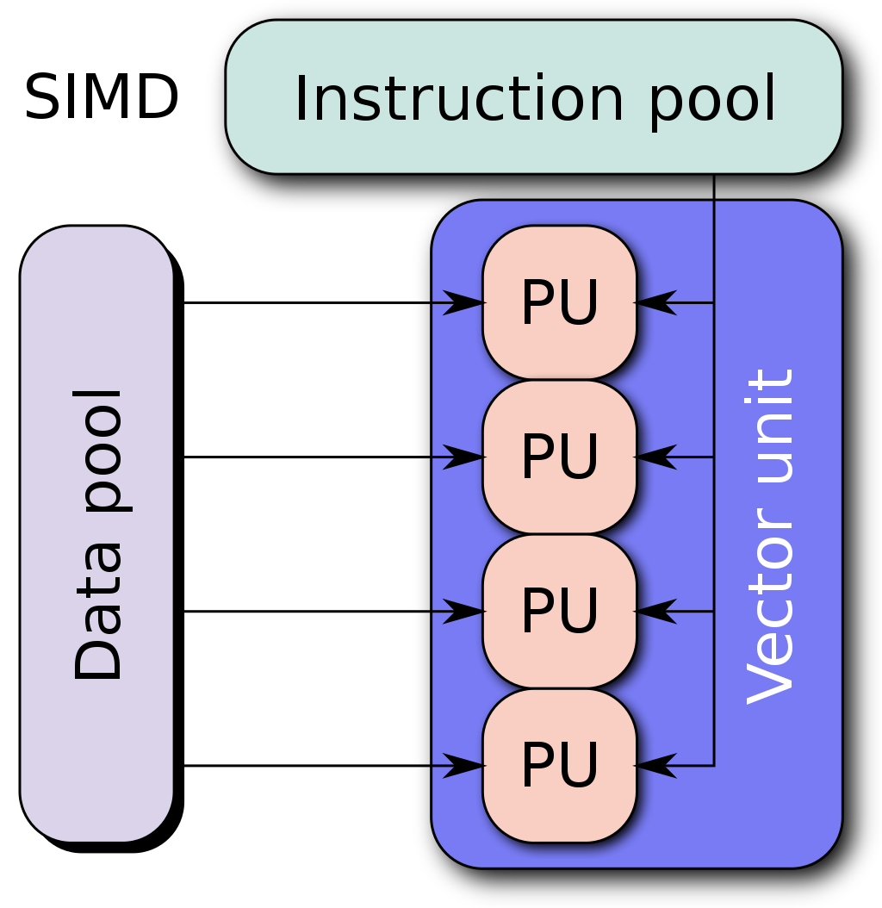
Single Instruction, Multiple Data
SIMD
Notes:
the conventional sequential approach using one instruction to process each individual data is called scalar operations.

Slide 22
What makes Mojo so fast?
SIMD
MLIR
LLVM

Slide 23
Multi-Level Intermediate Representation
Code
Dialects
Hardware Acc IR
Add newer hardware
LLVM IR
Reduce to single LLVM input
MLIR
LLVM
Assembly / Machine code
Notes:
You can define your own MLIR types and use them in Mojo and even Python code inside Mojo

Slide 24
What makes Mojo so fast?
SIMD
MLIR
LLVM

Slide 25
Low Level Virtual Machine
Developed by Chris Lattner in 2002
Super-compiler for multiple languages
Widely used in: Rust, C, Swift
LLVM
Not only translates, also optimizes

Slide 26
What makes Mojo so fast?
SIMD
MLIR
LLVM

Slide 27

Python & Mojo

Slide 28
Python & Mojo
import time def pi(n: int): total = 0.0 for i in range(1 - 2*n, 2*n + 1, 4): total += 1.0 / i return 4 * total start_time = time.time() print(pi(100_000_000)) end_time = time.time() print(end_time - start_time)
from python import Python fn pi(n: Int) -> FloatLiteral: var total: FloatLiteral = 0.0 for i in range(1 - 2*n, 2*n + 1, 4): total += 1.0 / i return 4 * total fn main() raises: let time = Python.import_module('time') let start_time = time.time() print(pi(100_000_000)) let end_time = time.time() print(end_time - start_time)
4.5 seconds
0.14 seconds

Slide 29
What is missing?
Python context managers(open, with)
No list or dict comprehensions
Exception is actually called Error
No polymorphism
Can't compile program with Python
No keyword arguments(x=42) yet
No classes
Notes:
Unhandled exception caught during execution: An error occurred in Python.
mojo: error: execution exited with a non-zero result: 1

Slide 30
My evaluation of Mojo
Pros
Cons
Backed by a strong team
Not open source, yet
Python reusability
No packages index, yet
Can compile to executable
Small subset of functions
MLIR types available in Python
Too strong reliance on Python

Slide 31

Will I use it?

Slide 32


My info
Linkedin
vito.minheere
Github
VitoMinheere

