Slide 1
PCSX2
The Open Source PS2 Emulator
Why this topic?
The PlayStation 2 is the best-selling console of all time — over 155 million units sold.
PCSX2 lets you relive those classics on modern hardware, completely free.

Slide 2
Three Key Points
01
02
03
System Requirements
Download PCSX2
Games & BIOS
Minimum
Official site
Repository
Windows 10/11 or Linux
CPU x86-64 + SSE4.1
8 GB RAM · Vulkan 1.1
pcsx2.net
myrient.erista.me
Recommended
Build
Games
i7-4790 / Ryzen 5 1600
GTX 1650 / RX 570
16 GB RAM
Latest Nightly
(more fixes than Stable)
Redump / PlayStation 2
Platforms
BIOS
Windows · macOS · Linux
PS2 BIOS Images
v2.30 recommended

Slide 3
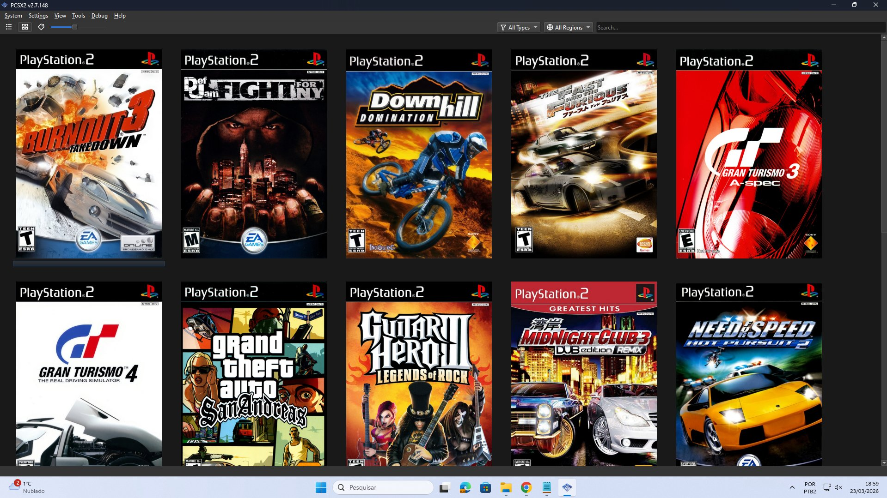
Something You Probably Didn't Know
Games Supported
PCSX2 covers the vast majority of the PS2 library with high compatibility.
Dev Console Trick
Enabling Dev Console in advanced settings unlocks extra memory for the emulator.
Auto Game Covers
PCSX2 fetches box art automatically from a GitHub repository — zero manual work.
PCSX2 running with full game library and HD covers
Nightly Beats Stable
Nightly builds have better compatibility and fewer bugs than the stable release.

Slide 4
Conclusion & My Take
"PCSX2 is more than an emulator — it's a time machine that brings a golden era of gaming back to life, completely free."
Preservation
Accessibility
Better Than Original
PCSX2 ensures classic PS2 games are never truly lost — an important part of gaming history.
Anyone with a mid-range PC can play 2,679 titles without buying aging hardware.
Upscaling, widescreen patches, and save states make games better than ever.

Slide 5
Q & A
Ready to answer your questions about PCSX2, setup, games, BIOS, or emulation in general.
pcsx2.net · myrient.erista.me

