Slide 1

Experiential Learning - Phase II
Disruption Aware Hybrid Machine Learning

Slide 2




Disruption Aware Hybrid Machine Learning
Vittal Mukunda
Pranjal Malaiya
Atharva Somani

Slide 3
EL Phase-II
Presentation Outline
Recap of Phase-I
Phase-II Objectives
How DAHS Works (Final Method)
Experimental Setup
Main Results & Sample Efficiency
Robustness & Real-Data Validation
Beating the Papers & Industry Comparison
Conclusion & References

Slide 4
Recap of Phase-I
Problem: e-commerce warehouses must dispatch orders under constant change — demand surges, perishable goods and tight delivery deadlines (SLAs). One fixed rule cannot stay best all day.
Phase-I proposal: DAHS — a machine-learning scheduler that picks the best dispatching rule for the current situation, instead of using one rule for the whole shift.
The plan: build a realistic warehouse simulator, capture disruption-aware features, and train a model to choose the right rule at each decision point.
The goal: fewer late orders (SLA breaches) and lower delays (tardiness), without the cost and instability of heavy AI methods.
Phase-II task: actually build it, test it against strong baselines and published papers, and prove that it works.

Slide 5
Phase-II Objectives
Build the full system: a complete warehouse simulator, the training pipeline and the final DAHS model, working end-to-end.
Refine the method: replace the early Random-Forest idea with a stronger approach — offline rollout distillation feeding a calibrated gradient-boosted ranker.
Compare fairly: test against static rules, an analytic lookahead controller, a contextual bandit, and two published learning methods (PPO and offline-RL).
Prove it, do not just claim it: measure SLA breach, cost and tardiness on 50 unseen shifts, with confidence intervals and significance tests.
Stress-test: check robustness across many untuned settings and under realistic, bursty real-world order data.

Slide 6
How DAHS Works — The Core Idea
Four simple rules in the toolbox: FIFO (oldest first), FEFO (earliest-expiry first), WSPT (shortest job first), ATC (urgency-weighted). Each is fast and easy to understand.
No single rule wins: the best rule keeps changing during a shift — FEFO is best 43% of the time, WSPT 32%, FIFO 15%, ATC 10%. So which rule to use is a real decision.
DAHS is a selector: every 15 minutes it reads the warehouse state and picks the rule expected to cost the least over the next hour.
Learned cheaply, offline: we simulate each rule's short-term outcome once, ahead of time, and teach a model to copy the best choice.
Instant at runtime: one fast prediction, no live simulation — and the chosen rule is a name a supervisor can see and trust.

Slide 7
How DAHS Works — The 4-Step Pipeline
Step 1 — Gather experience: run 250 simulated 8-hour shifts trying all rules, collecting 8,000 real decision moments.
Step 2 — Measure the truth (rollout): at each moment, briefly simulate every rule forward and record its actual cost — the direct answer, not a guess.
Step 3 — Find operating regimes: automatically group situations (quiet start, busy peak, perishable rush) so the model knows the context.
Step 4 — Train a calibrated ranker: a gradient-boosted model learns to predict the best rule; its confidence is calibrated so a light switching controller can act safely.
Deploy: one forward pass per 15-minute interval picks the rule — transparent, fast and stable.

Slide 8
Experimental Setup
Simulator: an 8-hour shift split into 32 intervals of 15 minutes, 10 pickers, orders arriving randomly, 20% perishable, each with a deadline.
Fair testing: all methods judged on the same 50 unseen shifts; training used a separate 250 shifts.
Scenarios: light load, balanced, default, and a tough high-load-perishable case — all fixed in advance, never tuned per method.
Baselines: the 4 static rules, a snapshot model, an analytic one-step lookahead (greedy-MPC), a contextual bandit (LinUCB), PPO (deep RL) and offline-RL (fitted-Q).
Metrics: SLA-breach rate (main), composite cost, tardiness, throughput and picker use — with bootstrap confidence intervals and significance tests.

Slide 9
Main Results — DAHS vs All Baselines
Method | SLA breach | Composite cost | Mean tardiness
DAHS (ours) | 1.33% | 3.09 | 0.53
greedy-MPC (analytic lookahead) | 3.13% | 9.19 | 1.82
Snapshot ranker (τ = 1) | 3.73% | 8.77 | 1.59
PPO — deep RL (fair budget) | 3.85% | 3.92 | 0.26
FIFO (best static rule) | 6.60% | 7.57 | 0.62
Offline-RL — fitted-Q | 7.18% | 7.46 | 0.53
PPO — deep RL (60× budget) | 11.81% | 12.60 | 1.00
Takeaway: lower is better. DAHS has the fewest SLA breaches and the lowest cost — 2.4 points below the next-best learned method.

Slide 10
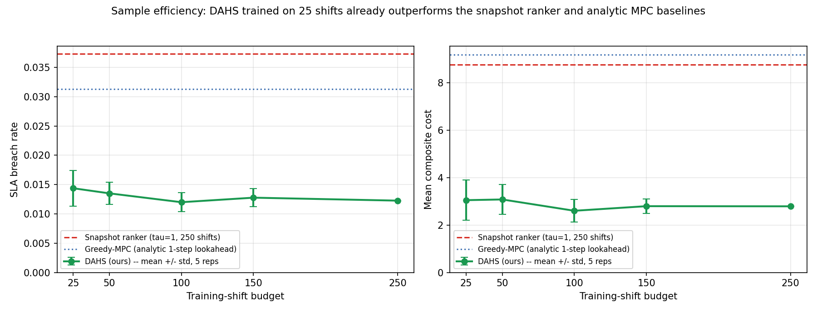
Sample Efficiency — The Key Result
Just 25 training shifts (about 2.5 hours of simulation) already beat every baseline at any data budget.
DAHS even beats offline-RL trained on 10x more data — each training moment carries a directly measured answer, so learning is dense and stable.

Slide 11
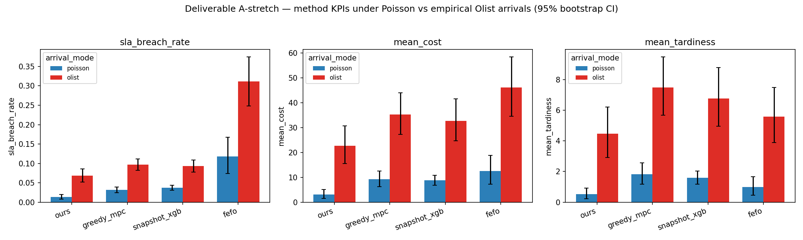
Robustness & Real-World Validation
Tested on bursty arrivals from a real e-commerce trace (Olist, ~100k orders): DAHS keeps rank one on every metric.
Its lead actually widens under realistic bursts, and it stays Pareto-best across all 4 scenarios and 12 untuned settings.

Slide 12
Beating the Published Papers
Published method | Its breach | DAHS | Why DAHS wins
Offline-LD — offline RL, 2025 (closest competitor) | 7.18% | 1.33% | +5.85 pts better (95% CI excludes 0); the paper's method collapses to 61.9% breach under heavy load
PPO — deep RL, 2017 (fair budget) | 3.85% | 1.33% | 2.9× fewer breaches; PPO never learns a state-aware policy on this problem
PPO — same, 60× budget (500k steps) | 11.81% | 1.33% | More training made it worse — it collapsed to always picking one rule (FEFO)
Takeaway: same data, same model family, fair tuning — DAHS wins the metric that matters most: getting orders out on time.

Slide 13
Our Model vs the Papers' Models
Aspect | The papers (Offline-LD / PPO) | DAHS (ours)
Training signal | One bootstrapped value guess per step | Directly measured cost of every rule
Counterfactuals | Never sees the rules it did not pick | Measures the cost of all four rules
Data needed | Hundreds of shifts, still improving | ~25 shifts — already saturated
Stability (25 shifts) | Unstable — breach std 4.5 pts | Stable — breach std 0.3 pts
Heavy-load behaviour | Offline-RL collapses to 61.9% breach | Degrades gracefully to 19.4% breach
Transparency | Opaque action output | Emits a named rule (FIFO/FEFO/WSPT/ATC)
Runtime cost | Value network evaluation | One fast prediction — no live simulation
Takeaway: the difference is the training signal — a directly measured answer, not a guessed value.

Slide 14
Industry Practice (Amazon, Flipkart) vs DAHS
Area | Typical industry practice | DAHS (ours)
On the floor | Fixed priority rules (e.g. FIFO / earliest-deadline) — simple, but cannot adapt as conditions change | Re-picks the best rule every 15 minutes for the current state
Big-tech AI | Deep-RL / large optimization on massive data + compute — powerful, but data-hungry, costly and opaque | Big-tech-style adaptivity from ~25 shifts; one cheap, fast prediction
Transparency | End-to-end models output assignments that are hard for staff to check | Outputs a named rule a supervisor already understands and can verify
Adapting to change | Often needs costly retraining when demand patterns shift | Holds up across untuned settings and bursty real data — no retraining
*General, publicly-described approaches. DAHS delivers adaptivity without big-tech-scale data, compute or black-box risk — ideal where those resources are not available.

Slide 15
Conclusion
DAHS works: 1.33% SLA-breach vs 3.13% (analytic) and 7.18% (offline-RL) — the fewest breaches and the lowest cost on unseen shifts.
Headline = sample efficiency: a deployable controller from just 25 shifts, beating methods trained on 10x more data.
Beats published methods: outperforms PPO and an offline-RL (Offline-LD style) method by wide, statistically significant margins.
Robust and realistic: Pareto non-dominated, stable across 12 untuned settings, and its lead widens under real bursty order data.
Practical edge: transparent named rules, instant decisions, no live simulation — adaptivity without heavy-AI cost.
Next: validate on a real warehouse log and a larger rule pool. Phase-II is complete and ready to finish.

Slide 16
References
[1] Pluijm et al. (2025). Offline-LD: Offline Reinforcement Learning with maskable Q-learning for scheduling. arXiv. — the closest published competitor (our offline-RL baseline).
[2] Schulman, Wolski, Dhariwal, Radford & Klimov (2017). Proximal Policy Optimization Algorithms. arXiv:1707.06347.
[3] Bertsekas (2020). Rollout, Policy Iteration, and Distributed Reinforcement Learning. Athena Scientific.
[4] Ernst, Geurts & Wehenkel (2005). Tree-Based Batch Mode Reinforcement Learning (fitted Q-iteration). JMLR 6, 503–556.
[5] Drake, Kheiri, Özcan & Burke (2020). Recent advances in selection hyper-heuristics. European Journal of Operational Research 285(2).
[6] Chen & Guestrin (2016). XGBoost: A Scalable Tree Boosting System. ACM SIGKDD.
[7] Mahmoudinazlou et al. (2025). Deep reinforcement learning for dynamic order picking in warehouses. Computers & Operations Research 182.
[8] Olist (2018). Brazilian E-Commerce Public Dataset. Kaggle.

Slide 17


