Slide 1

Experiential Learning
Disruption Aware Hybrid Machine Learning

Slide 2




Disruption Aware Hybrid Machine Learning
Vittal Mukunda
Pranjal Malaiya
Atharva Somani

Slide 3
EL Phase-I
Presentation Outline
Introduction
Problem Definition
Literature Review
Objectives
Methodology
Proposed Outcomes
Conclusion
References

Slide 4
Introduction
DAHS, a hybrid ML scheduler that dynamically selects the best dispatching rule for warehouse operations.
Uses a simulation-based environment of an e-commerce warehouse with real-world disruptions (failures, surges, delays).
Applies a Random Forest meta-model to choose optimal scheduling strategies based on system state features.
Introduces new disruption-aware features to better capture system instability and improve decision-making.
Achieves significant performance improvement by reducing delays and SLA violations compared to traditional scheduling methods.

Slide 5
Problem Definition
Handling inefficient scheduling in e-commerce warehouses under dynamic and unpredictable conditions.
Overcoming the limitations of fixed dispatching rules that fail during disruptions.
Managing real-time decision-making complexity in a highly stochastic job shop environment.
Reducing high order delays and SLA violations caused by poor scheduling choices.
Adapting scheduling to frequent disruptions like machine failures, demand surges, and priority changes.

Slide 6
Literature Review
Ref | Author / Year | Key Idea | Limitation
[1] | Statista (2024) | Shows rapid growth of e-commerce → need for efficient scheduling | No technical solution
[2] | Zhang et al. (2020) | Learns optimal dispatching rules automatically | High training cost, low interpretability
[3] | SimPy (2023) | Models real-world systems for testing scheduling strategies | Only simulation tool, not a solution
[4] | Bitsch & Schweitzer (2023) | Selects best scheduling strategy using ML | Limited to specific AGV scenarios
[5] | Wang et al. (2023) | Generates data-driven dispatching rules | Computationally expensive
[6] | Bai et al. (2022) | Highlights role of ML in scheduling and routing | General overview, lacks specific model

Slide 7
Objectives
Develop a dynamic scheduling system that adapts to real-time warehouse conditions.
Select the best dispatching rule automatically using machine learning.
Minimize total tardiness and order delays in operations.
Reduce SLA violations under uncertain and disruptive environments.
Improve overall efficiency and throughput of e-commerce fulfilment systems.

Slide 8
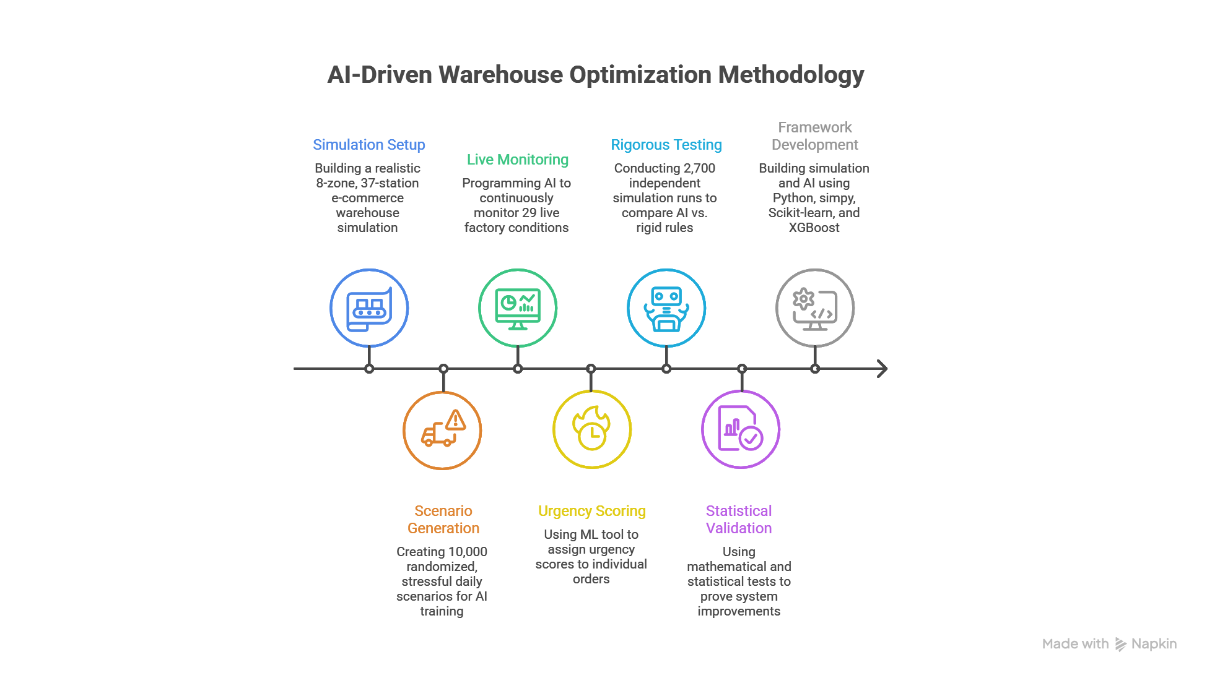
Methodology

Slide 9
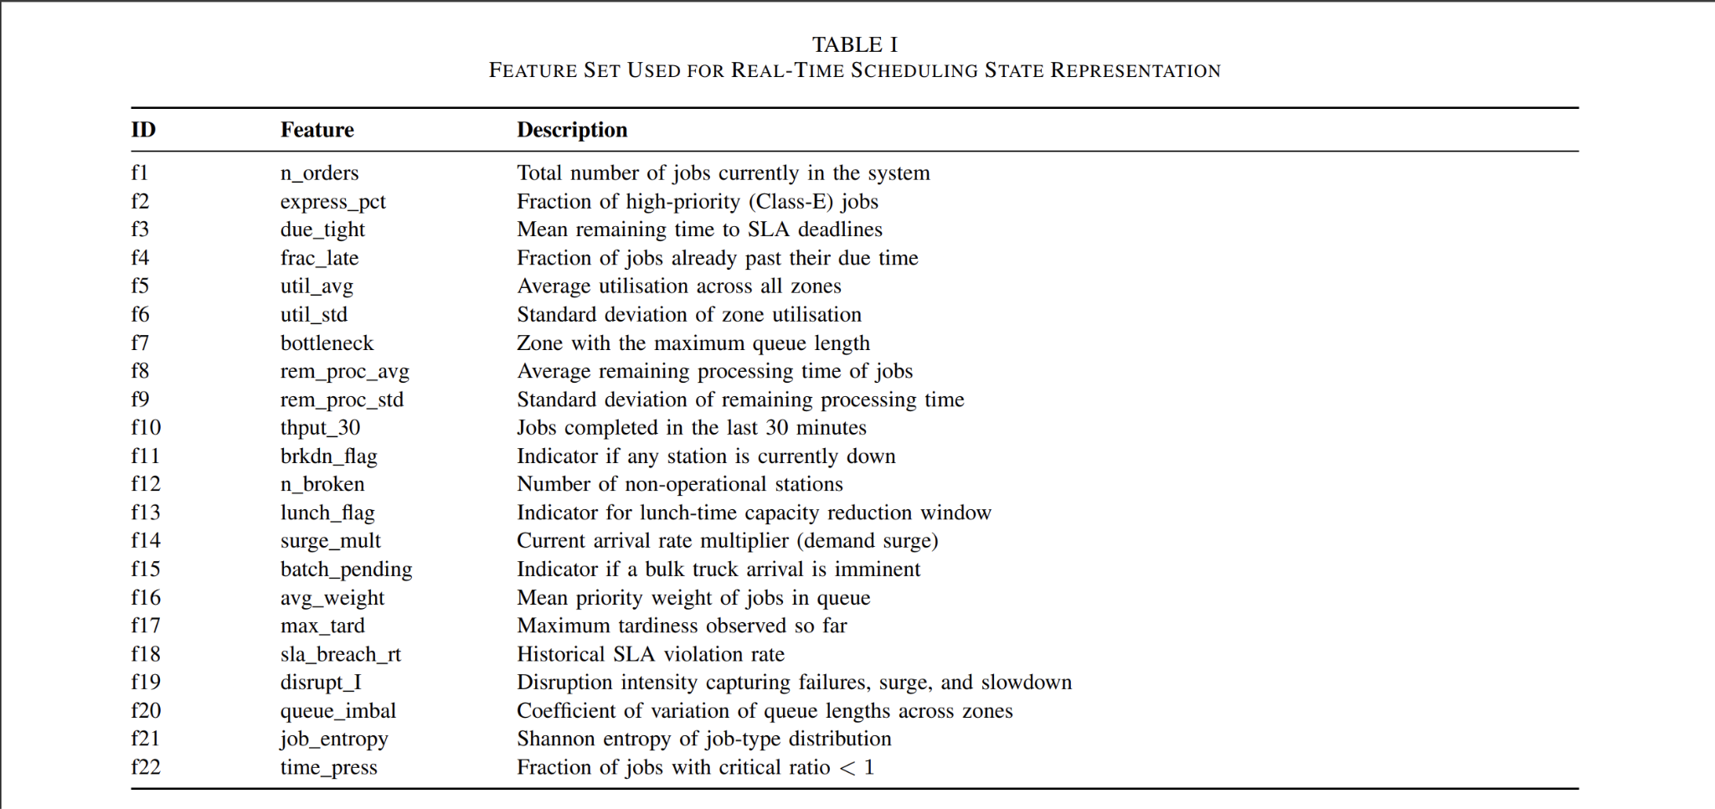
Methodology

Slide 10
Methodology
Model a warehouse system using discrete-event simulation with multiple zones and job types.
Incorporate real-world disruptions such as machine breakdowns, demand surges, and capacity variations.
Capture system-state features, including disruption-aware metrics, at each decision point.
Generate training data using multiple scheduling heuristics across diverse scenarios.
Develop a Random Forest-based model to dynamically select the best scheduling rule.
Apply a Gradient Boosting model for precise job priority scoring.
Evaluate system performance using metrics like tardiness, SLA breach rate, and throughput.
Validate improvements through extensive simulations and statistical analysis.

Slide 11
Proposed Outcomes
Achieve significant reduction in order delays (tardiness) compared to traditional methods.
Reduce SLA breach rates, ensuring more timely order fulfilment.
Enable adaptive and real-time scheduling decisions under dynamic conditions.
Improve overall warehouse efficiency and throughput.
Provide a robust system that performs well under disruptions like failures and demand surges.
Demonstrate the effectiveness of machine learning-based scheduling over fixed heuristics.

Slide 12
Conclusion
The project aims to make a novel machine learning-based scheduling approach for dynamic warehouse environments.
Adaptive decision-making outperforms traditional fixed scheduling rules.
The system will effectively handle uncertainty and real-world disruptions.
It will significant improve in achieving reduced delays and SLA violations.
The approach will prove to be scalable and practical for modern e-commerce systems.
Overall, it will highlight the potential of AI-driven scheduling in optimizing complex operations.

Slide 13
References
[1] Statista Research Department, “Global retail e-commerce revenue 2019 2027,” Statista, 2024.
[2] C. Zhang, W. Song, Z. Cao, J. Zhang, P. S. Tan, and X. Chi, “Learning to dispatch for job shop scheduling via deep reinforcement learning,” in Adv. Neural Inf. Process. Syst. (NeurIPS), vol. 33, 2020, pp. 1621–1632
[3] SimPy Development Team, “SimPy 4.1: Discrete-event simulation for Python,” 2023. [Online]. Available: https://simpy.readthedocs.io
[4] G. Bitsch and F. Schweitzer, "Choosing solution strategies for scheduling automated guided vehicles in production using machine learning," Applied Sciences, vol. 13, no. 2, p. 806, Jan. 2023.
[5] H. Wang et al., "A data-driven simulation-optimization framework for generating priority dispatching rules in dynamic job shop scheduling with uncertainties," Oct. 2023. [Online]. Available: ResearchGate.

Slide 14
References
[6] R. Bai et al., "Analytics and machine learning in scheduling and routing research," International Journal of Production Research, Oct. 2022, doi: 10.1080/00207543.2022.2131930.
[7] A. Corsini, S. Calderara, and M. Dell’Amico, “Learning the quality of machine permutations in job shop scheduling,” arXiv preprint arXiv:2207.03244, 2022.
[8] R. Bai, G. Kendall, and E. K. Burke, “Analytics and machine learning in scheduling and routing research,” International Journal of Production Research, vol. 61, no. 1, pp. 1–22, 2022.
[9] M. Xu, Y. Mei, F. Zhang, and M. Zhang, “Learn to optimise for job shop scheduling: A survey with comparison between genetic programming and reinforcement learning,” Artificial Intelligence Review, vol. 58, 2025.
[10] A. K. Kaban, Z. Othman, and D. S. Rohmah, “Comparison of dispatching rules in job-shop scheduling problem using simulation,” International Journal of Simulation Modelling, recent applications extended in 2022 studies on ML-based scheduling.

Slide 15


