Slide 1


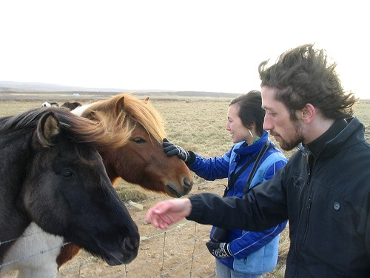
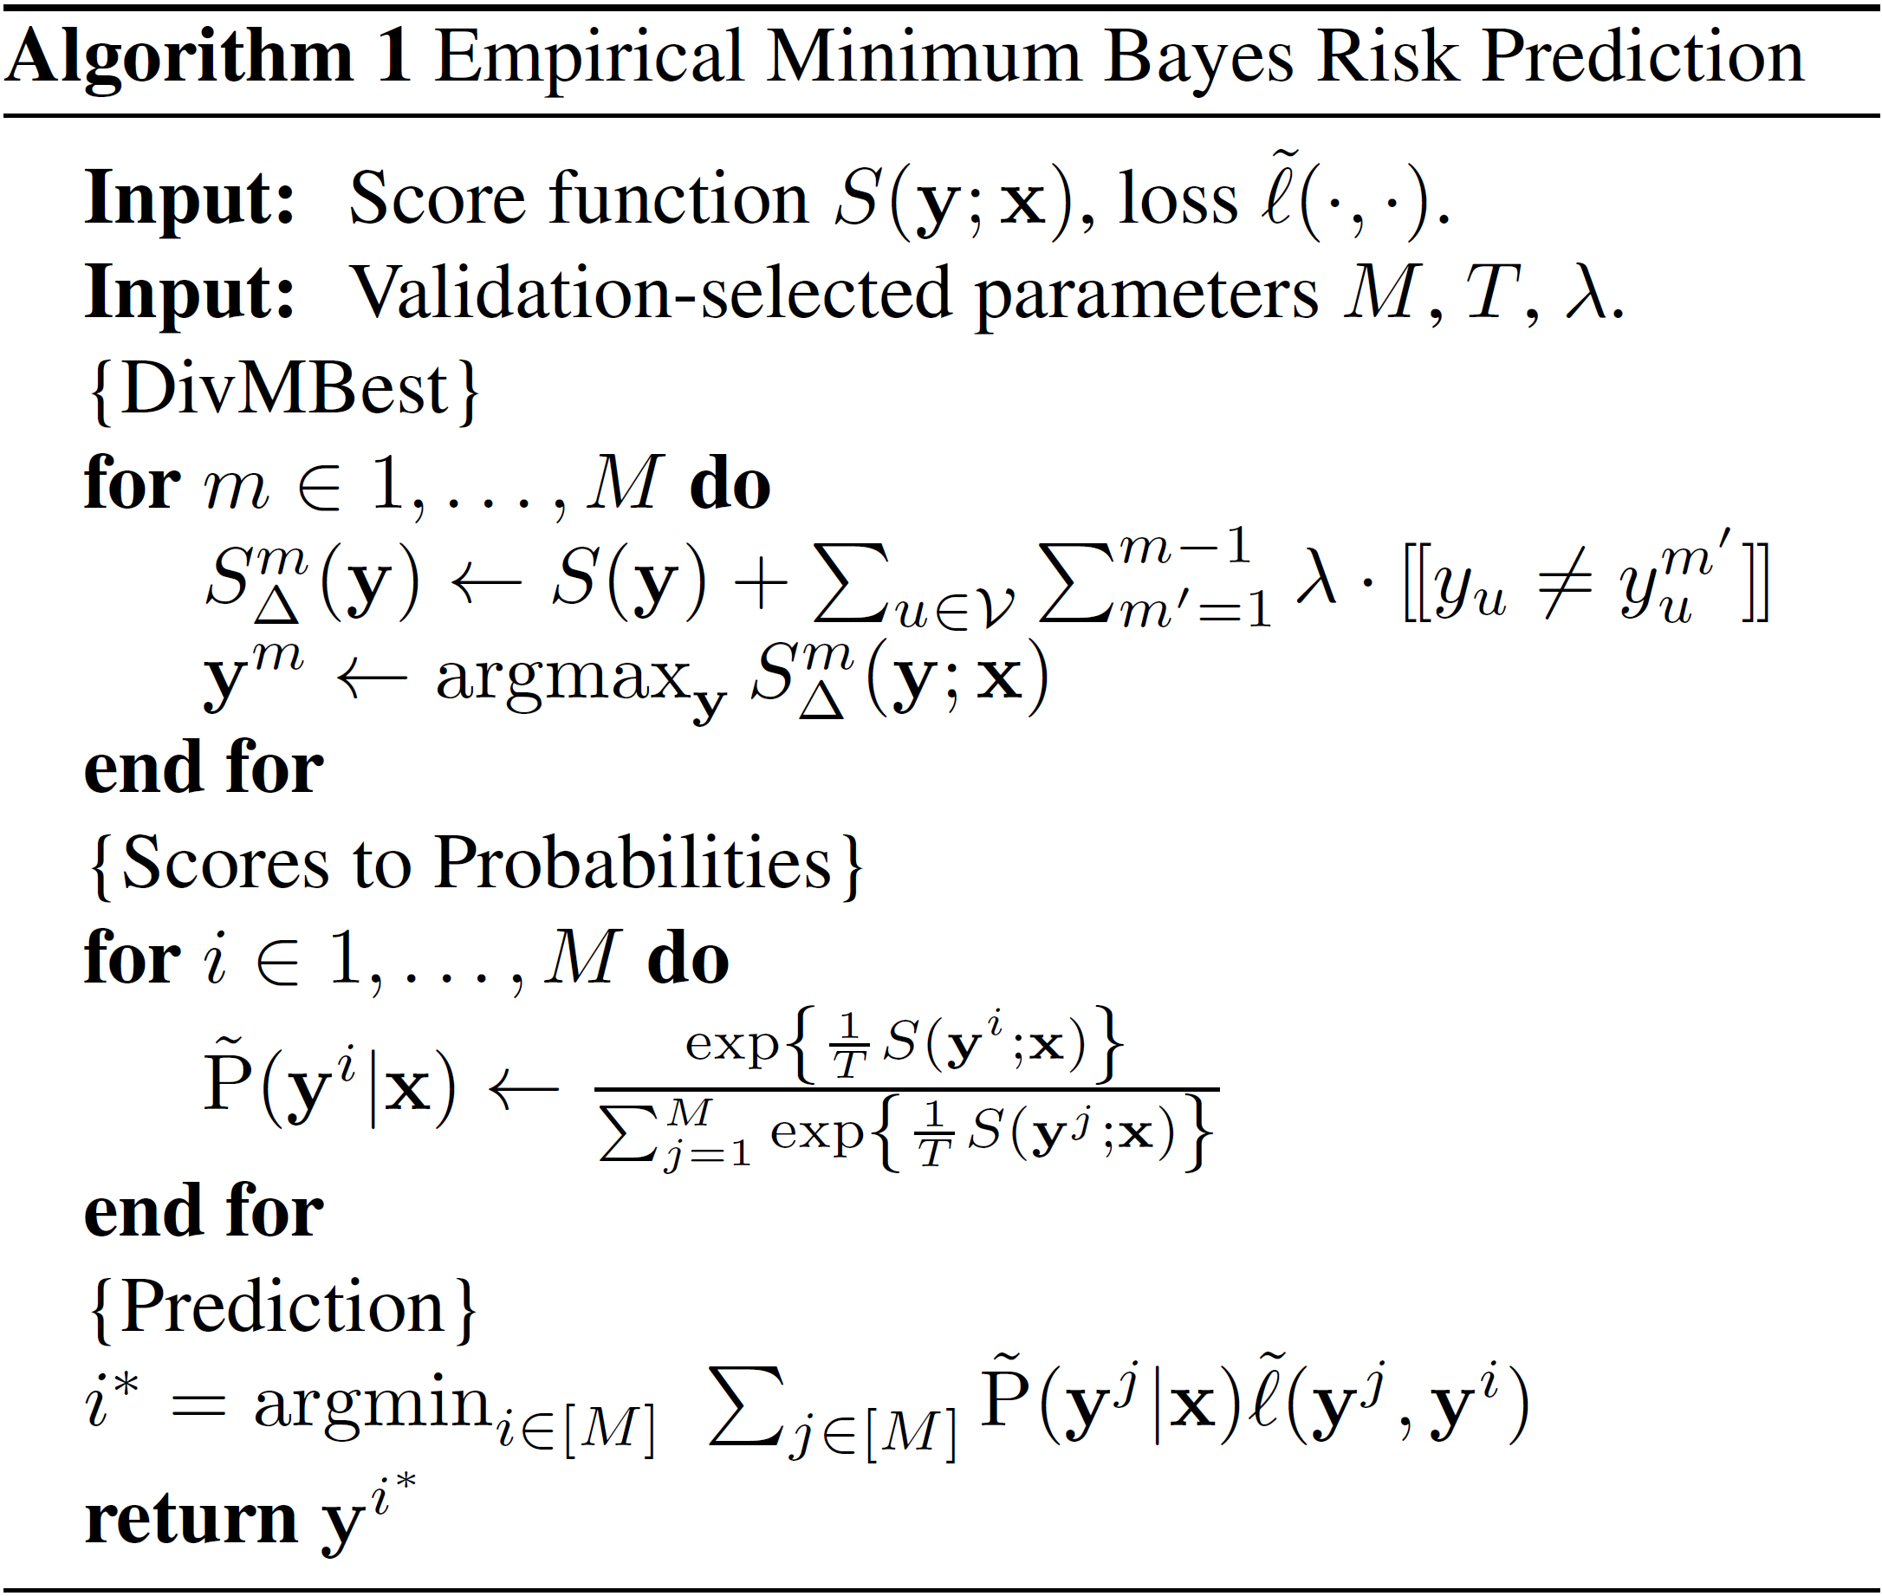
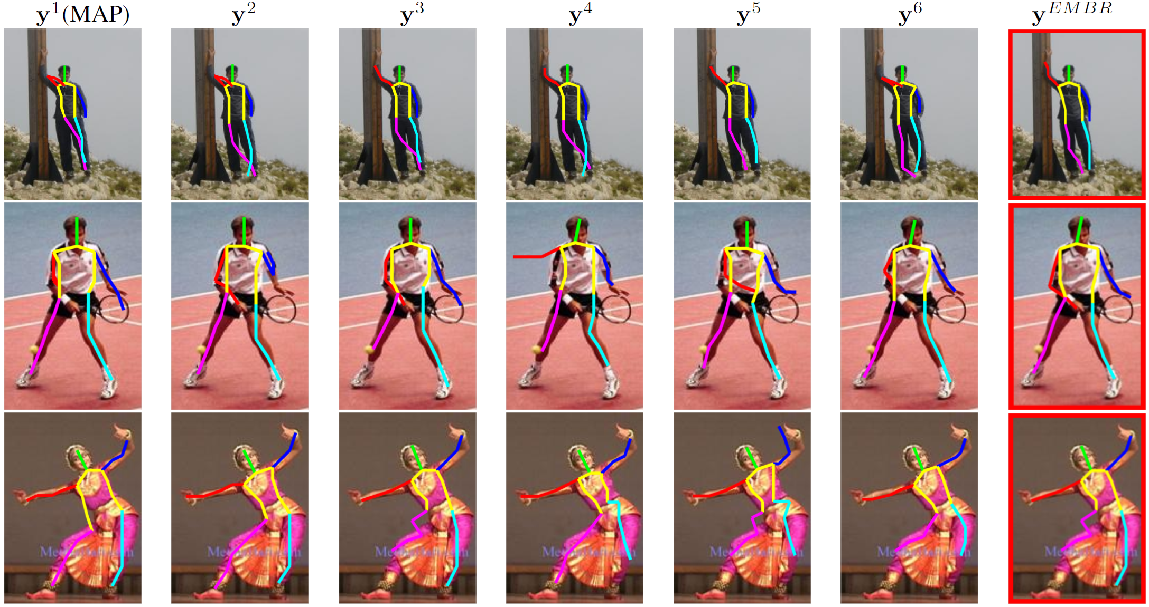
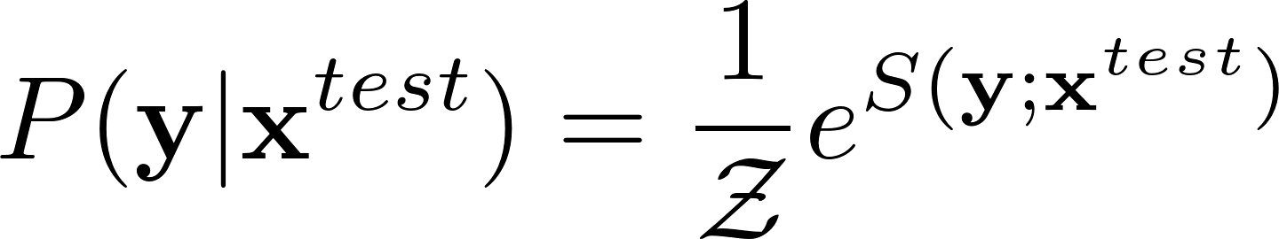


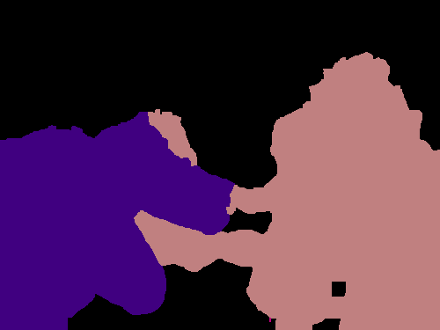

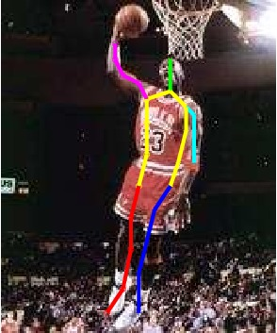


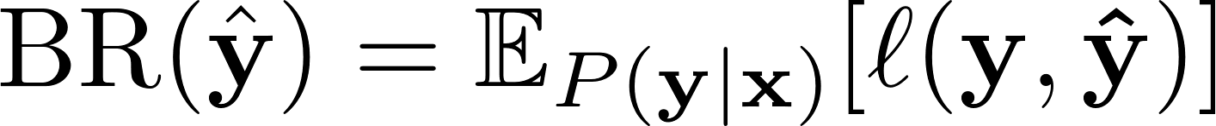

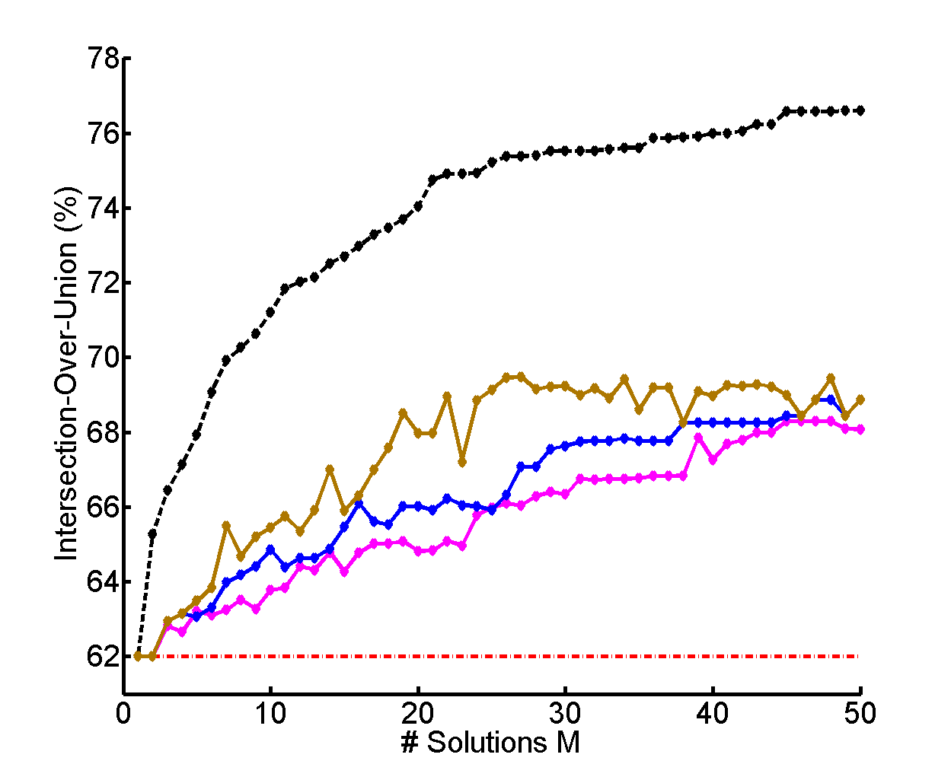
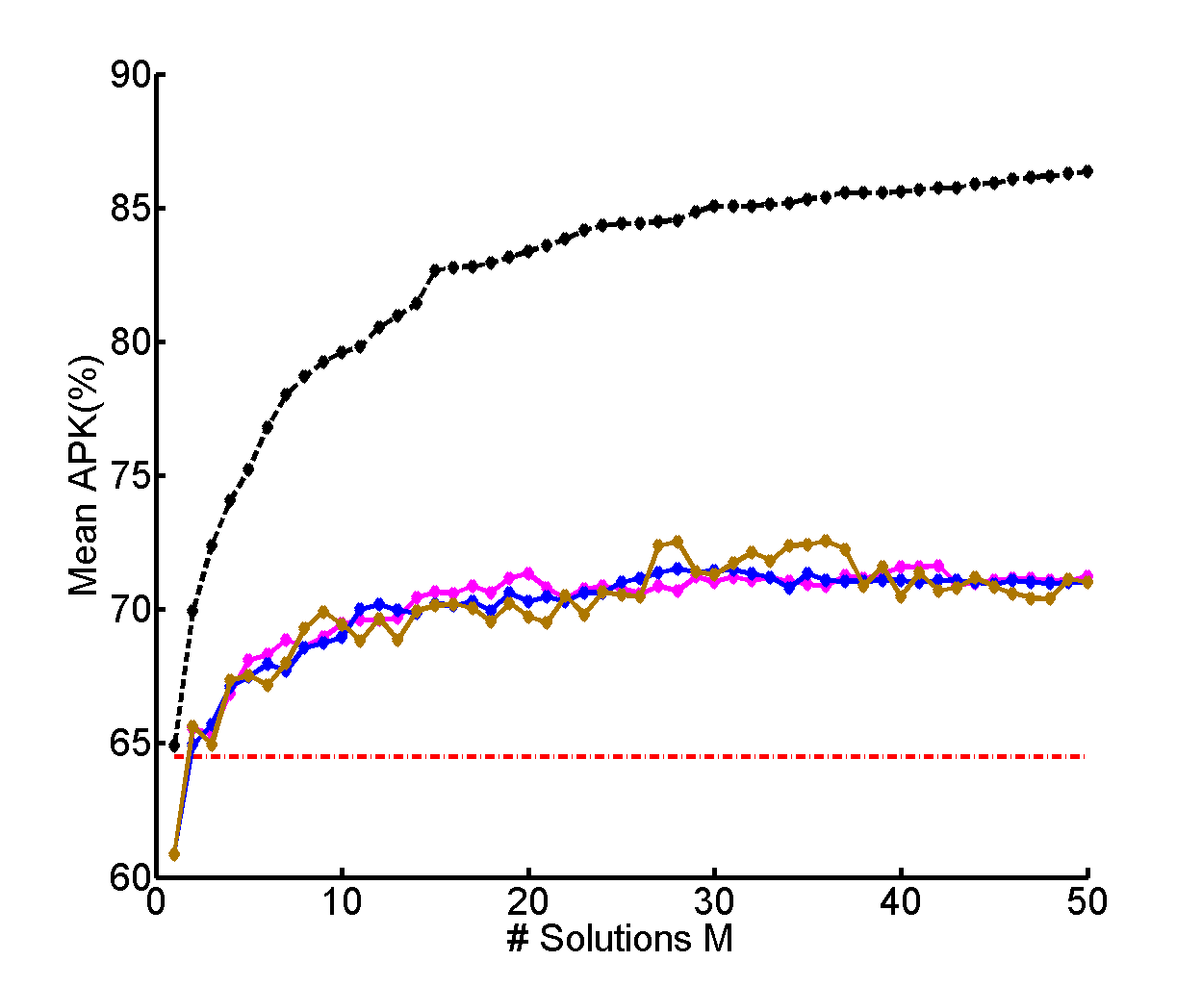
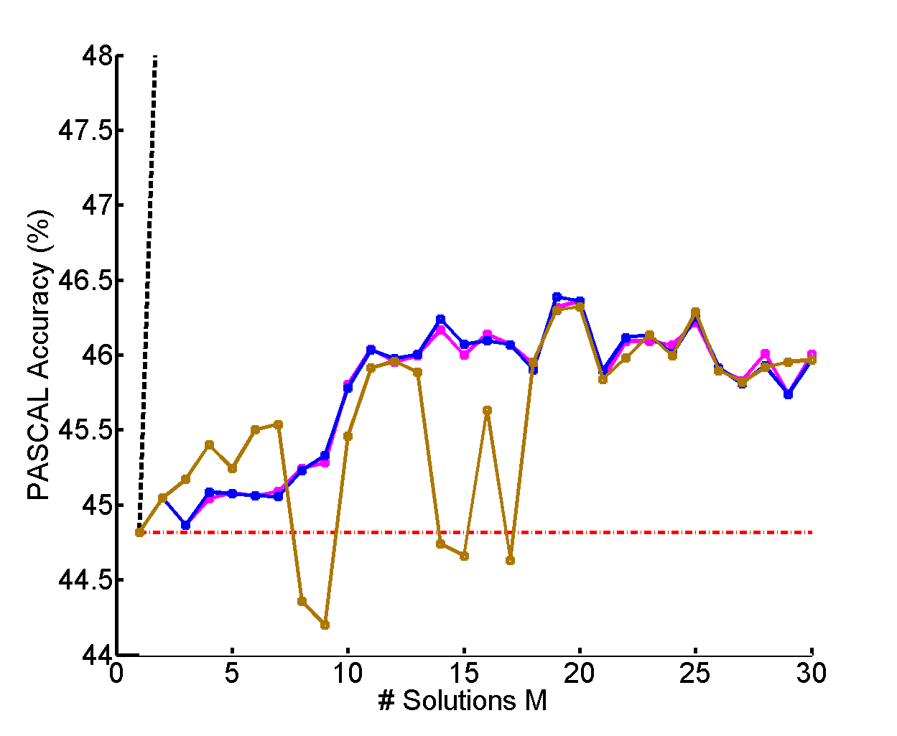
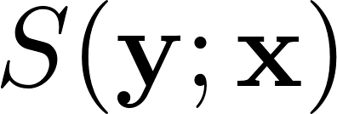
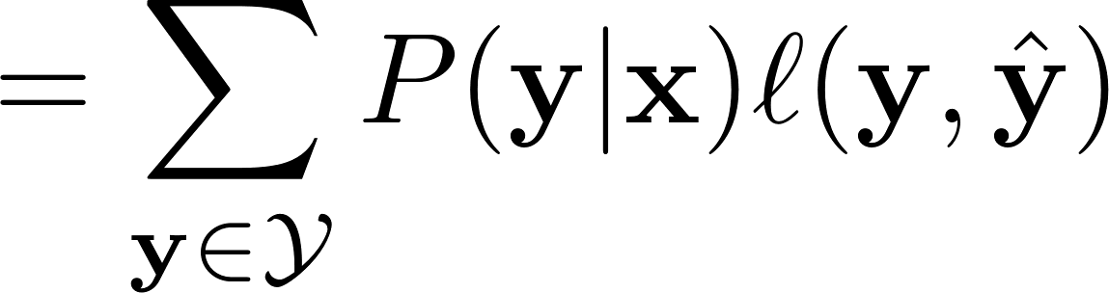
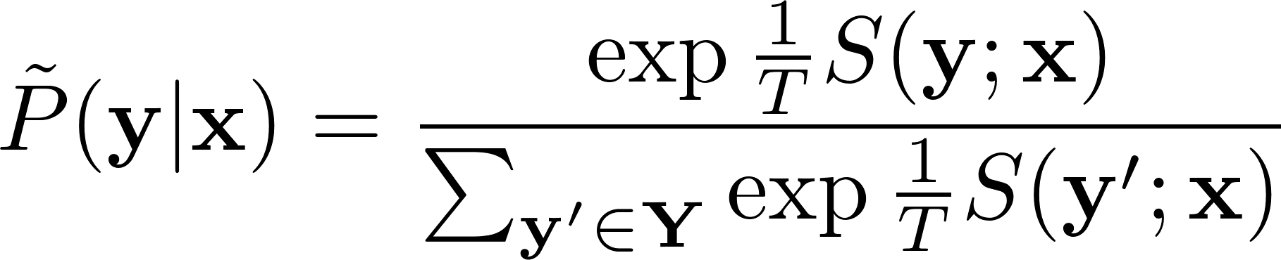
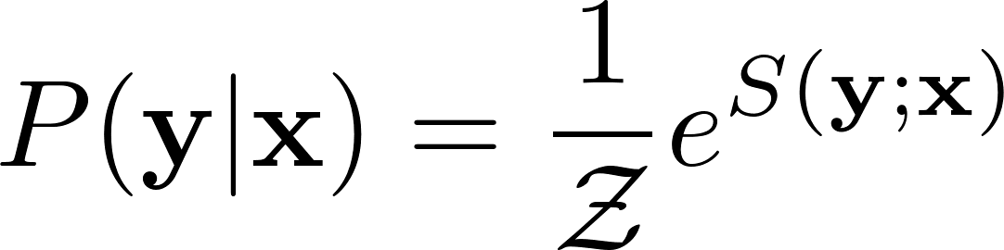
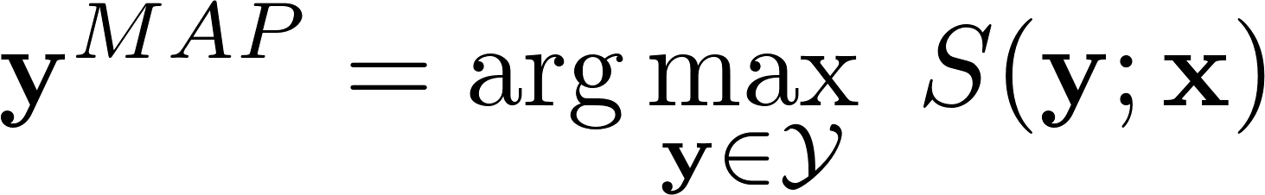
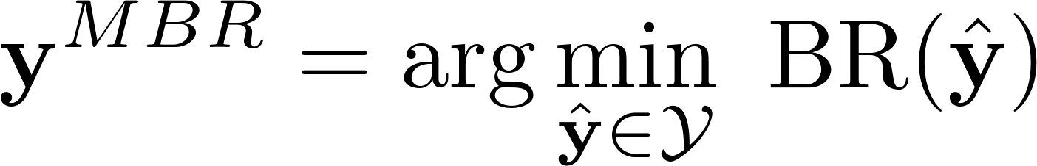
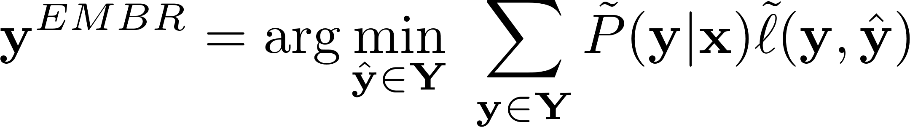






Empirical Minimum Bayes Risk Prediction: How to extract an extra few % performance from vision models with just three more parameters
Vittal Premachandran (NUS), Daniel Tarlow (Microsoft Research), Dhruv Batra (Virginia Tech)
Overview of EMBR Predictor
Algorithm
Three Parameters
Qualitative Results
Model
Loss Function
λ
Diversity
Parameter
e.g.
$$\frac{∩}{∪}$$
Classical MBR
Prediction / Decision
M
# Diverse
Solutions
Black Box
λ
M
T
T
Temperature
Parameter
Empirical MBR
0.406
0.398
0.359
0.334
…
person
person
dog
person
horse
person
Quantitative Results
Binary Segmentation
Pose Estimation
Semantic Segmentation
MAP Predictor
MBR Predictor
EMBR Predictor
Dataset: Pascal VOC 2010 (100 images)
Model: 2-label Pairwise CRF
Inference: Graph Cuts
Dataset: PARSE Dataset
Model: Tree-structured parts model
Inference: Message passing
Dataset: Pascal VOC 2012 Val Set
Framework: CPMC+O2P
Inference: Greedy pasting
Bayes Risk:
Loss Function:
Intersection
Over Union
Loss Function:
Percentage of
Correct Parts
Loss Function:
Jaccard Index
Score Function:
Gibbs Distribution:
~7% Gain
~7% Gain
~1.5% Gain
MAP Predictor:
MBR Predictor:
EMBR Predictor:
Yang and Ramanan, TPAMI, 2013
Oracle
MAP
1-Param
2-Params (λ, T)
2-Params (λ, T) – Sensitivity Analysis

