Slide 1
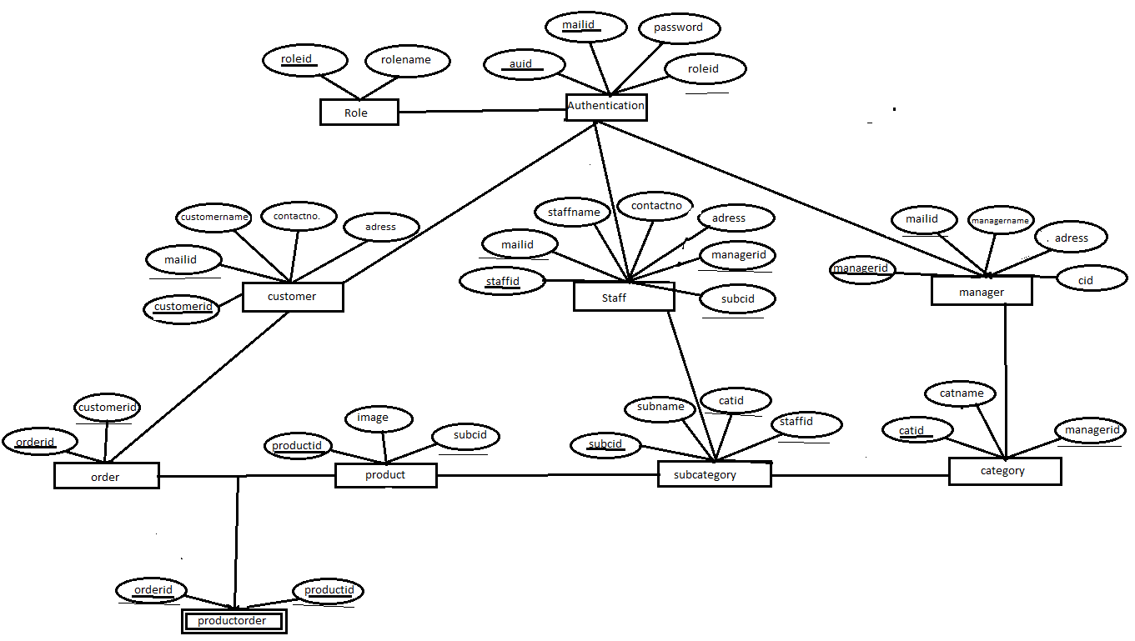
1
m
require
requires
requires
requires

