Slide 1
Overview: Front-end Developer Course

Slide 2
Agenda
Course plan and objectives
Examples of course content for Week 1
Digital workbook
Example of in-class activity
Assignment examples
Final course product: static HTML page
Notes:
For presenter: Provide explanation for Digital Workbook bullet; i.e.: We plan to use digital instead of a printed workbook
[For Sara Sclaroff presentation: If presenting to ats-a11y, may change agenda to include something about pilot of course.]

Slide 3
Developer course timeline
Digital Accessibility Foundations class
Digital Accessibility for front-end developers
Overview presentation
Overview presentation
Digital Accessibility Pilot for
front-end developers
Digital Accessibility Course for front-end developers
2018-19
2019-20
April 28 ‘20
Feedback from developers, content creators, and managers
Design of course presentation, activities, and materials
Jason Shaffner
Sara + ATS team
Improvement on timing and content clarity
IT Academy recurring course

Slide 4
Front-end developer course: objectives & plan
Notes:
Link to the objectives and plan for the course that captures, we believe, the approach that was discussed during our August 2019 meeting.

Slide 5
The course process
Class activities – skill building
Next week assignment
Presentation and demonstration of the 10 essentials
Development tasks
Implementation of accessible code
AUX integration
Skill building
Experience sharing
AUX integration
Notes:
The focus for the course is skill-building, experience-sharing, as well as accessibility and user experience integration with development and coding processes in use by attendees.

Slide 6
Course slides: Week 1
Notes:
What follows are the slides for Week 1 of the course.

Slide 7
Digital Accessibility: Workshop for front-end developers
Facilitated by:
Notes:
Title slide for the course

Slide 8
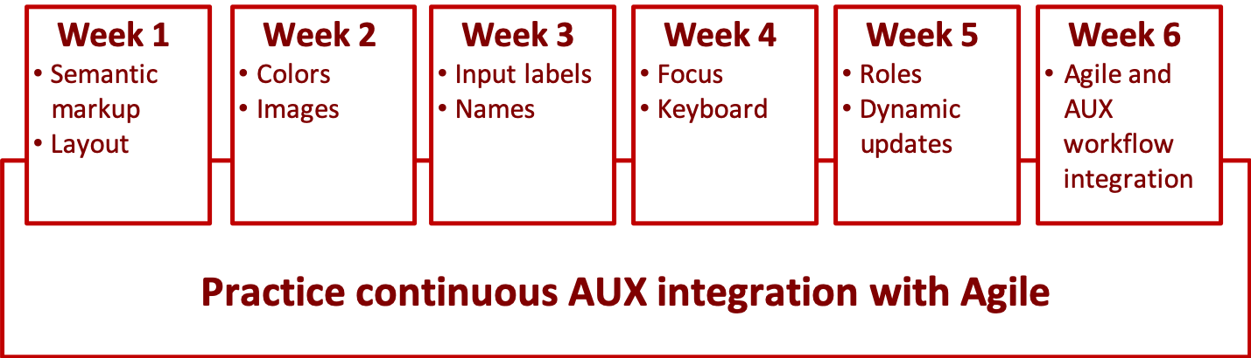
Course structure
Notes:
During the six weeks of the course, the instructor will:
Cover the 10 essential accessibility concepts for developers and,
Their related coding techniques.
These concepts and techniques are needed in order to create websites and applications that are accessible to assistive technology users.
We will also be discussing and working with methods to incorporate accessible user experience (AUX) into the Agile framework.
The weekly assignment is the opportunity for students to incorporate AUX into their agile practice outside of the weekly class.
The length of each class is two hours.

Slide 9
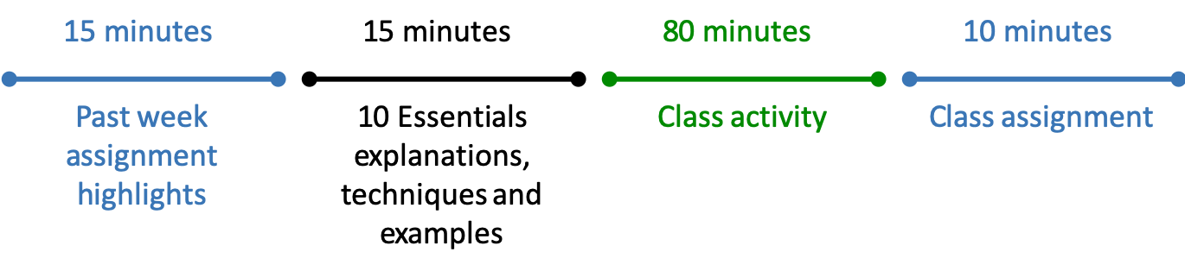

Timelines
In Class
Weekly
Notes:
In this course, the term ‘activity’ describes in-class work.
The term ‘assignment’ describes work done in the week between each class.
Each week, the class time will be divided into a review of the previous week’s assignment, a discussion about the two new techniques covered during the class and 80 minutes for attendees to practice coding for the new techniques. The last topic discussed during class time is a brief overview of the next week’s assignment.
Each week, the expectation is for attendees to attend class for two hours and then, in the week between classes, find opportunities to incorporate the lessons and techniques learned during the class into their agile practice. This includes tracking their AUX/Agile progress to share and discuss during the following week’s class.

Slide 10
Course Objectives
Understand 10 Essentials
Produce accessible code for the 10 Essentials
Integrate accessible user experience (AUX) with Agile
Notes:
The objectives for this course include:
Provide a clear and thorough understanding of the 10 Essentials (concepts) for Front-end Developers.
Provide a working knowledge of the techniques needed to meet the requirements of the 10 Essentials for Front-end Developers.
Provide sufficient information for front-end developers to understand how agile and accessible user experience (AUX) align.

Slide 11
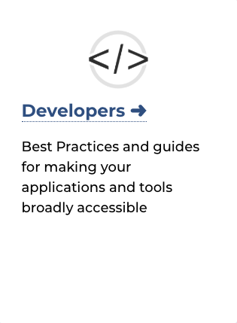
Online Accessibility – Developers
“Developers” develop websites and web applications.
This section contains best practices, examples, testing methods, and resources to support Accessibility guidelines.
Notes:
Throughout our activities for the course, we’ll be leveraging Harvard’s Online Accessibility website (https://accessibility.huit.harvard.edu/home) to review the 10 Essentials for Developers, including explanations about each and related coding techniques for achieving accessible digital content.

Slide 12
10 essentials for Developers
Semantic Markup: Levels of headings.
Input Labels: Descriptive.
Focus: Keyboard focus and logical sequence.
Keyboard: Access to all interactive elements.
Names: Descriptive names for interactive controls.
Roles: Custom controls and widgets.
Dynamic Updates: Clearly conveyed.
Colors: Sufficient color contrast.
Layouts: Adaptable window widths and text sizes.
Image Alternatives: Meaningful and descriptive.
Notes:
During the first class, there will be a review of the 10 Essentials for developers as they appear on Harvard’s Online Accessibility website.
Along with an explanation that during the following five weeks we’ll be reviewing two of these 10 Essentials each week, starting with the simplest concepts and then moving to the more complex.

Slide 13
Digital Accessibility: for front-end developers Week 1
Notes:
This is the separator slide for Week 1. A slide like this exists at the start of each week’s class activities and assignment segment.

Slide 14
Semantic Markup [1] — explanation
Provide semantic elements for regions and content.
Identify section headings and heading hierarchy using markup.
Identify page sections and landmarks.
Identify lists using markup.
Mark up tables using table markup.
Notes:
Each week the two new ‘essentials’ are introduced to the class by the instructor. An explanation slide and a techniques slide is provided for each of the new concepts.
Section headings. Identify headings with HTML heading markup (i.e., h1 – h6). Headings should be short and descriptive of the content that follows. Heading elements should never be empty.
Landmarks and page sections. These include headers, footers, banners, and main sections. ARIA landmark roles should be used to identify these page content areas, even when making use of HTML5 section elements.
Lists. Use proper list markup depending on the list type. For example, <ul> and <li> for unordered lists, <ol> for ordered list, <li> for numbered lists, etc.
Tables. Be certain to use table markup [e.g., table (table), row (tr), table header (th), etc.].

Slide 15
Semantic Markup [1] — techniques
Use heading structure.
<!-- / Correct heading structure -->
<h2>Topic 1</h2>
<h3>Sub-topic 1</h3>
<p>…<p/>
<h3>Sub-topic 2</h3>
<p>…<p/>
<h4>Sub-sub-topic 1</h4>
<p>…<p/>
<!-- / Incorrect heading structure -->
<h2>Topic 1</h2>
<h4>Sub-topic 1</h4>
<p>…<p/>
<h3>Sub-topic 2</h3>
<p>…<p/>
<h4>Sub-sub-topic 1</h4>
<p>…<p/>
Notes:
An explanation about the concept of semantic markup was presented in the previous slide, while an example of the coding technique for heading structure is shown here.

Slide 16
Semantic Markup [1] — technique
Create Main Landmark.
<!-- / Correct Main and other landmarks-->
<header>
<!-- / header content – logo, navigation, etc.-->
</header>
<main>
<section aria-label="title for this section">
<!-- / The main landmark can contain other landmarks-->
</section>
</main>
Notes:
Another semantic markup technique. This time, for coding page regions or landmarks.

Slide 17
Layout [9] — explanation
Support flexibility and adaptation.
Avoid using images of text.
Allow text to be resized without losing content or meaning and without unnecessarily requiring horizontal scrolling.
Support user-defined style sheets.
Allow content to display in orientation preferred by user.
Notes:
An explanation for the second of the two accessible coding concepts, i.e., layout, that are introduced in Week 1 of the course.
Except for logos that may contain text, avoid using images of text. Wherever possible, use text provided in HTML and styled in CSS instead of images of text.
Use relative units when specifying text and container size so that text can be enlarged using a browser’s native text-resizing functionality. Ensure that text can be increased to 150% of the browser’s default size without loss of text or overlapping with other content. And, ensure that text reflows into a single column such that users do not need to scroll horizontally to read the content.
User-defined style sheets. Make certain that CSS styling can be overridden by user stylesheets (to control the appearance of content, including headings, paragraphs, hyperlinks, and lists).
Device orientation. Build applications that respond to the orientation of the device by using responsive design principles.

Slide 18
Layout [9] — technique
Enable text resizing.
In this example, 100% means “100% of the size the user chose in their browser or OS settings”
<!-- / Correct heading structure -->
html {
font-size: 100%;
}
p {
font-size: 1em;
line-height: 1.5;
}
<!-- / Incorrect heading structure -->
html {
font-size: 100%;
}
p {
font-size: 1em;
line-height: 20px;
}
Notes:
Coding example for text resizing.

Slide 19
Layout [9] — technique. Responsive.
Enable text resizing (viewport meta tag).
Use the correct viewport meta tag to make sure text resizing via pinch zoom on touch devices.
<!-- / Correct meta information -->
<meta name="viewport
content=”
width=device-width,
initial-scale=1.0">
<!-- / Incorrect meta information -->
<meta name="viewport
content=”
width=device-width,
initial-scale=1.0,
minimum-scale=1.0,
maximum-scale=1.0,
user-scalable=no">
Notes:
Coding example for responsive text resizing.

Slide 20
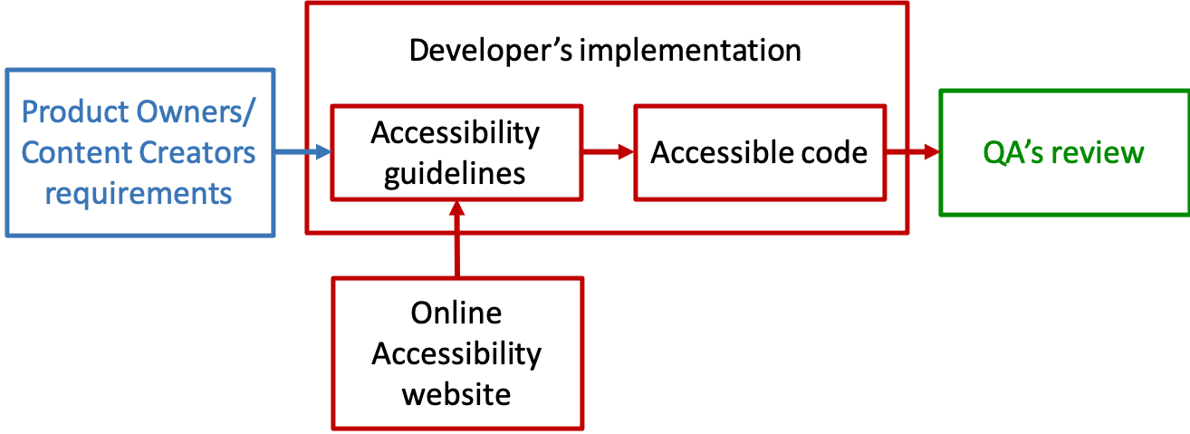
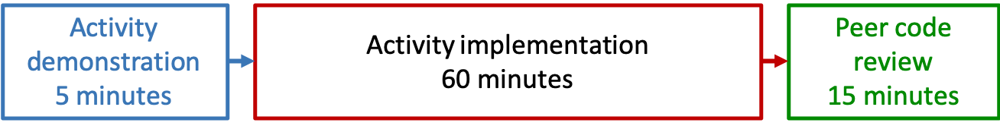
Week 1. In-class activity
Process
Timeline
Notes:
The process diagram provides a capsule explanation of the various roles and resources typically required for a developer to ensure an accessible digital product.
A product owner or designer provides a functional specification and/or user story for each component of the product/application.
The developer’s responsibility is to use the functional specification and/or user story along with an understanding and skills of accessible coding techniques to develop a result that, ideally, provides a good user experience for all users.
The developer output is tested by quality assurance personnel to ensure that it meets the functional and accessibility requirements.
The timeline diagram describes how the class will be spending the next 80 minutes:
The instructor will provide a general explanation about the parameters of the coding activity in which the class will next engage.
The students will spend 60 minutes coding for accessible semantic markup and layout based on the user story provided by the instructor.
At the end of the coding period, students will pair off and spend 15 minutes in a review and critique of each other’s code.

Slide 21
Digital workbook for course
Notes:
[Link to browser to show online workbook]
Presenter:
As noted earlier, we’re using a digital, rather than a print, workbook. Each week, the instructor will add a link to the listed content, such that in Week 1, only that link is active. For week 2, the content for the first two weeks are active, and so on
During the first week of the course, the presenter will show students how to access the workbook on the OpenScholar website.

Slide 22
Week 1. In-class activity ― task
User story
As a user of this web content, I want 4 areas of content with the titles listed below based on the style sheet in workbook, so that I can add specific information later.
Acceptance criteria
Create 4 areas of content with these titles:
(Header) “Digital Accessibility for front-end developers”
(Main)
“Definition of ready”
“Definition of done”
“Resources”
“Personal notes”
(Aside)
“Results”
“Engagement meter”
“Techniques into practice meter”
“AUX integration”
(Footer) “© 2020 President and Fellows of Harvard College”
Download style sheet from workbook
Notes:
At every activity demonstration, the attendees will be expected to ensure code accessibility of the presented user stories by reviewing the Essentials of the current and previous weeks. Note that the acceptance criteria of these user stories don’t provide accessible information, nor considerations. Attendees must prioritize accessibility and, if needed, change the requirements of the acceptance criteria.
At the end of each activity period, attendees are paired up so that they can check (QA) each other’s code. At the beginning of next week’s class, the presenter will show an example of the completed activity with accessible code.

Slide 23
AUX/Agile template: after completion of Week 1 activity
Notes:
Based on the ‘Week 1 In-class activity Acceptance Criteria’ in the previous slide, we would expect that by the beginning of the Week 2 class, students will have completed a static HTML page with four areas of content in place similar to this one. That is, the page would consist of a header, a main section containing four sub-heads, the Aside section containing four sub-heads, and a footer).

Slide 24
Agile integration & consolidation of techniques Week 1 assignment
Notes:
This assignment slide is another separator slide that indicates the start of a discussion about the assignment for the upcoming week.

Slide 25
Assignment – Week 1
Check all the ways you’re able to integrate semantic markup and layout techniques into your agile and/or development process
Stand-up meetings
User stories
Retrospective
Discussions with designer, QA, business or product owner
Techniques to produce accessible code for semantic markup and layout
Notes:
Assignment needs to be complete and submitted 24 hours prior to start of the next week’s class.
At the start of next week’s class, students need to be prepared to speak about how they’ve integrated semantic markup and layout techniques into their agile and development practice during the week. And, that’s the expectation for handling each week’s assignment.

Slide 26
Week 1 assignment template
Notes:
The online workbook includes the assignment template for each week.

Slide 27
Weekly Excel assignment meters
Notes:
This is an example of completed techniques and engagement meters at the end of the course. As part of the weekly assignment, we’re asking students to track how often they were able to use the accessibility coding techniques they covered during each week’s class, and to track (in the engagement spreadsheet) how often and during which agile activities (e.g., retrospectives, stand-ups) they engaged in accessibility-related discussions or actions.

Slide 28
AUX/Agile template: after completion of Week 5 activity
Notes:
This is an example of the final work product after the completion of week 5 – i.e., a static HTML page that includes the details outlined in the Acceptance Criteria for each week’s in-class activity. In addition to the workbook, the expectation is that the HTML page created by each student will provide a useful reference tool after the course has been completed.

