Slide 1

Comparative Analysis of Feature Extraction Techniques for Robust Deepfake Image Detection
Vittorio Pisapia - 1918590

Slide 2

Table of Contents
Introduction
▶ Introduction
▶ Feature Extractors
▶ Dataset
▶ Evaluation Metrics
▶ Results
▶ Conclusions
Page 2

Slide 3

Introduction to the problem
Introduction 1 Sottotitolo
Deepfake image detection has become a critical challenge in computer vision, due to the development of generative AI.
Deepfakes raise critical ethical, legal and security issues.
Robust techniques are essential for identifying manipulated or generated content.
The goal of the project is to compare various feature extraction techniques for deepfake image detection: LBP, HOG, CNNS…

Slide 4
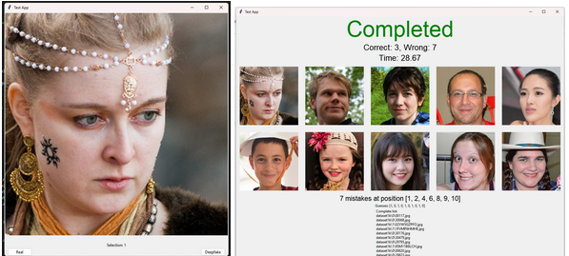
Human Performance
Introduction 1 Sottotitolo
24 partecipants were tested and 132 runs were collected.
Each partecipant was presented with 10 images and asked to classify them as fake or real. The required time was recorded for each run.
Mean accuracy: 65%
Avarage time per test: 49 seconds

Slide 5
Table of Contents
Introduction
▶ Introduction
▶ Feature Extractors
▶ Dataset
▶ Evaluation Metrics
▶ Results
▶ Conclusions
Page 5

Slide 6
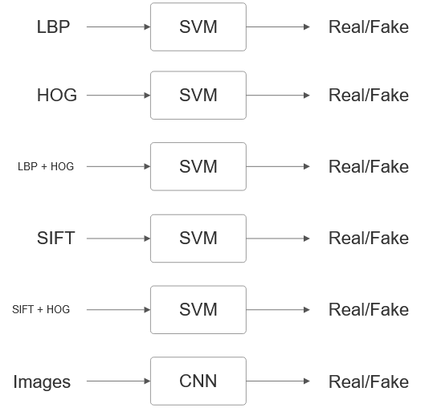
Traditional Feature Extraction
Feature Extractors 1 Sottotitolo
LBP: Texture descriptor, encodes relationship between a pixel and its neighboring pixels.
HOG: Focuses on gradient orientation distributions, making it effective in detecting shapes and edges.
SIFT: identifies and describes local keypoints of a image
Dense SIFT: keypoints are predetermined points arranged on a grid.
Mean SIFT: Computes the mean of all SIFT descriptor found in the image.

Slide 7
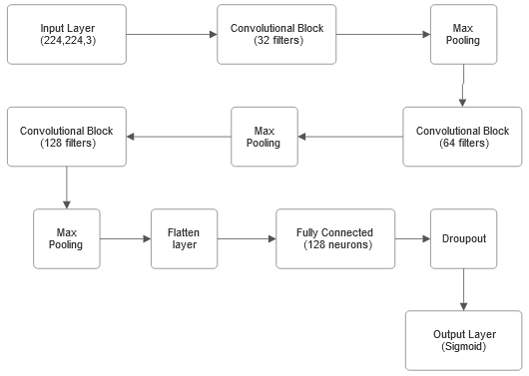
Deep Learning-based feature extraction
Feature Extractors 1 Sottotitolo
CNN: Designed to perform feature extraction and classification in a single pipeline. Directly trained on raw image data.

Slide 8
Table of Contents
Introduction
▶ Introduction
▶ Feature Extractors
▶ Dataset
▶ Evaluation Metrics
▶ Results
▶ Conclusions
Page 8

Slide 9
Dataset and Training Data
Dataset 1 Sottotitolo
The dataset includes both real and fake images:
Real images: Flickr-Faces-HQ (FFHQ) provided by Nvidia.
Fake images: ‘’1 Million Fake Faces’’ created with StyleGand and provided by Bojan Tunguz.
A total of 3000 samples were used for training (1500 real images and 1500 fake images).
For simpler feature extracton methods (LBP), 20.000 total samples were tested for training, but it led to similar performance while significantly increasing training time.

Slide 10
Table of Contents
Introduction
▶ Introduction
▶ Feature Extractors
▶ Dataset
▶ Evaluation Metrics
▶ Results
▶ Conclusions
Page 10

Slide 11
Accuracy, Efficiency and Robustness
Evaluation Metrics 1 Sottotitolo
Performance will be evaluated using the following criteria:
Accuracy: evaluated alongside F1-score to measure balance between precision and recall.
Computational Efficiency: Extraction times and training times will be compared to assess computational performance.
Robustness to Adversarial Attacks:Using adversarial attack generation techniques (Adversarial Robustness Toolbox), the resilience of each model against perturbed inputs will be analyzed.

Slide 12
Adversarial Robustness
Evaluation Metrics 1 Sottotitolo
Adversarial robustness was evaluated using two attacks from the Adversarial Robustness Toolbox (ART):
Fast Gradient Method (FGM): FGM computes the gradient of the loss function with respect to the input features. Adversarial examples are generated by perturbing the input features in the direction that maximizes the loss function. This is a straightforward and computationally efficient attack method.
Carlini and Wagner L2 Attack (CL2): A state-of-the-art iterative method, CL2 formulates adversarial example generation as an optimization problem. It seeks the minimal perturbation required to misclassify the model, offering a more precise and effective attack compared to FGM.

Slide 13
Table of Contents
Introduction
▶ Introduction
▶ Feature Extractors
▶ Dataset
▶ Evaluation Metrics
▶ Results
▶ Conclusions
Page 13

Slide 14
Accuracy, f1-score and training time
Results 1 Sottotitolo
FEATURE EXTRACTOR | Training time (seconds) | accuracy | f1-score
LBP | 86,17 | 0,64 | 0,64
HOG | 67,97 | 0,74 | 0,74
LPB+HOG | 1908,29 | 0,82 | 0,82
Mean SIFT | 47,84 | 0,62 | 0,62
Dense SIFT | 1848,04 | 0,82 | 0,82
Mean SIFT + HOG | 2125,73 | 0,81 | 0,81
CNN (20ep) | 919,38 | 0,69 | 0,69
CNN (10ep) | 456,57 | 0,7 | 0,7
CNN (5ep) | 232,03 | 0,67 | 0,66
Training time:
Mean SIFT (47.84 seconds) is the fastest, followed by HOG (67.97 seconds) and LBP (86.17 seconds), highlighting their efficiency.
CNN (5 epochs) has a reasonable training time (232.03 seconds).
LBP + HOG (1908.29 seconds), Mean SIFT + HOG (2125.73 seconds), and Dense SIFT require significantly more time due to high-dimensional input space.
CNN (20 epochs) is a middle ground at 919.38 seconds.

Slide 15
Accuracy, f1-score and training time - 2
Results 1 Sottotitolo
FEATURE EXTRACTOR | Training time (seconds) | accuracy | f1-score
LBP | 86,17 | 0,64 | 0,64
HOG | 67,97 | 0,74 | 0,74
LPB+HOG | 1908,29 | 0,82 | 0,82
Mean SIFT | 47,84 | 0,62 | 0,62
Dense SIFT | 1848,04 | 0,82 | 0,82
Mean SIFT + HOG | 2125,73 | 0,81 | 0,81
CNN (20ep) | 919,38 | 0,69 | 0,69
CNN (10ep) | 456,57 | 0,7 | 0,7
CNN (5ep) | 232,03 | 0,67 | 0,66
Accuracy and F1-score:
Dense SIFT (0.82), LBP + HOG (0.82) and Mean SIFT + HOG (0.81) are the best performers, demonstrating the benefit of combining complementary features.
HOG (0.74) achieves a strong performance despite its semplicity and fast training time, outperforming LBP (0.64)
CNN (10 epochs) achieves an accuracy and f1-score of 0.70, outperforming its counterpart with fewer epochs and approaching HOG’s performance.

Slide 16
Adversarial Robustness - LBP
Results 1 Sottotitolo
LBP | Mean of original L2 norms | Mean of L2 norm of differences | % wrt mean of original L2 norms | Successful attacks (out of 100)
FGM eps = 0.01 | 4,7768 | 0,051 | 1,067 | 5
FGM eps = 0.03 | 4,7768 | 0,153 | 3,2 | 15
FGM eps = 0.08 | 4,7768 | 0,4079 | 8,53 | 49
CL2 c = 0.05 | 4,7768 | 0,5024 | 10,51 | 95
CL2 c = 0.08 | 4,7768 | 0,5491 | 11,49 | 95
CL2 c = 0.1 | 4,7768 | 0,5695 | 11,92 | 95
FGM Attack:
LBP shows robustness against FGM, with only 49% of successful attacks even at high epsilon value (0.08)
For epsilon = 0.08, the perturbation induces a 8.53% variation in the L2 norms.
CL2 Attack:
LBP is significantly more vulnerable to the advanced CL2 attack, with a 95% success rate even at lower confidence thresholds.

Slide 17
Adversarial Robustness - HOG
Results 1 Sottotitolo
HOG | Mean of original L2 norms | Mean of L2 norm of differences | % wrt mean of original L2 norms | Successful attacks (out of 100)
FGM eps = 0.01 | 89,7785 | 0,9 | 1,002 | 22
FGM eps = 0.03 | 89,7785 | 2,7 | 3,007 | 73
FGM eps = 0.08 | 89,7785 | 7,2 | 8,019 | 100
CL2 c = 0.05 | 89,7785 | 0,3745 | 0,4171 | 41
CL2 c = 0.08 | 89,7785 | 0,3963 | 0,4414 | 40
CL2 c = 0.1 | 89,7785 | 0,3464 | 0,3858 | 36
FGM Attack:
HOG features shows vulnerability to FGM attacks: at epsilon = 0.01, 22% of the attacks succeed , despite only a 1% difference in the L2 norms.
At higher epsilon values, the success rate reaches 100%.
CL2 Attack:
HOG performs well against CL2 attacks, keeping the success rate under 50% across all confidence level.

Slide 18
Adversarial Robustness - Mean SIFT
Results 1 Sottotitolo
Mean SIFT | Mean of original L2 norms | Mean of L2 norm of differences | % wrt mean of original L2 norms | Successful attacks (out of 100)
FGM eps = 0.01 | 11,0991 | 0,1131 | 1,019 | 16
FGM eps = 0.03 | 11,0991 | 0,3394 | 3,057 | 45
FGM eps = 0.08 | 11,0991 | 0,9051 | 8,1547 | 89
CL2 c = 0.05 | 11,0991 | 0,5006 | 4,5102 | 95
CL2 c = 0.08 | 11,0991 | 0,5656 | 5,0959 | 95
CL2 c = 0.1 | 11,0991 | 0,6084 | 5,4815 | 95
FGM Attack:
Mean SIFT shows sligtly better performance than HOG, especially for epsilon = 0.01 and 0.03
CL2 Attack:
Mean SIFT demonstrates limited robustness to Carlini and Wagner L2 attacks. For all tested confidence levels, the success rate remains consistently 95%.

Slide 19
Adversarial Robustness – Concatenation and Dense SIFT
Results 1 Sottotitolo
LBP + HOG | Mean of original L2 norms | Mean of L2 norm of differences | % wrt mean of original L2 norms | Successful attacks (out of 100)
FGM eps = 0.01 | 162,3967 | 1,6208 | 0,998 | 24
FGM eps = 0.03 | 162,3967 | 4,8624 | 2,9941 | 77
FGM eps = 0.08 | 162,3967 | 12,9664 | 7,9843 | 99
Mean SIFT + HOG | Mean of original L2 norms | Mean of L2 norm of differences | % wrt mean of original L2 norms | Successful attacks (out of 100)
FGM eps = 0.01 | 162,7266 | 1,6239 | 0,9979 | 20
FGM eps = 0.03 | 162,7266 | 4,8718 | 2,9938 | 76
FGM eps = 0.08 | 162,7266 | 12,9916 | 7,9836 | 98
Dense SIFT | Mean of original L2 norms | Mean of L2 norm of differences | % wrt mean of original L2 norms | Successful attacks (out of 100)
FGM eps = 0.01 | 313,5703 | 3,1397 | 1 | 30
FGM eps = 0.03 | 313,5703 | 9,4192 | 3 | 81
FGM eps = 0.08 | 313,5703 | 25,1178 | 8.01 | 99

Slide 20
Adversarial Robustness
Results 1 Sottotitolo
FGM Attack:
All three methods showed similar performance to HOG, with Dense SIFT slightly underperforming compared to the concatenated feature methods.
LBP + HOG and Mean SIFT + HOG performed almost identically, achieving a 25% attack success rate at epsilon = 0.01 and 75% at epsilon = 0.03.
Dense SIFT performed worse, with 30% success at epsilon = 0.01 and 81% at epsilon= 0.03.
At epsilon = 0.08, almost all attacks were successful for all models.
CL2 Attack:
Due to the high dimensionality of inputs and the iterative nature of the Carlini and Wagner L2 attack, computation for these methods was not feasible with the available resources.

Slide 21
Adversarial Robustness - CNN
Results 1 Sottotitolo
CNN (10 epochs) | Accuracy on benign samples | Accuracy on adversarial samples | Success rate of attack (%)
FGM eps = 0.01 | 0,7 | 0,59 | 41
FGM eps = 0.03 | 0,74 | 0,54 | 58
FGM eps = 0.08 | 0,71 | 0,54 | 58
FGM Attack:
The CNN demonstrates consistent robustness against FGM attacks across different epsilon values (ϵ=0.01,0.03,0.08). The success rate of attacks remains close to 50% regardless of the increasing epsilon.
Even at higher values of epsilon, the model does not show a significant accuracy drop compared to lower epsilon values, suggesting resilience to strong perturbations.
CL2 Attack:
The Adversarial Robustness Toolbox currently lacks the implementation of the Carlini and Wagner L2 attack specifically for deep learning models.

Slide 22
Table of Contents
Introduction
▶ Introduction
▶ Feature Extractors
▶ Dataset
▶ Evaluation Metrics
▶ Results
▶ Conclusions
Page 22

Slide 23
Conclusions
Conclusions 1 Sottotitolo
Best performance in terms of accuracy and F1-score were achieved by Dense SIFT or by concatenating traditional complementary features, such as LBP and HOG.
They generate features with a high number of components, increasing significantly computational time (~2000% of LBP’s training time) and resulting in models highly vulnerable to adversarial attacks.
HOG features stood out for the balance between performance and computational efficiency.
It achieved better accuracy than the tested participants while requiring only ~68 seconds of training time (78.8% of LBP’s training time).
In terms of adversarial robustness, it performed comparably to the LBP + HOG model for simpler attacks and demonstrated relatively strong resilience against more complex attacks, with a success rate below 45% at the tested confidence levels.
CNN models, have the potential to achieve higher accuracy levels given sufficient computational resources and larger datasets.
However, under the constraints of this project, CNN underperformed compared to more complex traditional features extractor. Despite their lower accuracy, CNN demonstrated greater robustness to FGM attacks for higher values of epsilon.

Slide 24
Future Works
Conclusions 1 Sottotitolo
Opportunities for Growth:
Further analysis on CL2 attacks:
With additional resources, it would be possible to extend the analysis of CL2 attacks to more complex feature extractors, such as Dense SIFT, LBP + HOG, and Mean SIFT + HOG.
Dimensionality optimization:
Using Principal Component Analysis (PCA), the dimensionality of the best-performing features could be reduced, embedding them in a lower-dimensional space. This would result in shorter training times and improved computational efficiency.
Explore other feature extractor:
Investigate additional feature extraction method.
Optimization of CNN model:
Further analysis could focus on developing a more complex and optimized neural network architecture.
With increased resources, a larger training dataset could be utilized to fully exploit the advantages of deep learning.

Slide 25
▶ Thanks for the attention!
Page 25

Slide 26
Pre-processing
Backup slides 1 Sottotitolo
For all SVM-based models, images undergo the following processing:
Image resizing to 224 x 224 pixels;
Conversion to grayscale;
Feature extraction, specific to each model;
Feature concatanation (applied to LBP + HOG and Mean SIFT + HOG);
Transformation using Kera’s StandardScaler;

Slide 27
Features dimensions
Backup slides 1 Sottotitolo
Feature Dimensions for SVM-based Models:
LBP: Each feature consists of 26 components.
HOG: Each feature consists of 26.244 components.
Mean Sift: Each feature consists 128 components.
Dense SIFT: Each feature consists 100.352 components.

