Slide 1

Robotics 2 project
Robust tracking control based on bounds on dynamic coefficients
Paradiso Emiliano, 1940454
31 August 2024

Slide 2
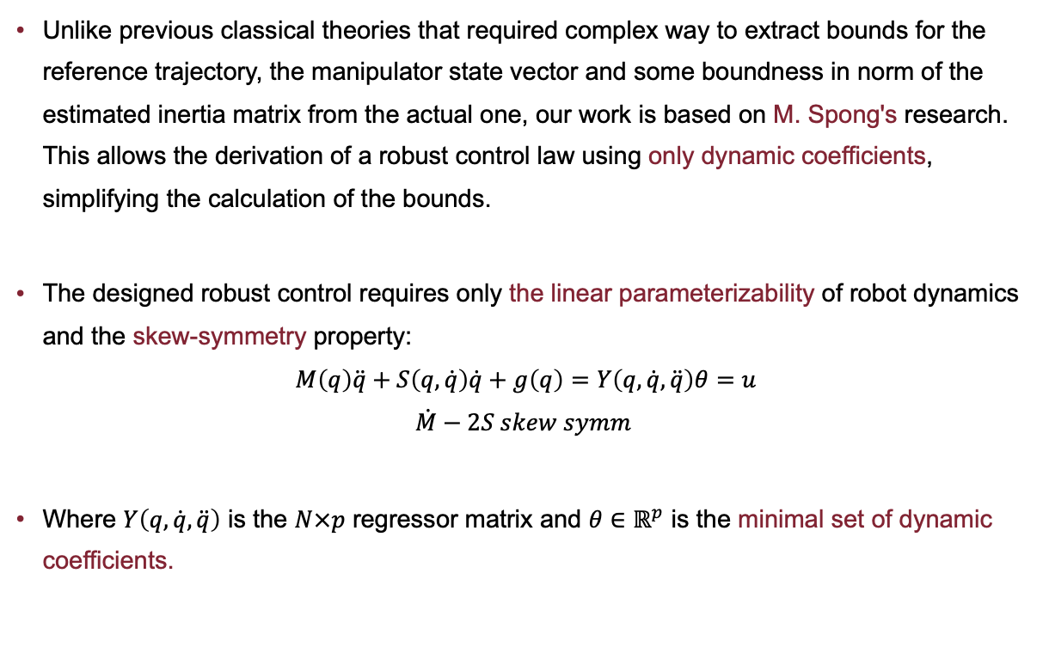
Robust control
Unlike previous classical theories that required complex way to extract bounds for the reference trajectory, the manipulator state vector and some boundness in norm of the estimated inertia matrix from the actual one, our work is based on M. Spong's research. This allows the derivation of a robust control law using only dynamic coefficients, simplifying the calculation of the bounds.
The designed robust control requires only the linear parameterizability of robot dynamics and the skew-symmetry property:
$$M\left(q\right)\ddot{q}+S\left(q,\dot{q}\right)\dot{q}+g\left(q\right)=Y\left(q,\dot{q},\ddot{q}\right)θ=u$$
$$\dot{M}−2S skew symm$$
Where $Y\left(q,\dot{q},\ddot{q}\right)$ is the $N×p$ regressor matrix and $θ∈ℝ^{p}$ is the minimal set of dynamic coefficients.

