Slide 1
Pagina web replicata: https://www.apple.com/it/?cid=aos-it-kwgo-brand

Slide 2


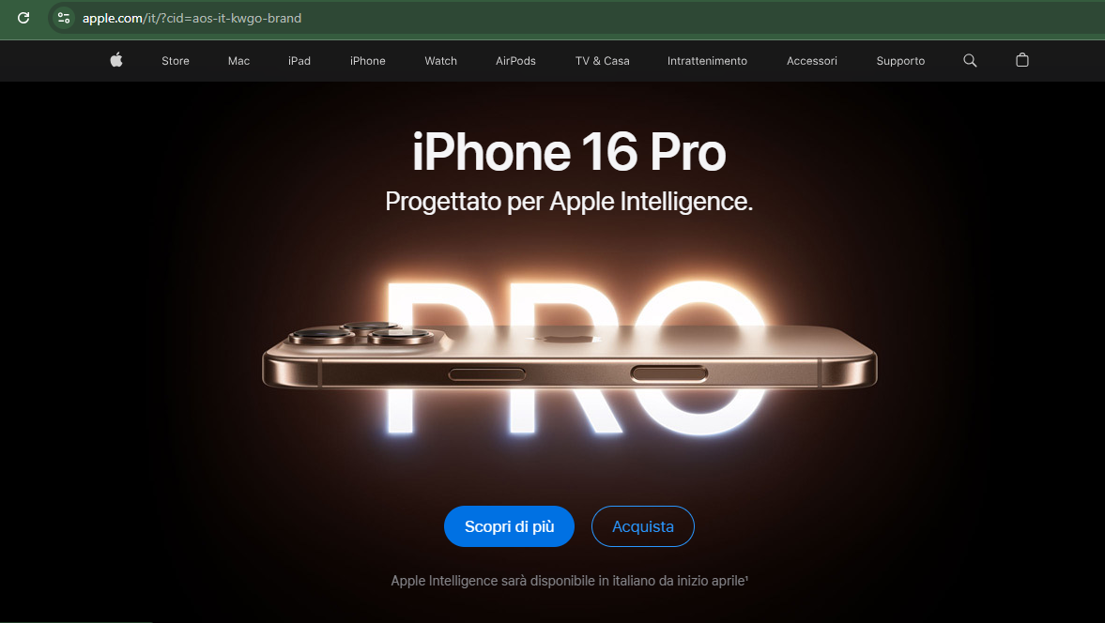

Slide 3
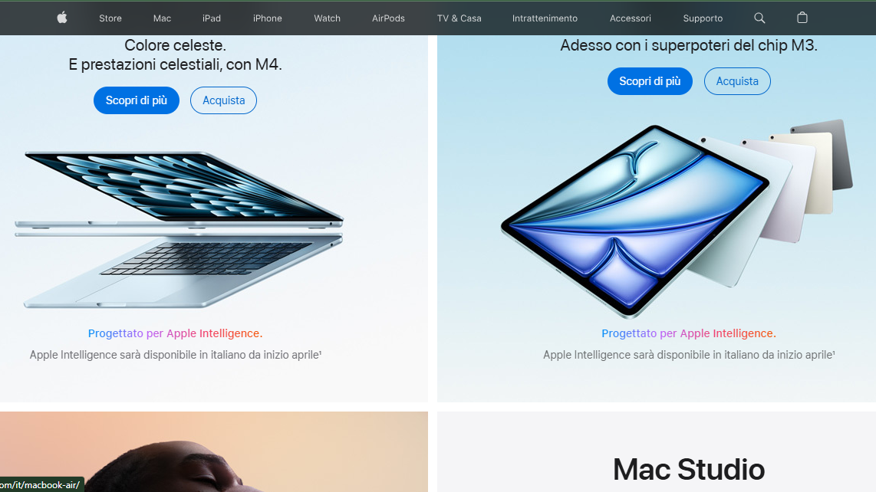

Slide 4
