Slide 1
Exotrix Learning Python project
VELLATURI PAVAN KUMAR
INFORMATION TECHNOLOGY
HINDUSTAN INSTITUTE OF TECHNOLOGY AND SCIENCE

Slide 2
WEEKLY TASKS
1. Question
Appusamy is running a hotel called Brindavan and he wants to greet the customers with the message "Welcome to Brindavan". Help Appusamy by completing the program to print the desired welcome message. OUTPUT: Welcome to Brindavan
Answer
print("Welcome to Brindavan")
Output
Welcome to Brindavan

Slide 3
2.Question
Nitish is studying in fifth standard and he wants to write a program which will accept an input number N and then print the number with the message "You entered N“. Help Nitish by completing the program. Please note that the output is case sensitive and hence Y in You must be in upper case. INPUT: 50 OUTPUT: You entered 50
Answer
N= 50
print("You entered",N)
Output
You entered 50

Slide 4
3. Question
Read two input integers using input() and perform mathematical operations such as addition , subtraction, multiplication, division, modulus, exponential and floor division. Print the result of each operation. INPUT: 25 50 OUTPUT: Sum= 75 Difference= -25 Product= 1250 Division= 0.5 Modulus= 25 Exponential= 7.888609052 x 10^69(approx) Floor Division= 0
Answer
a = 25
b = 50
print("Sum",a+b,"\n","Difference",a-b,"\n","Product",a*b,"\n","Division",a/b,"\n","Module",a%b,"\n","Expo",a**b,"\n","Floor Division",a//b)

Slide 5
Output
Sum 75
Difference-25
Product 1250
Division 0.5
Module 25
Expo 7888609052210118054117285652827862296732064351090230047702789306640625
Floor Division 0

Slide 6
4.Question
Write a python program to convert Celsius to Fahrenheit like wise Fahrenheit to Celsius.
Formula : T(℉) = T(℃) x 9/5 + 32 (Celsius to Fahrenheit ) T(oC) = ((T(oF) - 32 ) × 5)/9 (Fahrenheit to Celsius )
Answer
print("Enter Temp in fahrenheit: ")
fah = float(input())
cel = (fah-32)/1.8
print("\n Temp in celsius: ", cel)
print("Enter Temp in celsius: ")
cel=float(input())
fah= (cel * 1.8) + 32
print("\n Temp in fahrenheit: ", fah)

Slide 7
Output
Enter Temp in fahrenheit: 100
Temp in celsius: 37.77777777777778
Enter Temp in celsius: 37.77777777777778
Temp in fahrenheit: 100.0

Slide 8
5.Question
Print the following pattern
1
2 2
3 3 3
4 4 4 4
5 5 5 5 5
Answer
for num in range(6):
for i in range(num):
print (num, end=" ") #print number
# new line after each row to display pattern correctly
print("\n")

Slide 9
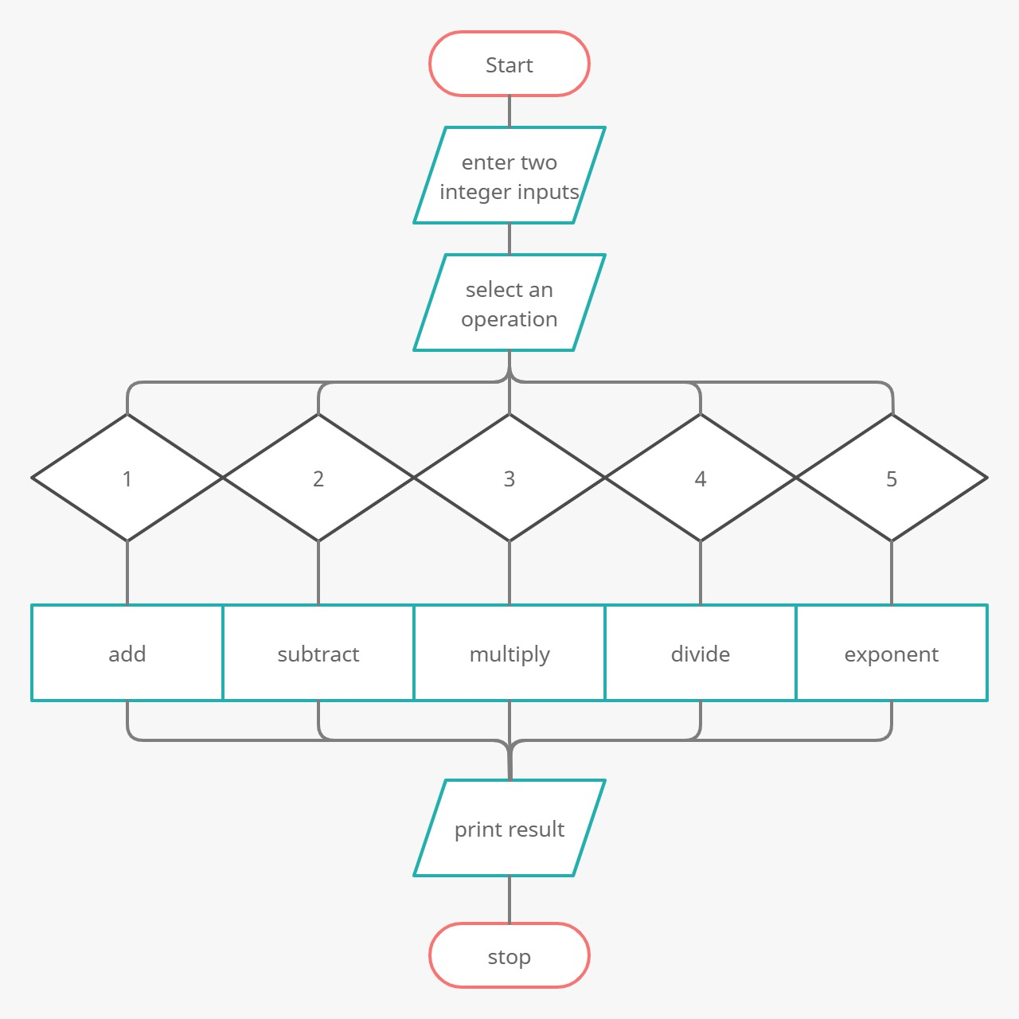
SIMPLE CALCULATOR
Flow chart

Slide 10
Algorithm
Start
Get two inputs to perform operations (ADD , SUB , MULTIPY , DIVIDE, EXPONENTIAL)
Select an operation to perform
Enter any two integers
Print the output
If the input is invalid print “invalid input”
Stop

Slide 11
PROGRAM

Slide 13
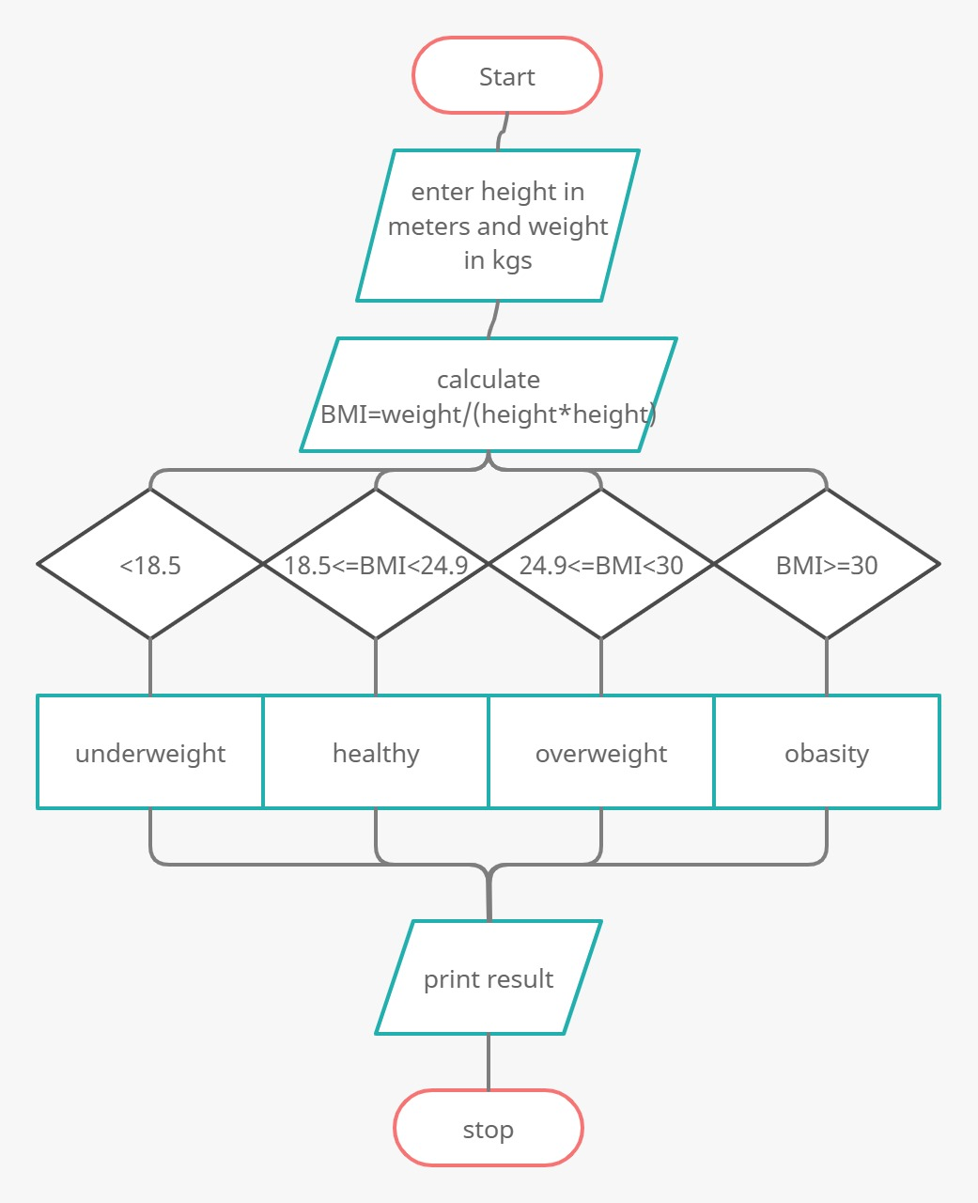
BMI CALCULATOR
FLOW CHART

Slide 14
ALGORITHM
START
INPUT HEIGHT(METERS) AND WEIGHT(KILOGRAMS)
APPLY FORMULA FOR CLACULATING BMI
BMI = (weight / (height*height))
DISPLAY BMI IF
BMI<18.5
THEN PRINT “UNDERWEIGHT”
BMI>=18.5 and <24.9
THEN PRINT “HEALTHY”
BMI>=24.9 and <30
THEN PRINT “OVERWEIGHT”
BMI>=30
THEN PRINT “OBESITY”
DISPLAY THE OUTPUT
END OF THE PROGRAM

Slide 15
PROGRAM
CODE EXECUTED IN PYCHARM

Slide 16
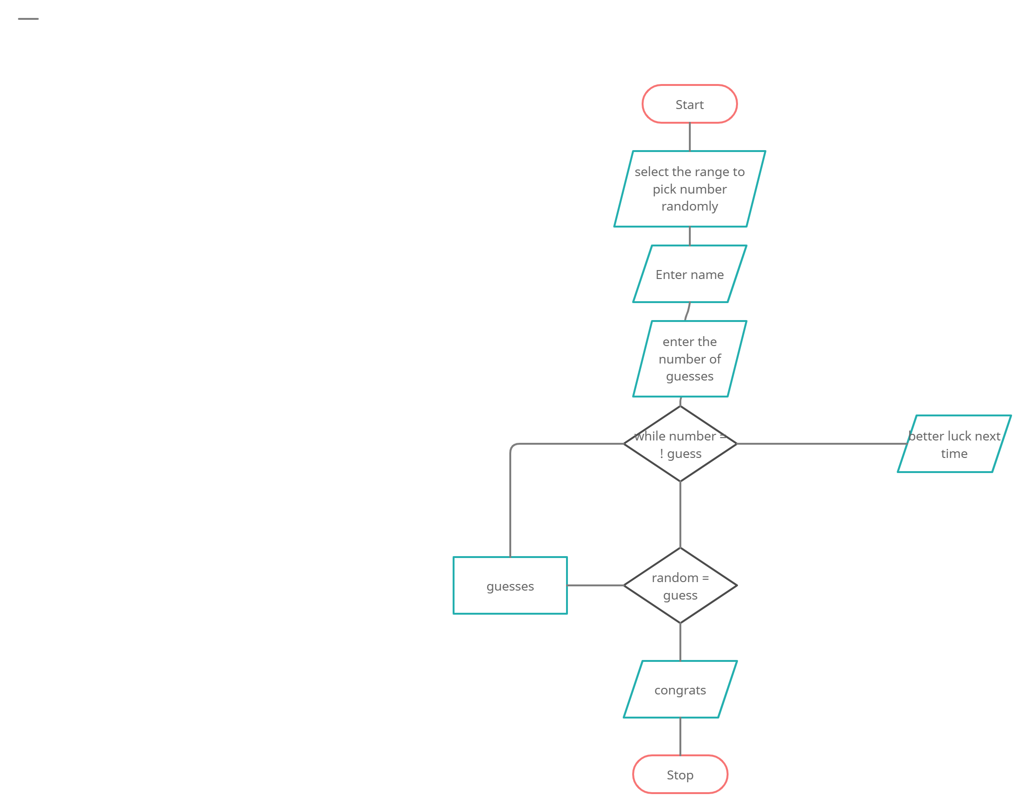
NUMBER GUESSING GAME
FLOW CHART

Slide 17
ALGORITHM
START
PROGRAM GENERATES A RANDOM NUMBER BETWEEN 0 AND 20
ENTER YOUR NAME
GUESS THE NUMBER GENERATED
IF GUESSED NUMBER < RANDOM NUMBER
PRINT GUESS IS SMALLER NUMBER
IF GUESSED NUMBER > RANDOM NUMBER
PRINT GUESS IS LARGER NUMBER
IF GUESSED NUMBER = RANDOM NUMBER
PRINT YOUR GUESS IS RIGHT
STOP

Slide 18
PROGRAM
CODE EXECUTED IN PYCHARM

Slide 19
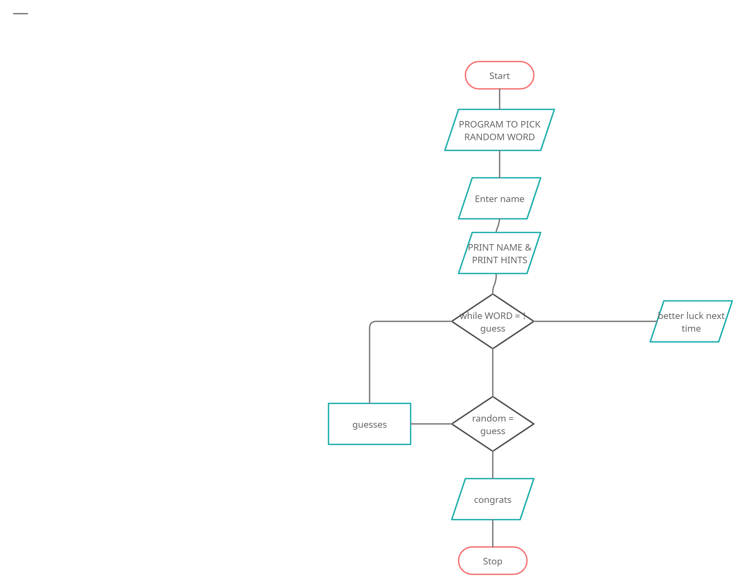
WORD GUESSING GAME
FLOW CHART

Slide 20
ALGORITHM
START
SAVE SOME PRE-DEFINED NAMES IN PROGRAM
PROGRAM GUESS A NAME RANDOMLY
ENTER THE NAME
IT DISPLAYS LENGTH OF THE WORD GUESSED
IF WE GUESS THE WORD WITHIN 10 ATTEMPTS
PRINT “CONGRATULATIONS” AND THEN PRINT THE WORD
ELSE PRINT “BETTER LUCK NEXT TIME .THE WORD IS” AND THEN PRINT THE WORD
STOP

Slide 21
PROGRAM
CODE EXECUTED IN PYCHARM

Slide 22
THANK YOU

