Slide 1

EZOverseas
Group 14
Members
LI YIYAO A0285760W,
LIANG ZHU A0285771R, SHEN KAIYUAN A0285764M
ZHANG QIYUAN A0285787A, ZHU XUANYA A0285912X
Date 10/02/2023

Slide 2
Contents
1 Introduction
2 Market Research
3 Project Scope
4 Data Collection and Preparation
5 System Design
6 Results and Progress
7 Conclusion

Slide 3
1 Introduction

Slide 4
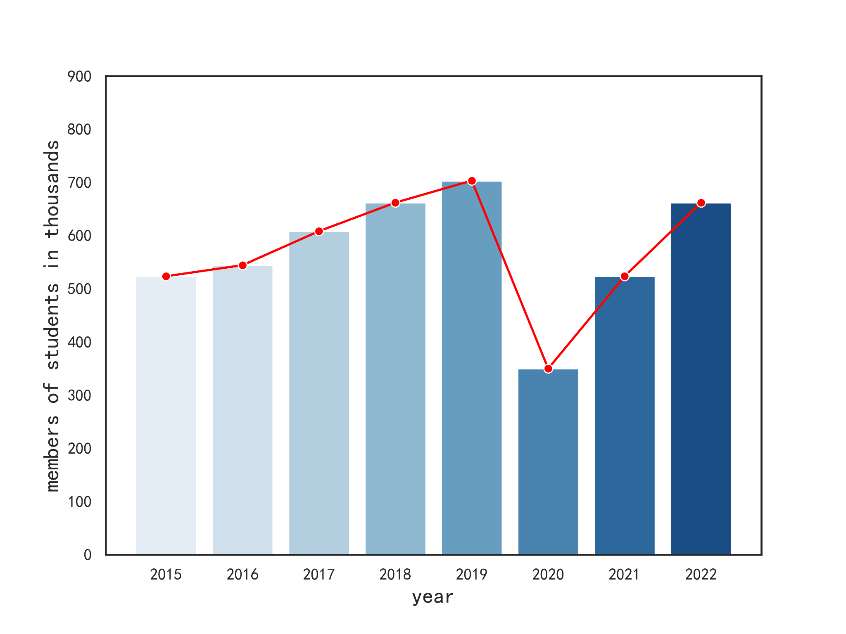
1 Introduction - Background
With the advancement of globalization, international exchanges have become more frequent, making studying abroad an effective way to broaden horizons and enhance international competitiveness. More and more students are inclined to pursue their education overseas.
Number of students from China going abroad for study from 2015 to 2022
Importance
Accurate guidance
Selecting the suitable major
Measure application success rates.
Relevance
The trend of intelligence
Lack of application information
Dated data from AI assistants like GPT
Goals
Intelligent major and university recommendations
Free information and reliable advice
Continuously updated data

Slide 5

1 Introduction - Project
EZOverseas aims to revolutionize the way prospective students access crucial information about universities and majors. In contrast to costly commercial consulting services and scattered online resources, our project employs LLM to create an intelligent chatbot, offering personalized guidance on university-related inquiries.
Who are we What do we provide
Participants in university applications who believe it shouldn't be this difficult.
Sharers of information aiming to assist more students
Advocates for educational equity
Latest University Information
Efficient Admission Consultation
Accurate University/Major Recommendations

Slide 6
2 Market Research

Slide 7




2 Market Research - Comparison
Current competitor Potential Competitor
can be improved
Manual return answer
Unavailable for real-time answering
Fees for exact consultation service
Too many ads
cannot obtain the latest data due to dated database

Slide 8



2 Market Research
Consulting Service
Manual solution
LLM solution
Professional
Evaluation
Holland
MBTI & Holland

Slide 9
2 Market Research
Our advantages
Instancy
Answer questions about studying abroad intelligently
Objectivity
Provide suggestions about studying abroad without human bias
Data timeliness
Answer questions related to studying abroad based on the latest corpus compared with GPT
Free for all
Provide free consultation

Slide 10
3 Project Scope

Slide 11
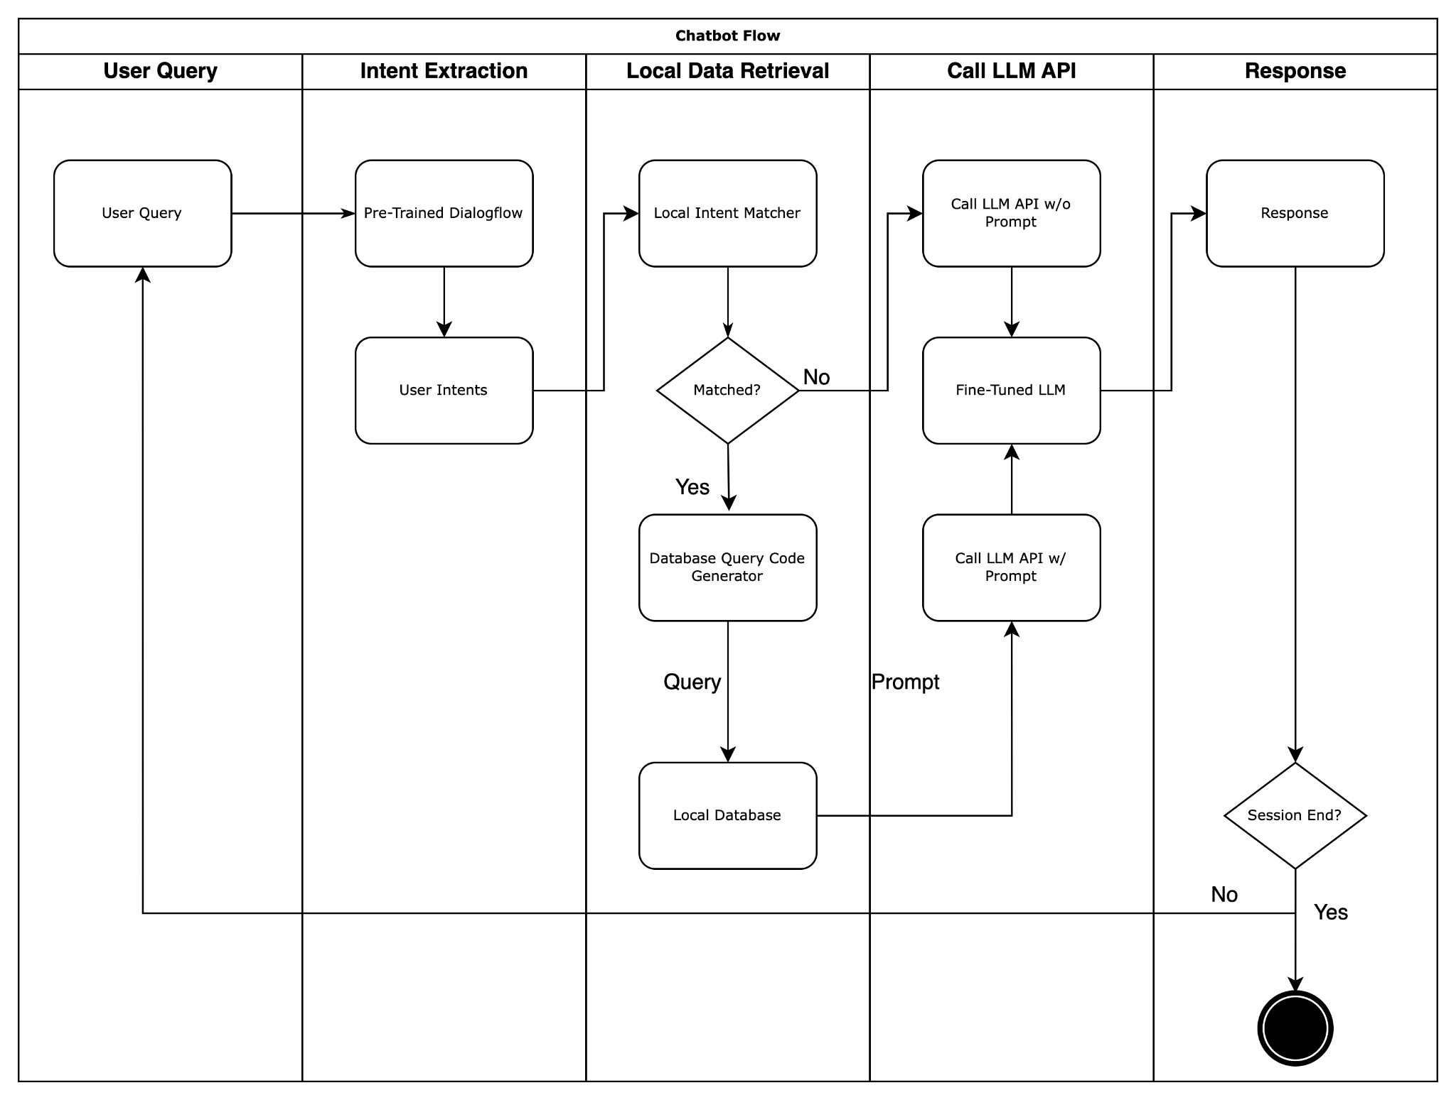
Project Scope – Chatbot
Function
Answer questions about studying abroad
Techs
NER / Unsupervised Data / Generation / Fine-tune LLM
Constraints
Large potential solution space makes it difficult for NER to correctly identify user intentions.
Token length limit of the LLM API makes local data to be concise and efficient.
Instant interactivity makes great demands on the efficiency of algorithms and data retrieval.

Slide 12
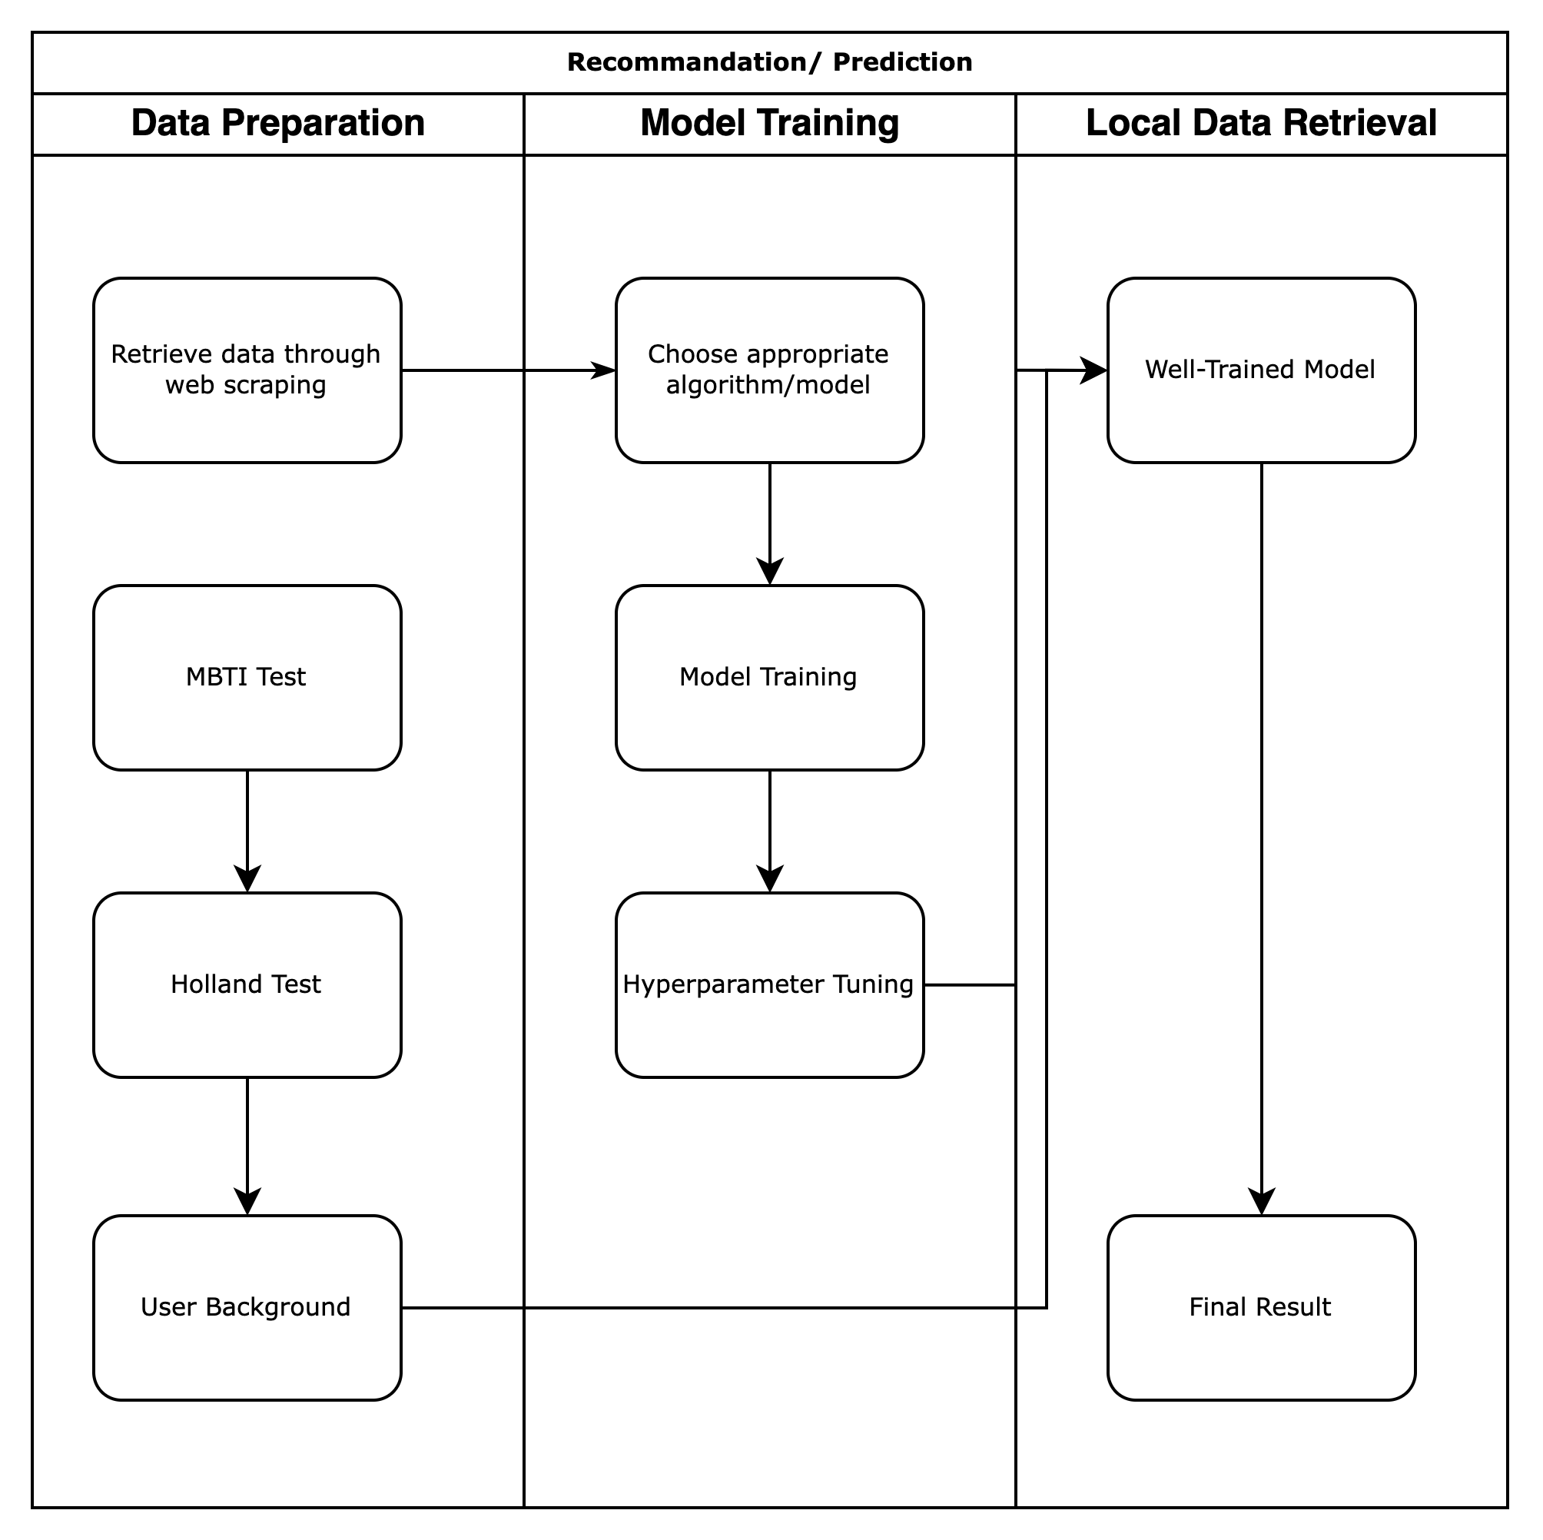
Project Scope – Recommendation
Function
Recommend and predict colleges to apply for based on students’ background
Techs
CF / Boosting / Logistic Regression
Constraints
Too many hyperparameters make it difficult to train a robust model
Highly correlated features makes parameter estimates of logistic regression models potentially unstable.
Data containing a large number of missing values makes the model prediction results unstable.

Slide 13
4 Data Collection and Preparation

Slide 14
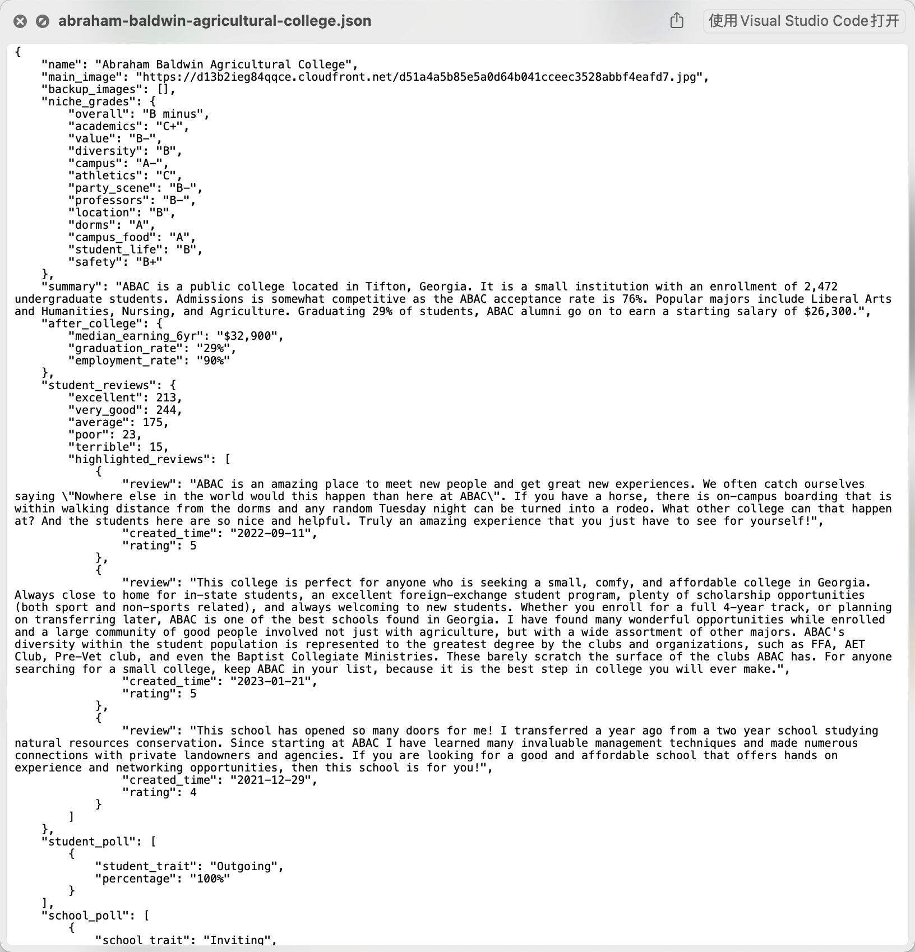
Data Collection and Preparation
Recommendation data
Scraping data of schools within QS1000 with Python (Over 15k pages)
Cleaning and Structurally Storing Data from Various Sources
(Completed)

Slide 15
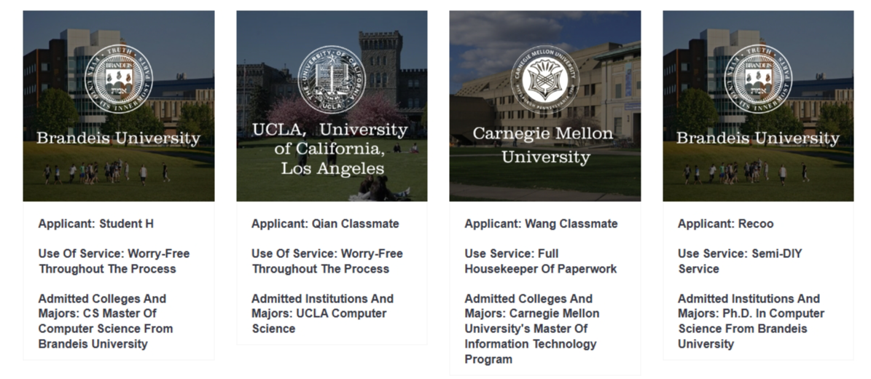
Data Collection and Preparation
Student Background Data
Official websites of some universities statistics
Questionnaire for some schools
Neg samples are difficult to obtain (in progress)

Slide 16
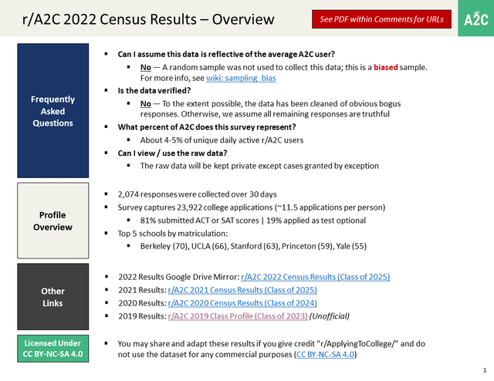
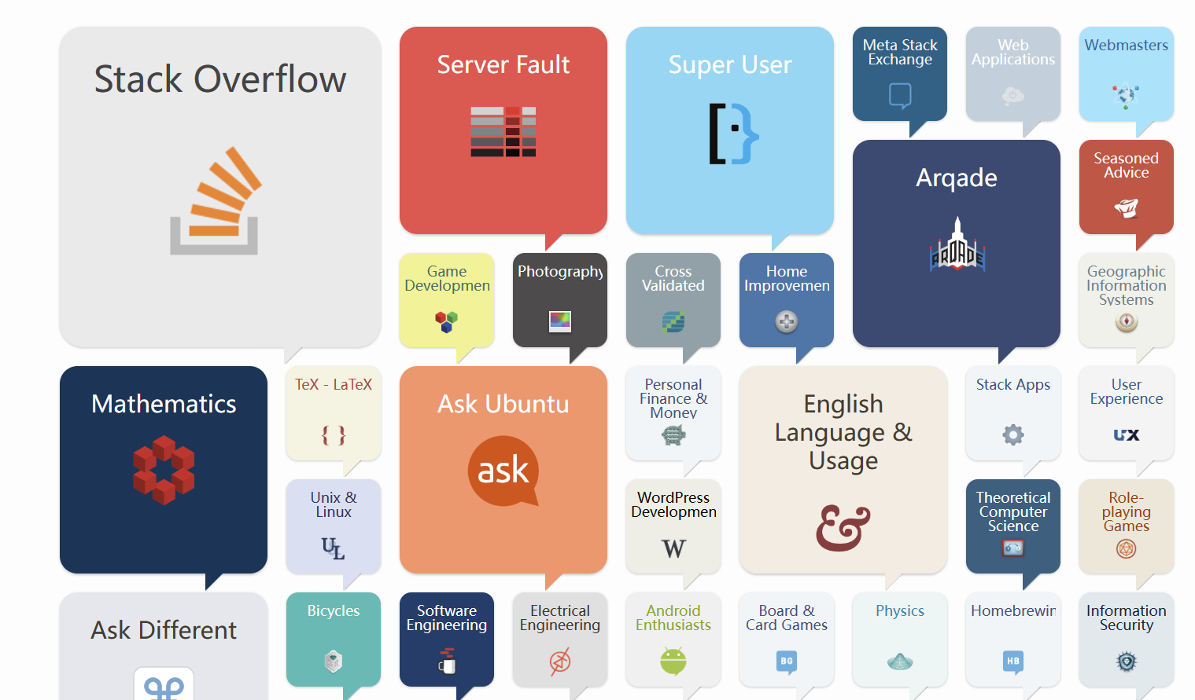
Data Collection and Preparation
Chatbot Data
Stack Exchange/Kaggle/Reddit
Generate from GPT
data cleaning(to be carried)

Slide 17
5 System Design

Slide 18
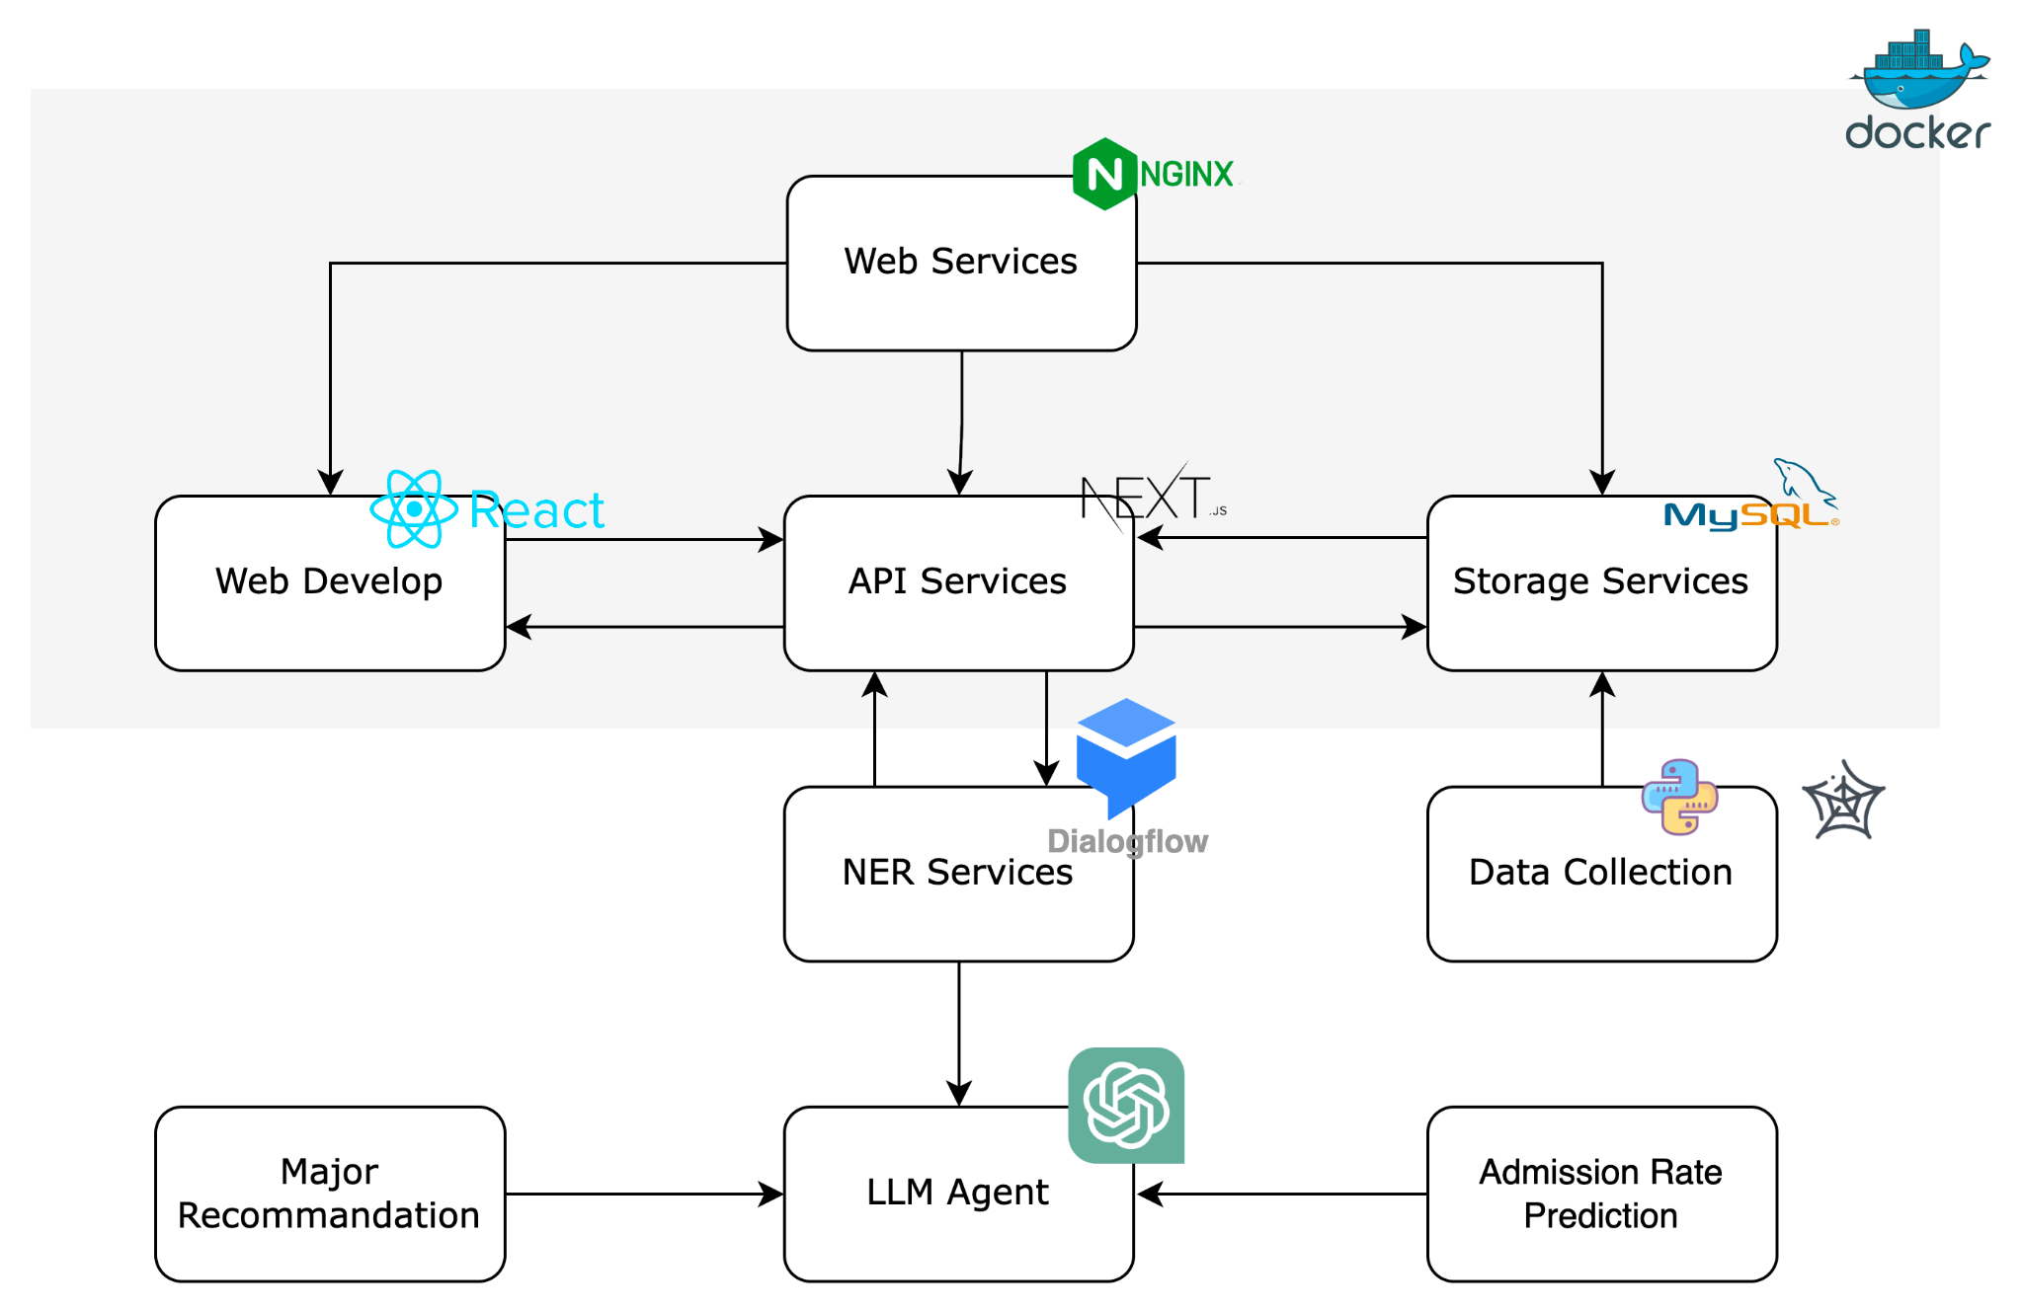
System Design

Slide 19
6 Result and Progress

Slide 20
7 Conclusion

Slide 21
Conclusion
Summary
Designed a web product that integrates admission evaluation, college\major recommendation and intelligent consultant.
Academic and real-world problem
Based on the academic issues of Unsupervised Data Generation Based on LLM / LLM Fine-Tuning and the fact that the current mainstream products on the market are mainly artificial, we have carried out an intelligent product to provide comprehensive information free for students who want to study abroad.

Slide 22
Thanks

Slide 23
Appendix
[1]Koren Y, Rendle S, Bell R. Advances in collaborative filtering[J]. Recommender systems handbook, 2021: 91-142. [2]Sharma A, Singh B. AE-LGBM: Sequence-based novel approach to detect interacting protein pairs via ensemble of autoencoder and LightGBM[J]. Computers in Biology and Medicine, 2020, 125: 103964. [3]Li Y, Xu J, Yang M. Collaborative filtering recommendation algorithm based on KNN and Xgboost hybrid[C]//Journal of Physics: Conference Series. IOP Publishing, 2021, 1748(3): 032041. [4]Zhang D, Gong Y. The comparison of LightGBM and XGBoost coupling factor analysis and prediagnosis of acute liver failure[J]. IEEE Access, 2020, 8: 220990-221003. [5]Krauck A, Penz D, Schedl M. Team JKU-AIWarriors in the ACM Recommender Systems Challenge 2021: Lightweight XGBoost Recommendation Approach Leveraging User Features[M]//Proceedings of the Recommender Systems Challenge 2021. 2021: 39-43. [6]Tang C, Luktarhan N, Zhao Y. An efficient intrusion detection method based on LightGBM and autoencoder[J]. Symmetry, 2020, 12(9): 1458. [7]Ghosal D, Majumder N, Mehrish A, et al. Text-to-Audio Generation using Instruction-Tuned LLM and Latent Diffusion Model[J]. arXiv preprint arXiv:2304.13731, 2023. [8]Hu Z, Lan Y, Wang L, et al. LLM-Adapters: An Adapter Family for Parameter-Efficient Fine-Tuning of Large Language Models[J]. arXiv preprint arXiv:2304.01933, 2023.
[9]Jungherr A. Using ChatGPT and Other Large Language Model (LLM) Applications for Academic Paper Assignments[J]. 2023.

