Slide 1
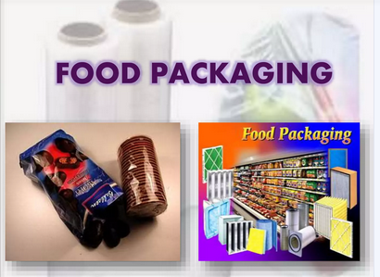
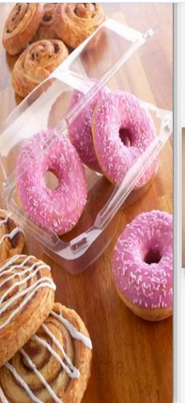
UNIT 4 - FOOD PACKAGING SYSTEM

Slide 2
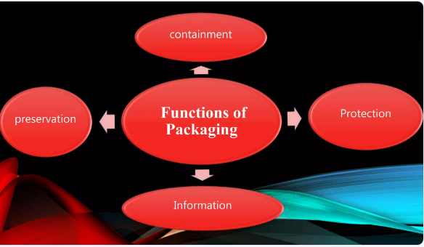

Slide 3
Packing definition
packaging as the enclosure of products in a wrapped pouch, bag, box, cup, tray, can, tube, bottle or other container form to perform
containment,
protection,
preservation,
communication,
If the device or container performs one or more of these functions, it is considered a package.

Slide 4
OBJECTIVES
to protect food products from the outside environment
Protect from damage by abrasion,
to contain the food,
to provide consumers with information
(ingredients and nutrition, quantity, price, brand name, food type and the expiry date of the product)
Packaging is an important tool for advertisement.
Brand awareness and customer attraction
(Customers often make their purchase decisions based on the appearance of the product, and the logo, colors, and style of food packaging)

Slide 5
FUNCTION of Packaging
Packaging materials have the four basic functions (Primary function)of providing
protection,
Communication,
Convenience
Containment
Secondary functions
Traceability
tamper indication

Slide 6
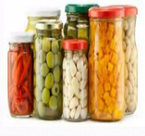
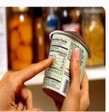
Primary functions
Protection
to protect food against spoilage or deterioration due to physical damage, chemical changes or biological damage.
2. Communication
provide consumers with information about ingredients and nutrition, quantity, price, brand name, food type and the expiry date of the product
Identification of manufacturer’s brand, quantity,
quality and type of product.

Slide 7
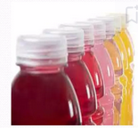
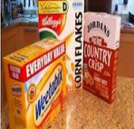
3. Convenience
Food containers can be designed to have features that make the handling, consumption, and preservation of food items easier for customers
4.Containment
Hold the contents and keep them secure until they are used.

Slide 8
Secondary functions
Traceability:
Ability to track any food through all stages of production, processing and distribution.
Tamper indication:
Food tampering is the intentional contamination of a food product, with intent to cause harm to the consumer or to a private company

Slide 9
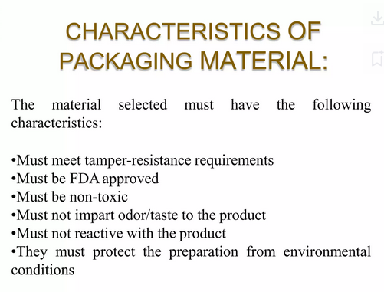

Slide 10
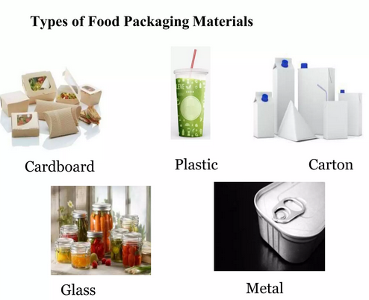

Slide 11

Two broad categories:
Rigid packaging materials
Flexible packaging materials
Rigid packaging materials:
Metal cans:
Primarily for heat sterilized food products.
Made of tin plate, aluminium or tin free steel.

Slide 12
2.GLASS CONTAINERS
Advantages:
Chemically inert in nature.
Excellent product visibility.
Excellent barrier to solids, liquids and gases.
Molded into various shapes and sizes.
Withstand sterilization temperature.
Refillable
Disadvantages:
Fragile.
Heavy weight.

Slide 13
3.RIGID PLASTIC PACKAGES:
Advantages :
Low cost
Ease of fabrication
4. WOODEN BOXES AND CRATES
5.FIBRE BOARD AND CARD BOARD BOXES
Used to make shipping cases exclusively in bulk packaging.
Advantages:
Versatility
Light weight
Disposability
Low cost

Slide 14
FLEXIBLE PACKAGING MATERIALS
Aluminum foil
Lightweight
effective barrier to the effects of air, temperature, moisture and chemical attack
Aluminium foil is used for aseptic cartons, pouches, wrappings
Plastics

Slide 15
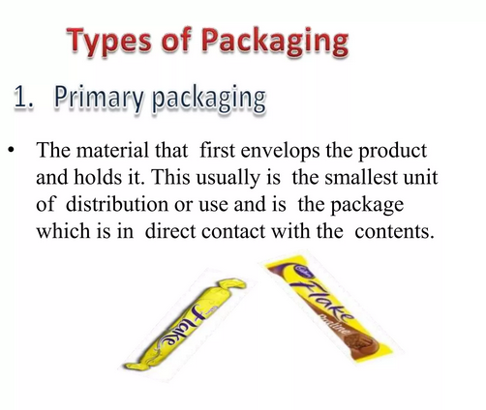

Slide 16
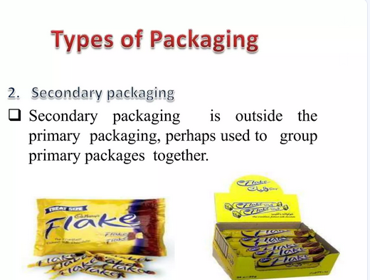
Secondary packaging is intended to protect not only the product, but also the primary packaging, which often is the packaging most visible to the consumer in retail displays.

Slide 17
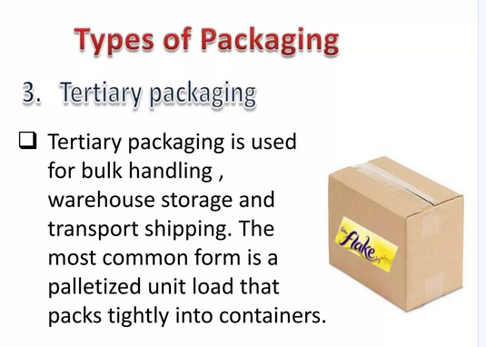

Slide 18
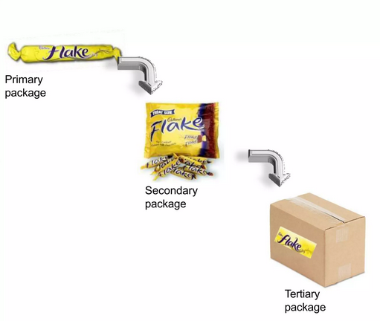

Slide 19
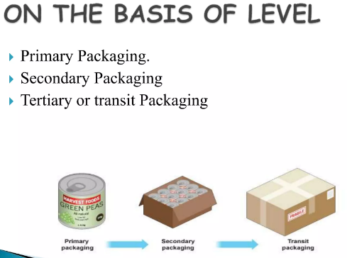

Slide 20
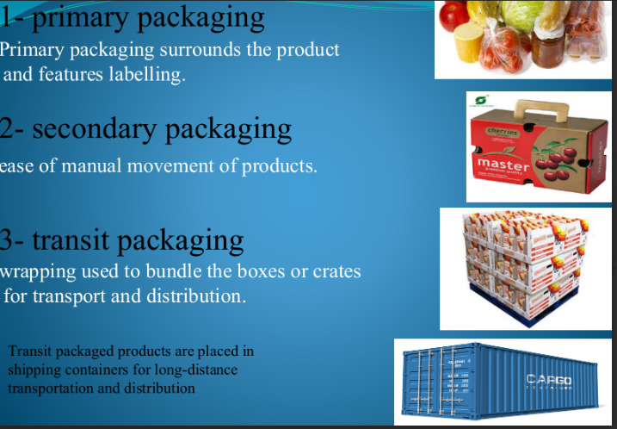

Slide 21
Active packaging
Active packaging refers to the incorporation of certain additives into packaging film or within packaging containers with the aim of maintaining and extending product shelf life.
modification of the environment inside the package by removing undesired gases .
Oxygen scavenging
Most moulds require oxygen to grow
mould growth which limits the shelf life of packaged baked goods.
Removal of oxygen can also delay oxidation
iron powder, ascorbic acid, enzymes (such as glucose oxidase and ethanol oxidase), immobilized yeast on a solid substrate - These materials are normally contained in a sachet

Slide 22
Anti microbial packaging
Food packages can be made AM active by incorporation
•Antimicrobials In this type of packaging, the packaging surface is polished with some materials like silver ions, chitin, chlorine dioxide, ethyl alcohol etc. which retards their growth.
Antimicrobials reduce the growth rate of microbes and acts against their growth. •

Slide 23
INTELLIGENT PACKAGING
intelligent packaging is ‘packaging which senses and informs to the customer about the status of the product
Protection against theft and tampering
INTELLIGENT TAMPER-PROOF PACKAGING
Optically variable films or gas sensing dyes, involving irreversible color changes.
Piezoelectric polymeric materials might be incorporated into package construction so that the package changes colour at a certain stress threshold

Slide 24
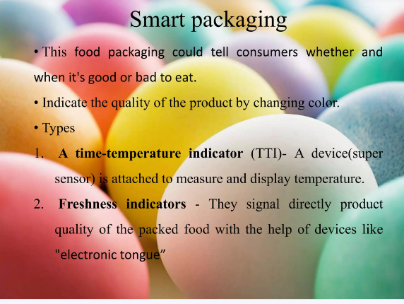

Slide 25
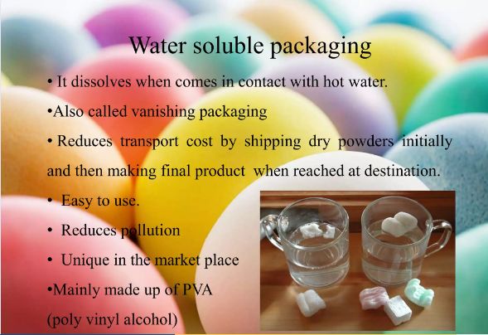

Slide 26
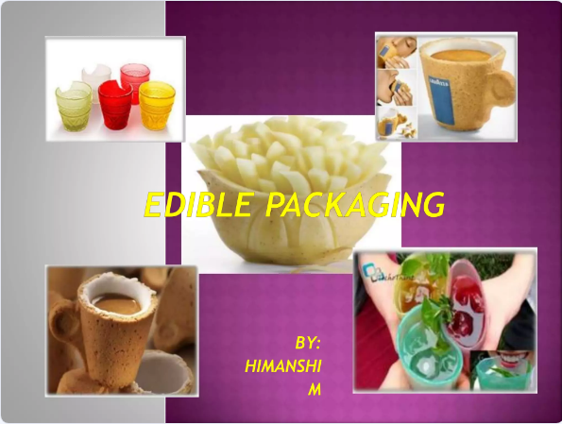

Slide 27
Edible Packaging
The food is generally packaged in edible material layers of other edible products.
This step is beneficial so as to reduce the environmental pollution.
The best thing about edible packaging is that it reduces the wastage of food

Slide 28
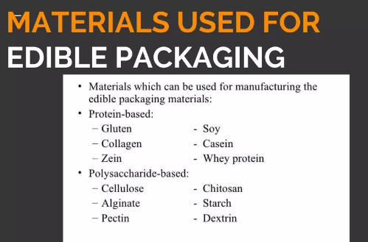

Slide 29
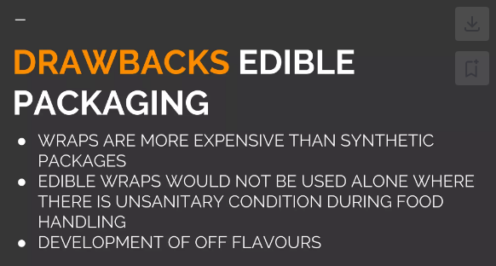

Slide 30
ASEPTIC PACKAGING
It is defined as the filling of a commercially sterile product into a sterile container under aseptic conditions
. • This results in a product which is shelf stable at ambient conditions.

Slide 31
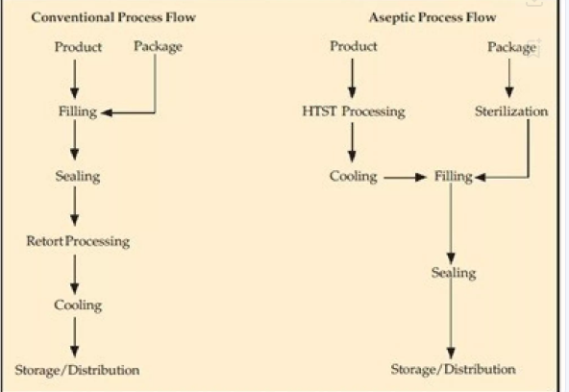

Slide 32
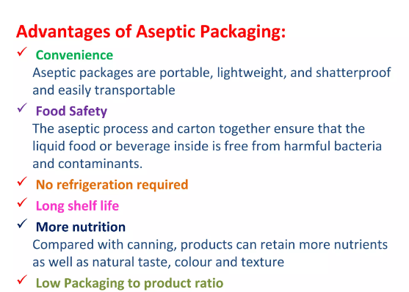

Slide 33
Modified Atmosphere Packaging (MAP)
MAP requires specialized machinery to flush out air from the packaging and replace it with a different gas or gas mixture.
The normal composition of air is 21% oxygen, 78% nitrogen and less than 0.1% carbon dioxide.
The modification of the atmosphere generally implies a reduction of O2 content or an increase of the CO2 concentration,
extend the shelf-life of perishable foods at chill temperatures.
The major gases used in MAP are N2, and CO2.
• Noble gases such as argon are used commercially for food products like coffee and other snacks, however its uses are limited.

Slide 34
Carbon dioxide (CO2) inhibits the increase of most aerobic bacteria.
It is the most important gas in the packaging of food under modified atmospheres. In general one can say the higher the CO2 concentration the longer the durability of the perishable food.
Nitrogen (N2) is an inert gas that is used to expel air especially Oxygen out of the packaging.

Slide 35
VACUUM PACKAGING
“Vacuum packagng is a method of packaging that removes air from the package and hermetically sealing it.”
Oxygen is a highly reactive element
many of the organic compounds in the food reacts with oxygen and cause negative changes in the color, flavor and odour.
In the absence of oxygen the food can retain its natural properties

Slide 36
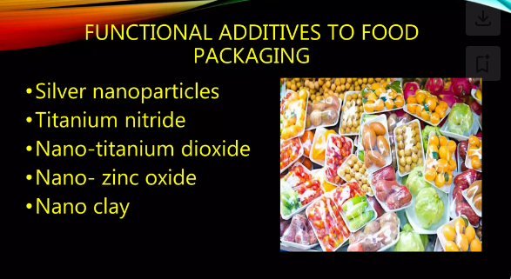
Nanotechnology in food packaging

Slide 37
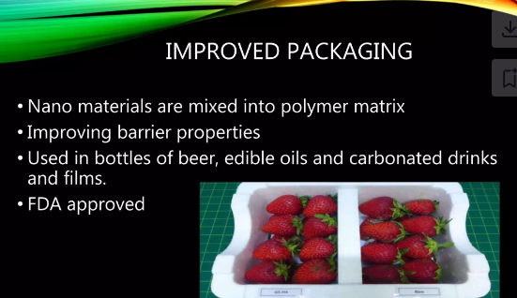

Slide 38
