Slide 1

QISKIT FALL FEST 2026 · ADVANCED TRACK
QUBIT
CROWN
A strategy game for exploring
quantum error detection
Team: Ayaan and Vivaan
Stack: Qiskit · Qiskit Aer · qiskit-paulice
Fidelity
Retention
Overhead
Live Qubit Crown main menu and Sector 01 tactical defense interface
Qubit Crown · Qiskit Fall Fest 2026 (Advanced Track)
1 / 8
Notes:
[Slide 1 · 0:00–0:10 (10s)]
Hi everyone, we're Ayaan and Vivaan. For the Qiskit Fall Fest 2026 Advanced Track, we built Qubit Crown, an interactive strategy game for exploring quantum error detection.

Slide 2
01 · THE CORE TRADE-OFF
Detecting errors comes at a cost.
CONCEPTUAL MODEL
Central Question: When does post-selection improve result quality enough to justify the shots and circuit resources it costs?
1. Noisy Circuit + Checks
Ancillas & parity gates add depth and 2Q gate noise before measurement.
2. Syndrome Filter
Ancilla outcomes classify each measurement shot as clean or flagged.
↗
↘
Accepted Shots (Kept): Evaluated for Post-Selected Fidelity (F) · Yield R = N_acc / N_total
→
Rejected Shots (Discarded): Thrown away — post-selection does NOT correct errors in flight.
1. Fidelity (F)
Result Quality
How closely the observed output distribution matches the ideal reference:
• Raw fidelity: before filtering.
• Post-selected: over accepted shots.
• Checks can lower fidelity if gate noise dominates.
2. Shot Retention (R)
R = accepted / total shots
The fraction of total measurement shots surviving post-selection:
• Every flagged shot is discarded.
• Stricter checks reject more runs, reducing usable sample yield.
3. Circuit Overhead
Added Hardware Cost
Extra circuit resources required to implement syndrome checks:
• Ancilla qubits added to the register.
• Extra two-qubit entangling gates.
• Deeper circuits and added decoherence.
Qubit Crown · Qiskit Fall Fest 2026 (Advanced Track)
2 / 8
Notes:
[Slide 2 · 0:10–0:28 (18s)]
Quantum error detection involves a fundamental trade-off. Using ancilla qubits and syndrome checks, we can post-select outcomes and discard runs where errors are flagged. That can improve the fidelity of accepted results, but it throws away shots and adds circuit gates that introduce their own noise.

Slide 3
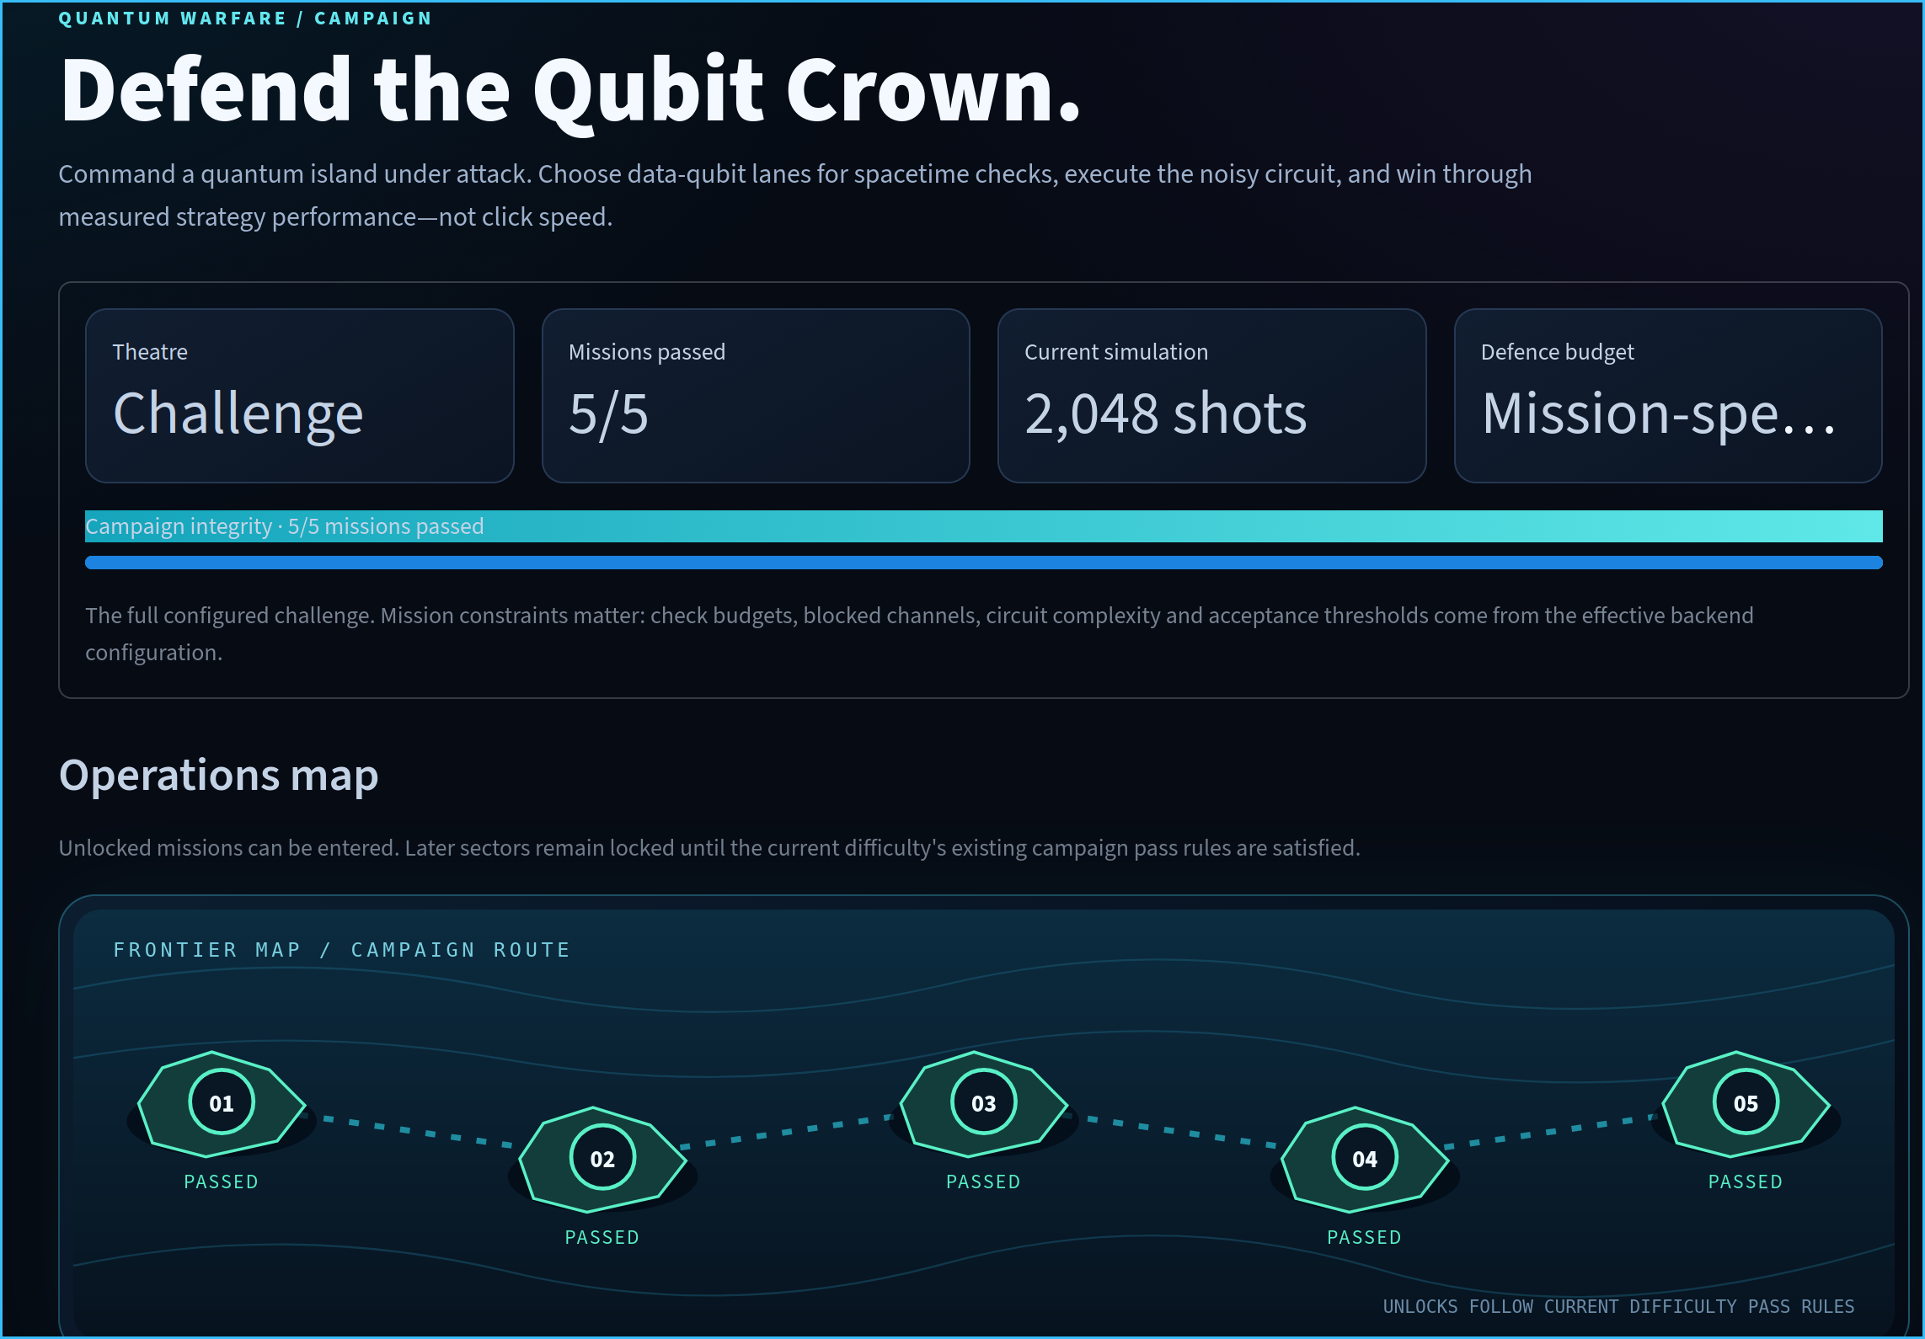
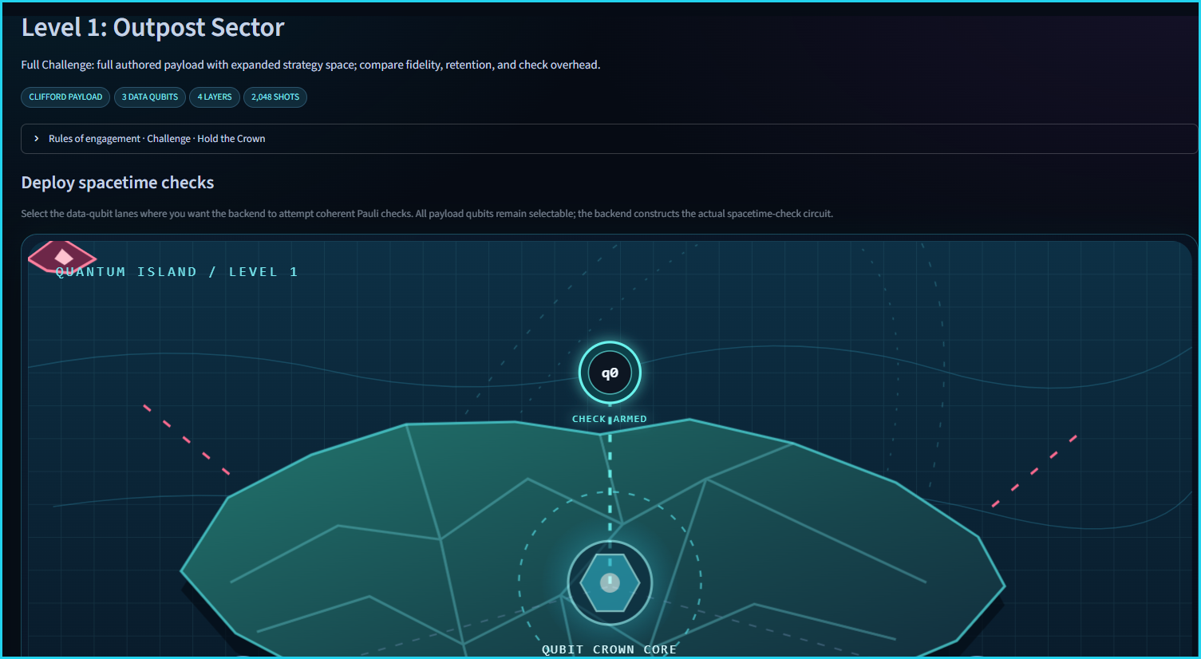
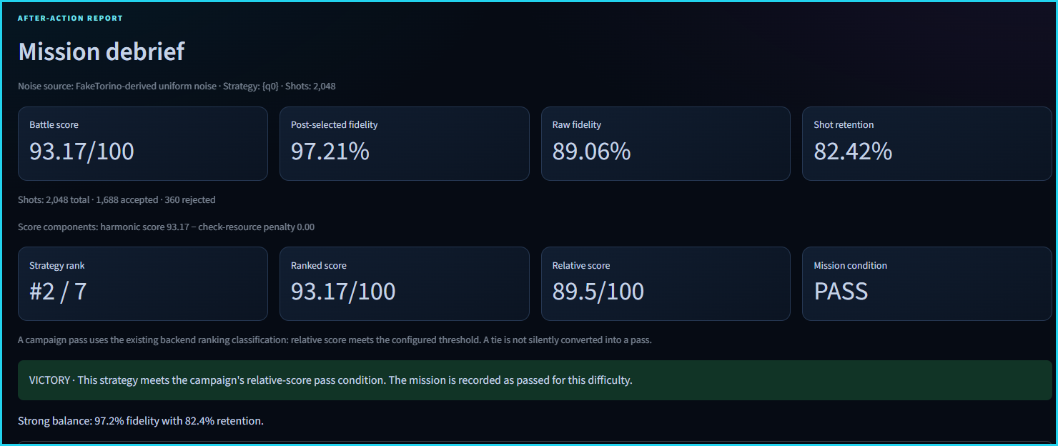
02 · INTERACTIVE CAMPAIGN & USER WORKFLOW
Turn error detection into a strategy.
Players progress through five campaign sectors, allocate checks within a budget, and test strategies under noise.
GAMEPLAY LOOP
STAGE 1 · CAMPAIGN & LEVEL SELECT
STAGE 2 · TARGET QUBIT ALLOCATION
STAGE 3 · TELEMETRY & EVALUATION
5 progressive sectors · 2,048 shots · Guided, Standard & Full Challenge tracks
Level 1 Outpost Sector (3 data qubits, 4 layers) with q0 spacetime check armed
Immediate debrief: 97.21% post-selected fidelity, 82.42% retention, PASS
01 · Choose Level
Select sector, difficulty preset & 2,048-shot config
02 · Select Qubits
Arm spacetime Pauli checks within check budget
03 · Simulate Shots
Execute noisy circuit runs in Qiskit Aer
04 · Inspect Metrics
Compare raw vs. post-selected fidelity & yield
05 · Rank Strategies
Evaluate composite score against all candidates
Qubit Crown · Qiskit Fall Fest 2026 (Advanced Track)
3 / 8
Notes:
[Slide 3 · 0:28–0:50 (22s)]
Qubit Crown turns this trade-off into a five-level campaign. In each mission, you inspect a Clifford payload circuit, choose which data-qubit lanes to guard within a check budget, and run a 2,048-shot noisy simulation. You then see whether your accepted fidelity and shot retention pass the level.

Slide 4
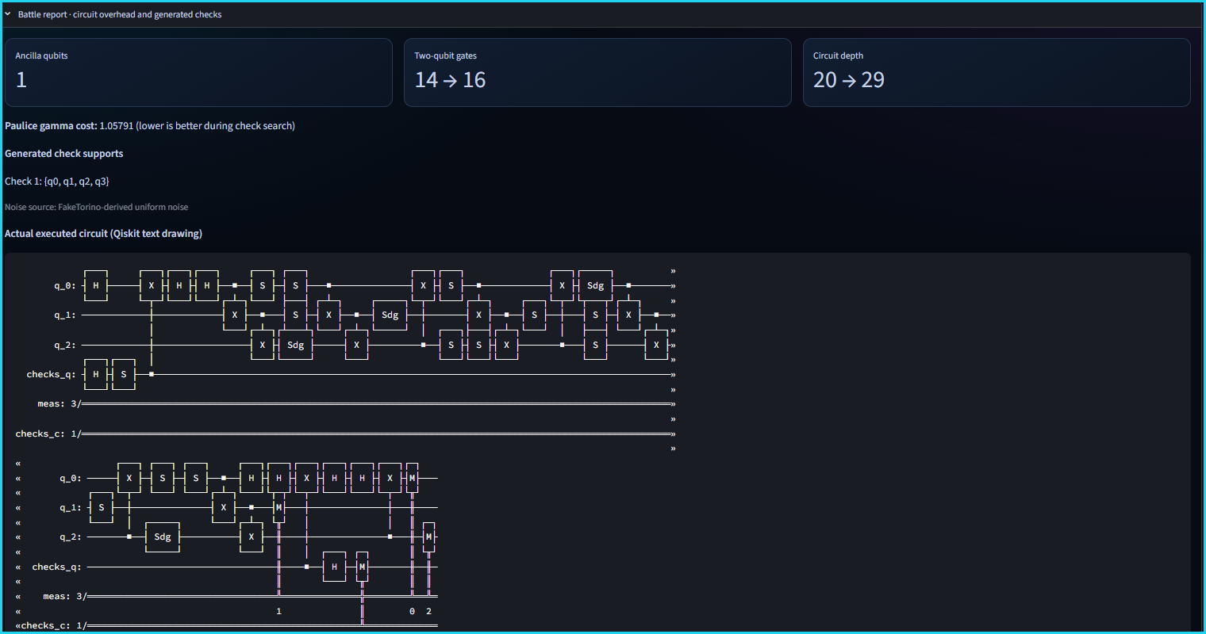
03 · SYSTEM ARCHITECTURE & EXECUTION PIPELINE
From noisy circuit to accepted results.
QISKIT + PAULICE
1. Payload Circuit
Clifford circuit
(3–7 data qubits)
2. Syndrome Checks
qiskit-paulice
spacetime checks
3. Noisy Simulation
Qiskit Aer
2,048 noisy shots
4. Syndrome Eval
Inspect ancilla
parity outcomes
5. Post-Selection
Filter flagged runs
keep clean shots
6. Compare Metrics
Fidelity, retention
& gate overhead
→
→
→
→
→
Technical Stack & Scope
▸ Clifford Payload Circuits: Campaign missions use Clifford-only payload circuits so stabilizer propagation remains exact.
▸ qiskit-paulice Checks: Constructs coherent spacetime Pauli checks (e.g., Check 1 support {q0, q1, q2, q3}) and ancilla registers (checks_q).
▸ Qiskit Aer Simulation: Executes 2,048 noisy shots under FakeTorino-derived uniform noise and records gate/depth overhead.
▸ Detection, Not Correction: Post-selection discards syndrome-flagged runs. It does NOT actively correct errors or perform fault-tolerant QEC.
Measured Level 1 {q0} Battle Report: +1 ancilla, 14 → 16 two-qubit gates, 20 → 29 depth, and Qiskit circuit diagram
Qubit Crown · Qiskit Fall Fest 2026 (Advanced Track)
4 / 8
Notes:
[Slide 4 · 0:50–1:10 (20s)]
Under the hood, each run starts with a Clifford payload circuit in Qiskit. We use qiskit-paulice to synthesize spacetime Pauli checks on the selected qubits, and simulate noisy shots in Qiskit Aer using a FakeTorino-derived noise model. Flagged shots are filtered out during post-selection—not corrected in flight.

Slide 5
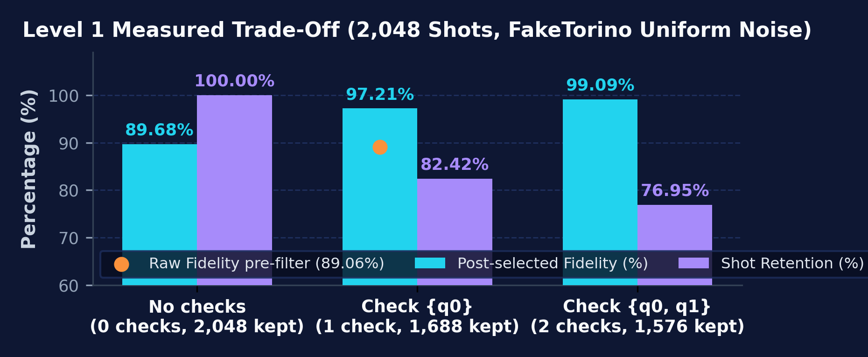
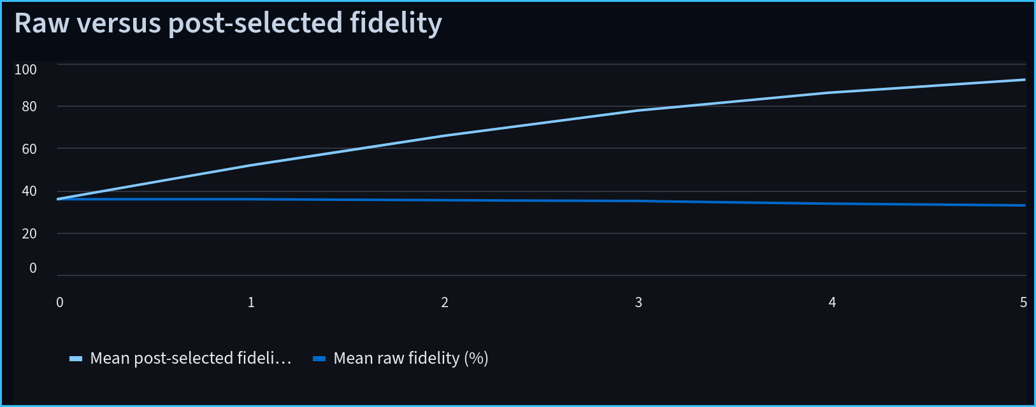
04 · MEASURED RESULTS & OVERHEAD TELEMETRY
Better accepted results. Fewer surviving shots.
LEVEL 1 · 2,048 SHOTS
NO-CHECK BASELINE
89.68%
Baseline Fidelity (unfiltered)
• Retention: 100% (2,048 kept)
• Rejected: 0 shots discarded
• Circuit: Depth 20 · 14 2Q · 0 anc
• Score: 91.98 / 100 (FAIL)
SYNDROME CHECK {q0}
97.21% (+7.53 pp)
Post-Selected (Raw: 89.06%)
• Retention: 82.42% (1,688 kept)
• Rejected: 360 shots (17.6%)
• Overhead: Depth 29 · 16 2Q · 1 anc
• Score: 93.17 / 100 (PASS #2)
Actual Level 1 {q0} Mission Debrief: 97.21% post-selected vs. 89.06% raw fidelity, 82.42% retention
When Retention Collapses
In Level 5 (5 checks), post-selected fidelity climbs to ~94%, but retention drops to ~24% (+23 2Q gates, +96 depth) — proving higher fidelity alone does not make a strategy better.
Qubit Crown · Qiskit Fall Fest 2026 (Advanced Track)
5 / 8
Notes:
[Slide 5 · 1:10–1:35 (25s)]
Here is what that looks like in Level 1. Without checks, baseline fidelity is 89.68 percent with 100 percent retention. Adding a single check on q0 increases circuit depth from 20 to 29 and adds two two-qubit gates. Post-selection discards 360 flagged shots, dropping retention to 82.42 percent, while lifting accepted fidelity to 97.21 percent.

Slide 6
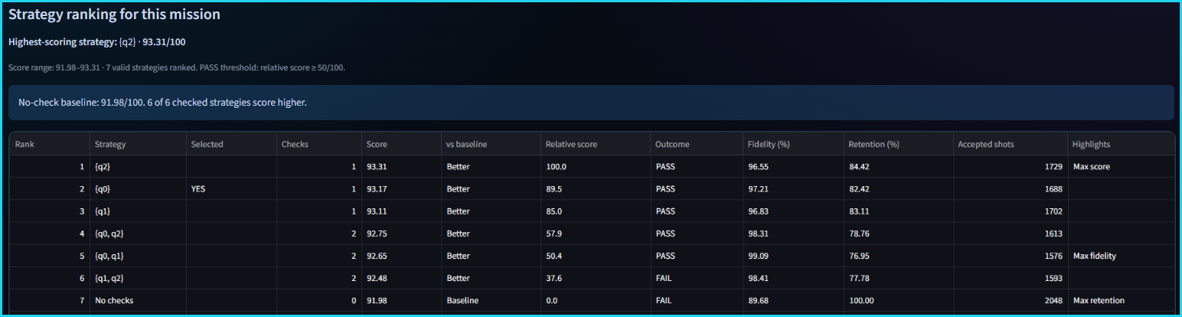

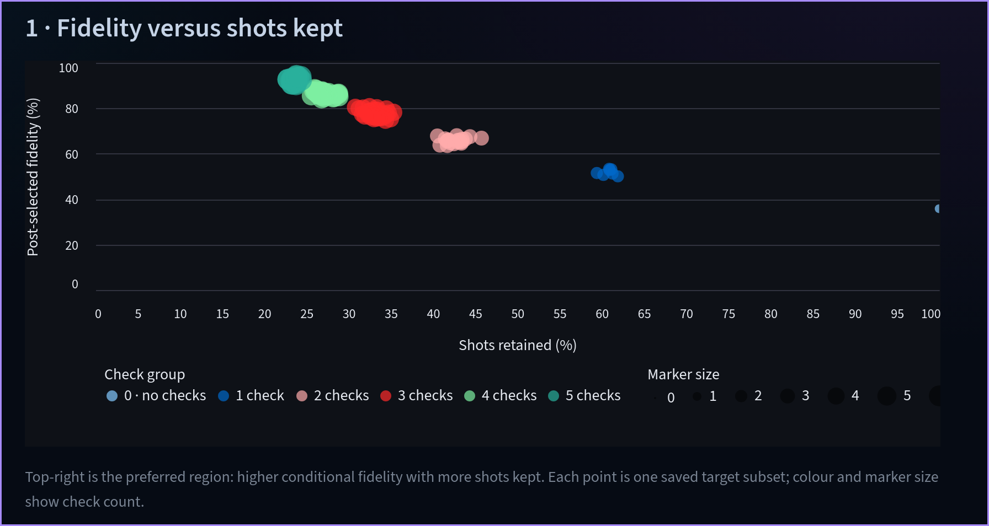
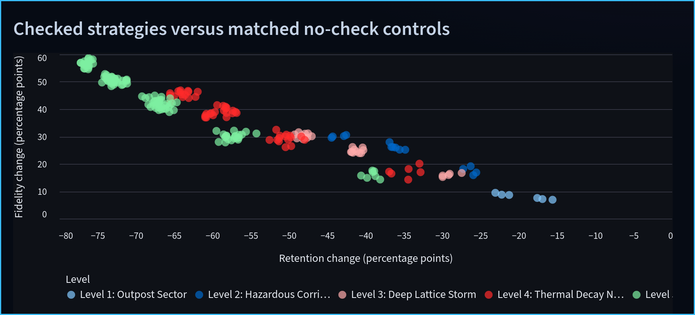
05 · STRATEGY RANKINGS & COMPOSITE SCORING
Which strategy is worth the cost?
7 RANKED STRATEGIES
VERIFIED COMPOSITE SCORE
Balancing Quality vs. Yield
Ranked by a weighted harmonic score minus a separate check-cost penalty:
Level 1 Leaderboard: {q0, q1} has max fidelity (99.09%, Rank #5), while 1-check {q2} wins max score (93.31, Rank #1)
• F (Post-selected fidelity): Conditional quality of accepted shots.
• R (Shot retention): Fraction of total shots kept (N_acc / N_total).
• β_l (Level parameter): Configures the relative weight of retention vs. fidelity (e.g., β₁ ≈ 1.77 in Level 1).
• Separate Check Penalty: Subtracted from H_β after the harmonic term (UI: harmonic score 93.17 − penalty 0.00).
Key Takeaway: No single check count is universally optimal; 2 checks maximize fidelity, but 1 check wins overall score.
Fidelity vs. shots kept by check count (0–5 checks)
Fidelity vs. retention shift across all 5 campaign levels
Qubit Crown · Qiskit Fall Fest 2026 (Advanced Track)
6 / 8
Notes:
[Slide 6 · 1:35–2:00 (25s)]
Higher fidelity alone isn't always worth the cost. In our Strategy Rankings, checking both q0 and q1 reaches 99.09 percent fidelity, but ranks fifth because retention drops to 76.95 percent. A single check on q2 ranks first under our weighted harmonic score, and in Level 5, adding five checks collapses retention near 24 percent.

Slide 7
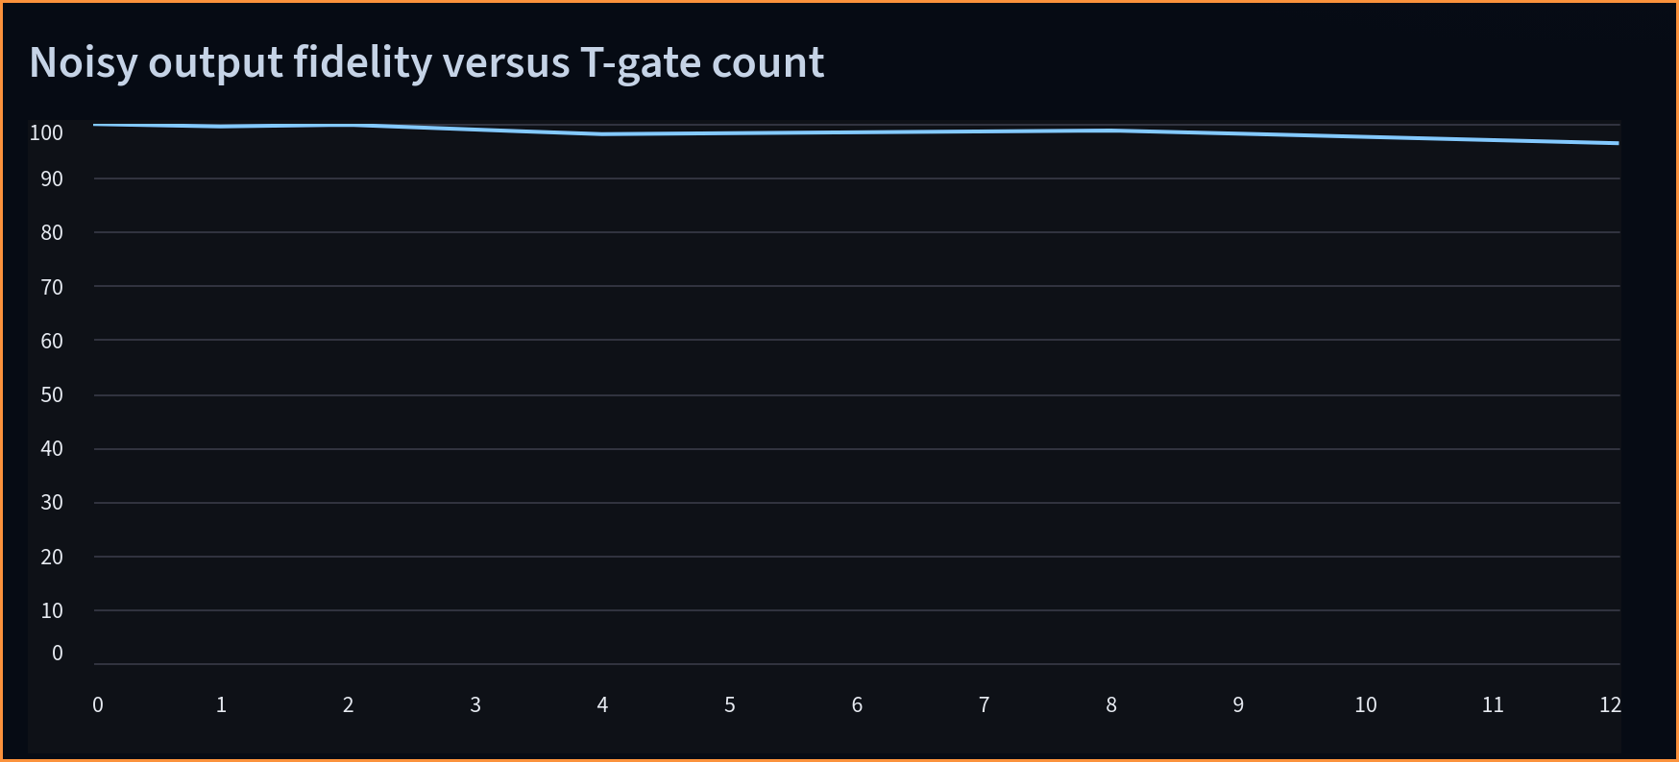
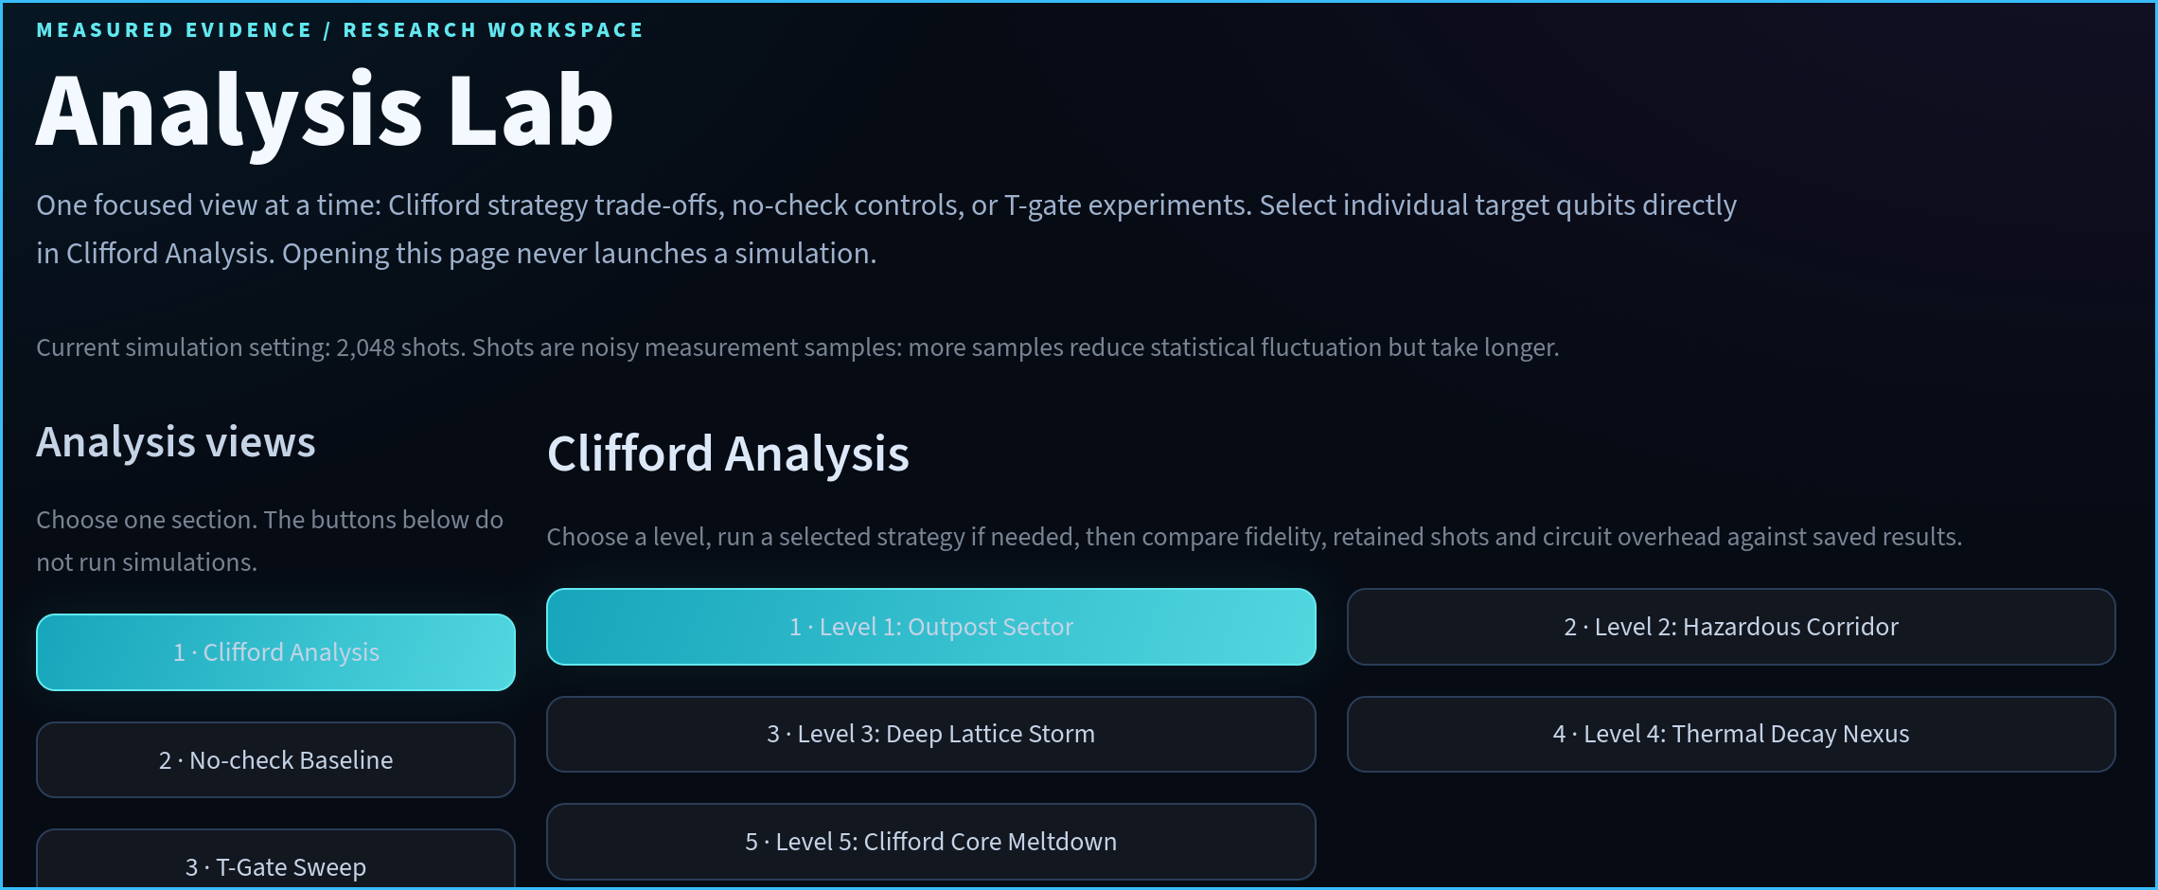
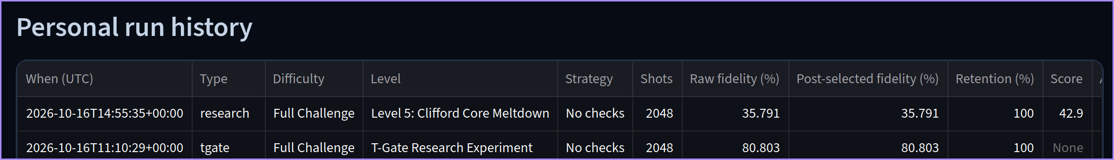
06 · NON-CLIFFORD INVESTIGATION
What changes beyond Clifford circuits?
T-GATE SWEEP (0–12)
Probing the Clifford Boundary
1. Why the Campaign Uses Clifford Circuits
The campaign's qiskit-paulice syndrome-check workflow relies on stabilizer structure to propagate Pauli checks cleanly through Clifford gates.
2. The T-Doped Circuit Investigation
In Analysis Lab (3 · T-Gate Sweep), we separately investigate T/Tdg-doped circuits across 0 to 12 T-gates (48 logged experiments) to observe how non-Clifford gates behave under experimental noise.
3. Crucial Scientific Distinction
This T-gate sweep is a separate baseline investigation (Score: None; No checks). It is NOT proof that the Clifford syndrome-check workflow directly supports arbitrary non-Clifford circuits.
Measured Analysis Lab Sweep: Noisy output fidelity across 0 to 12 T-gates
Recorded Field Telemetry
• 48 T-Gate experiments logged in profile
• Dedicated '3 · T-Gate Sweep' workspace
• Logged 2,048-shot T-Gate baseline: 80.803% raw fidelity (100% retention)
Qubit Crown · Qiskit Fall Fest 2026 (Advanced Track)
7 / 8
Notes:
[Slide 7 · 2:00–2:20 (20s)]
Because qiskit-paulice targets Clifford circuits, we also built a separate T-gate sweep in the Analysis Lab. We dope circuits with up to 12 T and T-dagger gates to observe how non-Clifford operations affect noisy output fidelity, marking the boundary where standard Clifford syndrome checks stop.

Slide 8
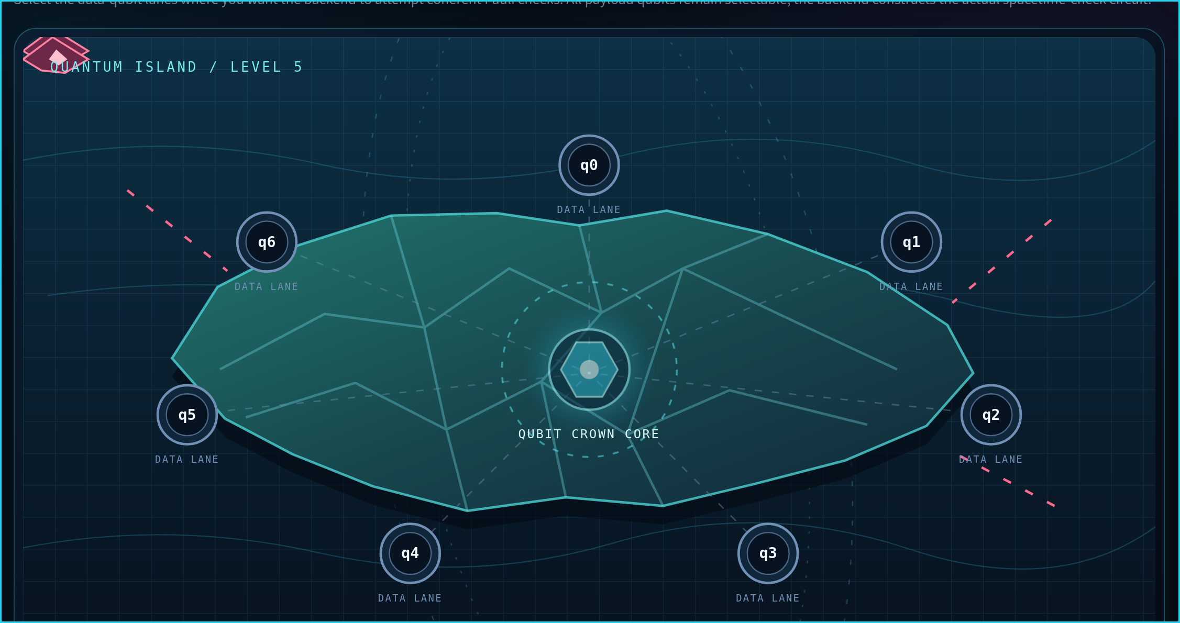
07 · CONCLUSION & KEY TAKEAWAYS
Error detection is a trade-off.
QUBIT CROWN · 2026
1. Post-selection changes the quality of accepted results.
Filtering syndrome-flagged runs raises accepted fidelity (e.g., 89.68% → 97.21% with {q0} in Level 1), evaluating conditional quality on surviving shots.
2. Rejected shots reduce the number of usable samples.
Flagged runs are discarded, not corrected in flight — cutting sample yield from 100% to 82.42% (1 check) and down to ~24% under heavy check loads.
3. Check circuitry introduces additional resource costs.
Ancilla qubits, extra two-qubit gates (14 → 16), and deeper circuits (20 → 29) add physical noise that must be weighed against fidelity gains.
Qubit Crown makes these trade-offs interactive and experimentally explorable.
Qubit Crown · Qiskit Fall Fest 2026 · Advanced Track · Team: Ayaan and Vivaan
Quantum Island · Level 5 (Clifford Core Meltdown): 7 data-qubit lanes around Qubit Crown Core
Qubit Crown · Qiskit Fall Fest 2026 (Advanced Track)
8 / 8
Notes:
[Slide 8 · 2:20–2:30 (10s)]
Ultimately, quantum error detection is about balancing accepted result quality against lost shots and circuit overhead. Qubit Crown makes that trade-off interactive and measurable.

