Slide 1
WINDOWS FUNDAMENTALS

Slide 2
INTRODUCTION TO OS
An operating system or OS is a software program that enables the computer hardware the communicate and operate with the computer software.
Without a computer operating system, a computer and software programs would be useless.
Types of operating Systems :
Network Operating System
Real Time Operating System
Distributed Operating System
Batch Operating System

Slide 3
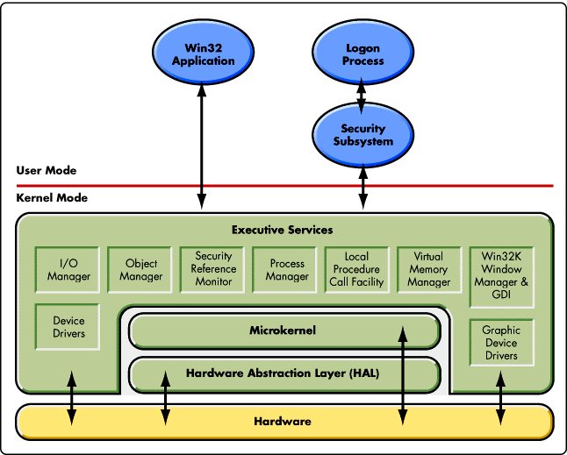
Windows Kernel and Architecture

Slide 4
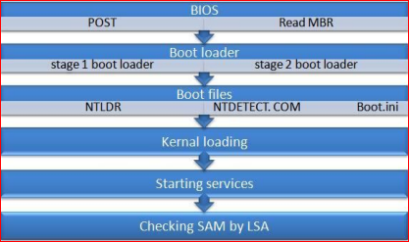
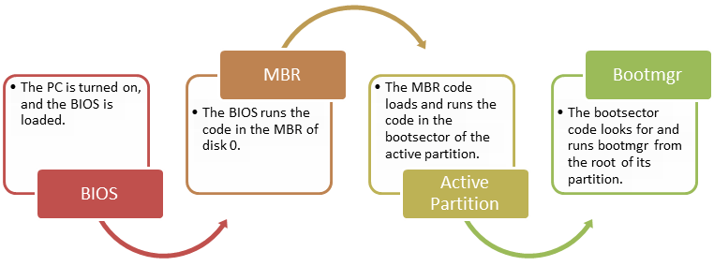
BOOTING PROCESS

Slide 5
Windows File System
The structure and logic used to manage the groups of information is called a "file system".

Slide 6
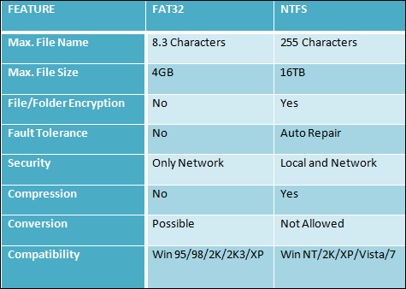
Comparison between NTFS & FAT

Slide 7
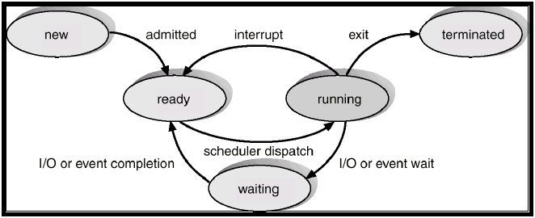
Process Management
Process Types:
Multi processing
Multi tasking
Multi threading
Hyper threading
Process State Diagram

Slide 8
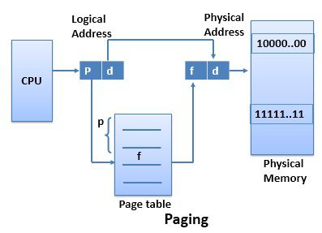
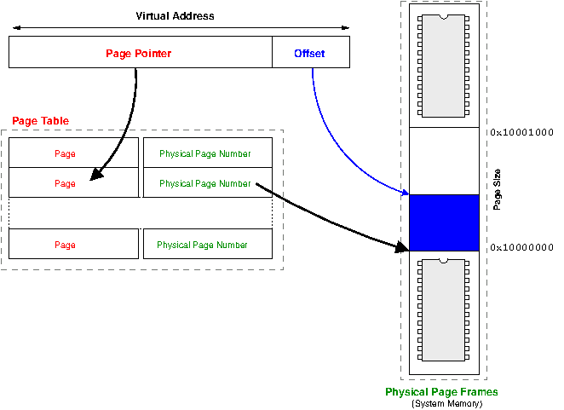
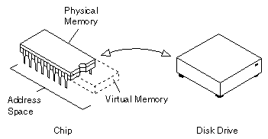
Memory Management
Virtual Memory
Virtual Address Space

Slide 9
Thankyou

