Slide 1
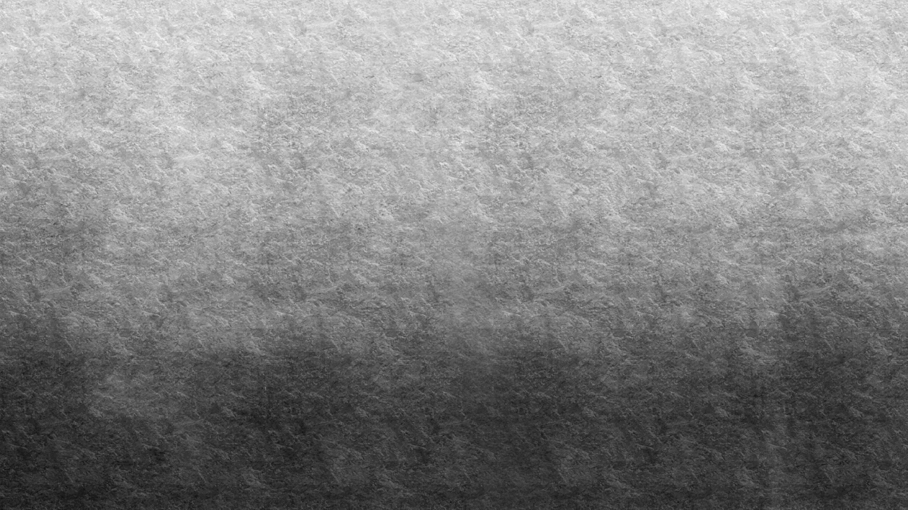
Introduction to radiosity

Slide 2
Introduction
Before its application to computer graphics, Radiosity was rooted in the heat transfer literature.
Here, energy radiates out from all surfaces, to greater or lesser degree.
In computer graphics, the energy of interest is light in the visible spectrum.
All surfaces are viewed as ideal diffuse (Lambertian) reflectors (reflecting light equally in all directions) and light sources are ideal diffuse emitters.

Slide 3
Solving the problem of global illumination
Radiosity models the transfer of light between surfaces.
Informally, radiosity is the rate at which light energy leaves the surface.
Two contributions to the energy: emission and reflection.
One of the ways to solve the global illumination problem – for example ray tracing solves it in another way.

Slide 4

Radiosity Algorithm
$B_{i} =E_{i} + p_{i}\sum_{j=1}^{n}{B_{j}F_{ij}}$ (1)
B_{i} is the radiosity of patch i, E_{i} is the emission of patch i, pi is the reflection coefficient of patch i, B_{j} is the radiosity of patch j, and F_{ij} is the form factor between patches i and j.
This equation is computed for each patch i.
Thus, we see an upper bound time complexity of O($n^{2}$).
As this equation implies, lighting is assumed to be constant over the patch, and one radiosity value is calculated per patch.

Slide 5
Radiosity Algorithm
The general algorithm for radiosity is:
Mesh scene into patches
Compute the form factors
Solve for radiosities (Using Equation 1)
Display the scene

Slide 6
Solve for radiosities by gathering
Gathering: One patch gathers radiosity from the other patches one by one.
This is a very slow technique because every patch has to gather from every patch several times to get a good result.
Multiple passes are required as initially, the only diffuse emitters are the light sources themselves, and in the final result, all surfaces are diffuse emitters.
Thus, we end computing the emission from surfaces that initially do not emit anything.

Slide 7
Solve for radiosities by shooting and sorting:
We first choose the patch with the most excess light. This patch then shoots its light away.
This process is repeated until the worst patch has excess light below some tolerance.
Sorting is needed to find the patch with the most excess light and thus, more time is required per iteration, but in general, less iterations are required.

Slide 8
Patching
Patches are a higher resolution object-space representation of the original surface geometry.
Patches are how we simulate area light sources (Recall that all surfaces are viewed as diffuse reflectors and light sources as diffuse emitters).
Rather than treating the surface as an area light source, we split it into smaller area light sources across the entire area of the original surface.
Therefore, if the surface is subdivided enough, higher quality results are feasible.

Slide 9
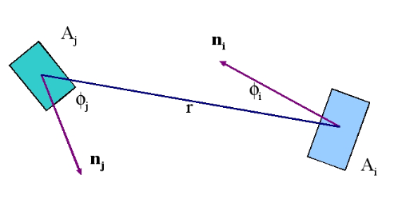
Patching
The relationship between two patches is shown above.
We need to use this relationship to determine the interaction of energy from every surface to every other surface.

Slide 10

Form factor
A simple geometric relation helps us to derive an equation for
calculating the form factors F_{ij}
The relation states: The area of the normal projection from a surface A onto another surface is reduced according to the cosine of the angle between the two surfaces, i.e. Acosθ (remember dot product)
The form factors couple every pair of patches, determining the proportion of radiated energy from one that strikes the other.
We need to use this relationship to determine the interaction of energy from every surface to every other surface.
This results in an O($n^{2}$) problem as noted before.
This can be calculated based on each surface pair’s geometrical relationships (distance between surfaces, relative orientation, relative area, etc.
This calculation results in the form factor.

Slide 11

Form factor equation
$F_{ij} =\frac{1}{A_{i}}\int{A_{i}}\int{A_{j}}p_{i}\frac{\cos{(φ_{i})}\cos{(φ_{j})}}{πr^{2}} dA_{j}dA_{i}$ (2)
F_{ij} can be calculated as follows:
Let us assume that the area of the patches is small compared to their
distance r. Let A_{j} be the area of P_{j}. Now imagine a hemisphere with
radius 1 being placed on patch P_{i} onto which patch P_{j} is projected. The
resulting area A_{j} ’ is approximately A_{j}cosφ_{j} , where φ_{j} denotes the angle
between the normal of patch P_{j} and the line between the two patches.
Remember that energy hitting patch P_{i} is proportional to the cosine of
this incident angle, which explains why we multiply by cosφi (which
corresponds to a projection onto the hemisphere’s base-plane) to come
up with the correct percentage of Pj ’s influence.
Since all form factors F_{ij} have to sum up to 1 (100%), we normalize the result with the hemisphere’s base surface area, i.e. with 1²π = π, and finally get the form factor F_{ij}.
Doing this will result in a value that can be used to scale the amount of energy leaving the transmission patch and arriving at the receiving patch.

Slide 12
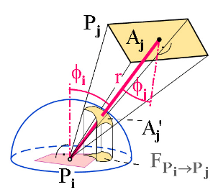
Hemi-space Projection (hemisphere)

Slide 13
Hemi-space Projection (hemicube)
In most implementations hemicubes are used instead of hemispheres on patches P_{i} to calculate the form factors.
The whole scene is then projected onto the hemicube.
We can then make use of the z-buffer technology, i.e. the hemicube’s faces are subdivided into a regular grid of pixels, then all other patches are projected onto them with the cube center acting as the center of projection.
For each pixel we determine its form factor in advance and then we add that percentage for each patch, which eventually gives us its form factor.

Slide 14
Hemi-space Projection Methods
As patches are rendered onto the surface of the hemicube, they will occupy hemicube pixels.
The farther away a surface is, the fewer pixels it will occupy.
The greater the angle of relative orientation, the fewer pixels it will occupy.
Using the z-buffer, we can let some patches partially (or fully) occlude other patches, causing them to occupy even fewer pixels (or none) which gives us visibility information.

Slide 15
Hemi-space Projection Methods
It would be expensive evaluate the form factor on a patch by patch basis.
Using a bounding hemisphere it can be shown that all patches that project onto the same area of the hemisphere have the same form factor.

Slide 16
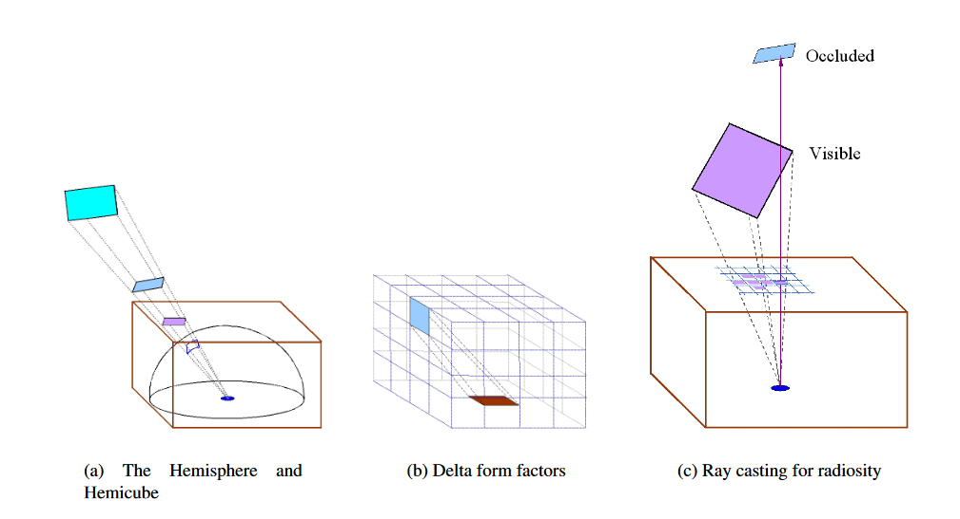
Hemi-space Projection Methods
Rendering of a patch onto the surface of the hemicube.

Slide 17

Hemi-space Projection Methods
The delta form factors are defined as follows for the top of the hemicube:
$$ΔF_{q}=\frac{1}{π{(x}^{2}+y^{2}+1)}$$
Where ∆A is the area of a pixel and q is that set of pixels onto which the patch Ai projects and is the nearest patch in that direction. x, y, and z are the coordinates of the pixel on the hemicube.
Now that we have the delta form factors, how do we get the actual form factor? It is equated via:
$$F_{ij}=\sum_{q}{ΔF_{q}}$$

Slide 18
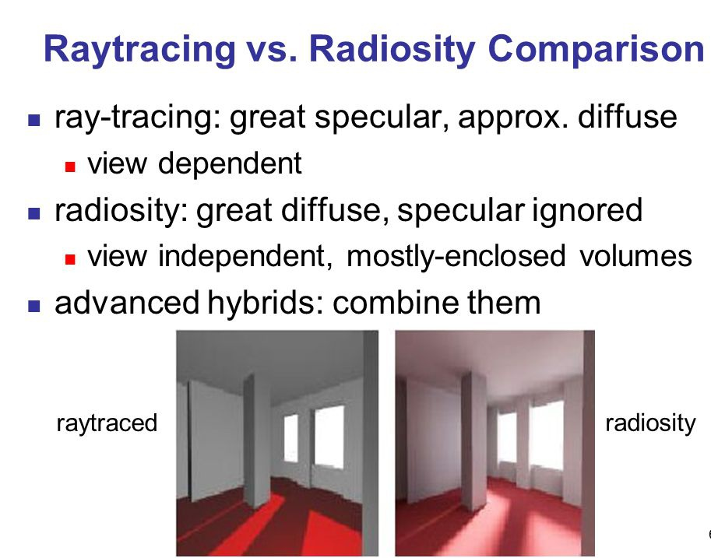
Radiosity vs other methods

Slide 19
Questions?

