Slide 1
Aliasing in C++

Slide 2
What is it?
Aliasing is when two or more pointers (references also) point to the same location in memory. Global variables and class members could make it worse (implicit aliasing through this pointer).
Note that aliasing is not strictly about concurrency or synchronization but more about hidden dependencies in the code and data.
Impacts correctness and performance of code.

Slide 3
Optimization problems
When compilers are unable to deduce that two pointers cannot alias each other, they must conservatively assume aliasing is present.
This assumption can impede certain optimizations such as leaving unnecessary memory load/store instructions even in optimized builds.
These memory instructions futher hinder instructions reordering, loop unrolling, CSE and stalling.

Slide 4
Examples (1/4)
int n = 42;
int* p1 = &n;
int* p2 = &n;
Here two pointers point to the same memory location designated by n, so they are said to alias each other. Also same with references.

Slide 5
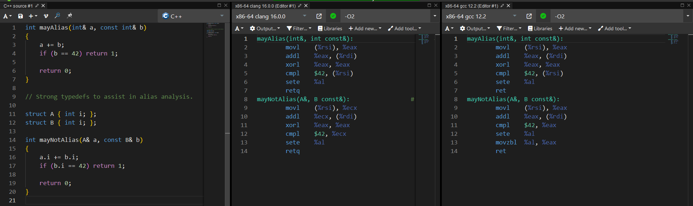
Examples (2/4)
Note how const does not affect the aliasing.
https://godbolt.org/z/qxM7vb1GM

Slide 6
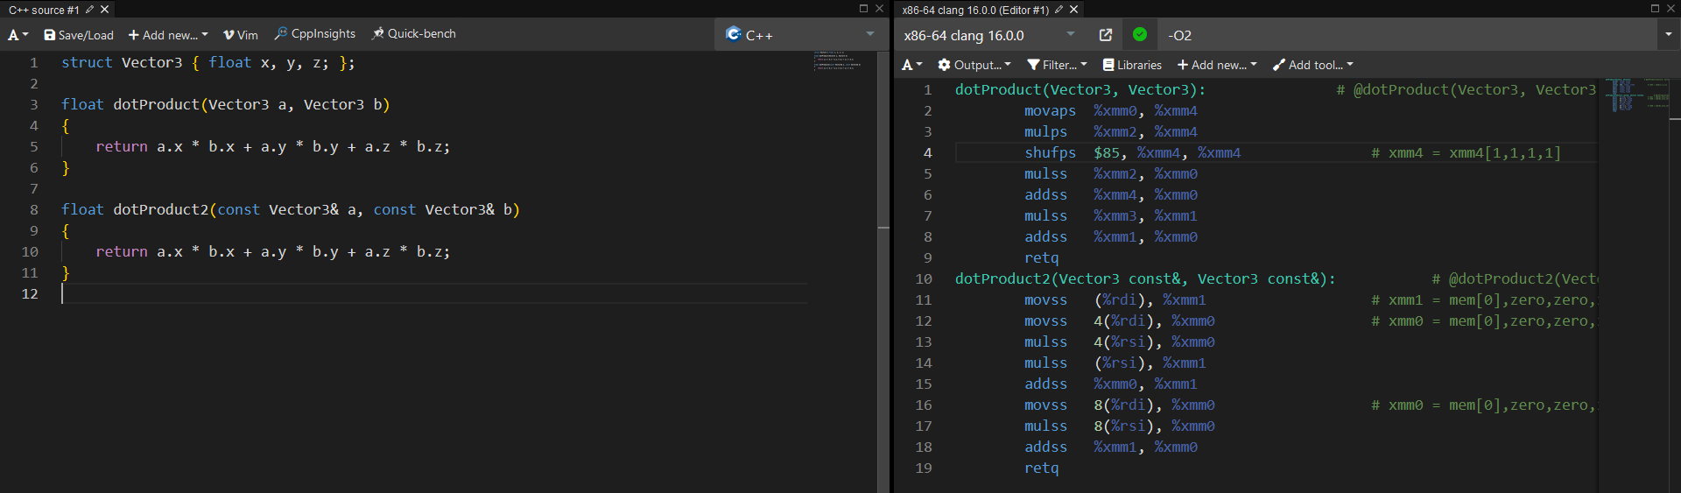
Examples (3/4)
Consider passing by value more often.
https://godbolt.org/z/MvKMWbWbo

Slide 7
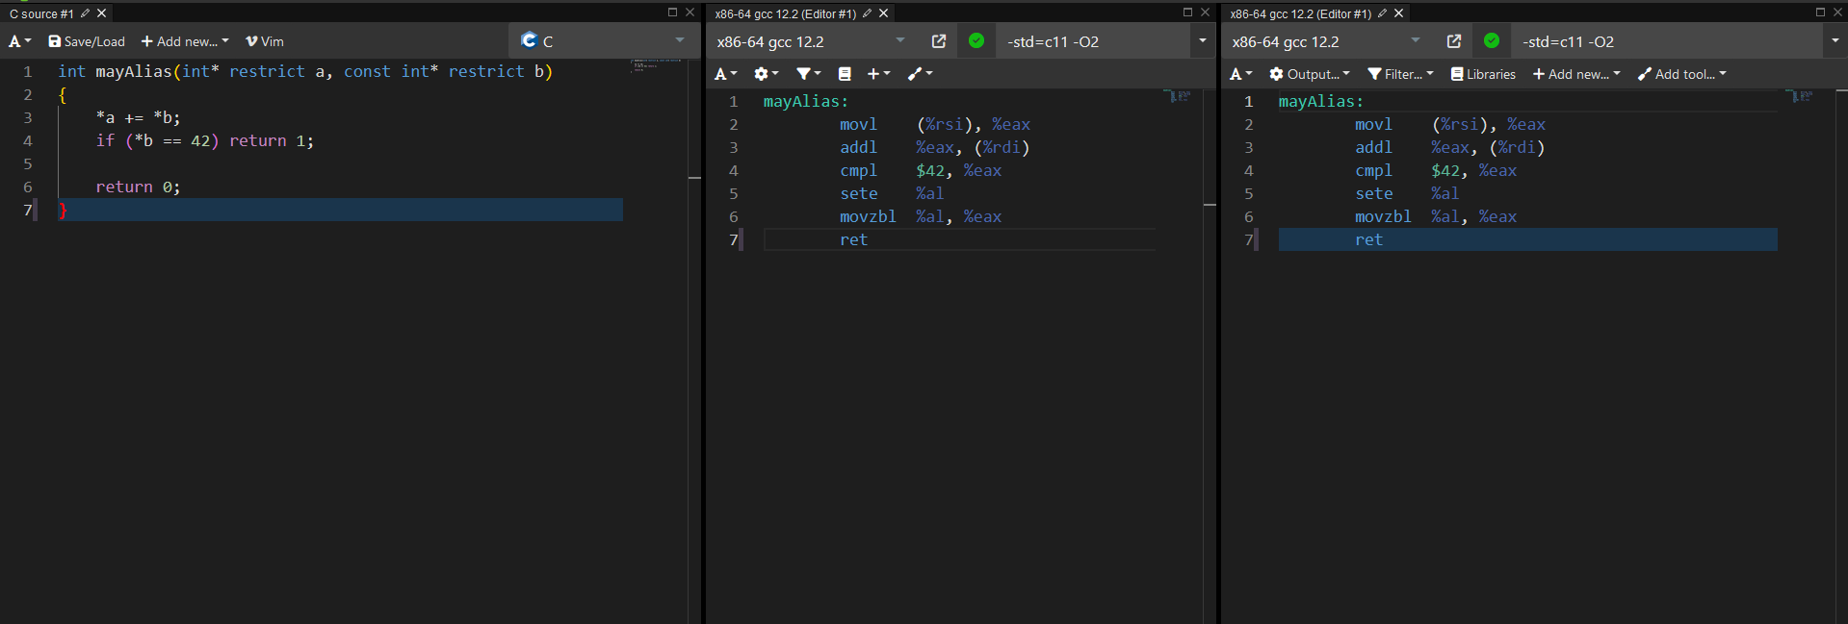
Examples (4/4)
C spec defines restrict to help with aliasing – a promise to the compiler that the pointee will only be accessed through the restricted pointer. (Not standardized in C++)
https://godbolt.org/z/7eoMv969h

Slide 8
Advice on reducing aliasing
Minimize use of globals, pointers and references (prefer value semantics if possible).
Try to inline small functions taking pointers and references.
Cache globals into locals.
Avoid taking addresses of objects to avoid aliasing completely if you can.
Remember that const does not eliminate aliasing problem.
When in C, be careful with using restrict. Inspect the output of the compiler.

Slide 9
Questions?

