Slide 1
Introduction to predicate transformer semantics or crash course to Floyd–Hoare logic

Slide 2
Definitions
State is a function from a set of predicates to the set of boolean values true and false.
Hoare triple {Q} S {R}, where Q is the precondition and R is the postcondition for command or program segment S.
Precondition (Q) a predicate which should be true for the input of the program segment.
Postcondition (R) a predicate which should be true for the result of the program segment.
Wp(S, R) a weakest precondition that represents the set of all states such that execution of program S begun in any one is guaranteed to terminate in state satisfying postcondition R in a finite time.
(Class/Loop) Invariant (P) predicate which should be maintained in between pre- and postconditions of a method/function.
Variant a function which should decrease between each iteration of a loop aka upper bound of a computation. (Used together with the loop invariant).
Notice how some of these definitions tie into the contracts discussion in C++.

Slide 3
Why try to prove correctness?
“Program testing can be used to show the presence of bugs, but never to show their absence” - Dijkstra.
The correctness of a program can be proved in any well-defined state where given conditions apply.
These conditions or predicates are the specified pre- and postconditions of a given program segment satisfied by the state of the program.
Other secondary predicates like invariant and variant or bound functions are also used in conjuction to assert the postcondition.

Slide 4
Tools of the trade
Assumes knowledge about manipulating boolean expressions for simpler but equivalent predicates aka predicate calculus.
De Morgan’s laws, law of implications etc.
Also could use inference rules by Hoare, but not investigated here.
Assumes single threaded data model – for concurrency an extended model is used, but not explored here (in next lecture).

Slide 5
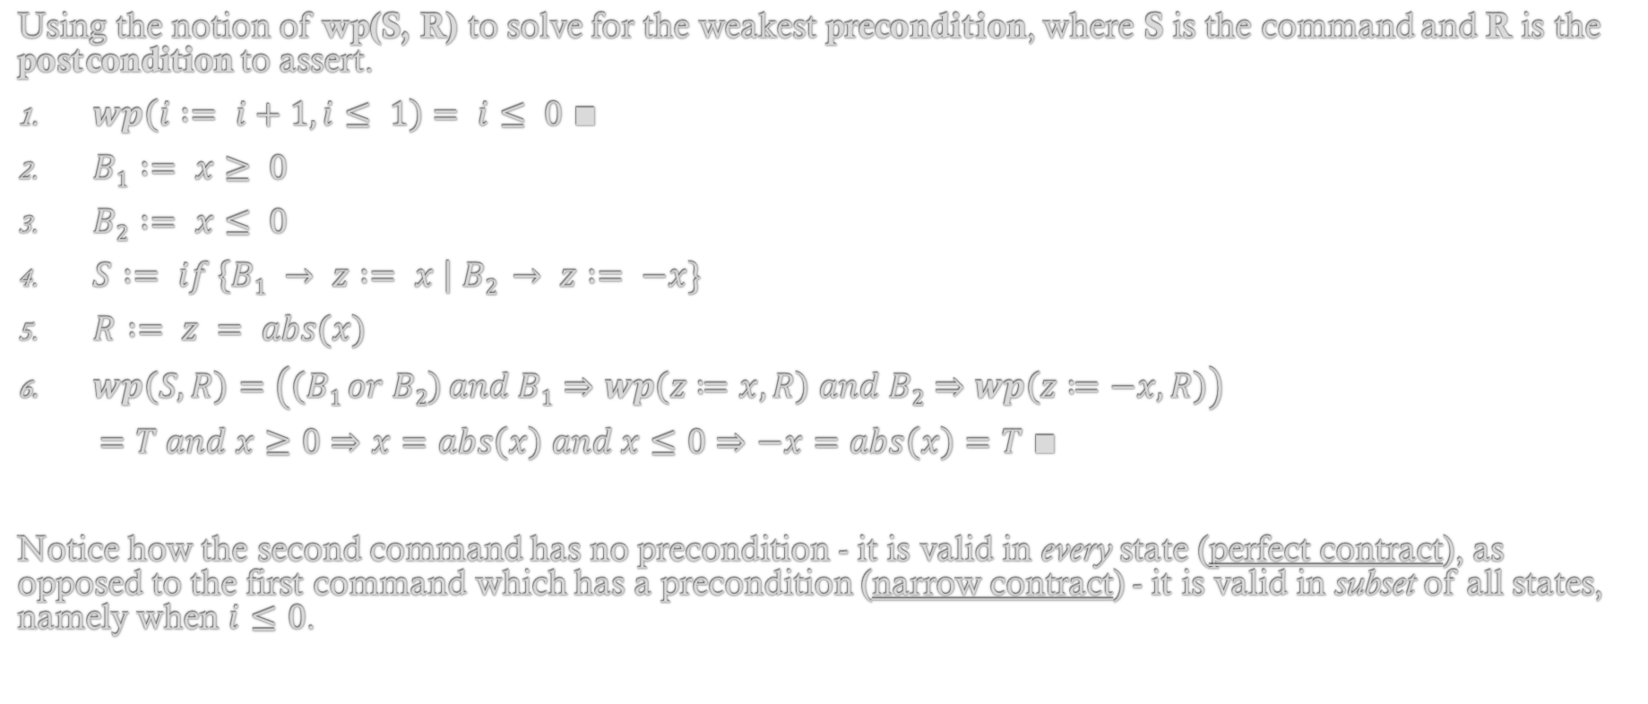
Guarded commands by Dijkstra (1/2) Assignment and alternative
Using the notion of wp(S, R) to solve for the weakest precondition, where S is the command and R is the postcondition to assert.
$wp\left(i := i+1, i≤ 1\right)= i≤ 0 ∎$
$B1 := x≥ 0$
$B2 := x≤ 0$
$S := if \left\{B1 → z := x \right| B2 → z := −x\}$
$R := z = abs(x)$
$wp\left(S, R\right)=\left(\left(B1 or B2\right) and B1⇒wp\left(z≔x, R\right) and B2⇒wp\left(z≔−x,R\right)\right)$
$=T and x≥0⇒x=abs\left(x\right) and x≤0⇒−x=abs\left(x\right)=T ∎$
Notice how the second command has no precondition - it is valid in every state (perfect contract), as opposed to the first command which has a precondition (narrow contract) - it is valid in subset of all states, namely when $i≤0$.

Slide 6
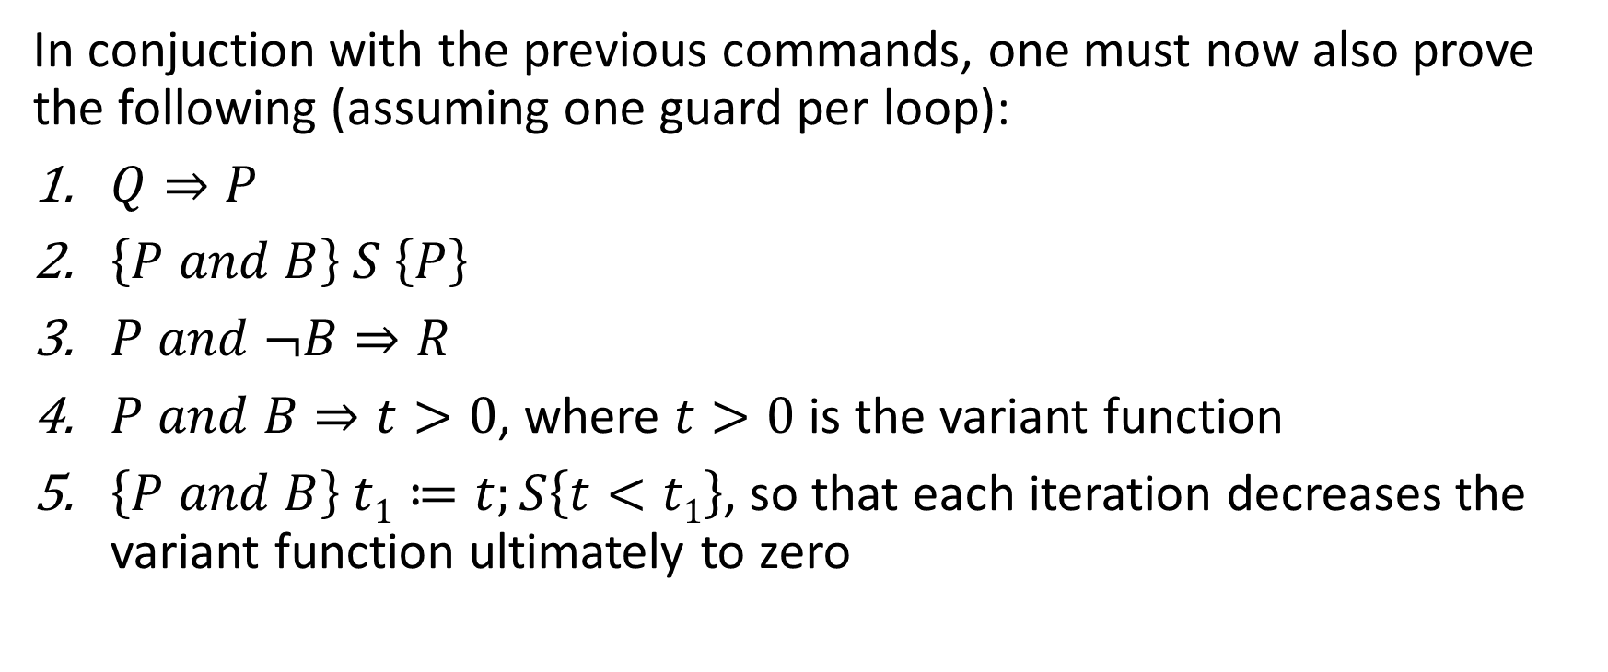
Guarded commands by Dijkstra (2/2) Iterative command (Composition left as an exercise)
In conjuction with the previous commands, one must now also prove the following (assuming one guard per loop):
$Q⇒P$
$\left\{P and B\right\} S \left\{P\right\}$
$P and ¬B⇒R$
$P and B⇒t>0$, where $t>0$ is the variant function
$\left\{P and B\right\} t1≔t;S\left\{t<t1\right\}$, so that each iteration decreases the variant function ultimately to zero

Slide 7
Questions?

