Slide 1
Projection matrix

Slide 2
Background
One of many stages in the graphics pipeline.
Used commonly in 3d computer graphics.
Many different types of projections exist, like orthogonal, oblique etc.
Here we focus only on the perspective one for perspective 3d rendering.

Slide 3
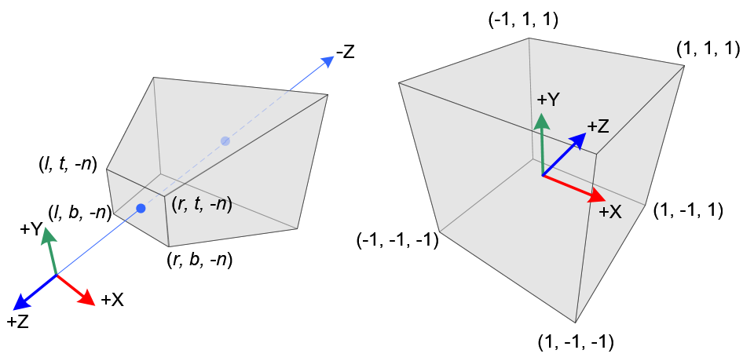
View and NDC spaces
Using the right-handed coordinate system on the left representing the view frustum that the camera sees from its point of origin in (0, 0, 0).
Defined by six planes: near, far, left, right, top and bottom for the view space.
Using the left-handed coordinate system on the right representing the transformed post-projection space (NDC, for normalized device-coordinates) where view frustum extentes are mapped to [-1,1] range to map then to viewport later.
Notice that before the NDC space the graphics pipeline needs to do clipping to make sure everything visible is inside [-1,1]

Slide 4

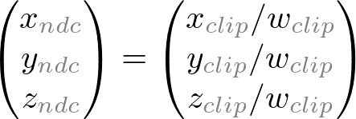
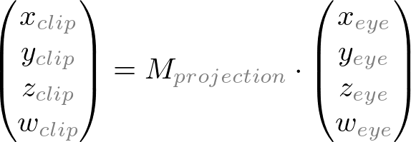
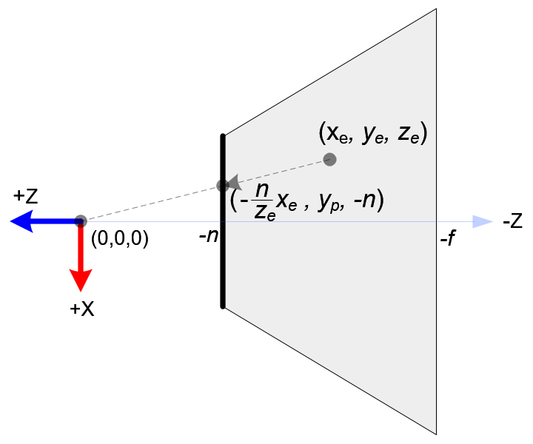
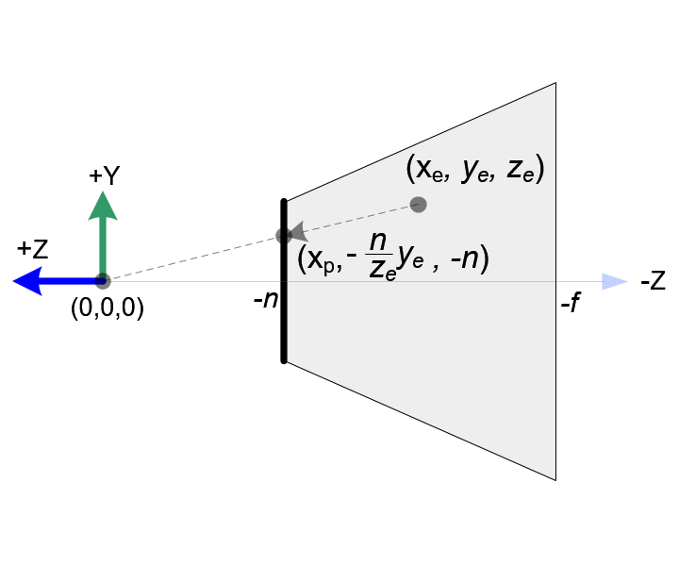
Perspective projection (1/4)
In OpenGL, a 3D point in eye space is projected onto the near plane (projection plane). The following diagrams show how a point (x_{e}, y_{e}, z_{e}) in eye space is projected to (x_{p}, y_{p}, z_{p}) on the near plane.
Note that both x_{p} and y_{p} depend on z_{e}; they are inversely proportional to -z_{e}. In other words, they are both divided by -z_{e}. This causes the perspective foreshortening.

Slide 5
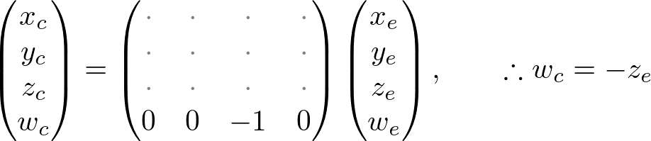
Perspective projection (2/4)
For constructing a perspective matrix for OpenGL, we first start by looking at the bottom for the homogeneous coordinate.
Therefore, we can set the w-component of the clip coordinates as -z_{e}. So, the 4th row of GL_PROJECTION matrix becomes (0, 0, -1, 0).

Slide 6
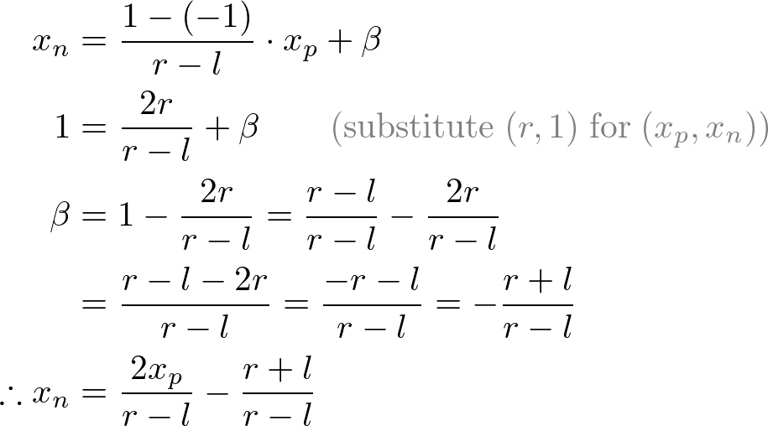
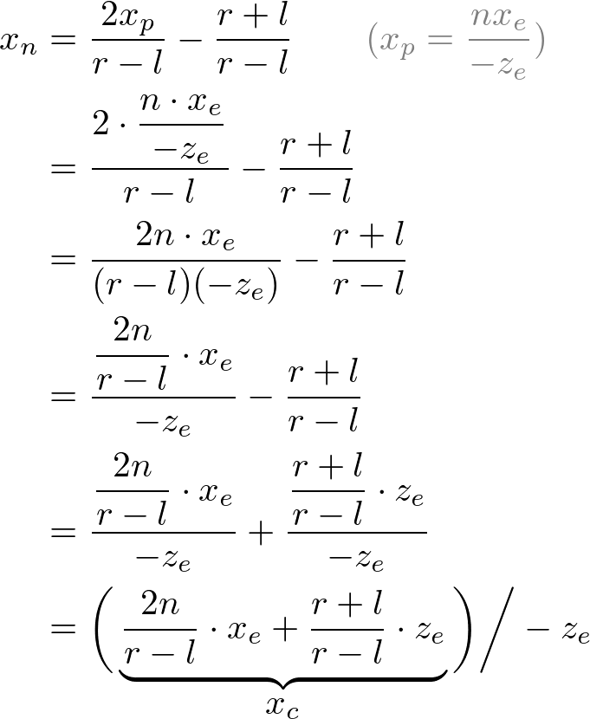
Perspective projection (3/4)
Next, we map x_{p} and y_{p} to x_{n} and y_{n} of NDC with linear relationship; [l, r] ⇒ [-1, 1] and [b, t] ⇒ [-1, 1].
Substitute x_{p} and y_{p} into the above equations.
Similar derivation for y_{n}.

Slide 7
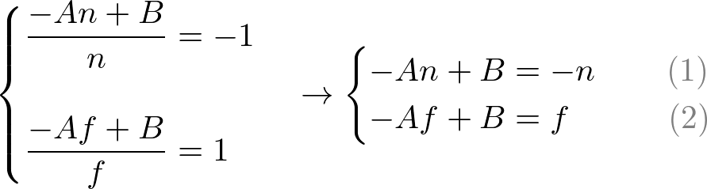
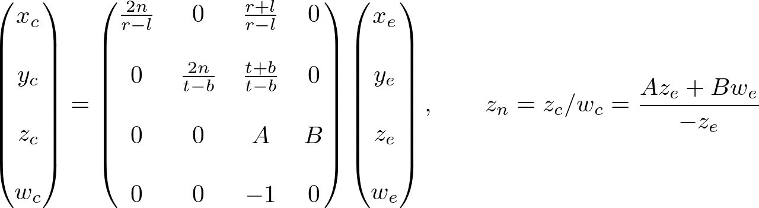
Perspective projection (4/4)
For z, the derivation is bit more involved:
Need to solve unknowns A and B.
To find the coefficients, A and B, we use the (z_{e}, z_{n}) relation; (-n, -1) and (-f, 1), and put them into the equations: (1, 2)
Two equations in two unknowns – easy to solve.

Slide 8
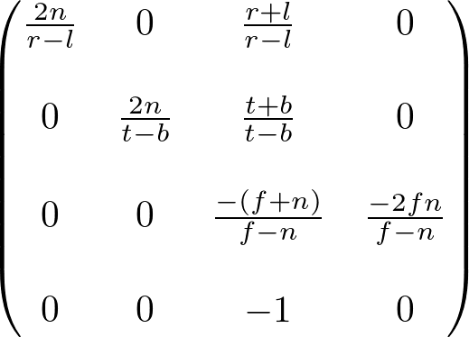
General projection matrix
Collecting all the terms from previous slides, we get the general projection matrix shown here, where again: near, far, left, right, top and bottom are: n, f, l, r, t, b respectively.

Slide 9
Questions?

