Slide 1
Representing integer signedness in C++

Slide 2
Representations
Two common representations exist
Signed (Two’s complement – other representations available but not discussed further) for positive and negative values
Unsigned for positive values

Slide 3
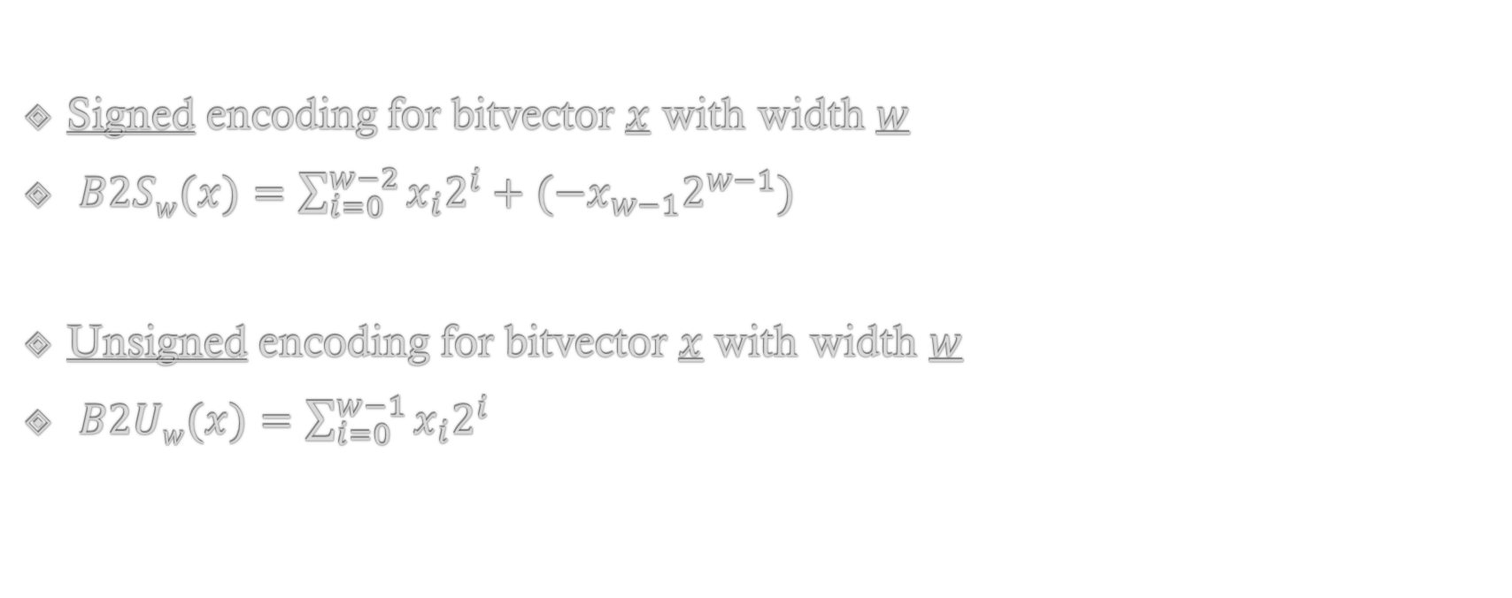
Encoding definitions
Signed encoding for bitvector $x$ with width $w$
$B2Sw{(x)}=\sum_{i=0}^{w−2}{x_{i}2^{i}}+({−x}_{w−1}2^{w−1})$
Unsigned encoding for bitvector $x$ with width $w$
$B2Uw{(x)}=\sum_{i=0}^{w−1}{x_{i}2^{i}}$

Slide 4
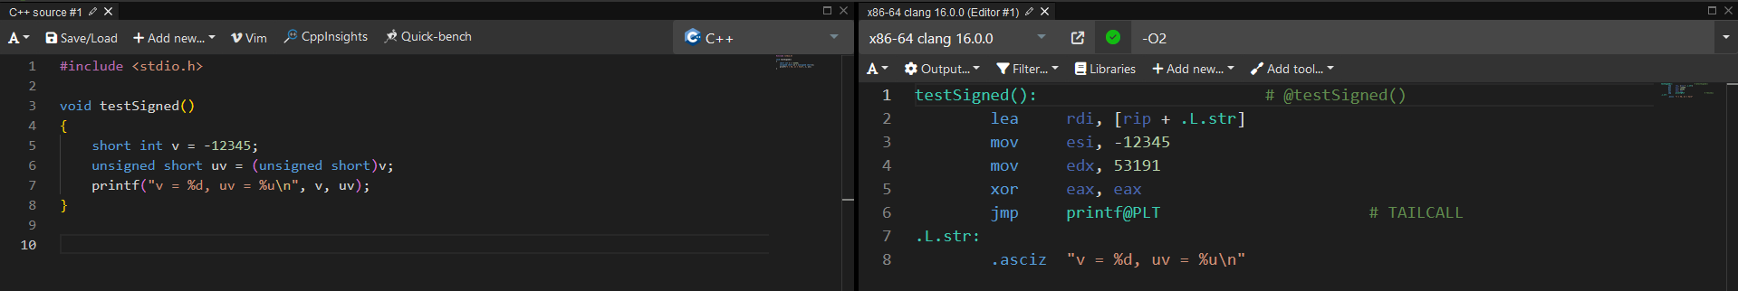
Trivia
https://godbolt.org/z/h3qPdYPEz

Slide 5
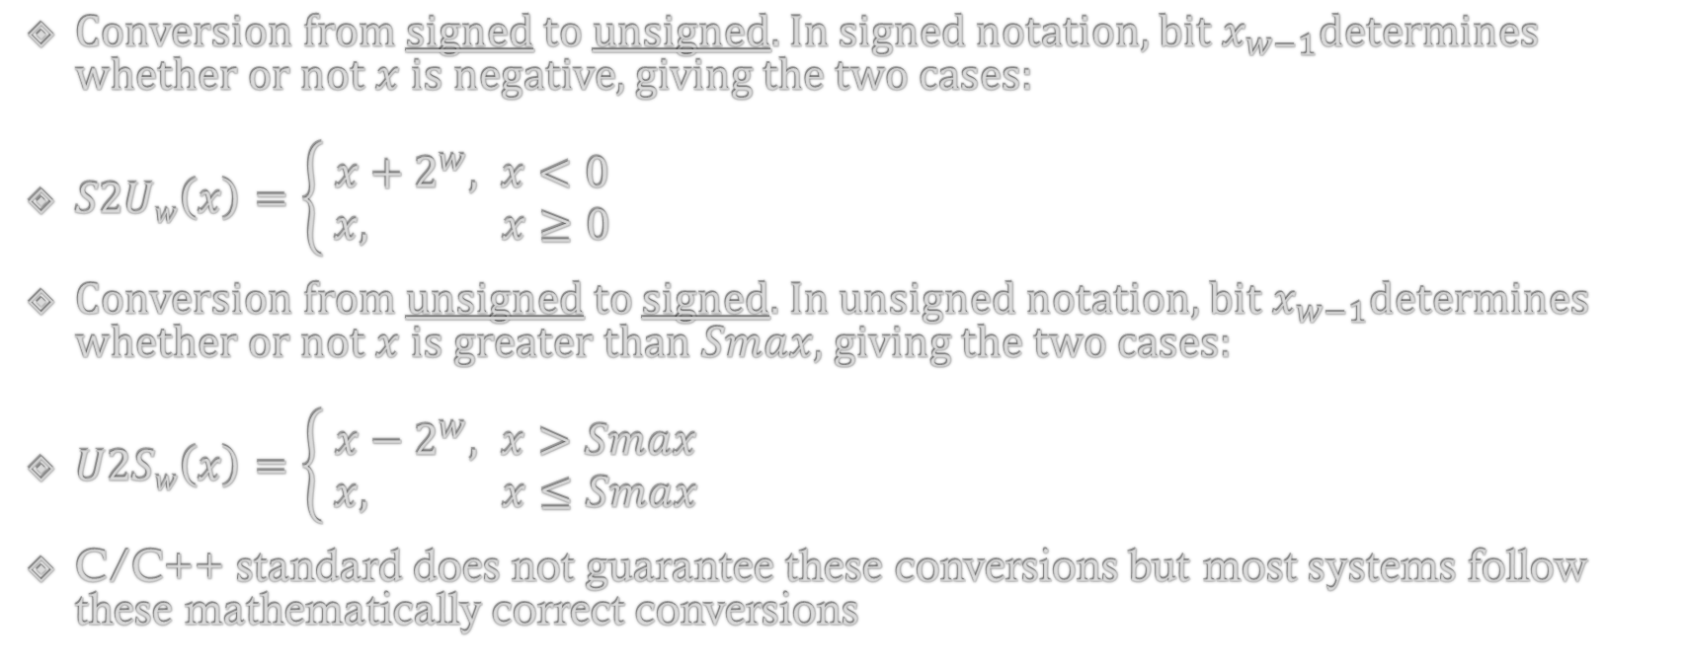
Conversions between representations (1/3)
Conversion from signed to unsigned. In signed notation, bit $x_{w−1}$determines whether or not $x$is negative, giving the two cases:
$S2Uw\left(x\right)=\left\{ \begin{aligned}x+2^{w}, x<0 \\ &x, x≥0\end{aligned}\right.$
Conversion from unsigned to signed. In unsigned notation, bit $x_{w−1}$determines whether or not $x$ is greater than $Smax$, giving the two cases:
$U2Sw\left(x\right)=\left\{\begin{aligned} x−2^{w}, x>Smax \\ x, x≤Smax\end{aligned}\right.$
C/C++ standard does not guarantee these conversions but most systems follow these mathematically correct conversions

Slide 6
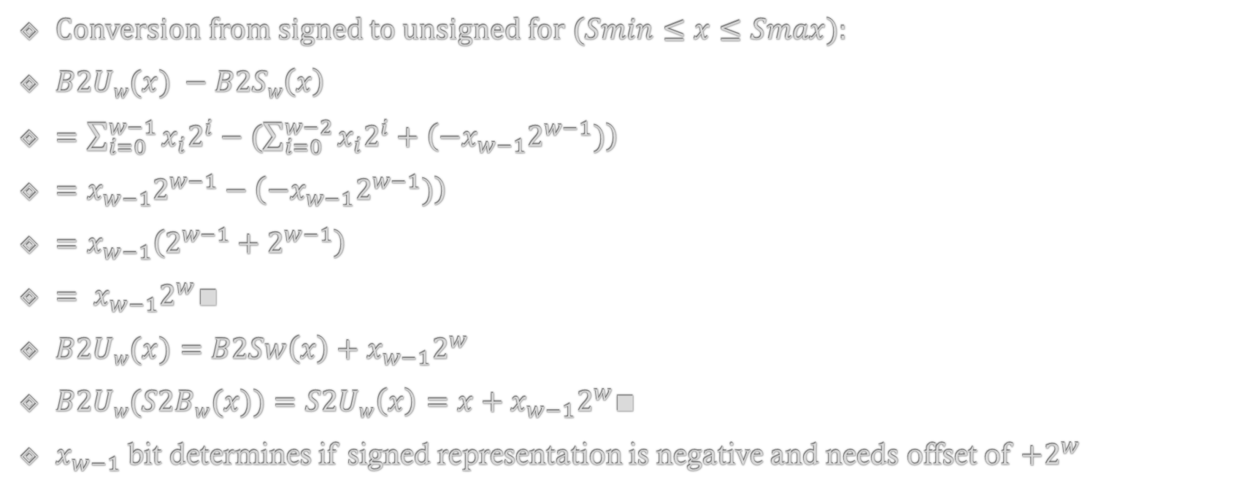
Conversions between representations (2/3)*
Conversion from signed to unsigned for $(Smin≤x≤Smax)$:
$B2Uw{(x)} −B2Sw\left(x\right)$
$=\sum_{i=0}^{w−1}{x_{i}2^{i}}−(\sum_{i=0}^{w−2}{x_{i}2^{i}}+\left({−x}_{w−1}2^{w−1})\right)$
$=x_{w−1}2^{w−1}−\left({−x}_{w−1}2^{w−1})\right)$
$=x_{w−1}\left(2^{w−1}+2^{w−1}\right)$
$= x_{w−1}2^{w}∎$
$B2Uw{(x)}=B2Sw\left(x\right)+x_{w−1}2^{w}$
$B2Uw{(S2Bw(x))}=S2Uw\left(x\right)=x+x_{w−1}2^{w}∎$
$x_{w−1}$ bit determines if signed representation is negative and needs offset of ${+2}^{w}$

Slide 7
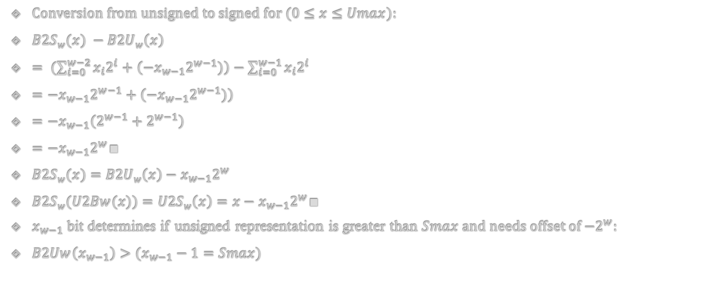
Conversions between representations (3/3)*
Conversion from unsigned to signed for $(0≤x≤Umax)$:
$B2Sw{(x)} −B2Uw\left(x\right)$
$= (\sum_{i=0}^{w−2}{x_{i}2^{i}}+\left({−x}_{w−1}2^{w−1})\right)−\sum_{i=0}^{w−1}{x_{i}2^{i}}$
$={−x}_{w−1}2^{w−1}+\left({−x}_{w−1}2^{w−1})\right)$
$={−x}_{w−1}\left(2^{w−1}+2^{w−1}\right)$
$={−x}_{w−1}2^{w}∎$
$B2Sw{(x)}=B2Uw\left(x\right)−x_{w−1}2^{w}$
$B2Sw{(U2Bw(x))}=U2Sw\left(x\right)=x−x_{w−1}2^{w}∎$
$x_{w−1}$ bit determines if unsigned representation is greater than $Smax$ and needs offset of ${−2}^{w}$:
$B2Uw\left(x_{w−1}\right)>(x_{w−1}−1=Smax)$

Slide 8
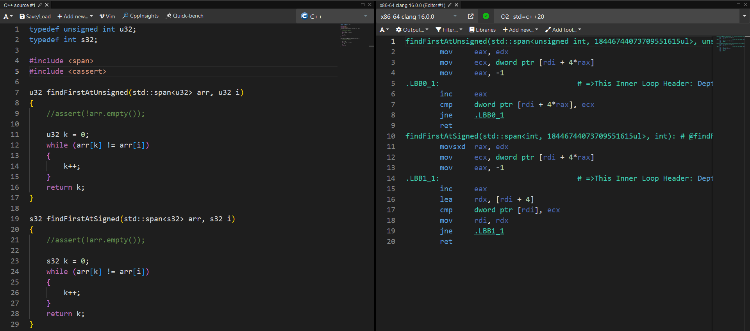
Examples (1/2)
https://godbolt.org/z/G4P3e673q

Slide 9
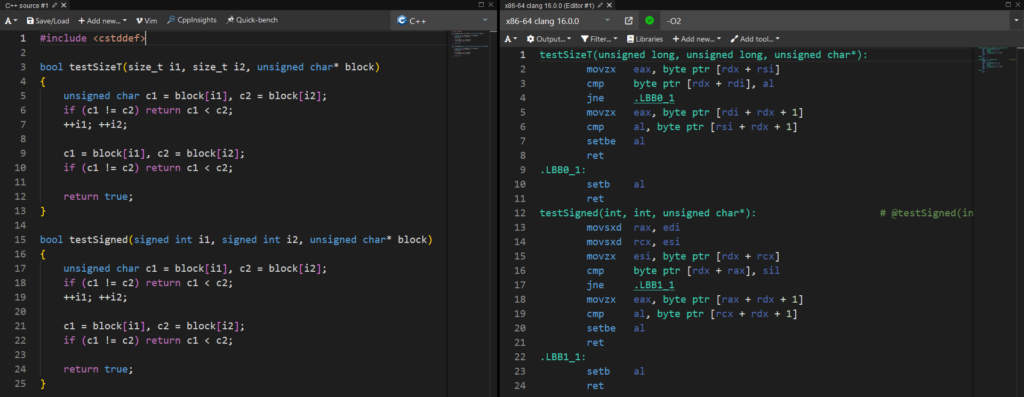
Examples (2/2)
https://godbolt.org/z/4jcG9aex6
Code taken from: https://www.youtube.com/watch?v=yG1OZ69H_-o

Slide 10
Advice on which representation to use
See for favoring unsigned:
https://www.youtube.com/watch?v=Fa8qcOd18Hc
https://graphitemaster.github.io/aau/
See also a bit outdated for favoring signed: https://www.youtube.com/watch?v=yG1OZ69H_-o

Slide 11
Not covered explicitly
Implicit conversions (Cppreference or any textbook should cover this in detail)
Truncations (Same as above)
Sign extensions (Same as above)
Arithmetic (Same as above)
Over- and underflows (Same as above. Always defined for unsigned but not for signed, as a result of this unsigned over- and underflows are always easier to test and detect)
All of these are based on the fundamental bit representations covered previously

Slide 12
Questions?

