Slide 1
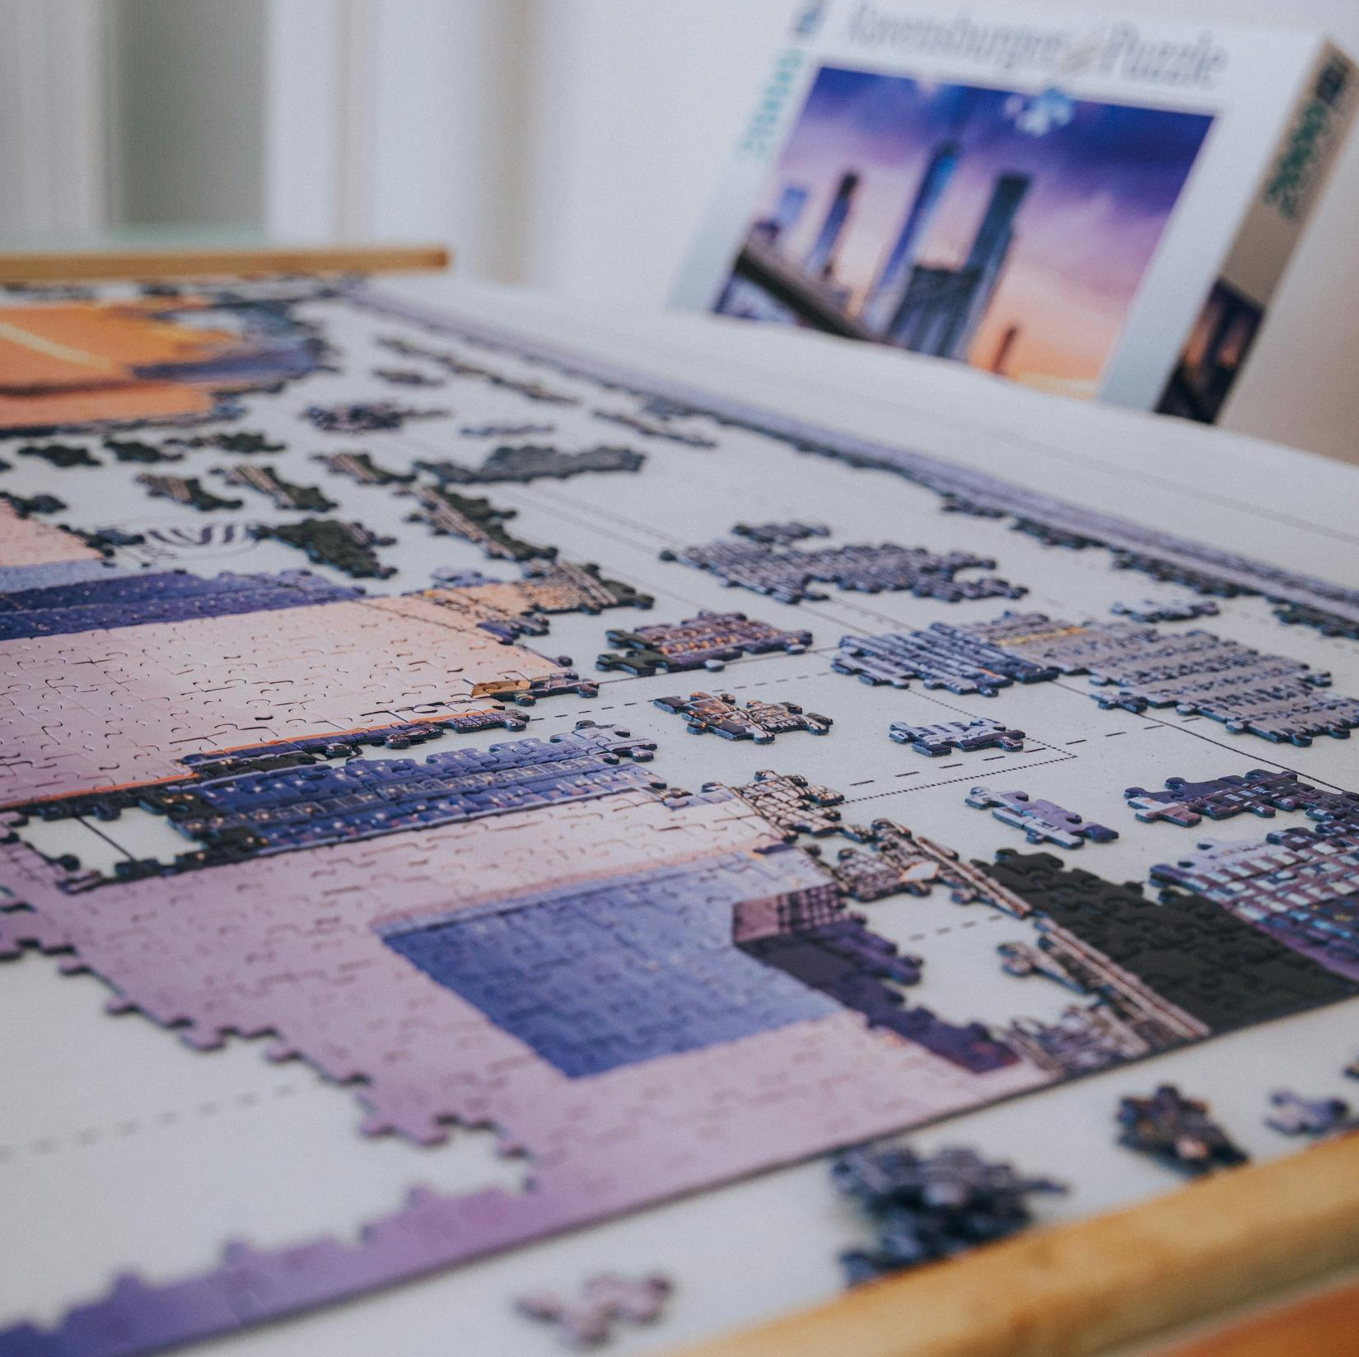
Modelling Study
Master of Applied IT

Slide 2


What is modelling?
Notes:
Photo by GALINA BOGDANOVA on Unsplash

Slide 3




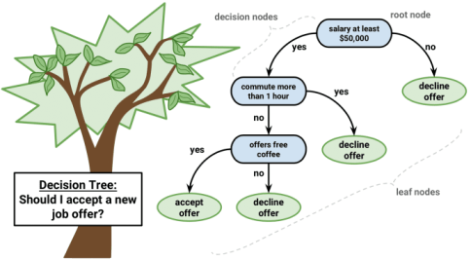
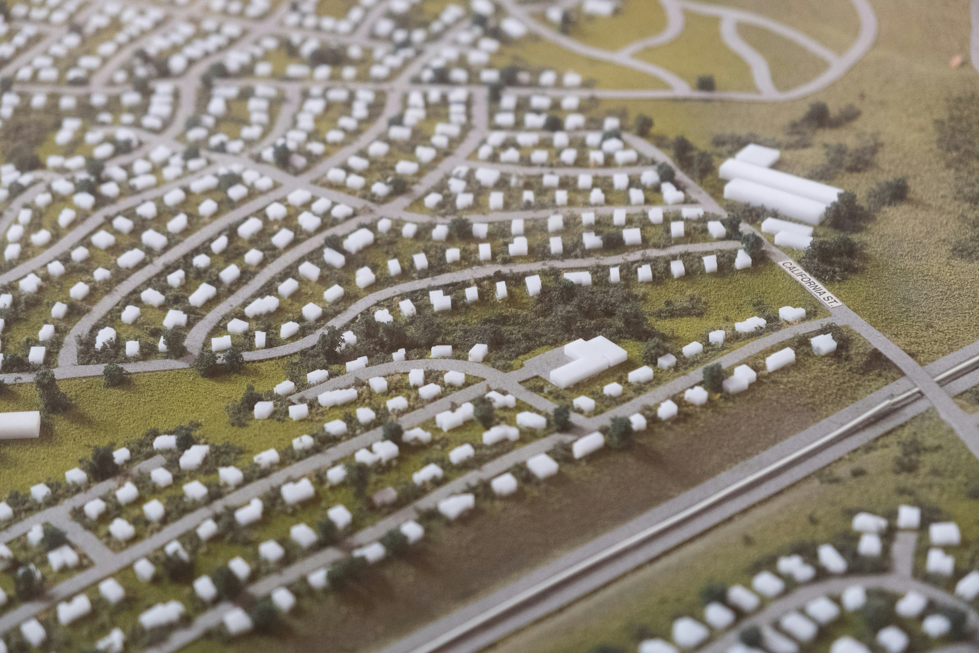
What is modelling?
Notes:
Photo by GALINA BOGDANOVA on Unsplash
Photo by Stock Birken on Unsplash
Photo by ANOOF C on Unsplash
Photo by Charlie Deets on Unsplash

Slide 4

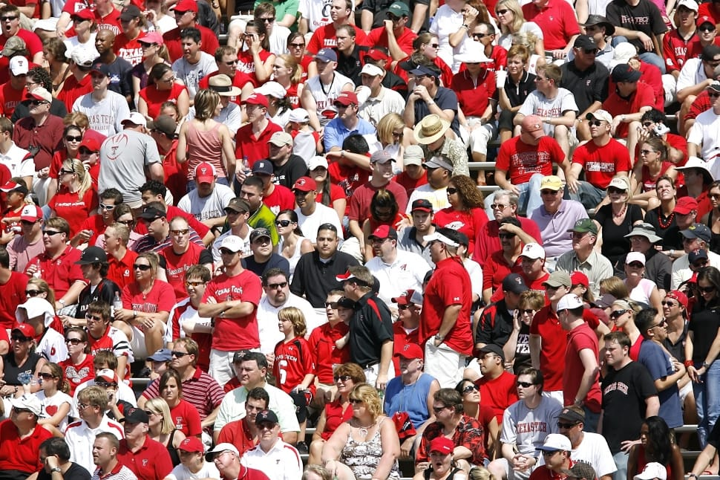
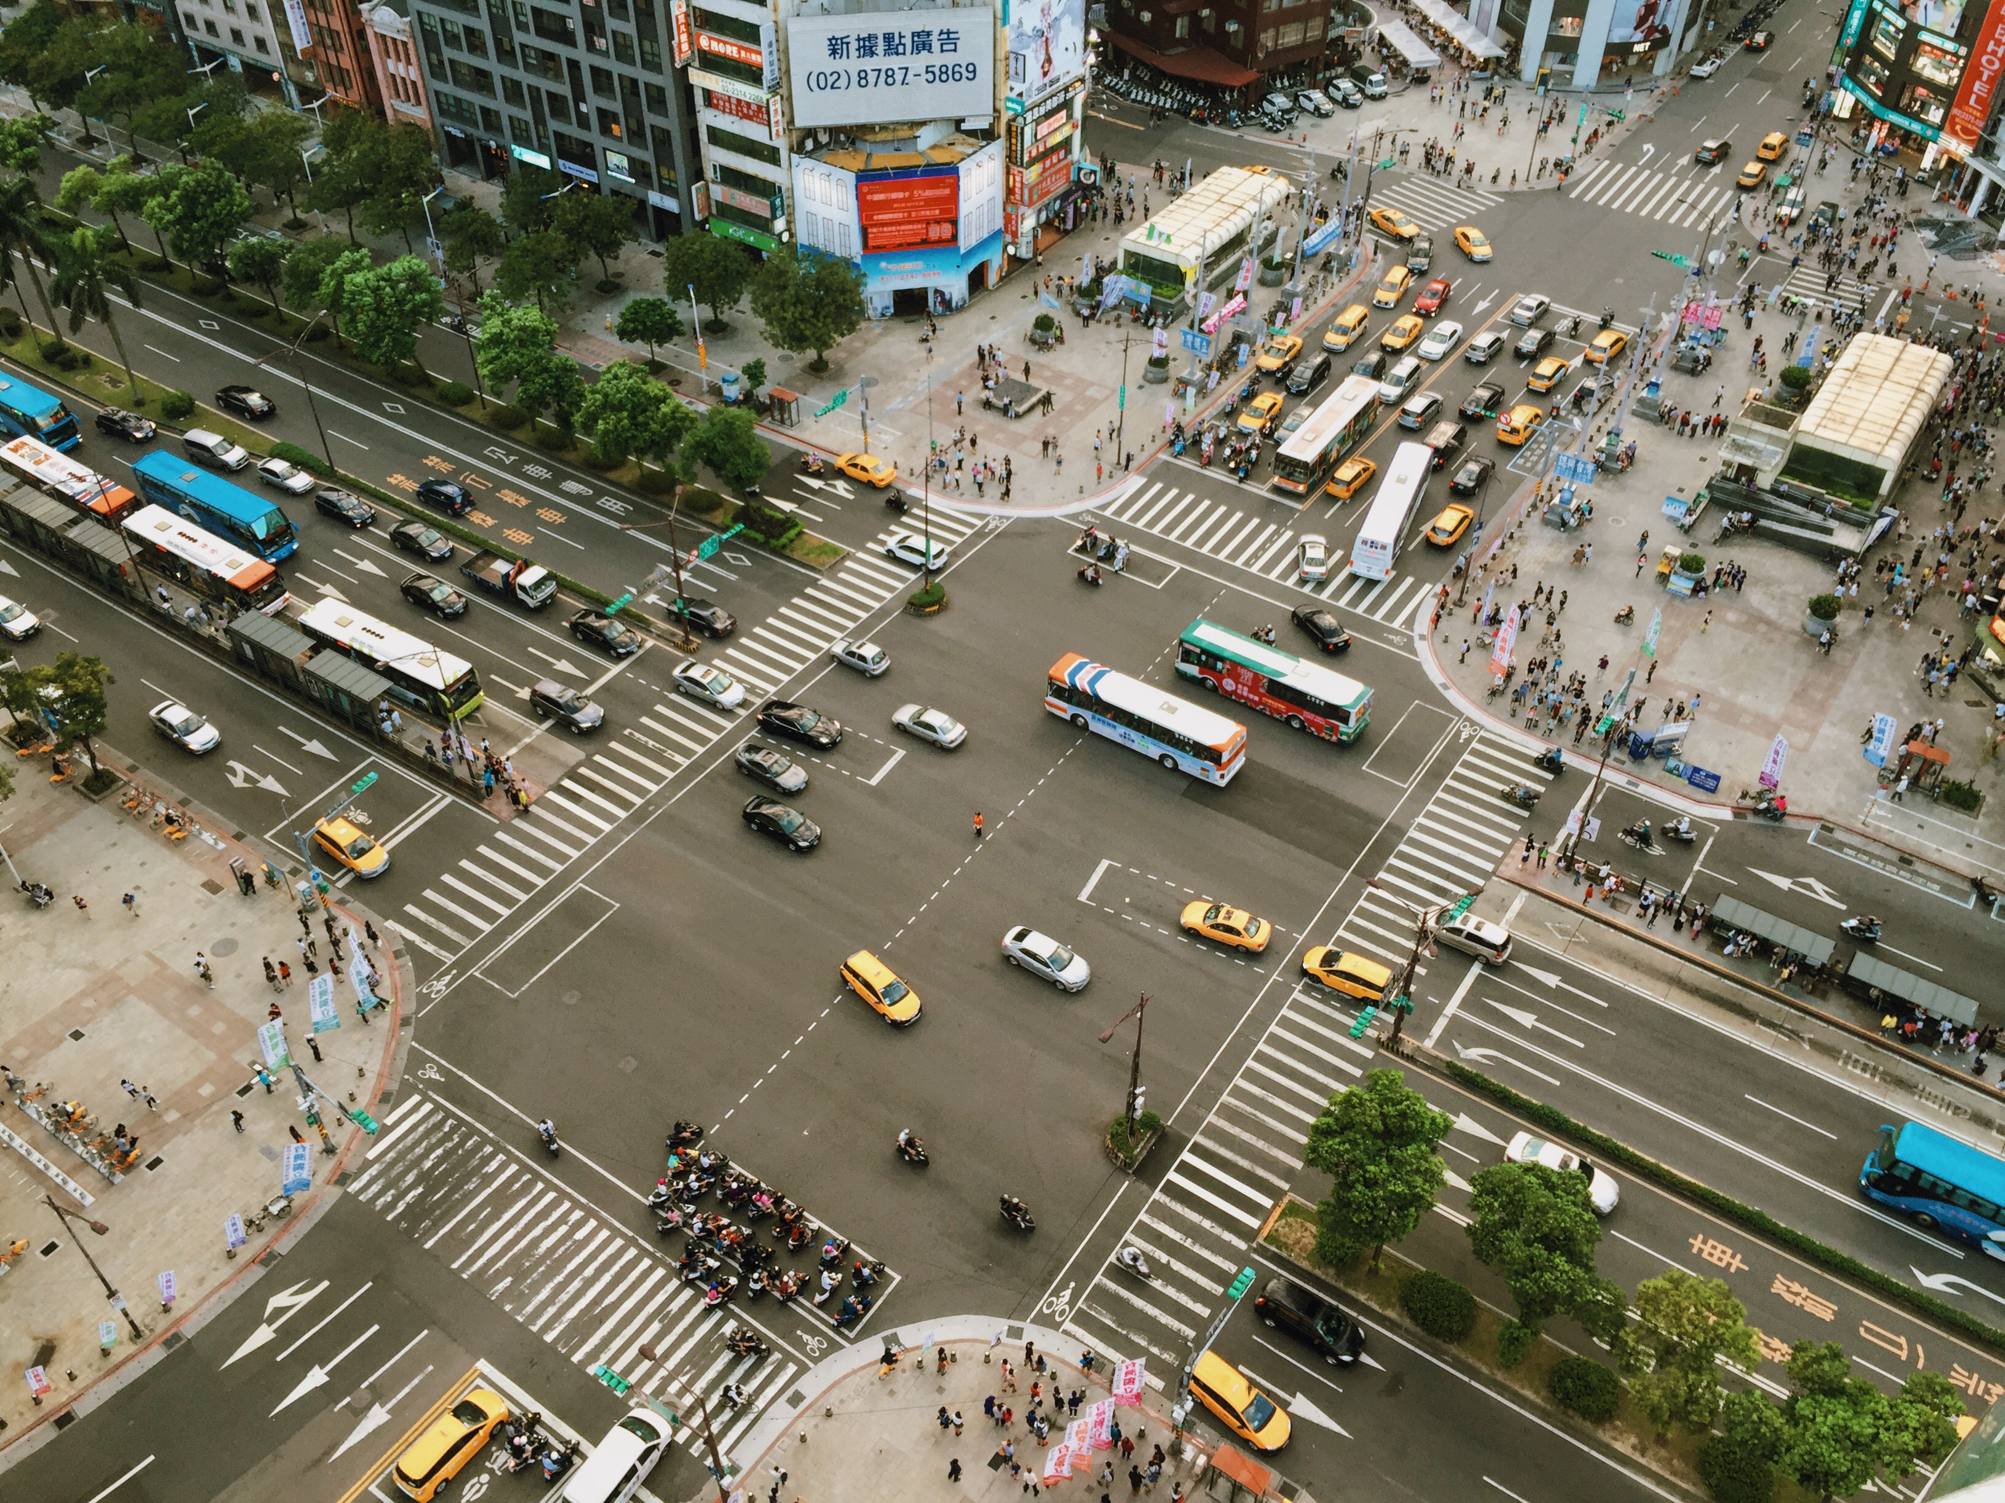
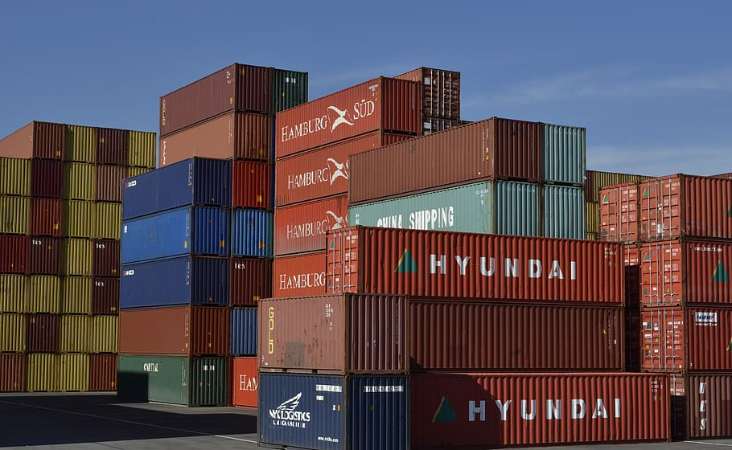
What is modelling and why is it relevant ?
Model = schematic representation of complex real-world systems
Like assembly lines, city traffic, ecological networks, financial markets etc. etc.
Why? way to understand, predict, simulate, optimize without high costs or consequences
Modelling is in every IT application domain!
Notes:
Modelling helps us understand, predict, and optimize complex systems without costly or risky real-world experiments
In Applied IT, typical uses include:
Capacity planning (servers, helpdesks, CI/CD pipelines) – for example How many agents do we need to meet SLA?
Process optimization (workflows, logistics, service systems) – like What is the probability we finish by the deadline?
Risk and uncertainty analysis (project schedules, costs, reliability
Design of policies (traffic, urban systems, environmental interventions) - How do signal timings affect delays?
…

Slide 5
Modelling Study (weeks 4-6) - Goals
Get familiar with common modelling techniques and their use in practice – also be able to distinguish different techniques by the kind of questions and settings they fit
Get familiar with key modelling concepts : purpose, I/O, assumptions, time, space, uncertainty, level of detail
Understand and apply the modelling cycle to a simple system
Build some coding and presentation skills
Get inspired for your own projects

Slide 6
Modelling Study (weeks 4-6) – Your Challenge
Build a small computational model of any real-life system/process of your choice, for a goal/question of your choice
create a proof-of-concept (PoC) demo model implementation
experiment with it to get results related to your goal
Interpret the results into answers about the original system
Describe your modelling study in a concise form, as a research poster
Deliverables: poster + demo -> SHOWTIME Tuesday in week 7 !
LO: Design
LO: Realise
LO: Analysis
LO: Advise
LO: PS, PD

Slide 7
WS1 – Modelling Cycle and modelling techniques

Slide 8
The Modelling Cycle
Real-World Complex System
A busy intersection
Model
I/O Parameters
Black / Grey / White Box process
Goals, Questions
How slow is this intersection? What can be done to improve it?
Analysis / Experiments
Answers
Results

Slide 9
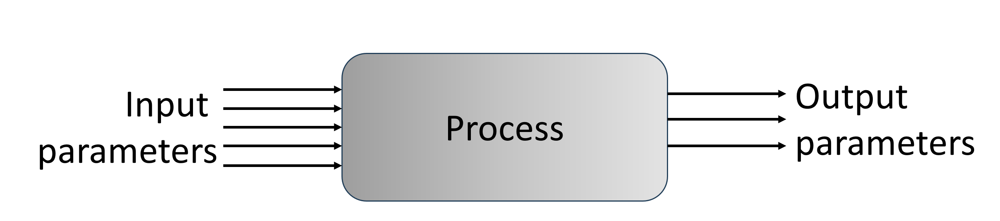
The Modelling Cycle
Real-World Complex System
A busy intersection
Model
Goals, Questions
How slow is this intersection? What can be done to improve it?
Analysis / Experiments
Change the green light time, measure car pass time
Answers
It is 3 minutes slow ..
30 seconds on green is optimal …
Results
Average pass time, optimal green light time

Slide 10
Essential concepts – Modelling Purpose
Improve, Optimize
Describe, explain
Decide, Predict
Notes:
To create a useful model, several essential aspects need to be considered:
Purpose – what is the model for, which type of question?
Inputs: parameters, settings, controls, initial conditions – which are controlable, which are uncertain (like weather..)
Outputs: KPIs, metrics, patterns, distributions, optimal solutions
Process: how much do we know and how much is relevant to model
Time/Space: no time, discrete, continous?

Slide 11
Essential concepts – Inputs, Outputs, Uncertainty
Process
Input
parameters
Output
parameters
“what we control”
Settings
Independent variables
Features
…
“what we observe”
KPI’s
Dependent variables
Target variables
…
Sometimes partial control – uncertainty!
Notes:
To create a useful model, several essential aspects need to be considered:
Purpose – what is the model for, which type of question?
Inputs: parameters, settings, controls, initial conditions – which are controlable, which are uncertain (like weather..)
Outputs: KPIs, metrics, patterns, distributions, optimal solutions
Process: how much do we know and how much is relevant to model
Time/Space: no time, discrete, continous?

Slide 12
Essential concepts – Level of Detail
A model is never complete. So what do we include and what do we leave out? → make explicit assumptions
Process
Input
parameters
Output
parameters
Black / Grey / White Box
depending on how much
of the internal logic is known and relevant for the goal
Time : no, discrete, continuous
Space: no, discrete, continuous
Notes:
To create a useful model, several essential aspects need to be considered:
Purpose – what is the model for, which type of question?
Assumptions
Inputs: parameters, settings, controls, initial conditions – which are controlable, which are uncertain (like weather..)
Outputs: KPIs, metrics, patterns, distributions, optimal solutions
Process: how much do we know and how much is relevant to model
Time/Space: no time, discrete, continous?

Slide 13
Observational models are straightforward
Q: Effect of caffeine on reaction speed?
Black Box model – we do not model the process at all, only look at I/O
Caffeine intake
(0 / 1)
Reaction speed
(cm on the falling ruler)
Experiment: measure reaction speed under the two conditions
Result: (probably) there is a difference
How do we interpret this result?
Is it a reliable result?
Validation: is it significant?
Notes:
This is the simplest way to learn from a system behaviour – no internal process model, just I and O
Suitable for comparing conditions and finding patterns in data from the real system.
We treat the system as a black box: we measure some input (or condition) and some output, and analyse whether I and O are related.
Or whether the output is different for different input conditions.
Assumptions:
The measured variables capture what matters
Other factors are either controlled or random enough to not produce bias
Time/space: usually not explicit
Uncertainty: handled via statistics (variation between measurements, confidence intervals, p-values).

Slide 14
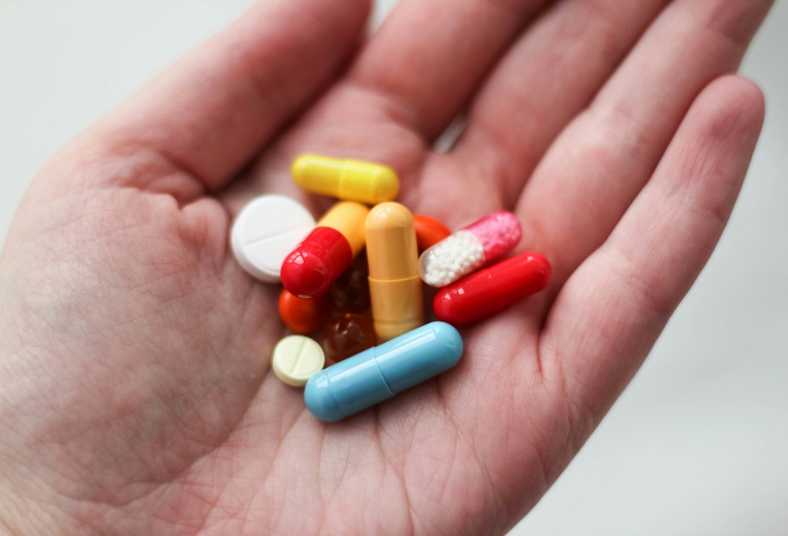
Observational models
Useful for
Comparing conditions, like two different website designs, different medications etc
Finding patterns
Verifying assumptions about the I/O relationship
In social studies, psychology, healthcare
Photo by Ksenia Yakovleva on Unsplash

Slide 15

If we collect a lot of (input, output) pair examples, then Predicting new outputs becomes possible
Machine Learning models

Slide 16
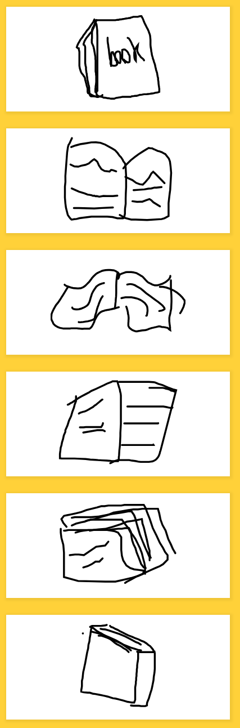

Machine Learning models learn from examples
Q: What did I draw?
https://quickdraw.withgoogle.com/
“book”
Train the model with past/example data
Predict outcomes for new inputs
How do we validate the predictions?
this Black Box is smarter than the Observational one – it has learned the I/O relation from examples and can now guess the O from the I
Notes:
ML models learn a mapping from inputs to outputs from examples (training data).
They are still largely black-box: we care more about prediction accuracy than understanding the internal mechanism.
Typical questions: “Given these features, what outcome do we expect?” (e.g. class, score, risk).
Assumptions:
- Past data is representative of future situations
- The chosen features contain enough information to predict the target
Inputs: features (e.g. pixel values, user attributes).
Output: prediction (class, value).
Time/space: sometimes included as a feature
Uncertainty: implicit in prediction errors; we evaluate with train/test splits, cross-validation, error metrics.

Slide 17

Machine Learning models
Used in
a huge number of applications! (where not?)
Recommended resources
https://www.interactive-ml.com/ - interactive demos and explanations of common ML algorithms
https://www.playwithml.com/ - learn ML on all levels, including example code
Photo by freestocks on Unsplash

Slide 18
What if we are actually interested in the system behaviour, not just the Inputs and Outputs ? Then we need to talk about ...
white-box models

Slide 19




(Partial) Differential Equation models describe changes in time
Q: How does surface heat, distributed in space, changes over time?
White Box!
PDE’s = rules for how a continous system changes in space and time
https://visualpde.com/basic-pdes/heat-equation/
initial temperature distribution
boundary conditions
diffusion speed
Temp pattern over time
The Heat equation :
T = temperature,
= how T changes over time,
D = diffusion coef (how quickly heat spreads),
(Laplacian) = smoothness, local difference with the surroundings
Notes:
Continuous models (ODE/PDE) describe how the system evolves in time, that is how state variables change according to mathematical rules.
They are white-box: the equations represent our understanding of the process (e.g. growth, diffusion).
Typical analysis questions: “How does temperature / population / plant height evolve over time (and space)?”
Assumptions:
-The chosen equations capture the dominant processes.
-Parameters (rates, diffusion coefficients) are constant or vary in a known way.
Time/space: continuous time and space (e.g. heat diffusion, pollutant spread).
Inputs: initial conditions, boundary conditions, parameters.
Outputs: trajectories over time, spatial patterns.

Slide 20
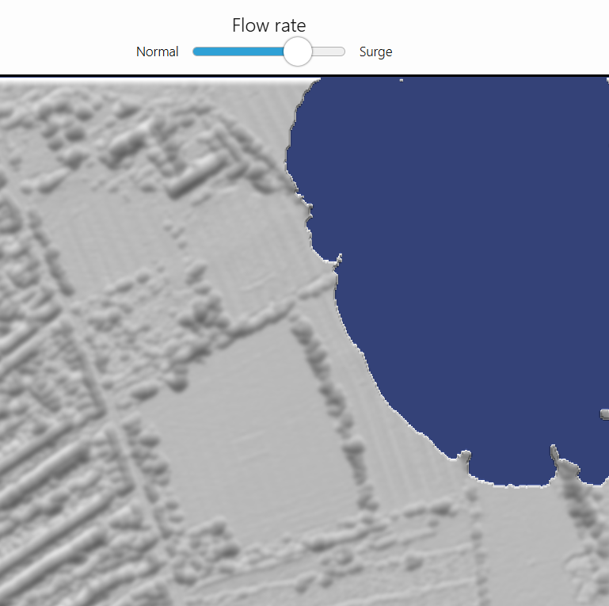
(Partial) Differential Equation models describe changes in time
Used in
Biology, Physics, Chemistry, Maths ..
Geographical simulations, like flood scenarios
Recommended resources
https://visualpde.com/explore.html - best demos and explanations, GitHub code available, support to create own PDE sims
Notes:
Application domain examples:
- Heat diffusion in a material
- Spread of a pollutant in water or air
- Population growth or epidemic curves

Slide 21
Sometimes the system is evolving in defined steps (discrete) rather than continuously, like in a factory line, at a helpdesk or at the carwash.
Discrete-Event Systems

Slide 22
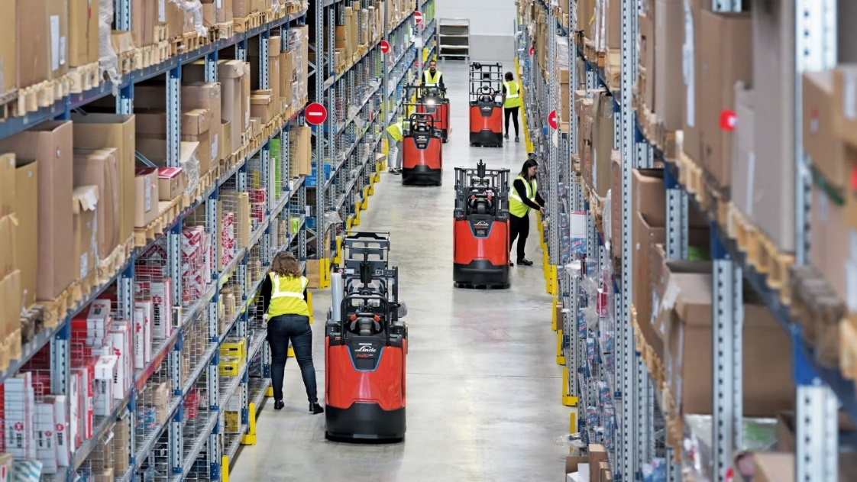
Discrete-Event Simulation models are about processes
The processes (Resources, Actors, Events) are well understood and can be described step-by-step.
-> a package arrives, waits, is sorted, rooted, leaves.
Complexity = combination of many entities and scale
Used in
Logistics, Warehouse order-picking,
Scheduling, Helpdesk ..
Notes:
DES represents a system as a sequence of events that happen at specific times (arrival, start service, end service, etc.).
The internal logic (process flow) is known; complexity comes from many entities and interactions (queues, resources).
Typical questions: “What are waiting times, queue lengths, throughput? What happens if we add a server or change the routing?”
Assumptions:
- Process structure is known (e.g. arrive → wait → serve → leave).
- Arrival patterns and service times can be described (often with probability distributions).
Time: discrete events (not continuous state evolution).
Space: often abstract (stations, nodes); layout is usually abstracted away.
Inputs examples: arrival rates, service time distributions, number of servers, routing rules.
Outputs examples: waiting times, queue lengths, utilization, throughput.
Uncertainty: variables can be stochastic

Slide 23
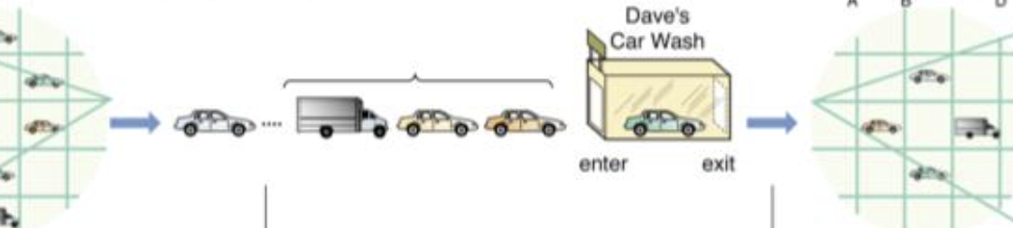
Discrete-Event Simulation models are about processes
Simple example: CarWash Queue
Cars arrive at washing facility, need to wait for the wash box.
Q: Waiting time? Throughput? Queue length? Better to open a second box?
Cra arrival pattern
Washin time
# machines
Average waiting time
Average queue length
throughput
Arrive -> Wait -> Wash -> Exit
Notes:
More domain examples:
- Helpdesk or call center staffing.
- Hospital patient flow, manufacturing lines, warehouse order picking.

Slide 24
Discrete-Event Simulation models are about processes
More examples
https://cloud.anylogic.com/model/29d54a61-aaac-4c47-8e50-941c0f5bb36e - Real example: manufacturing line solar panels
https://github.com/mihir-m-gandhi/Basic-Traffic-Intersection-Simulation

Slide 25
When there is a lot of uncertainty, large scale and/or focus on estimation of an outcome, then there is another very popular method ..
Monte Carlo simulations

Slide 26

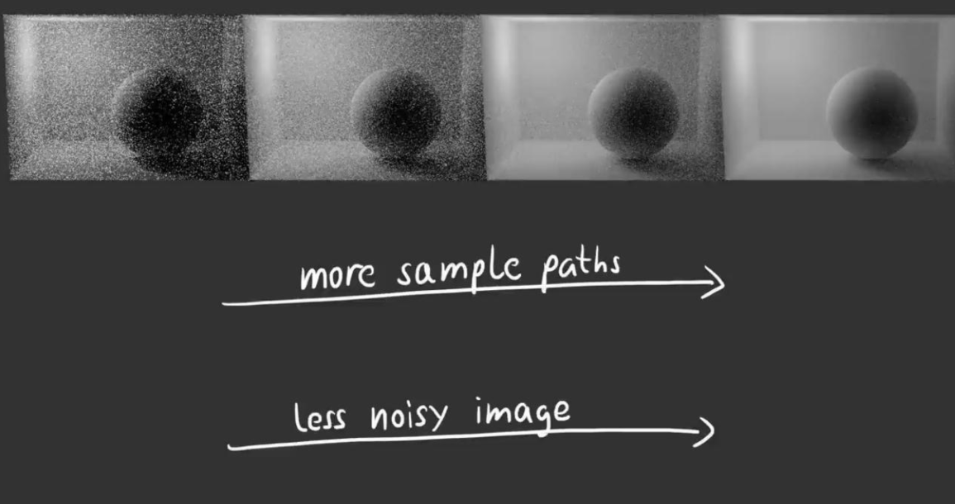
Monte Carlo Simulations
For complex problems with many sources of uncertainty, like financial planning
Or huge complexity, like light rendering in 3D
Idea
not technically a model but an established way to estimate outputs of models when the inputs are not fixed values but ranges of values
estimate outcomes by using many random sample inputs
works based on the Law of Large Numbers
Notes:
Monte Carlo is a way to deal with uncertain inputs.
Idea: instead of using fixed input values, we define probability distributions for uncertain inputs and run the model many times with random samples. The results is an output distribution that becomes more close to the truth the more experiments are run.
The mean of the recorded outputs will naturally converge towards a realistic estimation.
Typical questions: What is the distribution of outcomes?
Assumptions:
- We can specify reasonable distributions for uncertain inputs
The model structure itself is fixed; uncertainty is in the inputs
Inputs: distributions for uncertain parameters.
Outputs: distributions of outcomes, percentiles, probabilities.
Time/space: depends on the underlying model (can be static, or embedded in DES/ABM/PDE).
Uncertainty: central; uses random sampling and the law of large numbers.

Slide 27
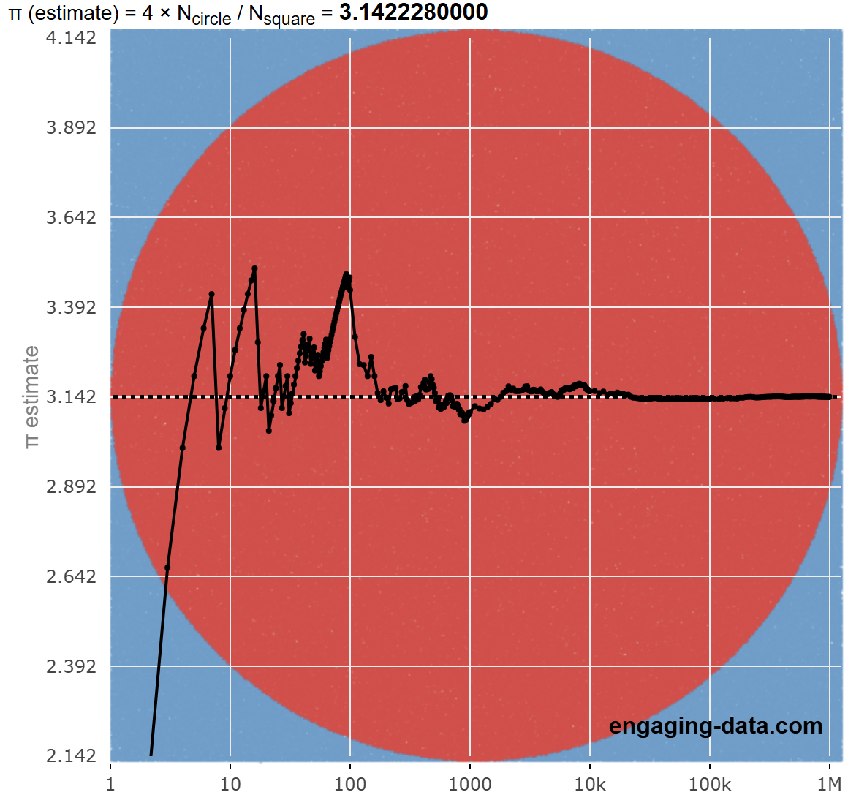

Monte Carlo Simulations
Example: estimate the value of !
https://engaging-data.com/estimating-pi/

Slide 28
Some systems are composed of many entities that do not act according to system laws but only based on their local knowledge
Agent-based models

Slide 29

Agent-Based Models are about distributed local agents
Used in
Modelling emerging and distributed behaviour – Biology, Logistics, Epidemics study
Many entities, local rules
Recommended resources
https://cloud.anylogic.com/model/40299513-8f20-4e86-817f-3a6358b9eaf6 Example: an European supply chain
https://jtsorlinis.github.io/BoidsWebGPU/ - the Boids example

Slide 30
Agent-Based Models are about distributed local agents
The Boids example
# agents
Initial positions
Params for the rules
..
Local steering rules: separation, alignment, cohesion
Emergent behaviour
Notes:
ABM represents a system as many agents (people, cars, animals, devices) that follow local rules.
Global patterns emerge from local interactions, there is no global controller.
Typical questions: What patterns emerge from these rules? How do local behaviors affect system-level outcomes?
Assumptions:
- Agents’ rules and interaction mechanisms are reasonably captured.
- Environment and initial conditions are specified.
Time: discrete steps or events.
Space: often explicit – grid or cube or continous space
Inputs: number of agents, rules, initial positions/states, environment parameters.
Outputs: emergent patterns, system-level metrics (e.g. average damage, clustering).
Uncertainty: can include randomness in behavior, environment, or interactions.
Domain examples:
- Pedestrian flow in stations or stadiums
- Epidemic spread with individual contacts
- Traffic, animal herds, supply chains

Slide 31
What if one needs a precise result, “what is the best setting for the input parameters” ?
Mathematical optimization

Slide 32
Linear Programming is the most common optimization approach
The LP model allocates limited resources (land, water) to maximize total economic yield.
  decision variables – area per plant
  constraints (max water, max land, min biodiversity)
  objective function (maximize economic yield)
---
-> LP solver finds the optimal solution = values for the dec variables
Constraints (equations) + Obj Function -> LP solver
Optimal valuation
Relevant constants
Notes:
LP is a mathematical optimization method for allocating limited resources to maximize or minimize a linear objective.
It assumes relationships are linear and parameters are known (deterministic).
Typical questions: What mix of activities maximizes profit/yield? What schedule minimizes cost while satisfying constraints?
Assumptions:
- Objective and constraints can be expressed as linear equations/inequalities.
- Parameters (coefficients) are known and fixed.
Time/space: usually not explicit
Uncertainty: typically deterministic (= no uncertainty)
Inputs: decision variables, constraints, objective function coefficients.
Outputs: optimal values of decision variables, optimal objective value
Domain example:
- Production planning: how much of each product to make.
- Staff scheduling: how many staff per shift under constraints.
- Transportation: how to route goods at minimal cost.

Slide 33
In summary ..
Modelling is a powerful way to describe and analyse real-life systems
There are many modelling techniques , we sampled most common ones
Next time we look at how these techniques look like when applied in one context, namely a food garden!

Slide 34
WS2 – The Edible Garden Case

Slide 35
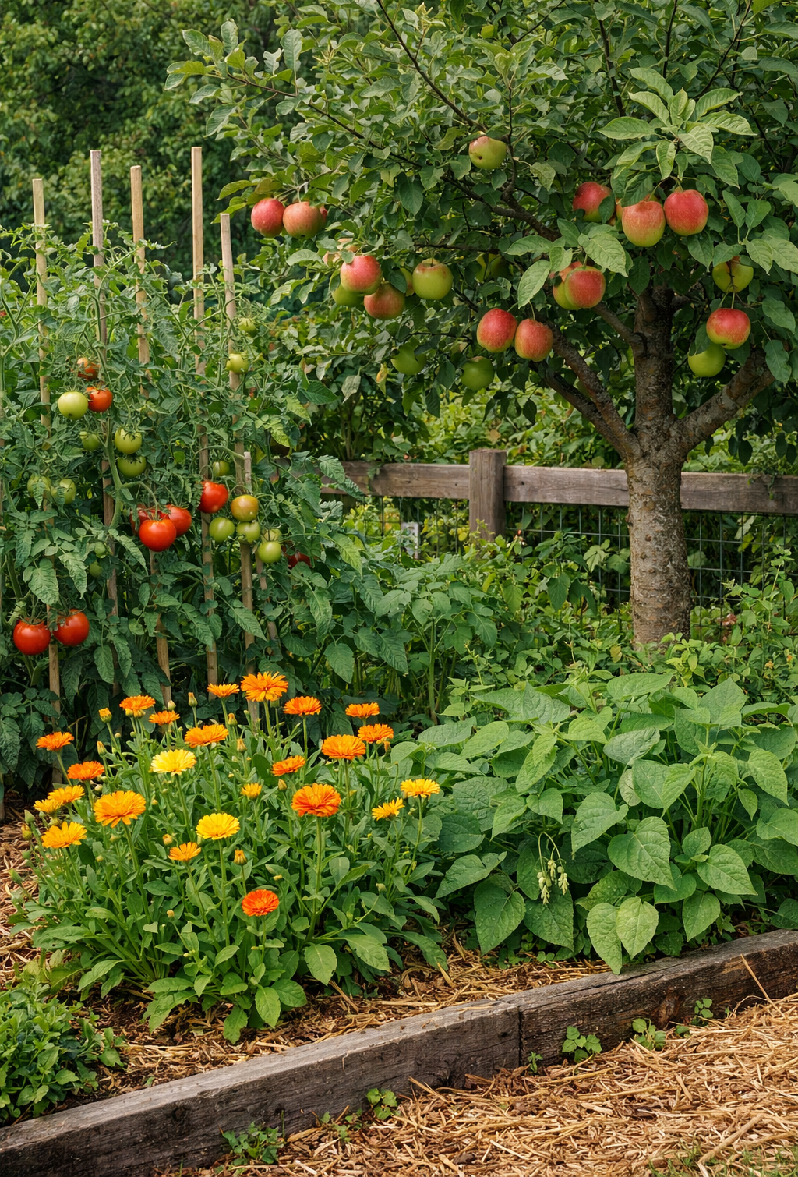
Case study : an edible garden!
You are the owner and manager of an edible garden, where you grow apple trees, bush beans, tomatoes and calendulas
Each with its own characteristics like height, resistance to slugs, water consumption
Various questions can be asked -> various modelling techniques will fit
There are 5 modelling examples provided for you to explore and understand

Slide 36
Examples
Download and unzip MODELLING-EXAMPLES.zip from Teams (in General->Shared->ModellingStudy). Direct link: MODELLING-EXAMPLES.zip
Examples for garden-related models DES, LP, MC, ABM, PDE
To run the Python notebooks: Visual Code or similar
To run the P5.js examples:
  Start a local http server in a terminal: python -m http.server 8000
  Go to localhost:8000 in the browser
OR use the online P5 editor at https://editor.p5js.org/

Slide 37
Homework for WS 2 (next week)
Express your interest for one of the 5 modelling techniques in the examples. Use this file to form groups around each technique/example: HomeworkForWS2.docx
In groups:
Explore the corresponding example, look for additional resources, change parameters etc etc.
Describe the modelling cycle, identify and comment on the essential concepts (time, purpose etc.)
Feel free to find other interesting examples of this technique, research its limitations and whatever you are curious about
Prepare a 10-minutes demo and explanation of this technique, starting from the garden example. Go as deep /wide as you like, while minding the time ☺

Slide 38
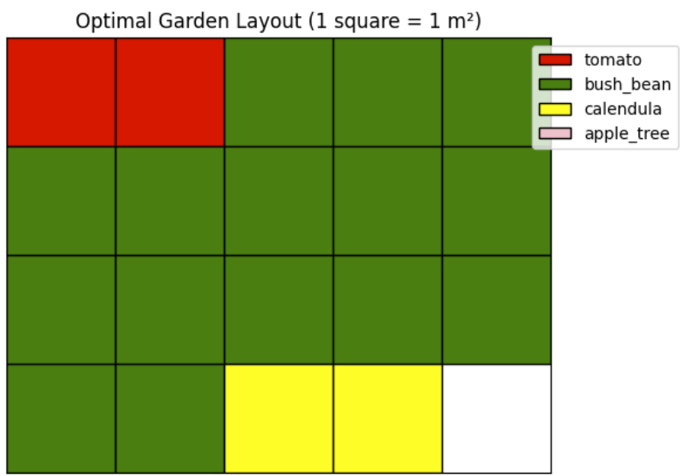
Linear Programming (LP)
The LP model assigns areas per plant such as to maximize total economic yield of the garden.
  decision variables – area per plant
  constraints (max water, max land, min biodiversity)
  objective function (maximize economic yield)
Some questions to explore with the example model
Which plant mix maximizes total yield from 20m2 when there’s unlimited water, biodiversity>=3?
What happens if water availability is reduced?
How does relaxing the biodiversity constraint changing the solution?
Which other LP studies you could think about in this setting?

Slide 39
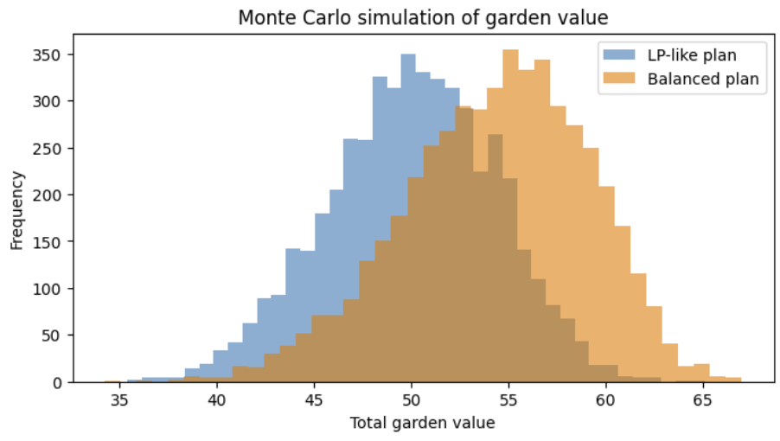
Monte Carlo Simulations (MC)
MC models uncertainty by running many random scenarios (weather, slugs, sunlight). Outputs are distributions.
Formally:
random variables (rainfall, slug pressure)
5000 simulation runs
Shows distribution of outcomes
Some topics to explore with the MC PoC
1. What is the expected total garden value?
2. Which planting plan would you recommend and why?
3. How does increasing slug pressure affect risk?
4. Which other MC studies you could think about in this garden setting?

Slide 40
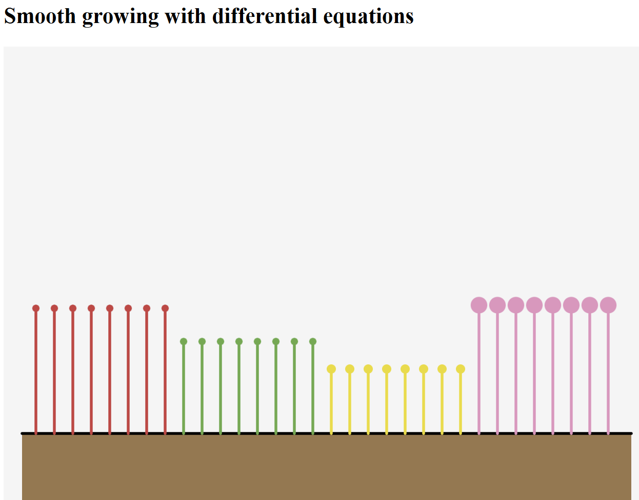
Partial Differential Equations (PDE)
PDE continuous growth model - each plant has its own growth rate and maximum height.
Growth depends on water availability and slows down as the plant approaches its maximum size.
For each plant: dh/dt = r * w * (1 - h / Hmax)
where: h = current plant height , r = intrinsic growth rate , w = water available/needed, Hmax = maximum possible height
Some topics to explore with the PDE PoC
Which plants grow fastest and which end up tallest?
What happens when water availability is reduced?
Why does growth slow down over time?
Which other PDE studies you could think about in this garden setting?

Slide 41
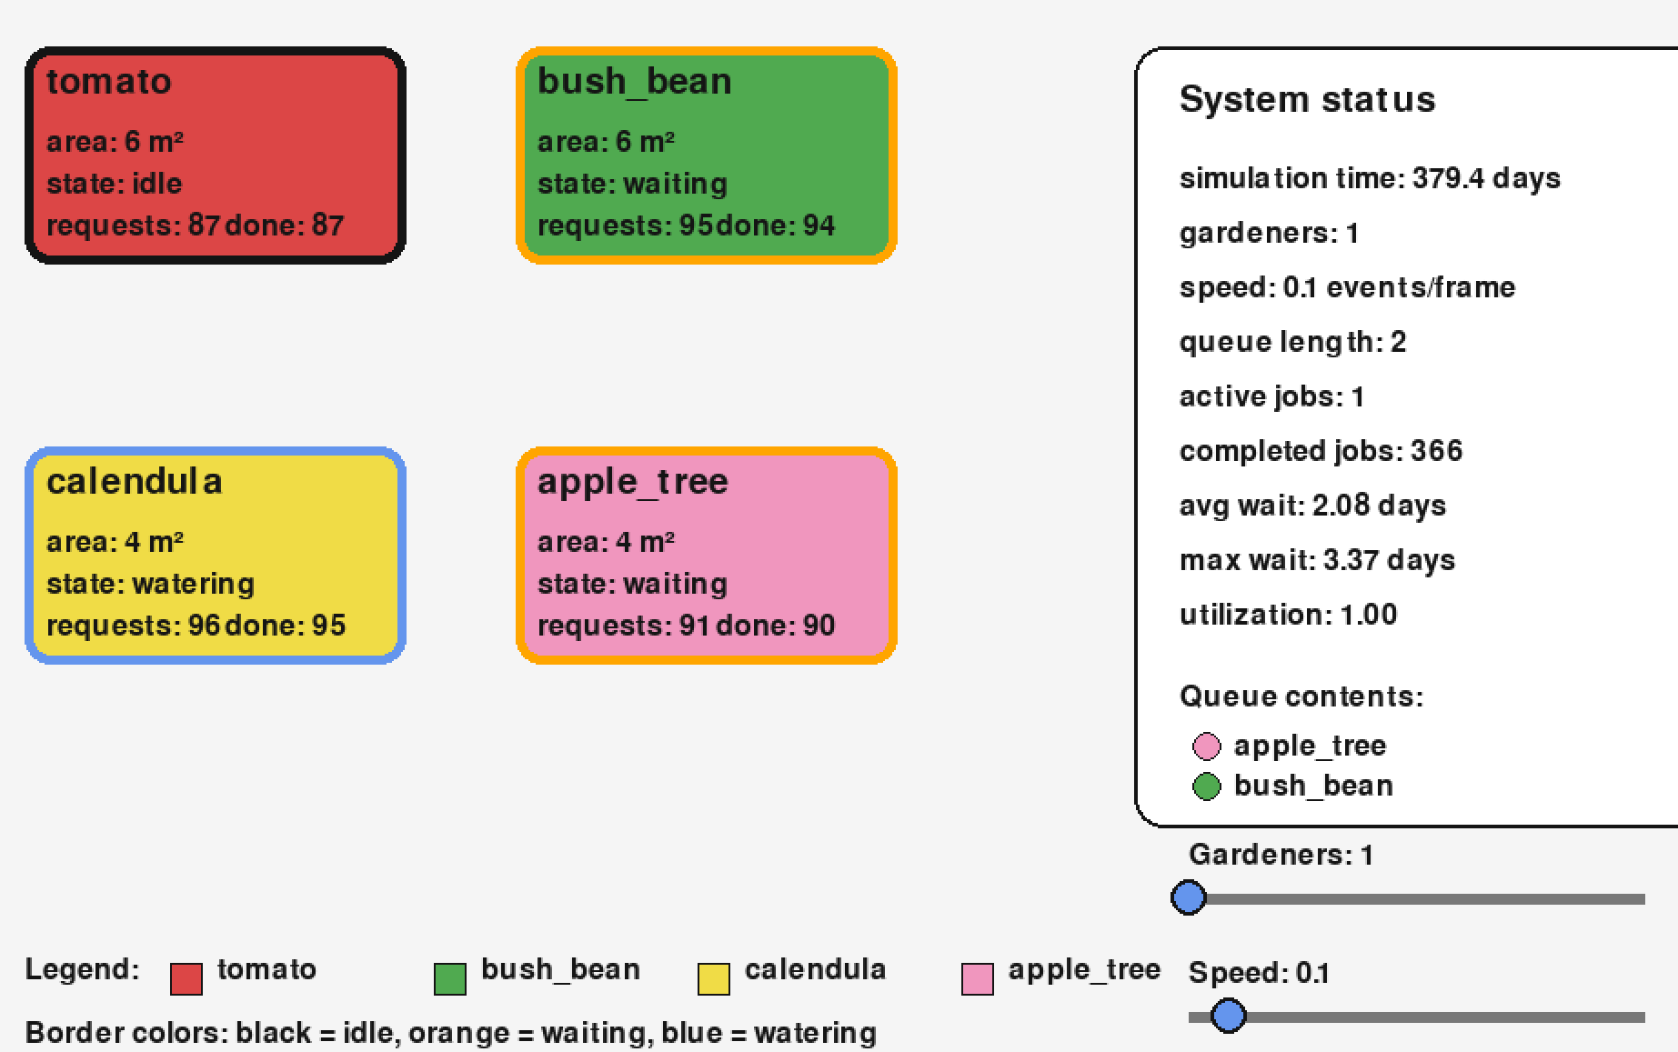
Discrete Event Systems (DES)
System evolves through discrete events over time:
plants generate watering requests,
gardeners (resources) serve them, queues form,
waiting times vary...
Some topics to explore with the DES PoC
When is the queues longest?
What happens when more gardners are added?
What is the total waiting time for plants when only one gardner works?
Which other DES studies you could think about in this garden setting?

Slide 42
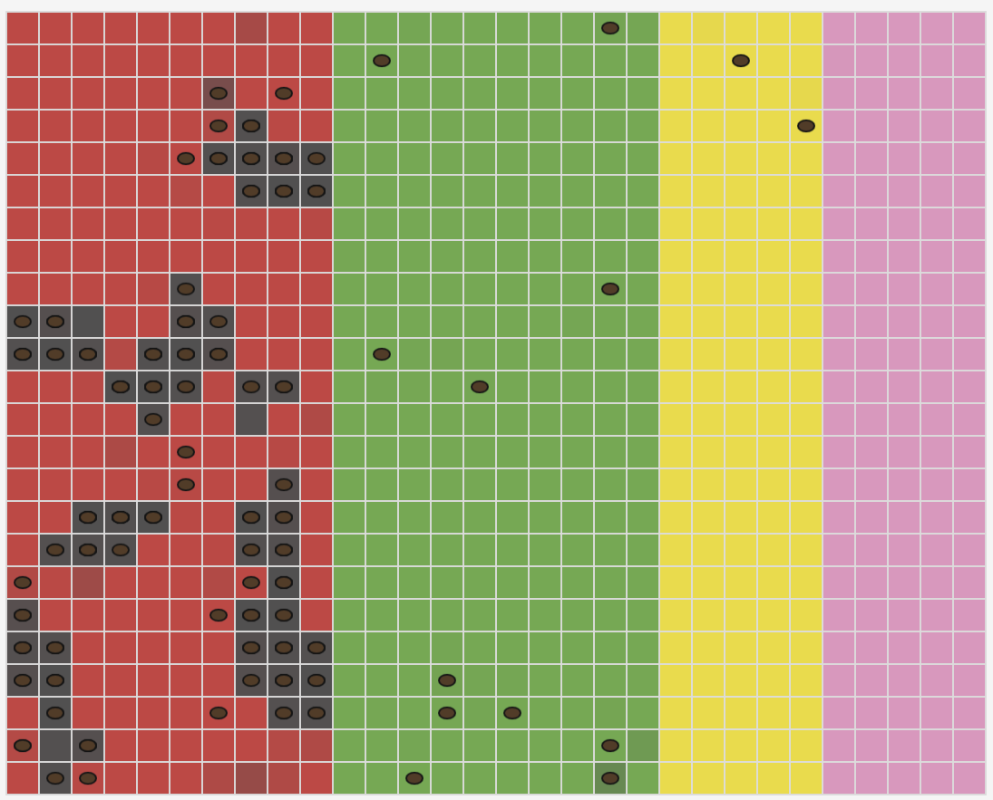
Agent-Based Models (ABM)
Agents (=slugs) follow several local rules:
move, eat, reproduce.
Some topics to explore with the ABM PoC
Why do slugs eventually move away from the calendula patch?
Are there any settings that lead to slug dissapearence ?
What happens if the reproduction slows down?
Which other ABM studies you could think about in this garden setting?

Slide 43
WS3 – Make Lab

Slide 44
Show-and-tell your project in-progress
Bring your idea, prototype, poster, whatever you feel confortable sharing

