Slide 1

UE23CS441A – Capstone Project Phase – 3
Project Progress Review # 1
Project Title : Detecting Depression using vocal cues Project ID : PW26_CBH_04
Project Guide : Ms. Chandravva Hebbi
Project Team : Srujan J, Vishruth Rallapalli, Yuvraj Rao,
Vivan Jeevan Naik

Slide 2
Detecting Depression using vocal cues
Abstract and Scope
ABSTRACT
• Participant-independent multimodal ML screening prototype for depression detection and severity assessment.
• Uses DAIC-WOZ semi-structured clinical interview audio recordings and transcripts.
• Three complementary streams — Acoustic (154D), Wav2Vec 2.0 (768D), BERT (768D) — fused into a 1,690-dimensional representation.
• CompactTriModalMLP simultaneously predicts 3-class severity, binary depression status, and continuous PHQ-8 score.
SCOPE
• A preliminary depression screening and research decision-support prototype.
• Not an autonomous diagnostic system.
• Designed to assist clinicians by extracting objective vocal and linguistic cues.

Slide 3
Detecting Depression using vocal cues
Problem Statement and Motivation
PROBLEM STATEMENT
• Depression assessment commonly relies on clinical interviews and questionnaire-based evaluation.
• Vocal and linguistic characteristics provide additional, objective information about mental state.
• Challenge: automatically identify depression-related patterns from how a person speaks and what they say.
OUR OBJECTIVE
• Develop a multimodal ML system for participant-level depression screening.
• Combine acoustic, speech and textual information to improve prediction of severity.
CLINICAL TARGET — PHQ-8
• 0–9 → Minimal / Mild 10–14 → Moderate 15–24 → Moderately Severe / Severe
KEY IDEA
• “Combine what a person says with how they say it.”

Slide 4
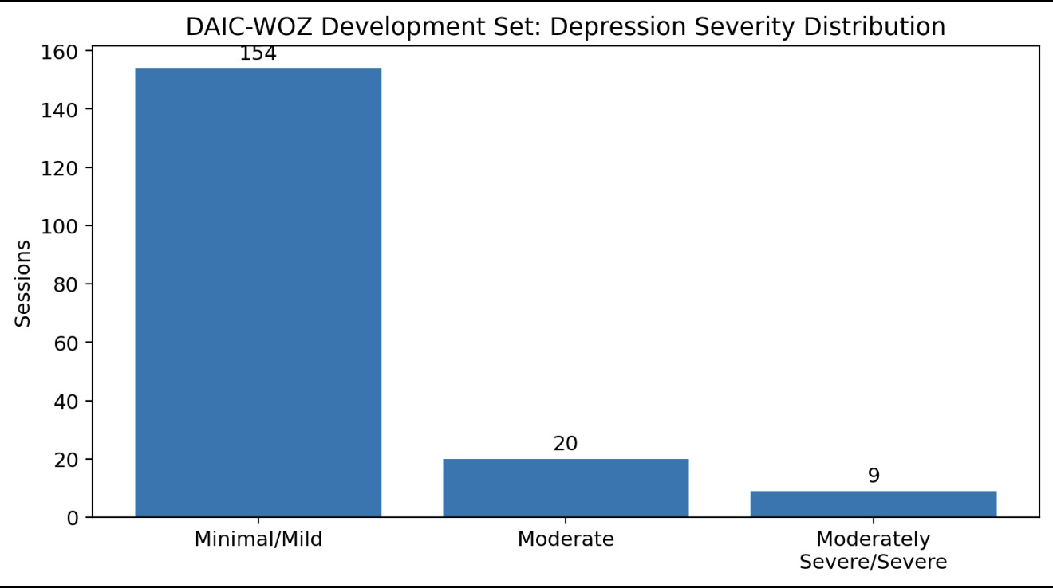
Detecting Depression using vocal cues
Dataset and Data Distribution
DATASET: DAIC-WOZ
• Development set: 183 interview sessions (113 Male / 70 Female).
SEVERITY DISTRIBUTION
• Minimal / Mild: 154 sessions (84.15%)
• Moderate: 20 sessions (10.93%)
• Moderately Severe / Severe: 9 sessions (4.92%)
DATA PARTITIONS
• Training 116 · Validation 30 · Test Holdout 37 · Reserved Unseen 9
KEY CHALLENGE
• Highly imbalanced — 84.15% Minimal / Mild; only 9 severe cases in the corpus.

Slide 5
Detecting Depression using vocal cues
Previous Work and Improvements
PHASE 1 / 2 BASELINE
• Basic MFCC extraction (Librosa) and pitch tracking — an acoustic-focused pipeline.
• 847,749-parameter recurrent BiLSTM with modality gating.
PROBLEM IDENTIFIED
• BiLSTM severely overfit the small cohort and collapsed to the 84% majority class.
• Holdout accuracy 83.78%; recall for Moderate & Severe classes 0.00%.
IMPROVEMENTS IN FINAL MODEL
• Participant-only speech filtering (removed interviewer / Ellie speech).
• Tri-modal feature fusion: Acoustic + Wav2Vec 2.0 + BERT.
• Compact MLP architecture: 847,749 → 225,413 parameters.
• Leak-free 5-fold Stratified Group Split (participant isolation + minority representation).
• Macro-F1 model selection (avoids majority-class-only models).

Slide 6
Detecting Depression using vocal cues
Overall System Architecture
SYSTEM PIPELINE
• DAIC-WOZ dataset → Audio (.wav) + Transcript (.csv).
• Preprocessing: 16 kHz resampling · silence trimming · participant-only transcript filtering.
• Three parallel feature branches:
– Acoustic — 154D (eGeMAPS, MFCC, prosodic features)
– Wav2Vec 2.0 — 768D (contextual speech embedding)
– BERT — 768D (linguistic text embedding)
• Feature standardization & fusion → 1,690-D fused vector.
• CompactTriModalMLP → three output heads:
– 3-class severity classification · Binary depression status · PHQ-8 score regression
KEY POINT
• 154D + 768D + 768D = 1,690D

Slide 7
Detecting Depression using vocal cues
Feature Extraction
1. ACOUSTIC — 154D
– eGeMAPS (88): pitch/F0, jitter, shimmer, loudness, alpha ratio, Hammarberg index, formants F1–F3.
– MFCC statistics (52): 26 mean + 26 std — articulation dynamics & spectral timbre.
– Prosodic & spectral (14): RMS energy, F0, spectral centroid, rolloff, zero-crossing rate.
2. WAV2VEC 2.0 — 768D
– Frozen facebook/wav2vec2-base-960h; contextual speech representations after 16 kHz resampling.
3. BERT — 768D
– Frozen bert-base-uncased; participant-only utterances; 512-token windows with 128-token overlap.
FINAL REPRESENTATION
• 154 + 768 + 768 = 1,690 dimensions

Slide 8
Detecting Depression using vocal cues
Model Design and Training
FINAL MODEL: CompactTriModalMLP
• Input: 1,690-D fused vector.
• Linear(1690 → 128) → LayerNorm → ReLU → Dropout(0.3).
• Linear(128 → 64) → LayerNorm → ReLU.
• Three output heads: 3-class severity · binary depression · PHQ-8 regression.
TRAINING CONFIGURATION
• Parameters 225,413 · Optimizer AdamW · LR 1e-3 · Weight decay 1e-3 · Batch size 16.
• CosineAnnealingLR · 5-fold Stratified Group Split · class-weighted Cross Entropy.
• Checkpoint on validation Macro-F1 · Temperature scaling T = 1.6742.

Slide 9
Detecting Depression using vocal cues
Modules and Technologies
MODULES
• Feature Store — caches compressed multimodal features (NumPy, Joblib).
• BERT Extractor — participant-only linguistic features (HuggingFace Transformers, PyTorch).
• Wav2Vec Extractor — self-supervised speech representation (Torchaudio, PyTorch).
• eGeMAPS Extractor — acoustic biomarker extraction (openSMILE, Librosa).
• Training Engine — leak-free training, stratification & benchmarking (PyTorch, Scikit-learn).
• Single Evaluator — inference on individual recordings (PyTorch, Joblib, Librosa).
• Unseen Benchmark — automated evaluation on reserved sessions (Pandas, PyTorch).
CORE TECHNOLOGIES
• Python · PyTorch · Scikit-learn · HuggingFace Transformers · Wav2Vec 2.0 · BERT · openSMILE · Librosa · Pandas.

Slide 10
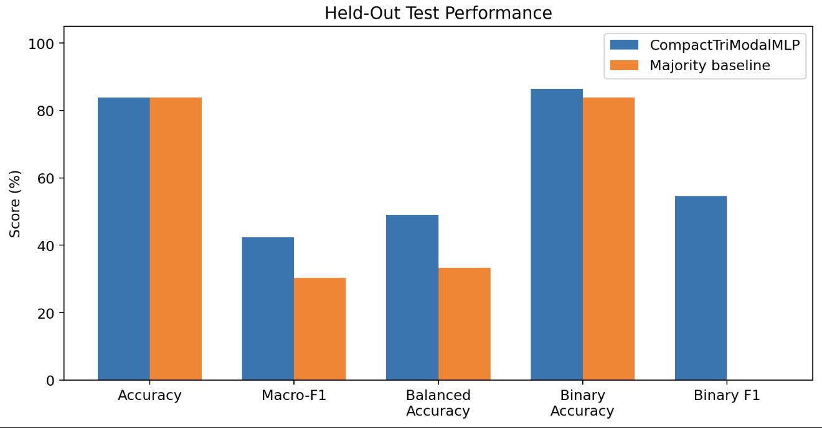
Detecting Depression using vocal cues
Experimental Results
TEST HOLDOUT — 37 SESSIONS
• 3-Class Accuracy 83.78% · Macro-F1 42.36% · Balanced Accuracy 48.92%.
• Binary Accuracy 86.49% · Binary F1 54.55% · PHQ-8 MAE 3.07 pts.
• Severe class recall 50% (1/2).
VS MAJORITY BASELINE
• Macro-F1: 42.36% vs 30.39%
• Balanced Accuracy: 48.92% vs 33.33%
• Binary F1: 54.55% vs 0.00%
KEY OBSERVATION
• Accuracy matches the baseline due to imbalance, but the model improves Macro-F1, Balanced Accuracy, Binary F1 and minority-class recognition.

Slide 11
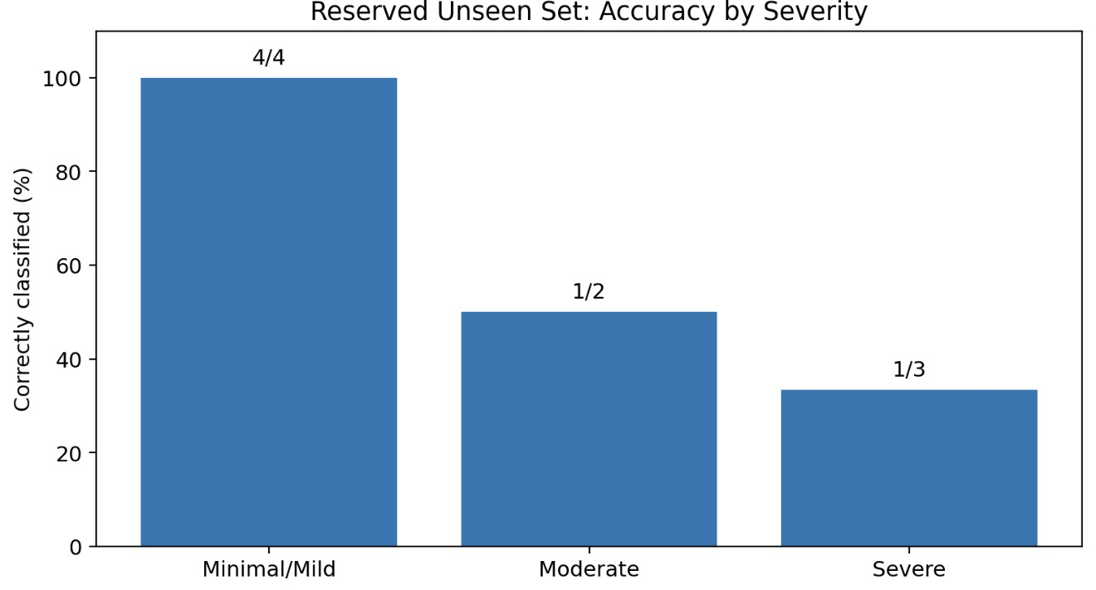
Detecting Depression using vocal cues
Reserved Unseen Dataset Evaluation
RESERVED UNSEEN SET
• 9 completely untouched clinical sessions, isolated from training, validation, feature scaling, threshold tuning and calibration.
OVERALL RESULT
• 66.67% accuracy — 6 / 9 sessions correctly classified.
RESULT BY SEVERITY
• Minimal / Mild: 4 / 4 (100%)
• Moderate: 1 / 2 (50%)
• Moderately Severe / Severe: 1 / 3 (33.3%)
LIMITATIONS
• Small sample; only 9 severe cases; strong imbalance; Moderate overlaps neighbours — preliminary evidence, not diagnosis.

Slide 12
Detecting Depression using vocal cues
Conclusion and Team Contributions
CONCLUSION
• Participant-independent multimodal depression-screening prototype fusing acoustic, Wav2Vec 2.0 and BERT features.
• Reduced complexity 847,749 → 225,413 parameters; participant-only filtering and leak-free group splitting.
• Final test accuracy 83.78%; reserved unseen accuracy 66.67%.
• Preliminary evidence that compact multimodal fusion can support participant-level screening.
TEAM CONTRIBUTIONS
• Vivan Jeevan Naik — multimodal neural architecture, tri-modal fusion, Stratified Group Splitting, training pipeline optimization.
• Vishruth Rallapalli — acoustic feature extraction, eGeMAPS, Librosa temporal features, audio cleaning & silence suppression.
• Yuvraj Rao — transcript parsing, participant-only text extraction, BERT embedding pipeline.
• Srujan Kumar J — unseen-dataset benchmarking, temperature calibration, clinical metric evaluation.

Slide 13
Detecting Depression using vocal cues
References
[1] Alghowinem, S., Goecke, R., Wagner, M., Parker, G. and Breakspear, M. (2013) ‘Detecting depression: A comparison between spontaneous and read speech’, IEEE ICASSP.
[2] Cummins, N. et al. (2015) ‘A review of depression and suicide risk assessment using speech analysis’, Speech Communication.
[3] Morales, M.R.A., Levitan, R. and Levitan, S.I. (2018) ‘Speech vs. text: A comparative study of multimodal depression detection’, Interspeech.
[4] Ringeval, F. et al. (2019) ‘AVEC 2019 Workshop and Challenge’.
[5] Eyben, F. et al. (2016) ‘The Geneva Minimalistic Acoustic Parameter Set (GeMAPS) for Voice Research and Affective Computing’, IEEE TAC.

Slide 14
Thank You

