Slide 1
Detecting Depression from Interview Speech
How the model improved over three versions, the results, and how the final model works
Final: 79.1% accuracy (cross-validation), 78.8% on 33 unseen people

Slide 2
The task: screen for depression from one interview
Input: audio of a 7-20 minute clinical interview
Output: is PHQ-8 >= 10 (clinically depressed)? yes / no
Data: DAIC-WOZ + E-DAIC (USC), the standard research benchmark
272
85
68.8%
people interviewed
depressed (31%)
accuracy of always guessing
"not depressed" (the baseline)
Notes:
Any model must beat 68.8% to be useful, because 69% of people are not depressed.

Slide 3
Part 1: our progress in three models
Model 1 (Phase 7) -> Model 2 (Phase 8) -> Model 3 (Phase 9, final)

Slide 4
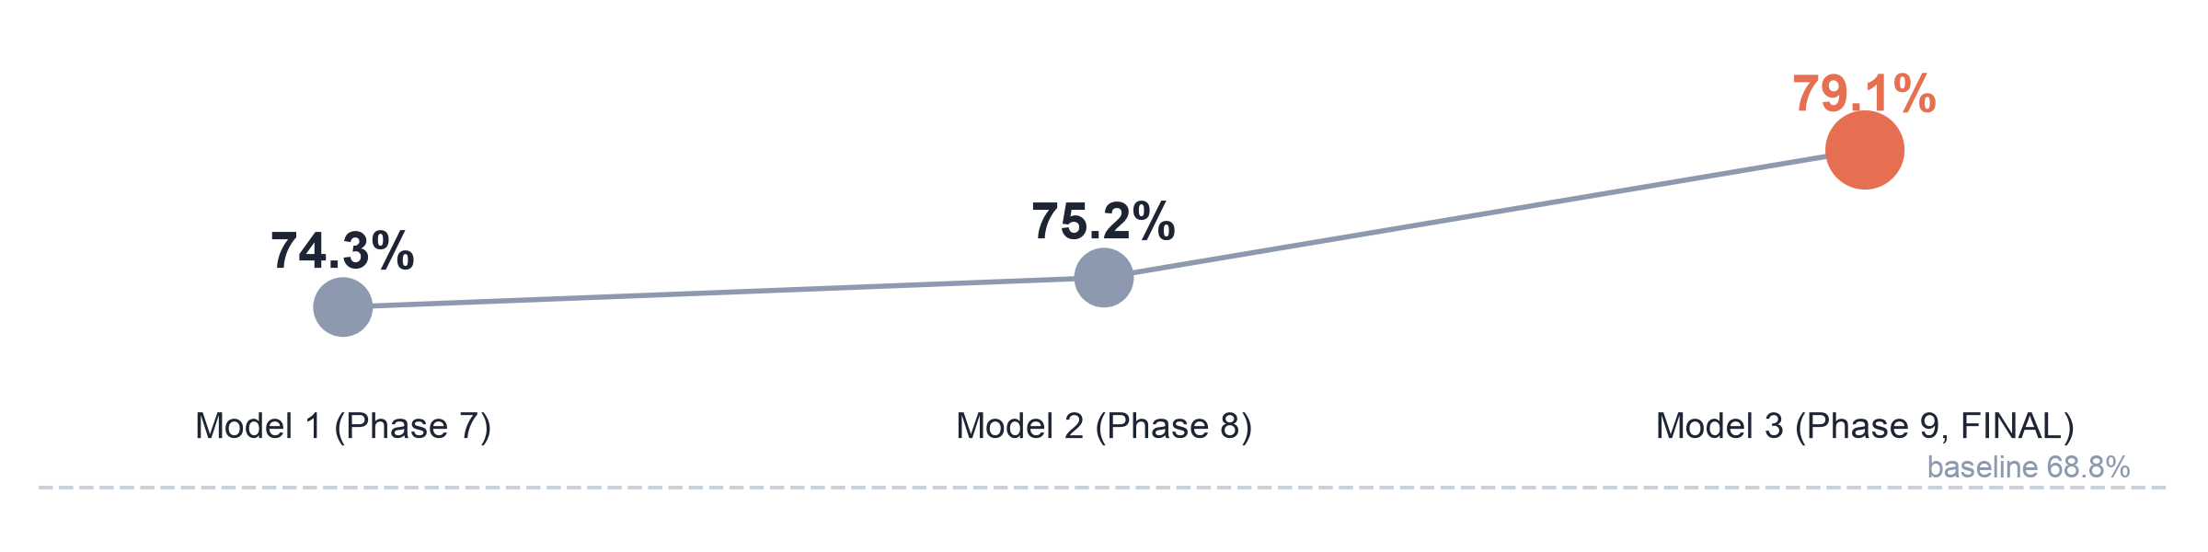
Progress at a glance
Model 1
Model 2
Model 3 (final)
Voice + text. Picks its best voice settings again in every training round.
Same, but the 3 voice settings are fixed. 12 extra learning tricks tested: none helped.
Model 2 + a local LLM that reads the transcript and rates the 8 PHQ-8 symptoms.
Notes:
Cross-validated accuracy. The big jump comes from Model 3, the LLM symptom scoring.

Slide 5
Model 1 (Phase 7): voice + text, 74.3%
MODEL 1
Audio
Voice features
Pick best 3
Text
Combine
speech parts found
by Silero VAD
wav2vec2, HuBERT,
Whisper: 15 layers
out of 60 voice
settings, re-chosen
in every round
transcript ->
emotion-RoBERTa
or BERT
logistic
regression
Result
What held it back
Accuracy 74.3% (baseline 68.8%)
AUC 0.764, balanced accuracy 67.0%
Catches 64% of depressed people (balanced threshold)
Voice alone carries a weak signal (AUC ~0.72)
Text model only captures emotional tone, not symptoms
Choosing among 60 settings each round adds noise
Notes:
Model 1 was our honest, fully nested model: it re-selects which voice layers to use inside every training fold.

Slide 6
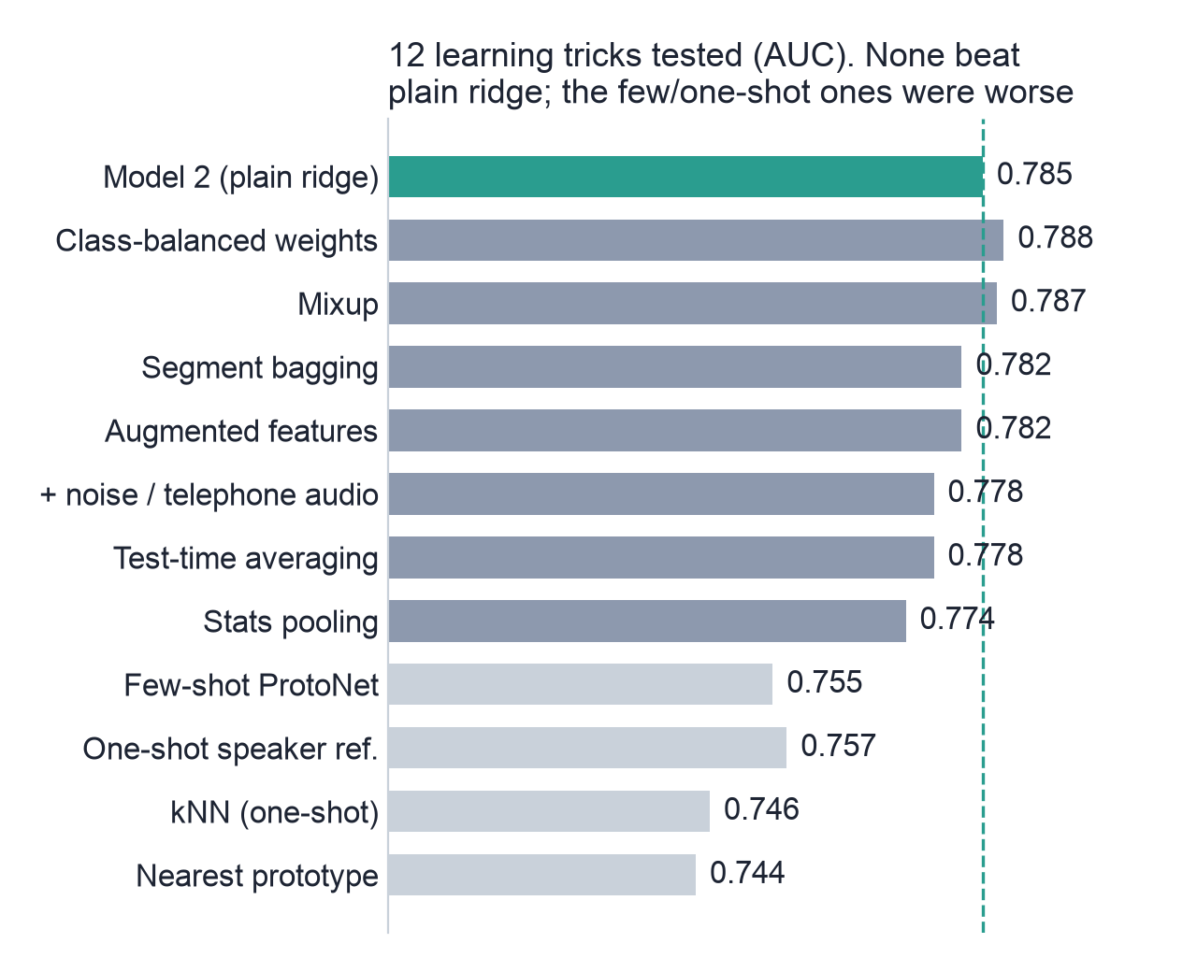
Model 2 (Phase 8): fixed voice settings, 75.2%
MODEL 2
What changed
Always use the same 3 voice settings: wav2vec2 layer 6 and HuBERT layers 19 and 20, each with ridge regression.
Then we tested 12 learning tricks (teacher's ideas included)
Data augmentation, mixup, class weights, few-shot (prototypical network), one-shot (kNN, prototypes), speaker referencing, domain centring, statistics pooling.
Result: 75.2% accuracy, AUC 0.785. None of the tricks helped.
Notes:
Lesson from Model 2: the limit was the information in the features, not the learning method. We needed a new kind of information.

Slide 7
Model 3 (Phase 9, final): + LLM symptom scores, 79.1%
MODEL 3
Why we added it
What changed
Model 2 showed new tricks do not help: we needed new information
Our literature review ranked "LLM scores PHQ-8 items from the transcript" as the most promising next step
People mention symptoms ("I can't sleep", "always tired"); the old text model ignored this
Mistral-7B reads the transcript and rates each of the 8 PHQ-8 symptoms (0-3)
Voice says HOW they speak; LLM says WHAT they report: the two add up
Accuracy 79.1%, AUC 0.843 (+0.057 over Model 2, statistically significant)

Slide 8
What is inside each model
 | Model 1 (Phase 7) | Model 2 (Phase 8) | Model 3 (FINAL)
Voice | best 3 of 60 settings, re-picked each round | fixed: wav2vec2 L6, HuBERT L19 + L20 | same as Model 2
Text | emotion-RoBERTa | emotion-RoBERTa | emotion-RoBERTa
Symptom scores (LLM) | no | no | YES: Mistral-7B, 8 PHQ-8 items
Combiner | logistic regression | logistic regression | logistic regression
Accuracy, cross-validation | 74.3% | 75.2% | 79.1%
Accuracy, 33 unseen | 72.7% | 72.7% | 78.8%
Only one ingredient is new in Model 3, so the gain comes from the LLM symptom scores.

Slide 9
Part 2: results
Test A: cross-validation on all 272 people
Test B: train on 239, test once on 33 unseen people

Slide 10
Two honest tests, no data leakage
A
Test A: cross-validation
B
Test B: unseen holdout
All 272 people. Train on 4/5, test on the other 1/5, rotate until everyone is tested; repeat with 5 different splits.
Each person is predicted by a model that never saw them.
Train only on 239 people. Test once on 33 people kept aside in the "unseen" folder.
All settings (strengths, combiner, threshold) chosen on the 239 only.
Rules we kept: nobody appears in both training and test; the LLM never sees a label; interviewer questions removed from transcripts; plan and adoption rule written and pushed to GitHub before running.

Slide 11
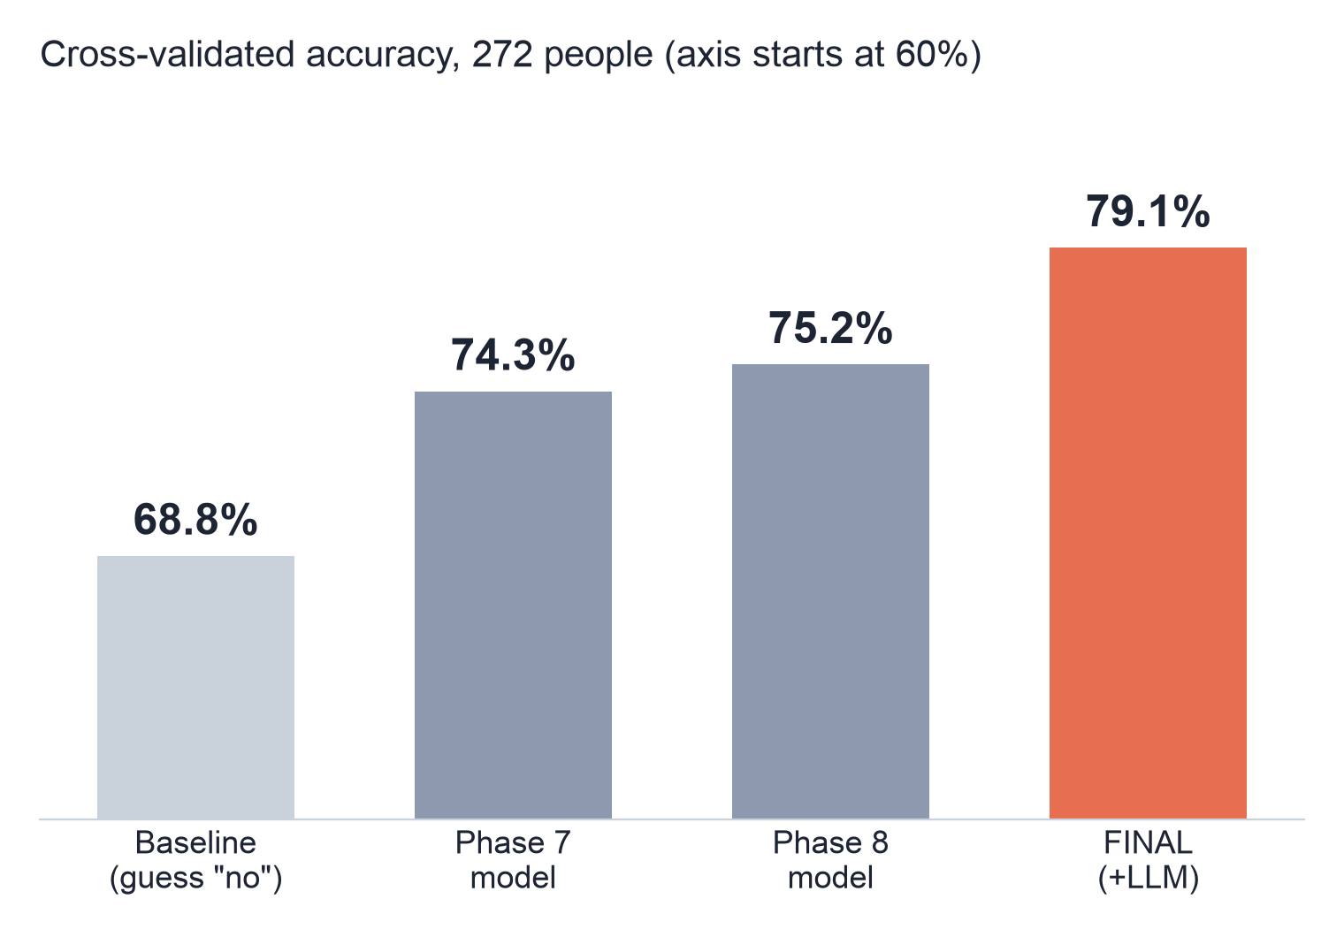
Result A: accuracy rises from 74.3% to 79.1%
0.843
AUC (Model 1: 0.764)
72.4%
balanced accuracy (Model 1: 67.0%)
77%
of depressed people caught at the balanced threshold (Model 1: 64%)

Slide 12
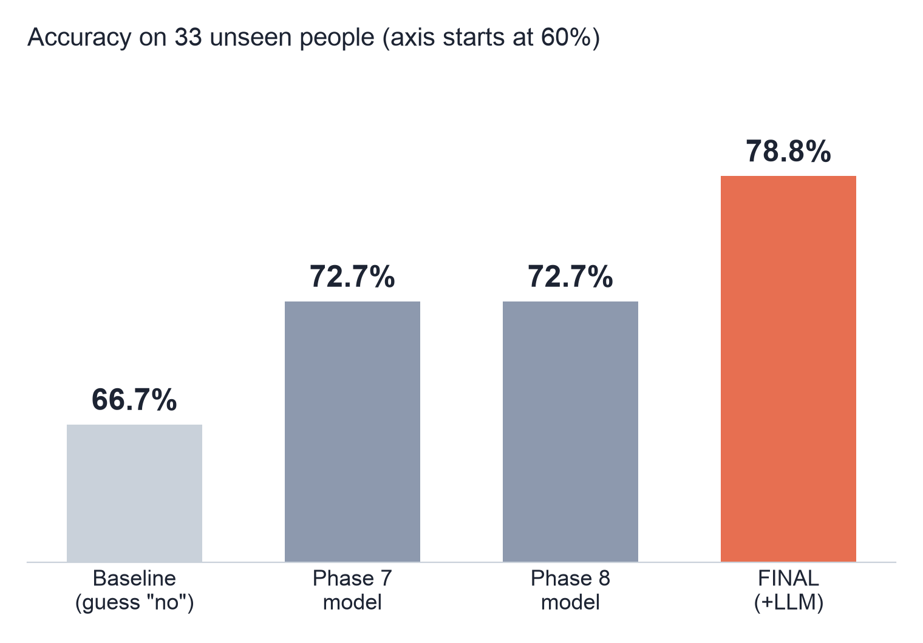
Result B: 26 of 33 unseen people correct
0.868
AUC (Model 1: 0.777)
21 / 22
healthy people correctly cleared
9 / 11
depressed caught at the balanced threshold (Model 1: 7)
Notes:
Test A 79.1% and Test B 78.8% agree within 0.3 points. With 33 people, one person is 3 percentage points.

Slide 13
All results side by side
Metric | Model 1 | Model 2 | Model 3 (FINAL)
Test A: cross-validation, 272 people (baseline 68.8%)
Accuracy | 74.3% | 75.2% | 79.1%
Balanced accuracy | 67.0% | 68.3% | 72.4%
AUC | 0.764 | 0.785 | 0.843
MCC / macro-F1 | 0.37 / 0.68 | 0.39 / 0.69 | 0.49 / 0.74
Test B: train 239, test 33 unseen (baseline 66.7%)
Accuracy | 72.7% (24/33) | 72.7% (24/33) | 78.8% (26/33)
AUC | 0.777 | 0.785 | 0.868
Depressed caught (balanced thr.) | 7 / 11 | 7 / 11 | 9 / 11
Model 3 vs Model 1: AUC +0.079 [95% CI +0.035, +0.124]. Model 3 vs Model 2: +0.057 [+0.015, +0.102]. Both significant.

Slide 14
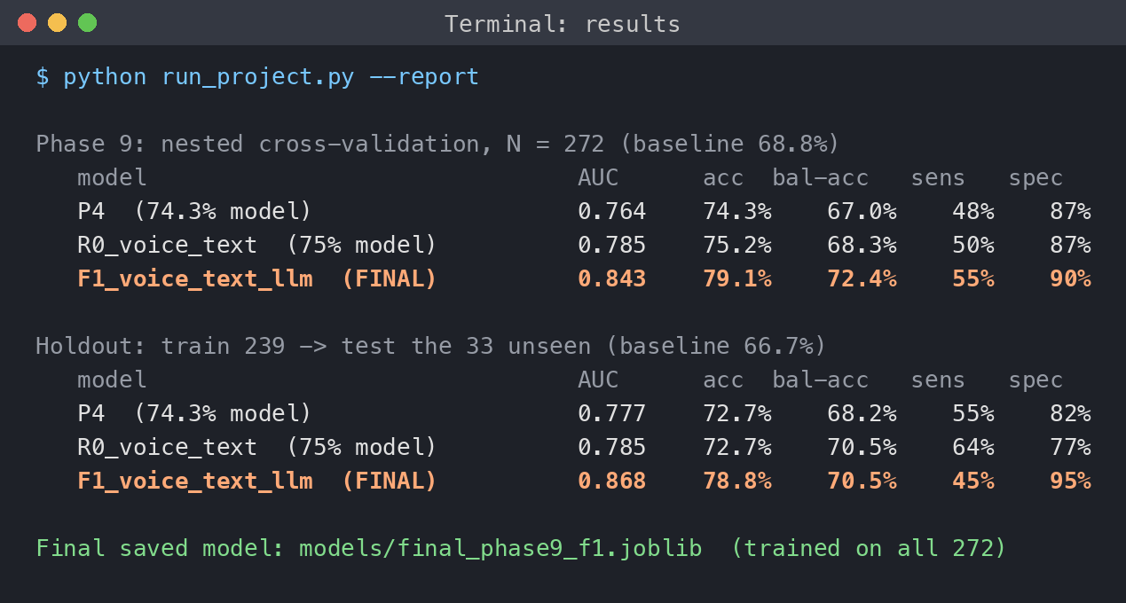
Screenshot: the results as printed
Top block: Test A, cross-validation on 272.
Bottom block: Test B, trained on 239, tested on 33 unseen.
P4 = Model 1, R0 = Model 2, F1 = Model 3 (orange).
acc = accuracy, bal-acc = balanced accuracy, sens = depressed caught, spec = healthy cleared.

Slide 15
Part 3: the final model, step by step
Step 1 voice | Step 2 text | Step 3 LLM symptom scores | Step 4 combine

Slide 16
The final model: four steps
Step 1. Voice: how they speak
Step 4. Combine
wav2vec2 + HuBERT (frozen) -> ridge
logistic regression
-> risk score 0-1
-> flag if above
threshold
Interview audio
Step 2. Text
participant
speech only
emotion-RoBERTa
emotional tone
Transcript
Whisper speech-
to-text
Step 3. LLM (NEW)
Mistral-7B rates the
8 PHQ-8 symptoms
Each step gives its own score from 0 to 1; step 4 merges the three into one risk score.

Slide 17
Steps 1 and 2: voice and text scores
Step 1: Voice (how they speak)
Find speech
Voice encoders
Average
Ridge regression
Voice score
Silero VAD cuts
out silence
wav2vec2 layer 6,
HuBERT layers 19, 20
over the whole
interview -> 768 /
1024 numbers
predicts the
PHQ-8 score
average of the 3,
as a 0-1 rank
Step 2: Text (emotional tone of the words)
Transcript
Emotion model
Embedding
Ridge regression
Text score
Whisper-tiny writes
what they said
emotion-RoBERTa-
large reads it
1024 numbers
describing tone
predicts the
PHQ-8 score
as a 0-1 rank
The encoders are pre-trained and frozen; we only train the small ridge regressions (strength chosen by inner cross-validation).
Notes:
The 0-1 rank: each raw prediction is converted to its position among the training predictions, so the three parts are on the same scale before combining.

Slide 18
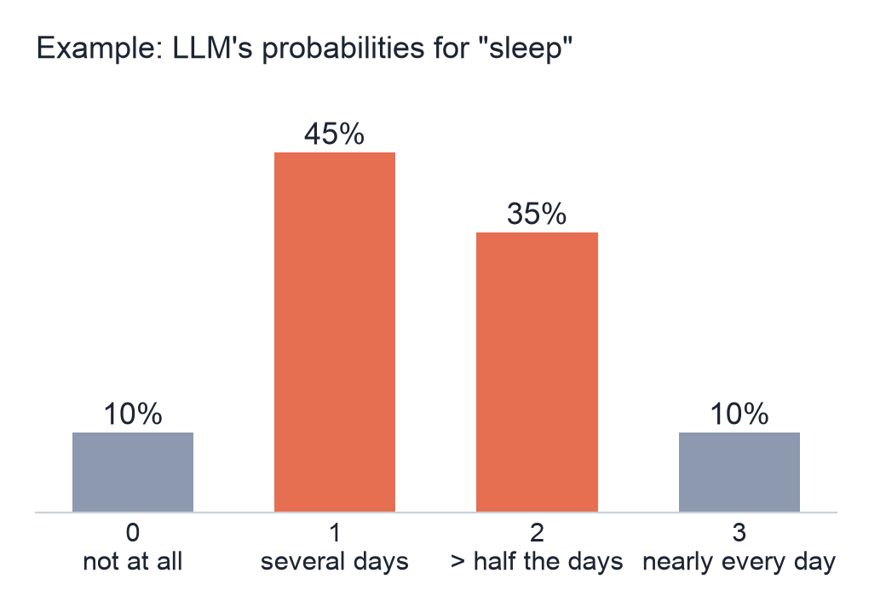
Step 3: how the LLM scores symptoms
Transcript
Prompt
Mistral-7B
8 symptom scores
Ridge -> LLM score
participant's words
only
"Rate each PHQ-8
item 0-3"
4-bit, runs offline
on the laptop
one number 0-3
per symptom
learns which symptoms
matter, 0-1 rank
Not just the answer: the probabilities
For each symptom we read how likely the model thinks 0, 1, 2 and 3 are, and take the average:
0 x 0.10 + 1 x 0.45 + 2 x 0.35 + 3 x 0.10 = 1.45
A score of 1.45 keeps the model's uncertainty, which works better than a hard "1".
Notes:
The bar chart is an illustration of the method. Zero-shot: Mistral was never trained or tuned on our data and never sees a PHQ-8 score.

Slide 19
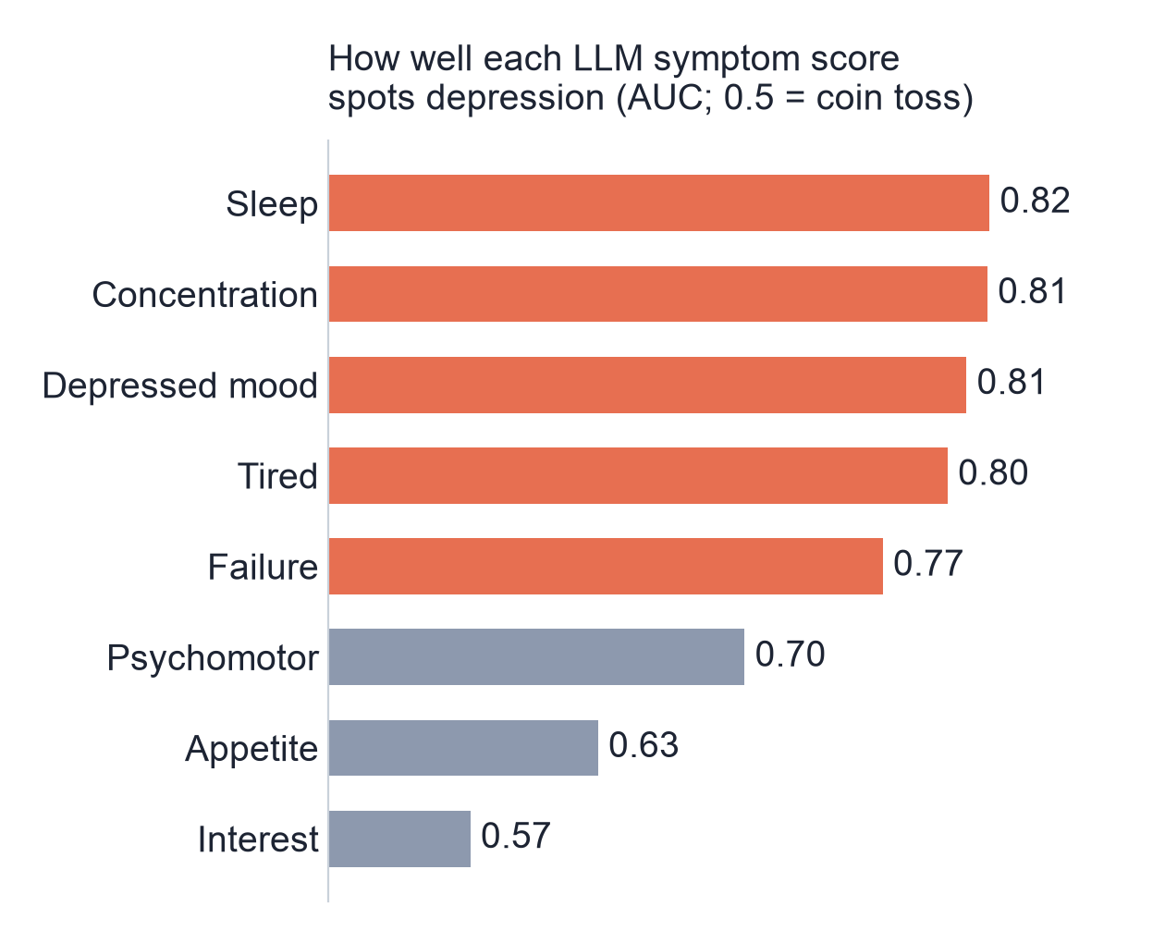
Step 3: which symptoms the LLM detects best
What this shows
Sleep, concentration, mood and tiredness each spot depression well on their own (AUC ~0.8)
Interest is weak: the LLM gives almost everyone the same score
All 8 together, with no training: AUC 0.82
Ridge then learns the best weighting: AUC 0.83

Slide 20
Step 4: combining the three scores
How much each part counts (logistic-regression weights)
Two decision thresholds
Voice
1.61
Risk score 0 to 1 from the three weighted parts.
Max-accuracy: flag if > 0.542
fewest mistakes overall (79% accuracy), but catches only about half of depressed people
Balanced: flag if > 0.196
catches 77% of depressed people; better for screening
Text
1.32
LLM symptoms
3.00
The LLM counts about twice as much as voice or text.
Notes:
Thresholds were chosen on out-of-fold training scores, never on test people.

Slide 21
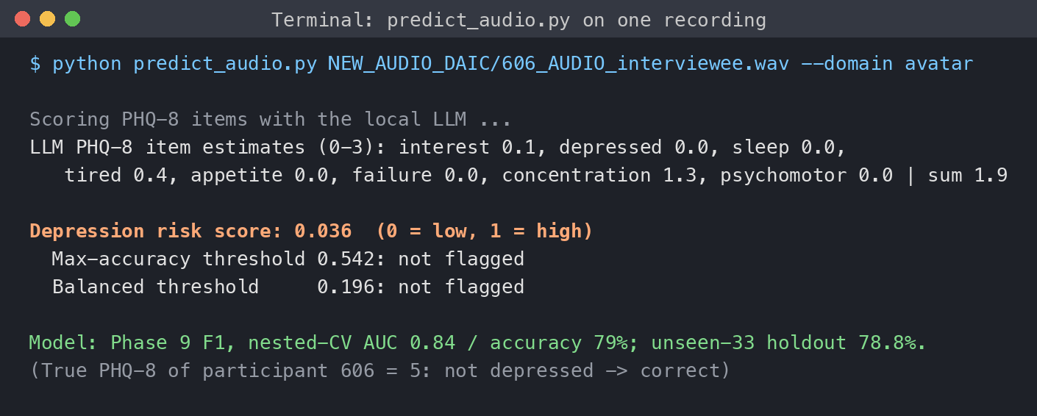
Training the final model and using it
Trained on all 272 people with exactly the steps that were tested.
One command: audio in, risk score out, with the 8 symptom ratings shown.
Matches the training pipeline exactly (score 0.036 for this person).
Saved as models/final_phase9_f1.joblib. Runs offline on an 8 GB MacBook in about 1-3 minutes. Screening aid only, not a diagnosis.

Slide 22
Why we trust it, and its limits
Why it is real
Limits
Both tests agree: 79.1% and 78.8%
Without the 17 people who say "I am depressed": AUC still 0.835
Works for both interview setups (AUC 0.84 / 0.86) and both genders
LLM never sees labels; nothing tuned on test people
33 unseen people is small: 1 person = 3 points
The 33 were opened once before (Oct 19), so a repeat check
At the max-accuracy threshold only about half of depressed people are caught
Research prototype, not a diagnosis

Slide 23
74.3% -> 79.1% accuracy
Model 1 to Model 2: fixed voice settings, +0.9 points. Model 2 to Model 3: added local LLM symptom scoring, +3.9 points.
Final model: 79.1% (cross-validation, AUC 0.84) and 78.8% on 33 unseen people (AUC 0.87), against a 68.8% / 66.7% baseline.

