Slide 1
Module IV
Network Layer: Internet Protocol

Slide 2
20-1 INTERNETWORKING
In this section, we discuss internetworking, connecting networks together to make an internetwork or an internet..
Topics discussed in this section:
Need for Network Layer Internet as a Datagram Network
Internet as a Connectionless Network
20.2

Slide 3
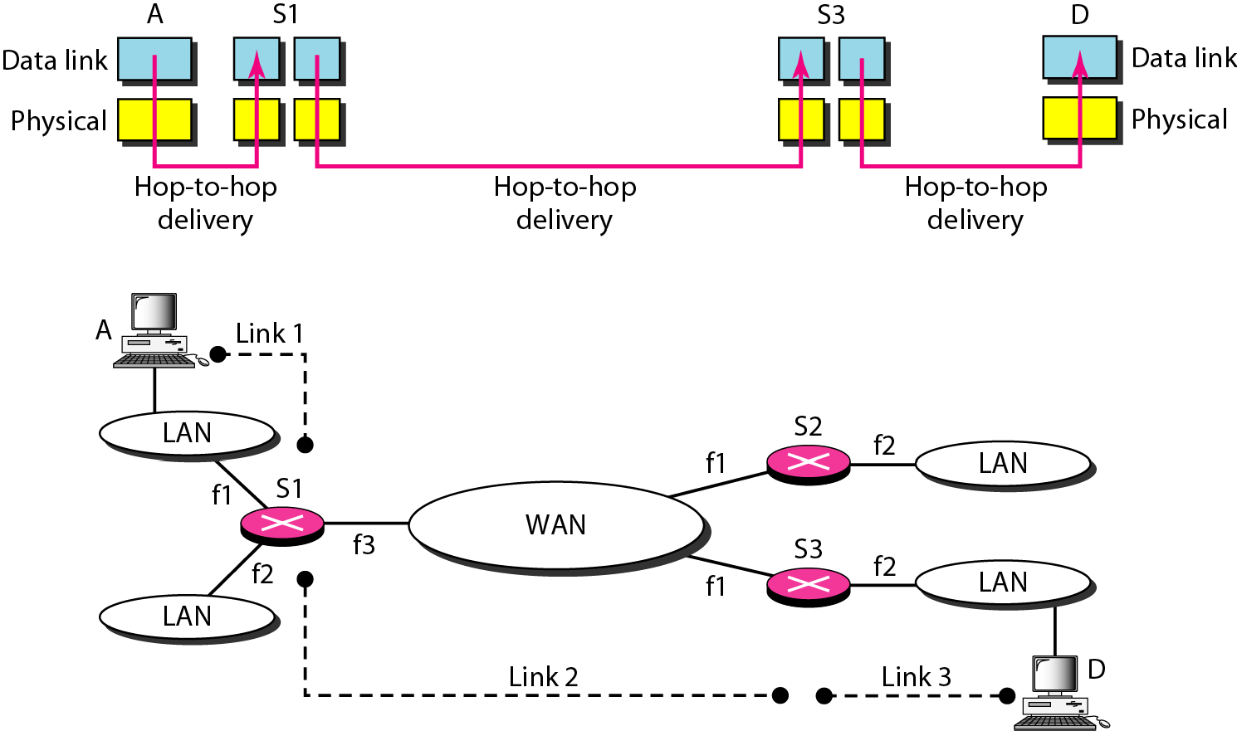
Figure 20.1 Links between two hosts
20.3

Slide 4
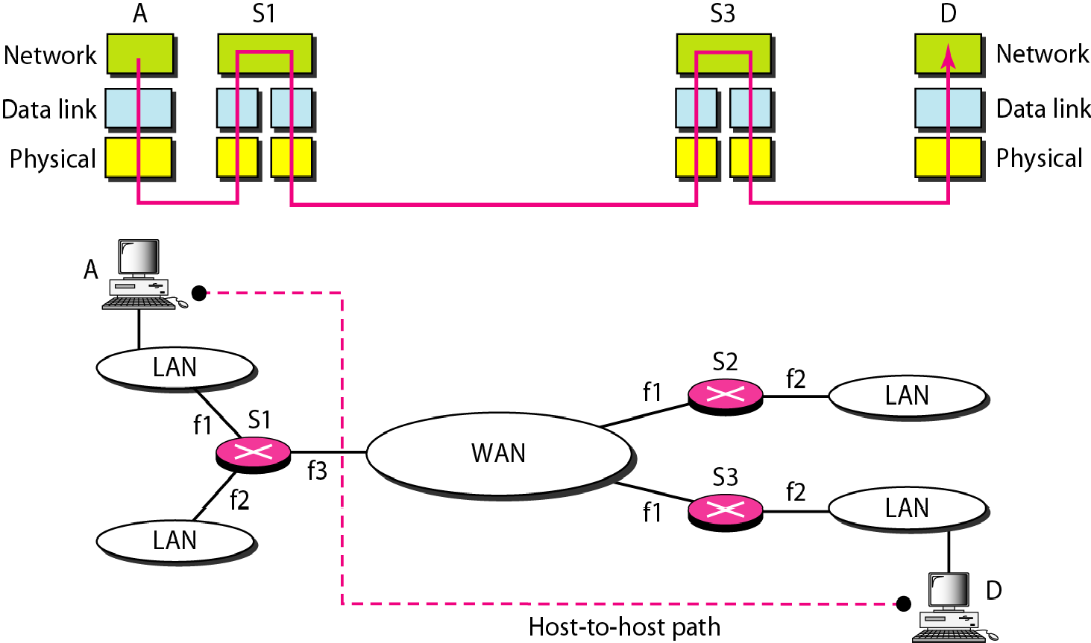
Figure 20.2 Network layer in an internetwork
20.4

Slide 5
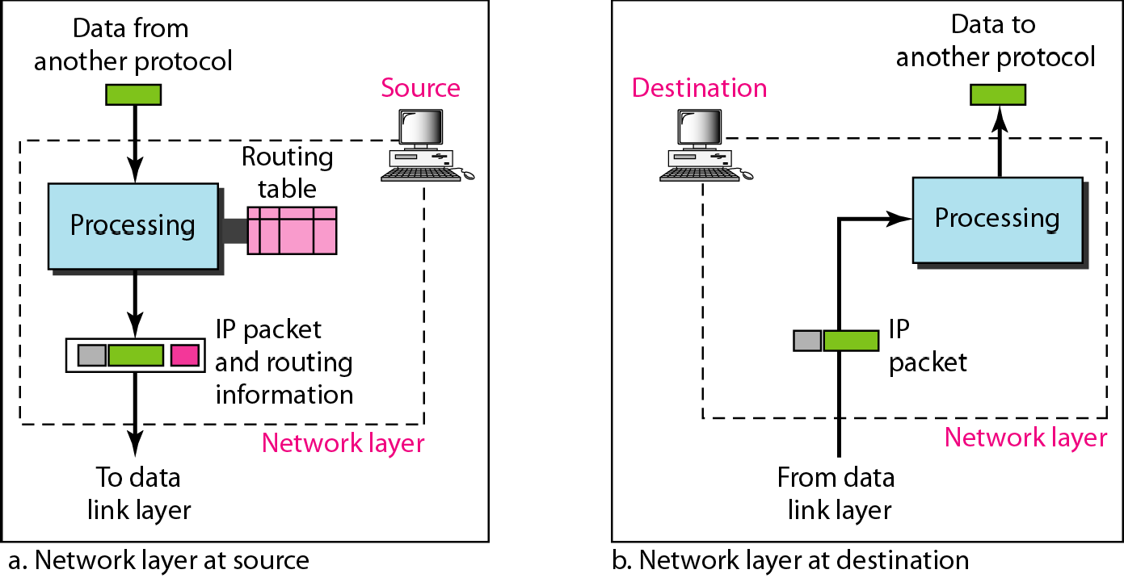
Figure 20.3 Network layer at the source, router, and destination
20.5

Slide 6
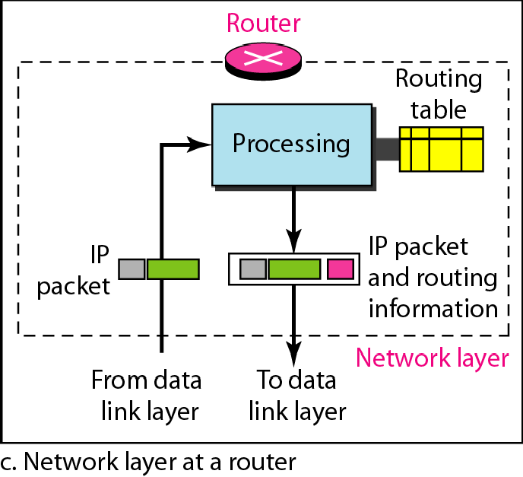
Figure 20.3 Network layer at the source, router, and destination (continued)
20.6

Slide 7
Note
Switching at the network layer in the Internet uses the datagram approach to packet switching.
20.7

Slide 8
Note
Communication at the network layer in the Internet is connectionless.
20.8

Slide 9
20-2 IPv4
The Internet Protocol version 4 (IPv4) is the delivery mechanism used by the TCP/IP protocols.
Topics discussed in this section:
Datagram Fragmentation Checksum Options
20.9

Slide 10
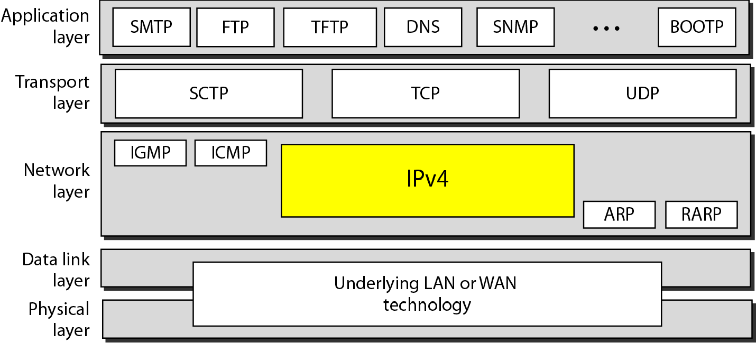
Figure 20.4 Position of IPv4 in TCP/IP protocol suite

Slide 11
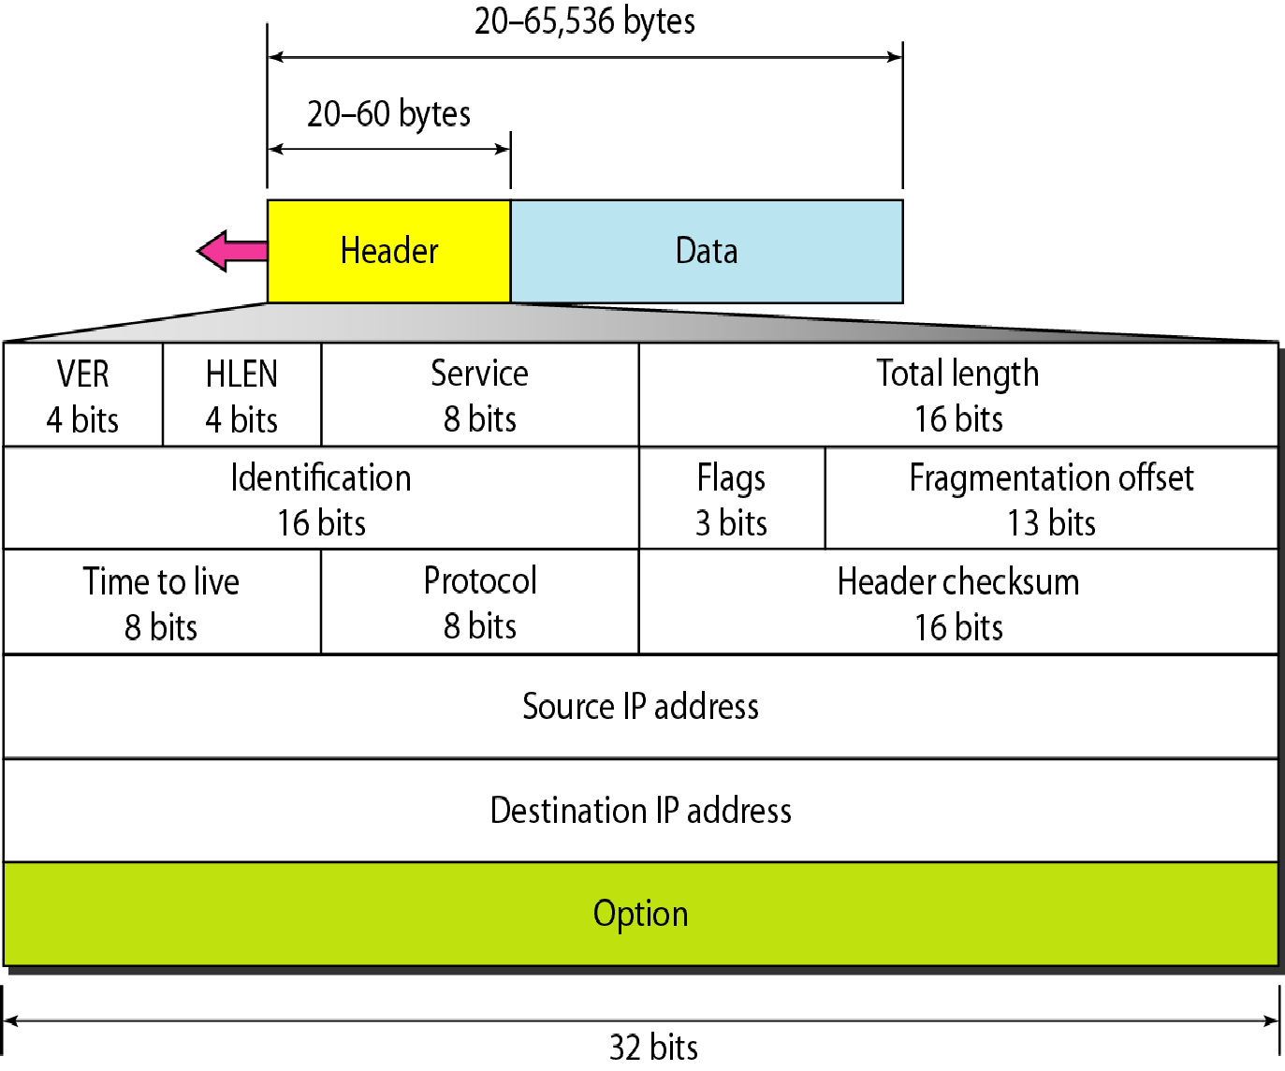
Figure 20.5 IPv4 datagram format

Slide 12
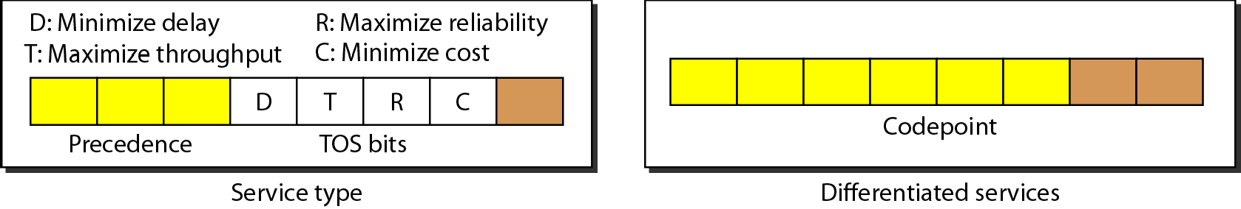
Figure 20.6 Service type or differentiated services

Slide 13
Note
The precedence subfield was part of version 4, but never used.

Slide 14
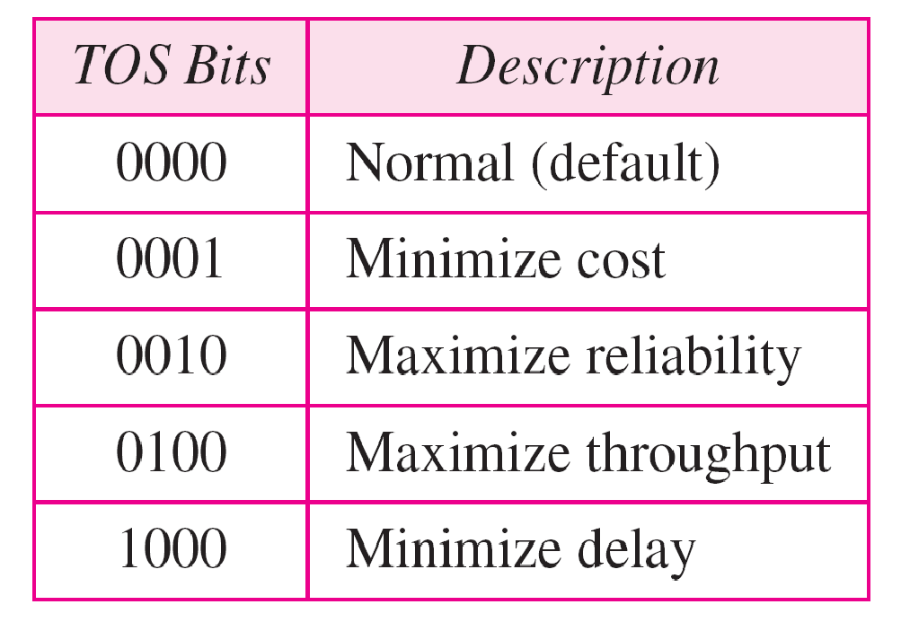
Table 20.1 Types of service

Slide 15
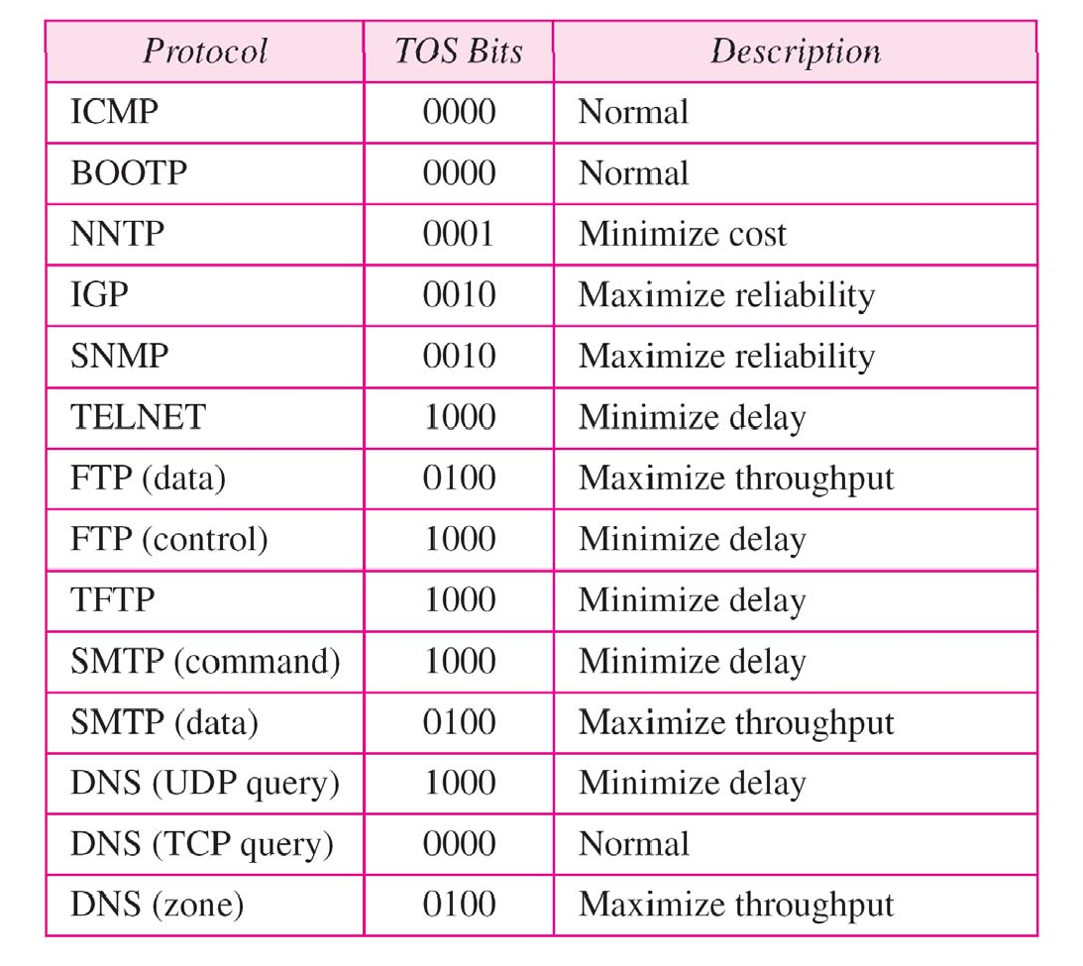
Table 20.2 Default types of service

Slide 16
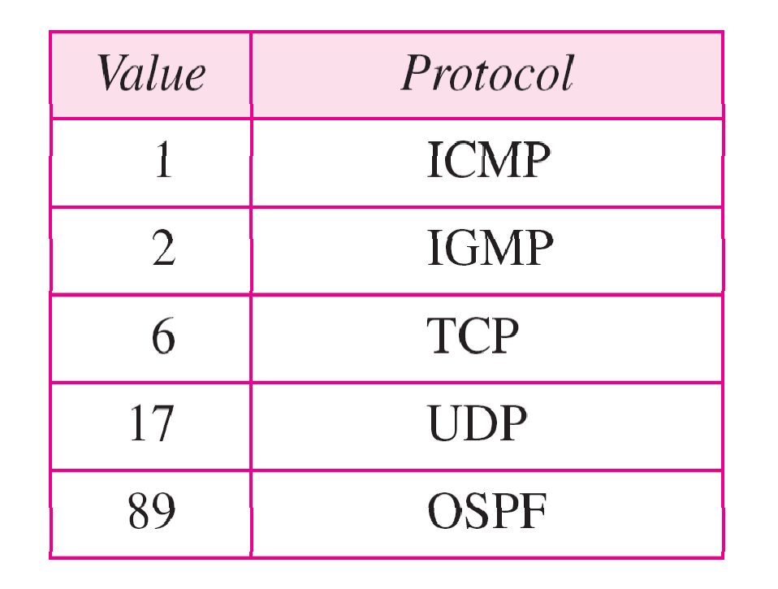
Table 20.3 Values for codepoints

Slide 17
Note
The total length field defines the total length of the datagram including the header.

Slide 18
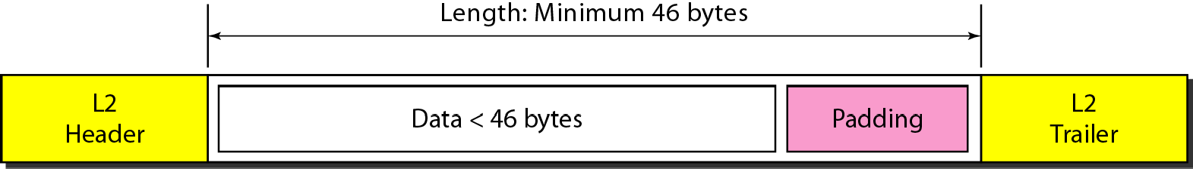
Figure 20.7 Encapsulation of a small datagram in an Ethernet frame

Slide 19
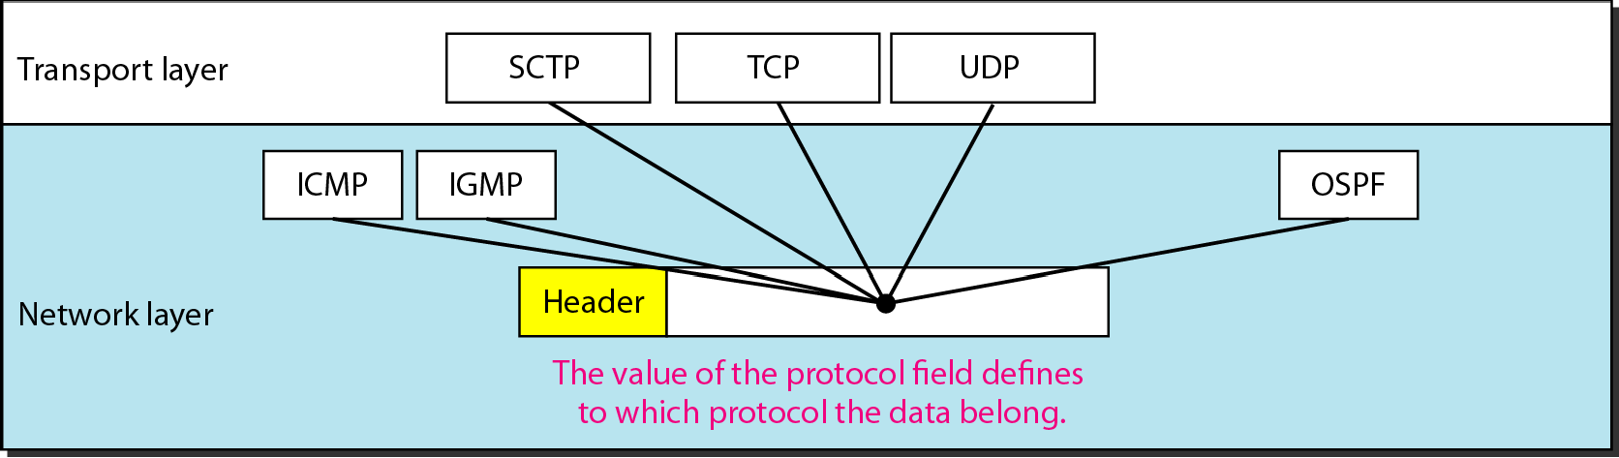
Figure 20.8 Protocol field and encapsulated data

Slide 20
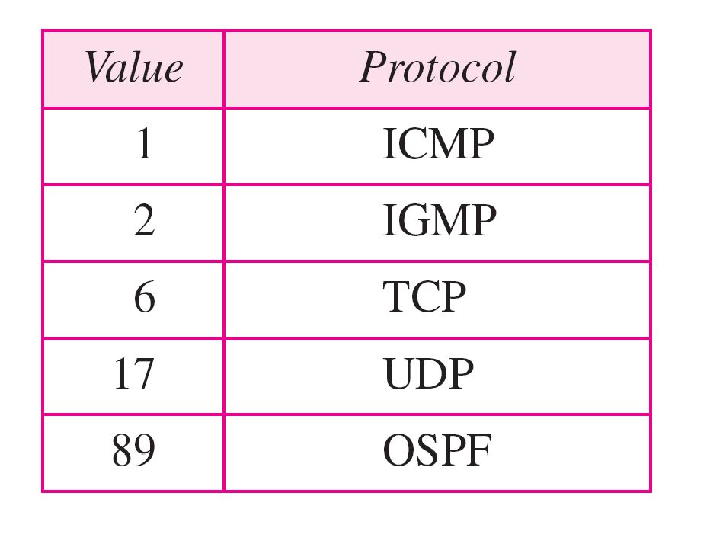
Table 20.4 Protocol values

Slide 21
Example 20.1
An IPv4 packet has arrived with the first 8 bits as shown:
01000010
The receiver discards the packet. Why?
Solution
There is an error in this packet. The 4 leftmost bits (0100) show the version, which is correct. The next 4 bits (0010) show an invalid header length (2 × 4 = 8). The minimum number of bytes in the header must be 20 The packet has been corrupted in transmission.

Slide 22
Example 20.2
In an IPv4 packet, the value of HLEN is 1000 in binary. How many bytes of options are being carried by this packet?
Solution
The HLEN value is 8, which means the total number of bytes in the header is 8 × 4, or 32 bytes The first 20 bytes are the base header, the next 12 bytes are the options.

Slide 23
Example 20.3
In an IPv4 packet, the value of HLEN is 5, and the value of the total length field is 0x0028. How many bytes of data are being carried by this packet?
Solution
The HLEN value is 5, which means the total number of bytes in the header is 5 × 4, or 20 bytes (no options) The total length is 40 bytes, which means the packet is carrying 20 bytes of data (40 − 20)

Slide 24
Example 20.4
An IPv4 packet has arrived with the first few hexadecimal digits as shown.
0x45000028000100000102 . . .
How many hops can this packet travel before being dropped? The data belong to what upper-layer protocol?
Solution
To find the time-to-live field, we skip 8 bytes. The time-to- live field is the ninth byte, which is 01. This means the packet can travel only one hop. The protocol field is the next byte (02), which means that the upper-layer protocol is IGMP.

Slide 25
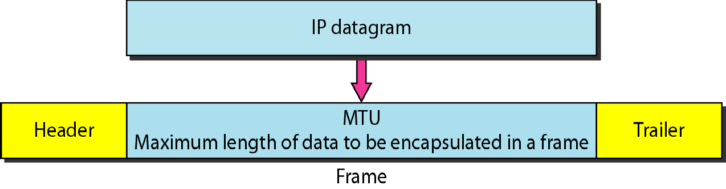
Figure 20.9 Maximum transfer unit (MTU)

Slide 26
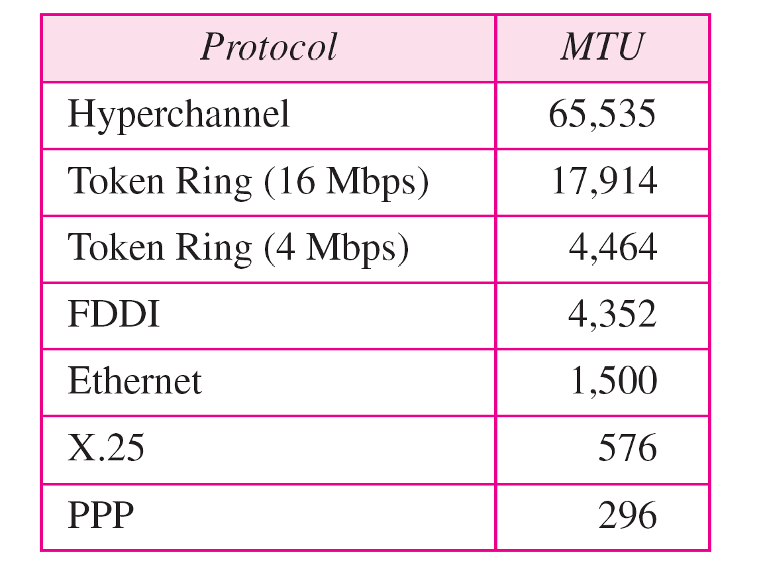
Table 20.5 MTUs for some networks

Slide 27

Figure 20.10 Flags used in fragmentation

Slide 28
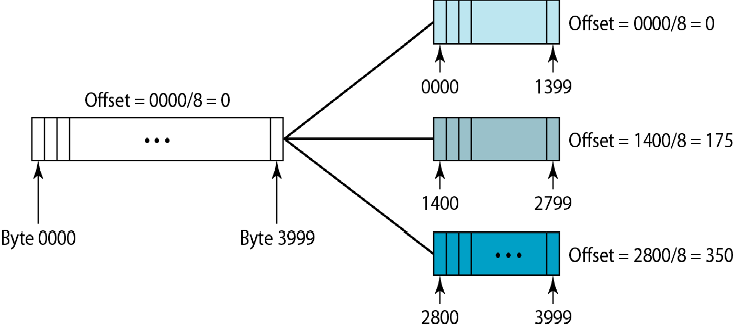
Figure 20.11 Fragmentation example

Slide 29
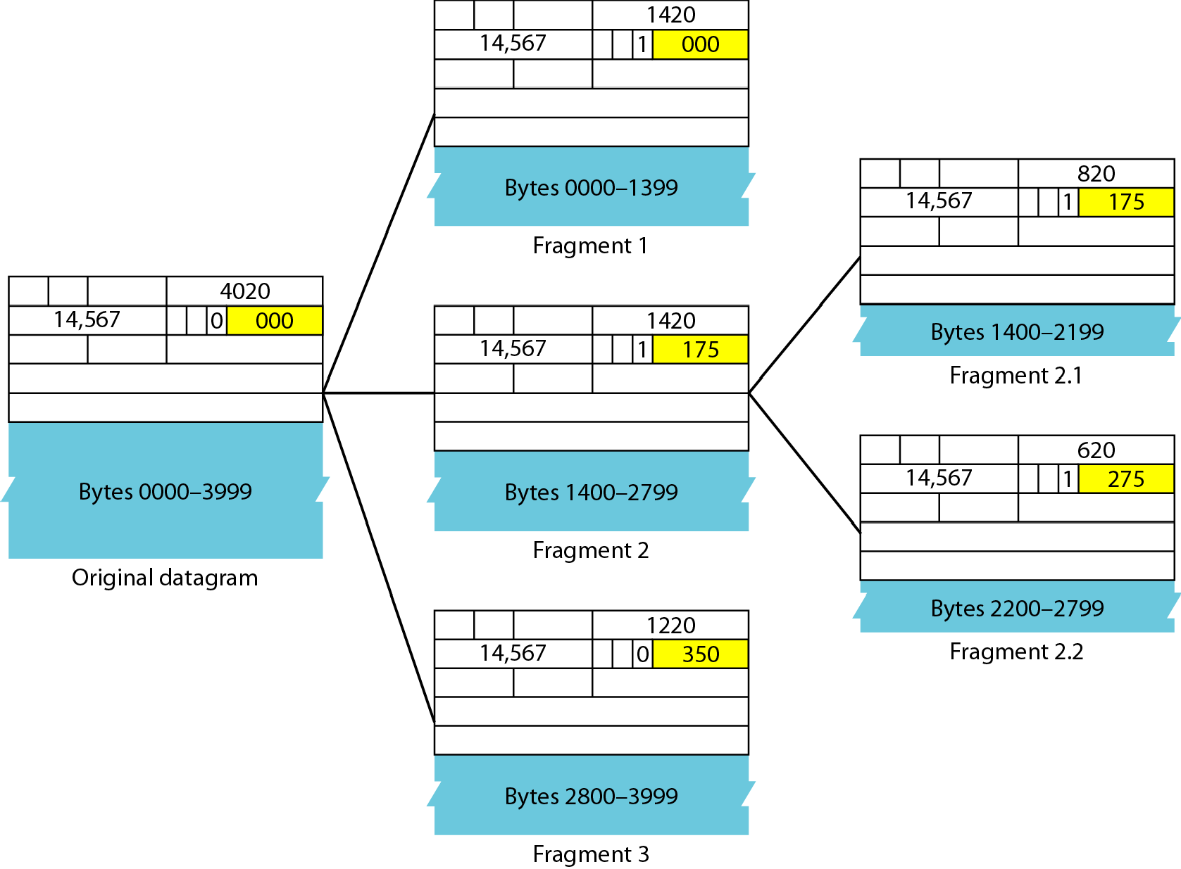
Figure 20.12 Detailed fragmentation example

Slide 30
Example 20.5
A packet has arrived with an M bit value of 0. Is this the first fragment, the last fragment, or a middle fragment? Do we know if the packet was fragmented?
Solution
If the M bit is 0, it means that there are no more fragments; the fragment is the last one However, we cannot say if the original packet was fragmented or not. A non-fragmented packet is considered the last fragment

Slide 31
Example 20.6
A packet has arrived with an M bit value of 1. Is this the first fragment, the last fragment, or a middle fragment? Do we know if the packet was fragmented?
Solution
If the M bit is 1, it means that there is at least one more fragment This fragment can be the first one or a middle one, but not the last one. We don’t know if it is the first one or a middle one; we need more information (the value of the fragmentation offset).

Slide 32
Example 20.7
A packet has arrived with an M bit value of 1 and a fragmentation offset value of 0. Is this the first fragment, the last fragment, or a middle fragment?
Solution
Because the M bit is 1, it is either the first fragment or a middle one Because the offset value is 0, it is the first fragment.

Slide 33
Example 20.8
A packet has arrived in which the offset value is 100. What is the number of the first byte? Do we know the number of the last byte?
Solution
To find the number of the first byte, we multiply the offset value by 8 This means that the first byte number is 800 We cannot determine the number of the last byte unless we know the length.

Slide 34
Example 20.9
A packet has arrived in which the offset value is 100, the value of HLEN is 5, and the value of the total length field is 100. What are the numbers of the first byte and the last byte?
Solution
The first byte number is 100 × 8 = 800. The total length is 100 bytes, and the header length is 20 bytes (5 × 4), which means that there are 80 bytes in this datagram. If the first byte number is 800, the last byte number must be 879

Slide 35
Example 20.10
Figure 20.13 shows an example of a checksum calculation for an IPv4 header without options. The header is divided into 16-bit sections. All the sections are added and the sum is complemented. The result is inserted in the checksum field.

Slide 36
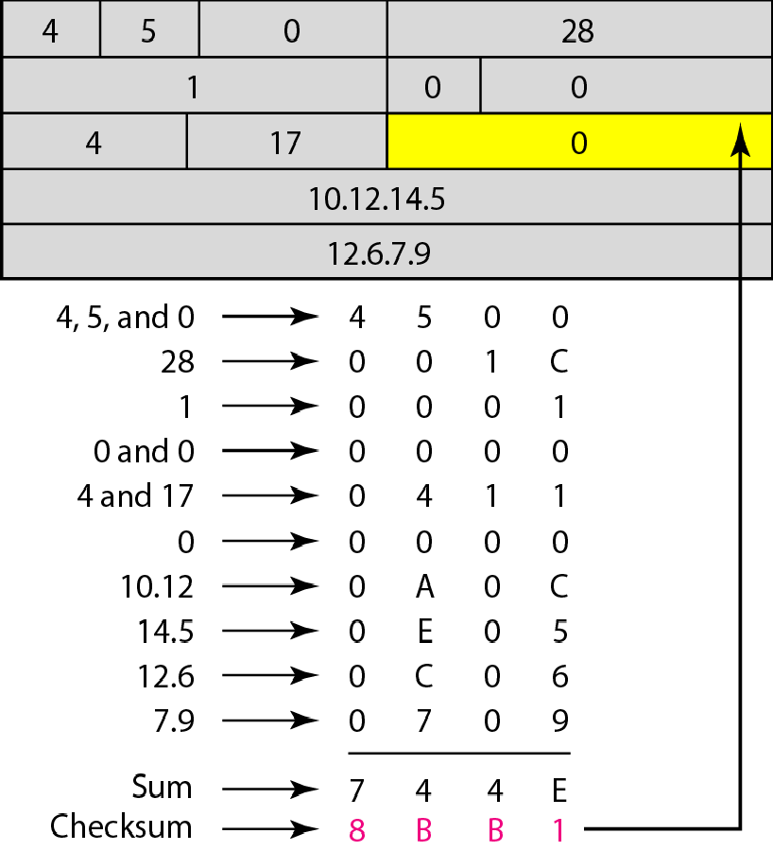
Figure 20.13 Example of checksum calculation in IPv4

Slide 37
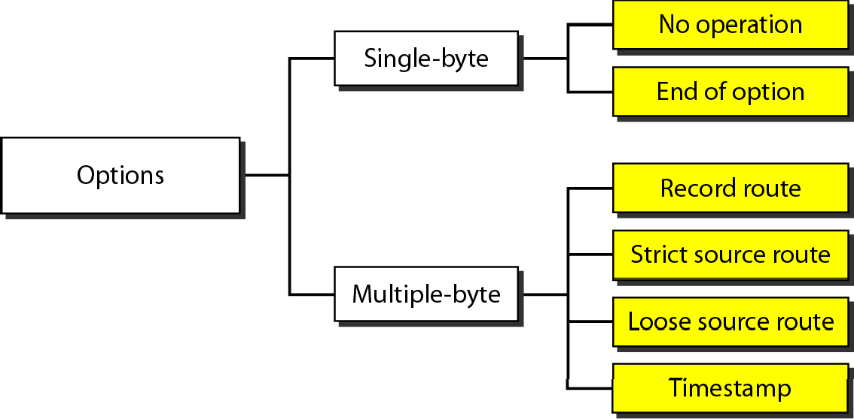
Figure 20.14 Taxonomy of options in IPv4

Slide 38
20-3 IPv6
The network layer protocol in the TCP/IP protocol suite is currently IPv4. Although IPv4 is well designed, data communication has evolved since the inception of IPv4 in the 1970s. IPv4 has some deficiencies that make it unsuitable for the fast-growing Internet..
Topics discussed in this section:
Advantages Packet Format Extension Headers

Slide 39
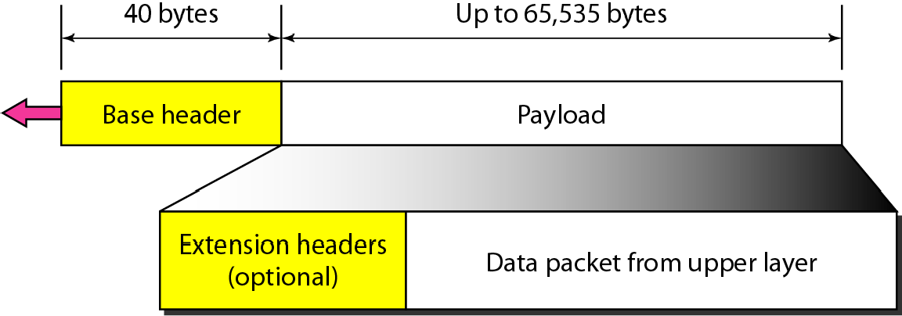
Figure 20.15 IPv6 datagram header and payload

Slide 40
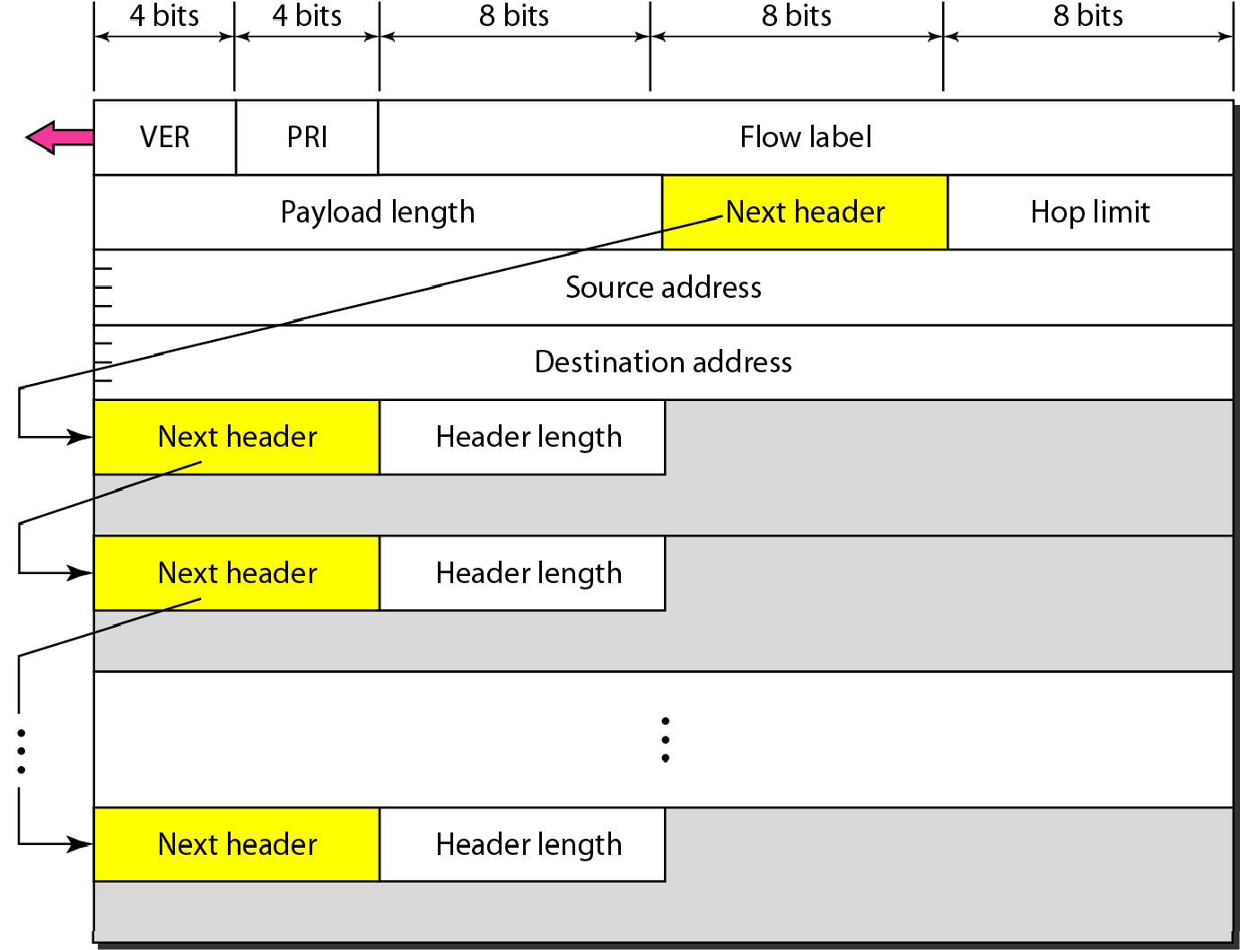
Figure 20.16 Format of an IPv6 datagram

Slide 41
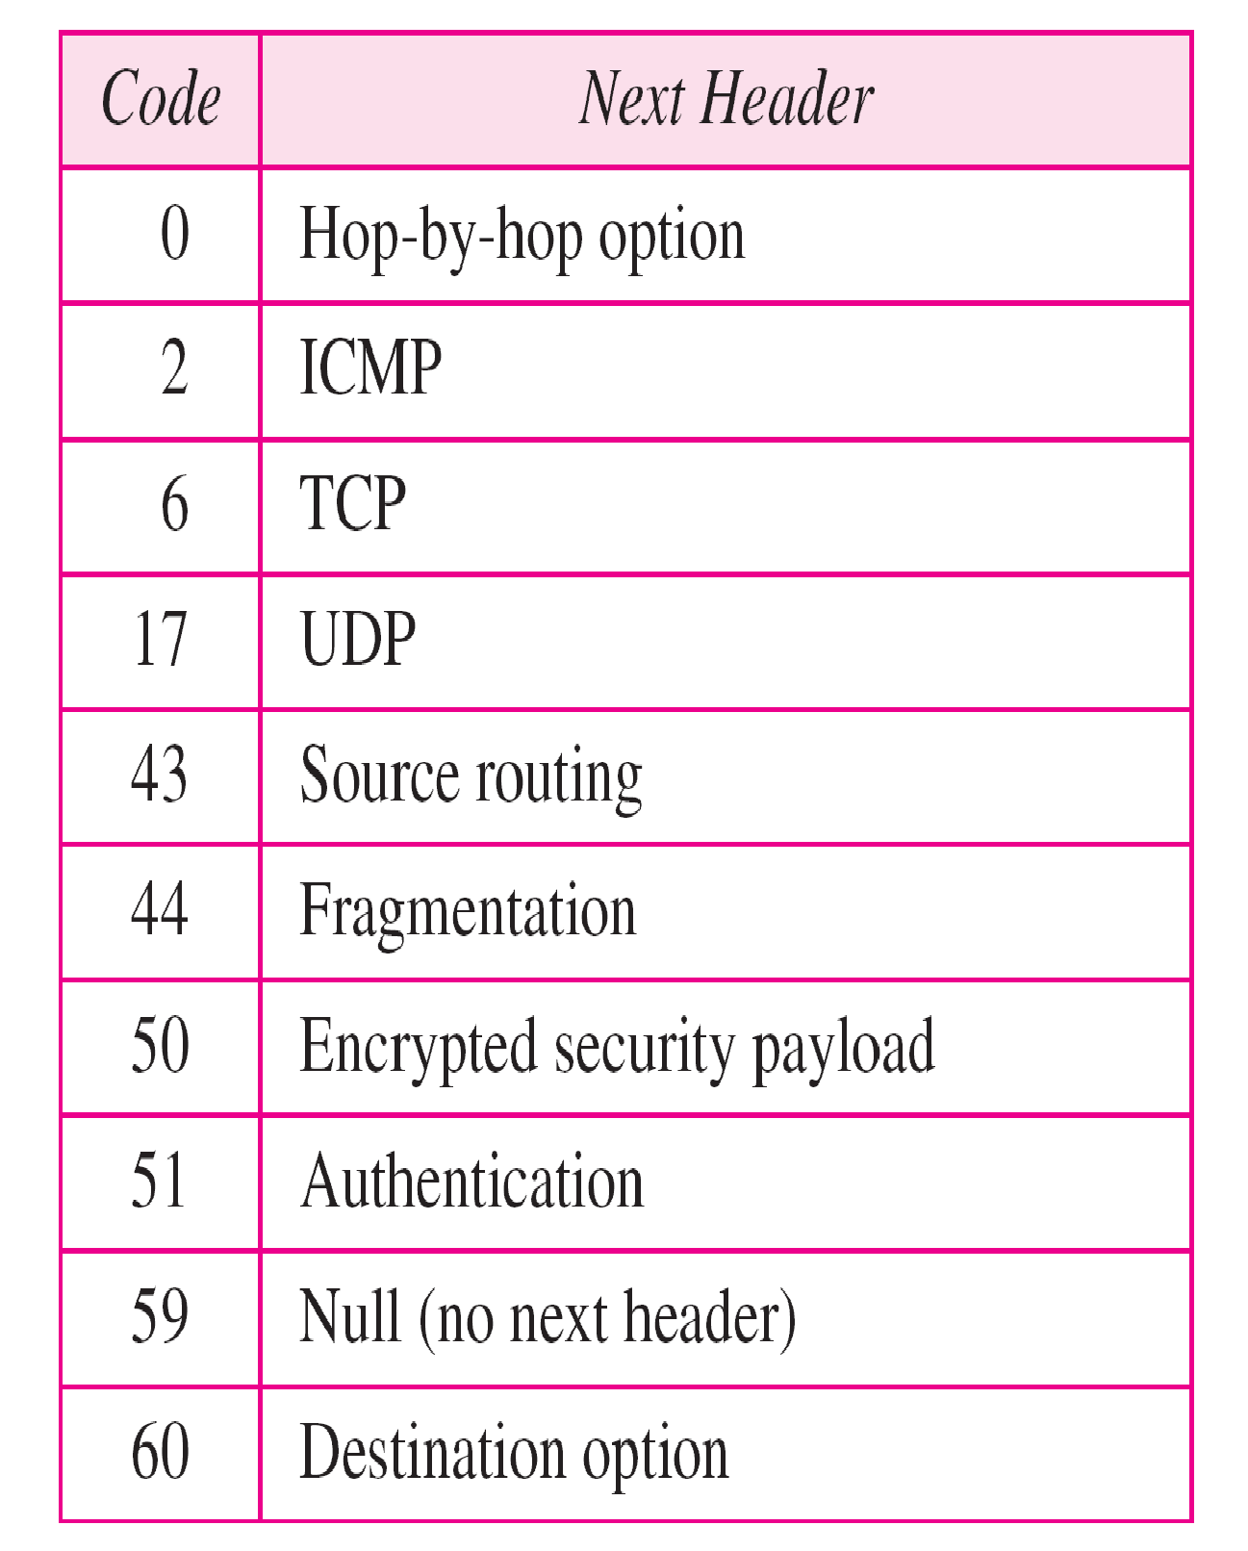
Table 20.6 Next header codes for IPv6

Slide 42
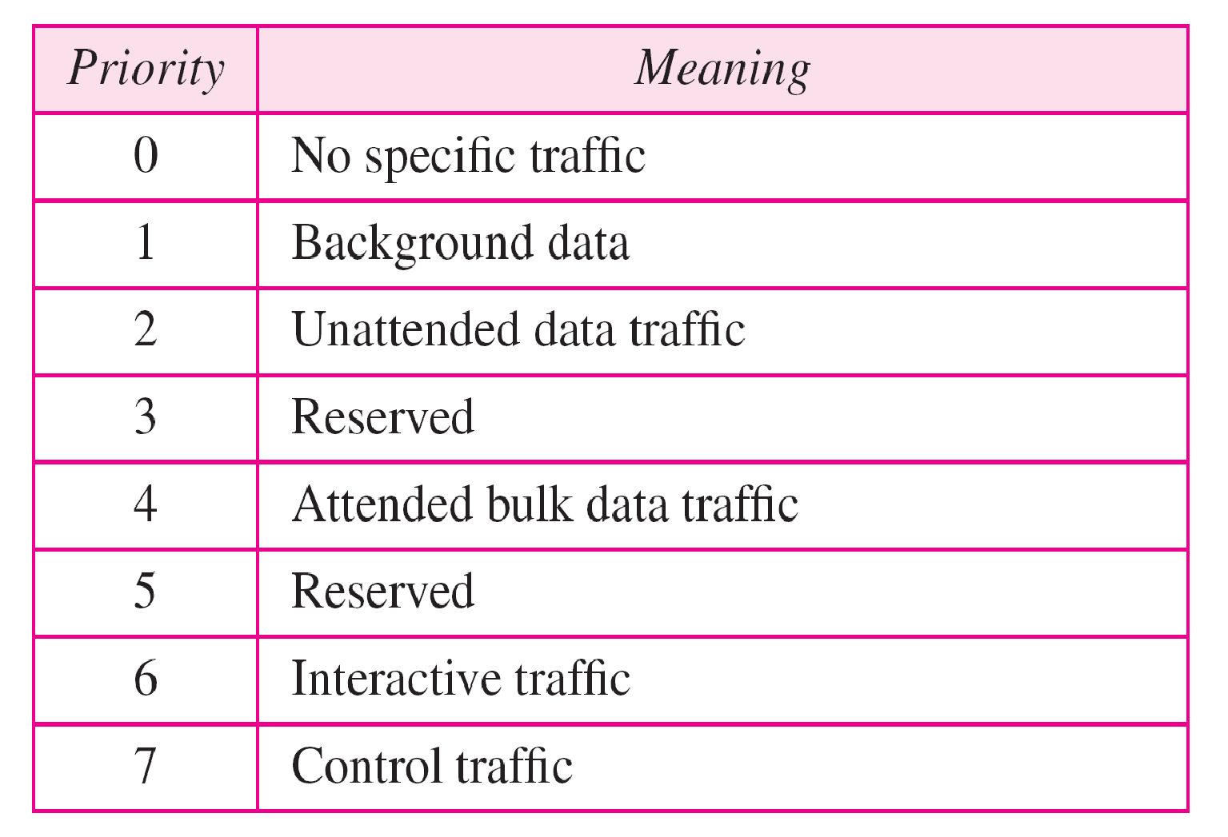
Table 20.7 Priorities for congestion-controlled traffic

Slide 43
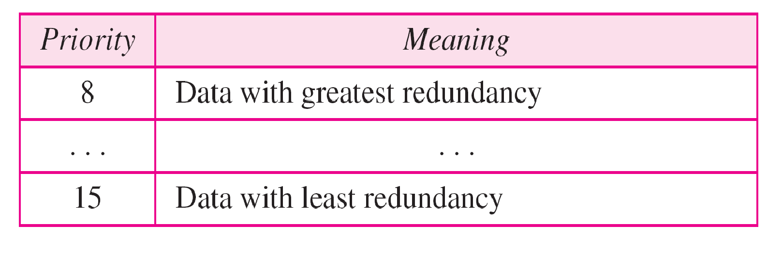
Table 20.8 Priorities for noncongestion-controlled traffic

Slide 44
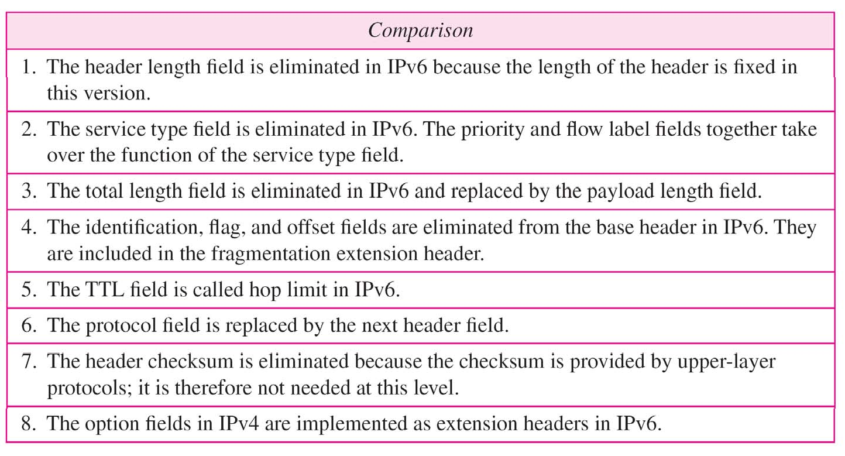
Table 20.9 Comparison between IPv4 and IPv6 packet headers

Slide 45
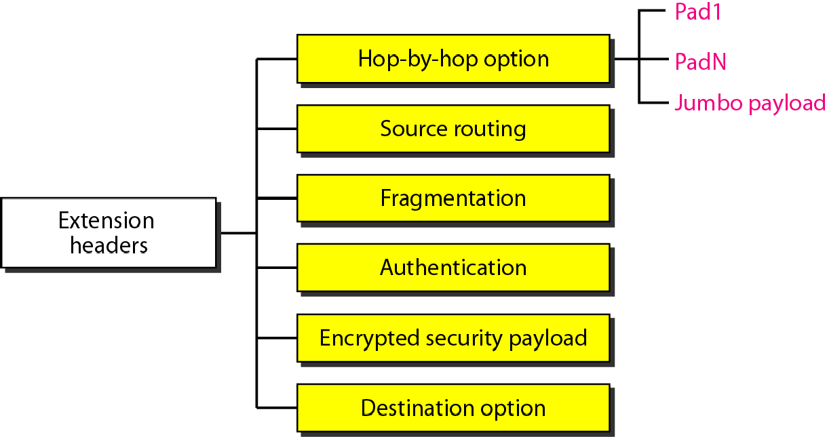
Figure 20.17 Extension header types

Slide 46
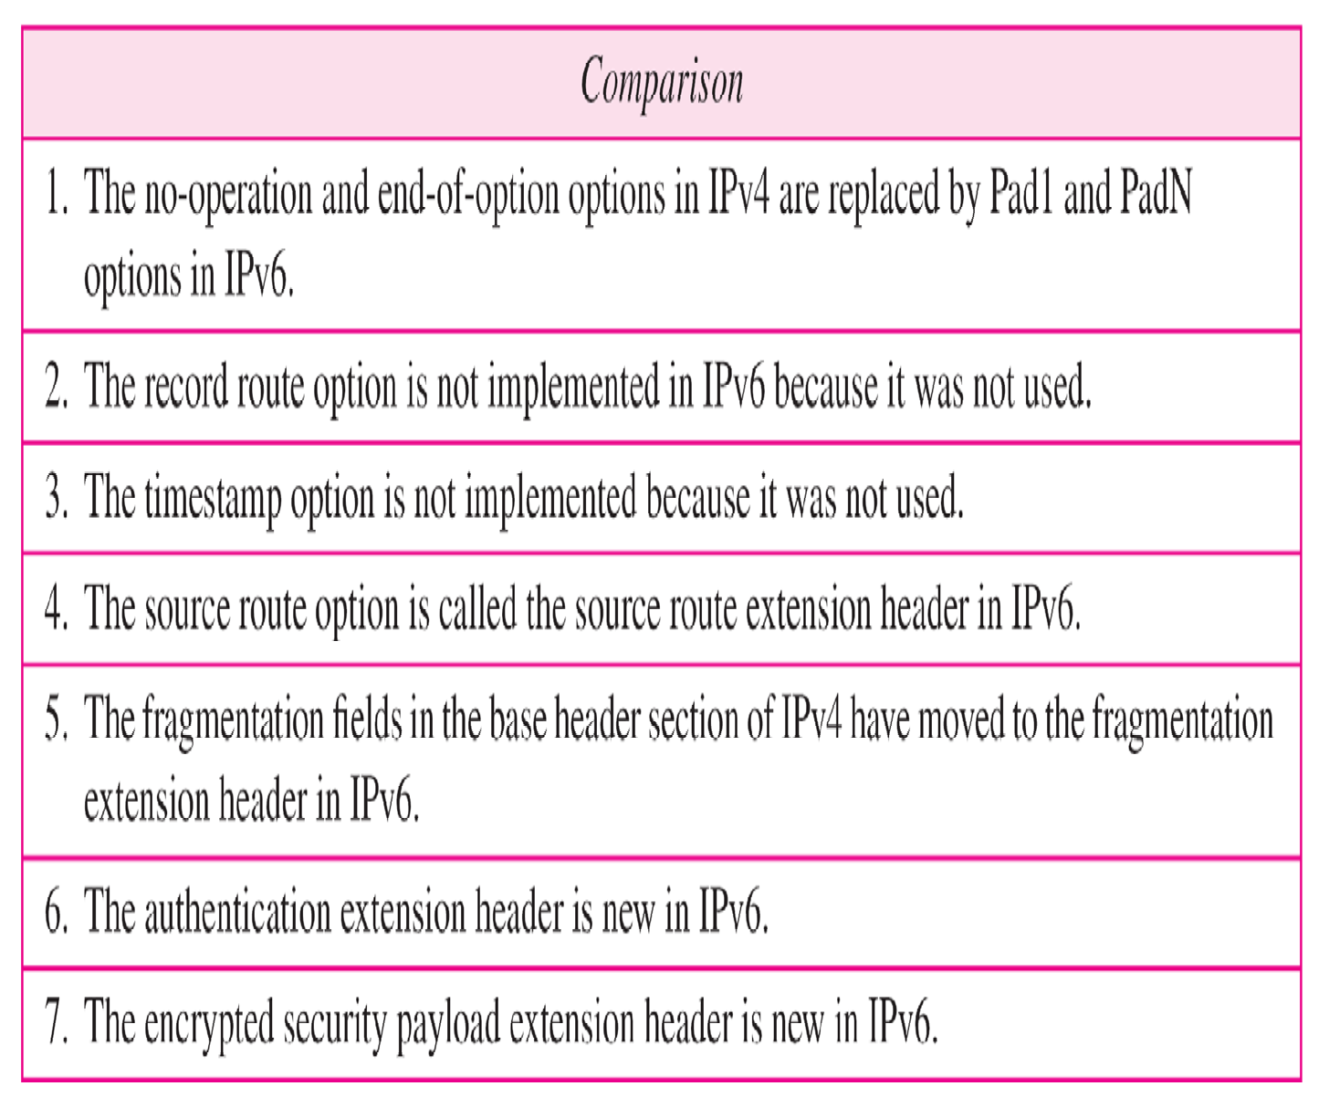
Table 20.10 Comparison between IPv4 options and IPv6 extension headers

Slide 47
20-4 TRANSITION FROM IPv4 TO IPv6
Because of the huge number of systems on the Internet, the transition from IPv4 to IPv6 cannot happen suddenly.. It takes a considerable amount of time before every system in the Internet can move from IPv4 to IPv6.. The transition must be smooth to prevent any problems between IPv4 and IPv6 systems.
Topics discussed in this section:
Dual Stack Tunneling
Header Translation

Slide 48
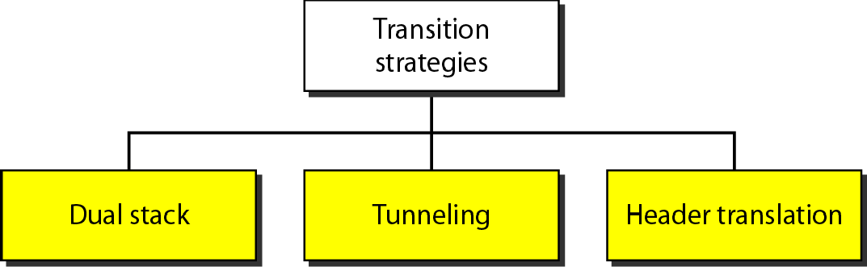
Figure 20.18 Three transition strategies

Slide 49
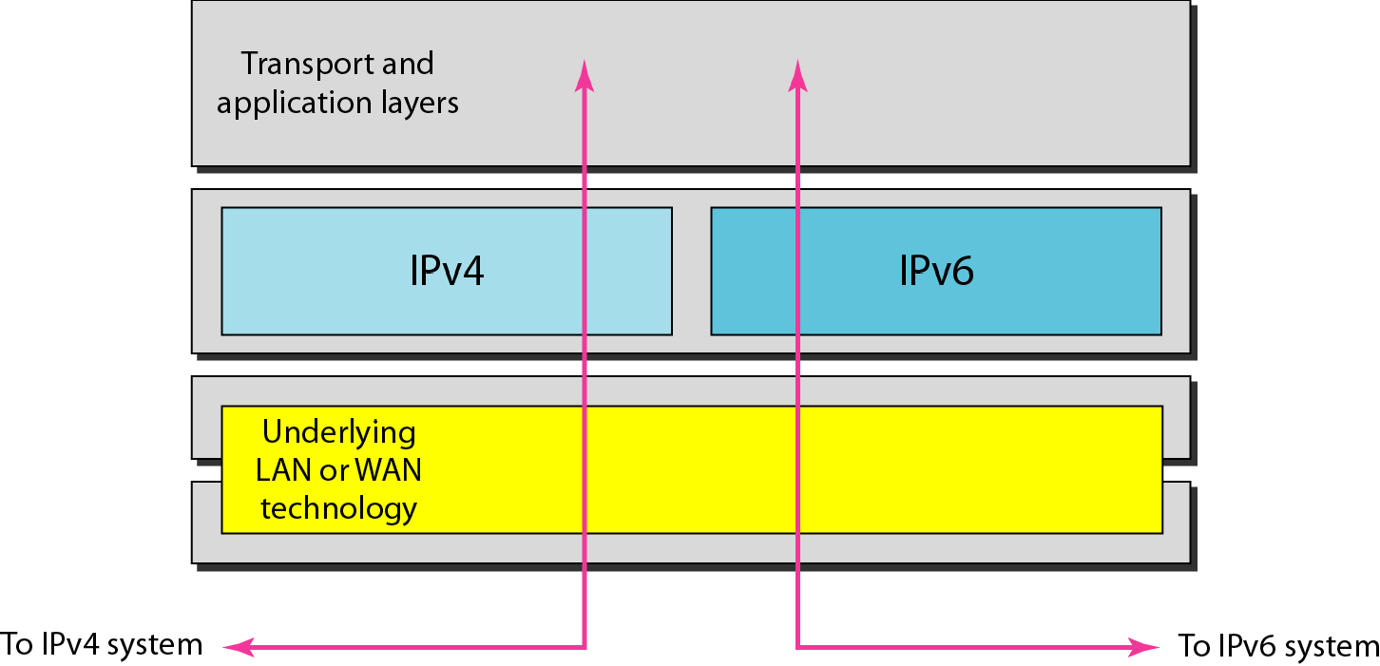
Figure 20.19 Dual stack

Slide 50
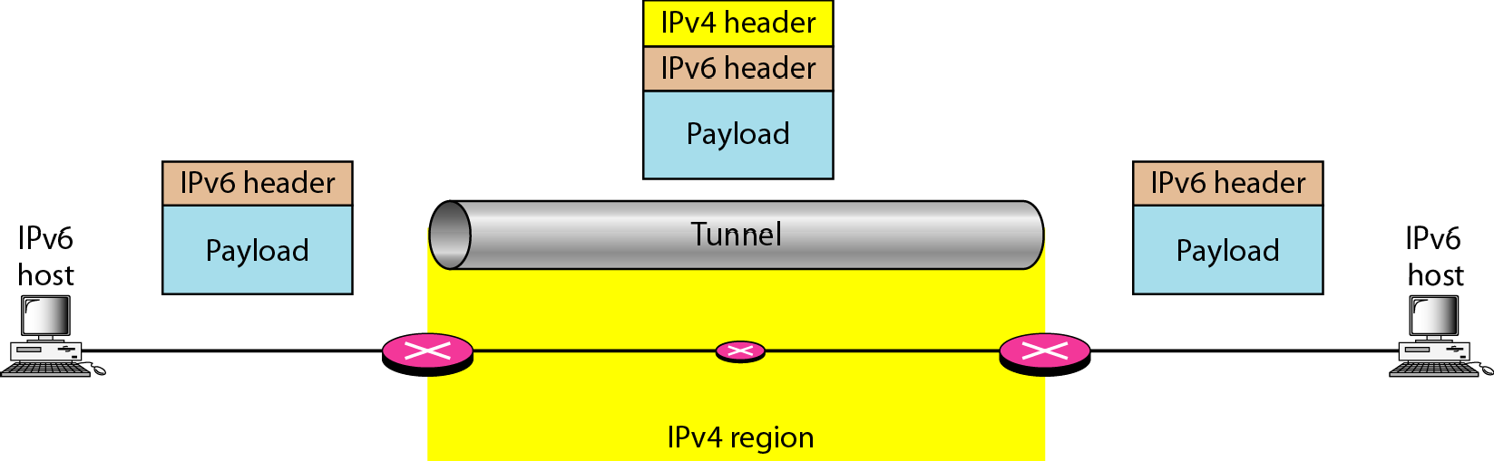
Figure 20.20 Tunneling strategy

Slide 51
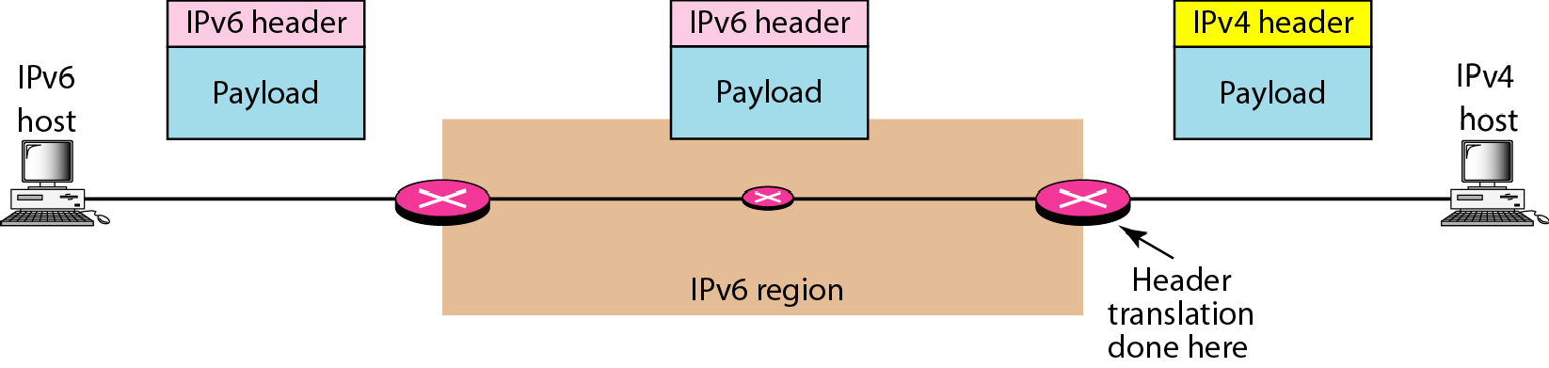
Figure 20.21 Header translation strategy

Slide 52
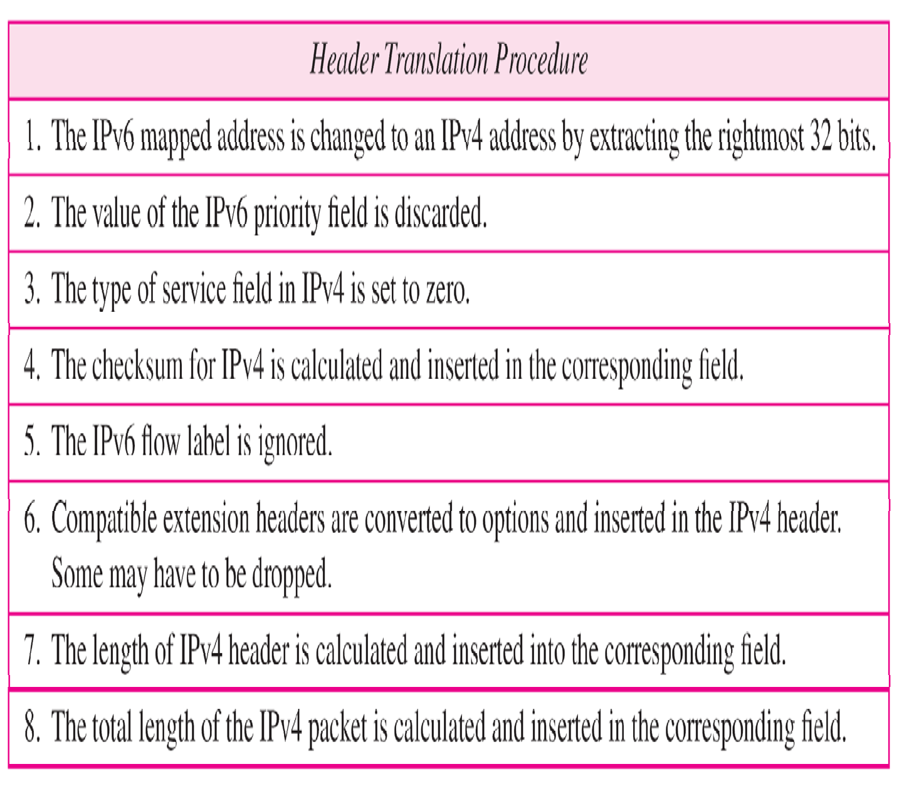
Table 20.11
Header translation

