Slide 1
Module IV
Network Layer: Address Mapping, Error Reporting, and Multicasting

Slide 2
21-2 ICMP
The IP protocol has no error-reporting or error- correcting mechanism. The IP protocol also lacks a mechanism for host and management queries.. The Internet Control Message Protocol (ICMP) has been designed to compensate for the above two deficiencies.. It is a companion to the IP protocol.
Topics discussed in this section:
Types of Messages Message Format
Error Reporting and Query Debugging Tools

Slide 3
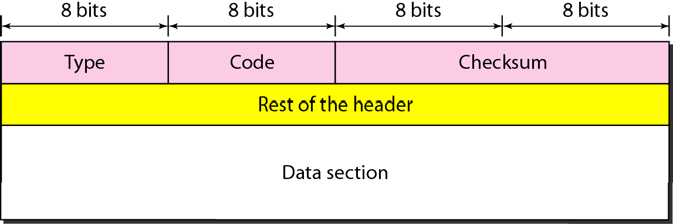
Figure 21.8 General format of ICMP messages

Slide 4

Note
ICMP always reports error messages to the original source.

Slide 5
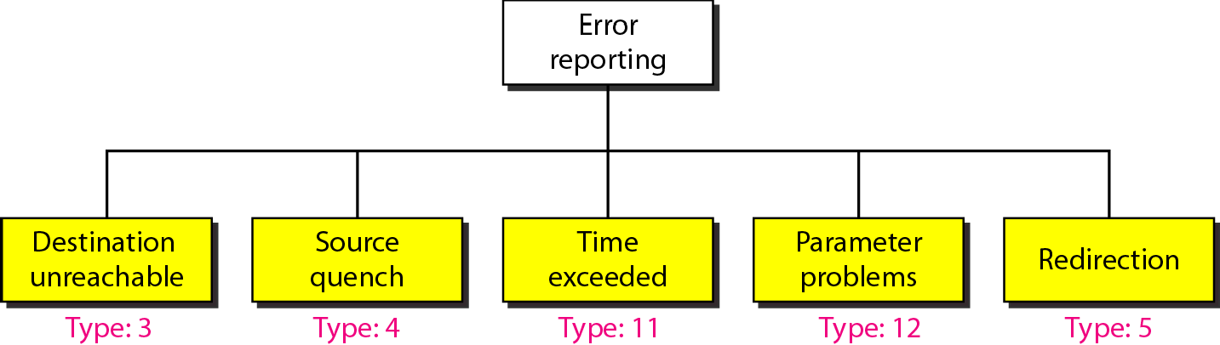
Figure 21.9 Error-reporting messages

Slide 6
Note
Important points about ICMP error messages:
No ICMP error message will be generated in response to a datagram carrying an ICMP error message.
No ICMP error message will be generated for a fragmented datagram that is not the first fragment.
No ICMP error message will be generated for a datagram having a multicast address.
No ICMP error message will be generated for a datagram having a special address such as
127.0.0.0 or 0.0.0.0.

Slide 7
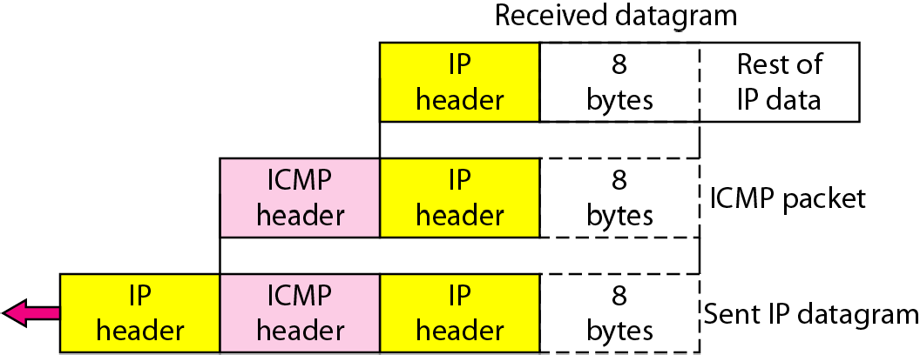
Figure 21.10 Contents of data field for the error messages

Slide 8
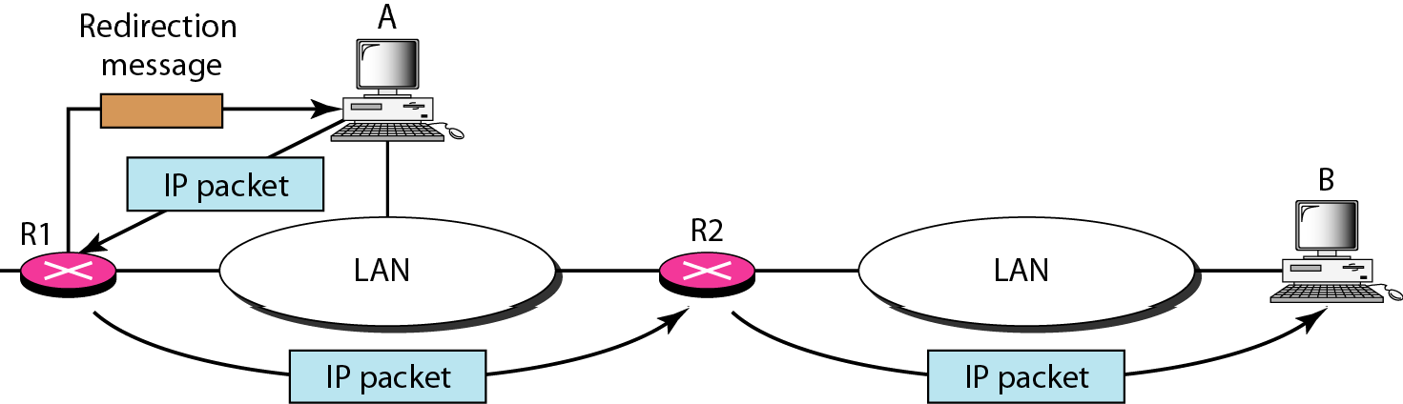
Figure 21.11 Redirection concept

Slide 9
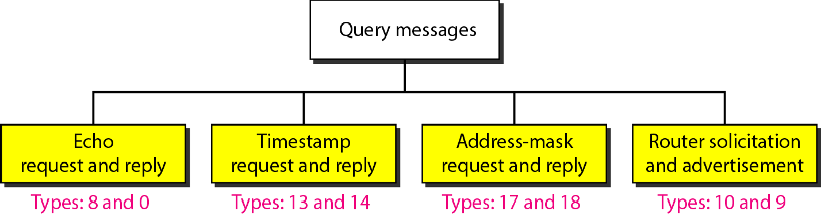
Figure 21.12 Query messages

Slide 10
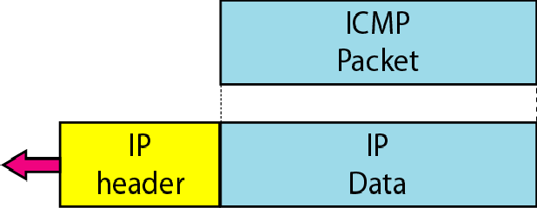
Figure 21.13 Encapsulation of ICMP query messages

Slide 11
Example 21.2
Figure 21.14 shows an example of checksum calculation for a simple echo-request message. We randomly chose the identifier to be 1 and the sequence number to be 9. The message is divided into 16-bit (2-byte) words. The words are added and the sum is complemented. Now the sender can put this value in the checksum field.

Slide 12
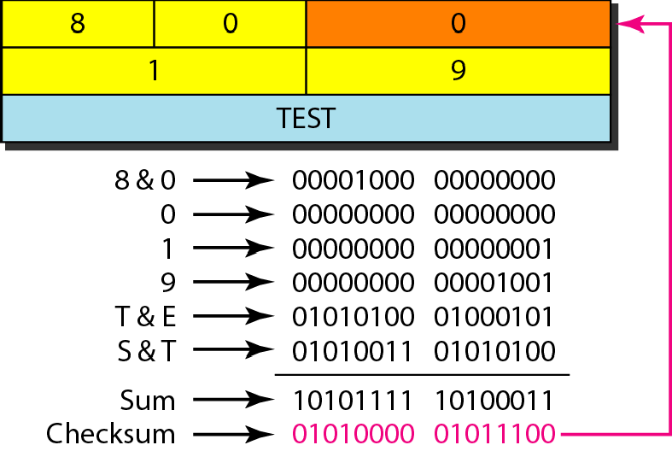
Figure 21.14 Example of checksum calculation

Slide 13
Example 21.3
We use the ping program to test the server fhda.edu. The result is shown on the next slide. The ping program sends messages with sequence numbers starting from 0. For each probe it gives us the RTT time. The TTL (time to live) field in the IP datagram that encapsulates an ICMP message has been set to 62. At the beginning, ping defines the number of data bytes as 56 and the total number of bytes as 84. It is obvious that if we add 8 bytes of ICMP header and 20 bytes of IP header to 56, the result is 84. However, note that in each probe ping defines the number of bytes as 64. This is the total number of bytes in the ICMP packet (56 + 8).

Slide 14
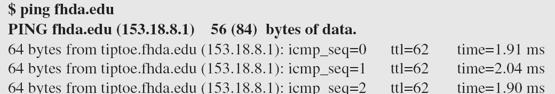
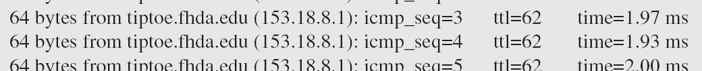
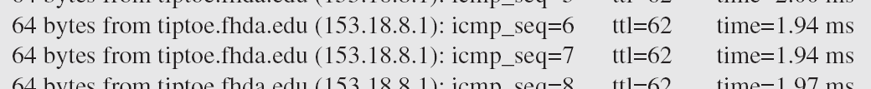
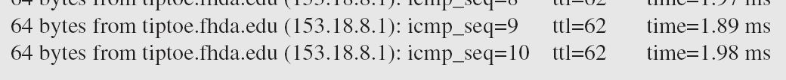

Example 21.3 (continued)

Slide 15
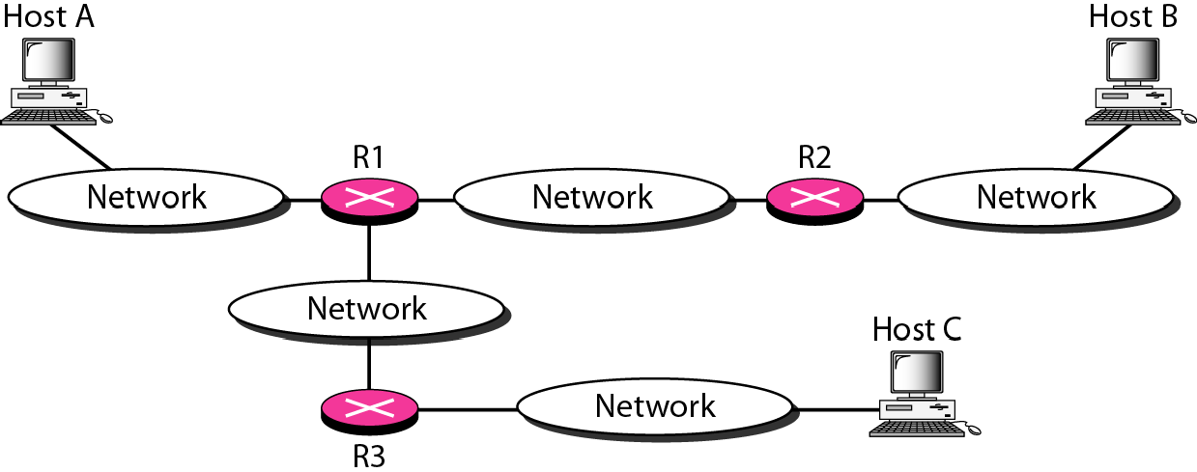
Figure 21.15 The traceroute program operation

Slide 16
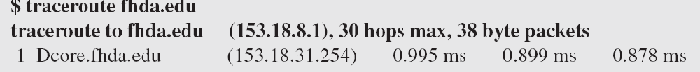
Example 21.4
We use the traceroute program to find the route from the computer voyager.deanza.edu to the server fhda.edu. The following shows the result:
The unnumbered line after the command shows that the destination is 153.18.8.1. The packet contains 38 bytes: 20 bytes of IP header, 8 bytes of UDP header, and 10 bytes of application data. The application data are used by traceroute to keep track of the packets.

Slide 17
Example 21.4 (continued)
The first line shows the first router visited. The router is named Dcore fhda edu with IP address 153 18 31 254 The first round-trip time was 0.995 ms, the second was 0 899 ms, and the third was 0 878 ms The second line shows the second router visited. The router is named Dbackup fhda edu with IP address 153 18 251 4 The three round-trip times are also shown. The third line shows the destination host We know that this is the destination host because there are no more lines. The destination host is the server fhda edu, but it is named tiptoe.fhda.edu with the IP address 153.18.8.1. The three round-trip times are also shown

Slide 18
Example 21.5
In this example, we trace a longer route, the route to xerox.com (see next slide). Here there are 17 hops between source and destination. Note that some round- trip times look unusual. It could be that a router was too busy to process the packet immediately.

Slide 19
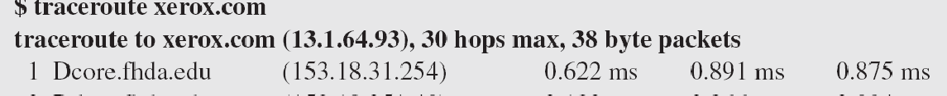
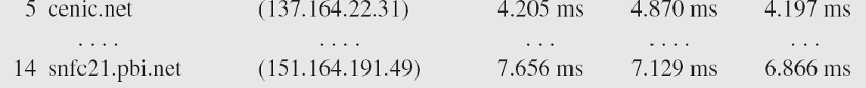
Example 21.5 (continued)

