Slide 1
Predicting Employee Attrition and Estimating Financial Loss
Sri Charan(se23ucse005), Vivardhan Reddy(se23ucse006), Amogh Raj (se23ucse022),
Pradhyumna G(se23ucse075), Koushik K(se23ucse096)

Slide 2
Abstract & Objectives
Predict employee attrition using classification models.
Estimate future salary using regression models.
Compute expected financial loss by combining attrition probability and future salary.
Provide actionable insights for HR planning and retention strategies.

Slide 3
Problem Statement
High attrition causes disruptions, training costs, and knowledge loss.
Strategic HR planning requires understanding who might leave and the financial impact.

Slide 4
Overview of Approach
Classification: Predict likelihood of employee leaving.
Regression: Predict future salary of likely-to-stay employees.
Expected Loss = P(attrition) × FutureSalary
Models evaluated with F1-score, ROC-AUC, R², RMSE.

Slide 5
Data & Preprocessing
IBM HR Analytics Dataset - 1470 entries, 35 features.
Label Encoding: Ordinal for categoricals, Scaling for numericals.
Split the data into training and testing data (test_size = 20 to 30 %)
Standardized the data (StandardScalar)

Slide 6
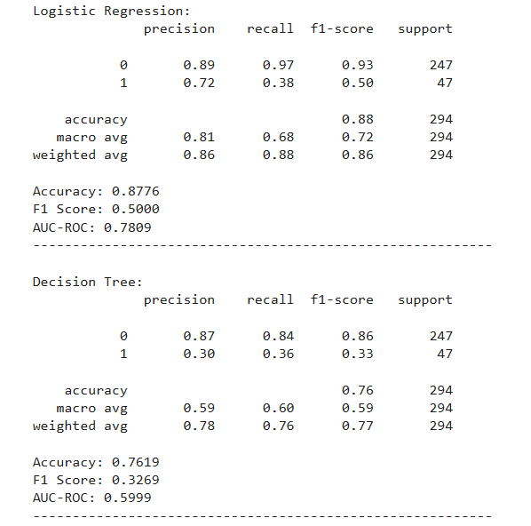
Classification Pipeline
Soft Voting Ensemble: Logistic Regression, Random Forest.
F1 Score: 0.50, Test ROC-AUC: 0.78.

Slide 7
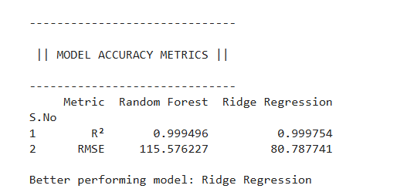
Regression Pipeline
Voting Regressor: Random Forest, Ridge.
Future salary simulated using performance-based increments.
R²: 0.999496, RMSE: 115.576227

Slide 8
Expected Loss Formula
ExpectedLoss = P(attrition) × FutureSalary.
Calculated only for employees with P(stay) > 0.6.
Total Loss Estimate: ₹9089929.4942
Likely-to-stay Loss Estimate: ₹1234124.2257

Slide 9
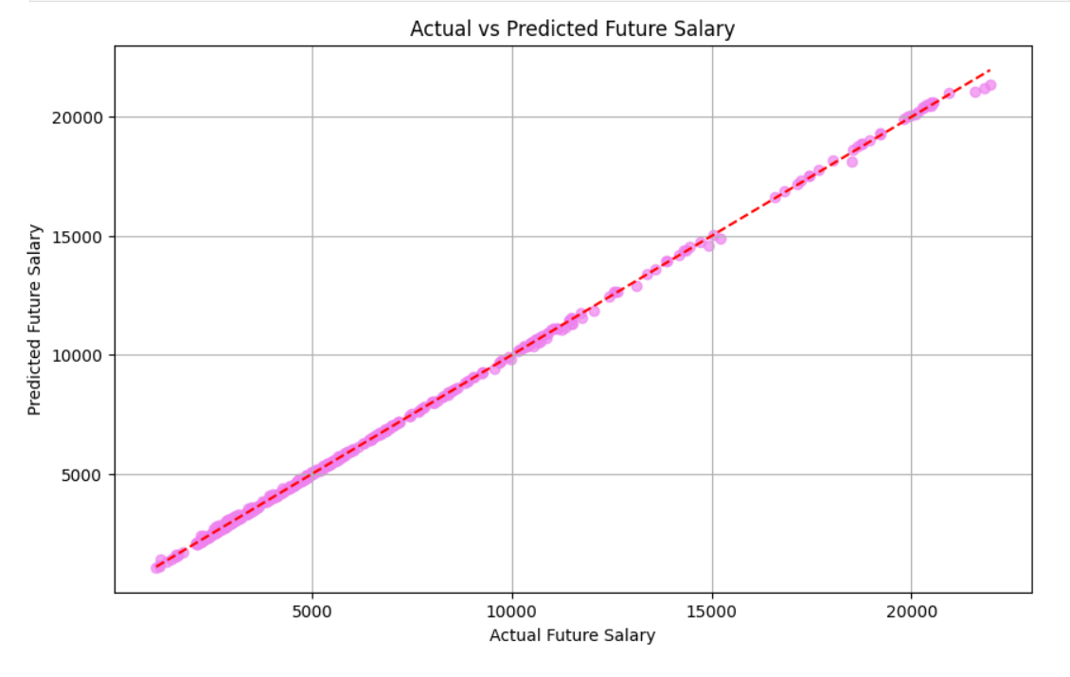
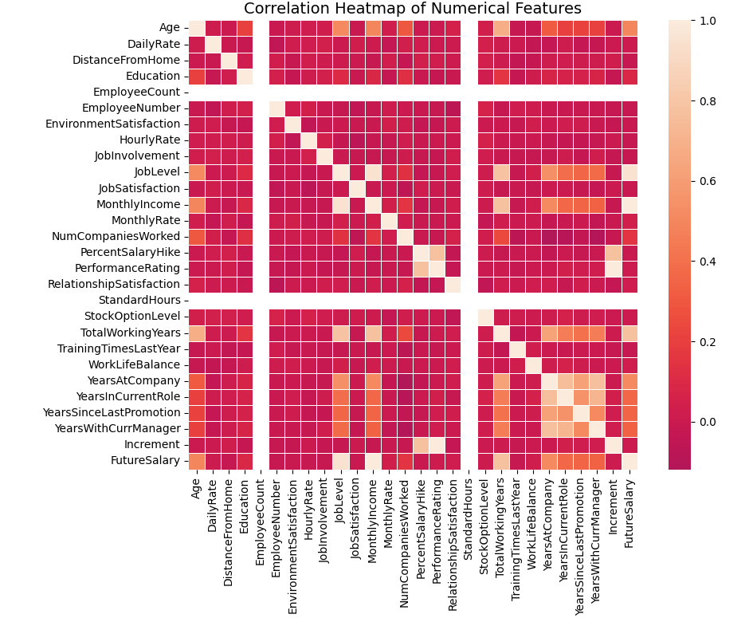
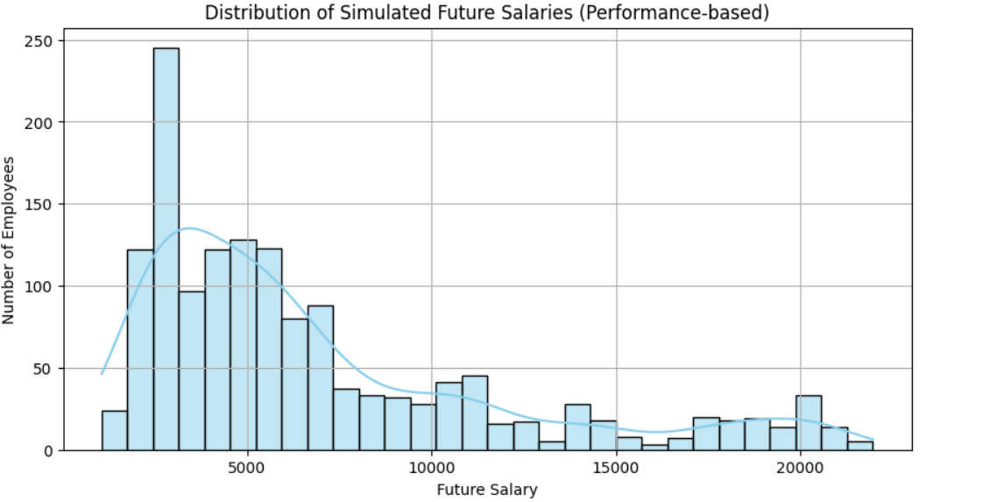
Graphs and Plots

Slide 10
Insights & Conclusion
High accuracy in predicting attrition and future salary.
Combining classification and regression provides financial perspective.
Supports proactive HR intervention for valuable employees.
Scalable solution, retraining recommended for real-world deployment.

