Slide 1
ShiftGuard10: Robust Image Classification Using Deep Residual Networks
Data Augmentation & Test-Time Augmentation for distortion-resilient multi-class recognition
EE708 PROJECT : GROUP 45
RESNET

Slide 2
The Problem
Real-World Images Are Messy
Standard image classifiers assume clean, well-aligned inputs. In practice, images arrive shifted, distorted, rotated, or corrupted by noise — degrading model performance significantly.
In order to address this problem, CNN is used. This neural network architecture is useful for identifying image features such as edges and textures through learning. Moreover, for enhanced efficiency, Residual Neural Network (ResNet) is designed using skip connections.
Shift
Distortion
Noise
Objects off-center or partially cropped
Geometric warping and perspective changes
Pixel-level corruption from sensors or compression

Slide 3
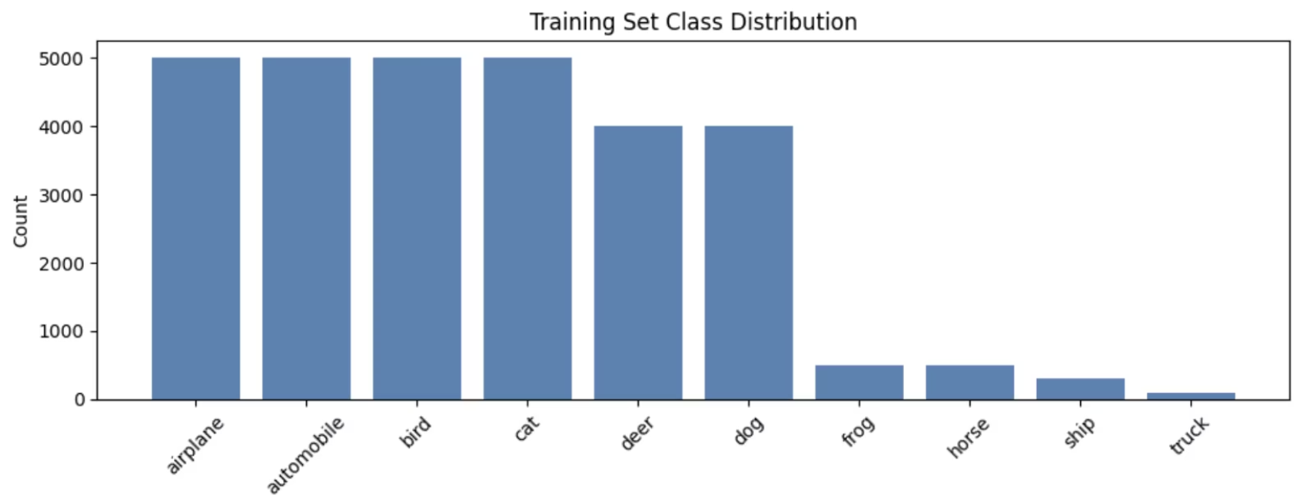
Dataset & Preprocessing
Structure
The dataset contains labeled training images and unlabeled test images for multi-class classification. All images are converted to RGB format and normalized to stabilize training.
The class distribution is highly imbalanced — some classes appear more frequently than others. To address this, stratified sampling ensures representative splits across training and validation sets. Labels are encoded using one-hot encoding.

Slide 4

Data Augmentation Strategy
To improve generalization, the training set is expanded with synthetic variations of each image — forcing the model to learn class-invariant features rather than memorizing specific pixel patterns.
Flipping
Rotation
Horizontal reflections to handle mirrored orientations
Random angle rotations to simulate perspective variation
Zooming
Shifting
Scale changes to improve scale-invariance
Translational offsets to handle misaligned inputs

Slide 5
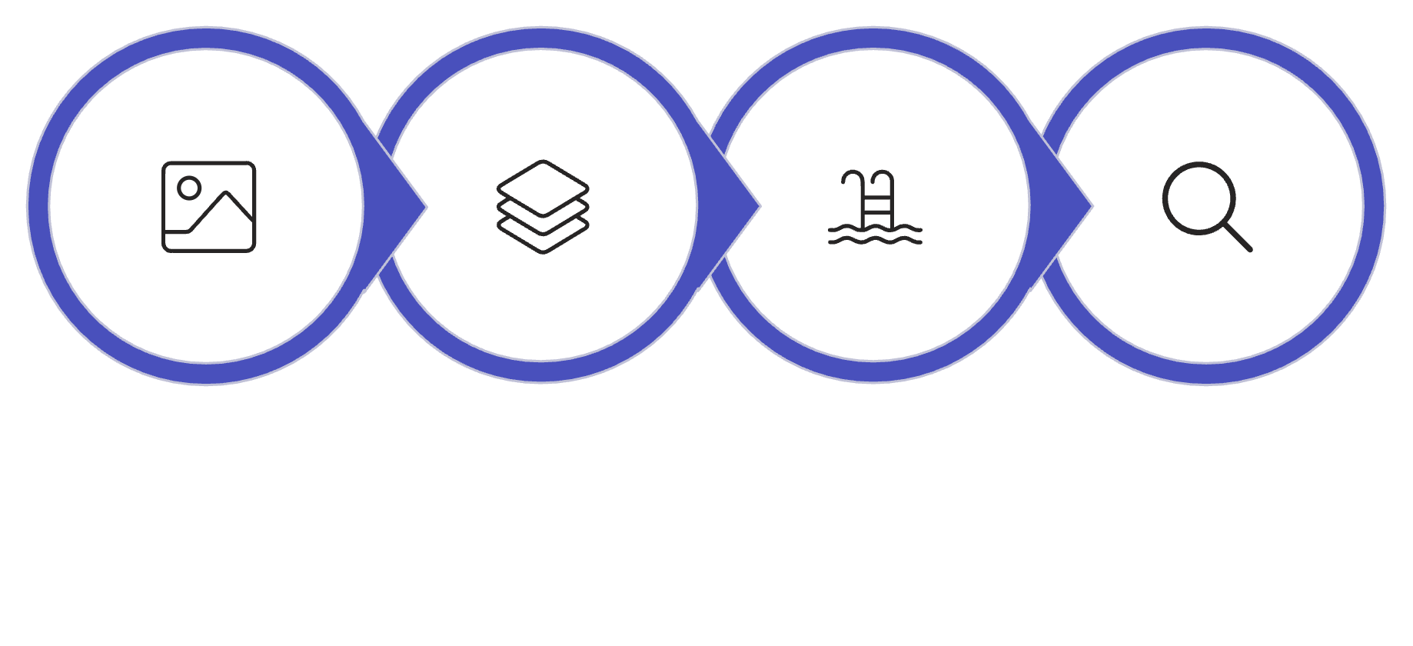
Model Architecture: ResNet
Why ResNet Over Standard CNN?
Skip connections allow gradients to propagate cleanly through many layers without degradation
Residual Blocks
Global Avg Pool
FC + Softmax
Deeper networks are achievable (64→512 filters) without accuracy collapse
Input
The network follows the ResNet structure: an input layer feeds a series of residual blocks built with convolution, batch normalization, and ReLU activation. These blocks progressively increase the number of filters from 64 to 128, 256, and 512.
Batch normalization + ReLU in each block stabilizes activations
Skip connections transmit gradients directly through the network, making it possible to train much deeper models while reducing the vanishing gradient problem. After the residual stack, global average pooling compresses the feature maps before the fully connected layer. Dropout adds regularization to reduce overfitting, and the final softmax layer produces the output probabilities.
Dropout + Global Average Pooling reduce overfitting before the classifier head

Slide 6

Training Strategy
Optimizer
Regularization
SGD with momentum & Nesterov acceleration for fast, stable convergence
Weight decay prevents overfitting; dropout applied before output layer
1
2
3
4
LR Schedule
Checkpointing
Cosine annealing gradually reduces the learning rate to fine-tune convergence
Early stopping and model checkpoints preserve the best validation epoch
Batch size: 64 — balances GPU memory efficiency with stable gradient estimates across all training runs.

Slide 7
Results & Analysis
Training Behavior
Accuracy
Loss
Accuracy increases steadily throughout training. Training accuracy approaches 1.0, while validation accuracy converges to a slightly lower value — indicating successful generalization with minimal overfitting. The loss gap between train and validation sets remains narrow throughout.
Training → ~1.0 Validation → strong generalization
Continuously declining with small train/val gap
F1-Score
Confusion Matrix
Test-Time Augmentation (TTA)
Consistent across classes with only minor per-class variation
Predictions concentrated on diagonal — errors limited to visually similar classes
Multiple augmented versions of each test image are generated at inference. Averaging their predictions reduces variance and improves overall stability — particularly for borderline or noisy inputs.

Slide 8
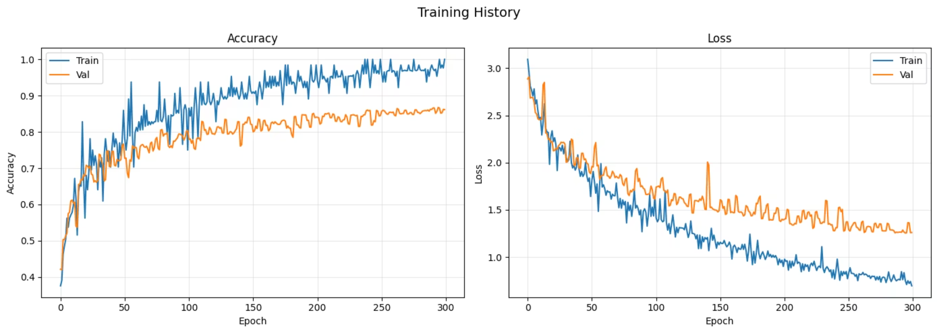
Results & Analysis
Accuracy rises gradually, reflecting learning. The training accuracy approaches 1.0, whereas validation accuracy con- verges to a little smaller value, reflecting successful generalization. The loss declines continually, where the gap between training and validation losses is minor, implying a little overfitting.

Slide 9
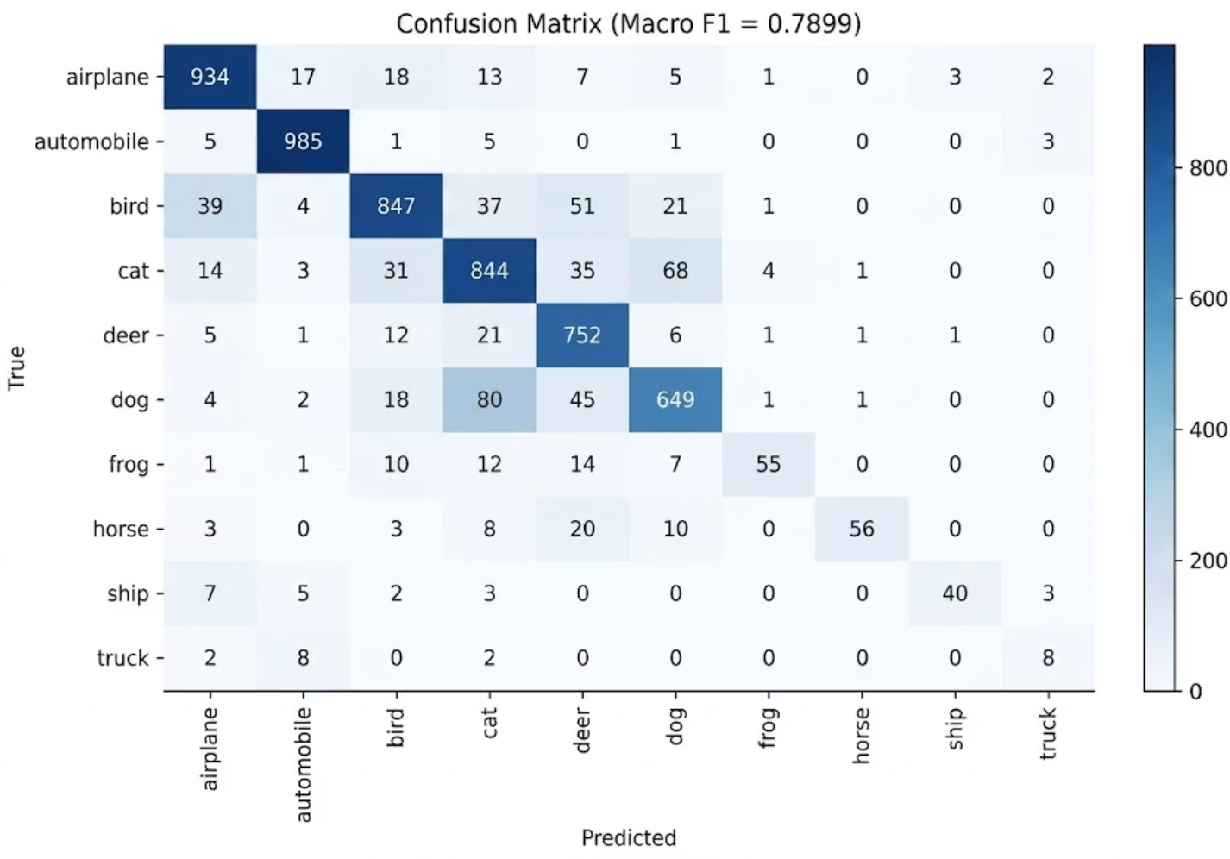
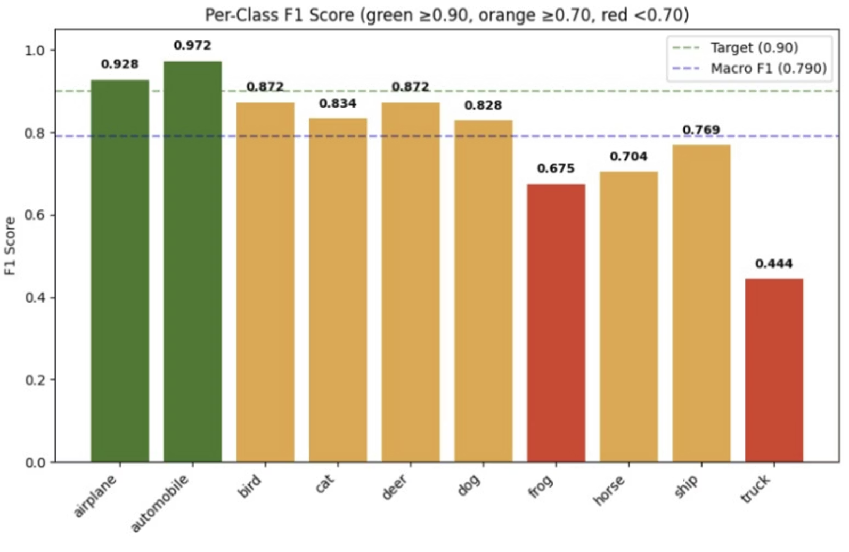
Results & Analysis
Most predictions lie along the diagonal, indicating correct classifications. Some errors occur between similar classes.
The model performs consistently across most classes with only slight variations, except truck and frog because we have very few samples of them.

Slide 10
Conclusion
1
ResNet + Skip Connections
Enabled deep, stable learning for a challenging multi-class distorted image classification task
2
Augmentation & Regularization
Data augmentation, dropout, and weight decay significantly improved generalization with low overfitting
3
Test-Time Augmentation
Averaging predictions over augmented test views boosted robustness and prediction stability
4
Future Directions
Model ensembles, advanced architectures (EfficientNet, Vision Transformers), and learned augmentation policies

