Slide 1




FLIGHT FARE PREDICTION
Submitted By:
Vivek. G

Slide 2


Problem Statement
Flight ticket prices can be something hard to guess, today we might see a price, check out the price of the same flight tomorrow, and it will be a different story.
To solve this problem, we have been provided with prices of flight tickets for various airlines between the months of March and June of 2019 and between various cities, using which we aim to build a model which predicts the prices of the flights using various input features.

Slide 3
What is Flight Price Prediction?
Nowadays, the number of people using flights has increased significantly. It is difficult for airlines to maintain prices since prices change dynamically due to different conditions. That’s why we will try to use machine learning to solve this problem. This can help airlines by predicting what prices they can maintain. It can also help customers to predict future flight prices and plan their journey accordingly.

Slide 4

Contents of the Project:
Exploratory data analysis and Data modeling
Handling Categorical Data
Feature Engineering
Feature Selection
Fitting model using Random Forest
Hyperparameter Tuning

Slide 5

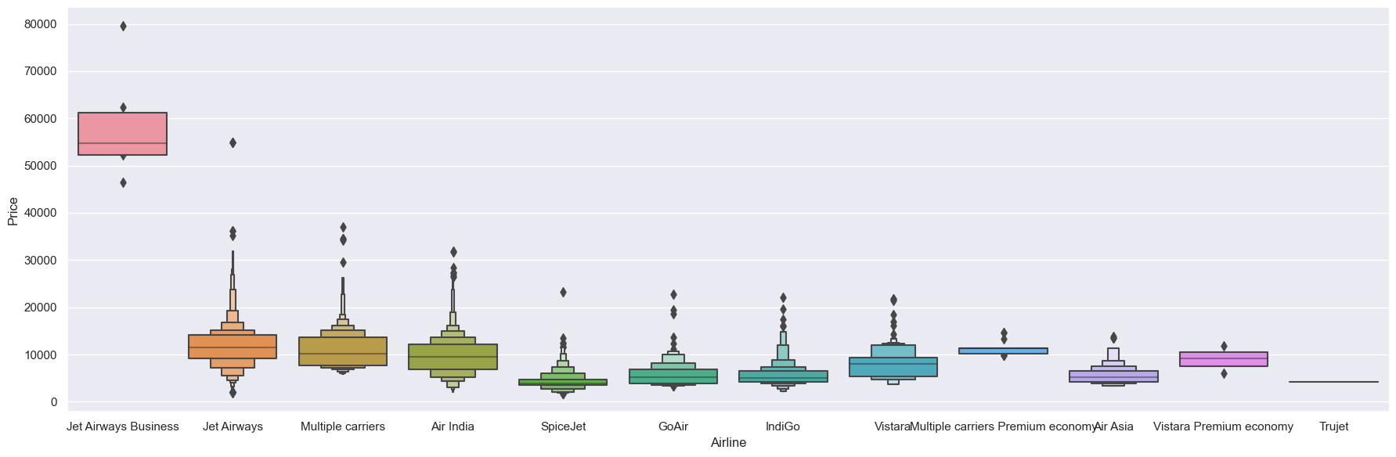
Visualizing Which Airline has the Highest Price?

Slide 6
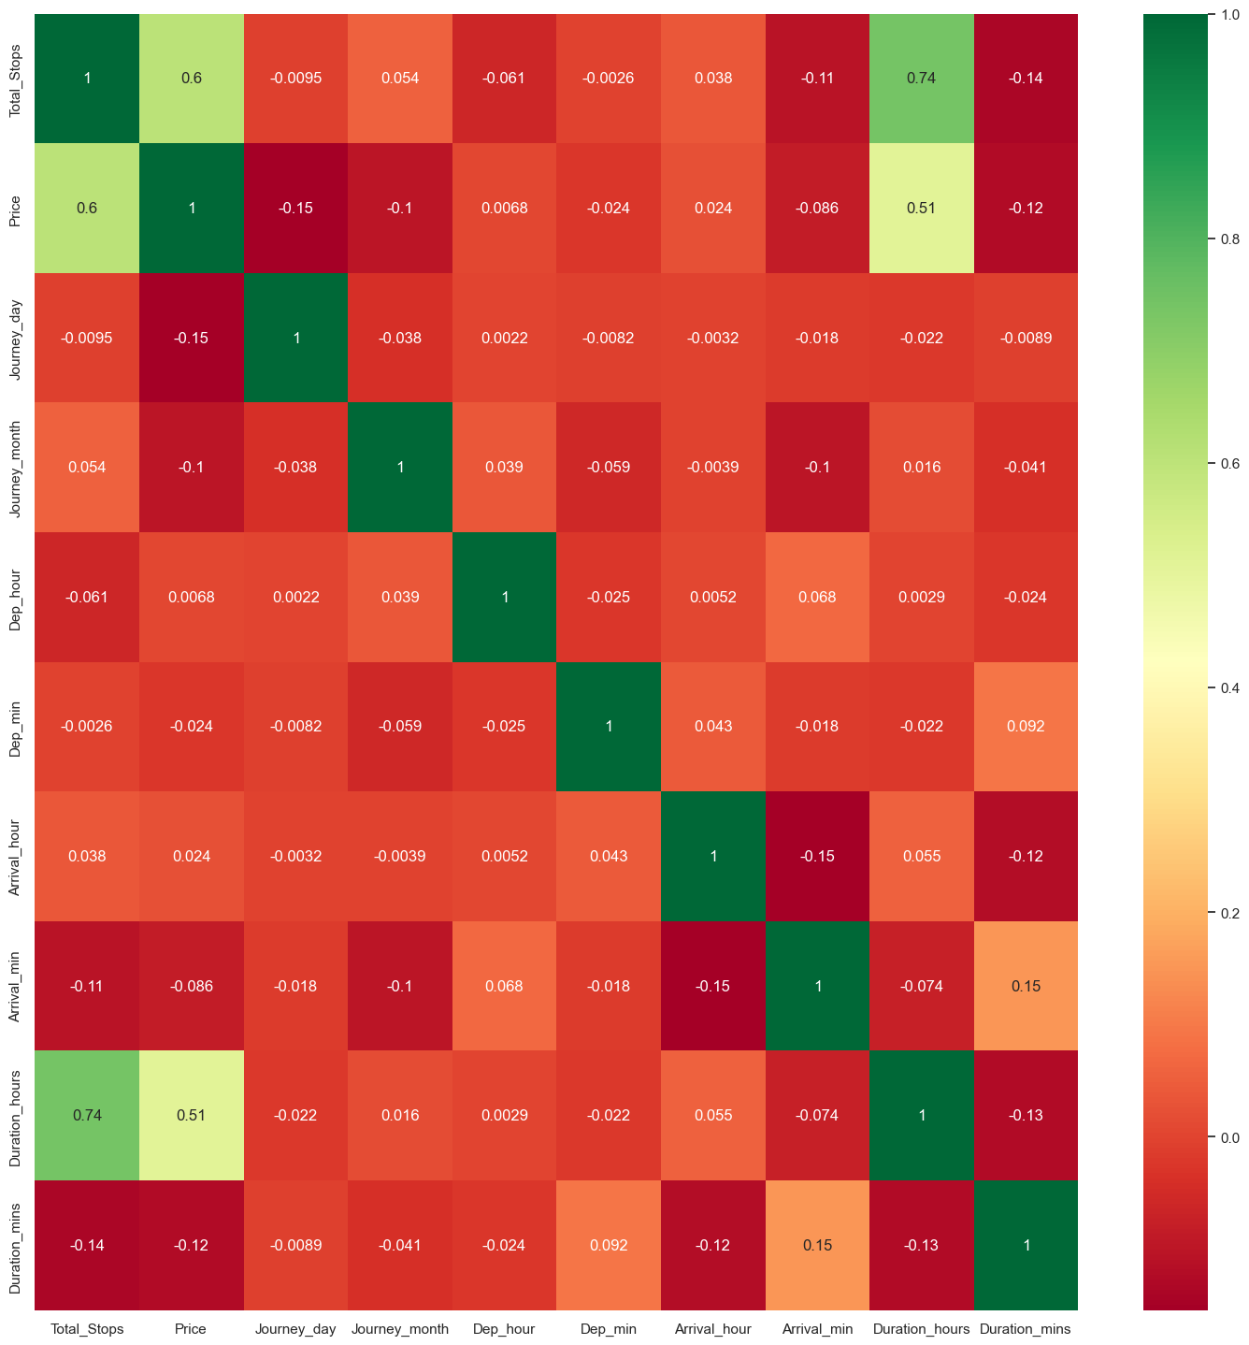
Visualizing the correlation between the features

Slide 7
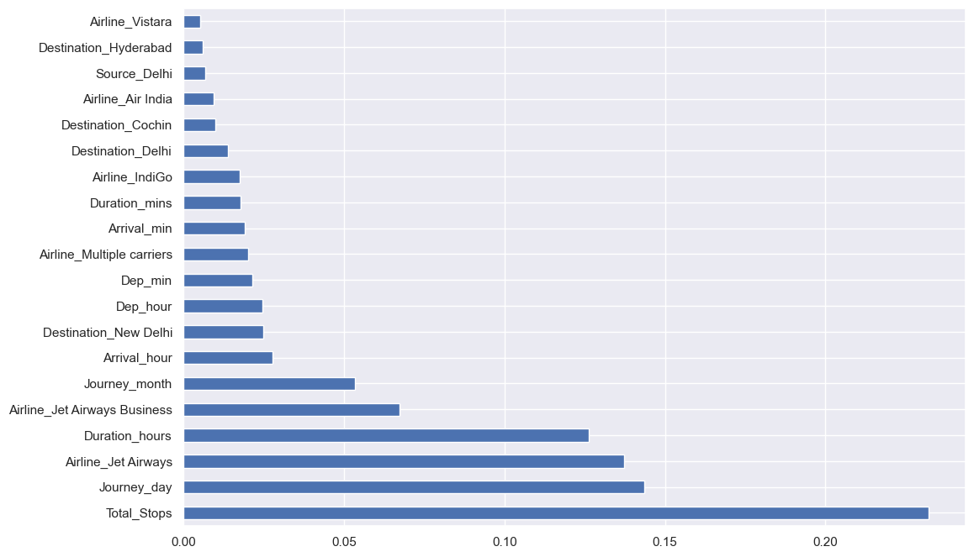
Finding the Feature Importance:
Here We can see the total stops is playing a major role

Slide 8

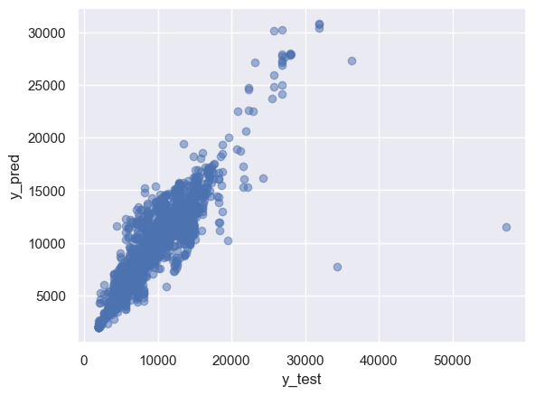
Finally Visualizing The Scatter plot of the prediction model

Slide 9
Conclusion:
Finally calculated the MAE, MSE, RMSE, and R2 score and completed the flight fare prediction model

