Slide 1
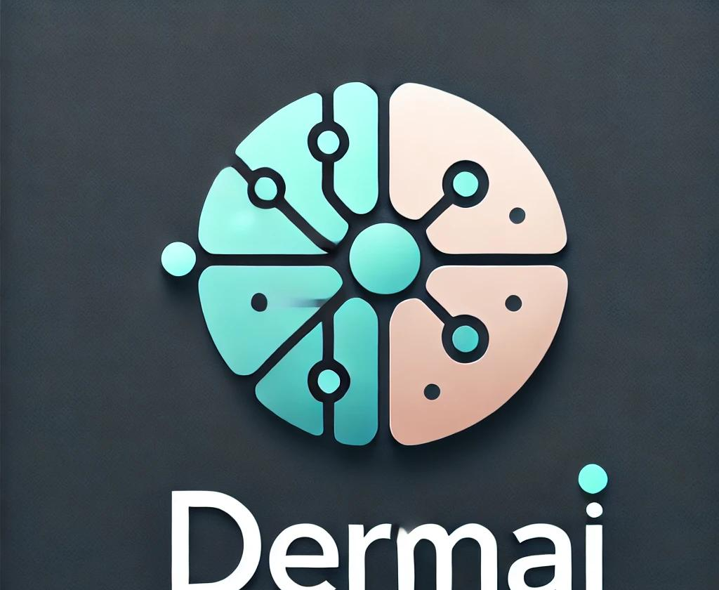
DermAI - Innovative AI Model for Early Skin Cancer Detection
Presented by DermAI Team

Slide 2
Introduction
Overview of Skin Cancer and the Accessibility Problem:
- Skin cancer is the most common cancer globally.
- Significant disparities in dermatological care access.
DermAI Objective:
Leverage AI to democratize early detection using low-quality smartphone images.

Slide 3
Problem and Motivation
Why DermAI Matters:
- Melanoma survival rates drastically improve with early detection.
- Over 40% of Americans lack timely access to dermatologists.
DermAI bridges this gap by providing a scalable, accessible AI solution.

Slide 4
System Design and Implementation
Key Features:
- Data preprocessing, augmentation, and fairness tools.
- ResNet-based transfer learning for skin lesion classification.
- Cloud deployment with strong encryption and scalability.

Slide 5
Technical Highlights
Exciting Aspects:
- Explainable AI (SHAP) enhances transparency.
- Data augmentation ensures fairness across demographics.
- Real-time feedback improves input quality.

Slide 6
Lifecycle Management
AI Lifecycle:
- Data Collection: Secure upload and public datasets.
- Model Training: ResNet, bias mitigation, and evaluation metrics.
- Deployment: Cloud infrastructure with scalability.
- Feedback: Iterative improvement based on user inputs.

Slide 7
User Interaction
User-Friendly Features:
- Simple interface with clear instructions.
- Real-time feedback ensures high-quality input.
- Accessibility: WCAG compliance with customizable features.

Slide 8
Results and Impact
Outcomes:
- High sensitivity and specificity in lesion classification.
- Significant usability improvements based on feedback.
- Scalable solution reducing delays in diagnosis.

Slide 9
Challenges and Future Directions
Challenges:
- Bias mitigation and dataset imbalance.
- Privacy and scalability.
Future Work:
- Enhanced UI and real-time image guidance.
- Advanced explainability with heatmaps.
- Integration with telemedicine for seamless referrals.

Slide 10
Conclusion
DermAI represents a scalable, accessible, and ethical AI solution for early skin cancer detection.
It sets a benchmark for AI-driven healthcare innovations, addressing both technical and ethical challenges effectively.

