Slide 1

Test Automation in Practice
November, 2012
Benkó Adrián
Software Testing Engineer
Adrian_Benko@epam.com

Slide 2



Presentation.contains()
Environment
Element Locator Management
“Dictionary”
Choosing a Good Location Strategy
Techniques
Implicit and explicit wait
Take a screenshot
Cookies
Native events
Challenges
Try to locate elements when you have no control over DOM
Testing the “AutoComplete” and the “Calendar” feature
Implicit and Explicit wait in action.
Agenda
2012 © EPAM Systems

Slide 3
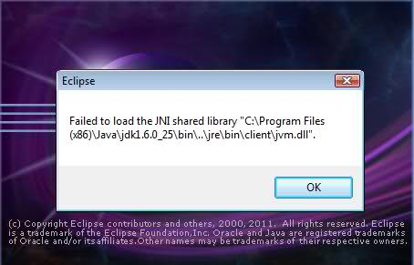
Environment
Eclipse
http://www.eclipse.org/downloads/
http://java.com/en/download
Note: 32-bit Eclipse => 32-bit JAVA (JRE)
64-bit Eclipse => 64-bit JAVA (JRE)
Eclipse
2012 © EPAM Systems

Slide 4
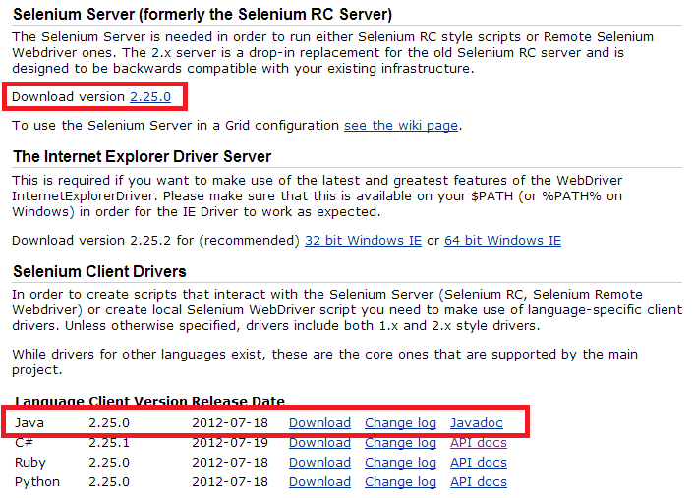
Environment
Selenium (WebDriver)
http://seleniumhq.org/download/
selenium-java-2.25.0.jar (WebDriver)
selenium-server-standalone-2.25.0.jar (RemoteWebDriver)
Selenium
2012 © EPAM Systems

Slide 5

Environment
Why WebDriver?
„Selenium WebDriver is the successor of Selenium Remote Control which has been officially deprecated. ” (seleniumhq.org)
Selenium
2012 © EPAM Systems

Slide 6



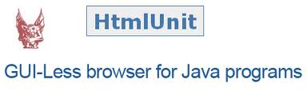

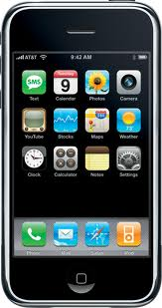

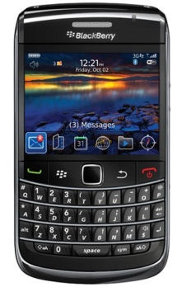
Which browsers does WebDriver support?
Supported Browsers
2012 © EPAM Systems

Slide 7
Selenium 1 vs. WebDriver
The difference…
Selenium 1 | Selenium 2 /WebDriver
isElementPresent(“xpath”) | findElements(By.xpath(“xpath”)).size() > 0
getXpathCount(“xpath”) | findElements(By.xpath(“xpath”)).size()
isVisible(element) | findElement(element)).isDisplayed()
getText(locator); | findElement(location).getText();
type(locator, text); | findElement(location).sendkeys(text);
select(location,"value=" + optionValue); | selectByValue(optionValue);
select(locator,"label=" + optionLabel); | selectByVisibleText(optionLabel);
selectWindow("name=windowName"); | switchTo().window("windowName");
Selenium 1 vs. WebDriver
2012 © EPAM Systems

Slide 8
Element Locator Management
Roy Osherove: The Art of Unit Testing
if (time.maintaining_existing_automated_test > time.creating_new_test){
Project.fail();
}
One of the reason: “poor element locator management”
We have the methodology…
Element Locator Management
2012 © EPAM Systems
Notes:
If you aren’t smart & careful, you can end up spending huge amounts of time updating/fixing up your test’s locators every time the UI changes!

Slide 9
Element Locator Management
Choosing Good Locator Strategy
The most common locator types:
the element’s ID:
IDs are unique on the page
the fastest and the best. Use it!
text/link:
helpful when testing links on page
CSS selectors:
fast to resolve
uniqueness is not guaranteed on the page (same as text/link)
XPath statement:
is extremely slow in IE(7);
locate an object with respect to another object on the page; extraordinarily brittle.
Bad XPATH: //table[5]/tbody/tr/td[2]/div/a/b
Ugly, breaks easily if the HTML structure changes
„Good“ XPATH: //div[@id = 'foo']//a
driver.findElement(By.id(”card-id”))
driver.findElement(By.linkText("Next Page"))
driver.findElement(By.cssSelector(“fbEventHeadline.fsxl“))
driver.findElement(By.xpath( "//*[@name='search' and @type='text']"))
Locator Types
2012 © EPAM Systems
Notes:
the element’s ID: IDs are unique on the page, so this strategy is the fastest and the best. Use it!
text/link: it’s helpful when testing links on page, but when there are more links with same text on the page…
CSS selectors: fast to resolve but uniqueness is not guaranteed on the page (same as text/link)
XPath statement: is extremely slow in IE(7); you can locate an object with respect to another object on the page; it’s extraordinarily brittle.

Slide 10

Element Locator Management
Dictionary
Centralize your locator definition!
Advantage: There is only ONE place where you have to update locator’s definition when the UI changes.
package com.epam.training.dictionary;
public class Dic {
// DropDownMenu variables
public static String DROPDOWN_URL = "http://www.asp.net";
public static String ICE_CREAM_FLAVOR = "SampleContent_Label";
public static String SELECTEDOPTION = "SampleContent_Select";
public static String ICE_CREAM_OPTION2 = "SampleContent_Option";
Dictionary
2012 © EPAM Systems

Slide 11
Techniques
Implicit wait
tells WebDriver to poll the DOM for a certain amount of time when trying to find an element or elements if they are not immediately available
Default setting is 0.
Is set for the life of the WebDriver object instance
WebDriver driver = new FirefoxDriver();
driver.manage().timeouts().implicitlyWait(10, TimeUnit.SECONDS);
driver.get(Dic.ImplicitWait_URL);
// dropDown list
WebElement myAJAXElement =
driver.findElement(By.id(Dic.Ajax_TextLabel));
myAJAXElement.click();
// try to click onto second element in the select box
driver.findElement(By.id(Dic.Ajax_SecondElementFromServer)).click();
Implicit wait
2012 © EPAM Systems
Notes:
Once set, the implicit wait is set for the life of the WebDriver object instance. See our Beer ordering example…

Slide 12
Techniques
Explicit wait
is code you define to wait for a certain condition to occur before proceeding further in the code.
Use explicit waits to delay your test’s execution until the content is loaded.
The worst case: Thread.sleep(), which sets the condition to an exact time period to wait. Do NOT use it!
// wait till the auto-complete part is visible
ExpectedCondition<Boolean> e = new ExpectedCondition<Boolean>() {
public Boolean apply(WebDriver d) {
d.findElement(By.xpath(Dic.FirstItemInTheList));
return Boolean.valueOf(true);
}
};
WebDriverWait w = new WebDriverWait(driver, 15);
w.until(e);
Explicit wait
2012 © EPAM Systems

Slide 13
Techniques
Take a screenshot
Execute tests overnight and check saved images the next day for bugs/issues/failures
When bilingual application is tested, screenshots can help with the linguistically review.
{…}
} catch (Exception e) {
WebDriver augmentedDriver = new Augmenter().augment(driver);
File screenshot = ((TakesScreenshot)augmentedDriver).getScreenshotAs(OutputType.FILE);
try {
FileUtils.copyFile(screenshot, new File("e:\\SC_event.png"));
} catch (IOException e1) {
System.out.println("Error...");
e1.getMessage();
}
}
{…}
You can add timestamp to filename ie. HomePage_2012-12-03 0954.png
Take a screenshot
2012 © EPAM Systems

Slide 14
Techniques
Cookies
WebDriver let us to add/delete/print out browser’s cookies
{…}
Set <Cookie> cookies = driver.manage().getCookies();
for (Cookie cookie : cookies) {
System.out.println("PATH " + cookie.getPath()
+ "; NAME: " + cookie.getName()
+ "; VALUE: " + cookie.getValue()
+ "; EXPIRY: " + cookie.getExpiry());
}
driver.manage().getCookieNamed("cookieName");
Assert.assertEquals(cookie.getName(), “Price");
Assert.assertEquals(cookie.getValue(), “1.200 GBP");
driver.manage().deleteAllCookies();
{…}
Take a screenshot
2012 © EPAM Systems

Slide 15
Techniques
Edit Firefox profile
WebDriver let us to change the User Agent string for our browser
{…}
FirefoxProfile profile = new FirefoxProfile();
profile.setPreference("general.useragent.override", "some UA string");
WebDriver driver = new FirefoxDriver(profile);
{…}
You can set the preferred language for profile
profile.setPreference("intl.accept_languages", "no,en-us,en");
Enable native events in Firefox
FirefoxProfile profile = new FirefoxProfile();
profile.setEnableNativeEvents(true);
profile.deleteExtensionsCacheIfItExists(null); WebDriver driver = new FirefoxDriver(profile);
Edit Firefox profile
2012 © EPAM Systems

Slide 16
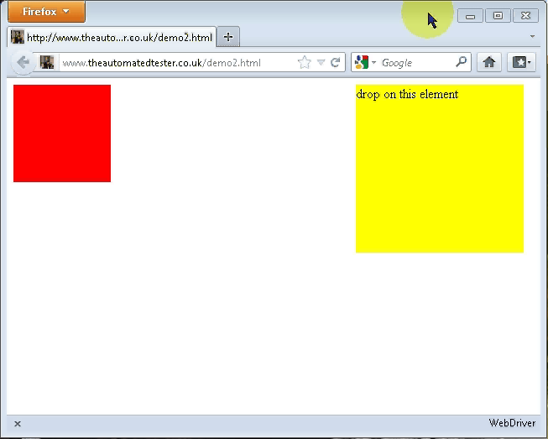
Techniques
What can be done by enabling “native events”?
Native Events example
2012 © EPAM Systems

Slide 17
Techniques
and the source code…
{…}
FirefoxProfile profile = new FirefoxProfile();
profile.setEnableNativeEvents(true);
WebDriver driver = new FirefoxDriver(profile);
driver.get("http://www.theautomatedtester.co.uk/demo2.html");
WebElement draggable = driver.findElement(
By.cssSelector(".draggable.ui-draggable"));
WebElement droppable = driver.findElement(
By.id("droppable"));
Actions dragging = new Actions(driver)
.dragAndDrop(draggable, droppable);
dragging.perform();
driver.quit();
{…}
Native Events Example
2012 © EPAM Systems

Slide 18
Challenge
Try to locate elements when you have no control over DOM (GWT)
Good control and easy visibility into the DOM structure: JSPs, JSF, etc.
BUT with GWT, this isn’t always the case…
WebDriver: element ID and XPath.
The Challenge:
How can we solve these to get maintainable tests that don’t break with minor layout changes?
Challenges #3
2012 © EPAM Systems
Notes:
GWT: Google Web ToolKit: A fő újdonság a Java-JavaScript fordítóban van: a fejlesztő elvégezheti a kódolást és a felhasználói felület hibakeresését Java nyelvet használva, majd legenerálja a végleges HTML/JavaScript kódot és használhatja.
In web applications that use templating (JSPs, JSF, etc.), you have good control and easy visibility into the DOM structure.
BUT With GWT, this isn’t always the case.
With WebDriver you can target elements using a few methods, but the most useful are by DOM element ID and XPath.
The Challenge:
How can we solve these to get maintainable tests that don’t break with minor layout changes?

Slide 19
Challenge
Solution
use XPath combined with IDs to limit scope
use IDs at top level elements like windows or tabs that are unique in the application
Example
By byUserName = By.xpath("//*[@id='userTab']//*[text()='User Name']/..//input");
WebElement userNameField = driver.findElement(byUserName);
userNameField.sendKeys("my new user");
It could be even more complex:
"//*[@id='userTab']//*[@class=‘userForm’ and @style=‘display:block’]//*[text()='User Name']/..//input"
Challenges #3
2012 © EPAM Systems

Slide 20
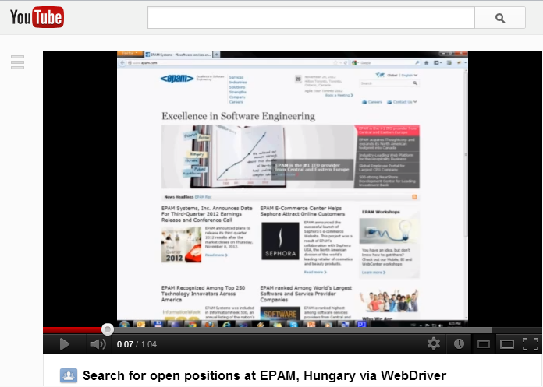
Find Open Positions @EPAM, Hungary
http://www.youtube.com/watch?v=p_jJROtg4SY
Find job (1)
2012 © EPAM Systems

Slide 21
Find Open Positions @EPAM, Hungary
Find Open Positions @EPAM, Hungary
/**** O P E N EPAM.COM ****/
driver.get("http://www.epam.com/");
// Verify window title
Assert.assertTrue(driver.getTitle().contains("EPAM Systems"), "FAIL: Title is NOT 'EPAM Systems'");
System.out.println("PASS: title is 'EPAM Systems'");
// Check if the 'Careers' link is displayed
WebElement careersLink = driver.findElement(By.xpath(
"//div[@id='topnav']//a[contains(text(), 'Careers')]"));
Assert.assertTrue(careersLink.isDisplayed(), "'Careers' link was NOT found in the header section.");
System.out.println("PASS: 'Careers' link was found");
Find job (2)
2012 © EPAM Systems

Slide 22
Find Open Positions @EPAM, Hungary
Find Open Positions @EPAM, Hungary
/***** C A R E E R S P A G E *****/
careersLink.click(); // Navigate to 'Careers' page
Assert.assertTrue(driver.getTitle().contains("Careers"), "FAIL: 'Careers' is not displayed"); // Check if the 'Careers' page is displayed
// Get counties from the left section
List<WebElement> counties = driver.findElements(By.cssSelector(
".aside-navigation.parbase.section>ul>li>a"));
boolean isFound = false;
for (WebElement webElement : counties) {
if(webElement.getText().contains("Hungary")) isFound = true;
System.out.print(webElement.getText() + " ");
}
Assert.assertTrue(isFound, "'Hungary' was NOT found in the list");
driver.findElement(By.linkText("Hungary")).click();
Find job (3)
2012 © EPAM Systems

Slide 23
Find Open Positions @EPAM, Hungary
Find Open Positions @EPAM, Hungary
/**** O P E N P O S I T I O N S I N H U N G A R Y *****/
Assert.assertTrue(driver.getTitle().contains("Hungary"), "FAIL: 'Hungary' page is not displayed");
driver.findElement(By.xpath("//div[@class='jo-filter']//span[@class='jo-dd-arrows']")).click(); // set Group filter to Software Engineering
WebElement groupFilters = driver.findElement(By.xpath("//div[@class='jo-sections-dropdown']/div"));
Assert.assertTrue(groupFilters.isDisplayed(), “FAIL: Group Filters");
// get all group filters
List<WebElement> listGroupFilters = groupFilters.findElements(By.xpath("//div[@class='jo-sections-dropdown']/div/ul/li"));
for (WebElement webElement : listGroupFilters) {
System.out.print(webElement.getText() + " ");
if (webElement.getText().contains("Software Engineering"))
webElement.click();
}
Find job (4)
2012 © EPAM Systems

Slide 24
Find Open Positions @EPAM, Hungary
Find Open Positions @EPAM, Hungary
// check if the 'Apply' button is available
WebElement btnApply =
groupFilters.findElement(By.linkText("Apply"));
Assert.assertTrue(btnApply.isDisplayed(),
"'Apply' button is NOT displayed");
btnApply.click();
// 'Consulting and Business Analysis' section is not displayed anymore
Assert.assertFalse(driver.findElement(
By.xpath("//*[@id='jo- start']//h3[contains(text(),'Consulting and Business Analysis')]")).isDisplayed(),
"'Consulting and Business Analysis' IS displayed.");
Find job (5)
2012 © EPAM Systems

Slide 25
Find Open Positions @EPAM, Hungary
Find Open Positions @EPAM, Hungary
// Type in 'Test' to search field
WebElement jobSearch = driver.findElement(By.xpath(
"//form[@class='jo-search']//input[@type='text']"));
Assert.assertTrue(jobSearch.isDisplayed(),
"Input field is NOT displayed!");
jobSearch.clear();
jobSearch.sendKeys("Test");
WebElement searchIcon = jobSearch.findElement(By.xpath(
"//input[@type='button' and @class='jo-search-button']"));
Assert.assertTrue(searchIcon.isDisplayed(),
"'Search icon' is NOT displayed");
searchIcon.click();
Find job (6)
2012 © EPAM Systems

Slide 26
Find Open Positions @EPAM, Hungary
WebElement expandedPosition = driver.findElement(By.xpath(
"//div[@class='jo-sections']//li[@class='jo-position expanded']"));
if ( expandedPosition.isDisplayed()
&& (expandedPosition.findElement(By
.xpath("//h4[@class='jo-title ']"))
Assert.assertTrue(expandedPosition.findElement(
By.xpath("//h4[@class='jo-title']")).getText()
.contains("Test"),
"There are no opened Tester positions");
Find job (7)
2012 © EPAM Systems

Slide 27

Let’s have a party!
The Mission: Let’s have a party! ☺
what do we need?
BEVERAGE
INVITATION CARD
FOOD
Mission Possible
2012 © EPAM Systems

Slide 28

Let’s have a party!
Food?
Order It! ☺
Xxx 1/7
2012 © EPAM Systems

Slide 29
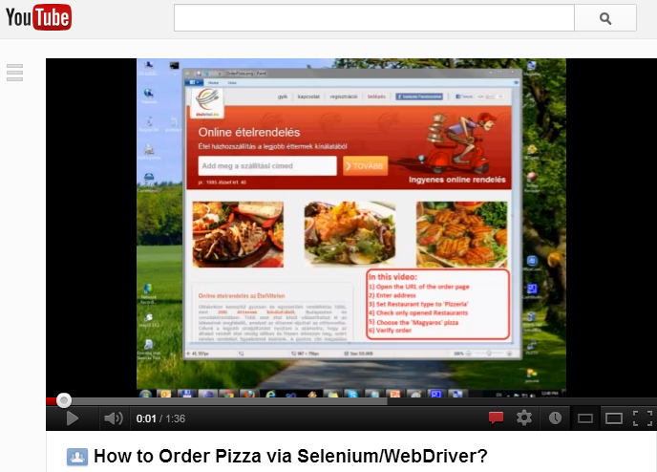
Find Open Positions @EPAM, Hungary
http://www.youtube.com/watch?v=dMmfM8XFQrw
Pizza 2/7

Slide 30
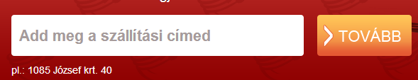
Let’s have a party!
Steps:
1) Open webpage and set address
driver.get(Dic.PizzaURL);
WebElement searchBox = driver.findElement(By.id(Dic.Pizza_Address));
searchBox.sendKeys("1082 Budapest, Futó utca 47, Magyar");
// wait till the auto-complete part is visible
ExpectedCondition<Boolean> e = new ExpectedCondition<Boolean>() {
public Boolean apply(WebDriver d) {
d.findElement(By.className(Dic.Pizza_AutoCompleteList));
return Boolean.valueOf(true);
}
};
WebDriverWait w = new WebDriverWait(driver, 30);
w.until(e);
// Select first item from auto-populated list
WebElement autocomplete = driver.findElement(By.xpath(Dic.Pizza_FirstAddress));
autocomplete.click(); {…}
Explicit wait for auto-complete list: 30 secs.
Pizza 3/7
2012 © EPAM Systems

Slide 31
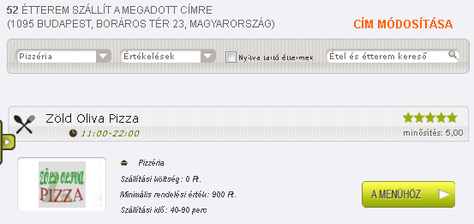
Let’s have a party!
2) Press “Tovább” button
and wait for the list of restaurants
// button ‘Tovabb’, to continue the ordering process
WebElement btnTovabb = driver.findElement(By.id(Dic.Pizza_TovabbBtn));
btnTovabb.click();
// wait till the list of restaurants is displayed
ExpectedCondition<Boolean> e2 = new ExpectedCondition<Boolean>() {
public Boolean apply(WebDriver d) {
d.findElement(By.className(Dic.Pizza_RestaurantList));
return Boolean.valueOf(true);
}
};
WebDriverWait waitList = new WebDriverWait(driver, 30);
waitList.until(e2); {…}
Pizza 4/7
2012 © EPAM Systems

Slide 32

Let’s have a party!
3) Select “Pizzeria”, sorted by “Értékelések” and check „only opened”
// we would like to eat pizza, so select only: pizzeria
driver.findElement(By.id(Dic.RestaurantType)).click();
driver.findElement(By.id(Dic.RestaurantTypePizza)).click();
// select restaurants with high quality rates
driver.findElement(By.id("restaurantOrder_chzn")).click();
driver.findElement(By.id("restaurantOrder_chzn_o_3")).click();
// it would be nice, if the restaurant will be opened during ordering:)
WebElement checkOnlyOpened = driver.findElement(By.id(Dic.Pizza_OnlyOpenedRestaurants_checkbox));
if (!checkOnlyOpened.isSelected())
checkOnlyOpened.click(); {…}
isSelected() ~ isChecked()
Pizza 5/7
2012 © EPAM Systems

Slide 33
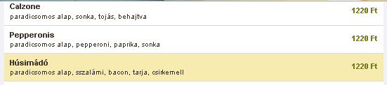
Let’s have a party!
4) Select the Menu of the first opened restaurant and choose “Húsimádó” pizza
// Open the Menu page of the restaurant
driver.findElement(By.xpath(Dic.Pizza_MenuBtn)).click();
// we need an energy, let's choose the "husimado" pizza
WebElement pizzaCategory = driver.findElement(By.xpath(Dic.Pizza_CategoryPage));
if (pizzaCategory.getText().contains("Húsimádó")){
pizzaCategory.findElement(By.xpath(Dic.Pizza_Husimado)).click();
} {…}
"//*[@class='mealName' and contains(text(),'Húsimádó')]"
Pizza 6/7
2012 © EPAM Systems

Slide 34
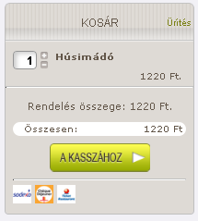
Let’s have a party!
5) Verify the order
WebElement orderCart = driver.findElement(By.className(Dic.Pizza_CartBox));
Assert.assertTrue(orderCart.getText()
.contains("Húsimádó"));
System.out.println("PASS: Pizza is here, order +1");
orderCart.findElement(By.id(Dic.Pizza_AddToCartImg)).click();
String displayedAmount =
driver.findElement(By.id(Dic.Pizza_CartAmount))
.getAttribute("value");
Assert.assertEquals(displayedAmount, “2”));
// How much is the pizza?
String price =
driver.findElement(By.className(Dic.Pizza_Money)).getText();
System.out.println("So, we need to pay: " + price);
driver.findElement(By.className(Dic.Pizza_PaymentLink)).click();
{…}
Pizza 7/7
2012 © EPAM Systems

Slide 35
Let’s have a party!
FOOD✓
BEVERAGE
?
Challenges #2
2012 © EPAM Systems

Slide 36

Let’s have a party!
Beverage?
Order It! ☺
Xxxx 1/7
2012 © EPAM Systems

Slide 37
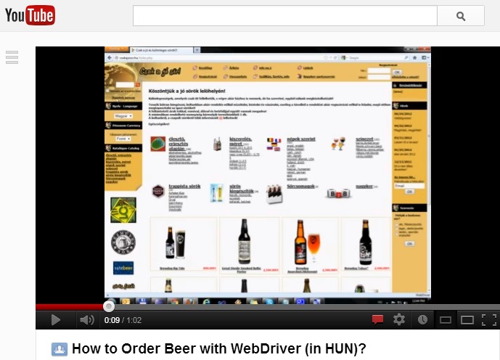
http://www.youtube.com/watch?v=h_2terNoyTc
Beer 2/7
2012 © EPAM Systems

Slide 38


Let’s have a party!
1) Enter to site (yep, we are over 18)
driver.get(Dic.Beer_URL);
WebElement getOverThis = driver.findElement(By.xpath(Dic.Beer_over18));
getOverThis.click(); {…}
2) Click onto “Összetett keresés”
WebElement specSearch = driver.findElement
(By.xpath(Dic.Beer_SpecSearchLink));
Assert.assertTrue(specSearch.isDisplayed());
specSearch.click(); {…}
How to optimize?
Beer 3/7
2012 © EPAM Systems

Slide 39
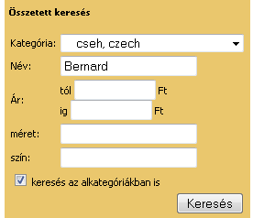
Let’s have a party!
3) Select „czech” from category
=> sub options are populated
Select beerCategory = new
Select(driver.findElement(
By.xpath(Dic.Beer_CategorySelect))); beerCategory.selectByValue("119"); {…}
4) Enter “Bernard” to search field, press “Keresés” button
"//*[@name='search_name' and @type='text']"
WebElement beerName = driver.findElement(By.xpath(Dic.Beer_NameBox)); beerName.sendKeys("Bernard");
Assert.assertTrue(beerName.isDisplayed());
WebElement btnSearch = driver.findElement(By.xpath(Dic.Beer_SearchBtn));
btnSearcch.click(); {…}
Beer 4/7
2012 © EPAM Systems

Slide 40
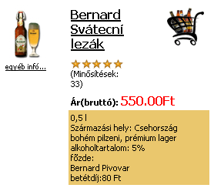
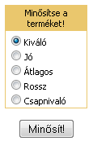
Let’s have a party!
5) Select “Bernard Sváteční Ležák“ from search results (click)
WebElement choosenBeer = driver.findElement(By.xpath(Dic.Beer_ChosenBeerSvatecni));
choosenBeer.click(); {…}
"//*[@class='cat' and contains(text(),'Svátecní')]"
6) Rate beer as „good“ (select „jó“ + click)
WebElement votingForm = driver.findElement(By.xpath(Dic.Beer_RatingForm));
votingForm.findElement(By.xpath(Dic.Beer_Rating_GOOD)).click();
Assert.assertTrue(votingForm
.findElement(By.xpath(Dic.Beer_Rating_GOOD)).isEnabled());
votingForm.submit(); {…}
Beer 5/7
2012 © EPAM Systems

Slide 41

Let’s have a party!
7) Click onto Cart img to add selected beer to shopping cart
WebElement addToCart = driver.findElement(By.xpath(Dic.Beer_CartImg)); addToCart.click();
Set<String> handlers = driver.getWindowHandles();
if (driver.getWindowHandles().size()>= 1){
for (String handler : handlers){
driver.switchTo().window(handler);
if (driver.getCurrentUrl().contains("cart.php?shopping_cart=yes")){
System.out.println("Get focus on Popup window");
break;
}
}
} else System.out.println("No windows found!"); {…}
Beer 6/7
2012 © EPAM Systems

Slide 42
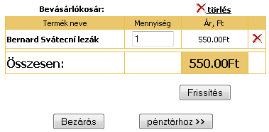
Let’s have a party!
8) Change amount to „15“
driver.findElement(By.xpath(Dic.Beer_Amount)).clear();
driver.findElement(By.xpath(Dic.Beer_Amount)).sendKeys("15");
9) Press button „Pénztárhoz >>“
for (String handle : driver.getWindowHandles()) {
driver.switchTo().window(handle);
}
Assert.assertTrue(driver.findElement(By.xpath(Dic.Beer_CassaHeader))
.getText().contains("Pénztár"));
System.out.println("PASS: we are back in the MAIN window.");
{…}
Beer 7/7
2012 © EPAM Systems

Slide 43
Let’s have a party!
FOOD✓
BEVERAGE
✓
INVITATION CARD ?
Invitation Card
2012 © EPAM Systems

Slide 44
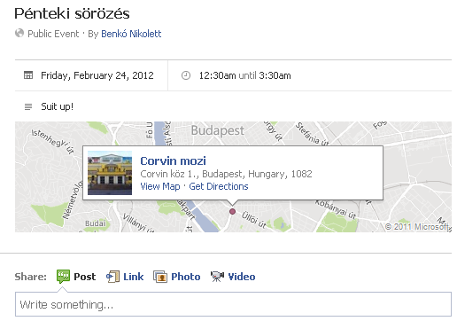
Let’s have a party!
Invitation Card?
Invitation card 1/12
2012 © EPAM Systems

Slide 45
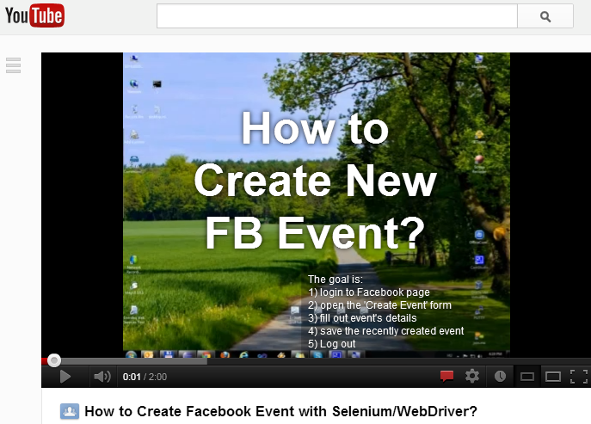
http://www.youtube.com/watch?v=W66W0bZLYdM
Invitation card 2/12
2012 © EPAM Systems

Slide 46

STEPS:
1) Enter to site (enter URL + log in)
driver.get(Dic.FB_URL);
WebElement loginForm = driver.findElement(By.id(Dic.FB_LoginForm));
Assert.assertTrue(loginForm.isDisplayed());
loginForm.findElement(By.id("email")).sendKeys(Dic.FB_email);
loginForm.findElement(By.id("pass")).sendKeys(Dic.FB_pswd);
loginForm.findElement(By.xpath(Dic.FB_LoginBtn)).submit();
{…}
Invitation card 3/12
2012 © EPAM Systems

Slide 47
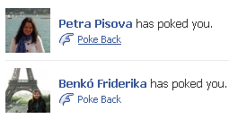

Challenges
Let’s have a party!
2) Who poked me? Poke back!
WebElement pokes = driver.findElement(By.id(Dic.FB_PokeApp));
String pokesCount =
pokes.findElement(By.xpath(Dic.FB_PokeCount)).getText();
if ( Integer.parseInt(pokesCount) > 0) ){
pokes.click();
WebElement pokePage = driver.findElement(By.id(Dic.FB_PokePage));
List<WebElement> allPokes =
pokePage.findElements(By.xpath(Dic.FB_PokeList));
for (int i = 0; i < allPokes.size(); i++) {
allPokes.get(i).findElement(By.xpath(Dic.FB_PokeBackLink)).click();
}
}
{…}
or: By.linkText()
Invitation card 4/12
2012 © EPAM Systems

Slide 48

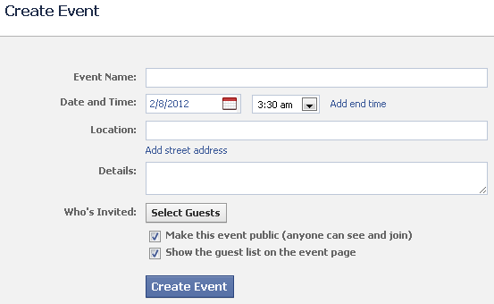
Challenges
Let’s have a party!
3) Click onto “Create event” link
driver.findElement(By.linkText(Dic.FB_CreateEventLink)).click();
4) Read the content of the Event form into variable…
WebElement createEventForm = driver.findElement(
By.id(Dic.FB_CreateEventForm));
String eventName = "Just a party";
createEventForm.findElement(
By.id(Dic.FB_EventNameBox))
.sendKeys(eventName);
createEventForm.findElement(
By.className(Dic.FB_EventDateBox))
.click();
Invitation card 5/12
2012 © EPAM Systems

Slide 49
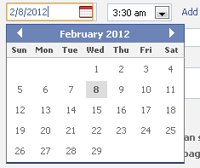
Let’s have a party!
5) Set event start date …
String monthTitle = driver.findElement(By.className(
Dic.FB_EventCalendarHeader)).getText();
createEventForm.findElement(By.name(
Dic.FB_EventStartDate)).clear();
createEventForm.findElement(By.name(
Dic.FB_EventStartDate)).sendKeys("2/22/2012");
if (monthTitle.contains("February“) && monthTitle.contains("2012")){
System.out.println(“Correct Year and Month is displayed");
} {…}
if (driver.findElement(By.cssSelector(
Dic.FB_CalendarHighlightedDay)).getText().contains("22")){
System.out.println("The event's day is highlighted.");
} {…}
Assert.assertTrue(createEventForm .findElement(By.name(Dic.FB_EventStartDate))
.getAttribute("value").contains("2/22/2012"));
Don’t forget to clear the input box!
".dayCell.selected"
Invitation card 6/12
2012 © EPAM Systems

Slide 50
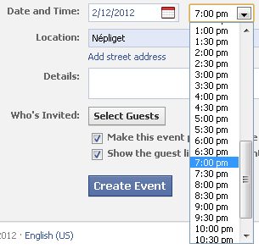
Let’s have a party!
5) … and time
// set start time
Select selectStartTime =
new Select(createEventForm.findElement(
By.id(Dic.FB_EventStartTime)));
selectStartTime.selectByVisibleText("7:00 pm");
Assert.assertTrue(createEventForm .findElement(By.name(Dic.FB_EventStartTime))
.getAttribute("value").contains("7:00 pm")); {…}
Invitation card 7/12
2012 © EPAM Systems

Slide 51
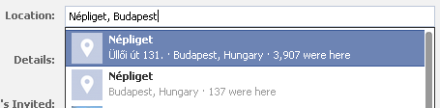
Let’s have a party!
6) Set Location to “Nepliget, Budapest”
WebElement locationBox = createEventForm.findElement(By.name(Dic.FB_LocationBox));
locationBox.sendKeys("Nepliget, Budapest");
// wait till the auto-complete part is visible
ExpectedCondition<Boolean> e = new ExpectedCondition<Boolean>() {
public Boolean apply(WebDriver d) {
d.findElement(By.xpath(Dic.FB_FirstLocationInTheList));
return Boolean.valueOf(true);
}
};
WebDriverWait w = new WebDriverWait(driver, 15);
w.until(e);
WebElement autocomplete = driver.findElement(By.xpath(Dic.FB_FirstLocationInTheList));
autocomplete.click(); {…}
Invitation card 8/12
2012 © EPAM Systems

Slide 52
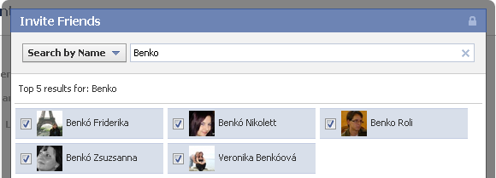
Let’s have a party!
7) Invite people (who’s name starts with “Benko”)
createEventForm.findElement(By.xpath(Dic.FB_InvitePeopleBtn)).click();
driver.findElement(By.xpath(Dic.FB_InvitePeopleSearchBox))
.sendKeys("Benko");
List <WebElement> invitedPeople = driver.findElements(By.xpath(Dic.FB_InvitePeopleCheckBox))
for (int i = 0; i < invitedPeople.size(); i++) {
invitedPeople.get(i).click();
}
driver.findElement(By.xpath(Dic.FB_InvitePeopleFinishBtn)).click(); {…}
Invitation card 9/12
2012 © EPAM Systems

Slide 53

Let’s have a party!
8) Make the event PRIVATE
if (createEventForm.findElement(
By.id(Dic.FB_PrivateEvent_checkbox)).isSelected())
createEventForm.findElement(
By.id(Dic.FB_PrivateEvent_checkbox)).click();
Assert.assertTrue(!createEventForm .findElement(By.id(Dic.FB_PrivateEvent_checkbox))
.isSelected());
System.out.println("PASS: The event was set to PRIVATE"); {…}
Invitation card 10/12
2012 © EPAM Systems

Slide 54
Let’s have a party!
9) Don’t show the Guest List
if (createEventForm.findElement(
By.id(Dic.FB_GuestList_checkbox)).isSelected())
createEventForm.findElement(
By.id(Dic.FB_GuestList_checkbox)).click();
Assert.assertTrue(!createEventForm .findElement(By.id(Dic.FB_GuestList_checkbox))
.isSelected());
System.out.println("Pass: Guest list is NOT displayed"); {…}
Invitation card 11/12
2012 © EPAM Systems

Slide 55
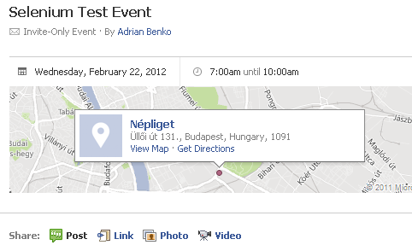
Let’s have a party!
10) Verify that the Event was created
createEventForm.findElement(
By.xpath(Dic.FB_SaveEventBtn)).submit();
WebElement createdEventHeader = driver.findElement(
By.cssSelector(Dic.FB_CreatedEventHeader));
Assert.assertTrue(createdEventHeader.getText()
.contains(eventName));
System.out.println("PASS: The event was successfully created.");
Invitation card 12/12
2012 © EPAM Systems

Slide 56
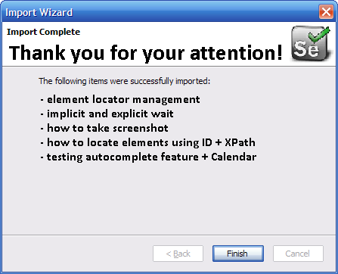
Thank You!
Thank you!
2012 © EPAM Systems

Slide 57

Questions?
http://www.serafinosays.com/
Questions?
2012 © EPAM Systems

Slide 58
Literature
31 Days of Testing—Day 11: Maintainable Functional Automation
(http://frazzleddad.blogspot.com/2011/12/31-days-of-testingday-11-maintainable.html)
31 Days of Testing—Day 13: Functional Test 201 (Common Problems)
(http://frazzleddad.blogspot.com/2011/12/31-days-of-testingday-13-functional.html)
WebDriver: Advanced Usage
(http://seleniumhq.org/docs/04_webdriver_advanced.html)
Selenium WebDriver - Wait for an element to load
(http://deanhume.com/Home/BlogPost/selenium-webdriver---wait-for-an-element-to-load/64)
Selenium Wiki
(http://www.seleniumwiki.com/)
Exploiting current and exploring new
(http://rostislav-matl.blogspot.com/)
Tips and Tricks for using WebDriver
(http://code.google.com/p/selenium/wiki/TipsAndTricks)
Selenium Advanced User Interactions – The Automated Tester
(http://www.theautomatedtester.co.uk/blog/2011/selenium-advanced-user-interactions.html)
Literature
2012 © EPAM Systems

