Slide 1
DebitLens
Find it. Understand it. Reconcile it. Verify it.
Evidence-backed financial commitment intelligence for consumers

Slide 2
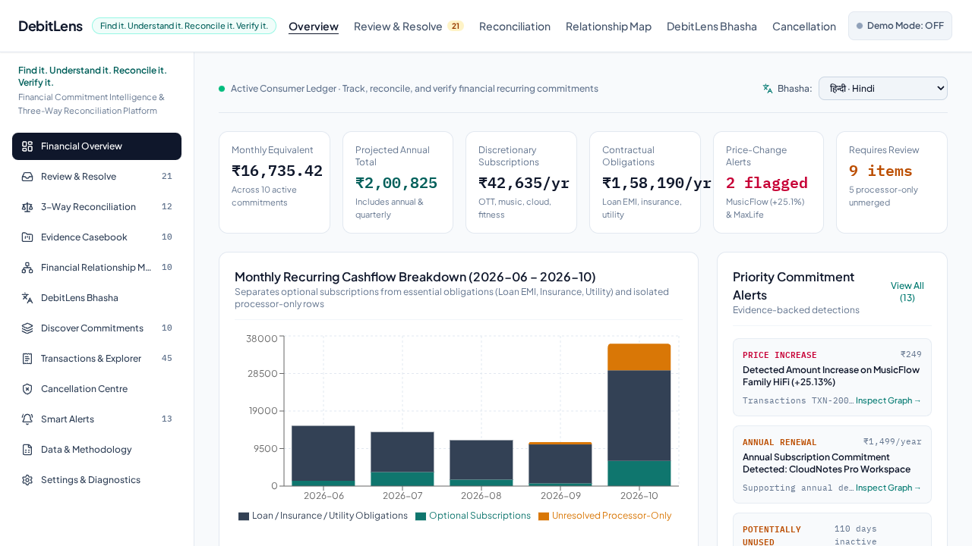
The consumer problem
Statement descriptors often hide the service, processor and action required.
Cancellation of a service and revocation of a payment mandate are separate processes.
Consumers need a traceable record of evidence, uncertainty and later observed activity.

Slide 3
Find: discover recurring debits
Import synthetic statement data through the application.
Deterministic recurrence detection identifies candidates without inventing merchant certainty.
Unknown and processor-only descriptors remain explicitly unresolved.

Slide 4
Understand: separate identities
Merchant identity, payment processor and payment rail are represented separately.
A processor descriptor alone does not establish the service merchant.
Explanations are grounded in the imported transaction and catalogue evidence.

Slide 5
Reconcile: evidence-backed financial state
Three-way reconciliation compares actual transactions, service terms and available mandates.
Amounts retain direction and currency; missing currency is not silently treated as INR.
Missing evidence remains visible instead of becoming a success-shaped fallback.

Slide 6
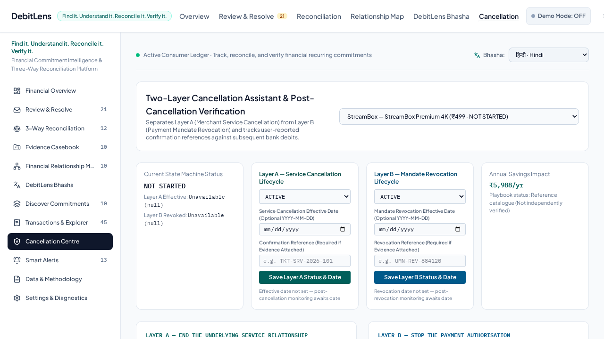
Verify: two independent cancellation layers
Layer A records service cancellation activity.
Layer B records payment-mandate revocation activity.
User-entered evidence is distinct from independent institutional verification.

Slide 7
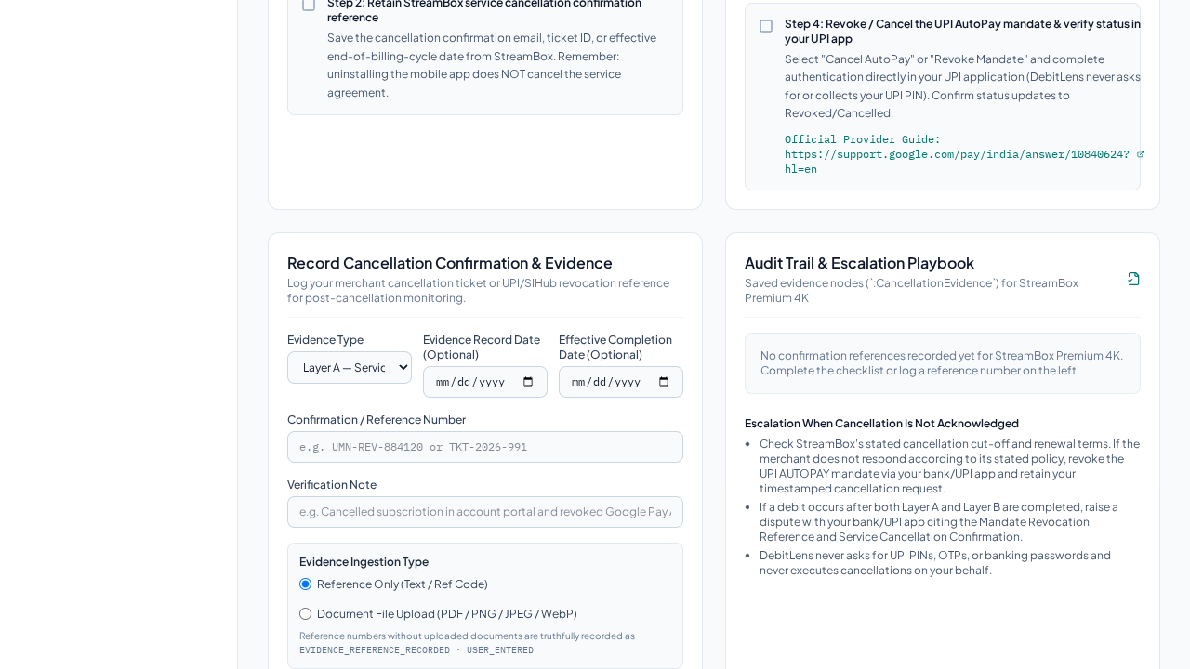
Evidence, Passport and monitoring
Reference-only evidence is labelled as a user-provided reference.
Real files are stored only after byte, size and signature checks; authenticity is not inferred.
Passport and Evidence Pack preserve provenance and observed post-cancellation activity.

Slide 8
Architecture and design choices
React + TypeScript + Vite frontend; Express + TypeScript backend.
Canonical JSON persistence is the authoritative local financial state.
Neo4j is a rebuildable relationship projection; Sarvam is optional language assistance.
Deterministic rules govern financial state; AI does not override evidence.
Notes:
Explain why the canonical JSON store remains authoritative and why optional integrations do not block local startup.

Slide 9
Prototype boundaries and honest claims
This is a local single-process prototype, not a production multi-user financial service.
It does not provide bank connectivity, legal cancellation, merchant authority or regulatory approval.
Use synthetic data in the demonstration and distinguish configured CI from executed CI.

Slide 10
Demo flow and closing
Import ? discover ? investigate ? reconcile ? cancel service ? revoke mandate ? preserve evidence ? monitor.
DebitLens helps consumers find recurring debits, understand who is charging them, reconcile the evidence and keep track of cancellation and mandate actions.
See submission/DEBITLENS_DEMO_VIDEO_SCRIPT.md for the executable recording plan.

