Slide 1

Next Word Prediction using LSTM

Slide 2
Introduction
About me – Vivek, a B.Tech Electronics & Communication Engineering graduate with strong enthusiasm for data science, currently pursuing a data science course at Innomatics Research Labs, eager to work in team-based environments and grow into a hands-on data professional.

Slide 3
Agenda (Project Flow)
Problem statement
Dataset
EDA
Preprocessing
Model architecture
Evaluation
Challenges faced

Slide 4
Problem Statement
Smartphone users expect keyboards to suggest the next word instantly,
yet traditional n‑gram engines struggle with slang, abbreviations, and
short-form chatter. This project trains an LSTM-based language model on
SwiftKey-style Twitter data to understand conversational context and generate
the most probable next word in real time, enabling faster and more
personalized typing assistance

Slide 5
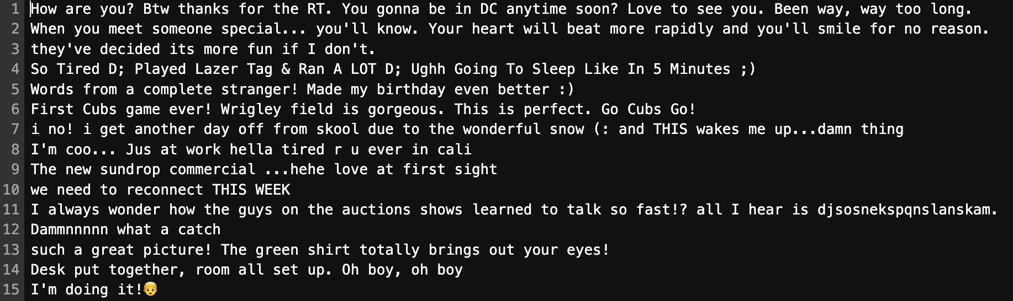
Dataset
Data: en_US.twitter.txt subset (3k lines) to mimic keyboard usage

Slide 6
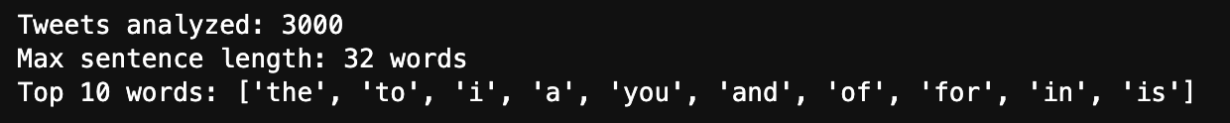
EDA
Cleansing: removed emojis/non-ASCII, lowercase, strip whitespace, skip blank rows.
Checked maximum length of a sentence
Top 10 words in the dataset

Slide 7
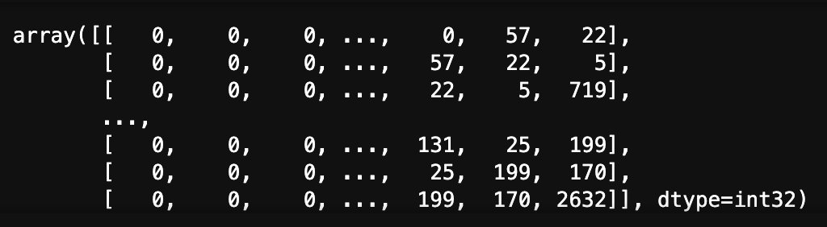
Preprocessing
Tokenization & Sequence Creation:
Keras Tokenizer limited to 50k most frequent words to balance coverage and size.
Sentences converted to integer sequences; manual spot checks ensured quality.
Constructed n-grams and pre-padded sequences to max length (34).

Slide 8
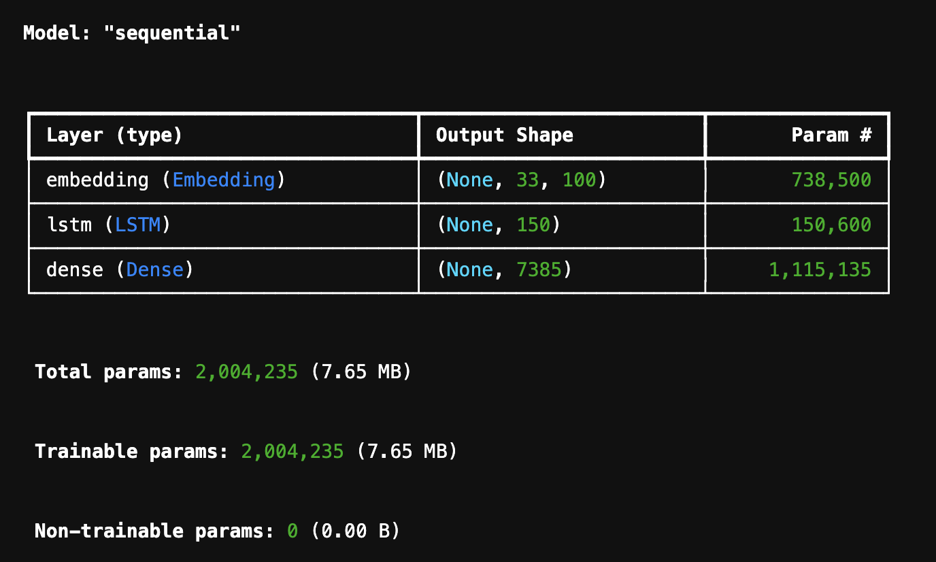
Model Architecture & Training Setup
Embedding layer: 50k vocab → 100-dim vectors
LSTM layer: 150 units , Dense softmax predicts next word.
Loss: categorical cross-entropy, Optimizer: Adam, Metrics: accuracy

Slide 9


Evaluation
Train/validation split on n-gram dataset to monitor learning curves.
Training accuracy: 92% after 40 epochs.
Manual testing:
input: output:

Slide 10
Challenges faced
Handling memory limits when tokenizing and padding large tweet data on a laptop.
Balancing dataset size versus training speed—small samples underfit, large samples stall.
Choosing the right vocabulary cap and sequence length without losing important context.
Selecting an LSTM size that fits memory while capturing enough context.

Slide 11


