Slide 1

INDIAN INSTITUTE OF INFORMATION TECHNOLOGY, DHARWAD
TITLE: IMPROVING HEALTHCARE USING SMART PILL BOX FOR MEDICINE REMINDER.
Submitted To:
Dr. Uma S
HOD Cse
Submitted By:
Bhargava H.S (18BCS018)
Palshini B (18BCS062)
Raghu prasad J N (18BCS073)
Vivek S (18BCS111)

Slide 2
Abstract
Many medical errors are due to the fact that people in charge of patient or elder's medication have to deal with sorting huge amounts of pills each day.
This medication pill box is focused on patients who frequently take medications or vitamin supplements, or attendants who deal with the more seasoned or patients.
Our smart pill box is programmable that enables medical caretakers or clients to determine the pill amount and timing to take pills, and the service times for every day.
The pillbox will remind clients or patients to take pills utilizing sound and light. The warning of pills should be taken will be shown by an android application which is held by the patient.

Slide 3
Introduction
There can be a lot of individuals out there who need constant help may it be our elderly people, family members, the ones who have special needs. Elders are more affected by the timing of taking a certain drug than others, in order to prevent any dysfunction or illness timing is a must.
Some people may forget to take the medicines at the correct time and can forget the medicines which they have to take. In order to eliminate the factors of always needed observation like nurses or taking a risk of a missed dose, we had to find an easy, portable and efficient solution.
In order to make a really useful smart pillbox it had to be easily integrated with the recent sweeping smart technologies

Slide 4
Problem Statement
As pills have taken such an important role in everyday life there has been the past years an increase in the number of medical neglect cases related to incorrect medication given to patients,
Several problems related to the high amount of pills nowadays are prescribed to patients are found in hospitals or in retirement homes. In these places one of the main jobs is to give out to its patient the correct pills. Managing, sorting and giving out the pills to each one of the patients can sometimes have a high chance of error, with a patient or resident receiving one or more incorrect pills.
Finally there are situation where taking an incorrect amount of pills is a matter of the patient's inexperience and/or ignorance. No matter the cause, it has been proven that there is a significant risk of people ending up swallowing the incorrect medication or dose.

Slide 5
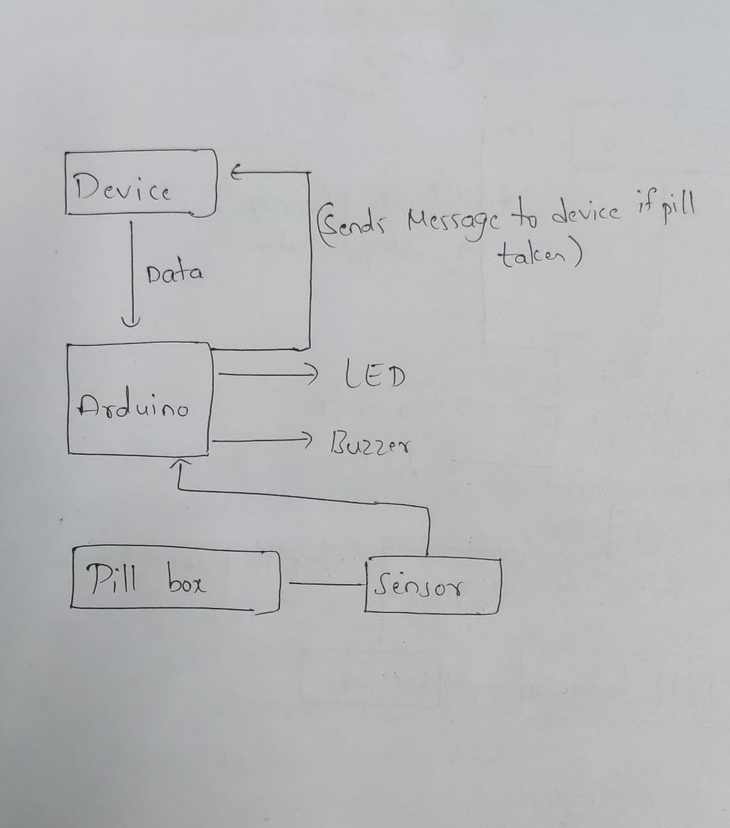
BLOCK DIAGRAM

Slide 6
Working
Steps:
When it is time for the patient to take the pills, our device (mobile application) sends data to the arduino containing name of the pills and timing via Bluetooth.
This triggers the buzzer on the particular box which contains the right pills and the buzzer starts ringing and the LED on the box starts blinking. Pill name is displayed on the LED.
When the patient opens the box, a signal is sent from the sensor on the box to the arduino which in turn makes the buzzer and LED stop.
Innovative Part: A message is sent to the mobile application saying that the patient has taken the right pills at the right time.

Slide 7
PROCESS
EVENT DATE
1) Synopsis Presentation 20/08/21
2) Project Setup and Model Preparing 25/08/21
3) Midsem PPT 20/09/21
4) Project Setup and Model Preparing 01/11/21
5) Prototype Testing 10/11/21
6) Endsem Evaluation and Report Submission 20/11/21

Slide 8
Conclusion
The aim of this study is to build a Smart Pill Box for Medicine Reminder and Monitoring System. When the pill time has been set, the pillbox will remind clients or patients to take pills utilizing sound and light. The warning of pills should be taken will be shown by an android application which is held by the patient. Contrasted and the conventional pill box that requires clients or attendants to stack the crate each day or consistently. This model can aid in help elders to take their medication.

Slide 9
Thank you

