Slide 1
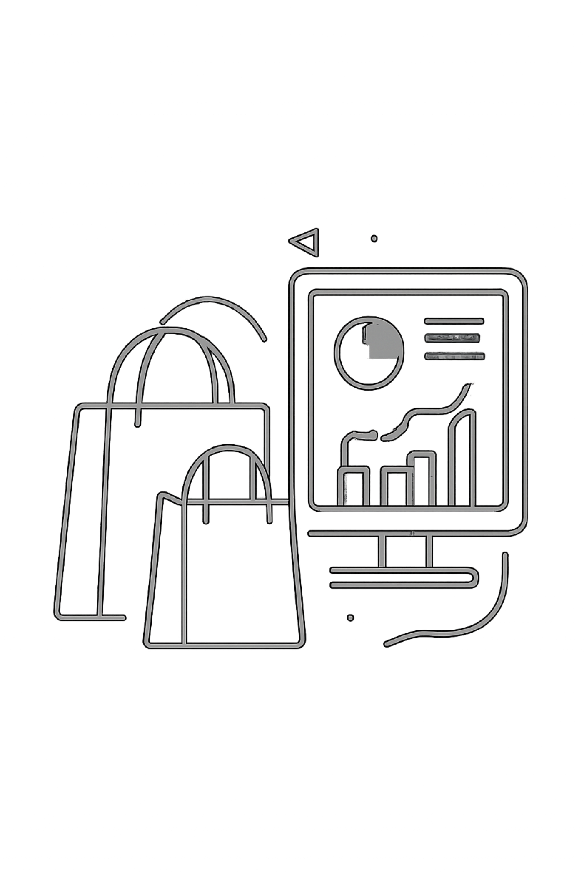
Customer Shopping Behavior Analysis
3,900 transactions · 18 features · 4 product categories

Slide 2
Dataset at a Glance
3,900
18
Transactions
Features
37
$59.76
Missing Values
Avg. Purchase
Review Rating column

Slide 3

Data Preparation in Python
Clean
Imputed missing Review Ratings using category medians
Standardize
Renamed columns to snake_case
Engineer
Created age_group & purchase_frequency_days
Integrate
Loaded cleaned data into PostgreSQL

Slide 4
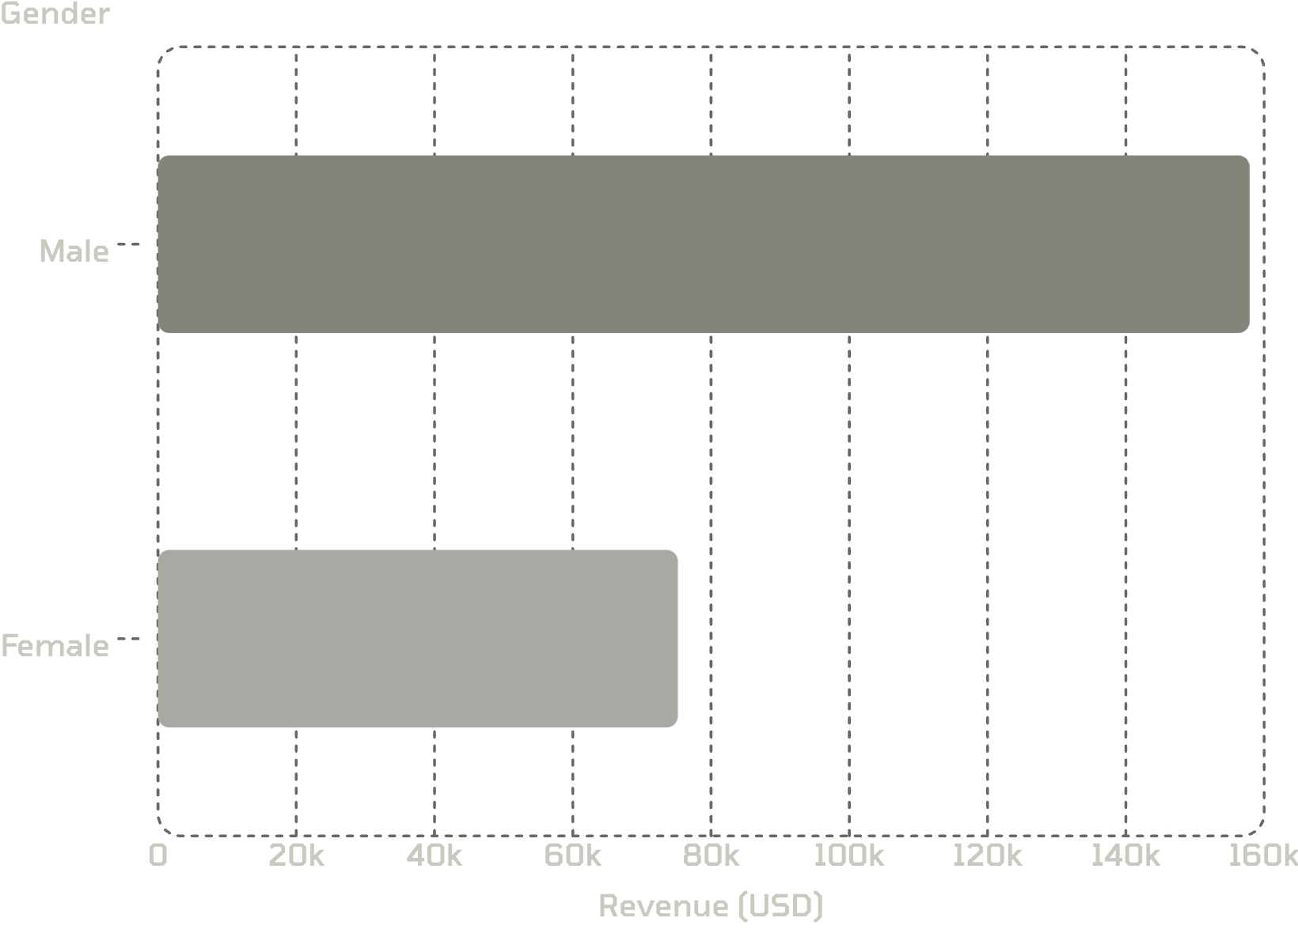
Revenue by Gender
Key Insight
Male customers generate 2.1× more revenue than female customers.
Male: $157,890
Female: $75,191

Slide 5
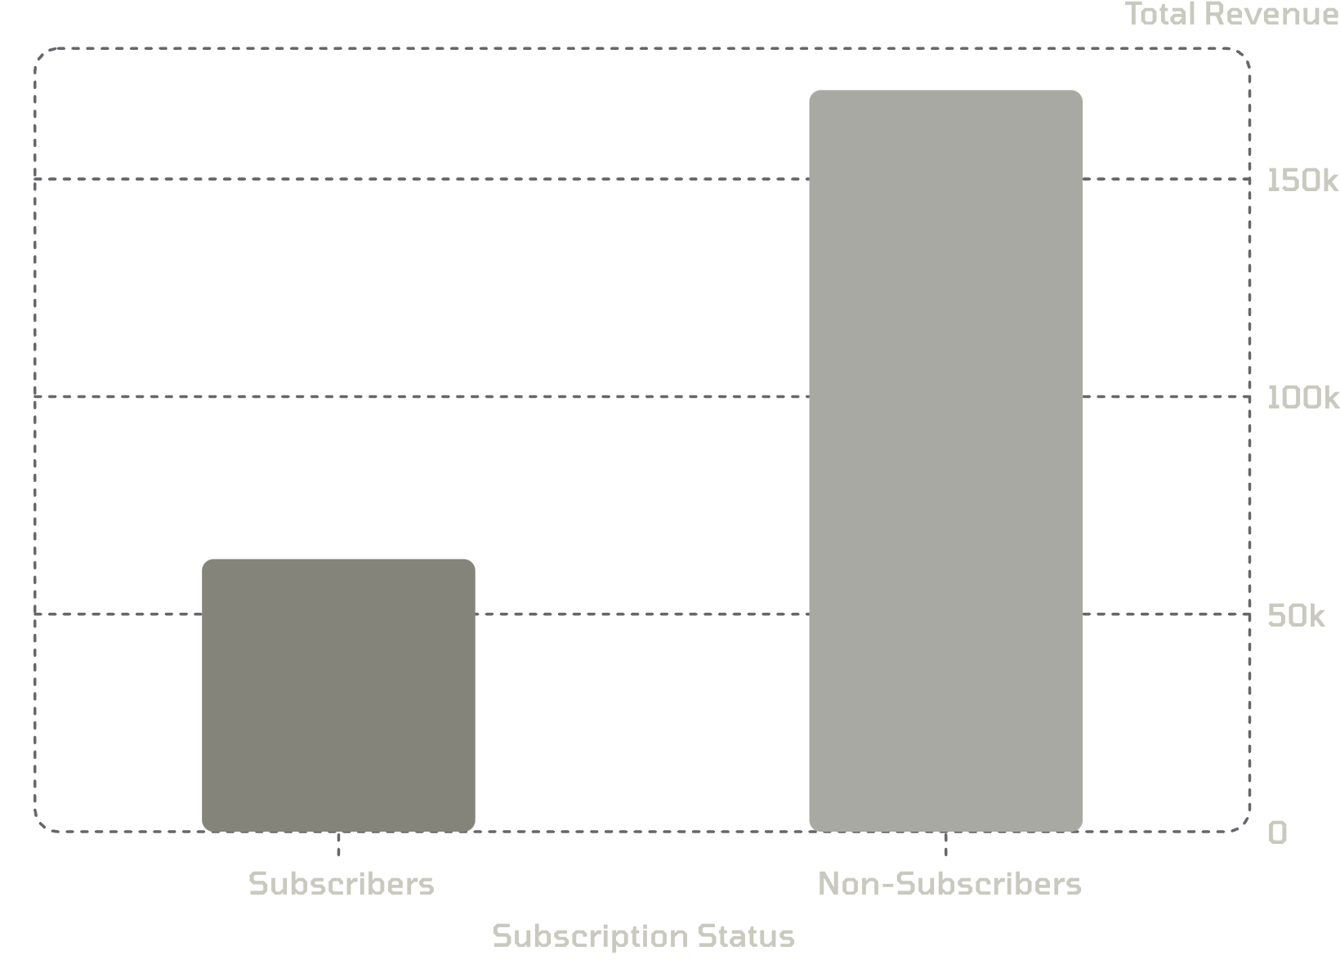

Subscribers vs. Non-Subscribers
Spending Behavior
Average spend is nearly identical — $59.49 vs $59.87
Yet 73% of customers are non-subscribers, driving 73% of total revenue.
Huge untapped subscription opportunity

Slide 6
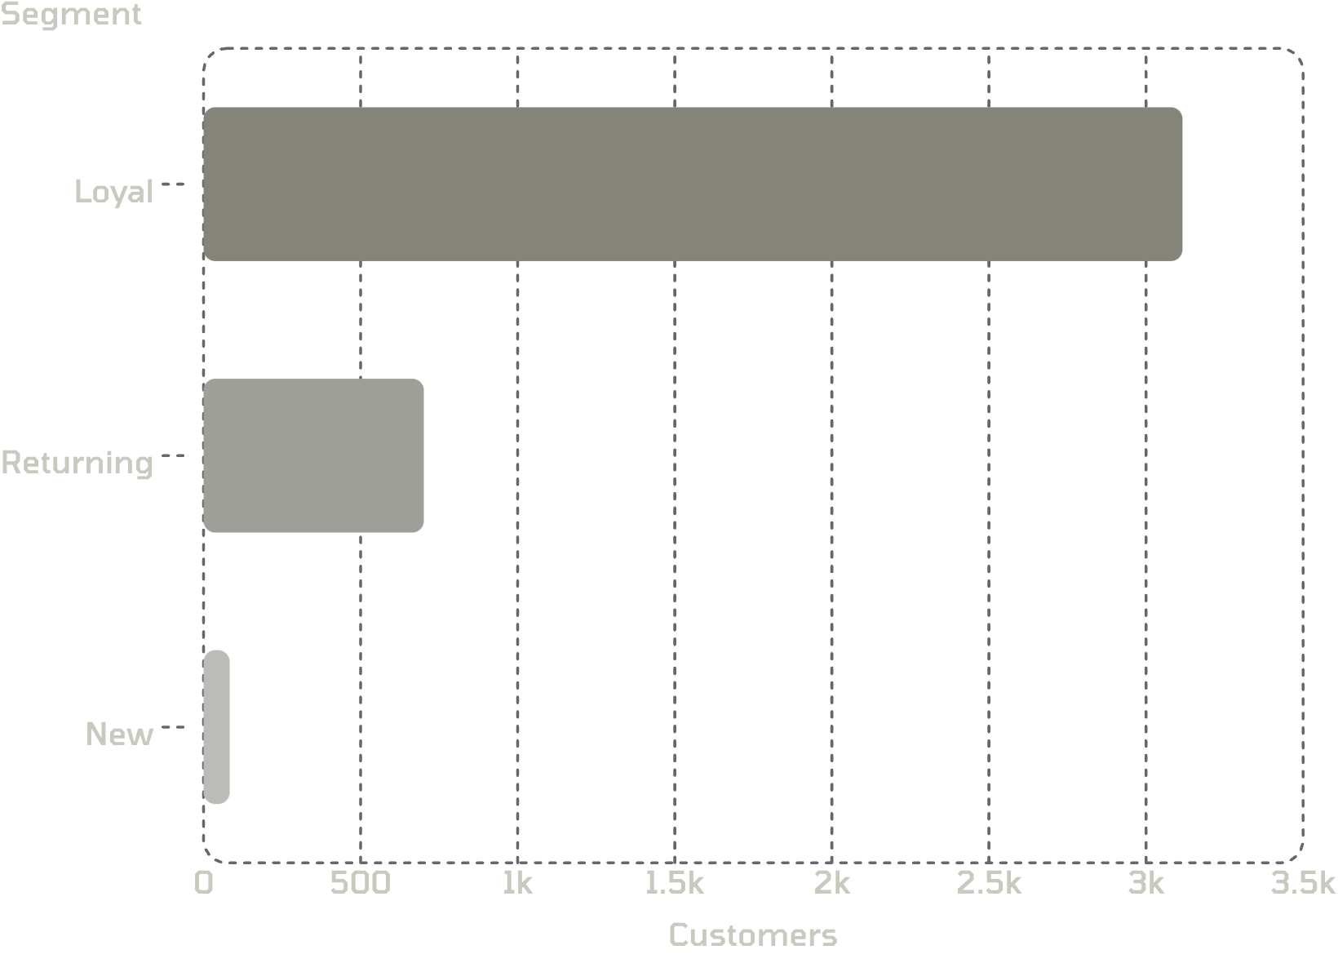
Customer Segmentation
Segment Breakdown
Loyal: 3,116 customers — core revenue base
Returning: 701 customers — growth opportunity
New: 83 customers — acquisition focus

Slide 7
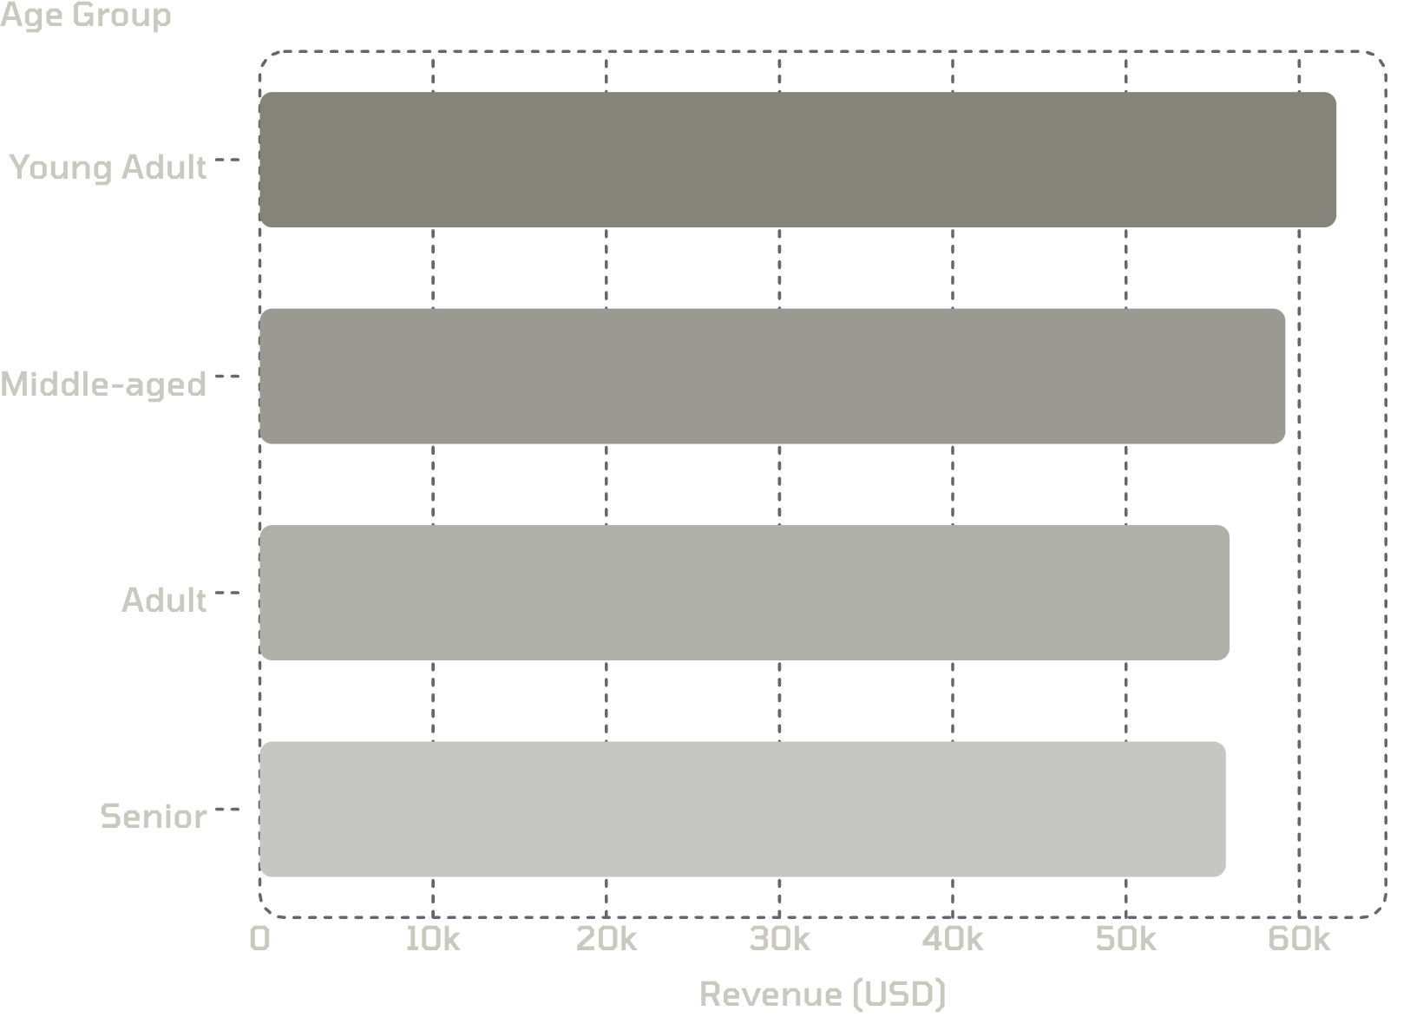
Revenue by Age Group
Top Contributor
Young Adults lead with $62,143 in total revenue.
Revenue is relatively evenly distributed across all age groups.

Slide 8
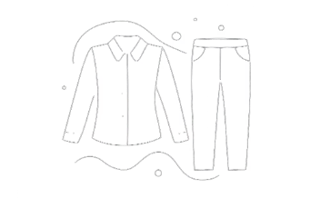



Top Products by Category
Clothing
Accessories
Footwear
Outerwear
Blouse · Pants · Shirt
Jewelry · Sunglasses · Belt
Sandals · Shoes · Sneakers
Jacket · Coat

Slide 9

Power BI Dashboard
3.9K Customers
Total customer count
$59.76 Avg
Average purchase amount
3.75 Rating
Average review rating
Filters
Subscription · Gender · Category · Shipping

Slide 10

Business Recommendations
Boost Subscriptions
Promote exclusive subscriber benefits
Loyalty Programs
Reward repeat buyers → Loyal segment
Review Discounts
Balance sales lift with margin control
Product Positioning
Highlight top-rated, best-selling items
Targeted Marketing
Focus on high-revenue age groups & express shippers

