Slide 1
Nutrition Agent
CAPSTONE PROJECT
Presented By:
Vivek Kumar
National Institute Of Technology Manipur
Computer Science Engineering
Email-patelvivek8874@gmail.com

Slide 2
Problem Statement
Nutrition Agent -
In today’s health-conscious world, individuals seek personalized nutrition guidance that aligns with their unique lifestyle, cultural habits, medical conditions, and evolving fitness goals. However, most available nutrition tools offer generic diet plans and lack the intelligence to adapt in real-time. Traditional diet consultations are time-consuming, limited in scalability, and inaccessible to many.
There is a pressing need for an intelligent, adaptive AI-driven Nutrition Assistant that can understand diverse user inputs—text, voice, or image—and provide dynamic meal plans, smart food swaps, and contextual nutritional advice. Such a solution must bridge the gap between rigid diet apps and human consultation by delivering real-time, personalized, and explainable recommendations powered by generative AI and large-scale food databases.

Slide 3
Proposed Solution
We propose developing an AI-powered Nutrition Agent that acts as a personalized virtual dietitian, capable of understanding user needs and delivering tailored nutritional guidance in real time.
Key components of the solution:
Multimodal Input Understanding
Accepts text, voice, and image inputs (e.g., food photos, grocery labels).
Uses NLP and computer vision to analyze and interpret user data.
Personalized Meal Planning
Generates dynamic meal plans based on user health goals, medical conditions, fitness routines, allergies, and cultural preferences.
Offers real-time food swaps and meal alternatives.
Contextual Explanations
Explains nutritional decisions, like “Why this food is better for you?”, to improve user awareness and trust.
Continuous Adaptation
Learns from user feedback, evolving needs, and behavior to refine suggestions.
Integrates with wearables or health apps (if available) for deeper insights.
Technology Stack
Powered by IBM Granite for generative AI capabilities and IBM Cloud Lite for scalable, secure deployment.
Uses dietary databases and health APIs for accurate recommendations.

Slide 4
Technology used
IBM cloud lite services
Natural Language Processing (NLP)
Retrieval Augmented Generation (RAG)
IBM Granite model

Slide 5
IBM cloud services used
IBM Cloud Watsonx AI Studio
Used to build, train, and evaluate generative AI models (like IBM Granite)
Offers a collaborative, no-code/low-code environment for experimenting with LLMs
Enables rapid prototyping of NLP workflows and agentic behavior
IBM Cloud Watsonx AI Runtime
Deployment environment for running and scaling AI models
Supports inference of foundation models like Granite
Manages performance, latency, and version control for production-ready models
IBM Cloud Agent Lab
A specialized workspace for creating Agentic AI systems
Helps integrate tools, memory, planning, and action-taking capabilities in your Nutrition Agent
Supports Retrieval-Augmented Generation (RAG) pipelines and multimodal workflows
IBM Granite Foundation Model
Large-scale pre-trained language model fine-tuned for enterprise AI
Powers the core capabilities of the Nutrition Agent:
Understanding natural language
Generating contextual meal plans
Explaining food recommendations

Slide 6
Wow factors
Truly Personalized Nutrition – Not One-Size-Fits-All
Unlike generic diet apps, the agent dynamically adapts meal plans based on real-time feedback, lifestyle changes, and health conditions.
Supports custom plans for diabetics, athletes, weight loss, allergy sufferers, and more.
Multimodal Interaction (Text + Voice + Image)
Users can speak naturally, type, or upload food photos/grocery labels.
AI interprets these inputs and instantly suggests smart food swaps, portion control tips, or full meal ideas.
Cultural and Regional Food Intelligence
Supports Indian food diversity, taking into account regional cuisines, fasting practices, and cultural eating habits.
Makes the agent truly inclusive and relatable across different communities.
Contextual Explanations Like a Real Dietitian
“Why is this food better?”
“How does this help my blood pressure?”
Empowers users with nutritional literacy, not just instructions.

Slide 7
End users
General Public
Fitness Enthusiasts & Athletes
Elderly & Patients with Medical Conditions
People with Food Allergies or Dietary Restrictions
Culturally Diverse Communities
Tech-Savvy Youth & Students

Slide 8
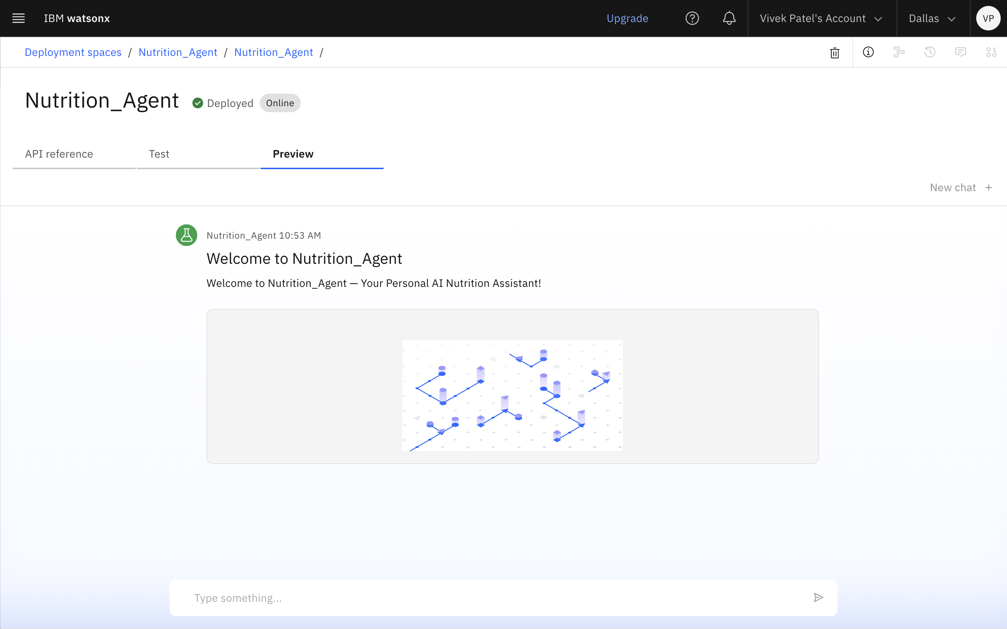
Results
Deployed AI Agent

Slide 9
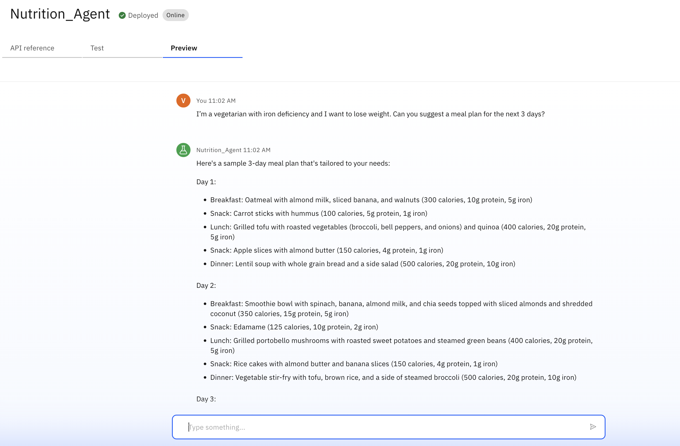
Results
Shows personalization (vegetarian + medical condition + goal).
Triggers diet planning, nutritional reasoning, and adaptation.
Great for showcasing your AI’s ability to think like a dietitian.

Slide 10
Conclusion
The AI-powered Nutrition Agent is a transformative step toward personalized, accessible, and intelligent dietary guidance. By leveraging IBM Granite, Watsonx, and Agent Lab, the system goes beyond generic diet plans to deliver:
Culturally-aware, health-conscious meal suggestions
Multimodal interaction (text, voice, image)
Contextual explanations that educate users
Continuous adaptation based on feedback and health progress
This solution not only bridges the gap between one-size-fits-all apps and professional consultations but also empowers users to make informed, sustainable lifestyle choices—anytime, anywhere.

Slide 11
GitHub Link
https://github.com/Vivek-kumar-v/Nutrition-Agent

Slide 12
Future scope
Integration with Wearable Devices Sync with smartwatches and fitness trackers to monitor real-time health metrics (e.g., steps, heart rate, calorie burn).
Mobile App Deployment Build a user-friendly mobile app for iOS and Android with offline capabilities and push notifications.
Deeper Health Data Integration Incorporate user’s blood reports, BMI, medical history, and prescription data for ultra-personalized recommendations.
AI-Powered Virtual Dietitian Chatbot Enable 24/7 conversational guidance for real-time dietary doubts, motivation, and meal suggestions.
Recipe Generator with Grocery List Generate healthy recipes and create auto-generated grocery lists for weekly planning.
B2B Use Cases Offer the platform to dietitians, hospitals, gyms, and wellness centers to scale personalized care.
Smart Kitchen Integration (IoT) Connect with smart fridges or kitchen scales to suggest recipes based on what's available at home.

Slide 13
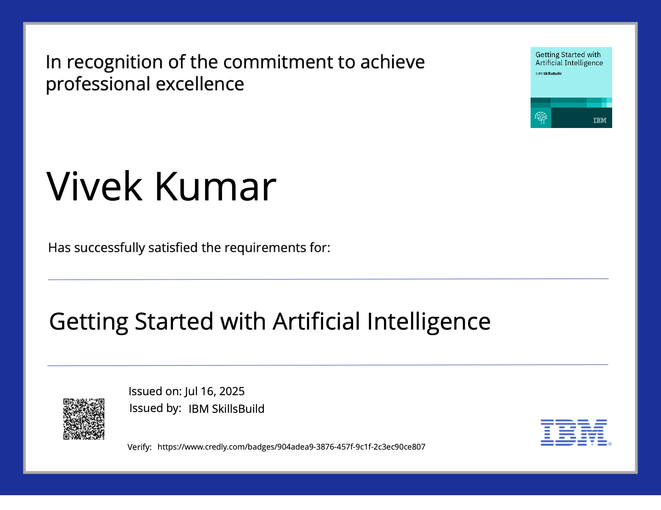
IBM Certifications
Getting started with AI)

Slide 14
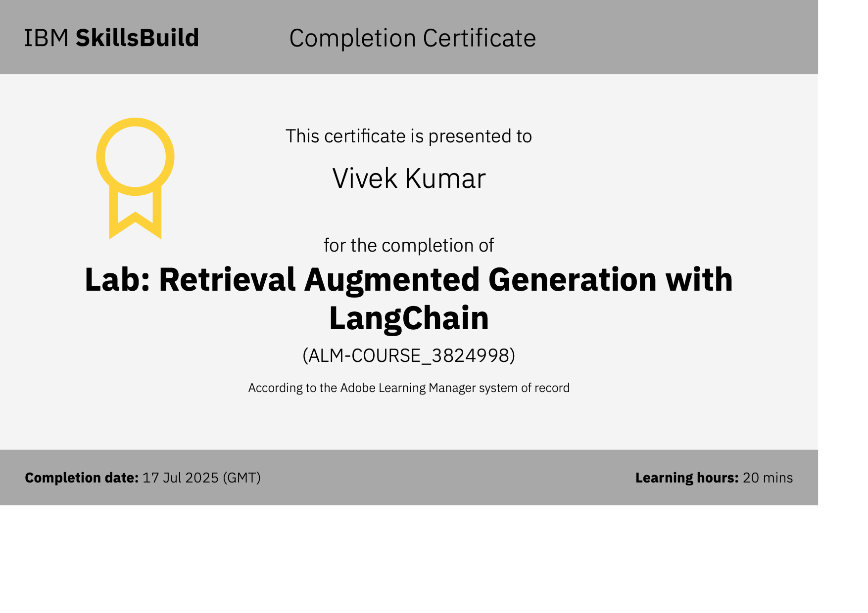
IBM Certifications
Retrieval Augmented Generation with LangChain

Slide 15
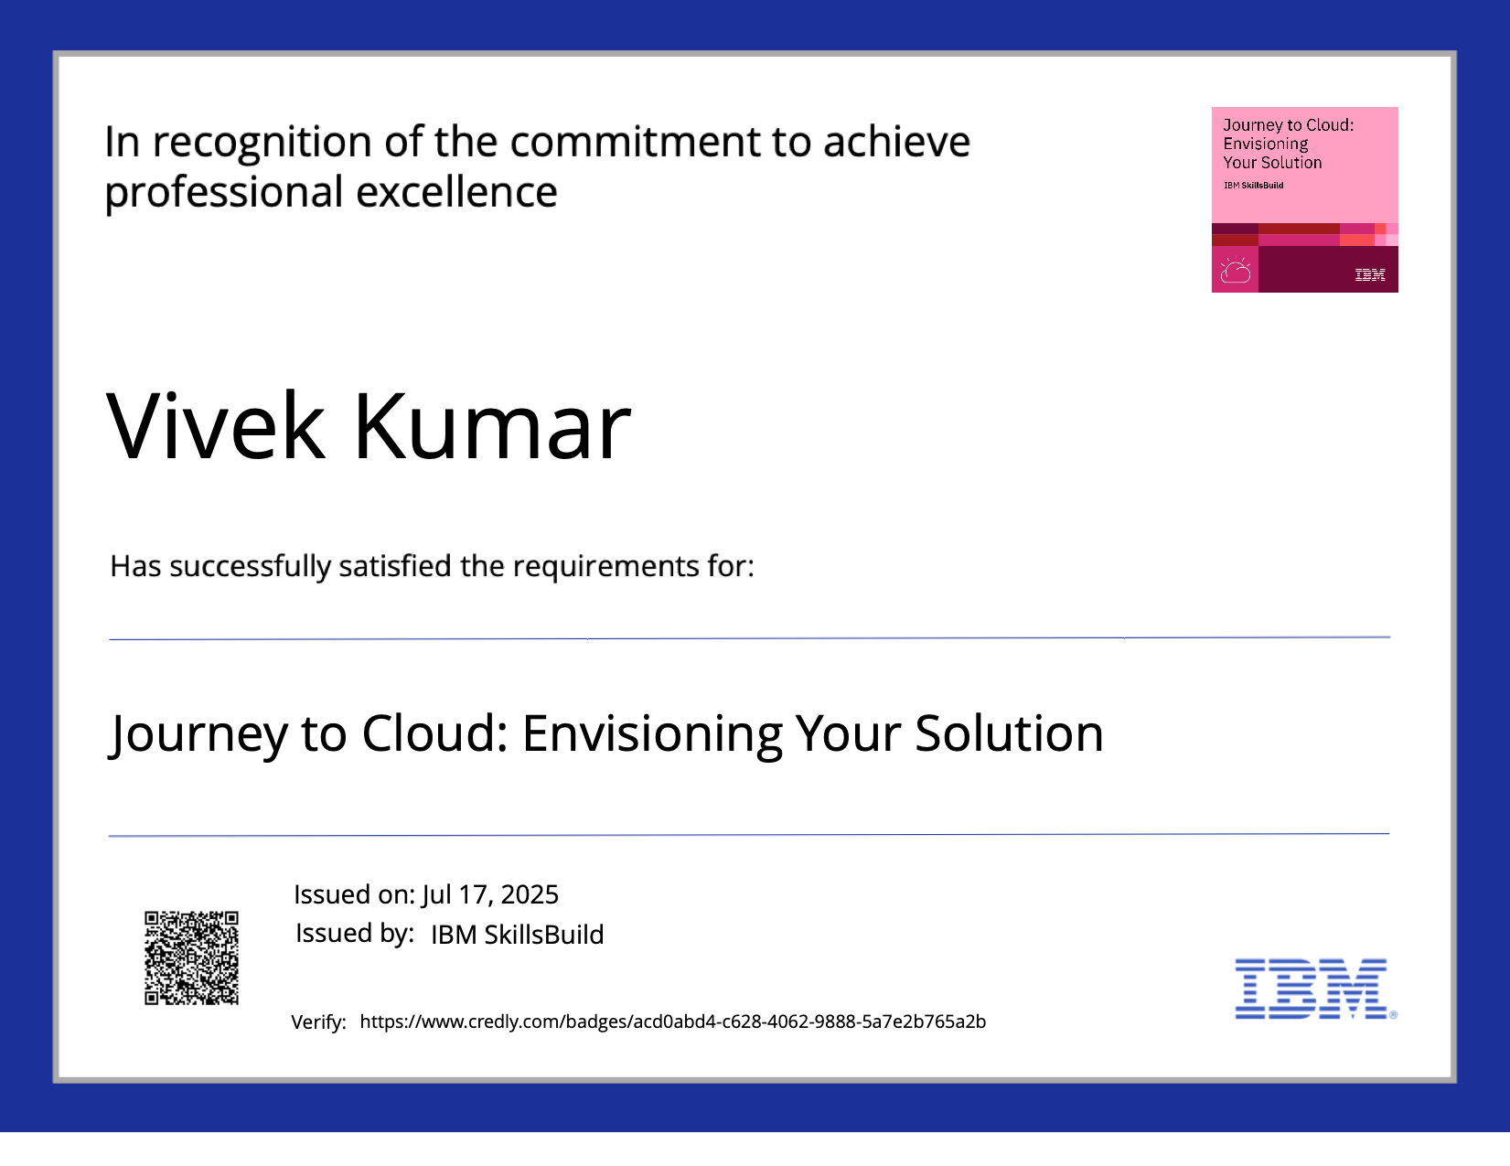
IBM Certifications
Journey to Cloud

Slide 16
THANK YOU

