Slide 1
Altair RapidMiner
Solution Presentation

Slide 2
Steps to create Process
Import data
Drag and Drop the Data into the process
Drag the models according to the requirements.
Connect to the result.

Slide 3
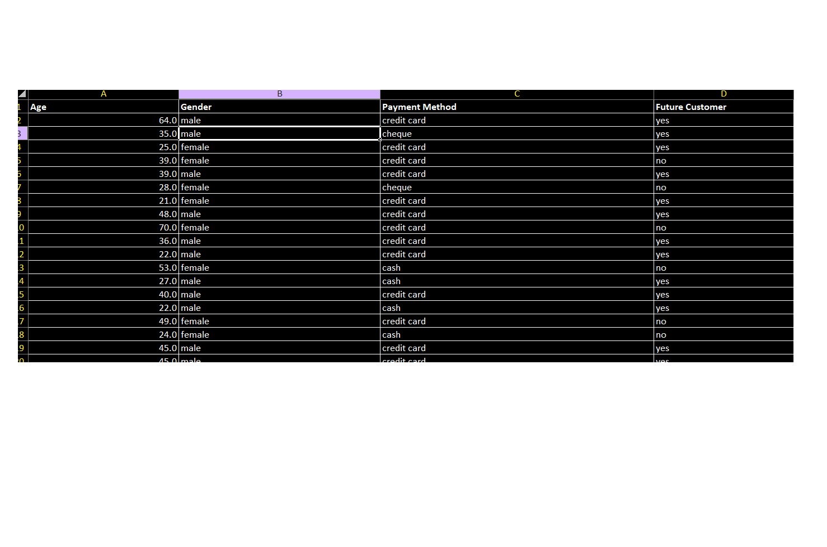
Used Dataset (Payment Methods)

Slide 4
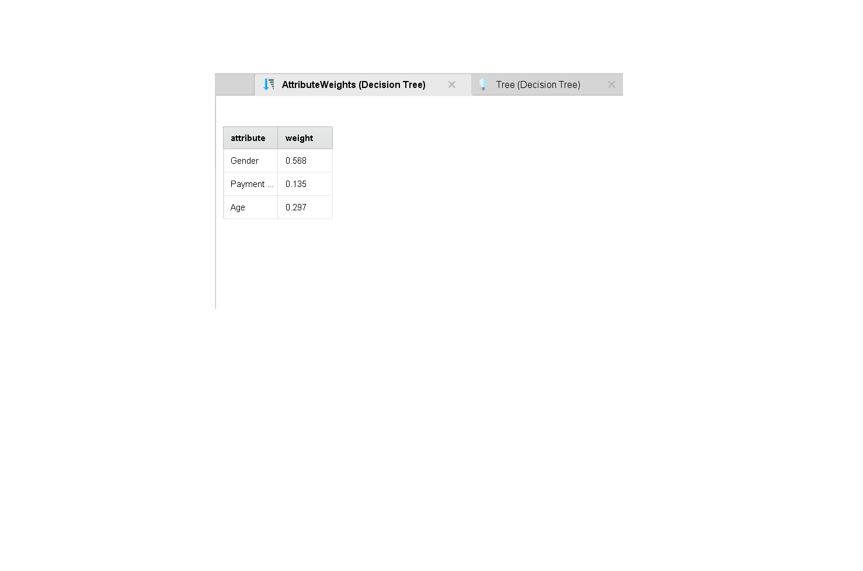
Sample Output (based on Weights)

Slide 5
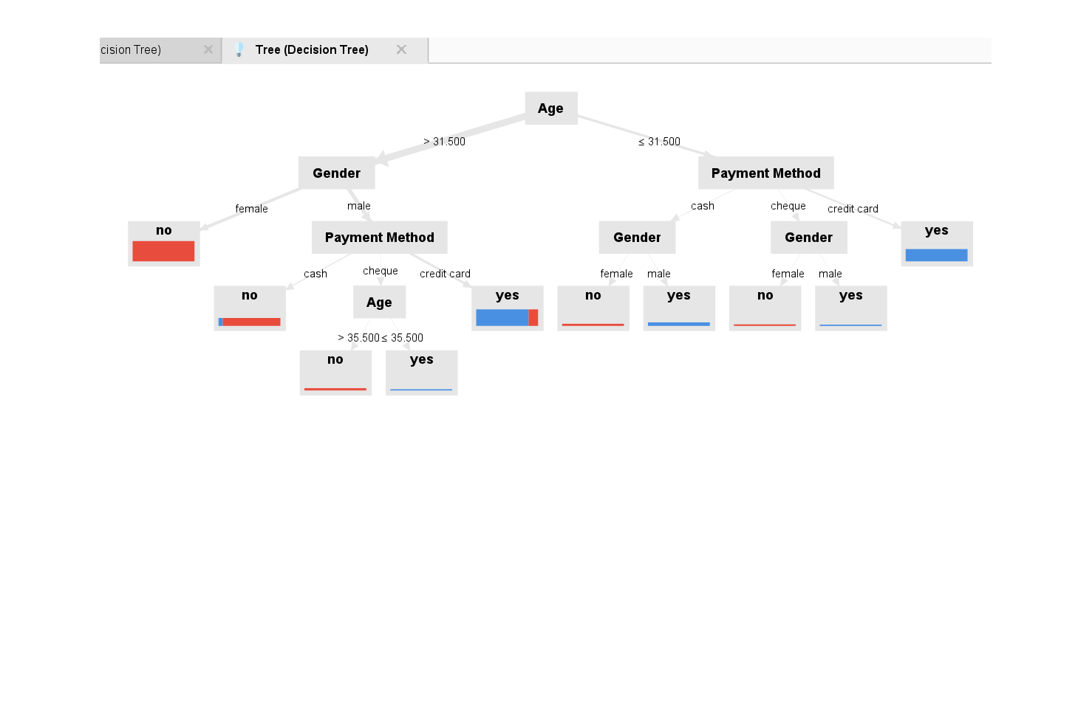
Sample Output (based on Decision Tree)

Slide 6
Summary
The decision tree is a classification model that predicts the outcome of a binary variable based on the features "Age," "Gender," and "Payment Method." It follows a series of rules to make predictions, such as splitting data based on age, gender, and payment method. The final nodes represent the predicted outcome, likely "yes" or "no.“
The table of attribute weights for a decision tree. The table includes three attributes: Gender, Payment, and Age, along with their corresponding weights: 0.568, 0.135, and 0.297, respectively. These weights represent the relative importance of each attribute in making predictions using the decision tree.

