Slide 1


Predict the fare amount of future rides using regression analysis
By
Vivek Pawar
Omkar Nalawade

Slide 2

Introduction
In this presentation, we will explore the methodology and findings of using regression analysis to predict fare amounts, highlighting its significance in shaping the future of ride-hailing and transportation services.
The use of regression analysis to predict the fare amount of future rides is a valuable and practical application in the transportation industry.

Slide 3
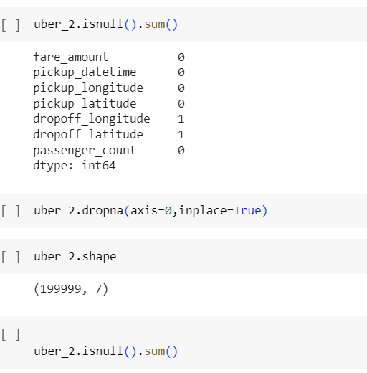
Data Preparation
- *Missing Value Analysis:* A critical step to ensure the reliability of the dataset, involving the identification of missing data points.
- *Impute the Missing Value:* Strategies were applied to handle missing values, ensuring the dataset's completeness without compromising its integrity

Slide 4
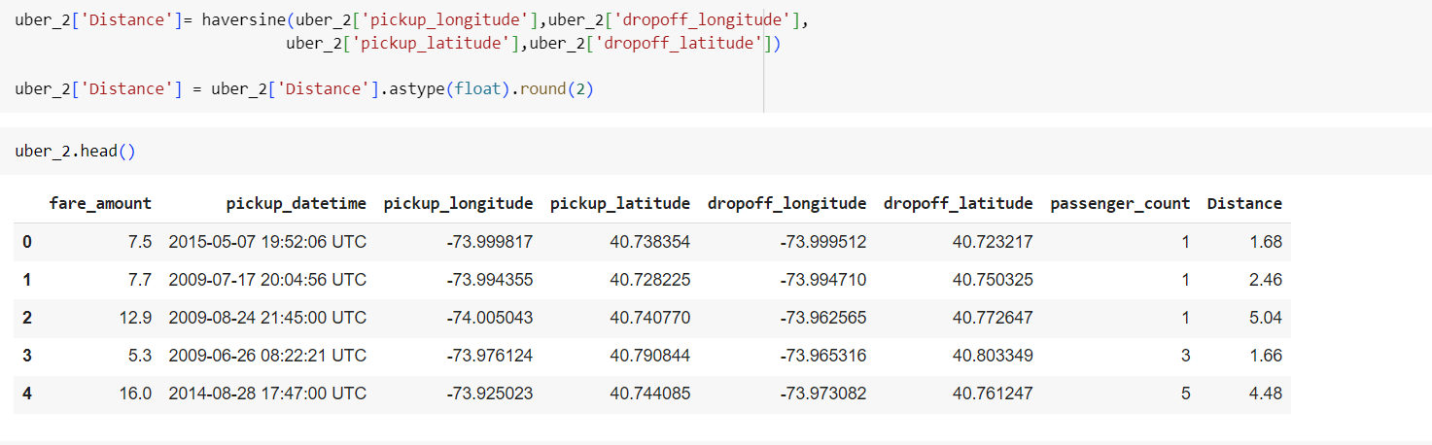

Haversine Formula
The Haversine formula is used to calculate the distance between two points on the surface of a sphere, given their latitudes and longitudes. It's commonly used for calculating distances between locations on Earth. Here's the formula:

Slide 5
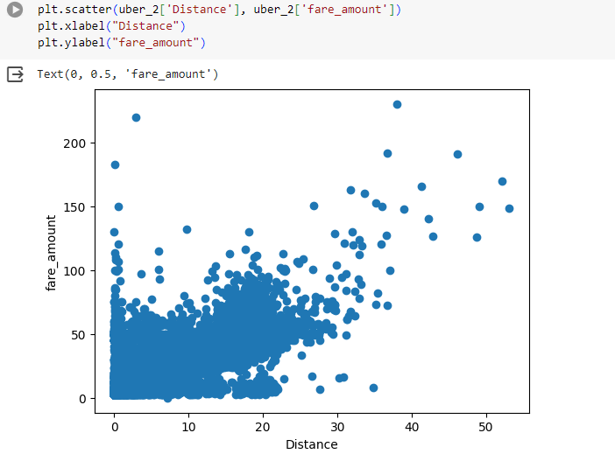
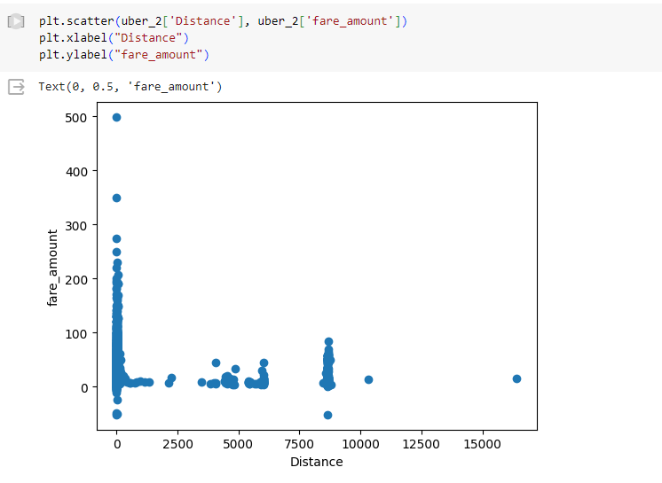
Outliers
Outliers are data points that significantly differ from other observations in a dataset.

Slide 6
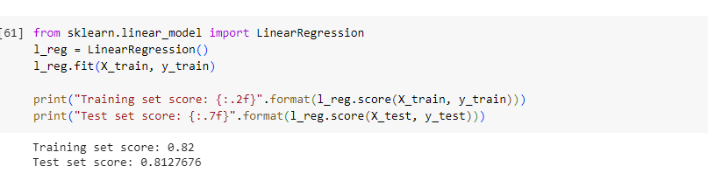
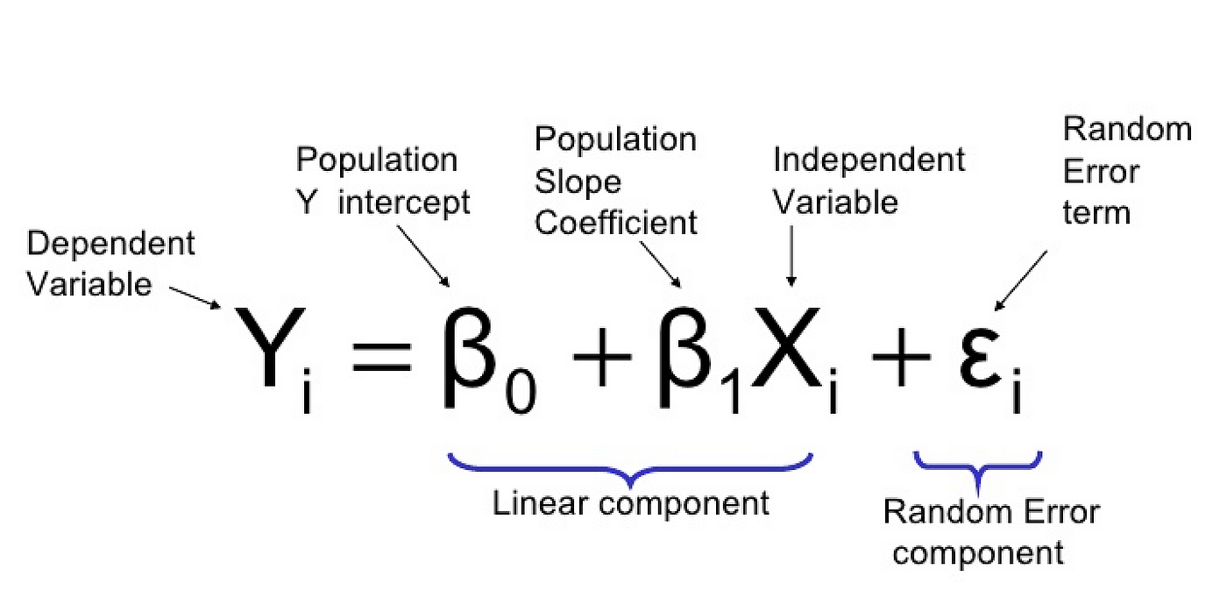
Simple Linear Regression
Simple linear regression is a statistical method used to model the relationship between two continuous variables, where one variable (the predictor or independent variable) is used to predict the value of another variable

Slide 7
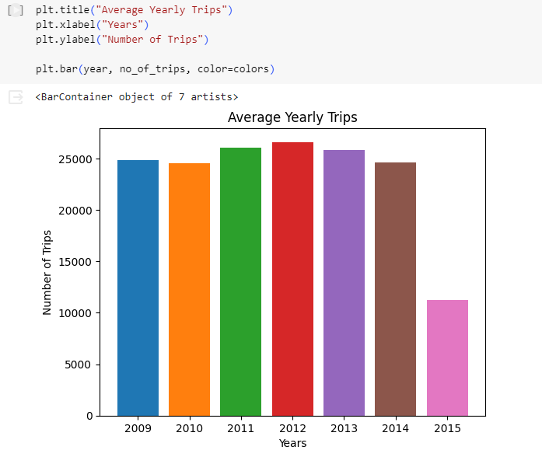
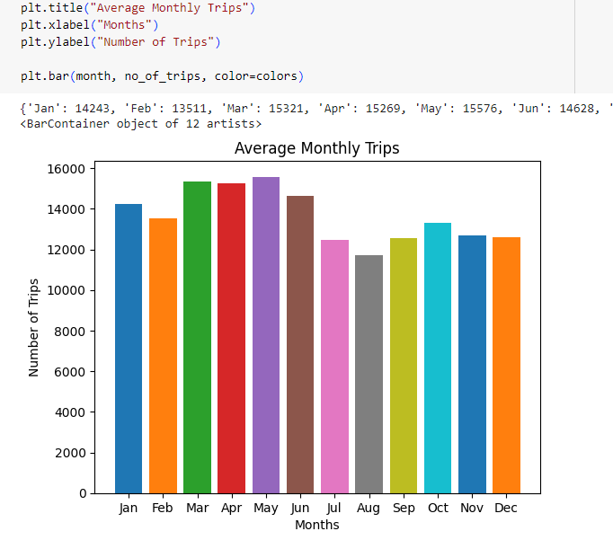
Data Visualizations
Finding the trends in the data variables.

Slide 8
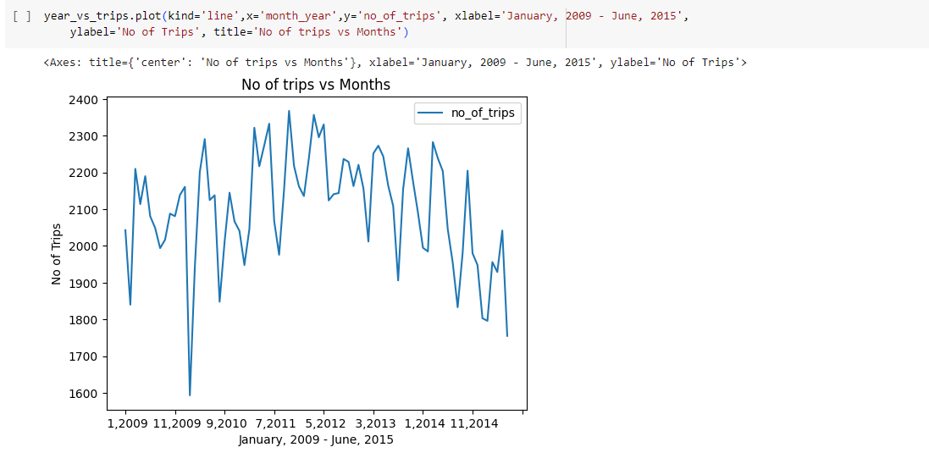
Rides vs Time
Relation between average number of rides over a period of time.

Slide 9
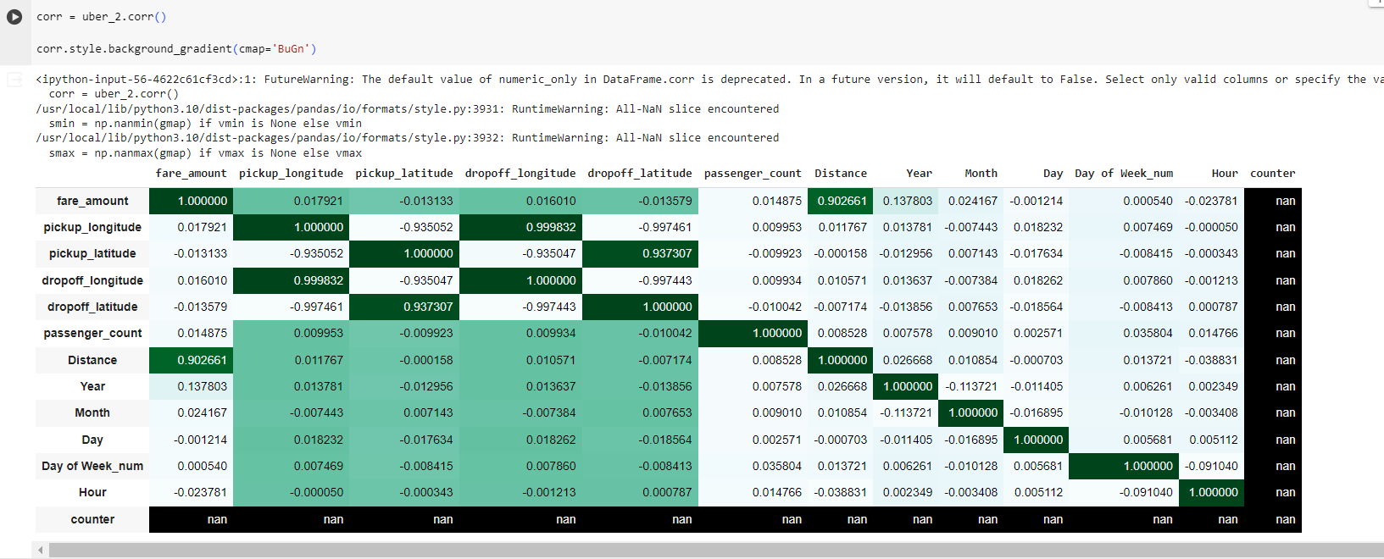
Correlation Matrix
There is some correlation between the distance and fare amount. So we will implement our simple linear regression model using these two variables.

Slide 10
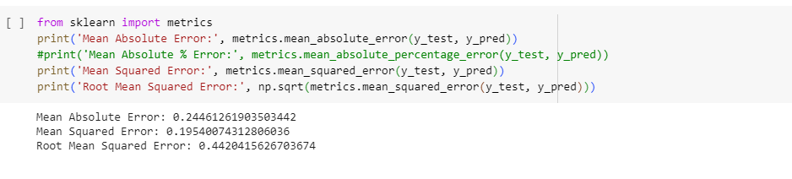
Accuracy Checking
Finding the MSE,MAE, RMSE, etc.

Slide 11
Conclusion
Summarizing the key insights from the presentation and emphasizing the significance of regression analysis in forecasting future ride fares. Highlighting the potential for improving pricing strategies in the ride-hailing industry.

Slide 12
REFERENCES
Kelareva, Elena. &quot;Predicting the Future with Google Maps APIs.&quot; Web blog
post. Geo Developers Blog,https://maps-
apis.googleblog.com/2015/11/predicting- future-with-google-maps-apis.html
Accessed 15 Dec. 2016.
Gunjan panda,Supriya p.panda.”Machine learning using exploratory analysis
to predict cab fare”. International Journal for Research in Applied Science &amp;
Engineering Technology (IJRASET) Aug 2019.
Weijie Wang and Yanmin Lu, Analysis of the Mean Absolute Error (MAE)
and the Root Mean Square Error (RMSE) in Assessing Rounding Model,ICMEMSCE,
IOP Publishing, 324 (2018), doi:10.1088/1757-899X/324/1/012049

Slide 13
THANK YOU

