Slide 1
Distributed & Scalable Data Engineering – 6007-02
Group -14
Aryanadh Kommineni
Vivekananda Arekatla
Rahul Kumar Mavuri
Venkata raja varaprasad sanayila

Slide 2
Optimizing Blood donation logistics

Slide 3
Contents
Business Understanding
Data Understanding
Data preparation
Problem
Solution
Tools & Technologies
Modeling
Evaluation
Deployment

Slide 4
Business Understanding
Client needs to have the data of the blood donations and information about the blood donors in the Data Warehouse.
The following justifies why the data is in the data warehouse:
1. To schedule the drives in accordance with business needs.
2. For analyzing the commercial aspects of the business.

Slide 5
Data Understanding
Dataset Contains the following features:
ID
NAME
AGE
GENDER
RACE
DATE
CITY
STATE
BLOOD GROUP
Source: Kaggle

Slide 6
Data Preparation
Remove or redirect the records whose age and blood group columns are null values.

Slide 7
Problem
Receiving the source data in the form of csv files and those csv files needs to cleanse to store in the data warehouse which is now happening using some ETL tools.
Effects of this process:
Time consuming
Lack of resources
Beyond the budget estimations

Slide 8
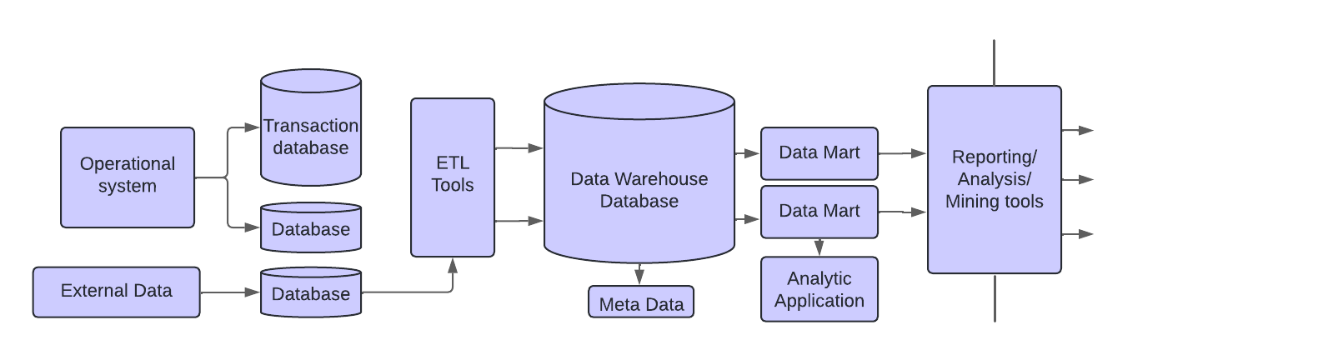
Solutions

Slide 9
Tools And Technologies
• Aws S3 - Amazon S3 or Amazon Simple Storage Service is a service offered by Amazon Web Services that provides object storage through a web service interface
• AWS Lambda - AWS Lambda is an event-driven, serverless computing platform provided by Amazon as a part of Amazon Web Services
• AWS Redshift - Amazon Redshift is a data warehouse product which forms part of the larger cloud-computing platform Amazon Web Services
Python 3.10
• Pandas - Pandas is a software library written for the Python programming language for data manipulation and analysis
• PowerBI - Power BI is an interactive data visualization software product developed by Microsoft with a primary focus on business intelligence

Slide 10
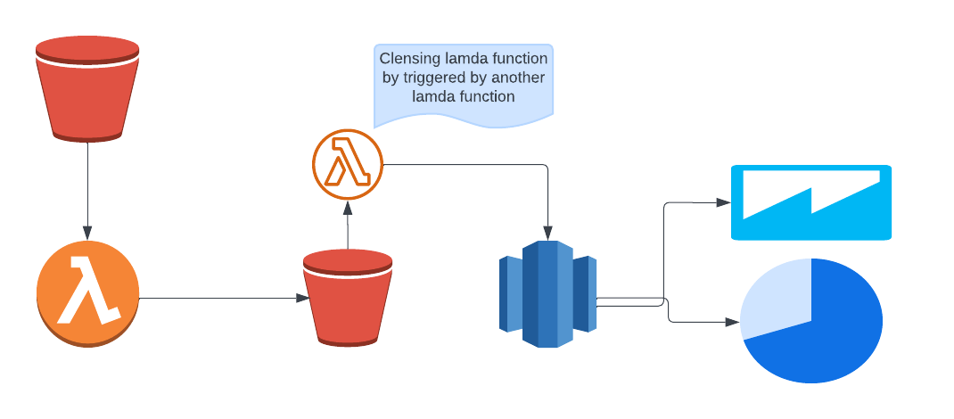
Modelling

Slide 11
Evaluation
• CSV files will be received into s3 bucket from the source.
• Lambda function triggers to cleanse and move the CSV data to Redshift.
• During cleansing process some of the metrics will be taken from the received data.
• Once Data is loaded into Redshift then BI(Business Intelligence) tools can be used to analysis the business.

Slide 12
Deployment
• Create a new S3 bucket attach a lambda function to it
• Attach a Lambda function trigger to the created s3 bucket and Data cleansing will be performed in this lambda function.
• Once data cleansing is done then a new csv file will be uploaded to destination bucket.
• Then another lambda function triggers which moves the data in the csv file to Redshift.
• Now the data is available in the Data Warehouse to built reports on top of it.

Slide 13
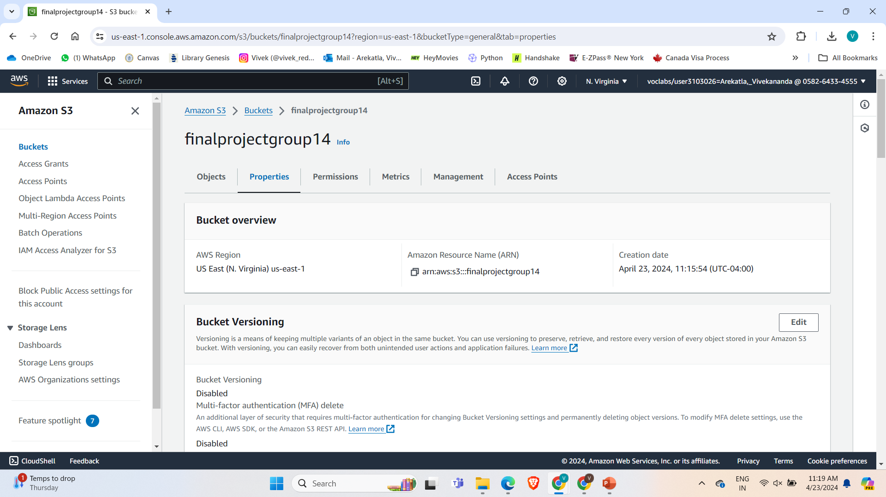
AWS

Slide 14
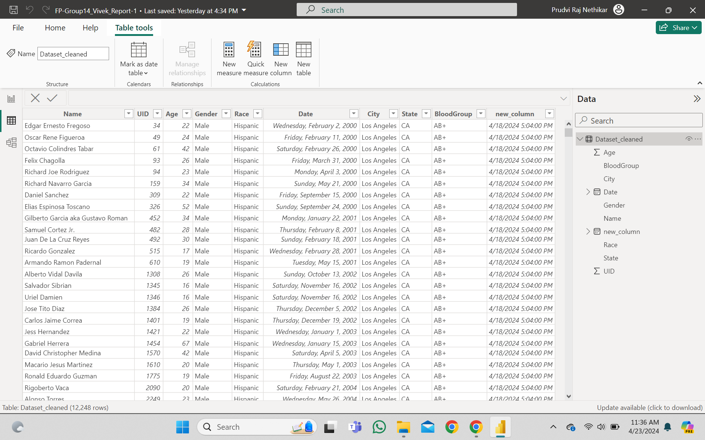
Dataset

Slide 15
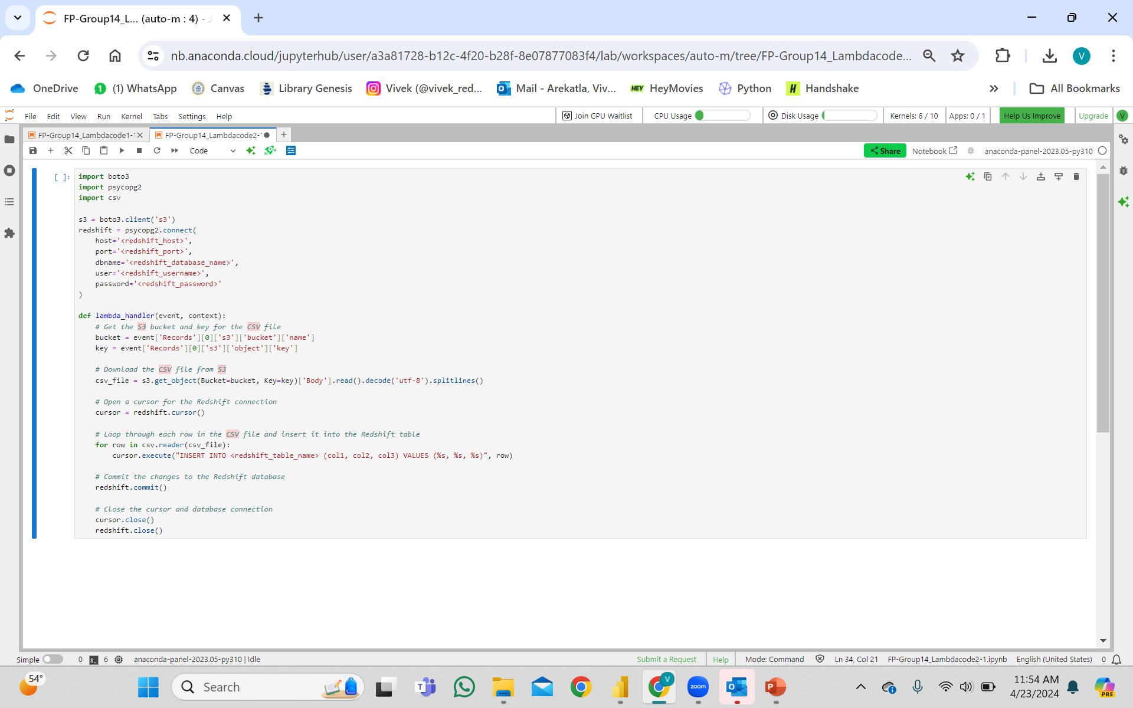
PYTHON CODE

Slide 16
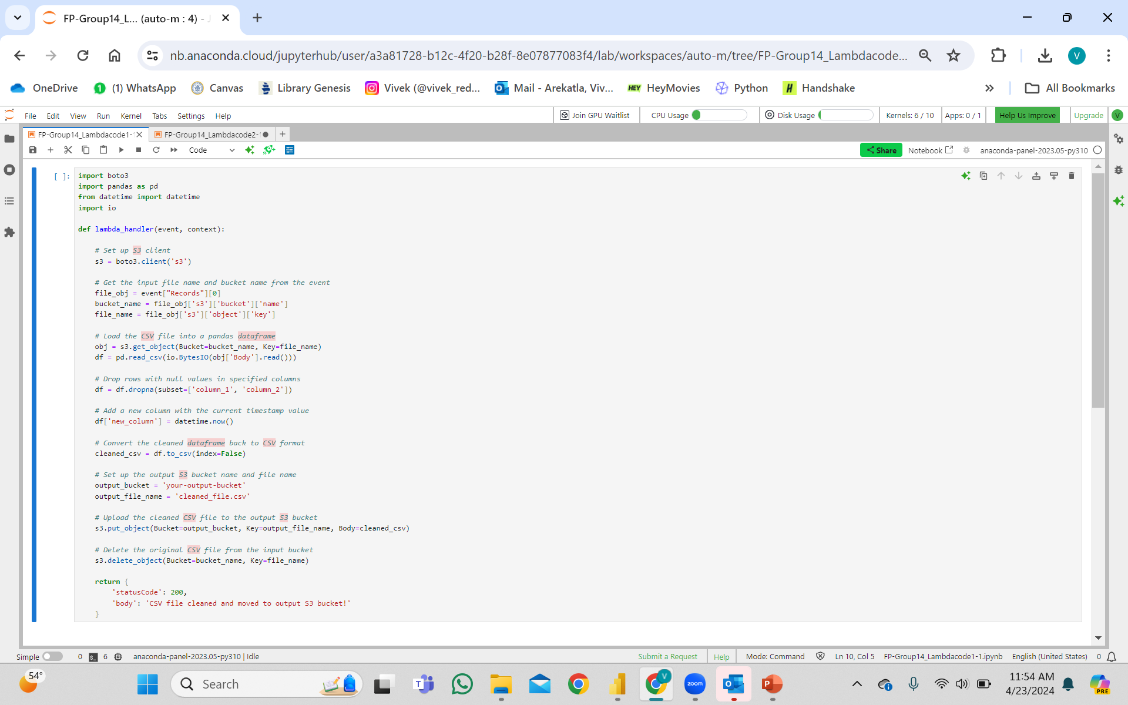
PYTHON CODE

Slide 17
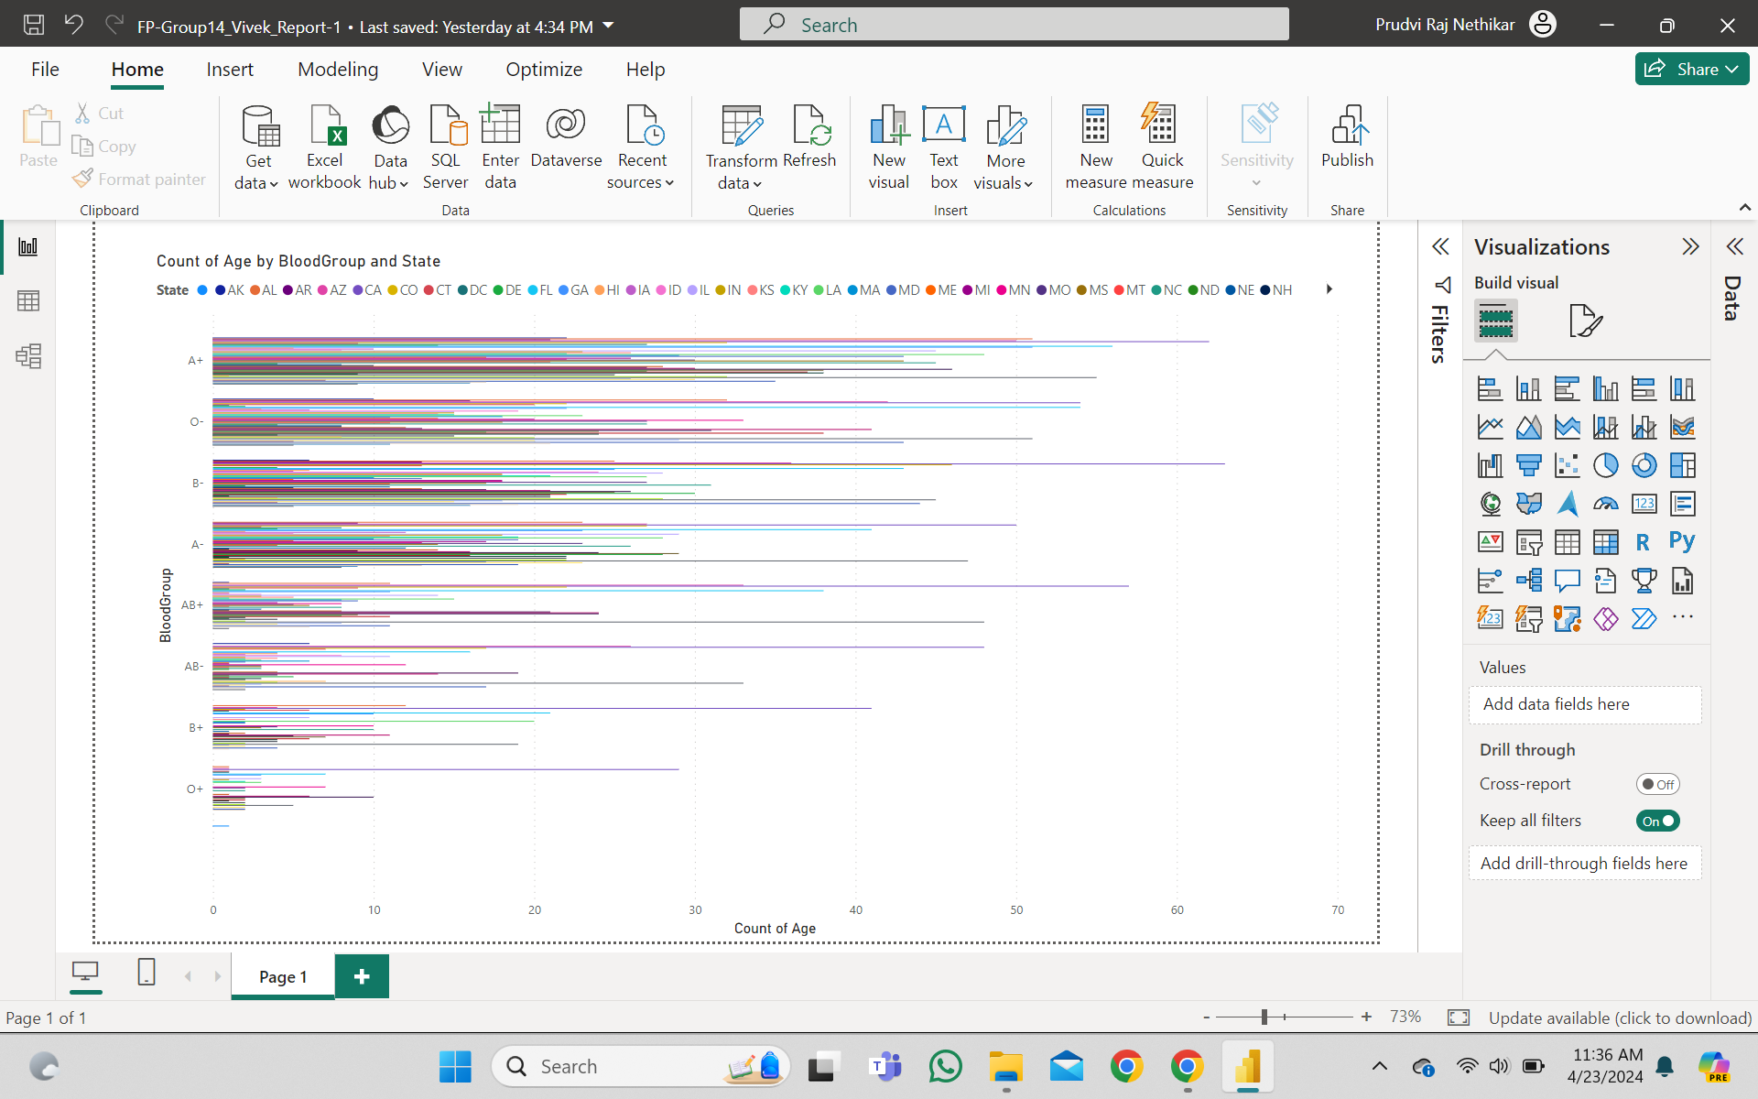
Report

Slide 18
Thank You

