Slide 1
Security and Privacy Modelling and Implementation with ALFA using Hyperledger Fabric Network

Slide 2
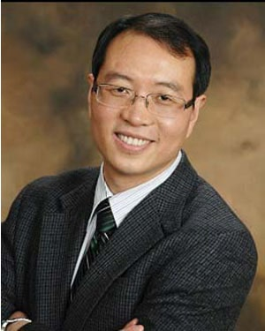








Meet the Team
Dr. Kewei, Sha
Dr. Kwok-Bun Yue
Dr. Wei Wei
Joses Selvan
Kayaanoosh Collector
Instructor
MENTOR
MENTOR
Mentor
MENTOR
Siddharth Illa
Farhana Begum Shaik
Maddi Venkata Naga Bhaavagni
Sripada Vallabh Kaparthi
Ganesh Nyaupane
TEAM MEMBER
TEAM MEMBER
TEAM MEMBER
TEAM MEMBER
TEAM MEMBER

Slide 3
Table of Contents
01
Problem Statement
02
Introduction
03
Design and Implementation
04
Future Scope and Milestones
05
Conclusion

Slide 4
Problem Statement
Develop precise and complete set of security policies and the required ABAC attributes for the Gateway MBSE model.
Develop and implement the ABAC policies in SC/CC using GOLANG.

Slide 5
Blockchain terminology

Slide 6

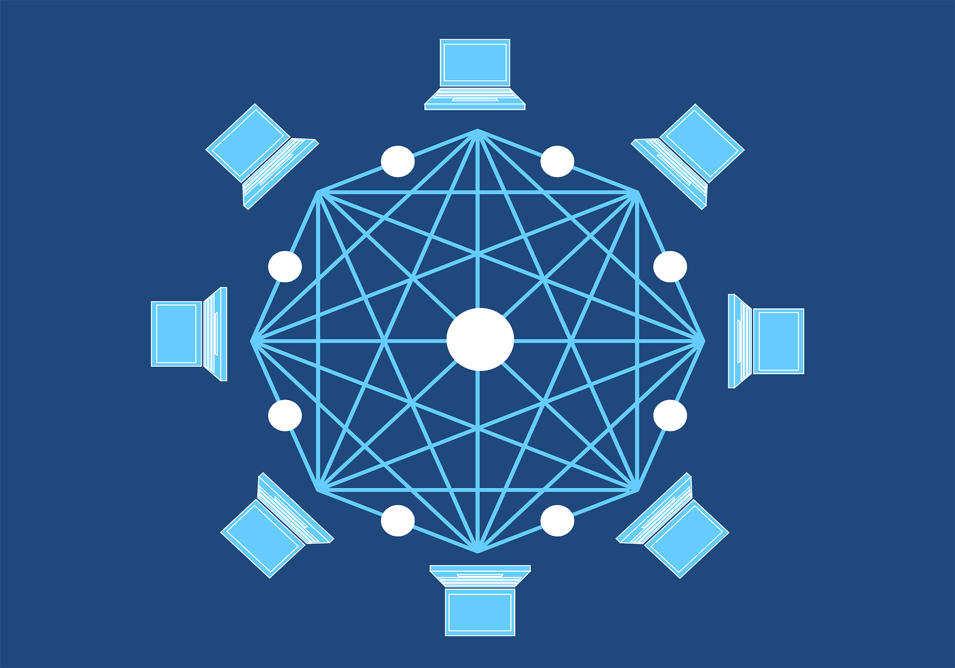
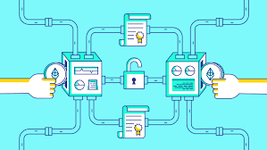
Blockchain: Digital ledger of transactions that is distributed across the entire network of computer systems on the blockchain.​
Network: Smart contracts are used to generate transactions which are subsequently distributed to every peer node in the network where they are recorded on their copy of the ledger.
Channels : Fabric channel is a private “subnet” of communication between two or more specific network members, for the purpose of conducting private and confidential transactions.​

Slide 7
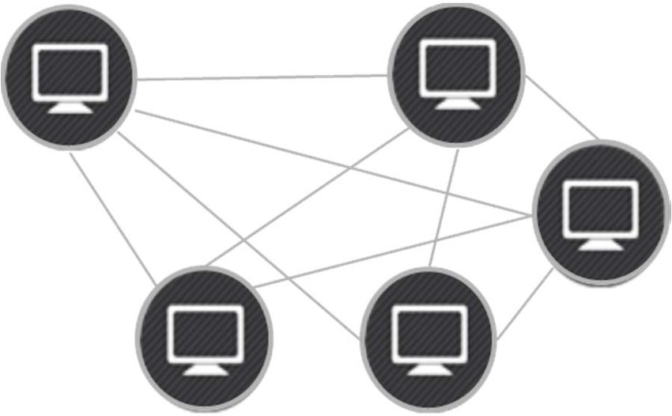
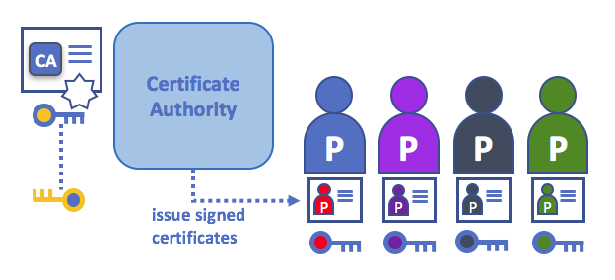
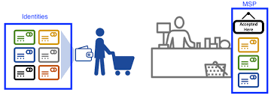
Peers : Peers are a fundamental element of the network, they host ledgers and smart contracts.
CA :Certificate Authority in Fabric does the registration of identities, issues Enrollment Certificates, Provides certificate renewal and revocation.
MSP : A Membership Service Provider (MSP) defines its own notion of identity, and the rules by which those identities are governed (identity validation) and authenticated (signature generation and verification).

Slide 8

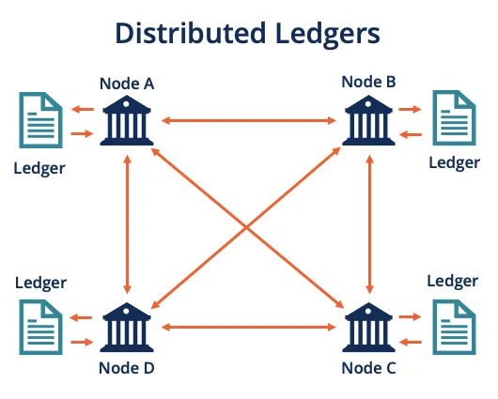
ALFA : It is a domain specific language, used for defining the policies. It has mainly policy set, policy and rule.
Postgres database : PostgreSQL is the relational open source database. It is a highly reliable, stable, scalable and secure system.
Ledger : Stores important factual information and consists of two parts- world state (a database that holds current values of a set of ledger states) and the blockchain(a transaction log that records all the changes that have resulted in the current the world state).

Slide 9
Architectural Design

Slide 10
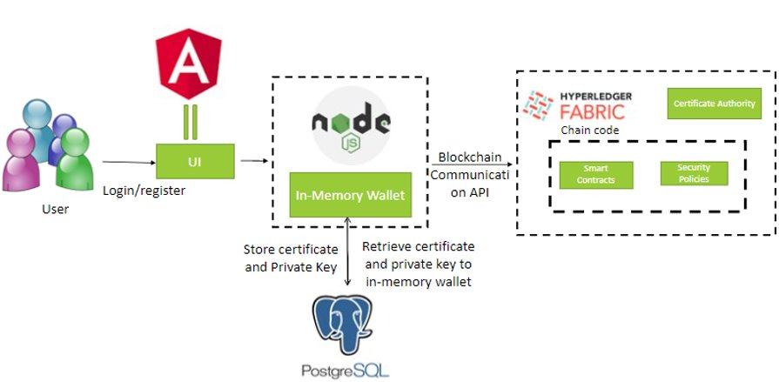

Slide 11
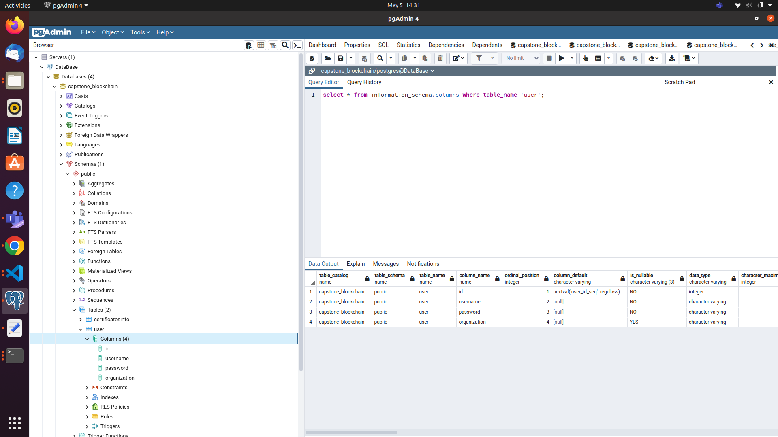
PostgreSQL Database
User

Slide 12
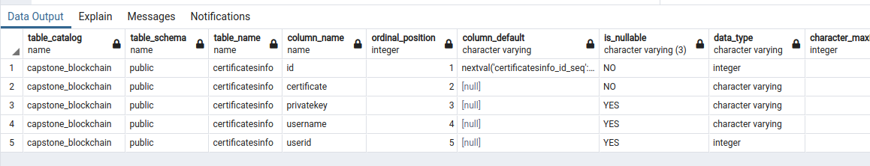
PostgreSQL Database
Certificate Table

Slide 13
Implementation Process

Slide 14
Network Setup
Start the Fabric test-network
A Fabric Network with two peer organizations and a single ordering organization is created.
The createchannel command creates a default channel named “mychannel” for transactions between Org1 and Org2.
In Fabric, Smart Contracts is deployed on the network in packages referred to as chaincode.

Slide 15
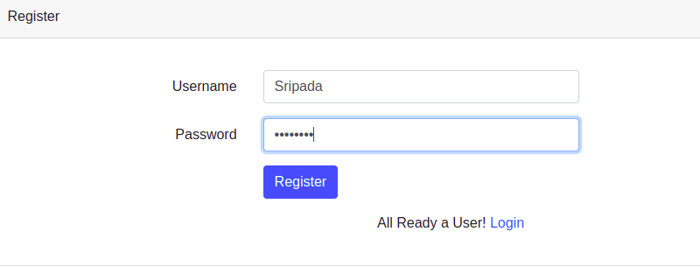
User Registration Process
A user is registered with the credential's username and password.
If a user is already registered, then the user can use their credentials to log in.

Slide 16
Enroll Admin
Network Configuration
Create a new CA client
Postgres wallet for managing identities
Enroll admin and import identity into wallet
Update Postgres Wallet DB

Slide 17
Register User
Authentication of the user in the postgres DB
Create a new in-memory wallet for managing identities
Build user objects for authenticating with CA
Register, enroll the user and import new identity into wallet
Update In-memory wallet and Postgres Wallet DB

Slide 18
Update Identities
Authentication of the user in the postgres DB
Create a new in-memory wallet for managing identities
Build user objects for authenticating with CA
Using IdentityService to update the identity of the user
Re-enroll the user to get the updated certificate
Update In-memory wallet and Postgres Wallet DB

Slide 19
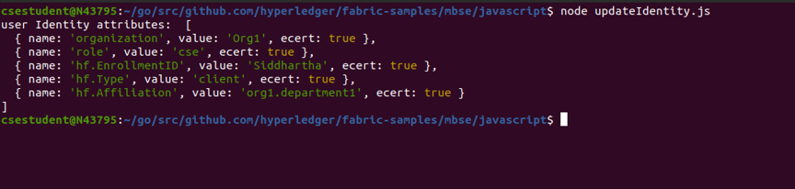
Update Identities

Slide 20
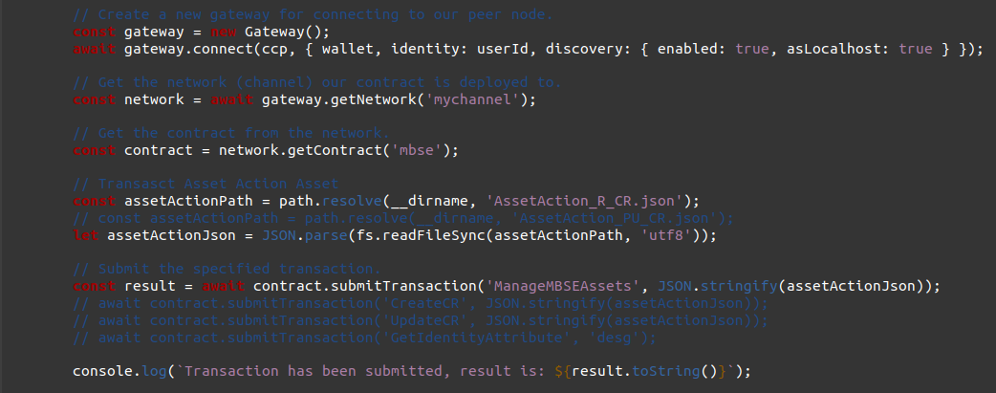
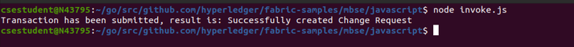
Invoking Smart Contracts

Slide 21

Working with Smart Contracts

Slide 22
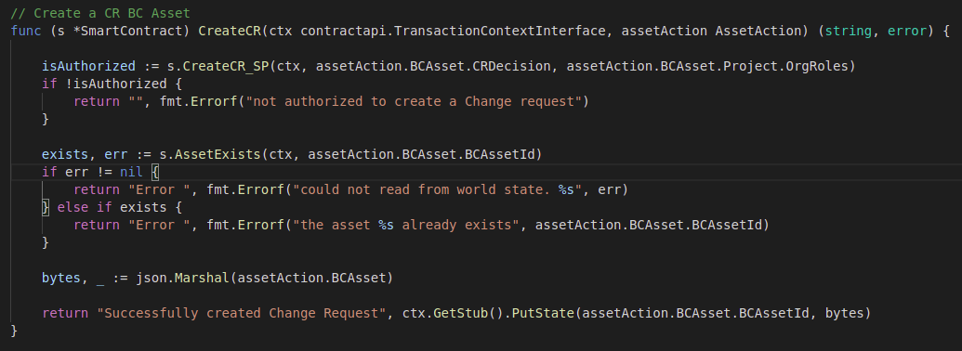
SC for Create Change Request Policy

Slide 23
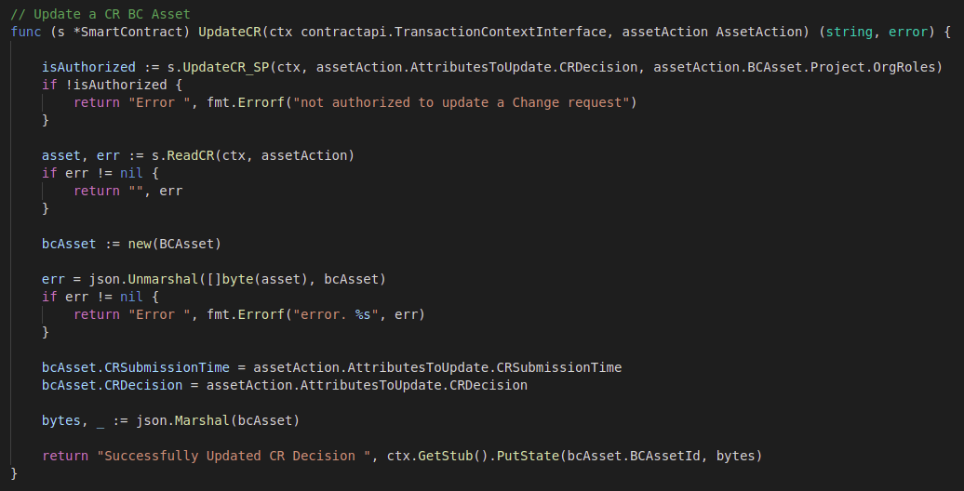
SC for Update Change Request Request Policy

Slide 24

Security Policies

Slide 25
Implementation of Security Policies
Create Change Request: The Policy is that only the CISE from the lead organization of a project can create a new change request document of the project.
Target: Change Request document which inside the blockchain
Action: Create
Combining Algorithm: denyOverrides
Conditions: The user works as the lead organization of project, the user works on the current project and lastly, the User role must be CISE (chief Integration System Engineer).

Slide 26
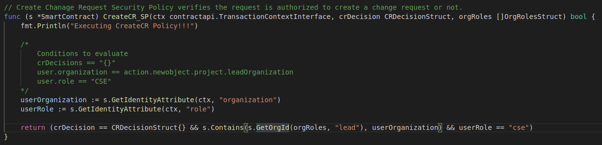
Create Change Request Security Policy Implemented as Smart Contract

Slide 27
Update Change Request: The policy verifies whether the request is authorized to update a change request or not.
Target: Change Request document which is inside the blockchain
Action: Update
Combining Algorithm: denyOverrides
Conditions: The condition to update CR status would be the same as to create the CR.

Slide 28
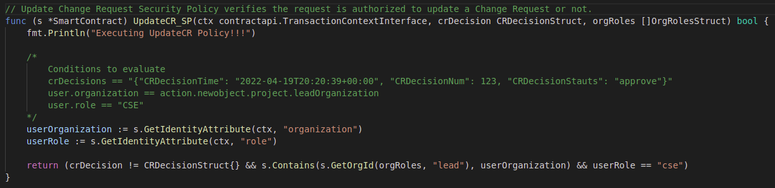
Update Change Request Security Policy Implemented as Smart Contract

Slide 29

Future Scope
The static structure was implemented following the official documentation.
In the future, we can use dynamic structure with the use of maps in order to avoid storing null values.
Integration of complete UI with Block chain.
Complete Database Schema to be developed.
Complete set of Security Policies can be implemented.

Slide 30
Milestones
Setting up the initial Fabric network and understood Approval Process workflow.
Understand the MBSE Gateway project sufficiently to capture its security requirements and develop security policies.
Implementing ChangeRequest policy, DocumentPackage policy and BCDocument policy.
Successful Authorization of accessing asset control using attributes with the help of CA & MSP.
Registering and enrolling identities with CA by adding user attributes, storing the User’s certificate and private key in external database with user’s authentication.
Implemented Security Policies as Smart Contracts and implemented in GOLANG.

Slide 31

Conclusion
Attribute-Based Access Control (ABAC) is the most flexible security model suitable for the requirements. The goal of this project is to use ALFA to specify the security and privacy requirement, so the security attributes are defined. Once the security attributes and policies are specified, the team implemented ChangeRequest policy, BCDocument policy, DocumentPackage policy.

Slide 32
[1] Use a PostgreSQL database as a Hyperledger Fabric wallet using Fabric Node SDK (https://github.com/IBM/fabric-postgres-wallet)
[2] Hyperledger fabric (https://hyperledger-fabric.readthedocs.io/en/release-2.4/whatis.html)
[3] Hyperledger Fabric CA (https://hyperledger-fabric-ca.readthedocs.io/en/latest/)
[4]Fabric Sample (https://github.com/hyperledger/fabric-samples)
[5] Abbreviated Language for Authorization and filed for standardization - ALFA (https://alfa-lang.io/intro.html)
[6] Hyperledger Fabric SDK for Node.js (https://hyperledger.github.io/fabric-sdk-node/)
[7] Attribute based access control (https://github.com/hyperledger/fabric-samples/blob/main/asset-transfer-abac/README.md)
References

Slide 33
THANK YOU
Any Questions?

