Slide 1



MEDICARE
Web App

Slide 2
PROBLEM STATEMENT
Emergency medical care is needed in diverse circumstances. Developing innovative strategies to meet the range of needs posed by such diverse circumstances is vital in the current era.

Slide 3
OUR BIG IDEA
Our mission is to roll out a web based application to create a platform for various medical emergencies. Creating a network connecting the needed with all the possible help nearby.
Efficient management of time constraint and user friendly

Slide 4
PROJECT GOALS
To provide with facilities during medical crisis or emergencies
Ambulance nearby
Blood donors
Doctors
Pharmacy
Taxi drivers
To provide accurate details in emergencies
Contact number
Location

Slide 5
EXECUTION PLAN
The design provides a well distinguished interface for the users.
There are two primary interfaces, one for the patient/person in need and the other one for contributors/people who are ready to provide their services when in need.
It functions as a social network for both the contributor and user, allowing them to exchange vital information in cases of a crisis or emergency.
User can easily access the contributors by speciality, availability, location and other parameters.

Slide 6
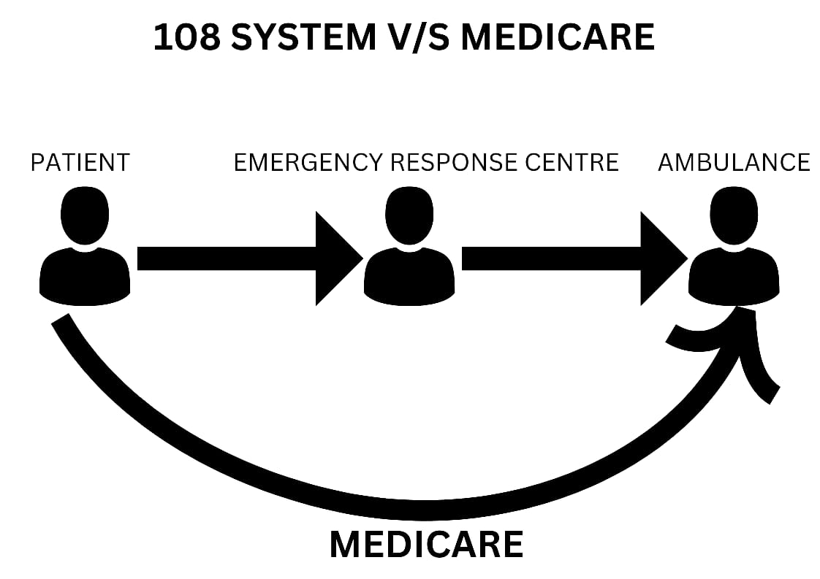
UNIQUENESS
Right now there are distinct options for medical emergencies and we’re trying to integrate all of those services into one platform.
Eliminate intermediate agent.
Efficient management of time constraint.
Filter out spam/unnecessary information.

Slide 7
TECHNOLOGIES USED
Frontend – HTML, CSS, JavaScript
Backend – Python Flask
Database – SQLite3
UI/UX – Figma, Photoshop

Slide 8
FUTURE UPDATES
Collaborative maps
Route tracking
Live location

Slide 9
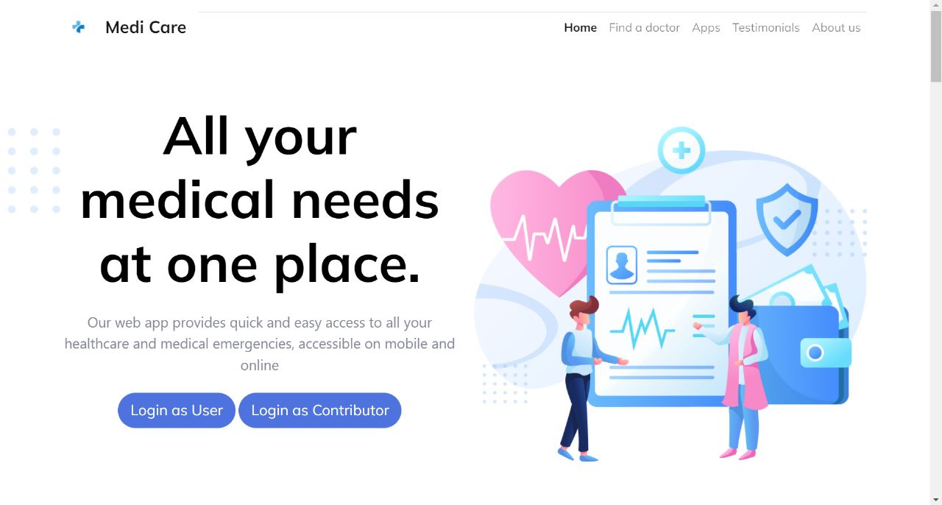
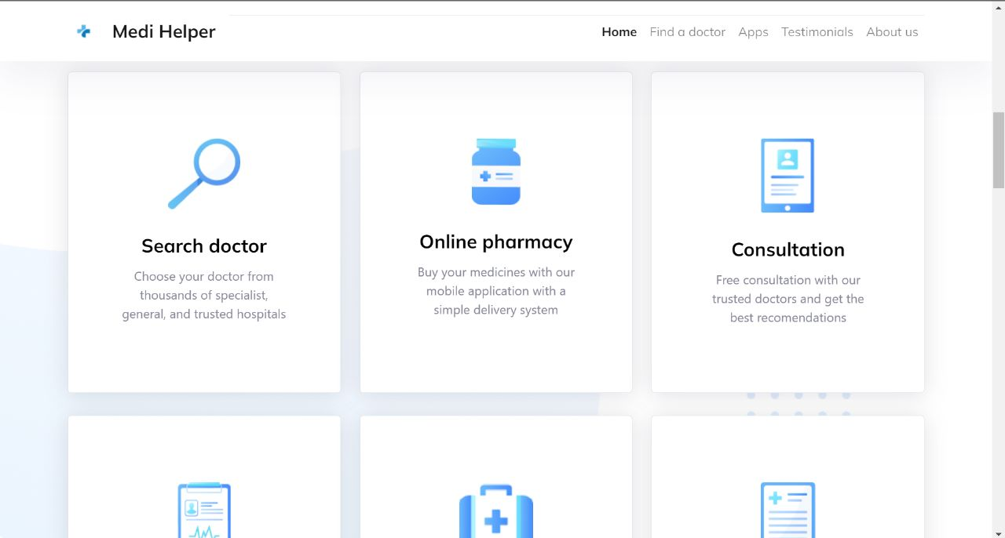
FINAL RESULTS
HOME PAGE

Slide 10
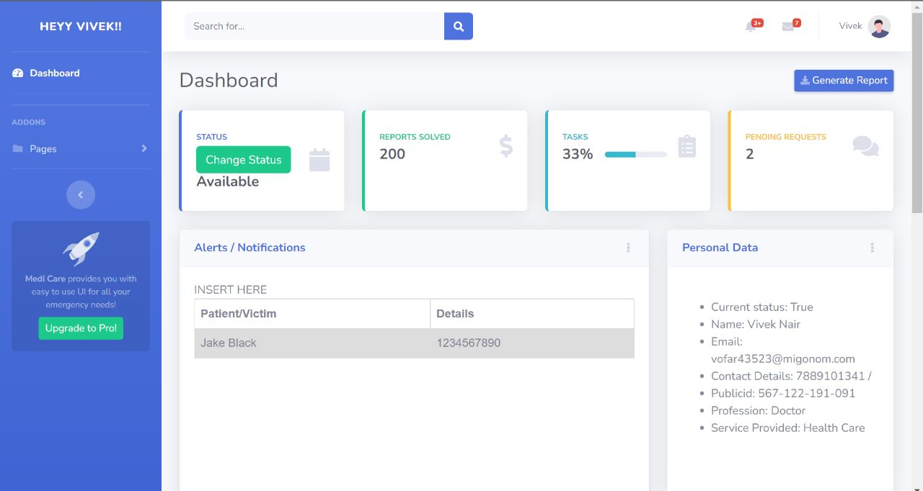
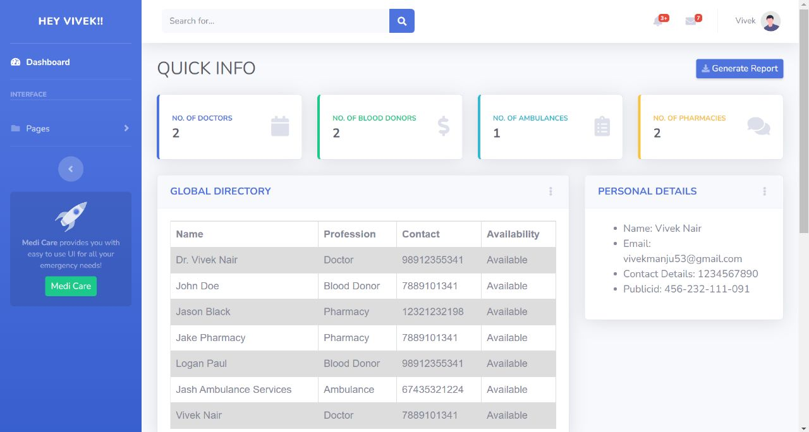
FINAL RESULTS
USER INTERFACE

Slide 11
THANK YOU

