Slide 1
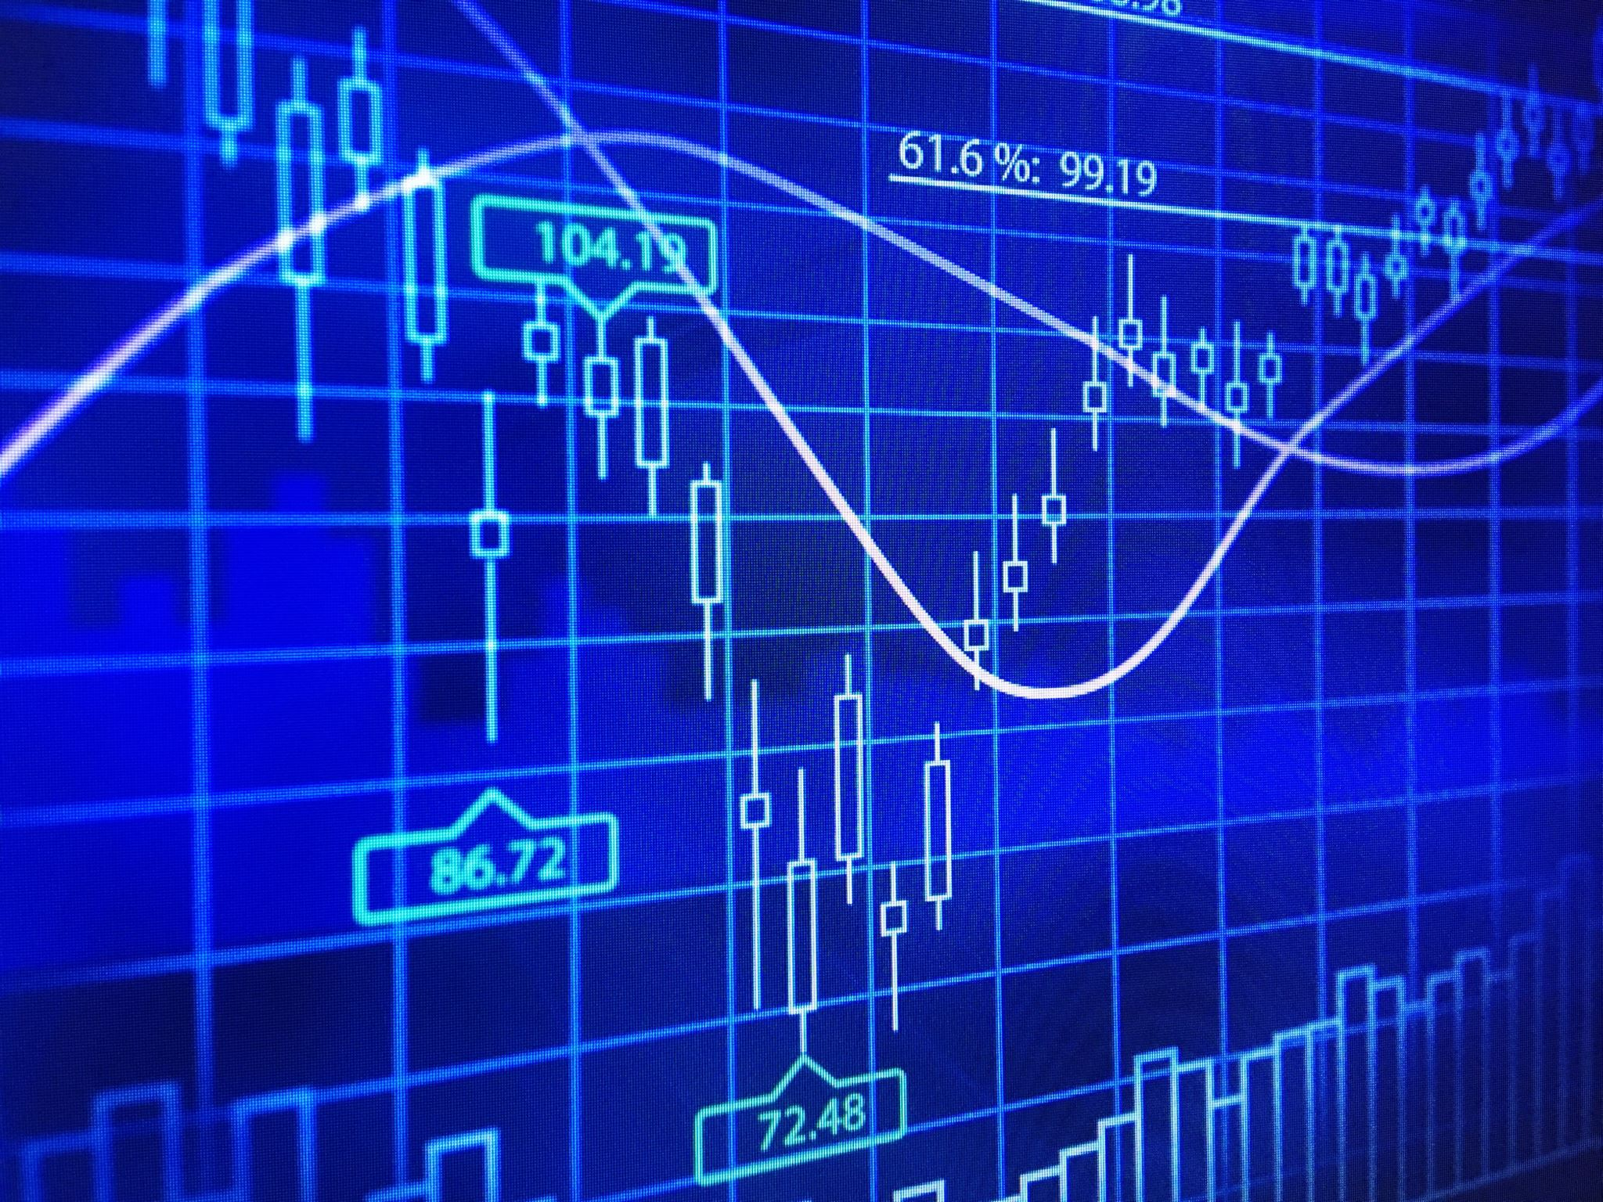
Data Visualization
Vivek Raja P S

Slide 2
Welcome note
Event: FDP on “Big Data and Analytics”
Data & Time: May 21, 2021, F.N
Organization/ Institution: Mepco Schlenk Engineering College
Humbled and grateful to my college Mr. S. Arivazhagan, Principal Mr. K. Muneeswaran, Head of Dept of Computer Science Organizers of the FDP program, Faculties Lab Technicians and Support staff

Slide 3

About me..
From Madurai, Tamil Nadu
Graduated B.E (CSE) from Mepco Schlenk Engineering College, 2020.
Data Scientist @ Nexstem, US (https://nexstem.ai)
AWS Community Builder – Machine Learning expert
Organizer @ Azure Developer Communities in Tamil Nadu (3000+ members)
Co-Organizer at AWS User Group India, TensorFlow User Group, Google Developer Group, Pythonista, Tamil FOSS Community
15x Multi—Cloud Certified
Microsoft Certified Data Scientist, AI Engineer & Data Engineer, Oracle Cloud Solutions Architect
20 times International & National Hackathon winner
Published 5+ Research papers, + 1 patent (AI & IoT)
Active Speaker, Mentor, Blogger, Open-source Contributor

Slide 4

Agenda

Slide 5
Overview of today’s session
What is Data Visualization?
Understanding importance of visualization in Data Science
Basics of Data Visualization – Plots, Statistics and more
Data Manipulation & Data Visualization
Visualization – Dataset, Regression, Classification, Time series
Resources
Open for Q&A

Slide 6

Let’s get started

Slide 7
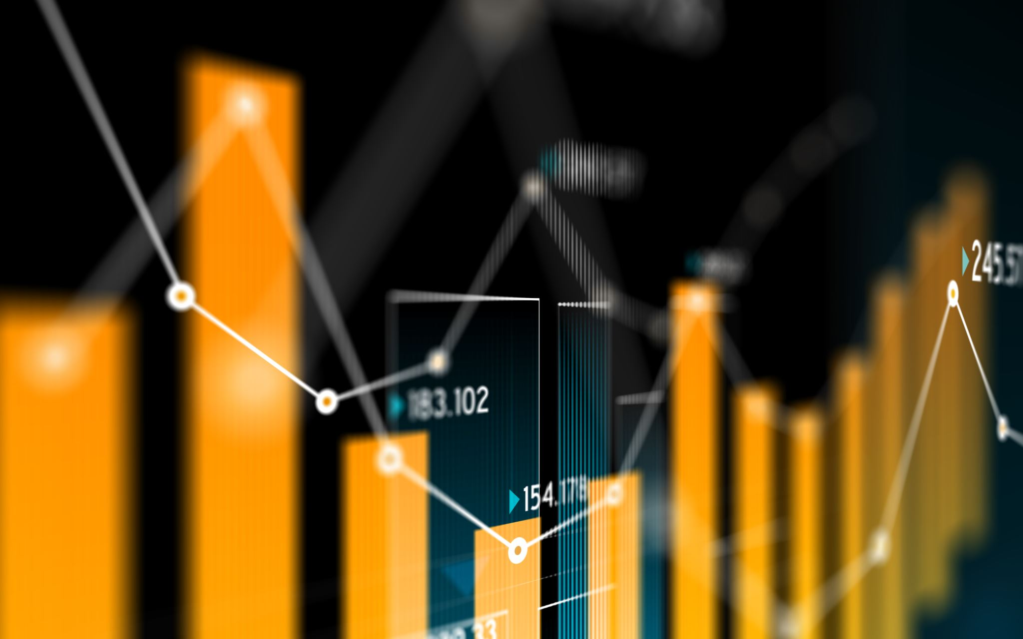
What is Data Visualization?

Slide 8
Wiki defines as…
Mapping of data with graphical elements such as lines, points etc
Very efficient in communicating data (numerous)
Helpful in understanding the insight of data
Has deep roots with Statistics but widely used in all fields

Slide 9

A picture is worth thousand words

Slide 10
Characteristics
show the data
avoid distorting what the data has to say
present many numbers in a small space
make large data sets coherent
encourage the eye to compare different pieces of data
reveal the data at several levels of detail, from a broad overview to the fine structure
serve a reasonably clear purpose: description, exploration, tabulation or decoration
be closely integrated with the statistical and verbal descriptions of a data set.

Slide 11

Data Visualization in Data Science

Slide 12
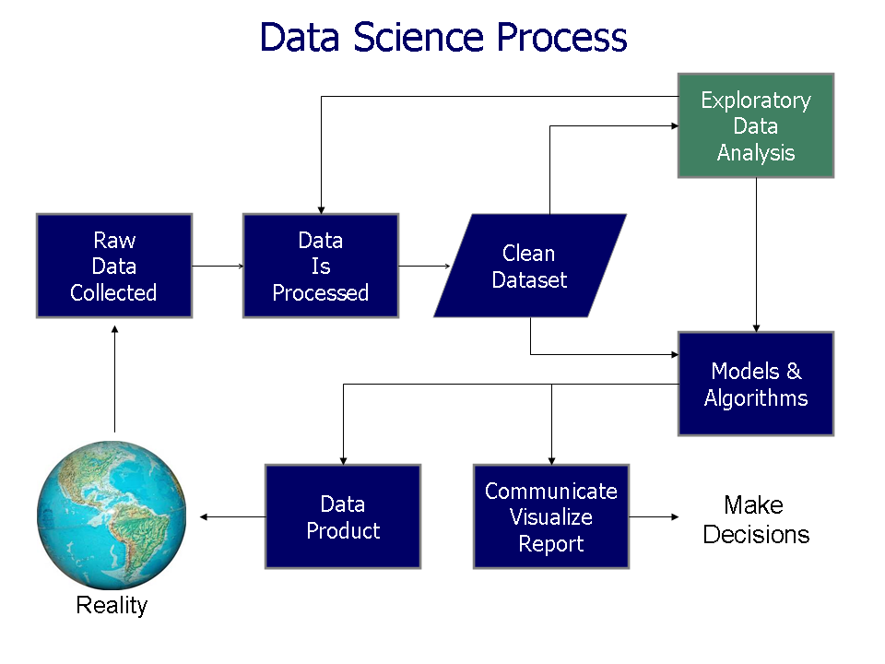
Understanding the Data Science Process

Slide 13
Exploratory Data Analysis
Initial understanding of data
Detecting Impurities
Data Manipulation

Slide 14
Model Performance
Monitoring model training
Model performance in different dataset split – Training, Test, Evaluation
Model Metrics

Slide 15
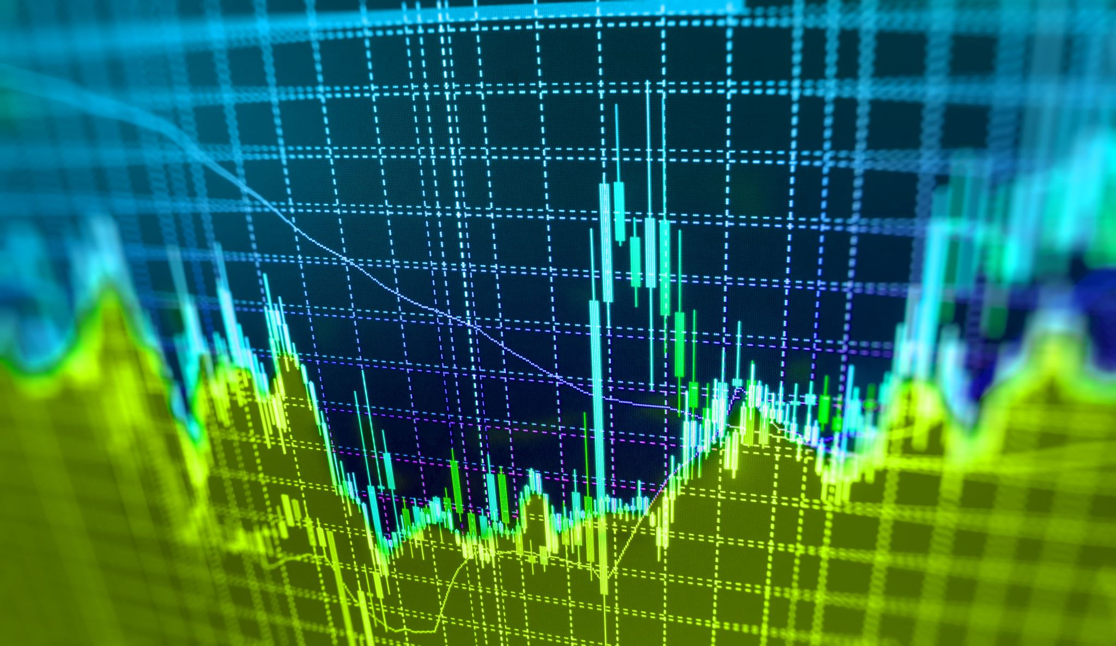
Basics of Visualization Plots, Statistics….

Slide 16
Pre-requisites
Python
A general purpose programming language
Widely used language in the Machine Learning / Data Analytics / Big Data workflows
Simple & Elegant
My personal favourite!
Environment
Jupyter Notebook / Google Colab
Basics of statistics
Concepts of mean, median, outliers etc
Basics of ML
Regression, Classification, Time series

Slide 17
Roadmap
Basics of pandas
Deriving statistical results of data using Pandas
Basics plots
Visualizing Categorical Data (Iris) + Classification Task
Visualizing Continuous Data (Diamonds) + Regression Task
Visualizing Time series Data
Visualizing NLP Data

Slide 18
Roadmap
Basics of pandas
Deriving statistical results of data using Pandas
Basics plots
Visualizing Categorical Data (Iris) + Classification Task
Visualizing Continuous Data (Diamonds) + Regression Task
Visualizing Time series Data
Visualizing NLP Data

Slide 19

Basics of Pandas library

Slide 20
Pandas library
pandas is a fast, powerful, flexible and easy to use open source data analysis and manipulation tool, built on top of the Python programming language.
Series, List, Dataframes

Slide 21
Roadmap
Basics of pandas
Deriving statistical results of data using Pandas
Basics plots
Visualizing Categorical Data (Iris) + Classification Task
Visualizing Continuous Data (Diamonds) + Regression Task
Visualizing Time series Data
Visualizing NLP Data

Slide 22

Statistical analysis using pandas

Slide 23
Statistics with pandas library
Library with methods to easily describe and give overview of dataset
Perform statistical analysis on features such as mean, median etc

Slide 24
Roadmap
Basics of pandas
Deriving statistical results of data using Pandas
Basics plots
Visualizing Categorical Data (Iris) + Classification Task
Visualizing Continuous Data (Diamonds) + Regression Task
Visualizing Time series Data
Visualizing NLP Data

Slide 25
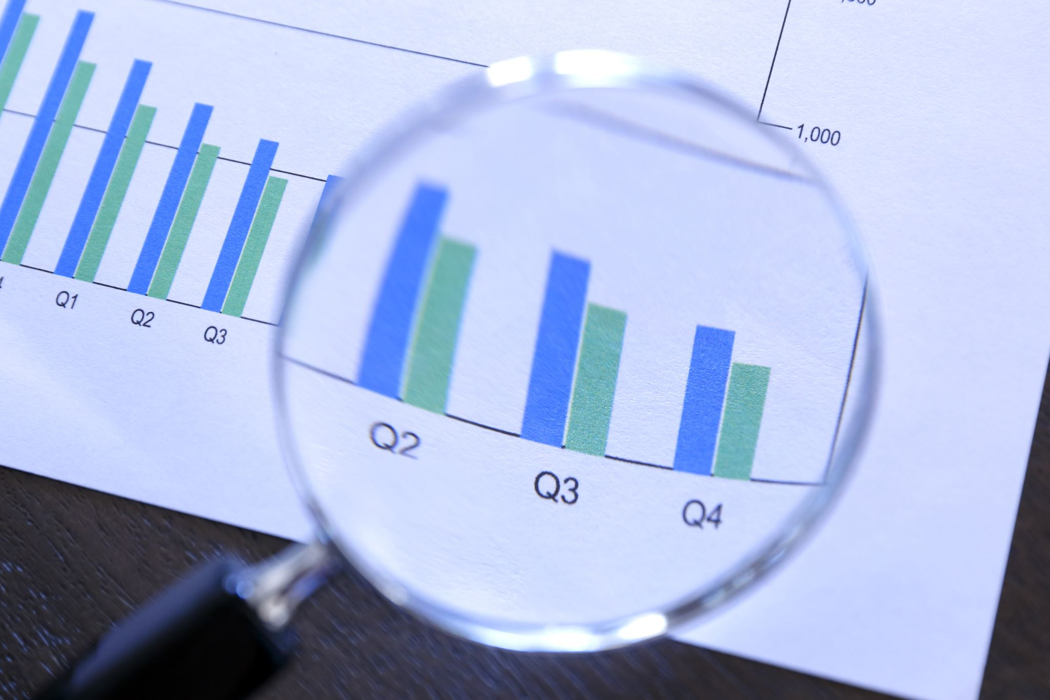
Basic plots

Slide 26
Line graph
A line graph is a unique graph which is commonly used in statistics. It represents the change in a quantity with respect to another quantity.
Uses:
to track the changes over the short and long period of time

Slide 27
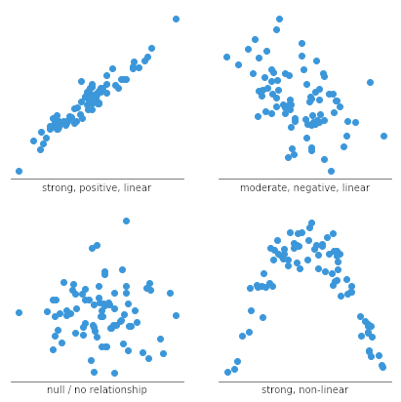
Scatter graph
A scatter graph establishes relationship between variables.
Uses:
Correlation between variables

Slide 28
Bar plot
A bar chart uses bars to show comparisons between categories of data. These bars can be displayed horizontally or vertically. A bar graph will always have two axis. One axis will generally have numerical values, and the other will describe the types of categories being compared.
The comparison you want to make will help determine whether to display the bars vertical or horizontal. You would need to decide whether the data you are trying to represent has an intuitive direction or not.

Slide 29
Histogram
A histogram is used to summarize discrete or continuous data.
Uses:
Histograms can display a large amount of data and the frequency of the data values.
The median and distribution of the data can be determined by a histogram.
In addition, it can show any outliers or gaps in the data.

Slide 30
Pie chart
A pie chart is a type of graph that represents the data in the circular graph. The slices of pie show the relative size of the data. It is a type of pictorial representation of data. A pie chart requires a list of categorical variables and the numerical variables.
Uses:
It helps in providing an effective communication tool for the even uninformed audience
Provides a data comparison for the audience at a glance to give an immediate analysis or to quickly understand information

Slide 31
Roadmap
Basics of pandas
Deriving statistical results of data using Pandas
Basics plots
Visualizing Categorical Data (Iris) + Classification Task
Visualizing Continuous Data (Diamonds) + Regression Task
Visualizing Time series Data
Visualizing NLP Data

Slide 32
Visualizing Categorical Data + Classification task

Slide 33
Categorical Data
Iris Data Set Information :
The data set contains 3 classes of 50 instances each, where each class refers to a type of iris plant.
Predicted attribute: class of iris plant.
Plots used: Scatter plot, Violin plot, Correlation matrix
Classification Algorithm:
Unsupervised: KNN
Supervised: K-Nearest Classifiers

Slide 34
Roadmap
Basics of pandas
Deriving statistical results of data using Pandas
Basics plots
Visualizing Categorical Data (Iris) + Classification Task
Visualizing Continuous Data (Diamonds) + Regression Task
Visualizing Time series Data
Visualizing NLP Data

Slide 35
Visualizing Continuous Data + Regression task

Slide 36
Continuous Data
Diamonds Data Set Information :
This classic dataset contains the prices and other attributes of almost 54,000 diamonds
Predicted attribute: Price of the diamond.
Plots used: Histogram plot, Univariate plot, Violin Plot matrix
Regression Algorithm:
Linear & Polynomial models

Slide 37
Roadmap
Basics of pandas
Deriving statistical results of data using Pandas
Basics plots
Visualizing Categorical Data (Iris) + Classification Task
Visualizing Continuous Data (Diamonds) + Regression Task
Visualizing Time series Data
Visualizing NLP Data

Slide 38
Visualizing Time series Data

Slide 39
Time Series Data
Air passengers Data Set Information :
Air Passengers per month
Plots used:
Line Plot, Scatter plot, Vertical Line Graph, Heat Map, Lag plot, Moving Average, Box Plot, Whiskers Plot, Seasonality & Trends, ACF

Slide 40
Roadmap
Basics of pandas
Deriving statistical results of data using Pandas
Basics plots
Visualizing Categorical Data (Iris) + Classification Task
Visualizing Continuous Data (Diamonds) + Regression Task
Visualizing Time series Data
Visualizing NLP Data

Slide 41
Visualizing NLP Data

Slide 42
Amazon Review Data
Amazon Review Data
This is a list of over 71,045 reviews from 1,000 different products provided by Datafiniti's Product Database. The dataset includes the text and title of the review, the name and manufacturer of the product, reviewer metadata, and more.
Visualization: Wordcloud, Frequency plots, Correlation Map
Classification: Random Forest Classifier, XG Boost

Slide 43

References

Slide 44
References & Resources
Source Code & Presentation Decks:
https://drive.google.com/drive/folders/1J3oGT2-hoUYUDJBZenZZZ-X0t5uio_Th?usp=sharing
https://github.com/Vivek0712/ML-Visualisation
References & Dataset:
Kaggle
GitHub
PolyDimensional Course & YouTube Channel

Slide 45

Q&A

Slide 46
Connect with me!
Social Handles:
Email: vivekraja98@gmail.com
Linkedin: https://linkedin.com/in/Vivek0712
Twitter: https://twitter.com/VivekRaja007
Repos:
GitHub: https://github.com/Vivek0712
Blogs:
Medium: https://vivekraja98.medium.com
Dev.to: https://dev.to/vivek0712
Meetups / Developer Communities:
Azure Developer Community: https://azdev.konfhub.com
AWS User Groups: https://www.meetup.com/awsusergroup-chennai/
Google Developers Group Madurai: https://www.gdgmadurai.in
TensorFlow User Groups : https://www.meetup.com/TFUGCbe/
Work Related Enquires:
For BCI enquiry/ purchase / Developer Program: vivek@cortexbci.com / https://nexstem.ai

Slide 47
Thank you

