Slide 1
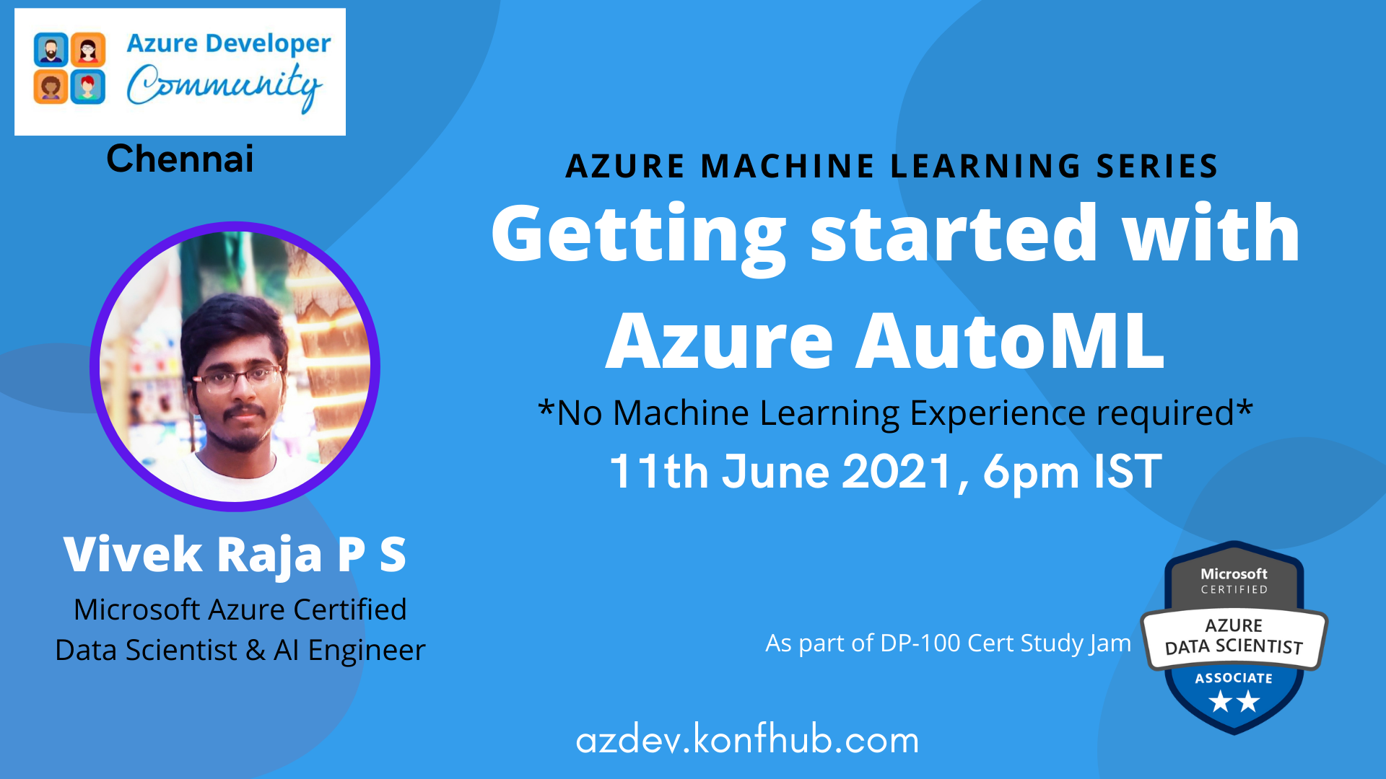

Slide 2

Agenda
Introduction to Machine Learning
What is AutoML (Automated Machine Learning) ?
AutoML versus Conventional ML practices
Intro to Azure Automated Machine Learning
Hands-on demo
Learning resources
Conclusion

Slide 3


About me
From Madurai, Tamil Nadu
Data Scientist @ CortexBCI Inc | Nexstem
Organizer at Azure Developer Communities – Tamil Nadu
Microsoft Certified Azure Data Scientist, AI Engineer and Data Engineer
15x Multi—Cloud Certified
20 times International & National Hackathon winner
Published 5+ Research papers, + 1 patent (AI & IoT)
Active Speaker, Mentor, Blogger, Open-source Contributor
@VivekRaja007

Slide 4

Introduction to
Machine Learning

Slide 5
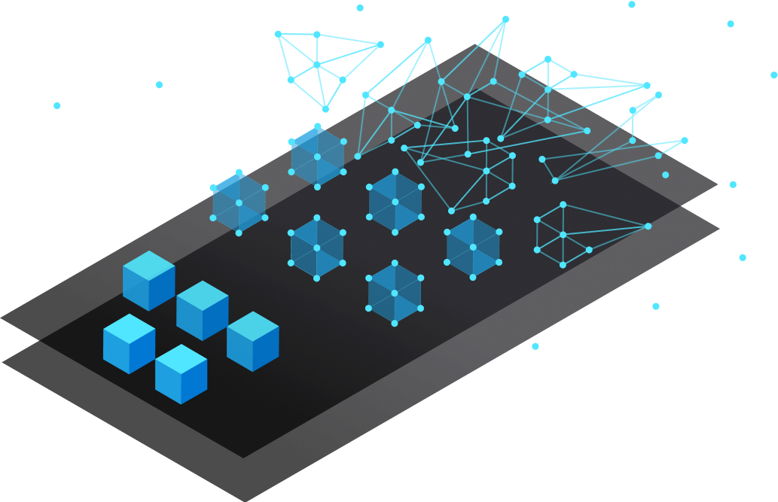
What is Machine Learning?
Machine learning (ML) is the process of using mathematical models of data to help a computer learn without direct instruction.
It’s considered a subset of artificial intelligence (AI). Machine learning uses algorithms to identify patterns within data, and those patterns are then used to create a data model that can make predictions.

Slide 6
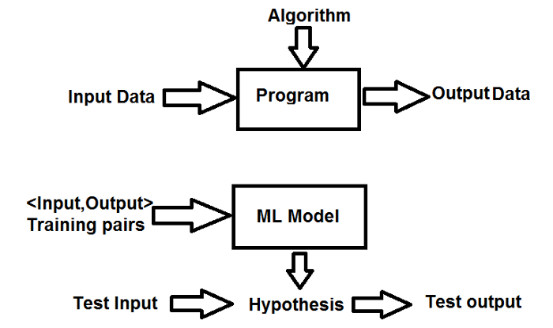
What is Machine Learning?

Slide 7
Supervised learning (Input - Target pairs)
Addressing datasets with labels or structure, data acts as a teacher and “trains” the machine, increasing in its ability to make a prediction or decision.
Unsupervised learning (Input data only)
Addressing datasets without any labels or structure, finding patterns and relationships by grouping data into clusters.
Reinforcement learning (Reward/Penalty based learning)
Replacing the human operator, an agent—a computer program acting on behalf of someone or something—helps determine outcome based upon a feedback loop.
Machine Learning Techniques

Slide 8
Benefits of Machine Learning
Uncover insight
Improve data integrity
Enhance user experience
Reduce risk
Anticipate customer behavior
Lower costs

Slide 9
Overview of Stages in Machine Learning
Data Collection & Preprocessing
Train the model
Validate the model
Interpret the results
Identify data source
Data collection
Data Transformation
Anomaly Detection
Cleaning the data
Domain understanding
Splitting the data
Selecting the model
Training
Hyper-parameter tuning
Validating on test dataset
Evaluating results
Finalising the data model
Prediction
Model monitoring
Visualizations

Slide 10
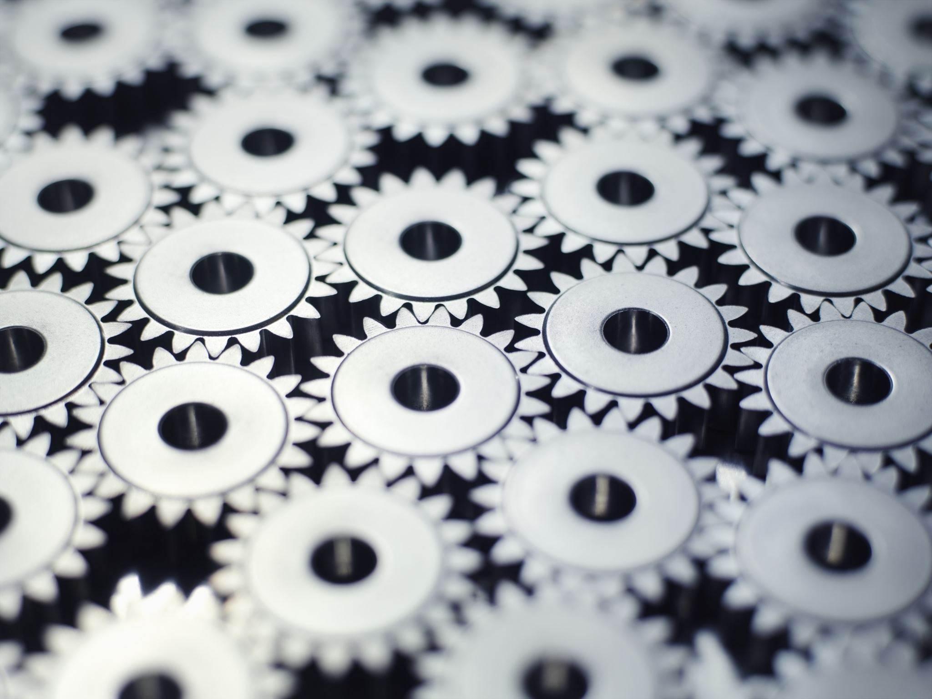
What is AutoML?
(Automated Machine Learning)

Slide 11
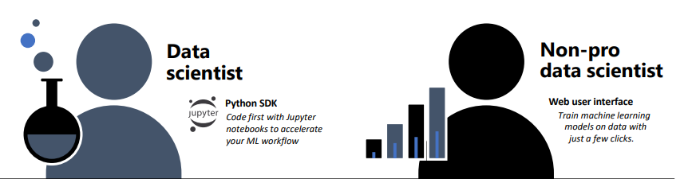
What is AutoML?
Automated machine learning, also referred to as automated ML or AutoML, is the process of automating the time consuming, iterative tasks of machine learning model development. It allows data scientists, analysts, and developers to build ML models with high scale, efficiency, and productivity all while sustaining model quality.

Slide 12
AutoML process

Slide 13

AutoML
Vs
Conventional ML Practices

Slide 14
Benefits of AutoML
Implement ML solutions without extensive programming knowledge
Save time and resources
Leverage data science best practices
Provide agile problem-solving

Slide 15
When to use AutoML?
A non-programmer or non-professional data scientist wants to leverage the power of ML
Handling too complex data
Lack of data domain knowledge
Quick Implementation
Building complex model with huge number of parameters to finetune

Slide 16
Introduction to
Azure Automated
Machine Learning

Slide 17
How Azure AutoML works?
During training, Azure Machine Learning creates a number of pipelines in parallel that try different algorithms and parameters for you.
The service iterates through ML algorithms paired with feature selections, where each iteration produces a model with a training score.
The higher the score, the better the model is considered to "fit" your data.
It will stop once it hits the exit criteria defined in the experiment.

Slide 18
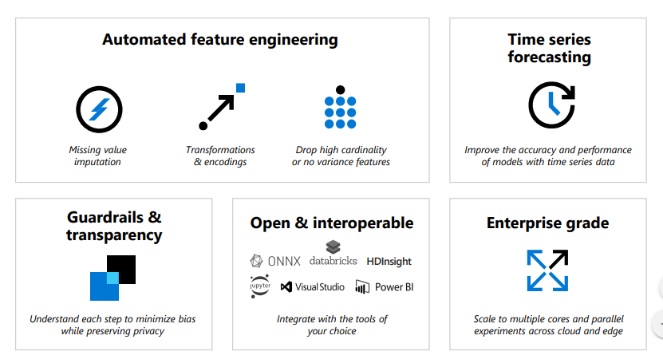
How Azure AutoML works?

Slide 19
Steps to design Azure AutoML
Identify ML problem and Platform
Data and Compute source
Config AutoML
parameters
Submit the run
Logged run information contains
metrics
The training run produces a Python serialized object (.pkl file) that contains the model and data preprocessing.
ML problem: classification, forecasting, or regression
Platform:
Azure ML Studio (limited code)
Python SDK
Data Source: Numpy arrays or Pandas dataframe
Compute Source:
local computer, Azure Machine Learning Computes, remote VMs, or Azure Databricks
Iterations over different models, hyperparameter settings, advanced preprocessing/featurization, metrics

Slide 20

Feature Engineering by Azure AutoML
Feature engineering is the process of using domain knowledge of the data by eliminating overfitting and imbalanced data to create features that help ML algorithms learn better
Automated machine learning featurization steps (feature normalization, handling missing data, converting text to numeric, etc.) become part of the underlying model. When using the model for predictions, the same featurization steps applied during training are applied to your input data automatically.
You can also add your own feature engineering technique

Slide 21

Hands on Demo

Slide 22
Learning Resources
Basics of Machine Learning: https://medium.com/@vivekraja98/machine-learning-for-beginners-187178d1326d
https://azure.microsoft.com/en-us/overview/what-is-machine-learning-platform/#:~:text=Machine%20learning%20(ML)%20is%20the,computer%20learn%20without%20direct%20instruction.&text=Machine%20learning%20uses%20algorithms%20to,model%20that%20can%20make%20predictions.
Azure free account:
https://azure.microsoft.com/en-in/free/
Automated Machine Learning:
https://docs.microsoft.com/en-in/azure/machine-learning/concept-automated-ml#how-automl-works

Slide 23
Open for QnA

Slide 24

Missed attending any meetups?
Access to presentation decks?
Stats of every meetup?
Wants to start collaborative Open-source project?
Study Resources for Azure?
Code repos for your blogs?
Got some cool memes?
We got you covered!!
https://github.com/Vivek0712/azdev-tn

Slide 25
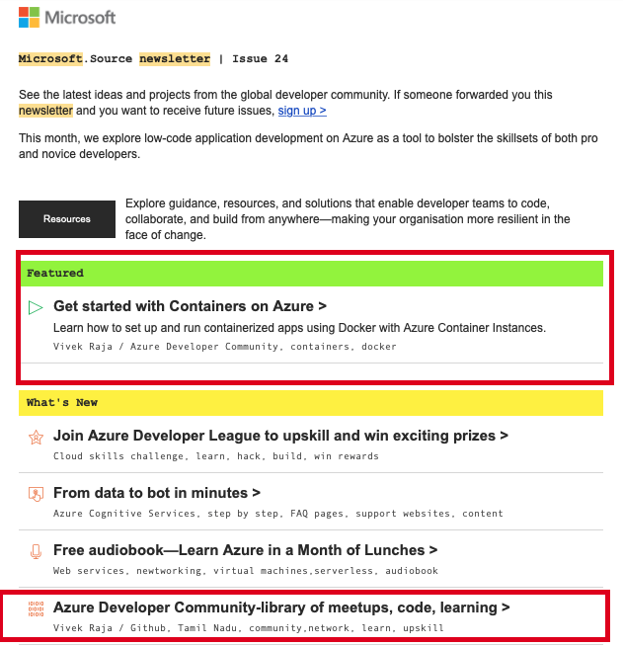
We got featured in
Microsoft Newsletter
Vivek0712/azdev-tn

Slide 26
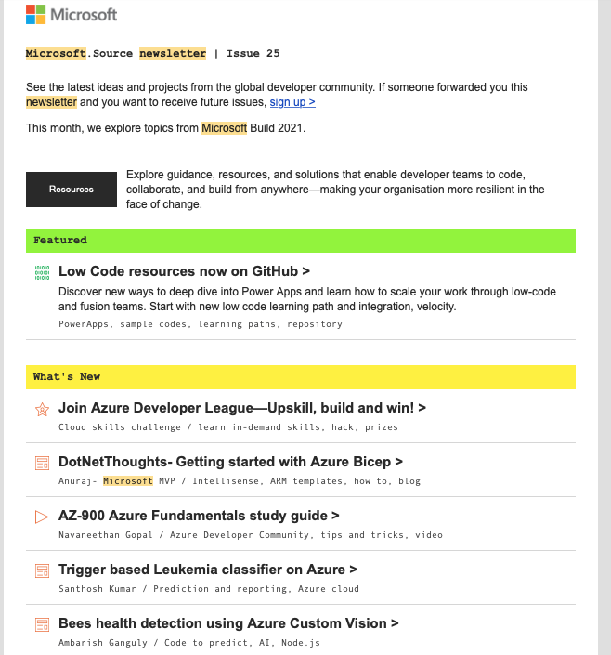
We got featured in
Microsoft Newsletter
Vivek0712/azdev-tn

Slide 27




Find us on
https://azdev.konfhub.com/

Slide 28

We are in Clubhouse!!!!!
Join us for more amazing audio sessions, discussions, guidance, tricks and tips, certification & fun contests
AZURE DEV COMMUNITY https://clubhouse.com/join/azure-dev-community/Hzv2xeEe/P9YVAJQk

Slide 29



Check out my awesome blogs &repos
Building End to End COVID-19 Forecast Model using Azure ML
Literature Text Translation & Audio Synthesis using Microsoft Azure Cognitive Services
Creating COVID19 stats newsletter using Azure Function Apps
@vivekraja98
@Vivek0712

Slide 30



Let’s connect
Email ID: vivekraja98@gmail.com
Linkedin: @Vivek Raja P S
GitHub: @Vivek0712
Twitter: @vivekraja007

Slide 31

Until next time…

Slide 32

Thank you நன்றி

