Slide 1

Literature Text Translation & Audio Synthesis using AI Services
Vivek Raja P S
Data Scientist @ NexStem Lead @ Azure Developer Community, India AWS Machine Learning HERO

Slide 2

Glimpse of today’s talk
Ever wanted to read your favorite literature book or poetry but language is a barrier? Worry not! Enjoy the world literature in your preferred language along with audio book with just a click of a button. "Literature Love" uses AI services to translate and generate audio format for literature texts.

Slide 3

About me!
From India
Data Scientist @ Nexstem, US (https://nexstem.ai)
Guinness World Record Holder (2021)
Organizer @ Azure Developer Communities in India (10k+ members)
AWS Machine Learning HERO
16x Multi—Cloud Certified
Microsoft Certified Data Scientist, AI Engineer, Data Engineer, Developer Associate , Oracle Cloud Solutions Architect, Alibaba Cloud Expert
20 times International & National Hackathon winner
Published 5+ Research papers, + 1 patent (In evaluation) (AI & IoT)
Active Speaker, Mentor, Blogger (Dev, Medium) , Open-source Contributor (Github @Vivek0712)
@VivekRaja007

Slide 4
Pre-requisite
Basic knowledge of Python
Basic understanding of Machine Learning
A curious mind to learn!

Slide 5
Agenda of today’s talk
About Literature Love Open-Source Project - 5 min
Introduction to Azure Cognitive Service - 2 mins
Using Azure Cognitive Service for Python SDK for Translation & Text-to-Speech - 10 mins
Hosting the web app in Azure - 3 mins
Literature Text Contribution & Collaboration - 2 mins
Q&A - 5 mins

Slide 6
About Literature Love
Literature Love - An open-source initiative to read, listen and enjoy literature texts, poems, novels, short stories in your preferred language. Using Azure Cognitive Services, the original literature texts are translated into various languages and audio is generated for the same. The literature texts are being contributed by literature lovers, authors all around the world.
Website: https://bit.ly/azurites

Slide 7
Features of the project
Translate - The literature text is translated to preferred language using Azure Cognitive Service: Translate API
Text-to-Speech - The Literature text is available as Audio Book using Azure Cognitive Service: Text-To-Speech API
LEARN & CONTRIBUTE MORE - Learn how this is implemented in my blog. Source Code is openly available at Github.

Slide 8
Source of inspiration
India is a diverse country with many languages and cultures and also has a rich history of literature.
I am passionate about the language Tamil – one of the oldest languages in the world and love to read the old literature texts written.
My friends who speak Hindi which is also a widely spoken language in India had difficulties to share and read the works in other languages.
With a little bit of research, most of the world literature texts has NOT been translated.

Slide 9
About the website ‘Literature Love’:
The website URL: https://bit.ly/azurites Source Code: https://github.com/Vivek0712/lit-translate-audio
The open-source websites brings in all the literature lovers to share, contribute, read and listen the literature texts translated into various languages and also synthesised into audio format for the same.

Slide 10

Introduction to Azure Cognitive Services
Cognitive Services brings AI within reach of every developer and data scientist. With leading models, a variety of use cases can be unlocked. All it takes is an API call to embed the ability to see, hear, speak, search, understand, and accelerate advanced decision-making into your apps. Enable developers and data scientists of all skill levels to easily add AI capabilities to their apps.

Slide 11
Explore the benefits of Cognitive Services
Use customisable, pretrained models built with breakthrough AI research
Deploy Cognitive Services anywhere from the cloud to the edge with containers
Empower responsible use with industry-leading tools and guidelines

Slide 12
Building Literature Love Website
Its really easy to get started with this. All you need is experience working with basic HTML,CSS, Javascript and Azure Account (Sign up for a free account!)
Website Techstack: Static Website (HTML,CSS, JS) Microsoft Azure Services: 1. Azure Static Web App Service 2. Azure Cognitive Service — Translator Python SDK 3. Azure Cognitive Service — Text to Speech API

Slide 13
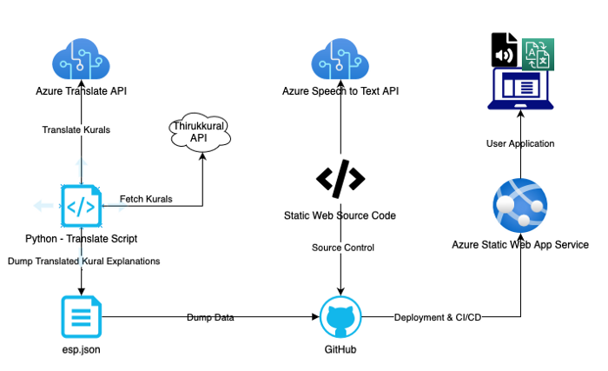
Architecture

Slide 14
About Thirrukural
The Tirukkural, or shortly the Kural, is a classic Tamil language text consisting of 1,330 short couplets of seven words each, or kurals. The user needs to enter the chapter from 1 to 133 to receive the ten kurals of that chapter. The Kural and its Tamil explanation is available through the API. The Tamil explanation is translated into English and Hindi using Microsoft Azure Cognitive Service — Translator API. The original text and the translated texts are available in the Github repo.
The Kurals and their explanations are also available in the Audio format using Microsoft Azure Cognitive Services — Text to Speech API.

Slide 15
Let’s get started
Create Azure Cognitive Services Subscription Key
Login into your Azure Portal and Create a new resource -> Cognitive Service. Fill out the relevant details. Refer here to create the same.
Once the resource is created. Go to the cognitive service resource and under Resource Management → Access Keys & Endpoint and copy the key.

Slide 16
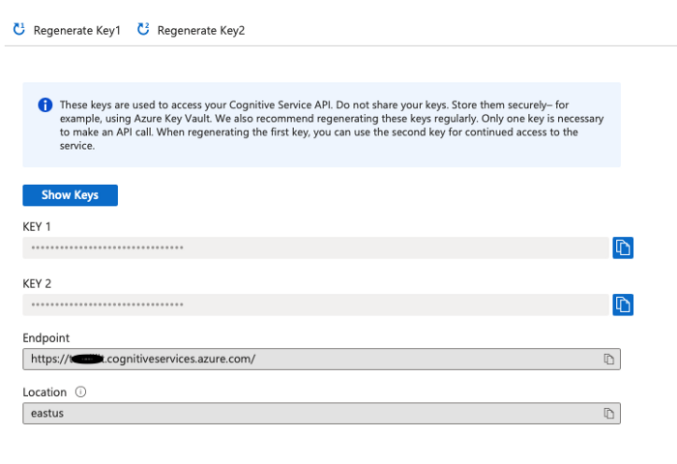

Slide 17
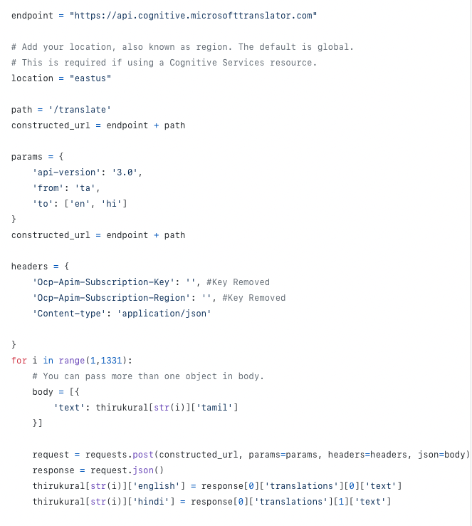
Using Translator API
Translation of Kurals and explanation
Copy paste the key and the region in the headers as mentioned in the code.

Slide 18
Using Translator API
We are using Azure Cognitive Service — Translator Python SDK. This will fetch the kurals from the API and translate the explanation from tamil to English and Hindi. The whole data is dumped in a JSON file so that it can be used by other developers for future use. The file is available in the Github Repo. This code can be run in Python Notebook in Azure or in your local Python IDE.

Slide 19
Using Text-to-Speech API
Creating the Audio Synthesis for the text translations.
Load the exp.json (thirukkural translation json file) in your Javascript code and add click listener to the button which will invoke the Azure Cognitive Service — Text to Speech API.
We are going to use Microsoft Azure Speech API, which requires us to include the following script file that will be imported through CDN. I have written a playaudio function which will perform Text-to-Speech using Azure Cognitive Service using Speech Synthesis Markup Language (SSML) . SSML gives us freedom to change the Standard voice, language.

Slide 20
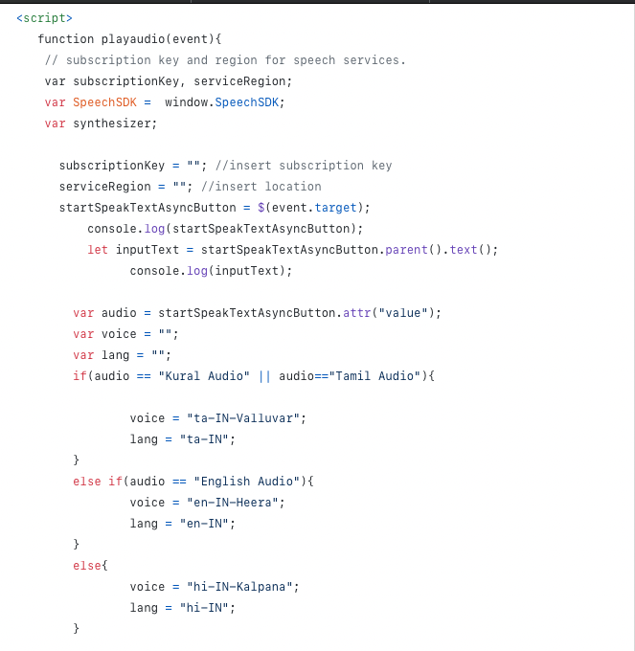

Slide 21
Deploying the application
Now that our whole website is ready, its time for the final step: DEPLOYMENT
MYTH: Deployment takes a lot of effort to set-up the environment. I need to buy a custom domain for my website. I need to set up CI/CD for my web app. All this takes more efforts and time.
FACT: AZURE STATIC WEB APP SERVICE does everything for you.
Azure Static Web App Service is used only for static website (HTML, JS,CSS). If your website is built on some framework, use Azure App Service which is exactly the same.

Slide 22
Steps to Deploy
Create a repository in Github and upload all the source files.
Go to Azure Portal -> Azure Static Web App (Preview) -> Create
Enter the relevant details and sign up with your Github Account for the deployment details.
Select your repo and the branch.
Create

Slide 23
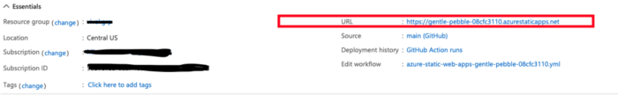
Verifying Deployment
You application will be deployed along with CI/CD pipelines (using GitHub Actions). You will can find the url of the website here.

Slide 24
Voila, We have successfully deployed our web app which can translate, perform Text-to-speech for the literature texts. You can enjoy reading, listening to Tamil, English and Hindi version of Thirukkural.

Slide 25
Literature Text Contribution & Collaboration
As a Literature Lover
If you are a literature lover irrespective of any language, you can help us by contributing the original text of literature to us by filling up this form.
As a reader, you can also enjoy the translated texts and audio books available and share the same with your book reading community, fellow readers etc. You are always welcome to suggest the literature works you want to read by filling this form.

Slide 26
Literature Text Contribution & Collaboration
As an API Developer
You can help us by creating APIs for the original literature texts. You can find the original texts in the same Github repo. The APIs will help us to create Translate and Text-to-Speech services in an easier way.
.

Slide 27
Literature Text Contribution & Collaboration
As a Web Developer
You can improve the website by working on developing and maintaining the website (usage of other Web tech stack like MERN etc is welcomed). You are just an issue or pull request away from making a big change towards the initiative.
.

Slide 28
Literature Text Contribution & Collaboration
As a Python/ML Developer
You can help us perform the Translations and Text-to Speech for the literature texts and review the same. On the future run, you can help us creating own ML Models to perform the same. Wanna have a chat or need help getting started, you are always welcomed to ping me in my social media handles.

Slide 29
Contributors to the initiative
Vivek Raja & Chinmaye Jain- Thirukurral
Dr. Marie Pierre Augustin, Head of French Department, Madurai Kamaraj University (Retd.) - Victor Hugo poems
Mrs. Vidya Raghunath, HR @ Redhat - Aathichoodi
Hariharan S - Authored Girl I met

Slide 30
References
https://azure.microsoft.com/en-in/services/cognitive-services/text-to-speech/
https://docs.microsoft.com/en-us/azure/cognitive-services/speech-service/speech-synthesis-markup?tabs=csharp
https://docs.microsoft.com/en-us/azure/cognitive-services/cognitive-services-apis-create-account?tabs=multiservice%2Cwindows
https://github.com/Azure-Samples/cognitive-services-speech-sdk
https://en.wikipedia.org/wiki/Tirukku%E1%B9%9Fa%E1%B8%B7
https://api-thirukkural.web.app

Slide 31



Let’s connect
Email ID: vivekraja98@gmail.com
Linkedin: @Vivek Raja P S
GitHub: @Vivek0712
Twitter: @vivekraja007

Slide 32

Thank you நன்றி

