Slide 1


Apache Kafka

Slide 2
Apache Kafka
Data Analytics is often described as one of the biggest challenges associated with big
data, but even before that step can happen, data must be ingested and made available
to enterprise users. That’s where Apache Kafka comes in. Kafka’s growth is exploding,
more than 1⁄3 of all Fortune 500 companies use Kafka. These companies includes the
top ten travel companies, 7 of top ten banks, 8 of top ten insurance companies, 9 of top
ten telecom companies, and much more. LinkedIn, Microsoft and Netflix process four
comma messages a day with Kafka (1,000,000,000,000).
Copyright @ 2018 Learntek. All Rights Reserved.
3

Slide 3
Introduction:
Apache Kafka is a streaming platform for collecting, storing, and processing high
volumes of data in real-time. Apache Kafka is a highly scalable, fast and fault-tolerant
messaging application used for streaming applications and data processing. This
application is written in Java and Scala programming languages. Apache Kafka is a
distributed data streaming platform that can publish, subscribe to, store, and process
streams of records in real time. It is designed to handle data streams from multiple
sources and deliver them to multiple consumers. In short, it moves massive amounts
of data – not just from point A to B, but from points A to Z and anywhere else you
need, all at the same time.
Apache Kafka started out as an internal system developed by LinkedIn to handle 1.4
trillion messages per day, but now it’s an open source data streaming solution with
application for a variety of enterprise needs.
Copyright @ 2018 Learntek. All Rights Reserved.
4

Slide 4
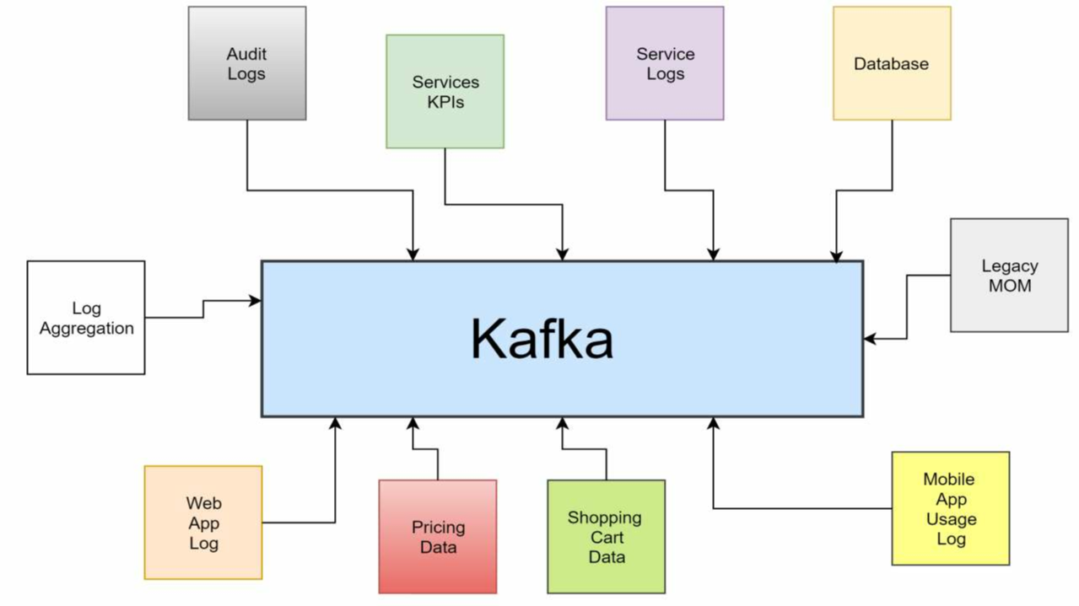

Copyright @ 2018 Learntek. All Rights Reserved.
5

Slide 5
Features:
•
Apache Kafka is a distributed publish-subscribe messaging system that is designed to
be fast, scalable, and durable
•
•
Apache Kafka is designed for distributed high throughput systems
Apache Kafka tends to work very well as a replacement for a more traditional
message broker
• Apache Kafka has better throughput, built-in partitioning, replication and inherent
fault-tolerance, which makes it a good fit for large-scale message processing
applications
• Apache Kafka maintains feeds of messages in topics
•
•
Producers write data to topics and consumers read from topics
Since Kafka is a distributed system, topics are partitioned and replicated across
multiple nodes
• Kafka is very fast and guarantees zero downtime and zero data loss.
Copyright @ 2018 Learntek. All Rights Reserved.
6

Slide 6
Who uses Apache Kafka?
A lot of large companies who handle a lot of data use Kafka. LinkedIn, where it
originated, uses it to track activity data and operational metrics. Twitter uses it as part
of Storm to provide a stream processing infrastructure. Square uses Kafka as a bus to
move all system events to various Square data centers (logs, custom events, metrics,
and so on), outputs to Splunk, Graphite (dashboards), and to implement an Esper-
like/CEP alerting systems. It gets used by other companies too like Spotify, Uber,
Tumbler, Goldman Sachs, PayPal, Box, Cisco, CloudFlare, NetFlix, and much more.
Copyright @ 2018 Learntek. All Rights Reserved.
7

Slide 7
Why is Kafka so Fast?
Kafka relies heavily on the OS kernel to move data around quickly. It relies on the
principals of Zero Copy. Kafka enables you to batch data records into chunks. These
batches of data can be seen end to end from Producer to file system (Kafka Topic Log)
to the Consumer. Batching allows for more efficient data compression and reduces I/O
latency. Kafka writes to the immutable commit log to the disk sequential; thus, avoids
random disk access, slow disk seeking. Kafka provides horizontal Scale through
sharding. It shards a Topic Log into hundreds potentially thousands of partitions to
thousands of servers. This sharding allows Kafka to handle massive load.
Copyright @ 2018 Learntek. All Rights Reserved.
8

Slide 8
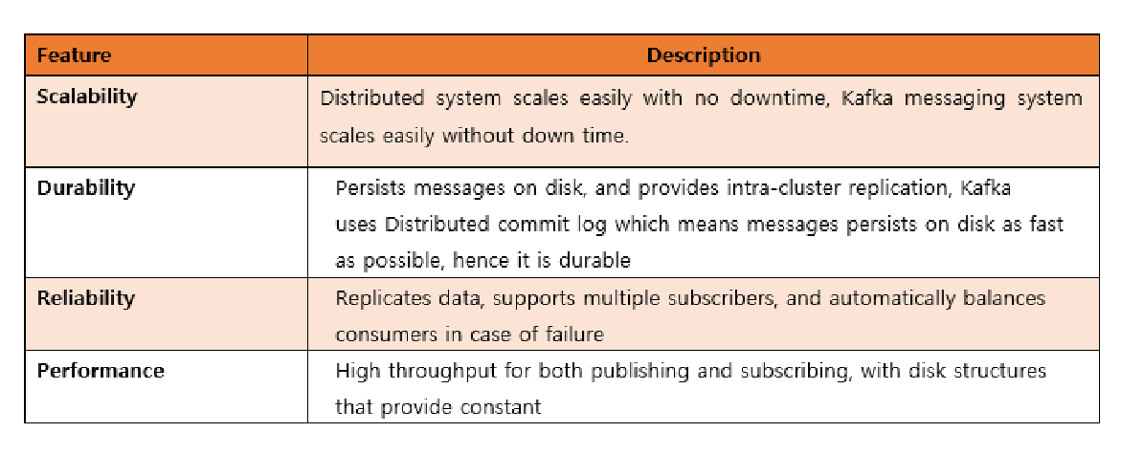
Key Benefits:
Copyright @ 2018 Learntek. All Rights Reserved.
9

Slide 9
Apache Kafka API:
Apache Kafka is a popular tool for developers because it is easy to pick up and
provides a powerful event streaming platform complete with 4 APIs: Producer,
Consumer, Streams, and Connect.
Basically, it has four core APIs:
Producer API: This API permits the applications to publish a stream of records to
one or more topics.
Consumer API: The Consumer API lets the application to subscribe to one or more
topics and process the produced stream of records.
Streams API: This API takes the input from one or more topics and produces the
output to one or more topics by converting the input streams to the output ones.
Connector API: This API is responsible for producing and executing reusable
producers and consumers who are able to link topics to the existing applications.
Copyright @ 2018 Learntek. All Rights Reserved.
10

Slide 10
Need for Apache Kafka :
•
•
Kafka is a unified platform for handling all the real-time data feeds
Kafka supports low latency message delivery and gives guarantee for fault
tolerance in the presence of machine failures
•
•
•
It has the ability to handle a large number of diverse consumers
Kafka is very fast, performs 2 million writes/sec
Kafka persists all data to the disk, which essentially means that all the writes go to
the page cache of the OS (RAM)
• This makes it very efficient to transfer data from page cache to a network socket
Copyright @ 2018 Learntek. All Rights Reserved.
11

Slide 11
Apache Kafka — Use Cases:
Kafka
can be used in many Use Cases. Some of them are listed below −
Metrics− Kafka is often used for operational monitoring data. This involves
aggregating statistics from distributed applications to produce centralized
feeds of operational data.
Twitter: Registered users can read and post tweets, but unregistered users
can only read tweets. Twitter uses Storm-Kafka as a part of its stream
processing infrastructure.
Netflix: Netflix is an American multinational provider of on-demand
Internet streaming media. Netflix uses Kafka for real-time monitoring and
event processing.
Copyright @ 2018 Learntek. All Rights Reserved.

Slide 12
Log Aggregation Solution− Kafka can be used across an organization to collect logs
from multiple services and make them available in a standard format to multiple
consumers.
LinkedIn: Apache Kafka is used at LinkedIn for activity stream data and operational
metrics. Kafka messaging system helps LinkedIn with various products like LinkedIn
Newsfeed, LinkedIn Today for online message consumption and in addition to offline
analytics systems like Hadoop.
Stream Processing− Popular frameworks such as Storm and Spark Streaming read data
from a topic, processes it, and write processed data to a new topic where it becomes
available for users and applications. Kafka’s strong durability is also very useful in the
context of stream processing.
Website activity tracking — The web application sends events such as page views and
searches Kafka, where they become available for real-time processing, dashboards and
offline analytics in Hadoop.
Copyright @ 2018 Learntek. All Rights Reserved.

